Slide 1
Dataset stats
Species | # | Read Length | Raw fragments | Unique | Complexity | MACS2 NumPeaks | MACS2 RPM | MACS2 PseudoRep NumPeaks | MACS2 RPM | NSC | RSC | QC
hg38_no_haps | Control_4_FGFR1_GSM2439179 | 1x50 | 36,740,346 | 29,580,521 | 0.55 | 28,791 | 79,988 |  |  | 1.421 | 1.027 | 1
hg38_no_haps | Control_4_input-GSM2439178 | 1x50 | 33,997,437 | 28,653,506 | 0.98 |  |  |  |  | 1.163 | 0.469 | -1
hg38_no_haps | Patient_3_FGFR1_GSM2439181 | 1x50 | 33,294,331 | 24,257,330 | 0.37 | 45,814 | 244,833 |  |  | 1.508 | 2.687 | 2
hg38_no_haps | Patient_3_NOTCH-GSM2439182 | 1x50 | 24,586,311 | 28,803,228 | 0.17 | 31,943 | 145,485 |  |  | 3.570 | 6.144 | 2
hg38_no_haps | Patient_3_input-GSM2439180 | 1x50 | 34,700,795 | 20,740,325 | 0.98 |  |  |  |  | 1.142 | 0.305 | -1
chrM | Control_4_FGFR1_GSM2439179 | 1x50 | 36,740,346 | 624,038 | 0.04
chrM | Control_4_input-GSM2439178 | 1x50 | 33,997,437 | 159,490 | 0.18
chrM | Patient_3_FGFR1_GSM2439181 | 1x50 | 33,294,331 | 123,458 | 0.16
chrM | Patient_3_NOTCH-GSM2439182 | 1x50 | 24,586,311 | 57,429 | 0.13
chrM | Patient_3_input-GSM2439180 | 1x50 | 34,700,795 | 125,139 | 0.23
Aligned against the genome as well as against chrM alone
(due to NUMTs, some of chrM is not uniquely mappable)

Slide 2
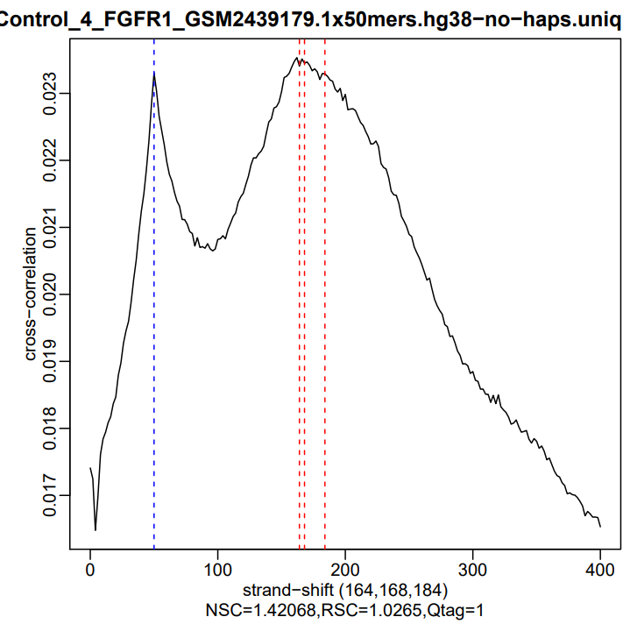
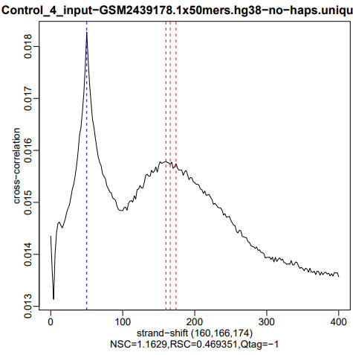
Cross-correlation QC

Slide 3
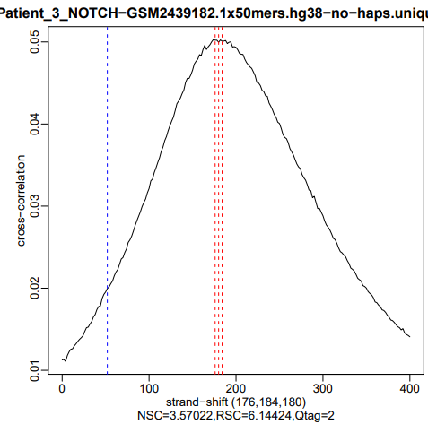
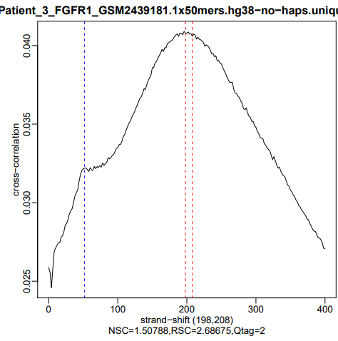

Slide 4
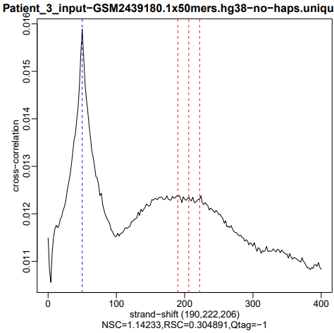
This is basic QC to make sure the ChIP shows good enrichment overall
It does

Slide 5
Peak overlap
#DataSet: |  | Control_4_FGFR1_GSM2439179 | Patient_3_FGFR1_GSM2439181 | Patient_3_NOTCH-GSM2439182
 | Regions | 28791 | 45814 | 31943
Control_4_FGFR1_GSM2439179 | 28791 | 1.00 | 0.79 | 0.62
Patient_3_FGFR1_GSM2439181 | 45814 | 0.43 | 1.00 | 0.46
Patient_3_NOTCH-GSM2439182 | 31943 | 0.58 | 0.75 | 1.00

Slide 6
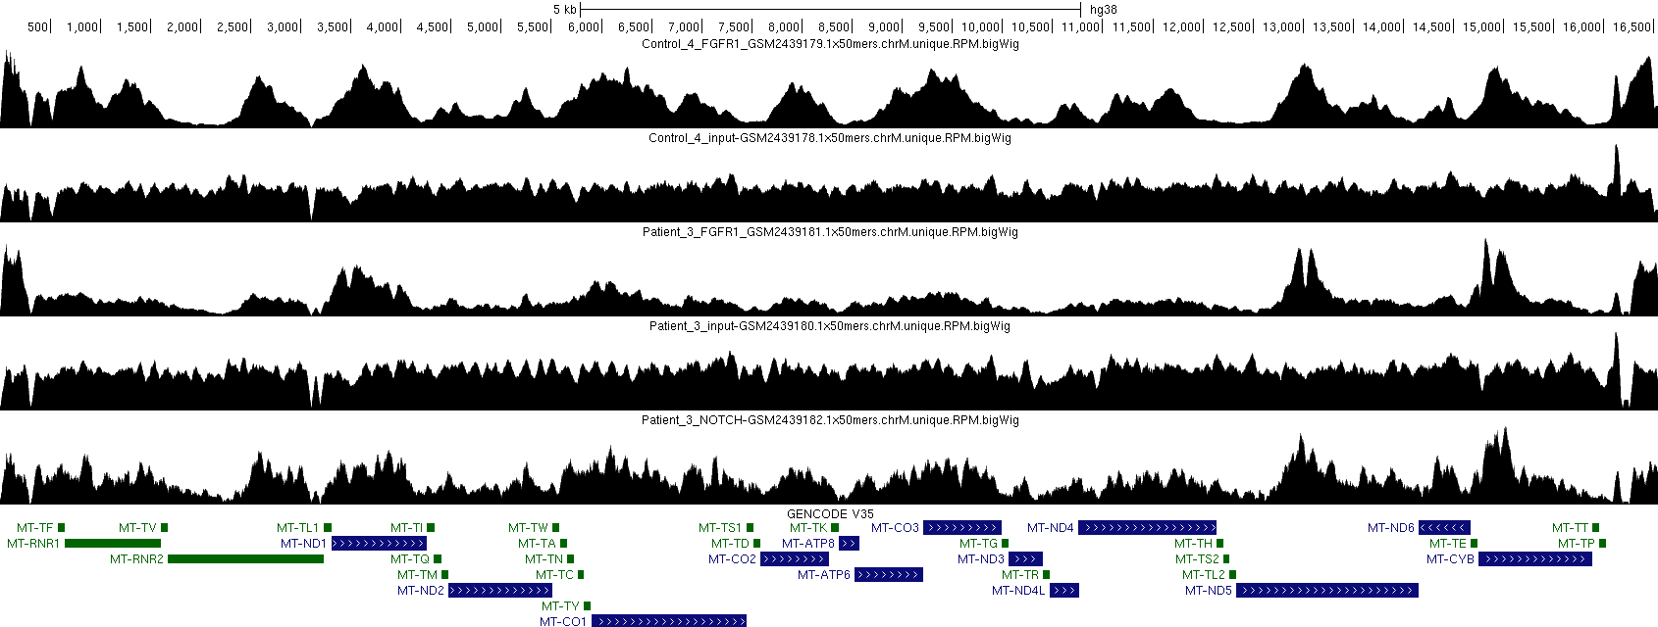
chrM

Slide 7
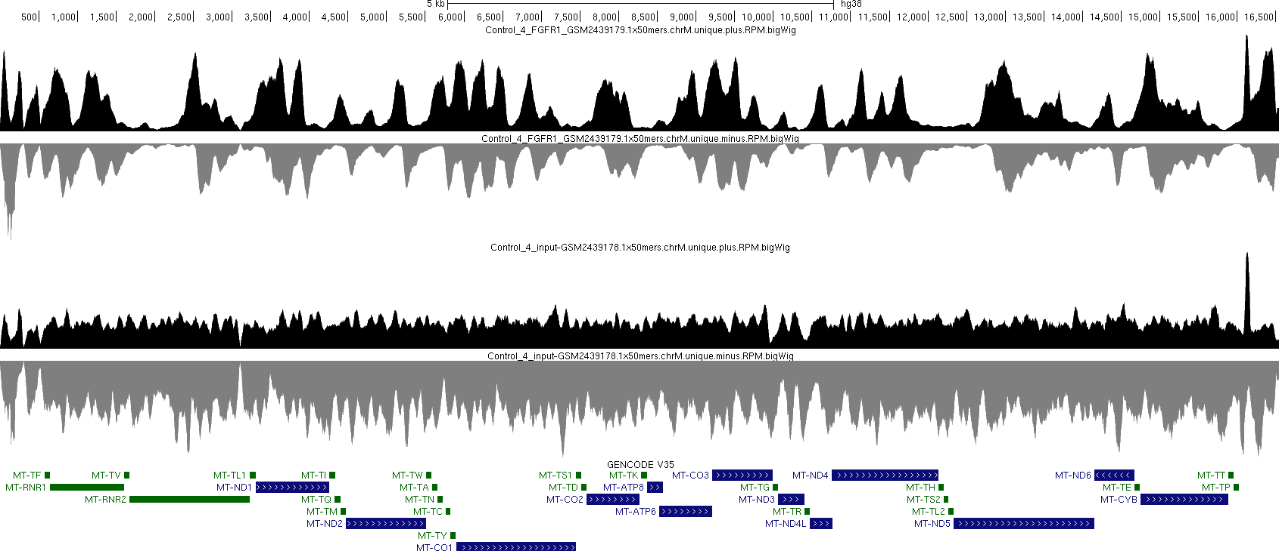
chrM stranded
The D-loop signal is probably an artifact, but the rest does look real

Slide 8
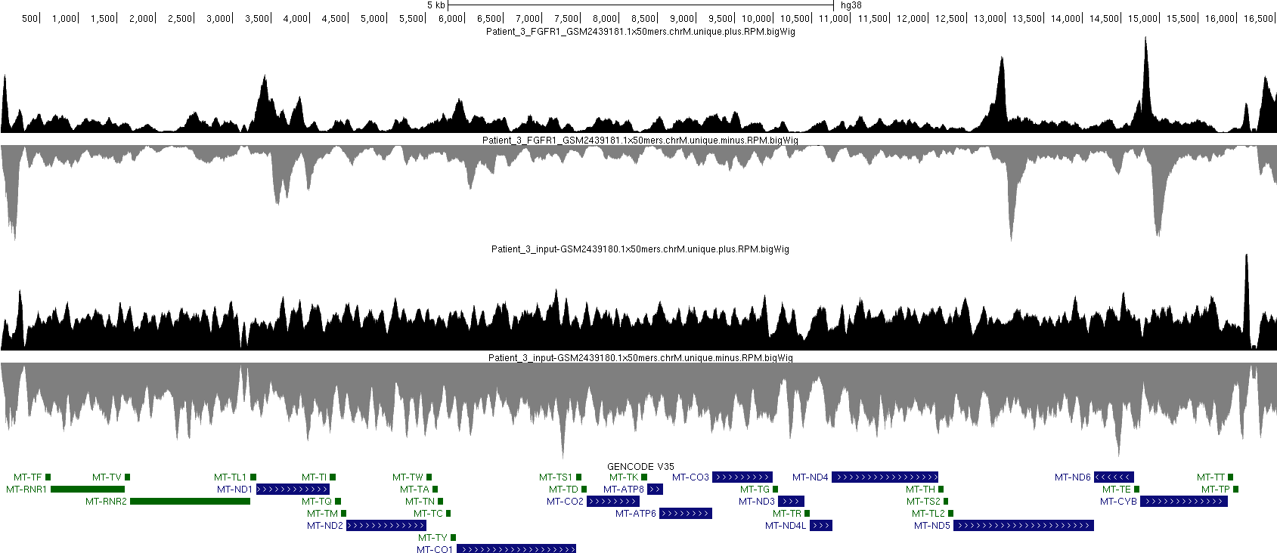
The expected strand asymmetry around occupancy sites is observed

Slide 9
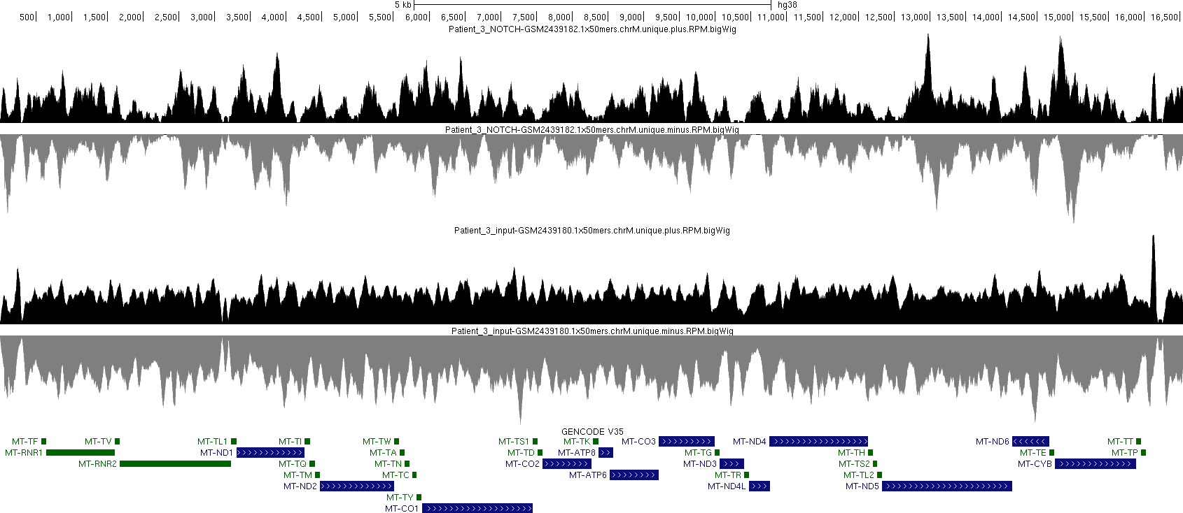

Slide 10
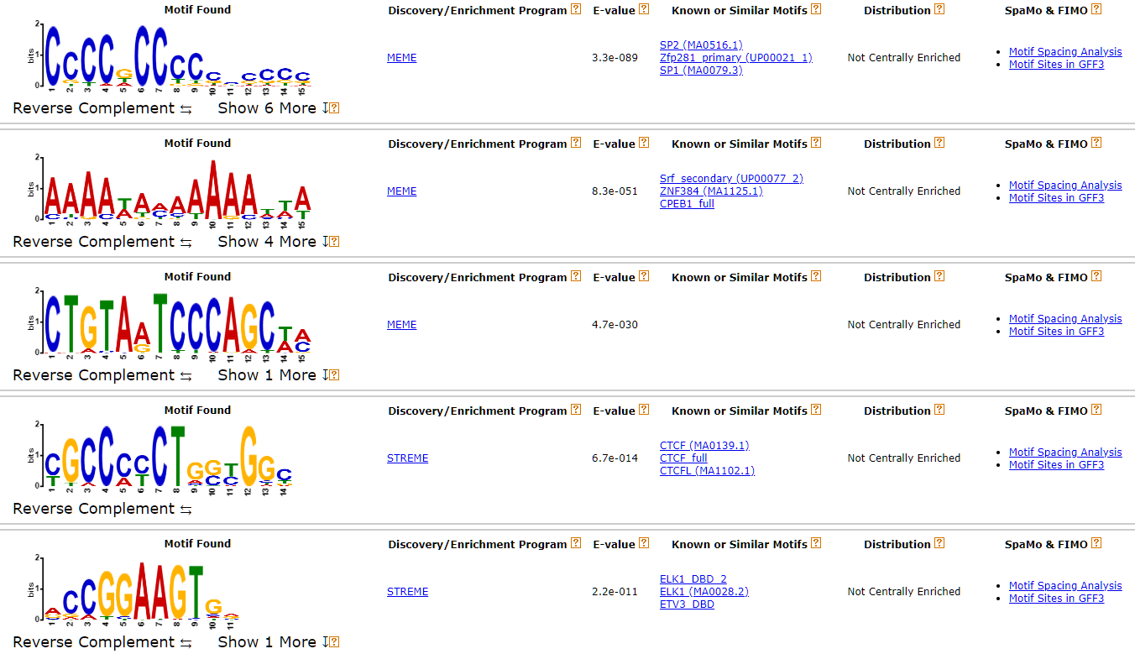
MEME-ChIP, Control FGFR1

Slide 11
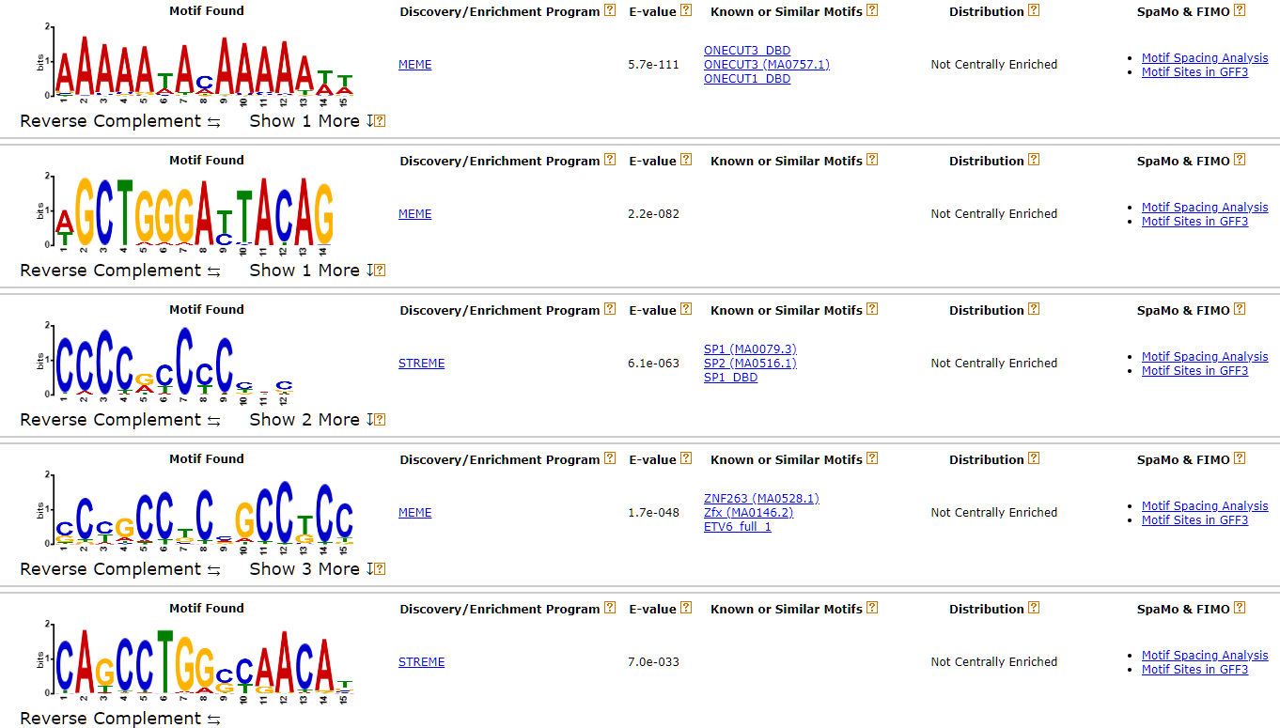
MEME-ChIP, Patient FFGFR1

Slide 12
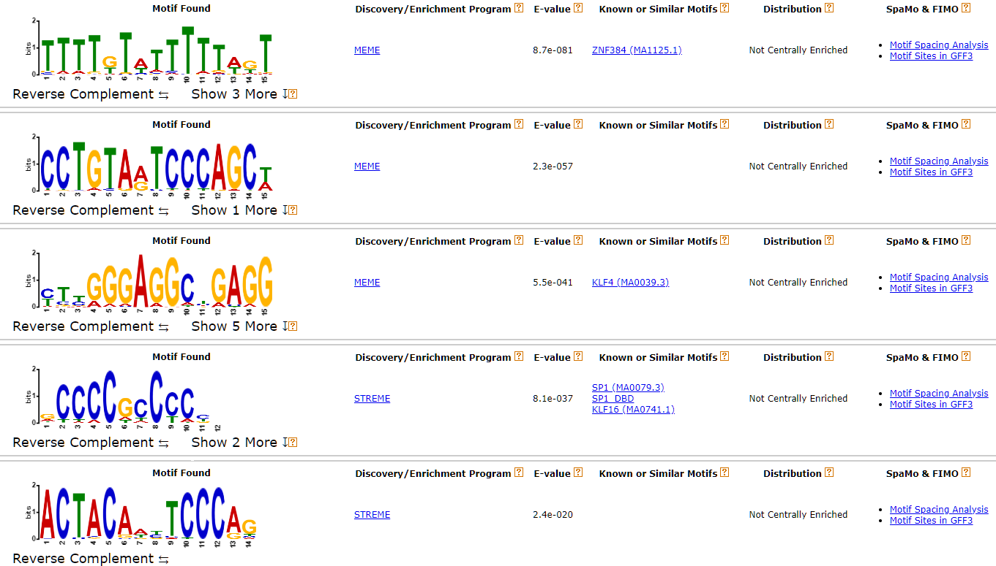
MEME-ChIP, Patient NOTCH

Slide 13
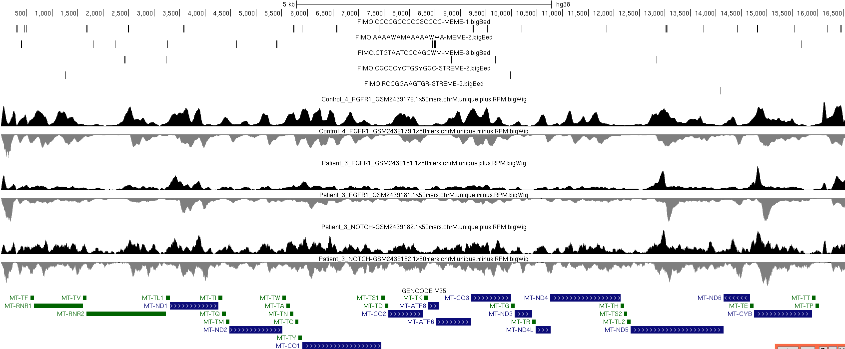
peaks and motifs
The top motif is seen in quite a few of the peaks, but not all of them

Slide 14
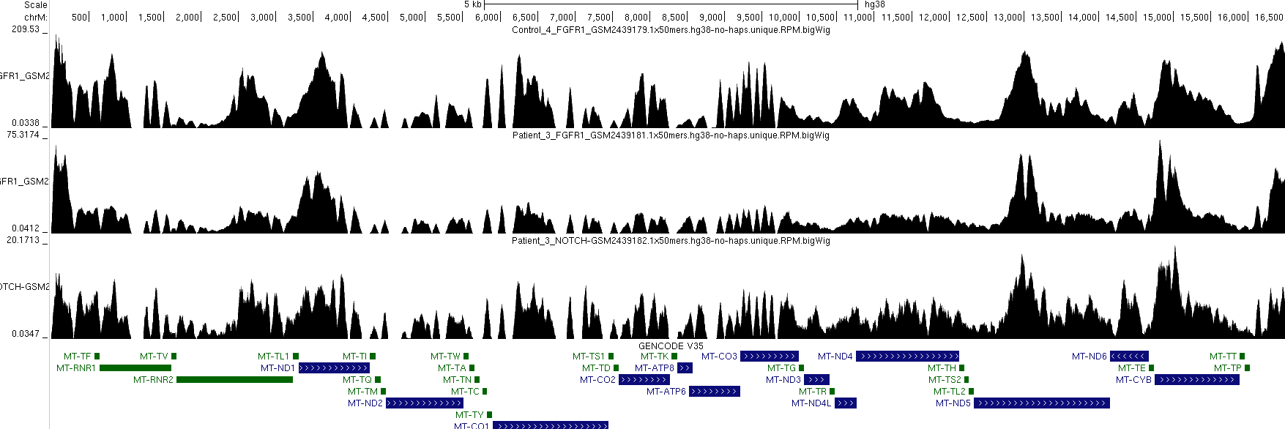
Peak height
These are RPM-normalized tracks, generated from the alignment against the whole genome

Slide 15
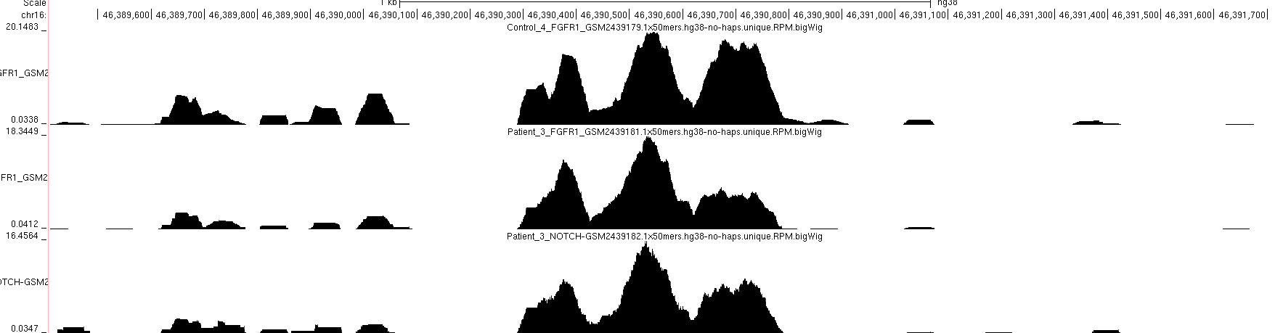
Top nuclear peaks (Control FGFR1)
This is likely an artifact

Slide 16
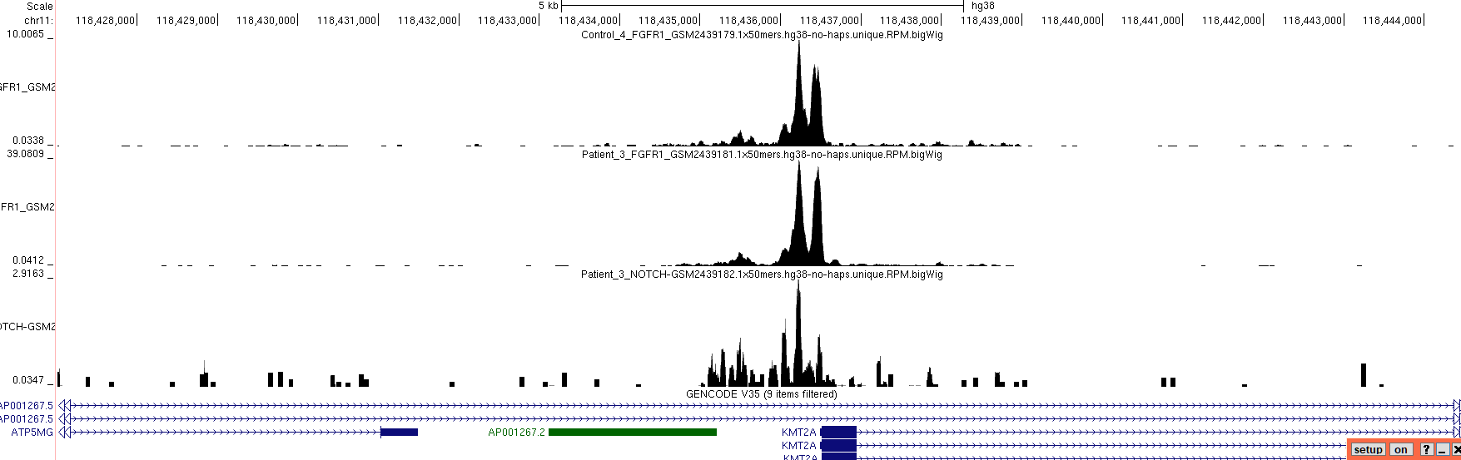
This is real

Slide 17
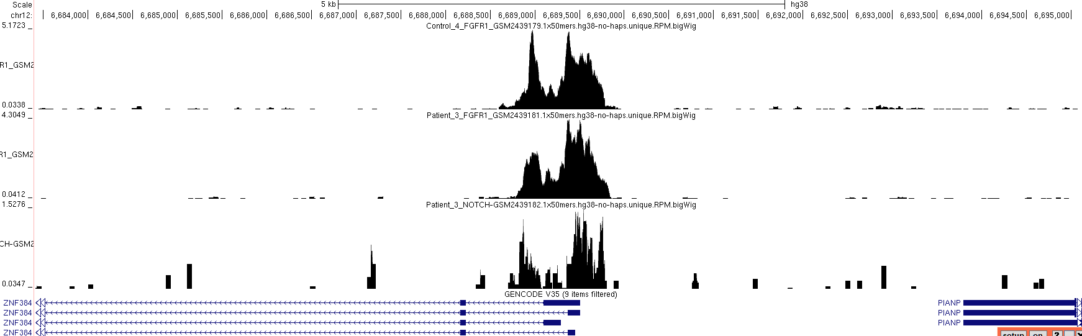
This is real too
Peak levels on chrM are several-fold higher than the top 3 nuclear peaks, i.e. they are unlikely to be due to NUMTs

Slide 18
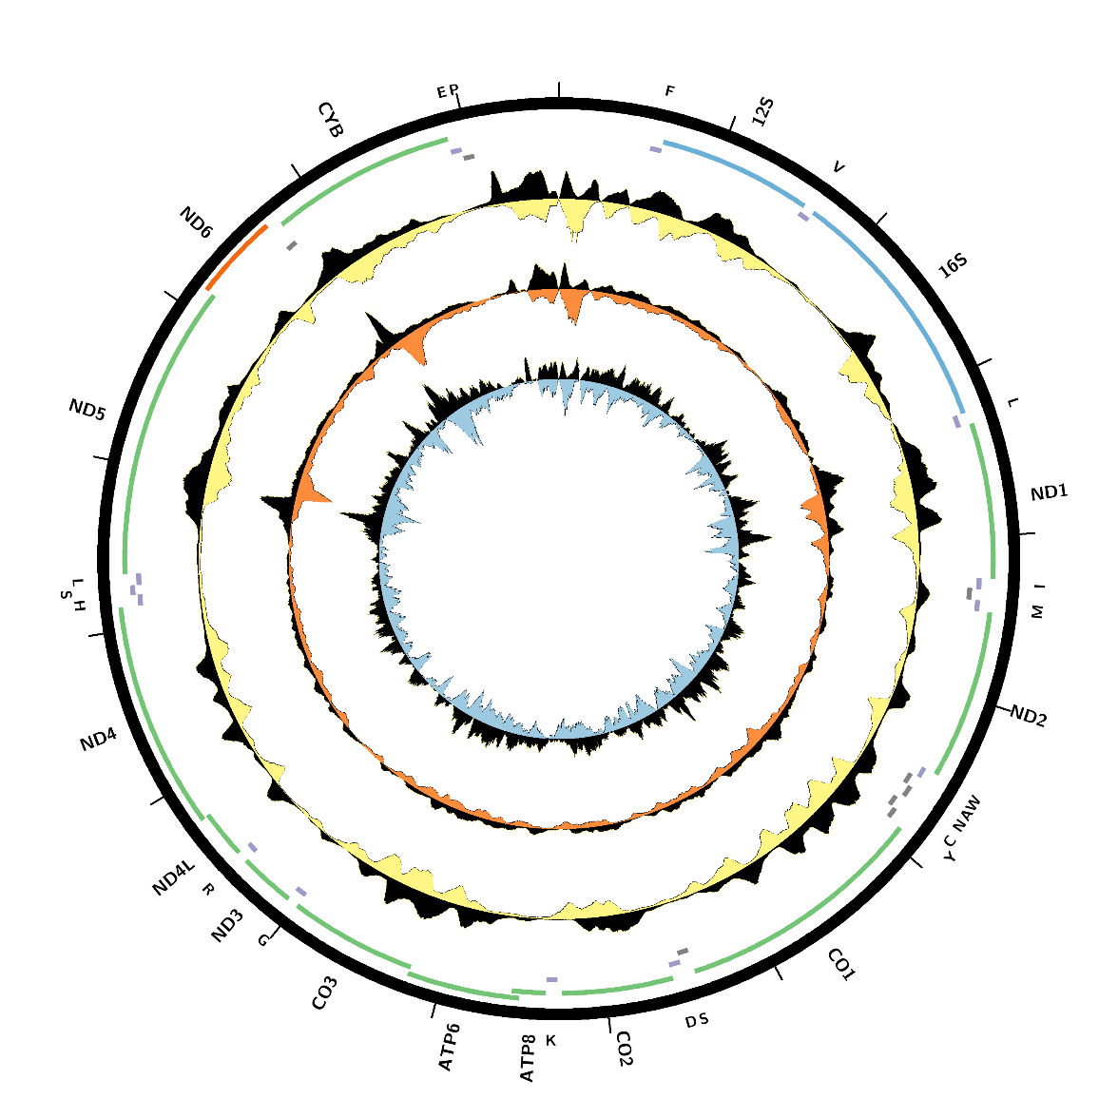
Circos plot
Control FGFR1
Patient FGFR1
Patient NOTCH

