Slide 1
THE PHYSICAL GENOME ACRROSS EVOLUTION

Slide 2
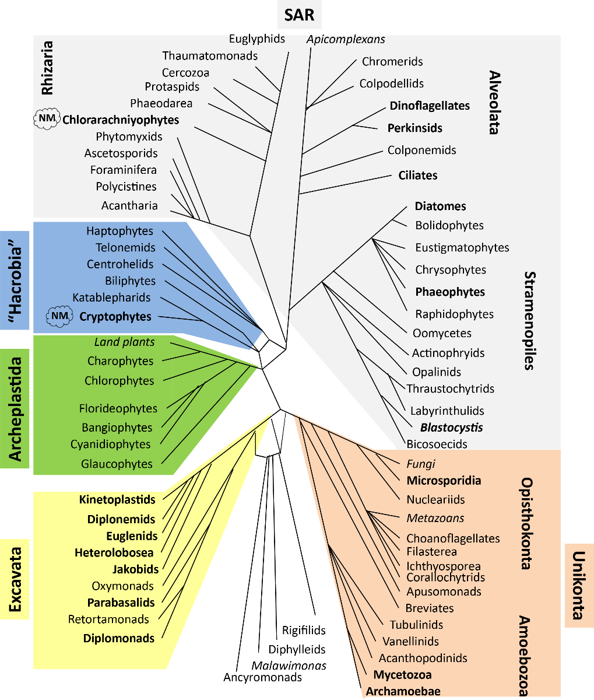
EUKARYOTE TREE

Slide 3
GENERAL QUESTIONS:
What are the deepest principles of chromatin organization and gene expression? Studying its extremes can make apparent previously obscured features.
Such deviations from the norm are known, but have generally not been studied at all with modern tools
How did the regulatory apparatus and mechanisms evolve across the eukaryotic tree of life
How many times did distal enhancers originate? Why and how?
What are the conserved and derived chromatin states across different lineages?
What is the relationship between genome organization and organismal complexity?
What does all of that tells us about mammalian genomes?
Finally, some things are just too cool on their own to not be studied.

Slide 4
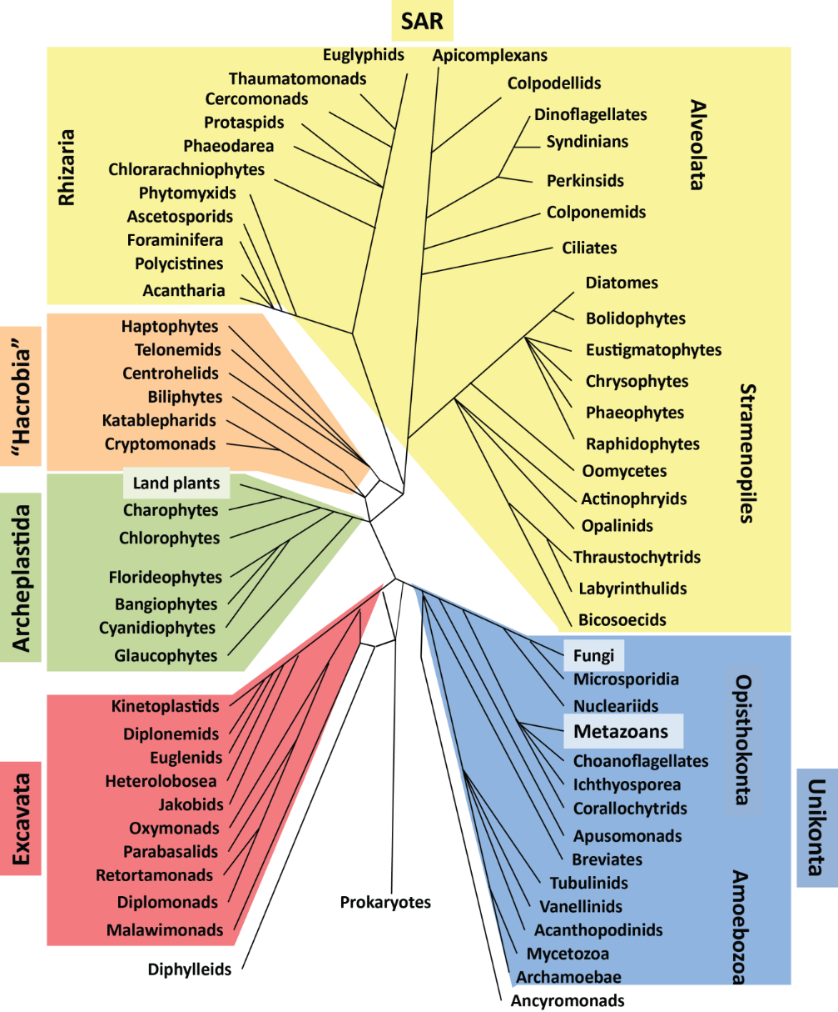
DINOFLAGELLATES

Slide 5
DINOFLAGELLATES AND THEIR SPECIAL FEATURES
Permanently condensed fibrilar chromosomes
Very low protein-to-DNA ratio (~1/10th of the usual)
Histones are in low abundance, long thought to be completely absent
High percentage of 5-hydroxymethyluracile (up to 40%)
Huge genomes, often with tandem arrays of the same gene
Extremely intron rich (19 introns per gene on average); unique splice sites
Few transcription factors
Gene regulation is hypothesized to happen either at the posttrascriptional level or at the level of the control of chromatin looping

Slide 6
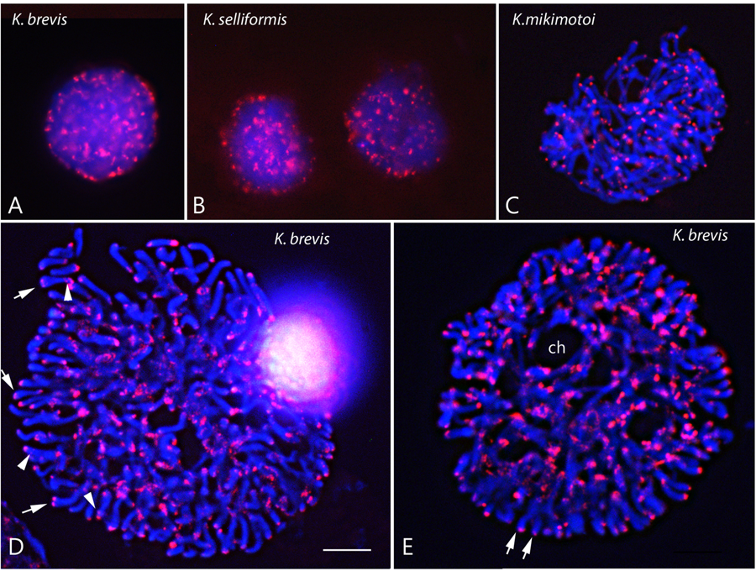
DINOFLAGELLATE CHROMOSOMES
Note: these are interphase chromosomes!
Cuadrado et al. 2019

Slide 7
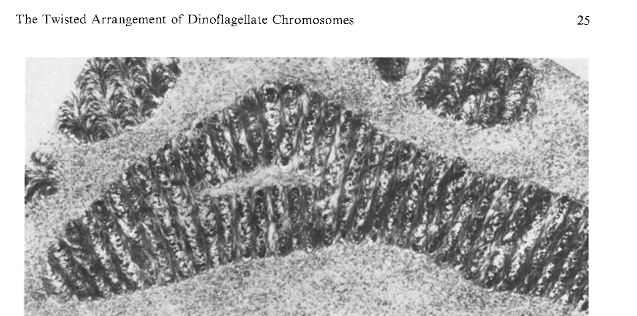
Livoland & Bouligand, 1978

Slide 8
GENERAL DINOFLAGELLATE QUESTIONS:
How is chromatin organized in 3D space in permanently condensed chromosomes mostly without histones?
How is transcriptional regulation (if it exists) accomplished in such an environment?
How has the transcriptional machinery adapted to transcribing through DVNPs
What is the role of the very divergent histones?
What is the role of dhmU?
and many others

Slide 9
SYMBIODINIUM HI-C

Slide 10
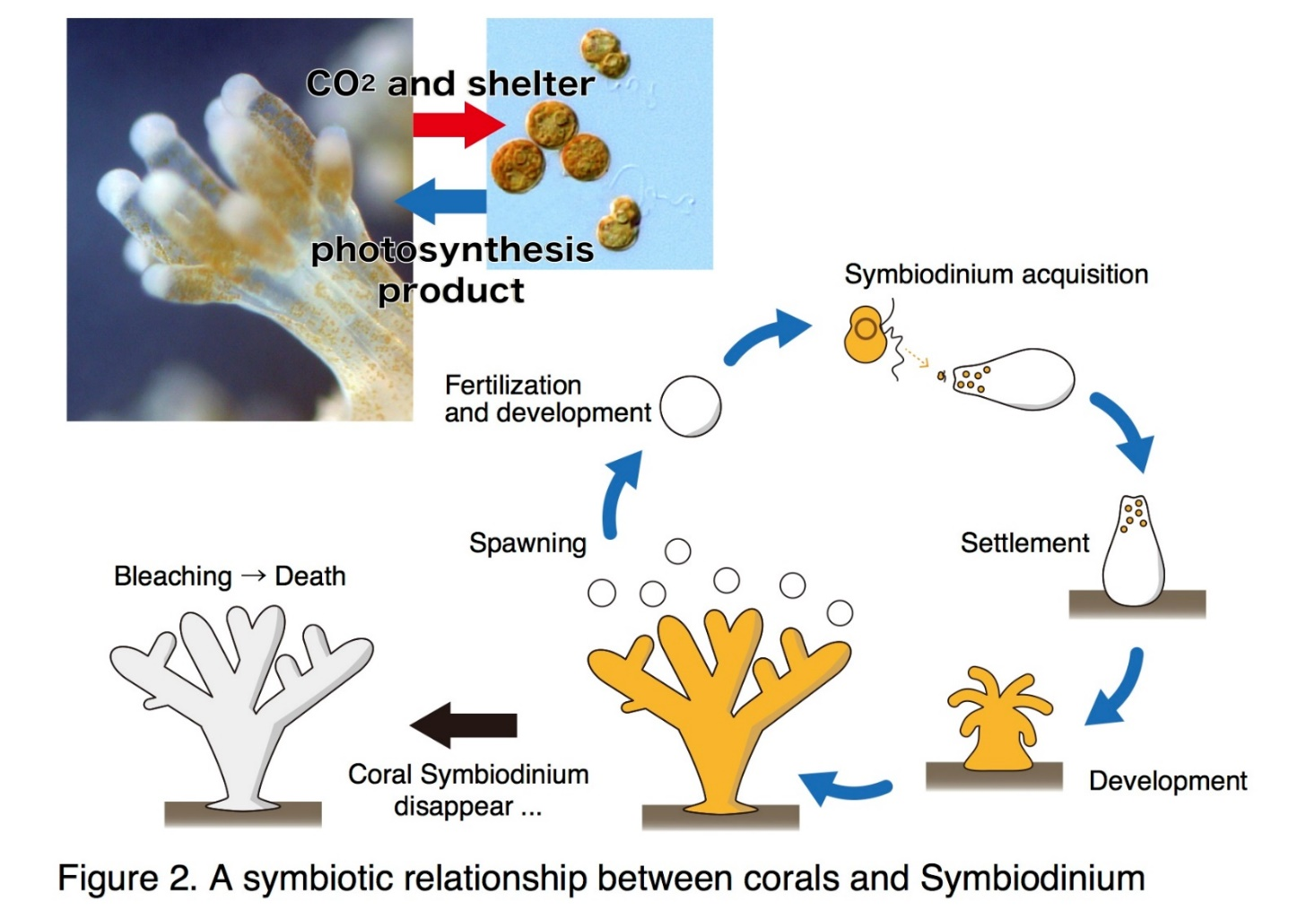
CORAL SYMBIOSIS

Slide 11
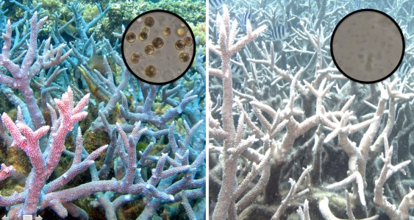
CORAL BLEACHING

Slide 12
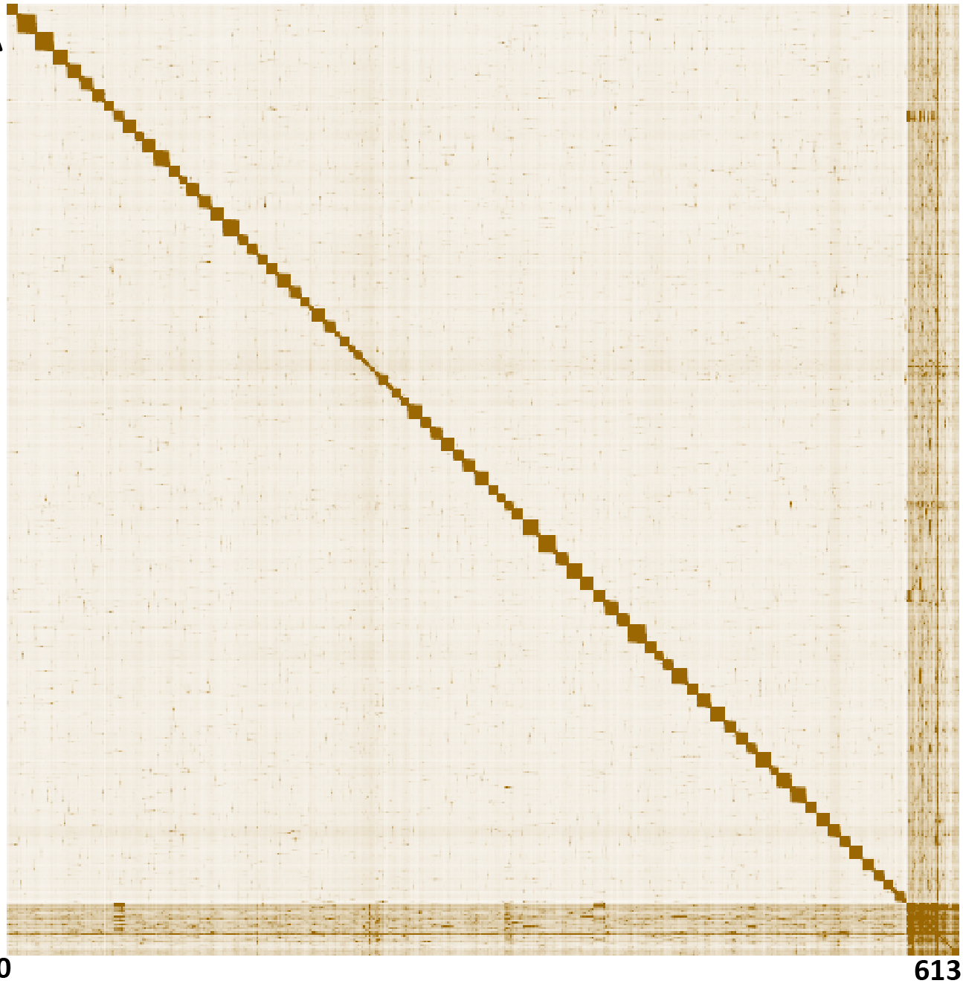
HI-C SCAFFOLDING

Slide 13
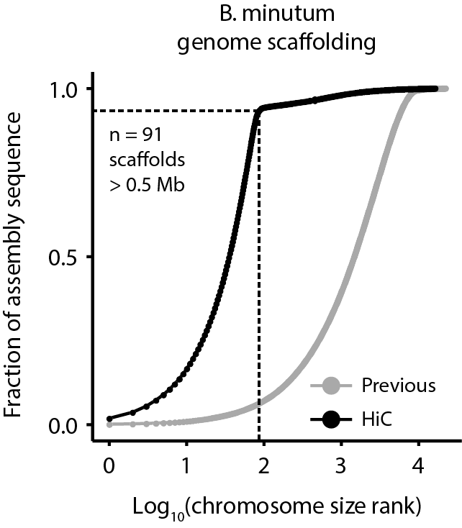
HI-C SCAFFOLDING

Slide 14
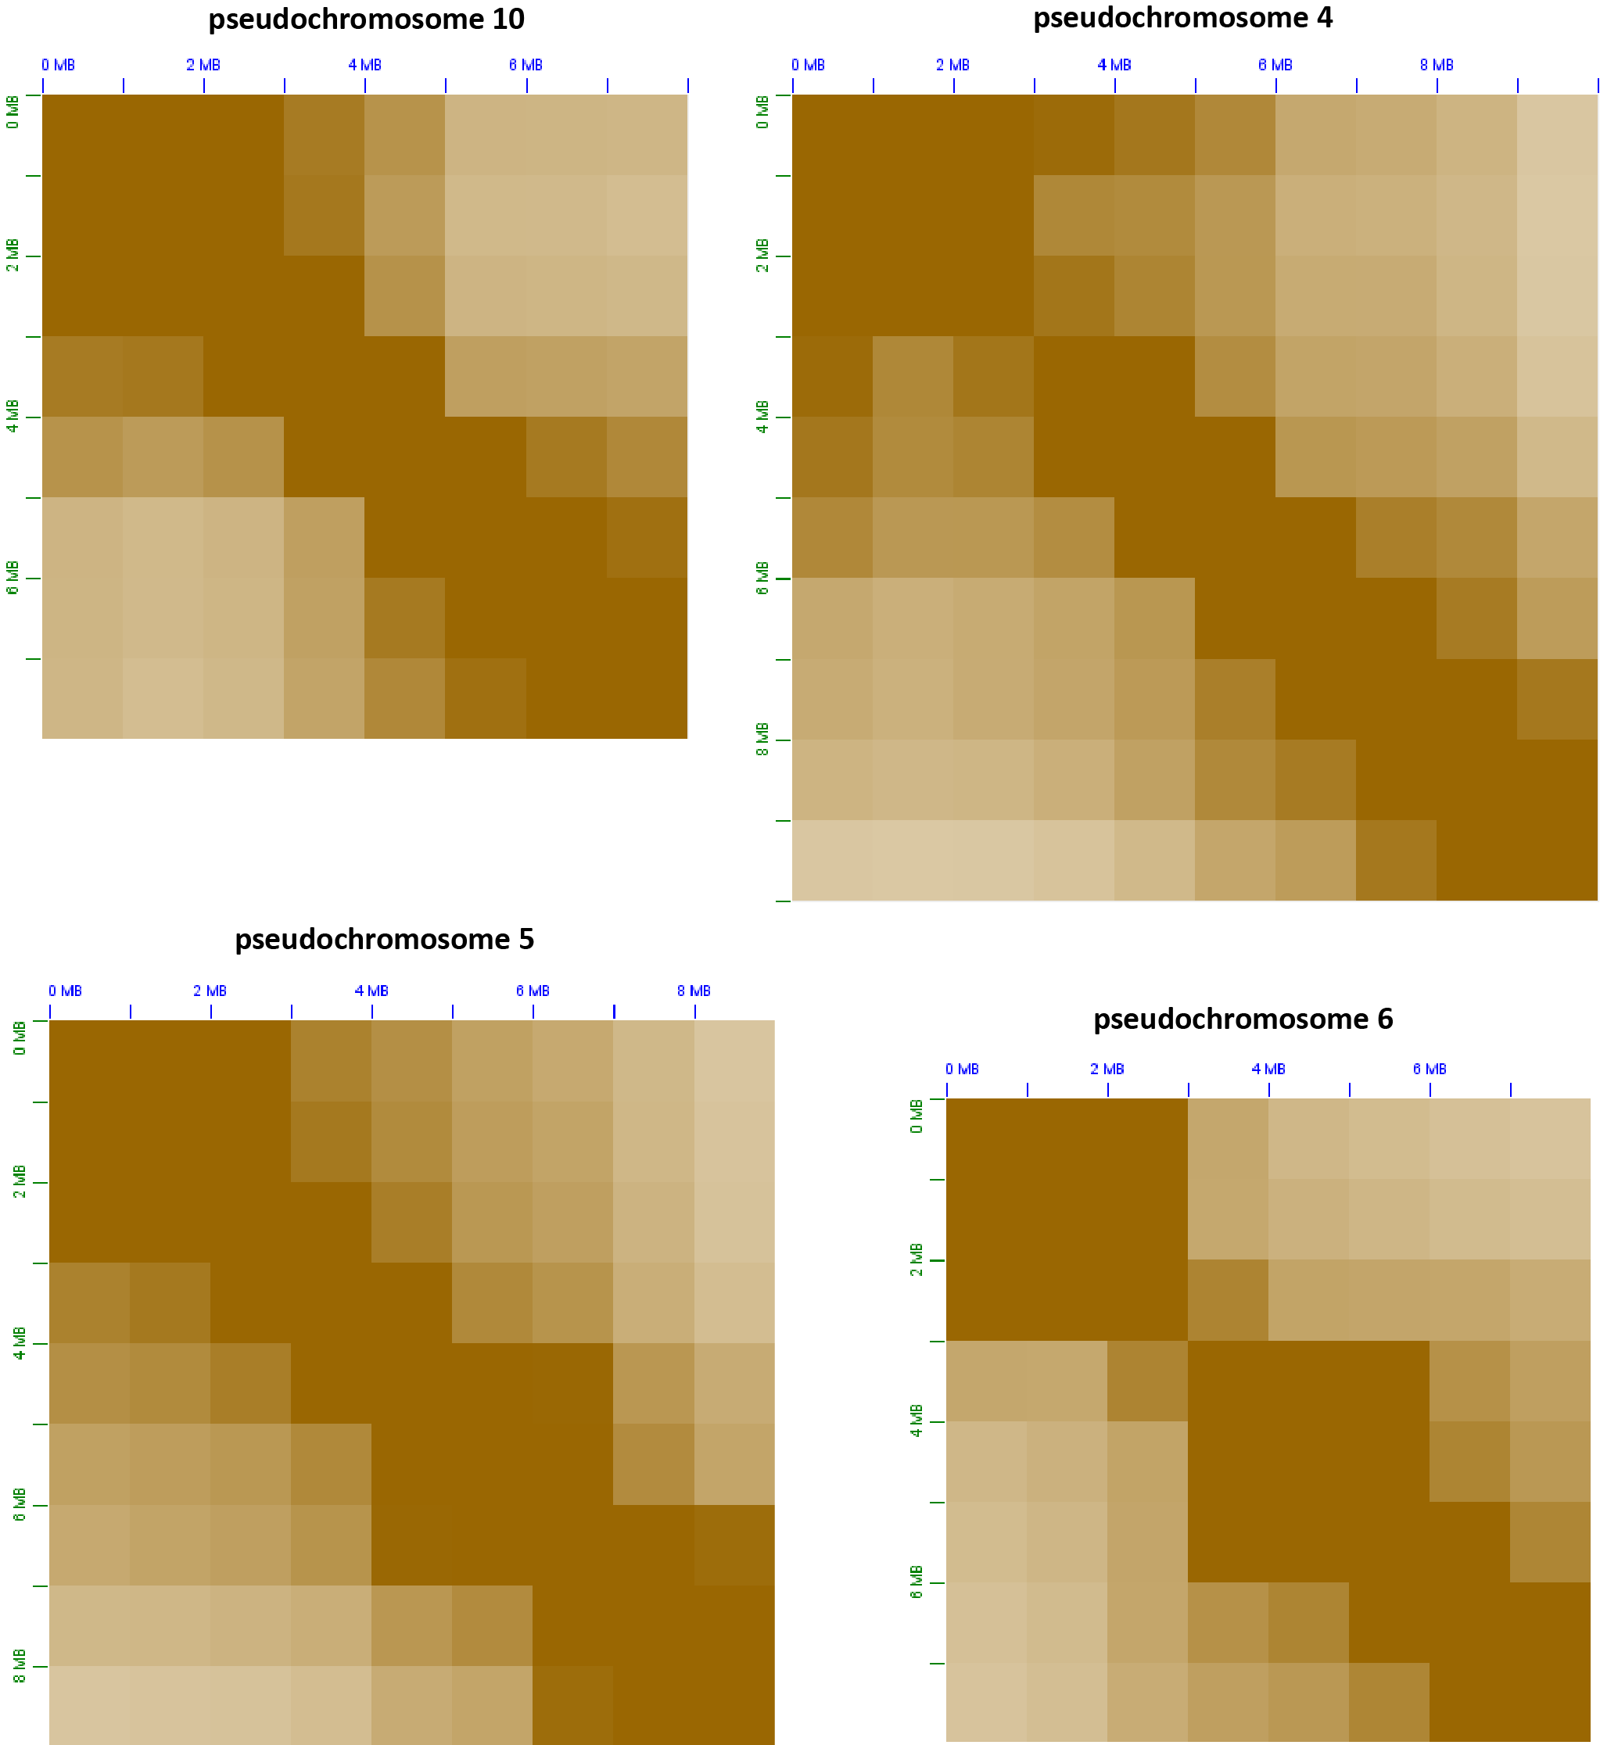
BROAD STRUCTURE:

Slide 15
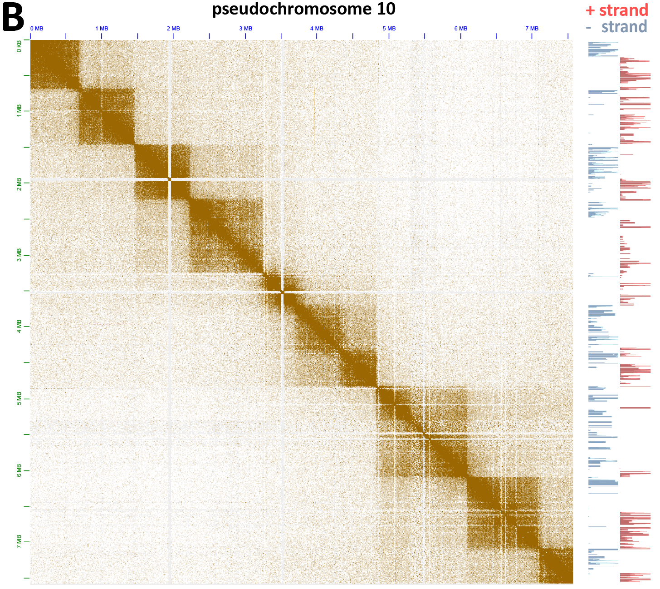
DOMAIN STRUCTURE:

Slide 16
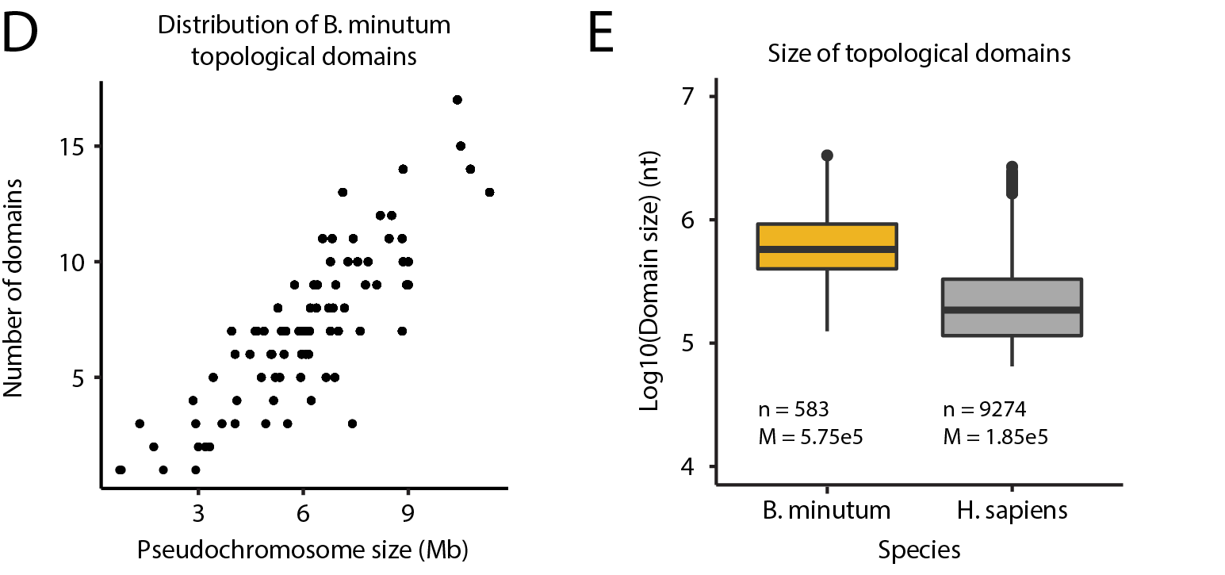

Slide 17
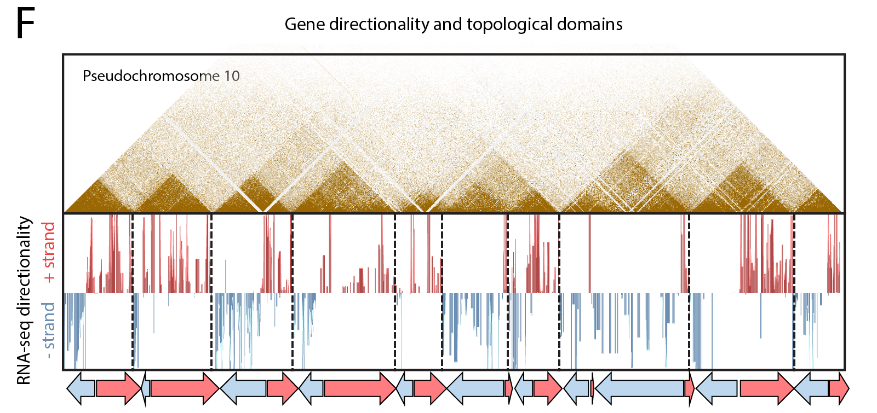

Slide 18
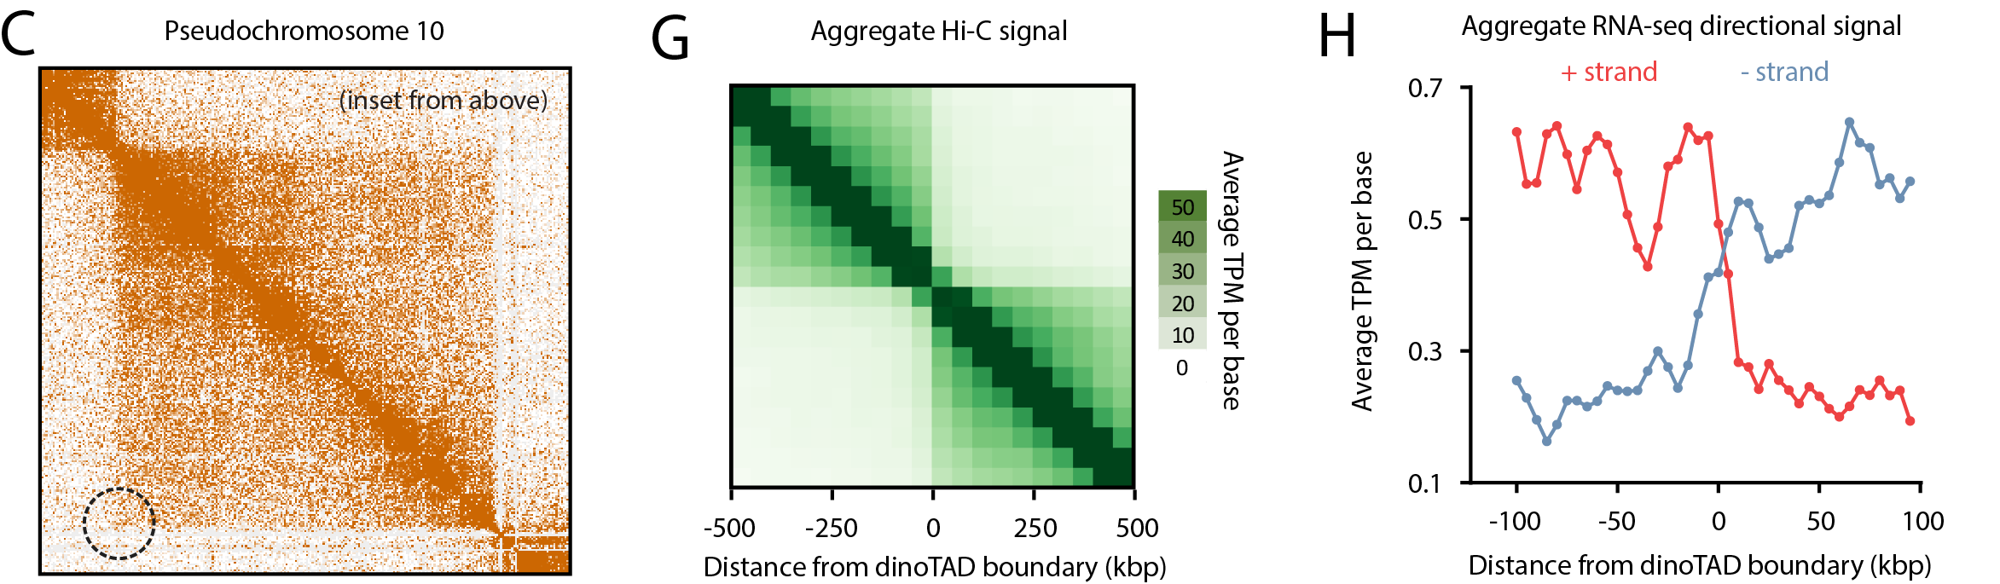
DOMAIN BOUNDARIES AND ABSENCE OF LOOPS

Slide 19
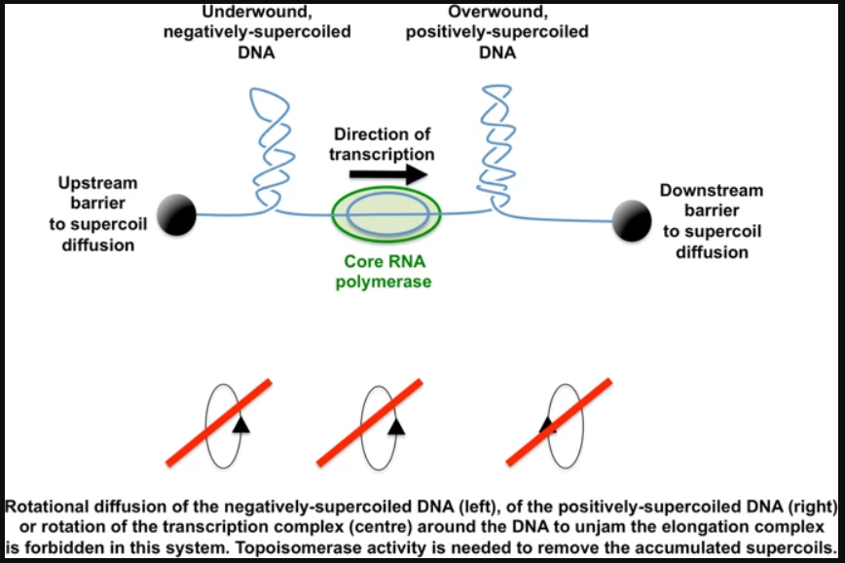
WHAT IS THE MECHANISM?
Transcription-induced supercoiling is one possibility

Slide 20
PREDICTION:
If transcription is blocked, domains should disappear

Slide 21
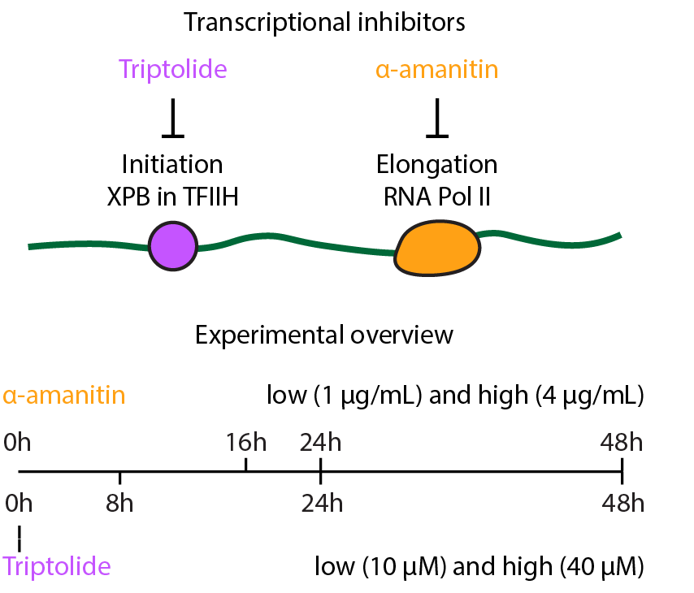

Slide 22
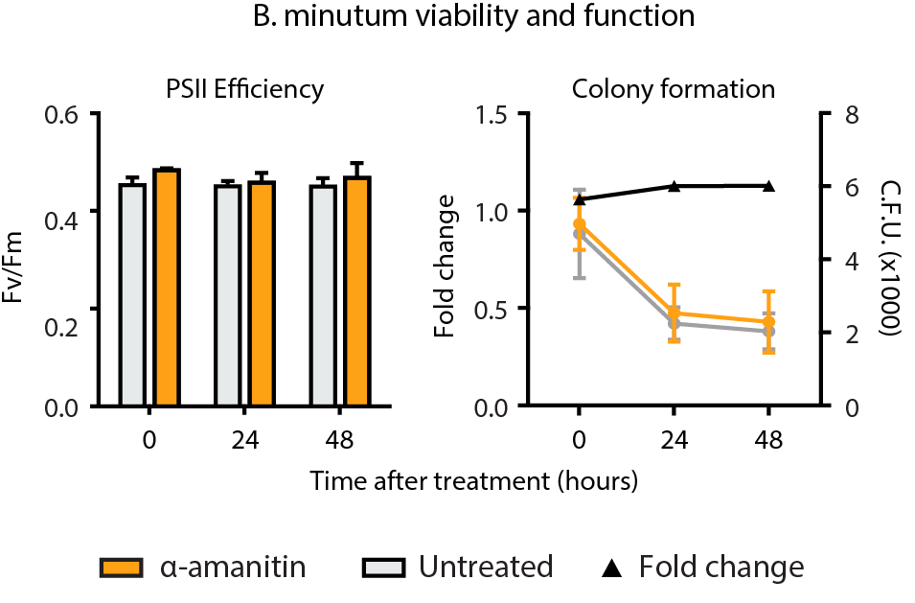

Slide 23
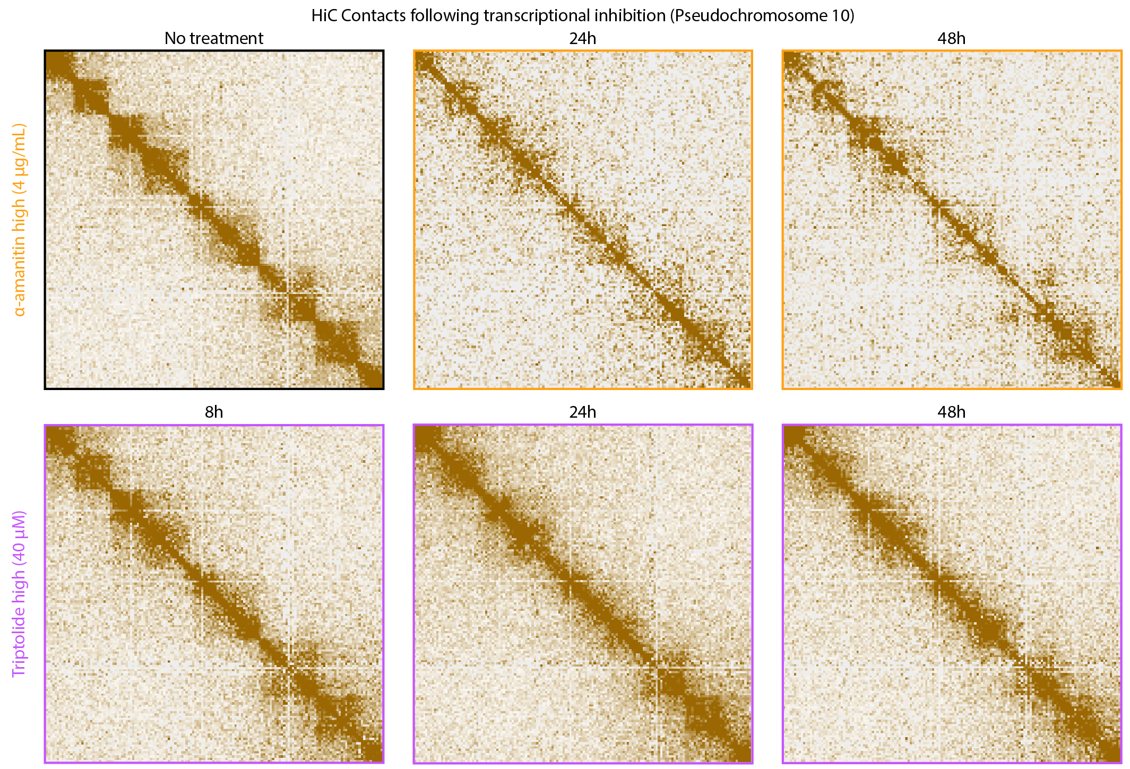

Slide 24
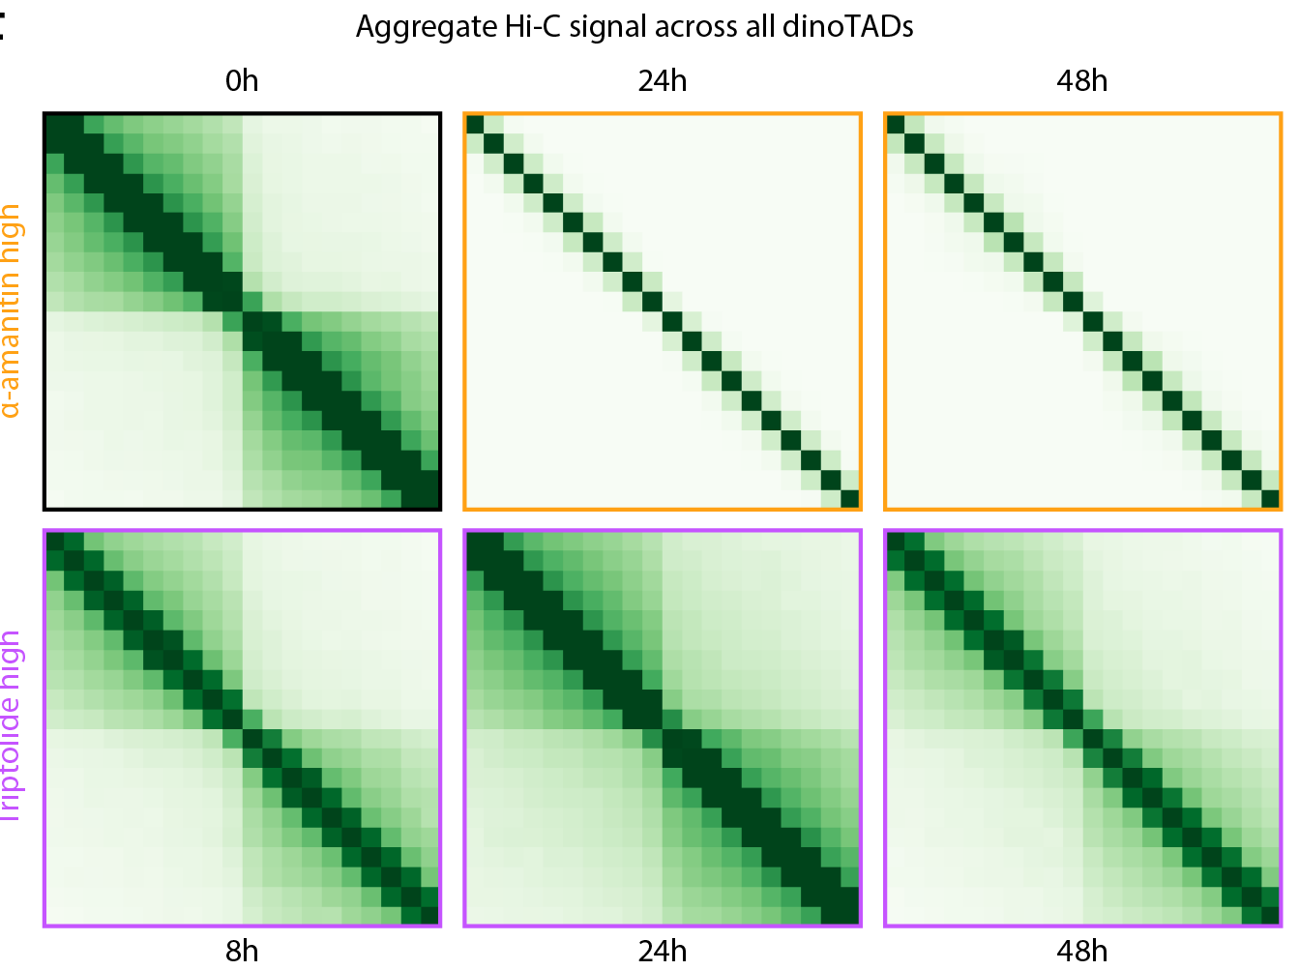

Slide 25
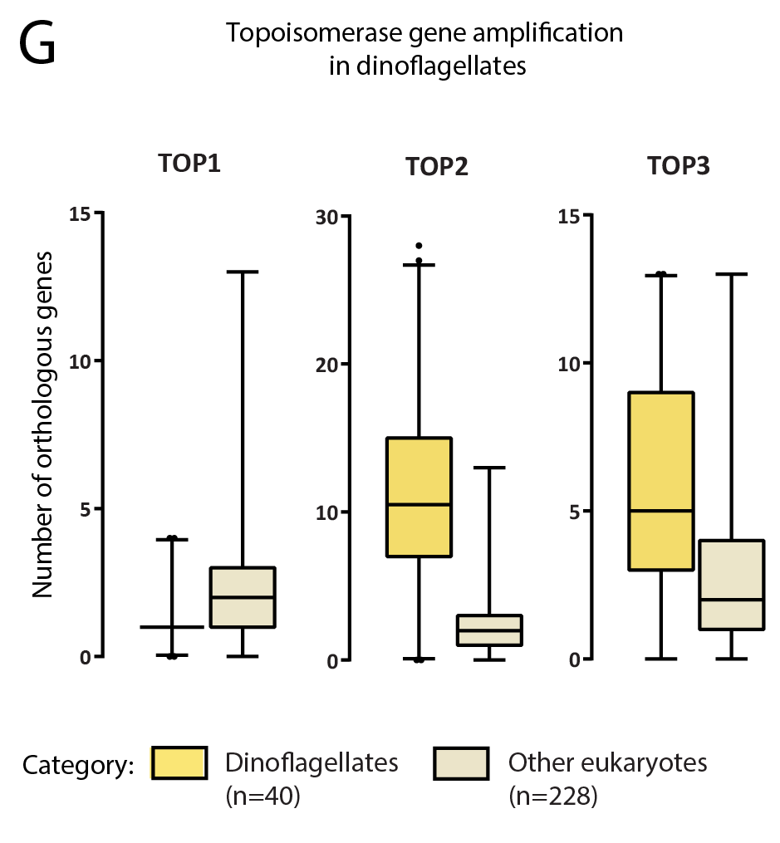

Slide 26
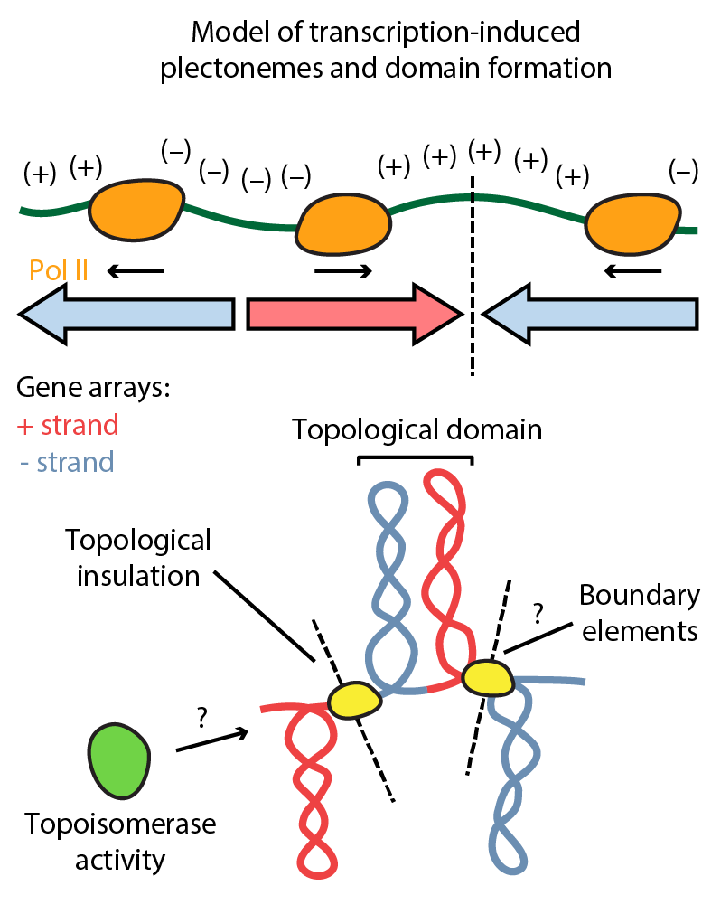

Slide 27
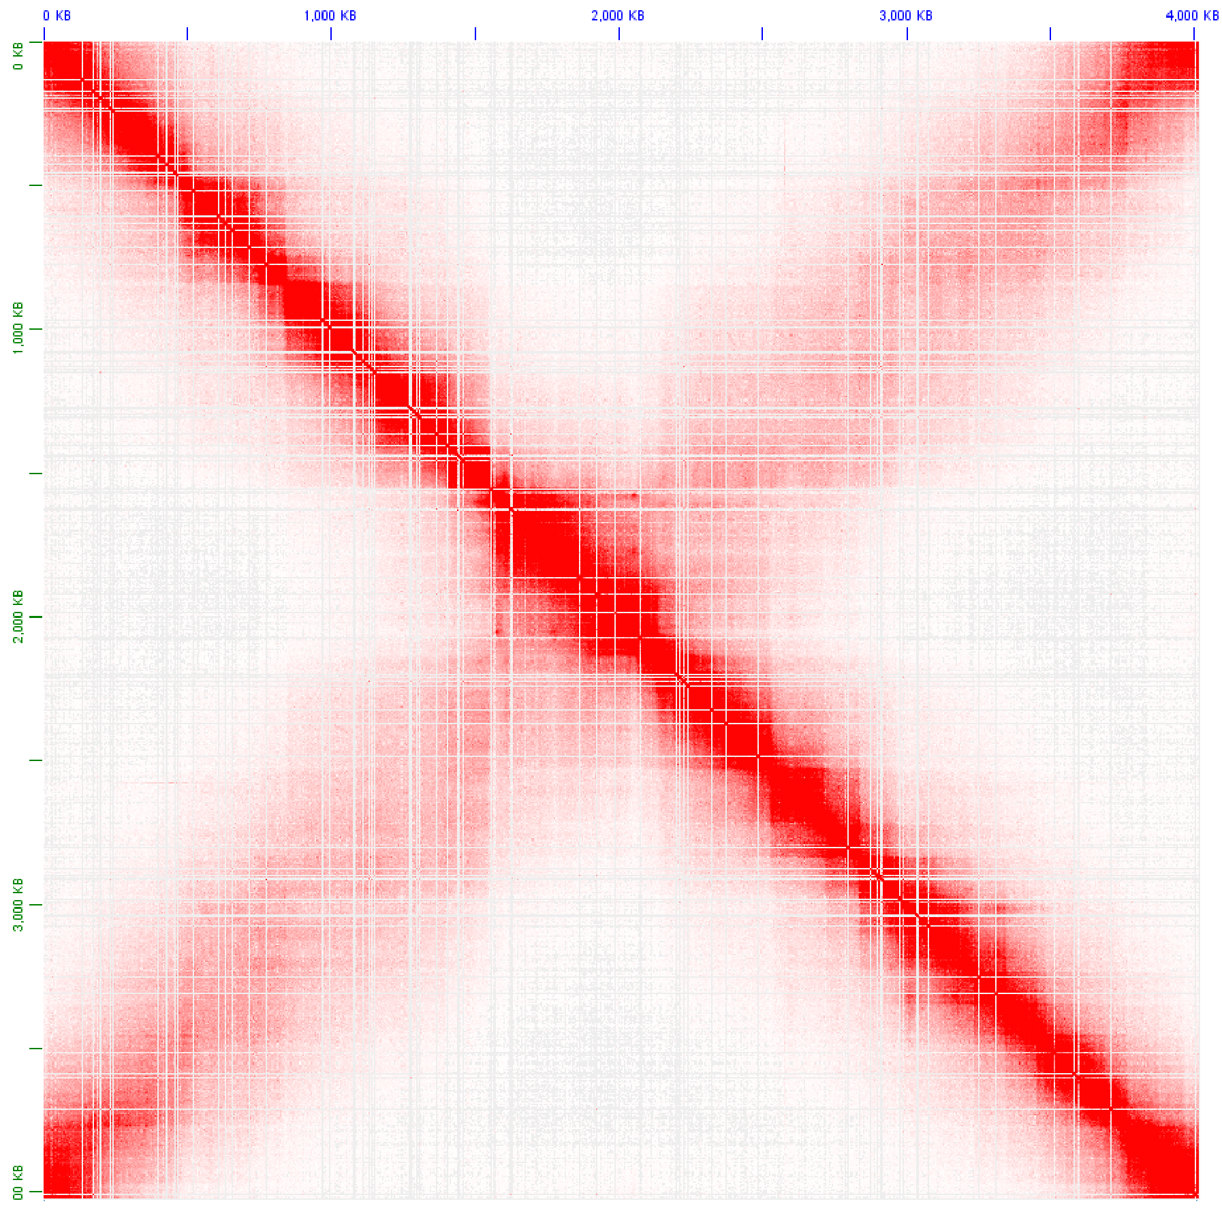
Caulobacter
- prokaryote

Slide 28
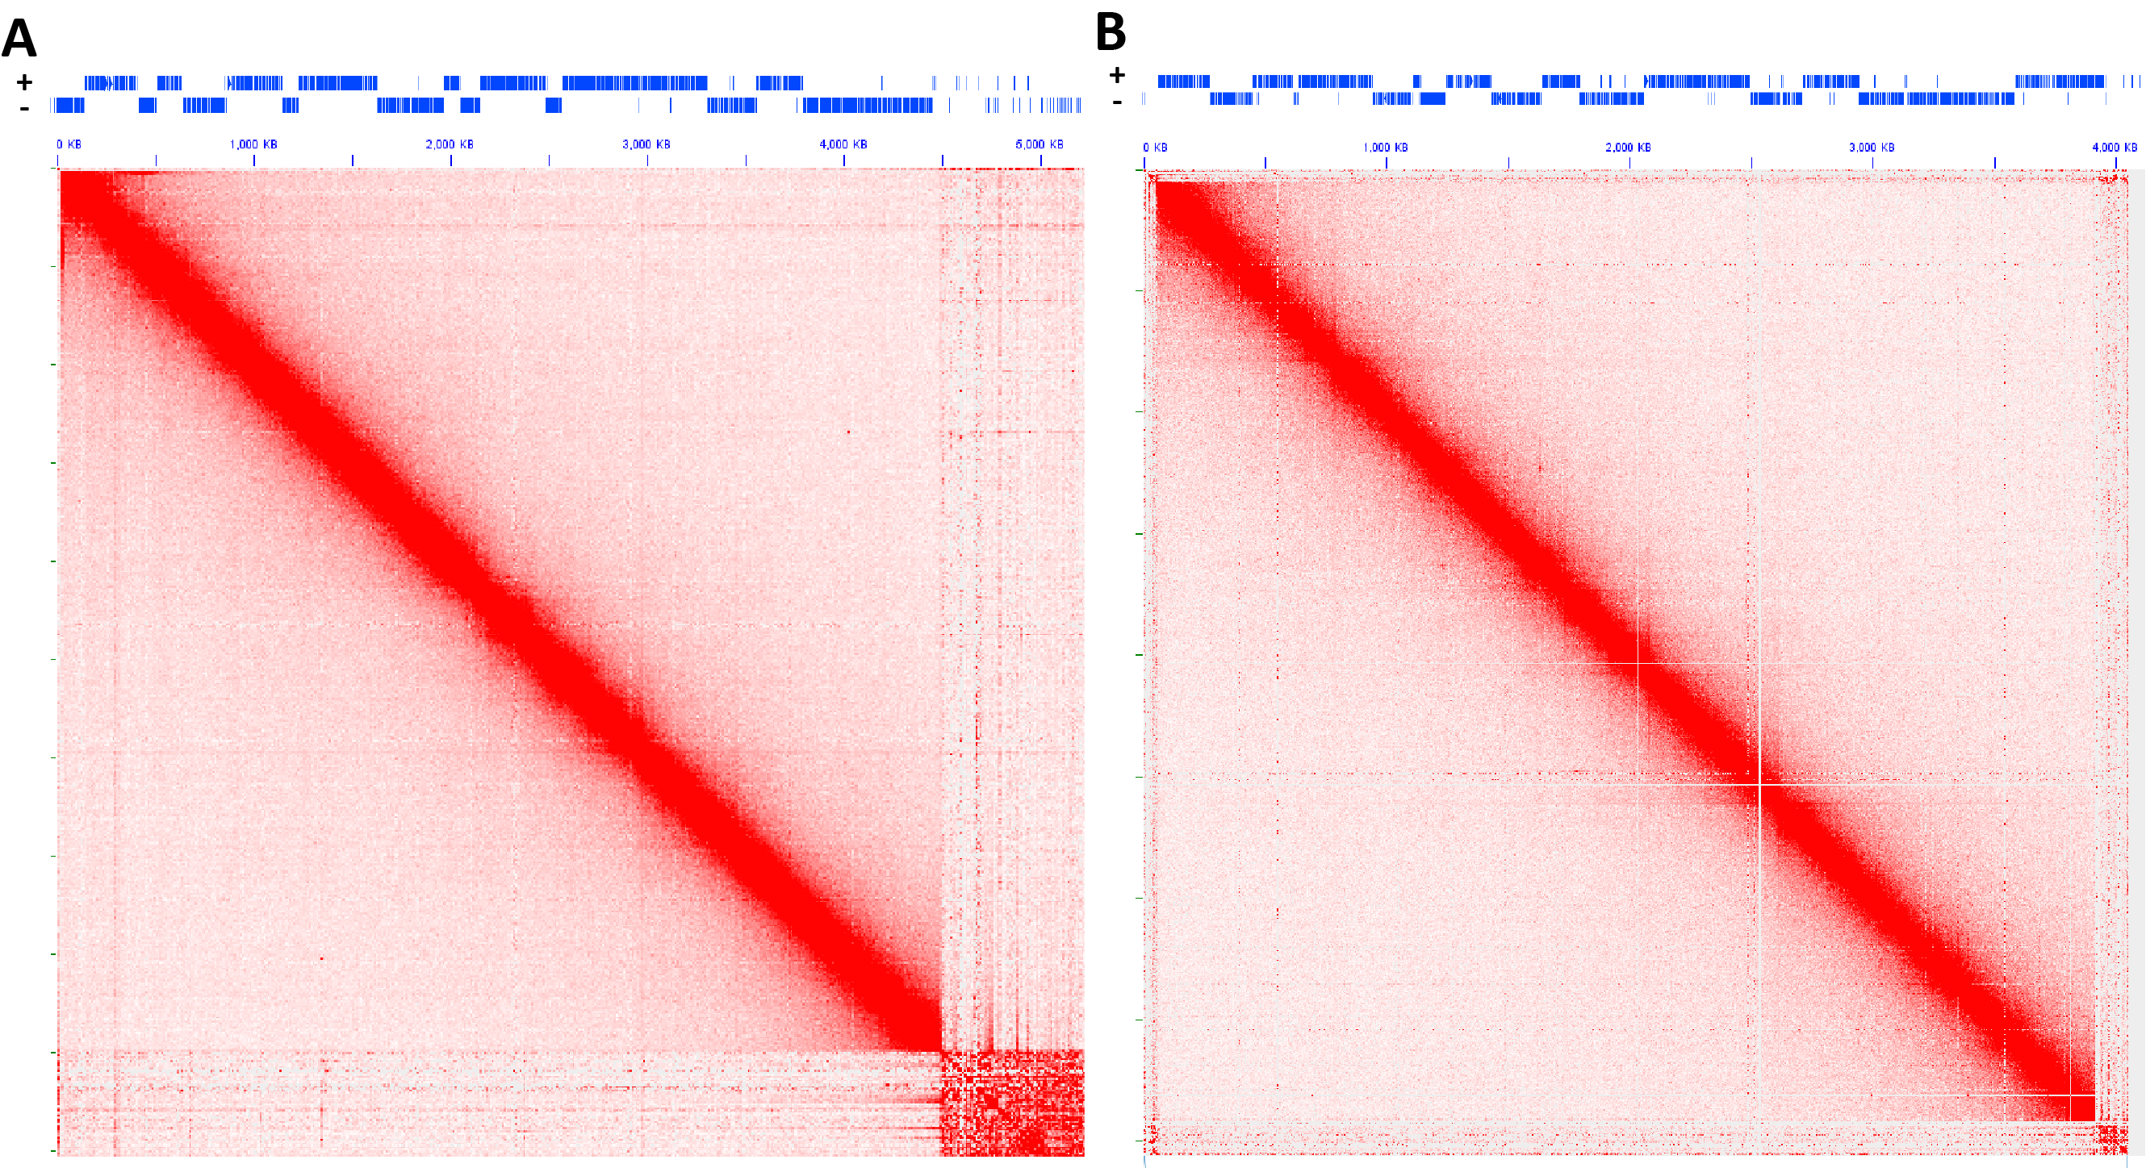
Trypanosoma
- eukaryote with gene arrays but also with histones

Slide 29
CONCLUSIONS
Strong insulation domains are observed in the Symbiodinium genome
These appear to correspond to pairs of divergent multicistronic gene arrays
Clear loop contacts are not immediately obvious
Transcription-induced supercoiling appears to be the mechanism driving their formation
Supercoiling emerges as another fundamental topological force shaping genome folding
Its effects are masked in most eukaryotes by the presence of nucleosomes – interactions between histones block the formation of plectonemes

Slide 30
OPEN QUESTIONS
How exactly is supercoiling creating self-interacting domains?
How could supercoiling create sharp boundaries?
Can these patterns be reproduced computationally?
Alternative hypotheses: it is possible that there are specific boundary elements with a distinct chromatin state, e.g. perhaps that is where the histones are
As it is at present not possible to answer that question without extensive additional experiments involving raising antibodies, ChIP-seq, mass-spectrometry, etc., we hope to use computational modelling to gain insights into the possible mechanisms

