Slide 1

LONG-RANGE SINGLE MOLECULE MAPPING FOR MAPPING THE MULTIKILOBASE ORGANIZATION OF ACCESSIBLE CHROMATIN
ZOHAR SHIPHONY
GEORGI K. MARINOV
September 19th 2018

Slide 2
REGULATORY ELEMENTS IN EUKARYOTES ARE NUCLEOSOME-DEPLETED
FIGURE FROM REVIEW

Slide 3
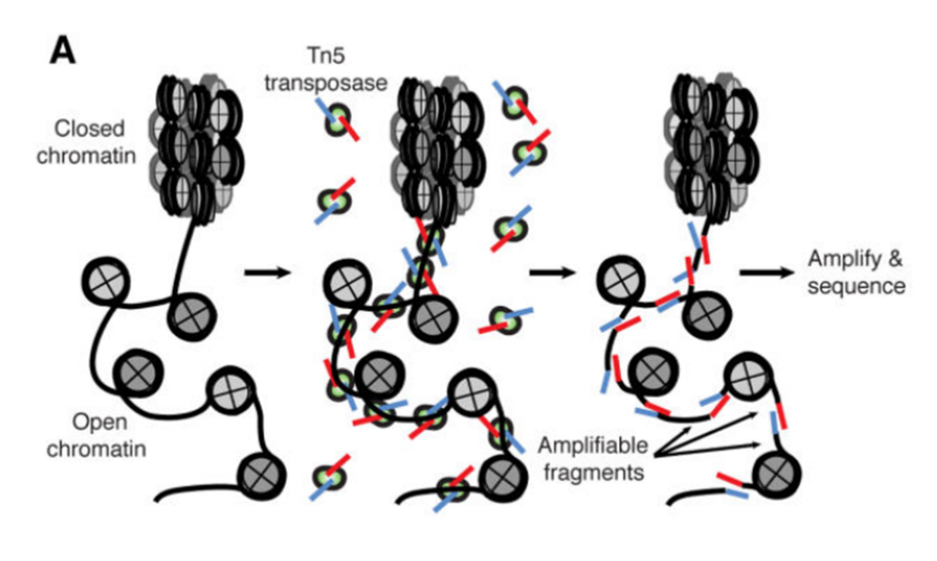
ACCESSIBLE CHROMATIN IS SUSCEPTIBLE TO ENZYMATIC CLEAVAGE
ATAC-seq
DNAse-seq, MNAse-seq, etc.

Slide 4
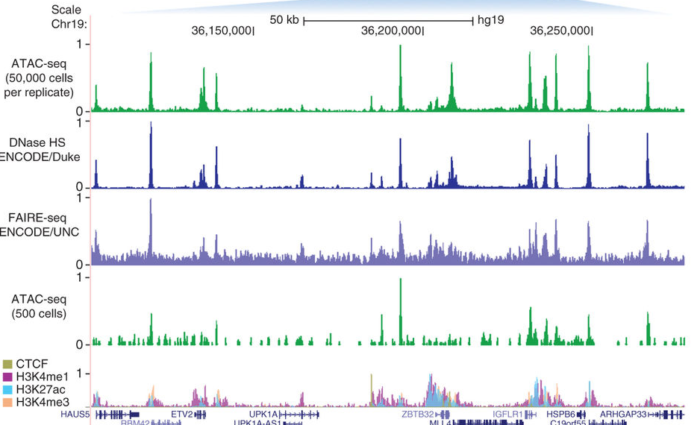
A TYPICAL SNAPSHOT OF A MAMMALIAN GENOME:

Slide 5
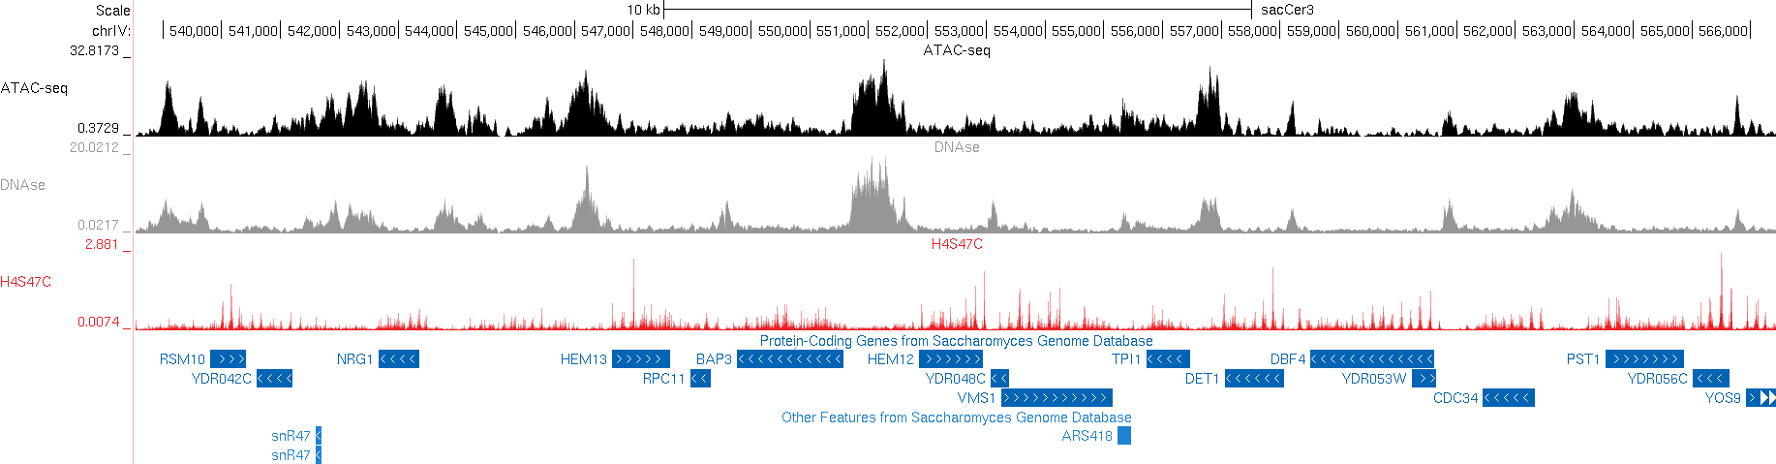
OPEN CHROMATIN IN YEAST (SMALL COMPACT GENOME)
ATAC-seq
DNAse-seq
Positioned nucleosomes

Slide 6
QUESTIONS:
Is the accessibility of distant open chromatin regions independently regulated or are they correlated?
What is the distribution of open chromatin states within the population?
Note: scATAC does not answer these questions because of how sparse it is and because of diploidy
TECHNICAL PROBLEM:
ATAC/DNAse/etc. reactions cut DNA, and linkage between fragments is lost.

Slide 7
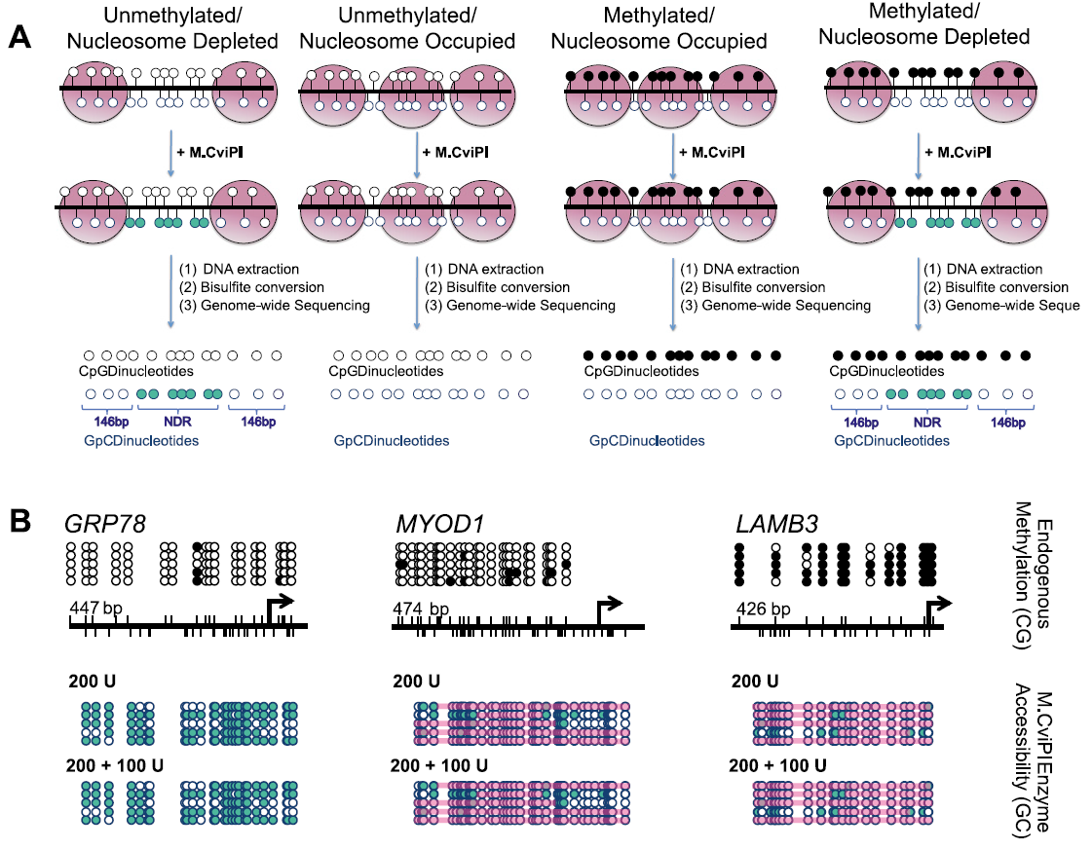
ALTERNATIVE TO CUTTING ENZYMES: METHYLTRANSFERASES
NOME-seq:
- GC methylation
- dSMF:
- CG+GC methylation
Kelly et al. 2012

Slide 8
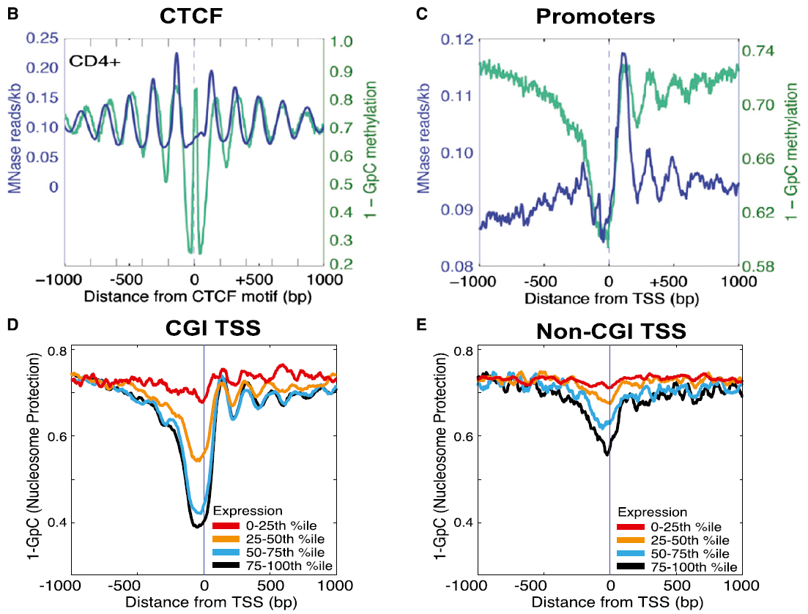

Slide 9
TECHNICAL PROBLEMS REMAIN:
Bisulfite treatment fragments DNA, only short fragments can be assayed
Low resolution due to rarity of CG/GC nucleotides

Slide 10
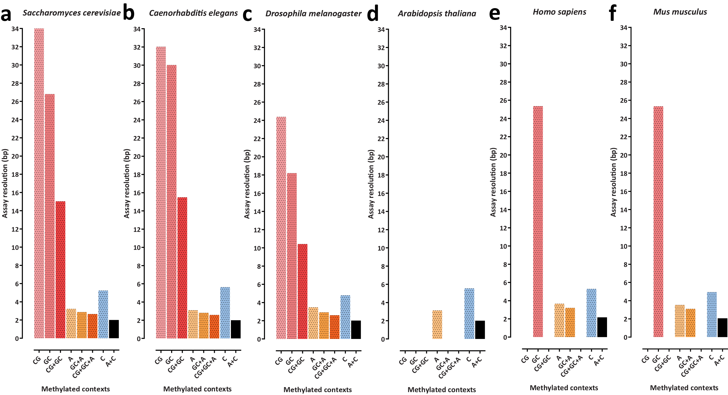
LOW RESOLUTION OF CG/GC METHYLTRANSFERASE-BASED ASSAYS

Slide 11
TECHNICAL PROBLEM REMAIN:
Bisulfite treatment fragments DNA, only short fragments can be assayed
Low resolution due to rarity of CG/GC nucleotides
SOLUTION: NANOPORE SEQUENCING
Can generate very long reads
Can read DNA modifications directly.
Can be used with methyltransferases other than CG/GC

Slide 12
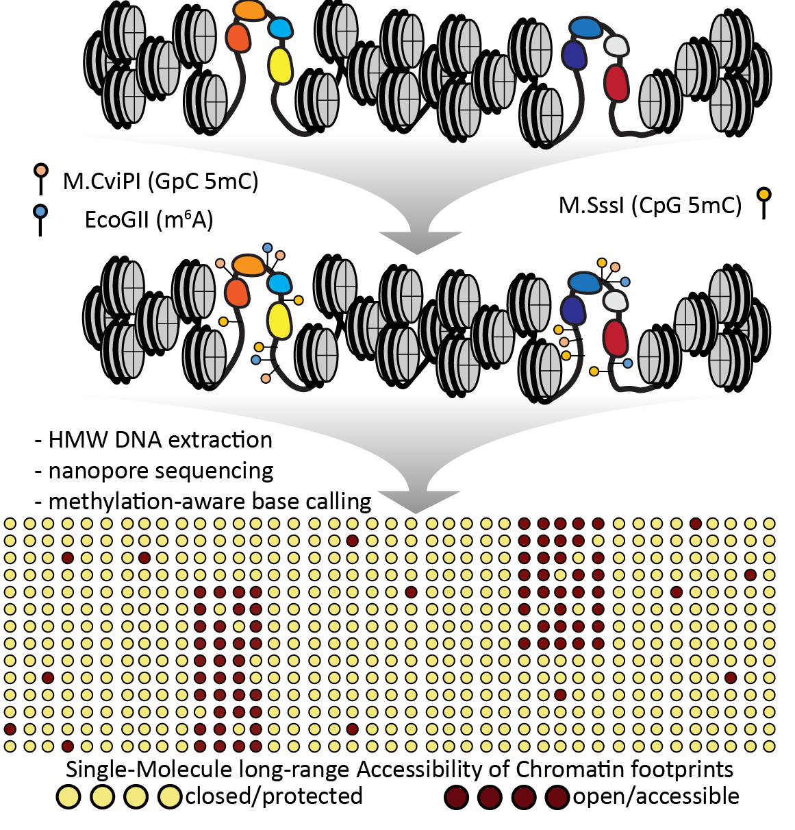
SMAC-SEQ

Slide 13
THEORETICAL SMAC-SEQ RESOLUTION

Slide 14
SMAC-SEQ PILOT STUDY IN YEAST

Slide 15
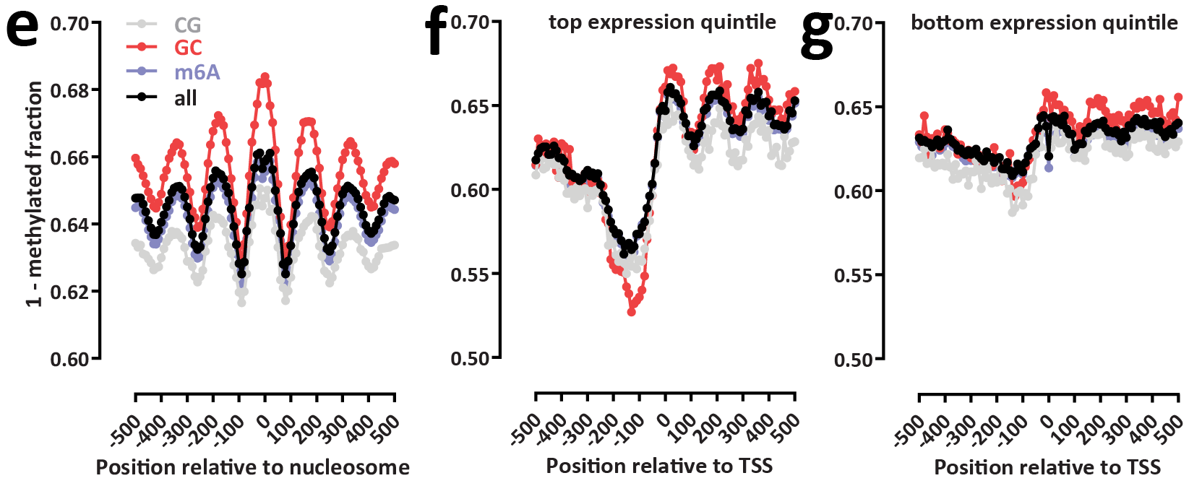
SMAC-SEQ REPRODUCES KNOWN FEATURES OF ACCESSIBLE CHROMATIN

Slide 16
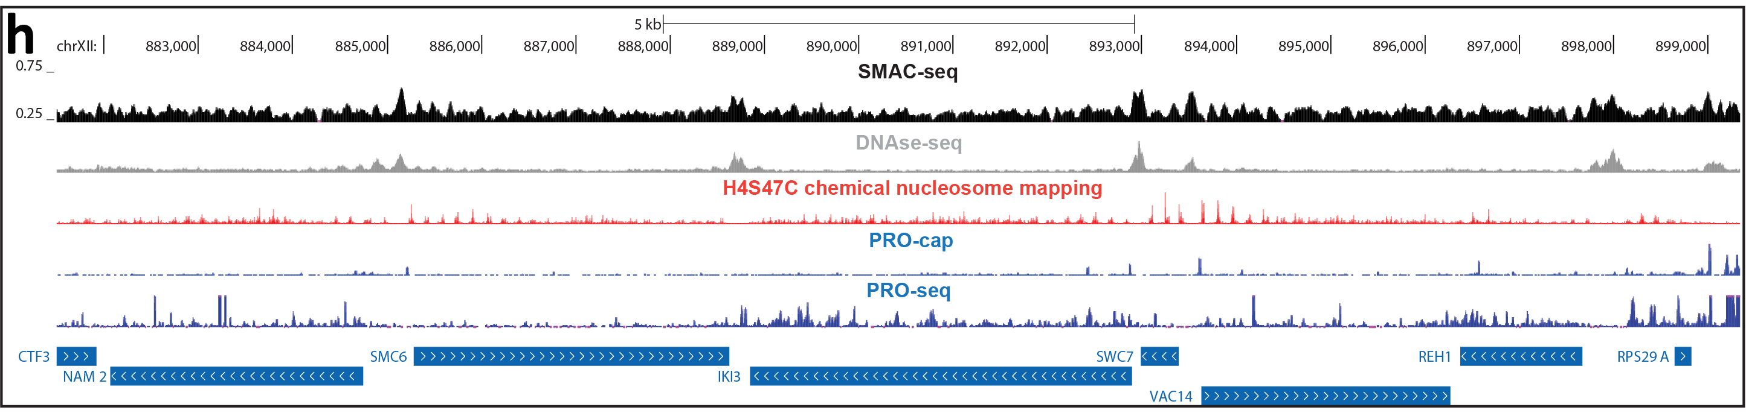

Slide 17
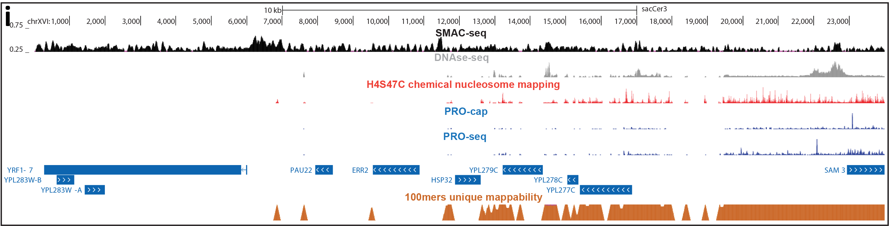
SMAC-SEQ RESOLVES CHROMATIN STRUCTURE IN REPETITIVE AREAS

Slide 18
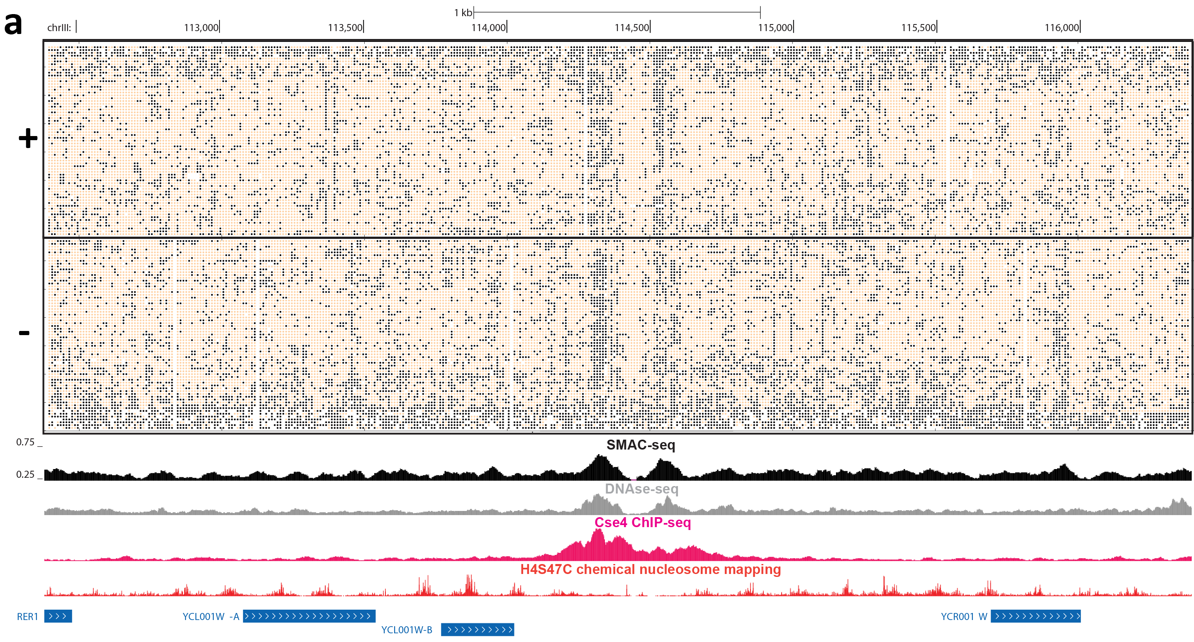
A SINGLE-MOLECULE POPULATION-SCALE VIEW OF CHROMATIN STATES

Slide 19
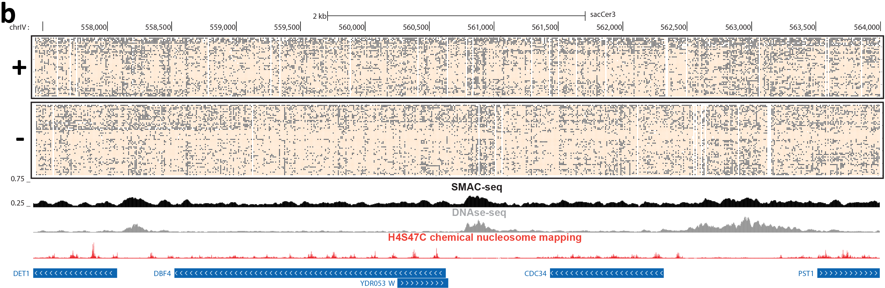
A SINGLE-MOLECULE POPULATION-SCALE VIEW OF CHROMATIN STATES

Slide 20
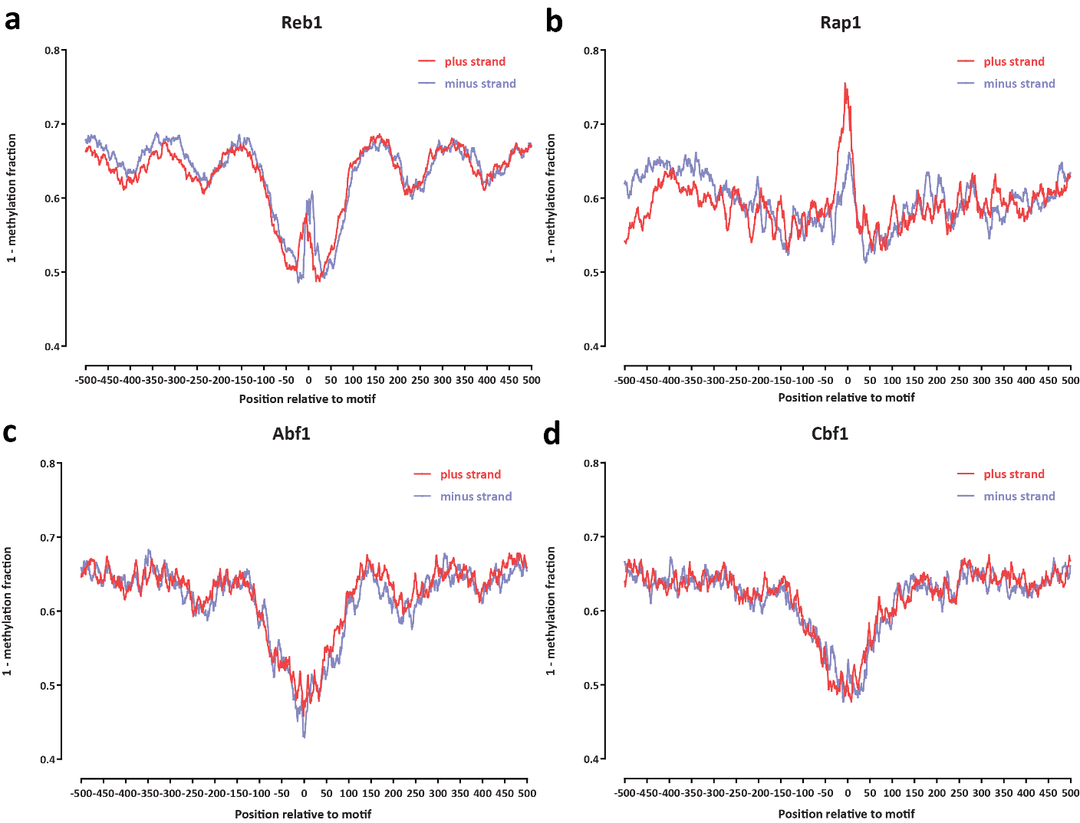
TRANSCRIPTION FACTOR FOOTPRINTING

Slide 21
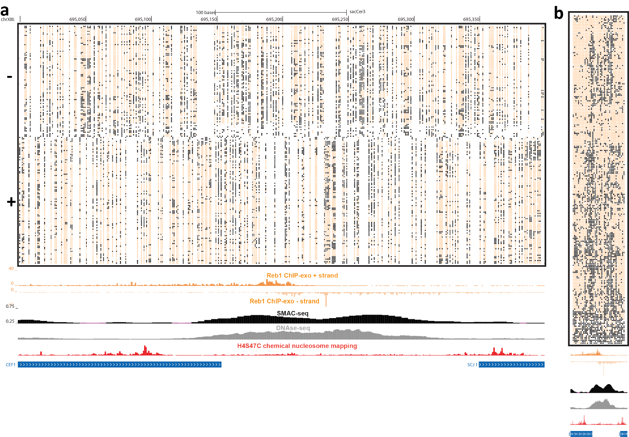
TRANSCRIPTION FACTOR FOOTPRINTING

Slide 22
A SINGLE-MOLECULE POPULATION-SCALE VIEW OF CHROMATIN STATES
NUCLEOSOME/PROMOTERS FIGURE

Slide 23
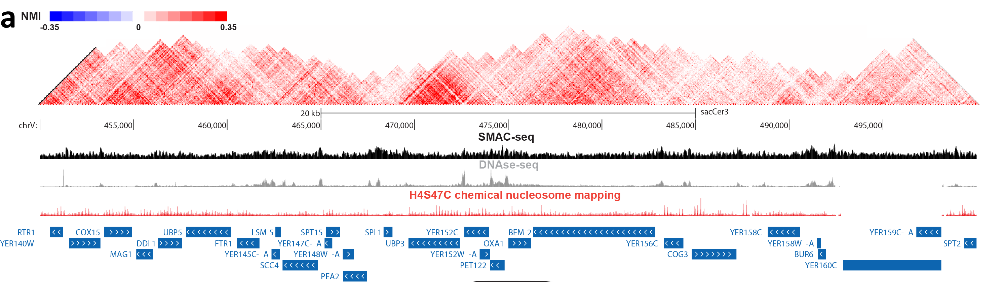
COACCESSIBILITY PATTERNS IN THE YEAST GENOME

Slide 24
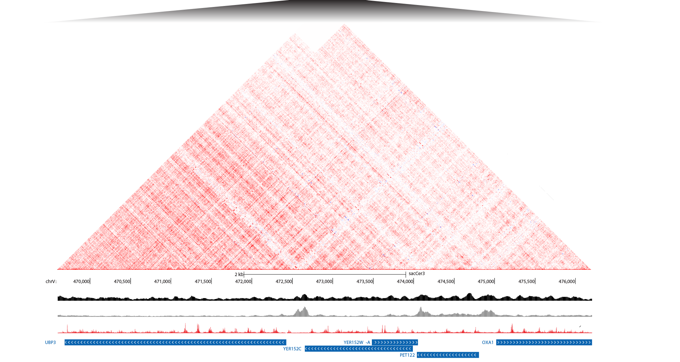
COACCESSIBILITY PATTERNS IN THE YEAST GENOME

Slide 25
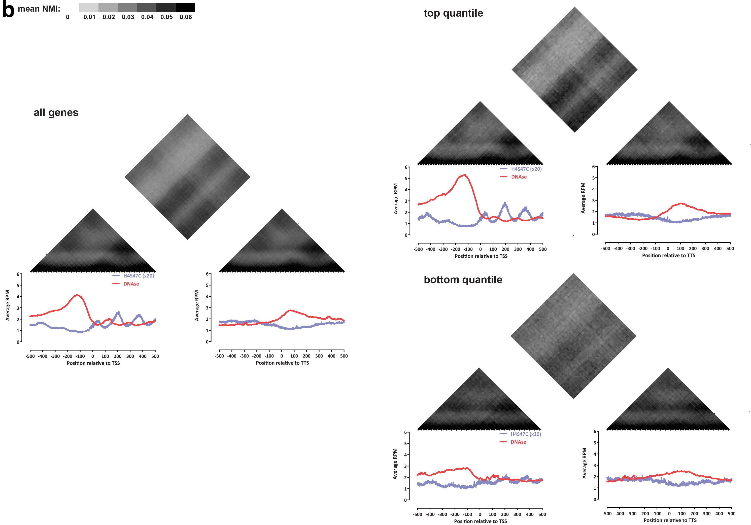
COACCESSIBILITY PATTERNS IN THE YEAST GENOME

Slide 26
XXXXXX
FINAL COACCESSIBILITY FIGURE

Slide 27
A SINGLE-MOLECULE VIEW OF THE CHROMATIN-LEVEL RESPONSE TO STRESS
DIAMIDE FIGURE

Slide 28
ACKNOWLEDGEMENTS
XXX
XXX
XXX
XXX
XXX
XXX

Slide 29
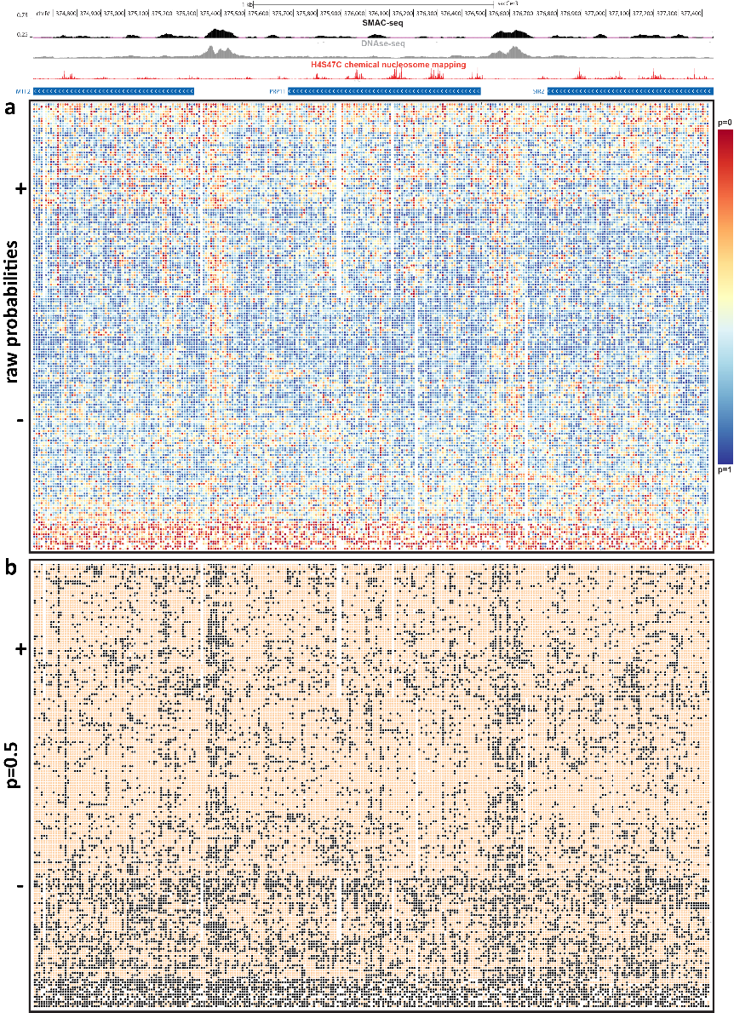
BINARIZATION OF NANOPORE METHYLATION CALLS:

Slide 30
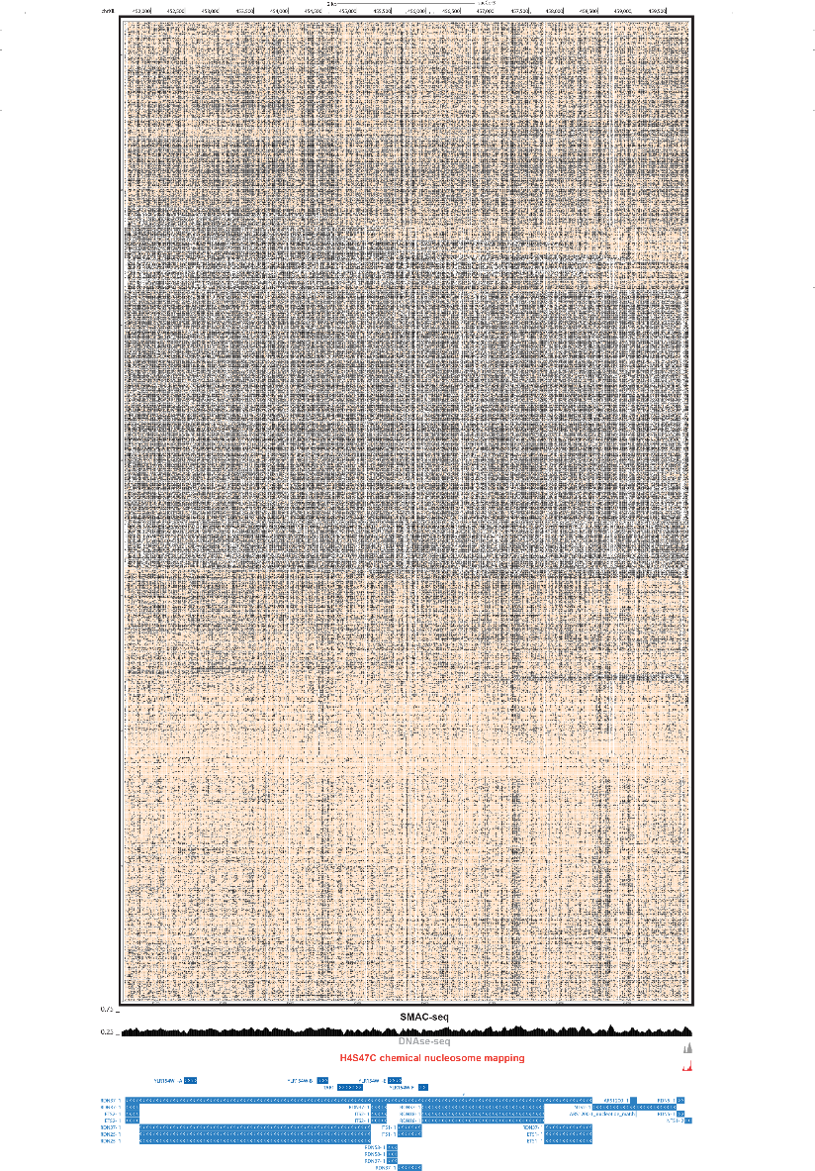
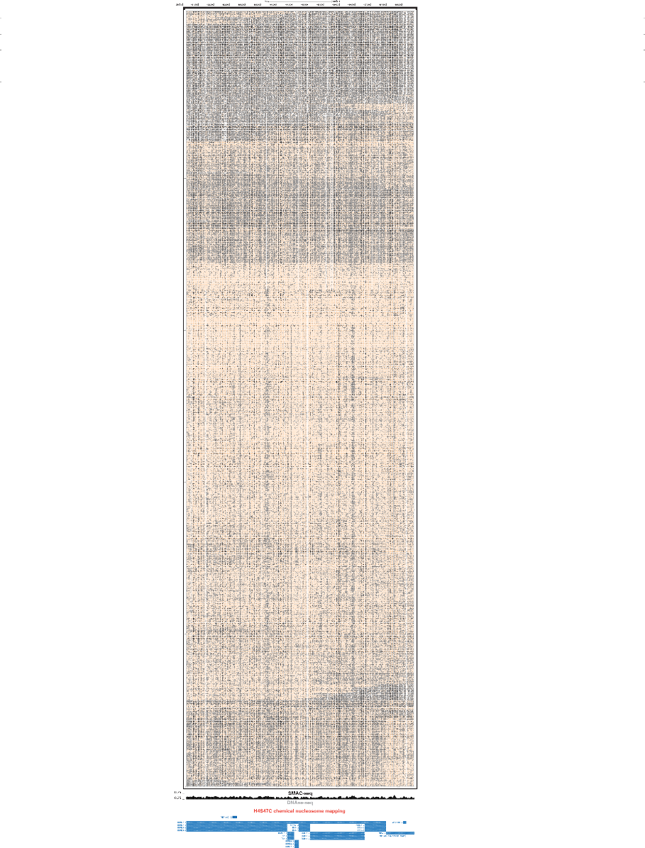
rDNA

Slide 31
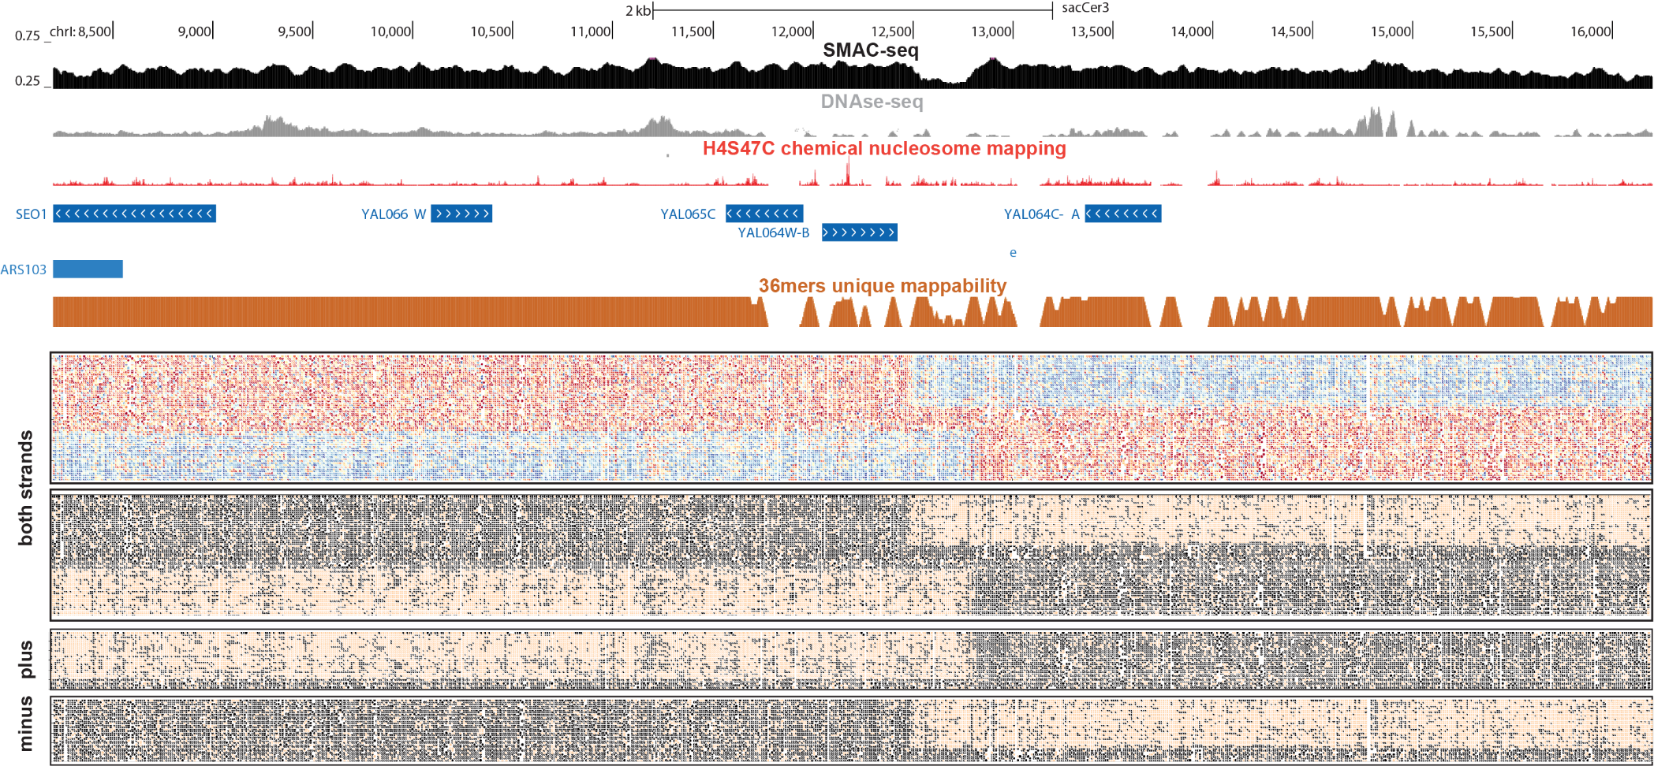
ACCESSIBILITY SWITCHES (ARTIFACT)

Slide 32
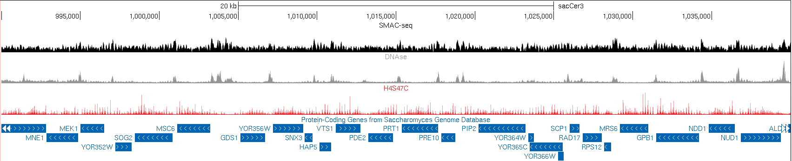

Slide 33
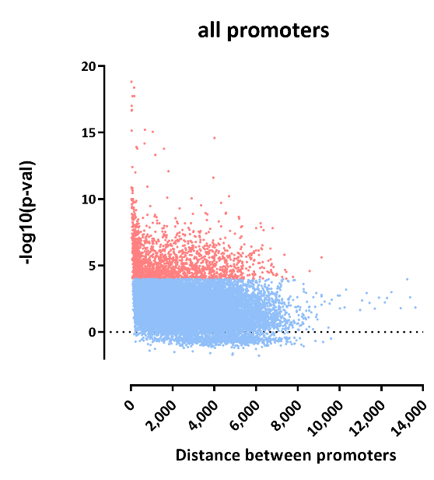
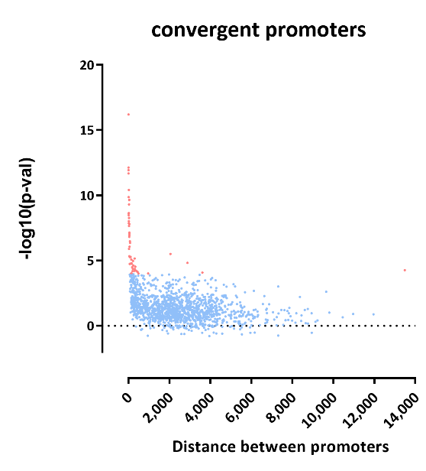
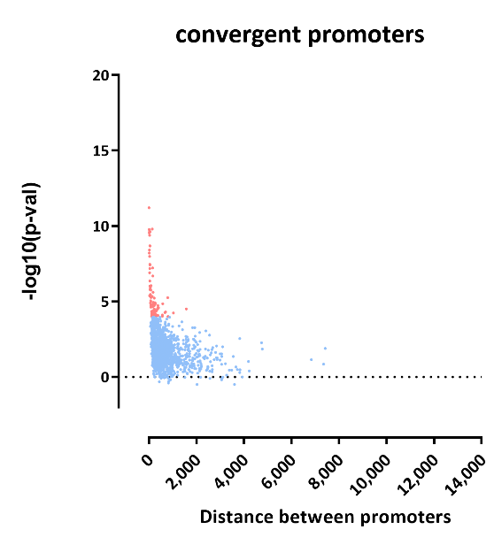
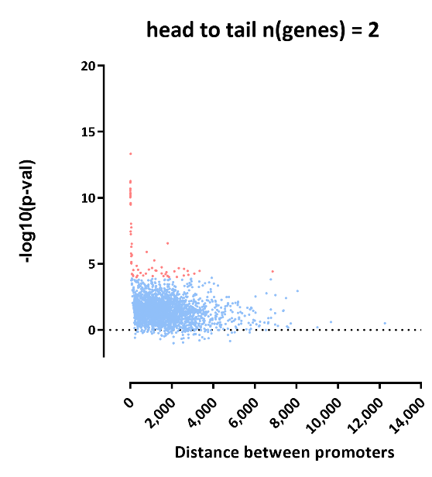
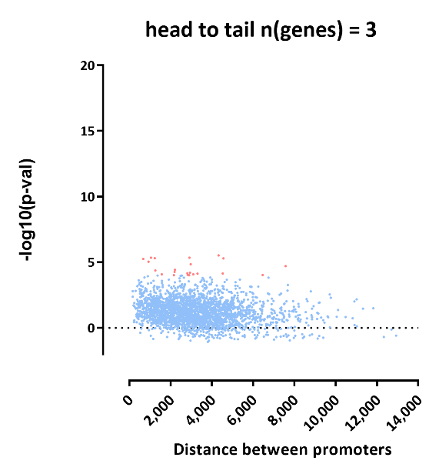
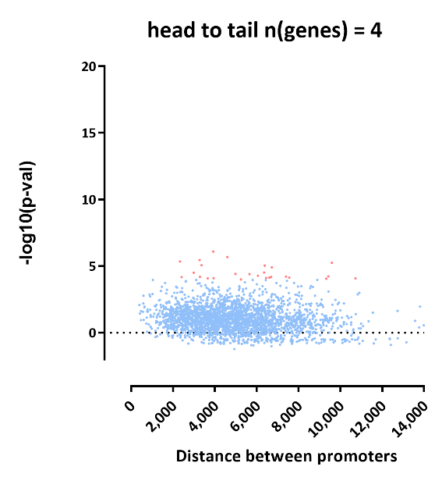

Slide 34
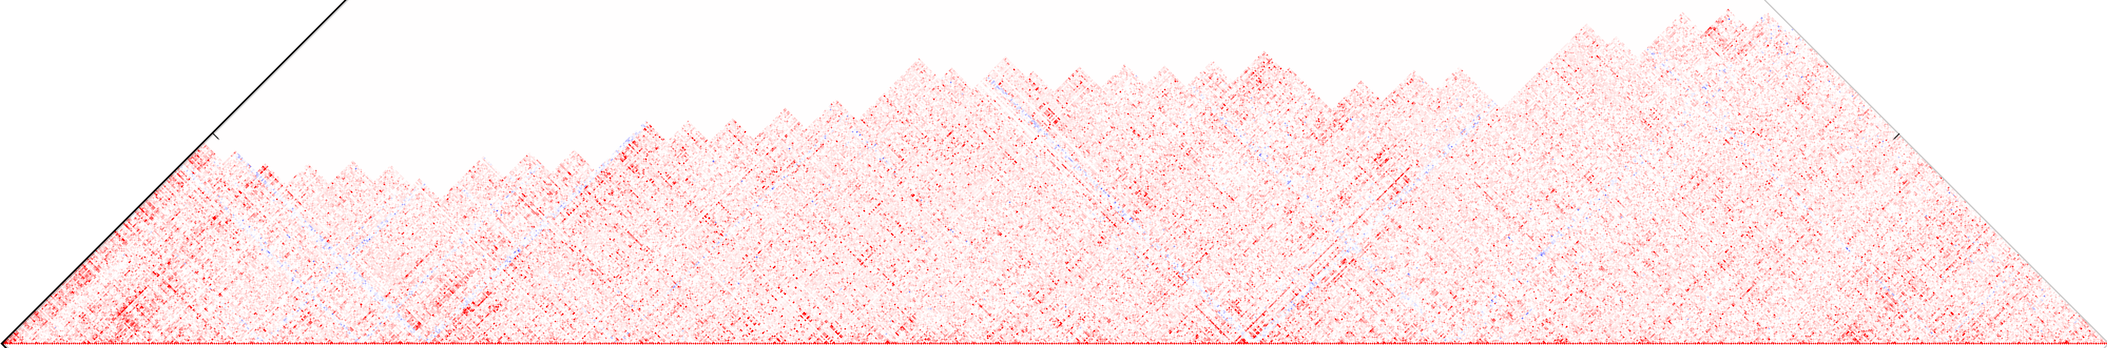
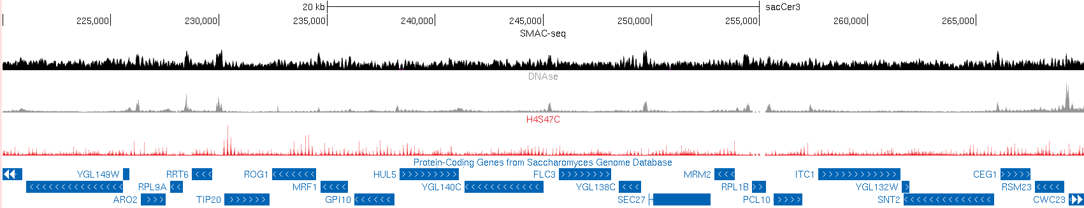

Slide 35
