Slide 1
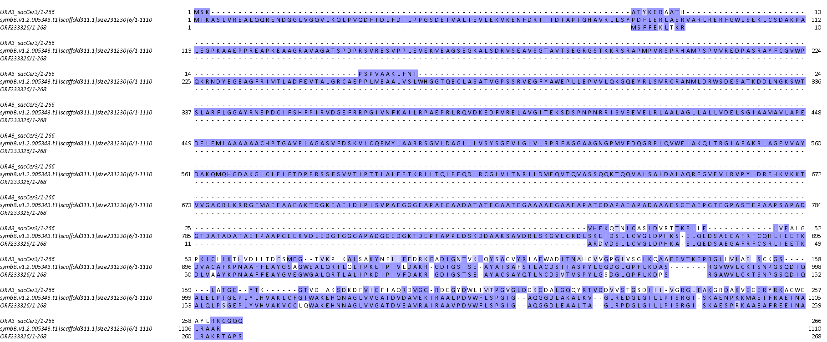
SSB01, SSA01, yeast URA3 protein sequences:
SSA01 is from transcriptome assembly, yeast one is from the sacCer3 S.cerevisiae assembly, the SSB01 is from the published S. minutum assembly and annotation. The SSB01 annotation is clearly wrong and includes a merge with an upstream gene. As annotated, it also includes a ArsA_ATPase domain, which is not found in URA3 itself (and should not be given its function as an anion transporter)

Slide 2
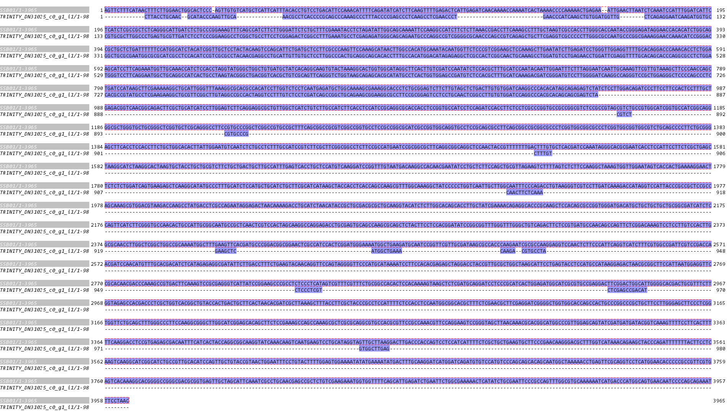
SSB01 and SSA01 nucleotide sequences:
Note that the SSB01 transcript is on the reverse strand

Slide 3
Exon 1:
>SSB01
AGTTCTTTCATAACTTTCTTGGAACTGGCACTCCC-AGTTGTGTCATGCTCATTCATTTACACCTGTCCTGACATTCCAAACATTTTCAGATATCATCTTCAAGTTTTGAGACTCATTGAGATCAACAAAACCAAAATCACTAAAACCCCAAAAACTGAGAA--ATTGAACTTAATCTCAAATCCATTTGGATCA __<---5'UTR__
TTCTCATCTCGCCGCTCTCAGGGCATTGATCTCTGCCCGGAAAGTTTCAGCCATCTTCTTGGGATTCTCTGCTTTCGAAATA
>TRINITY_DN31025_c0_g1_i1
-------------CTTACCTGCAAC--GCATACCCAAGTTGCA---------------AACGCCTCACCCCGCAGCCCAAAGCCCTTTACCCCGAGCCCTCAAGCCTCGAACCCT----------------------------GAACCCATCAAGCTGTGGATGGTTG--------CTCAGAGGAATCAAGATGG _?<---5'UTR?_
TGCCGTGCGCTTGGCCCTGAGTGCGTTGATCTCCTCCCGGAAGGCCTCGGCTGCCTTCCTCGGAGACTCGGCCTTTGAAATG
Exon 2:
>SSB01
CCTCTAGATATTGGCAGCAAAATTCCAAGGCCATCTTCTCTTAAACCGACCTTCAAAGCCTTTGCTAAGTCGCCACCTTGGGCACCAATACCGGGAGATAGGAACCACACA
>TRINITY_DN31025_c0_g1_i1
CCTCGAGAGATGGGCAGCAGAATGCCCAGGCCGTCGGGGCGCAACCCAGCCGTCAGAGCTGCTTCGAGGTCGCCCCCTTGGGCGCCAATGCCCGGCGAAAGGAACCAAACA
Exon 3:
>SSB01
TCTGGCAGCGCTGCTCTGATTTTTTCCATGGCATCTACATCGGTTGCTCC
>TRINITY_DN31025_c0_g1_i1
TCCGGGACGGCTGCGCGAATGGCGCGCATCGCCTCCACATCCGTCGCGCC
Exon 4:
>SSB01
TACTACAAGTCCAGCATTCTGATGCTCCTTCGCCCAAGTTCCAAAGCATAACTTGGCCACATGCAA
>TRINITY_DN31025_c0_g1_i1
TACAACGAGGCCTGCATTGTTGTGCTCCTTGGCCCACTGCAGGCAGCACACCTTTGCCACATGGAC
Exon 5:
>SSB01
ATACAATGGTTCTCCCGTCGGAAGCTCCAAAGCTTGAATATCTTG
>TRINITY_DN31025_c0_g1_i1
ATAGAGAGGCTCGCCACTCGGCAACTGCAAAGCCTGGATGTCCTG
Exon 6:
>SSB01
AGATCCTGGGTTGGAGGTTTTGCACAGGACCCAAACACCTCTGGAAGCATCCTTCAGAAATGGTTGCAAACCAT
>TRINITY_DN31025_c0_g1_i1
AGAACCTGGATTCGAGGTTTTGCACAGCACCCAGGCGCCTCTGGATGGGTCCTTCAGGAATGGCTGCAGGCCAT
Exon 7:
>SSB01
CTCCACCTAGGTATGGGCTGGCTGTGATGCTATCACAGGCAAGTGTACTAAAGGCACTGGTGGCATAGGCTTCACTTGTCGATCCAATATCTCCACGCTTTGCATCCAA
>TRINITY_DN31025_c0_g1_i1
CACTGCCTAAGTACGGGCTGACGGTCACGCTGTCGCAGTTCAGGGTCTGGTAAGCAGAGCACGCATATGCCTCACTGGTGGAGCCGATGTCTCCACGCTTTGCATCAAA
Exon 8:
>SSB01
TACAATTGGAATTTCTTTAGGAATCAATTGCAAAGTTCGTTGTAAAGCTTCCCAACCAGCTGATCCATAAGCTTCGAAAAAGGCTGCATTGGGTTTAAAGGCGCACGCCACATCC
>TRINITY_DN31025_c0_g1_i1
GACGATCGGGATGTCCTTGGGGATCAAGGCCAGGGTCCGCTGGAGGGCTCCCCAGCCCTCCACGCCGTATGCCTCGAAGAAGGCTGCGTTCGGCTTGTAGGCCGCCACTAGGTCC
Exon 9:
>SSB01
TTGGTCTCCTCAATGAGATGCTGGCAAAAGCGAAAGGCACCCTCTGCGGAGTCTTCTTGTAGCTCTGACTTGTGTGGATCAAGGCCCACACATAG
>TRINITY_DN31025_c0_g1_i1
TTTGTCTCCTCGATCAGCCGGCTGCAGAAGCGGAAGGCGCCTTCCGCGGAGTCCTCCTGCAACTCGGCCTTGTGTGGATCCAGGCCCACGCACAG
Exon 10:
>SSB01
CAGAGAG
>TRINITY_DN31025_c0_g1_i1
CAGCGAG

