Slide 1
CAGE data mapping stats

Slide 2
Read distribution

Slide 3
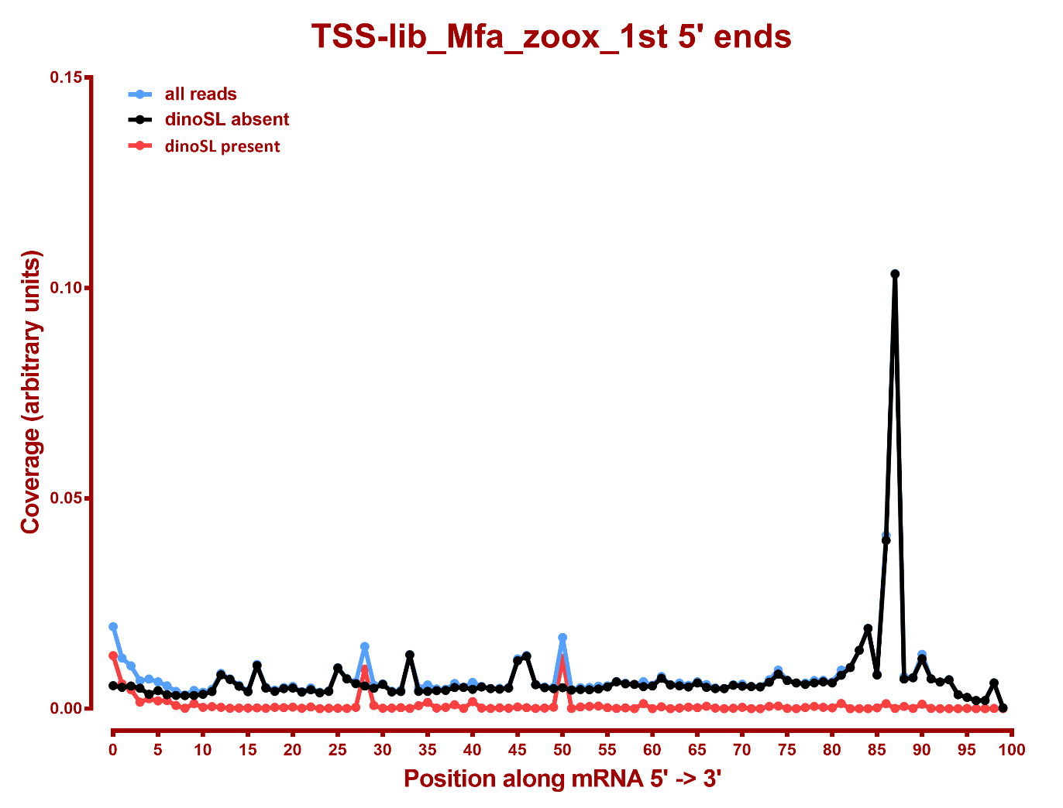
Read distribution

Slide 4
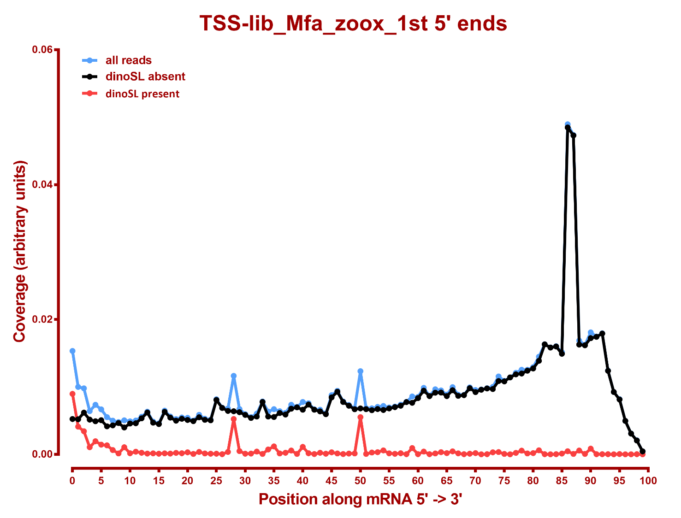

Slide 5
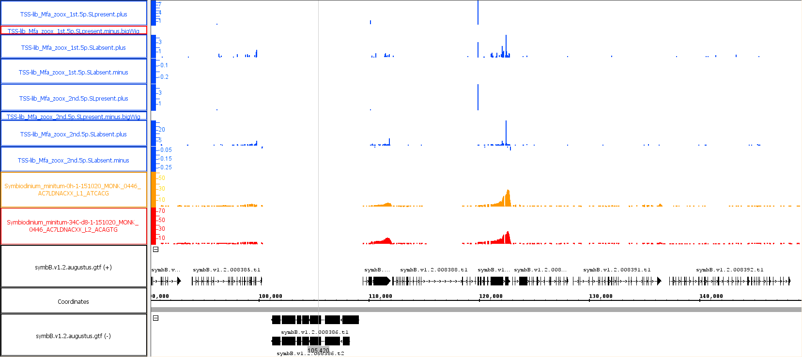
HSP70 context:
HSP70
This is a reverse transcriptase gene, i.e. a repeat

Slide 6
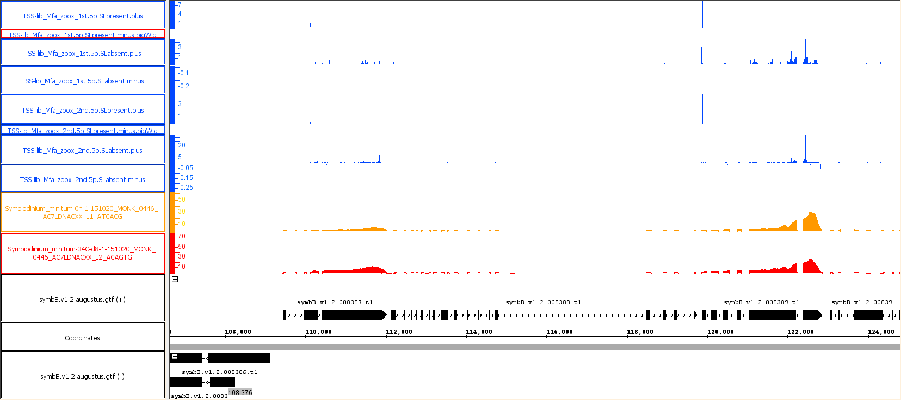
HSP70 zoom-in

Slide 7
HSP70 summary
- This HSP70 copy appears to be in a multicistronic array, with transcription beginning fro mthe upstream genes
- There is a clear dinoSL CAGE peak at the HSP70 beginning
There is no clear such peak at the beginning of the upstream gene though that gene is expressed
- Note, however, that the mapping here was done with default STAR settings, i.e. multimappers were limited to 20 places in the genome, and because of the big repeat that separate this array from the one to the left of it, this is probably why there is no apparent CAGE peak there. I need to realign with unlimited multimappers to check that.

Slide 8
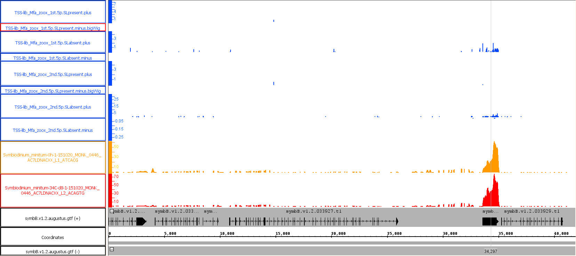
GAPDH context:
GAPDH

Slide 9
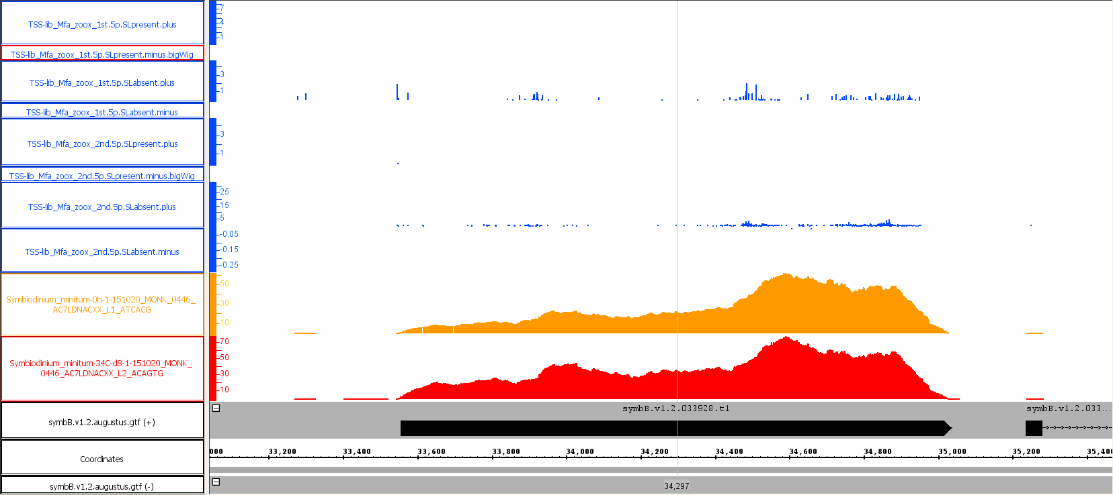
GAPDH zoom-in

Slide 10
GAPDH summary
- This GAPDH copy is on a very short contig, so it’s not clear what follows after it, but it does appear to be the first gene in the array
There is no dinoSL CAGE peak (and no strong CAGE peak without a dinoSL) at the beginning of the gene, but this is not a case of a repetitive element causing alignment

