Slide 1
MAPPING STATS

Slide 2
# | Exonic: | Intergenic: | Intronic:
2026-04-24-MS260224L04_MS260224L04_exp260209_RPE1-WT_Palbo-D4_polyA-RNA.hg38 | 0.95 | 0.01 | 0.04
2026-04-24-MS260408L01_MS260408L01_exp260209_RPE1-P53KO-TSC1KO_Palbo-D1_polyA-RNA.hg38 | 0.94 | 0.01 | 0.05
2026-04-24-MS260408L02_exp260401_RPE1toS2_2to1_1_polyA-RNA.dm6 | 0.96 | 0.02 | 0.03
2026-04-24-MS260408L02_exp260401_RPE1toS2_2to1_1_polyA-RNA.hg38 | 0.84 | 0.07 | 0.09
2026-04-24-MS260408L03_exp260401_RPE1toS2_6to1_1_polyA-RNA.dm6 | 0.96 | 0.02 | 0.02
2026-04-24-MS260408L03_exp260401_RPE1toS2_6to1_1_polyA-RNA.hg38 | 0.84 | 0.07 | 0.09
2026-04-24-MS260408L04_exp260401_RPE1toS2_2to1_2_polyA-RNA.dm6 | 0.96 | 0.02 | 0.02
2026-04-24-MS260408L04_exp260401_RPE1toS2_2to1_2_polyA-RNA.hg38 | 0.85 | 0.06 | 0.09
2026-04-24-MS260408L05_exp260401_RPE1toS2_6to1_2_polyA-RNA.dm6 | 0.96 | 0.02 | 0.02
2026-04-24-MS260408L05_exp260401_RPE1toS2_6to1_2_polyA-RNA.hg38 | 0.85 | 0.06 | 0.09
2026-04-24-MS260408L06_exp260401_RPE1toS2_2to1_3_polyA-RNA.dm6 | 0.96 | 0.01 | 0.02
2026-04-24-MS260408L06_exp260401_RPE1toS2_2to1_3_polyA-RNA.hg38 | 0.85 | 0.07 | 0.08
2026-04-24-MS260408L07_exp260401_RPE1toS2_6to1_3_polyA-RNA.dm6 | 0.96 | 0.01 | 0.02
2026-04-24-MS260408L07_exp260401_RPE1toS2_6to1_3_polyA-RNA.hg38 | 0.85 | 0.08 | 0.08

Slide 3
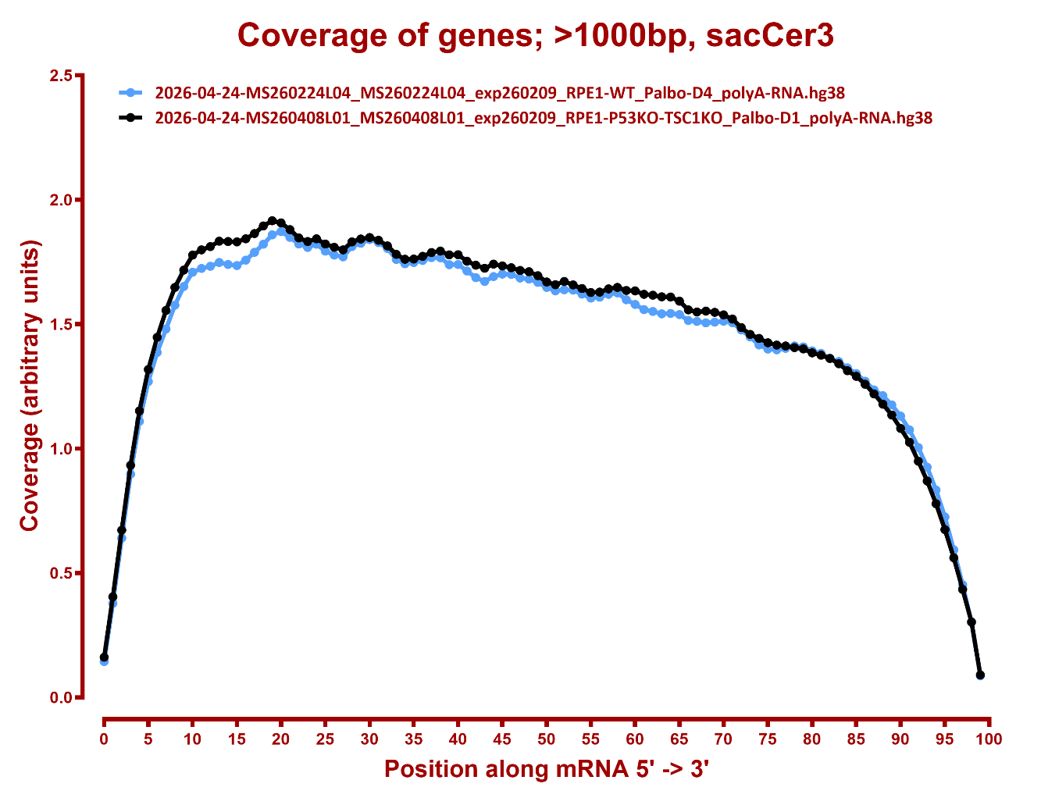
COVERAGE

Slide 4
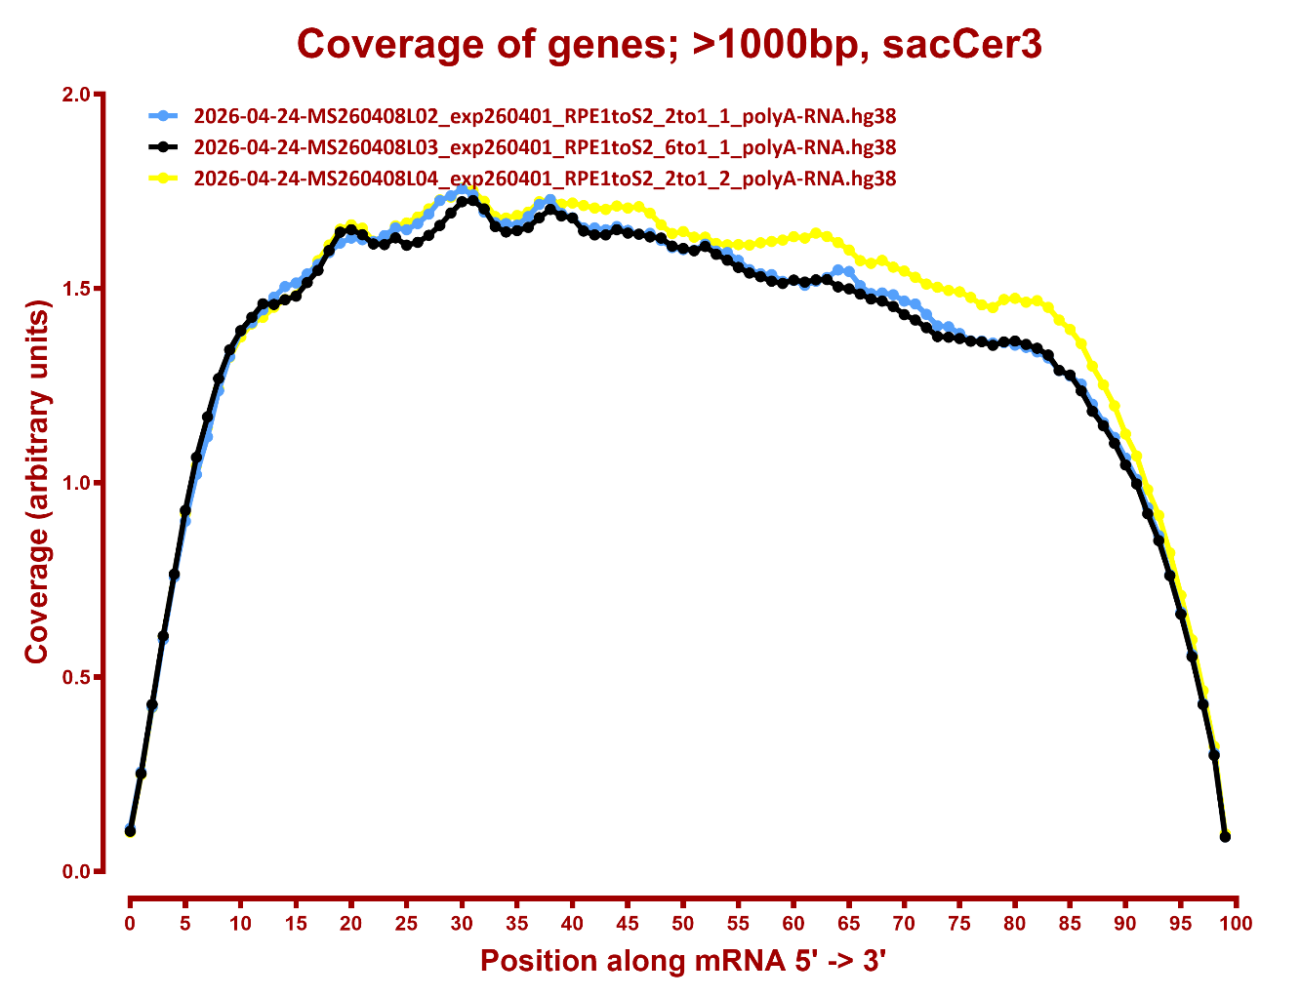

Slide 5
