Slide 1
MAPPING STATS

Slide 2
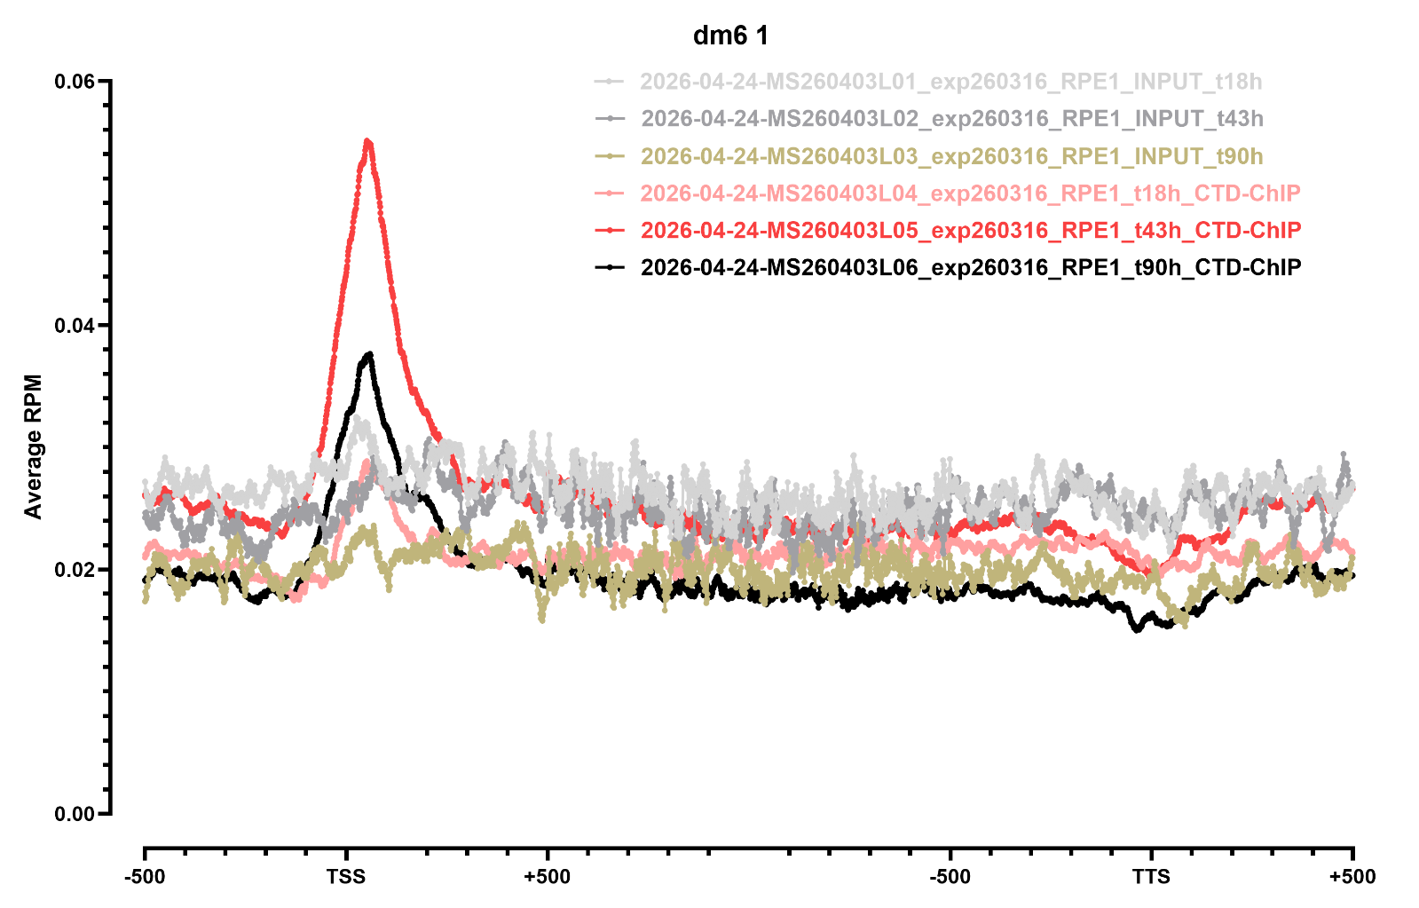
METAGENE PROFILES

Slide 3
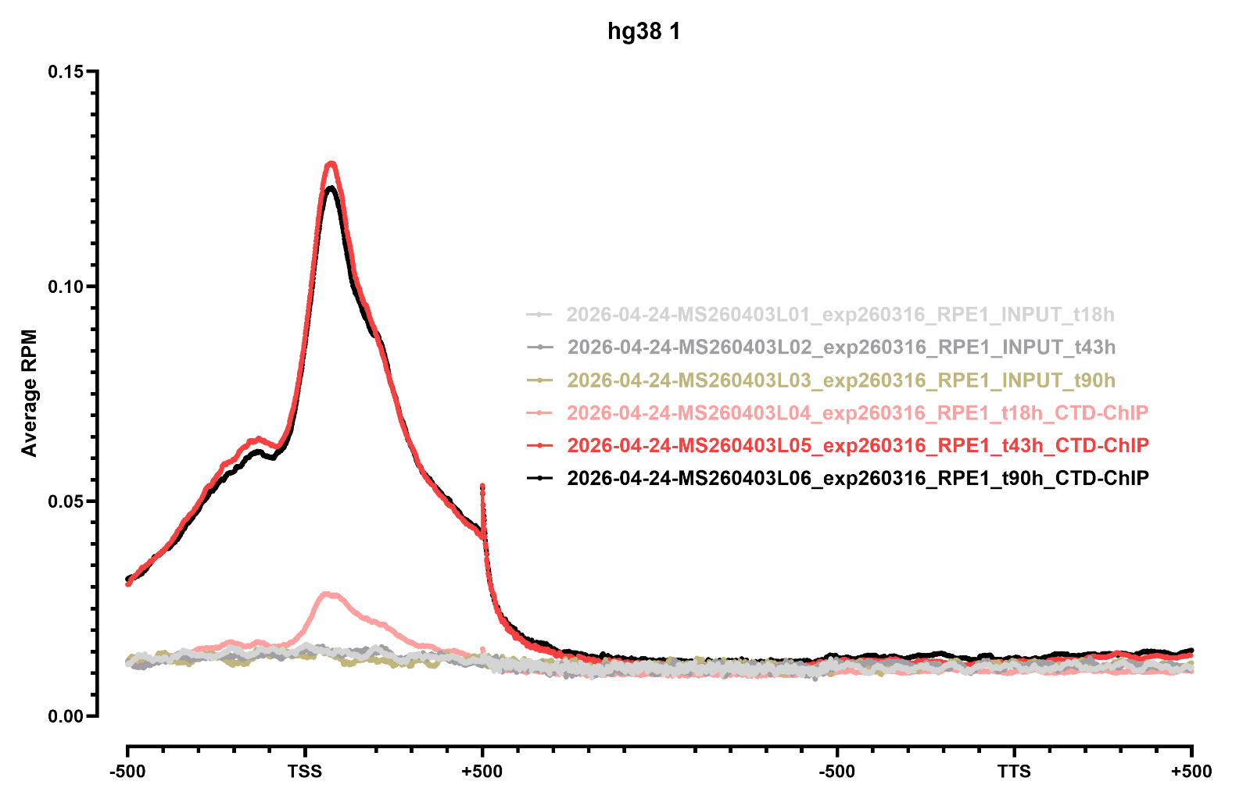
METAGENE PROFILES

Slide 4
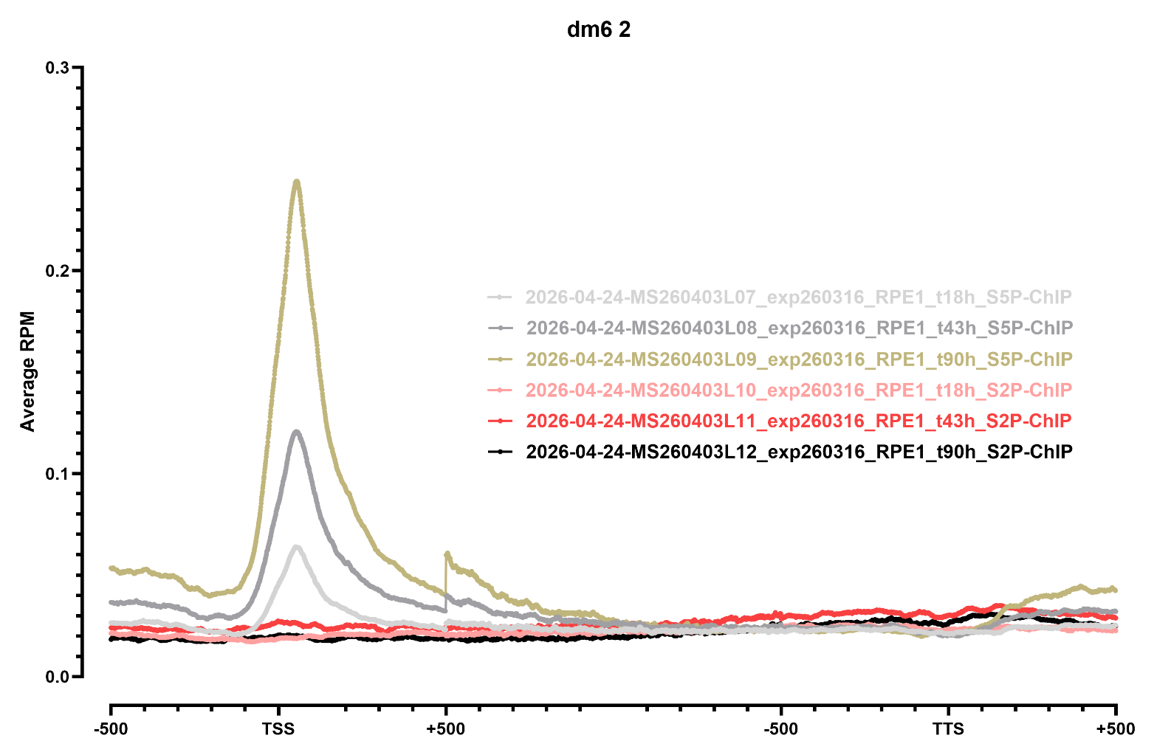
METAGENE PROFILES

Slide 5
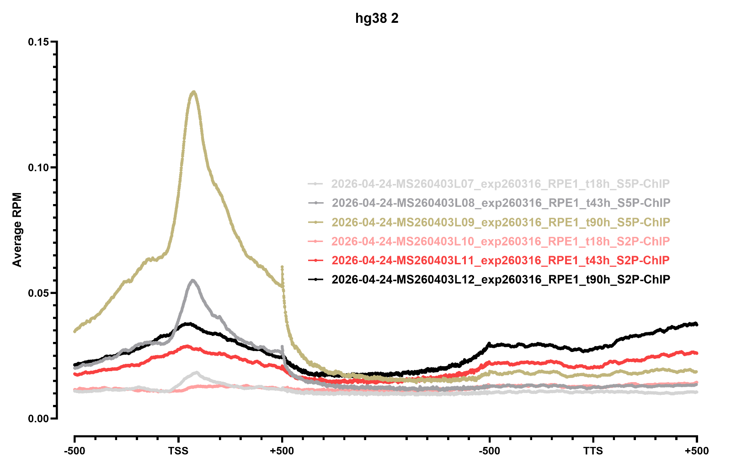
METAGENE PROFILES

Slide 6
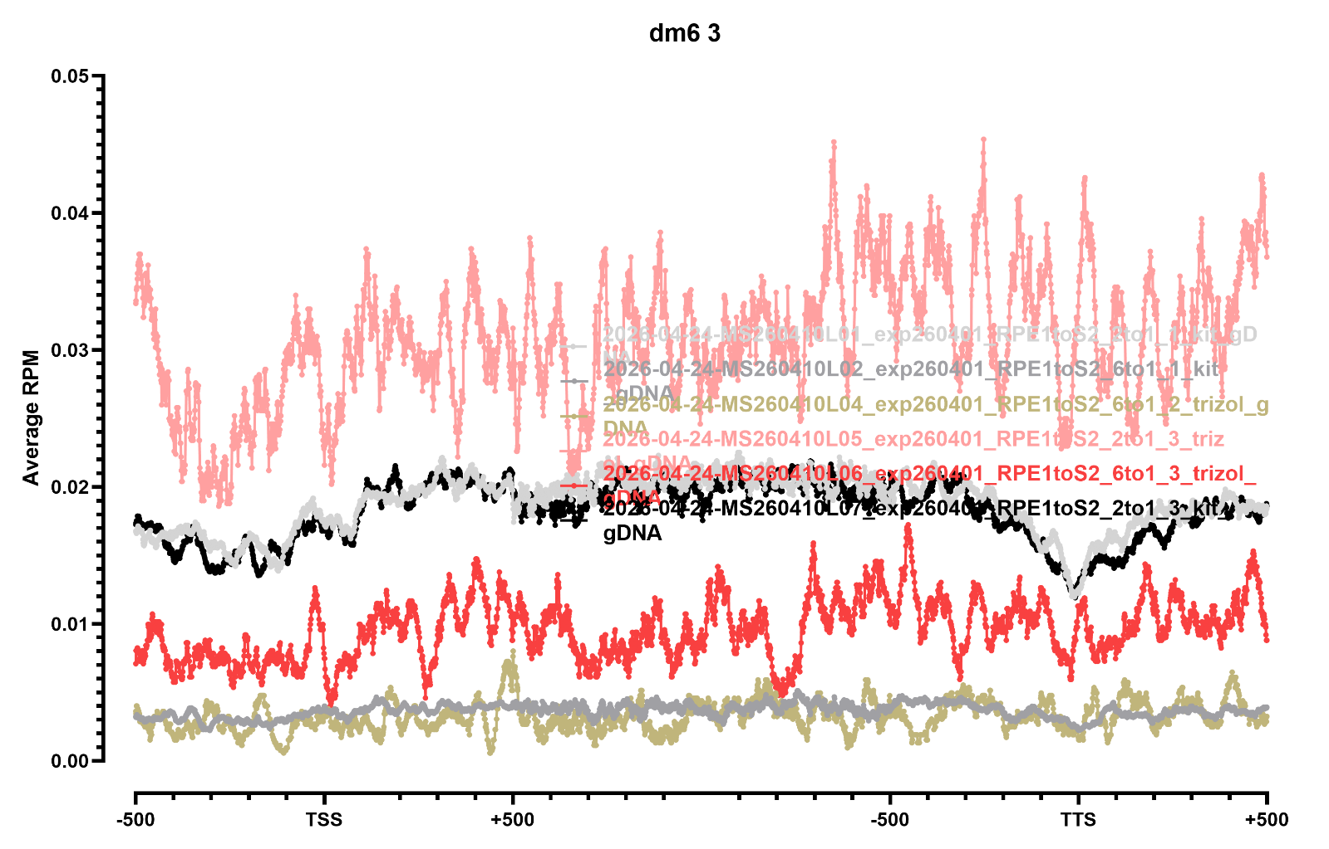
METAGENE PROFILES

Slide 7
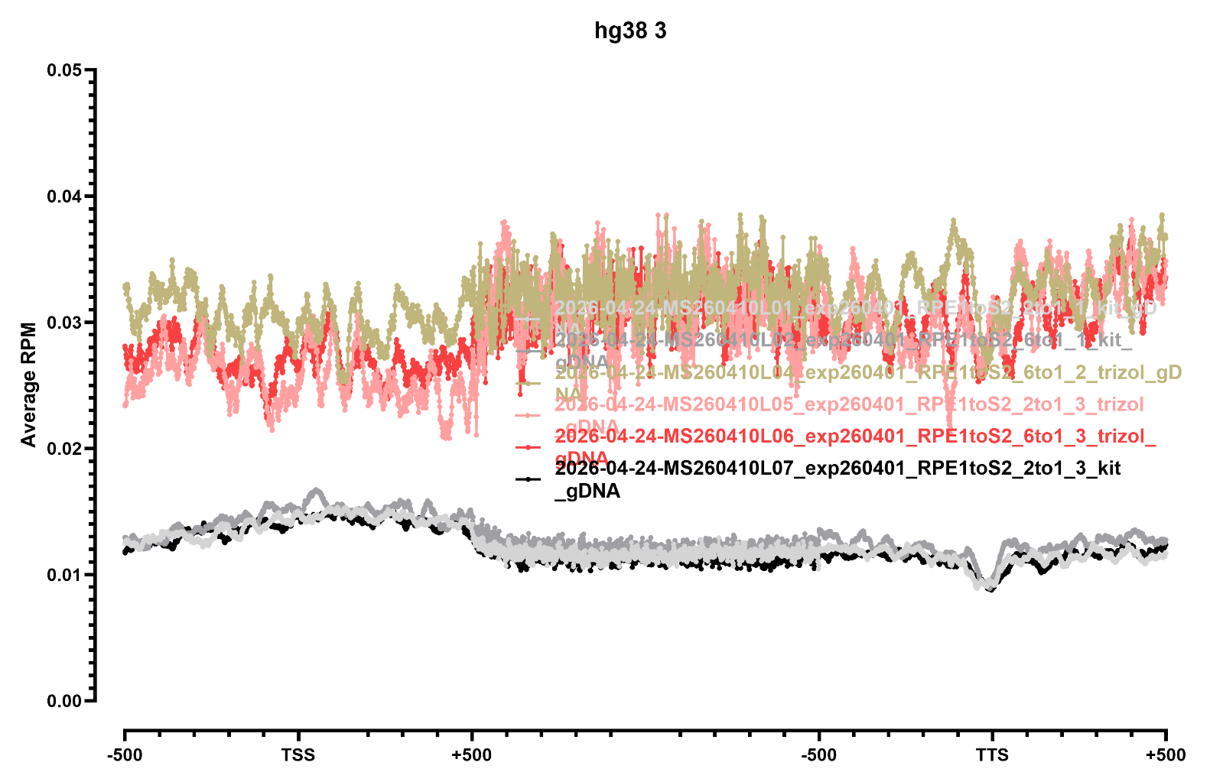
METAGENE PROFILES

Slide 8
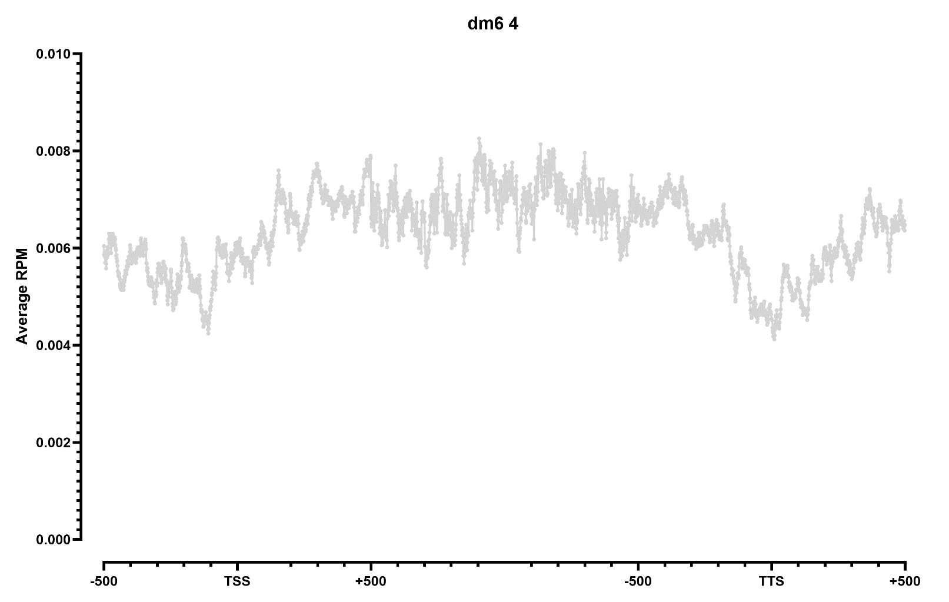
METAGENE PROFILES

Slide 9
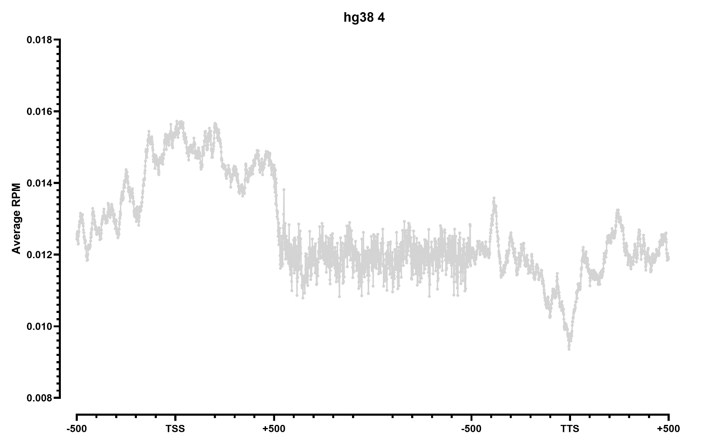
METAGENE PROFILES

