Slide 1
MAPPING STATS

Slide 2
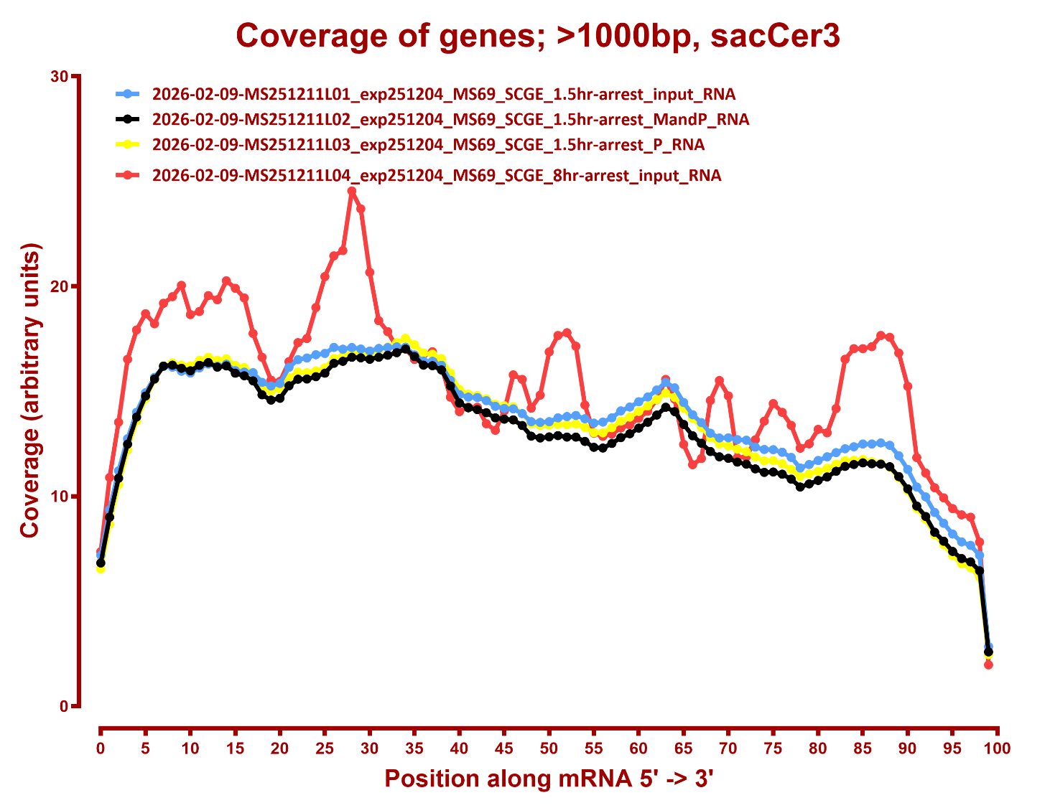
COVERAGE

Slide 3
