Slide 1
MAPPING STATS

Slide 3
# | Exonic: | Intergenic: | Intronic:
2026-01-03-AC251128L01_exp251111_MS756c2_SCD_1hr-arrest_polyA-RNA | 0.93 | 0.07 | 0.00
2026-01-03-AC251128L02_exp251111_MS756c2_SCD_1hr-arrest_PhIAA_polyA-RNA | 0.93 | 0.07 | 0.00
2026-01-03-AC251128L03_exp251111_MS756c2_SCD_1hr-arrest_Torin+PhIAA_polyA-RNA | 0.92 | 0.07 | 0.00
2026-01-03-AC251128L04_exp251111_MS756c2_SCD_4hr50min-arrest_polyA-RNA | 0.93 | 0.07 | 0.00
2026-01-03-AC251128L05_exp251111_MS756c2_SCD_4hr50min-arrest_PhIAA_polyA-RNA | 0.93 | 0.07 | 0.00
2026-01-03-AC251128L06_exp251111_MS756c2_SCD_4hr50min-arrest_Torin+PhIAA_polyA-RNA | 0.93 | 0.07 | 0.00
2026-01-03-AC251202L01_exp251106_MS1007_SCD_1hr-arrest_ATC_polyA-RNA | 0.93 | 0.07 | 0.00
2026-01-03-AC251202L02_exp251106_MS1007_SCD_5hr-arrest_ATC_polyA-RNA | 0.92 | 0.07 | 0.00
2026-01-03-AC251202L03_exp251106_MS1007_SCD_5hr-arrest_ATCLong_polyA-RNA | 0.93 | 0.07 | 0.00
2026-01-03-AC251202L04_exp251106_MS1116_SCD_1hr-arrest_ATC_polyA-RNA | 0.93 | 0.07 | 0.00
2026-01-03-AC251202L05_exp251106_MS1116_SCD_5hr-arrest_ATC_polyA-RNA | 0.93 | 0.07 | 0.00
2026-01-03-AC251202L06_exp251106_MS1116_SCD_5hr-arrest_ATCLong_polyA-RNA | 0.93 | 0.07 | 0.00
2026-01-03-AC251202L07_exp251106_MS951_SCD_1hr-arrest_ATC_polyA-RNA | 0.93 | 0.07 | 0.00
2026-01-03-AC251202L08_exp251106_MS951_SCD_5hr-arrest_ATC_polyA-RNA | 0.93 | 0.07 | 0.00
2026-01-03-AC251202L09_exp251106_MS951_SCD_5hr-arrest_ATCLong_polyA-RNA | 0.93 | 0.07 | 0.00
2026-01-03-AC251203L01_exp251017_MS69_SCD_1hr-arrest_OD-0.1_polyA-RNA | 0.93 | 0.07 | 0.00
2026-01-03-AC251203L02_exp251017_MS69_SCD_1hr-arrest_OD-0.3_polyA-RNA | 0.93 | 0.07 | 0.00
2026-01-03-AC251203L03_exp251017_MS69_SCD_2hr-arrest_OD-0.1_polyA-RNA | 0.93 | 0.07 | 0.00
2026-01-03-AC251203L04_exp251017_MS69_SCD_2hr-arrest_OD-0.3_polyA-RNA | 0.93 | 0.07 | 0.00
2026-01-03-AC251203L05_exp251017_MS69_SCD_3hr-arrest_OD-0.1_polyA-RNA | 0.93 | 0.07 | 0.00
2026-01-03-AC251203L06_exp251017_MS69_SCD_3hr-arrest_OD-0.3_polyA-RNA | 0.93 | 0.07 | 0.00
2026-01-03-AC251203L07_exp251017_MS69_SCD_4hr-arrest_OD-0.1_polyA-RNA | 0.93 | 0.07 | 0.00
2026-01-03-AC251203L08_exp251017_MS69_SCD_4hr-arrest_OD-0.3_polyA-RNA | 0.93 | 0.07 | 0.00
2026-01-03-AC251203L09_exp251017_MS69_SCD_5hr-arrest_OD-0.1_polyA-RNA | 0.92 | 0.08 | 0.00
2026-01-03-AC251203L10_exp251017_MS69_SCD_5hr-arrest_OD-0.3_polyA-RNA | 0.92 | 0.07 | 0.00
2026-01-03-AC251203L11_exp251017_MS69_SCD_6hr-arrest_OD-0.1_polyA-RNA | 0.92 | 0.08 | 0.00
2026-01-03-AC251203L12_exp251017_MS69_SCD_6hr-arrest_OD-0.3_polyA-RNA | 0.92 | 0.08 | 0.00
2026-01-03-AC251203L13_exp251017_MS69_SCD_6hr10min-arrest_OD-0.1_Torin-washout_polyA-RNA | 0.92 | 0.08 | 0.00
2026-01-03-AC251203L14_exp251017_MS69_SCD_6hr10min-arrest_OD-0.3_Torin-washout_polyA-RNA | 0.92 | 0.07 | 0.00

Slide 4
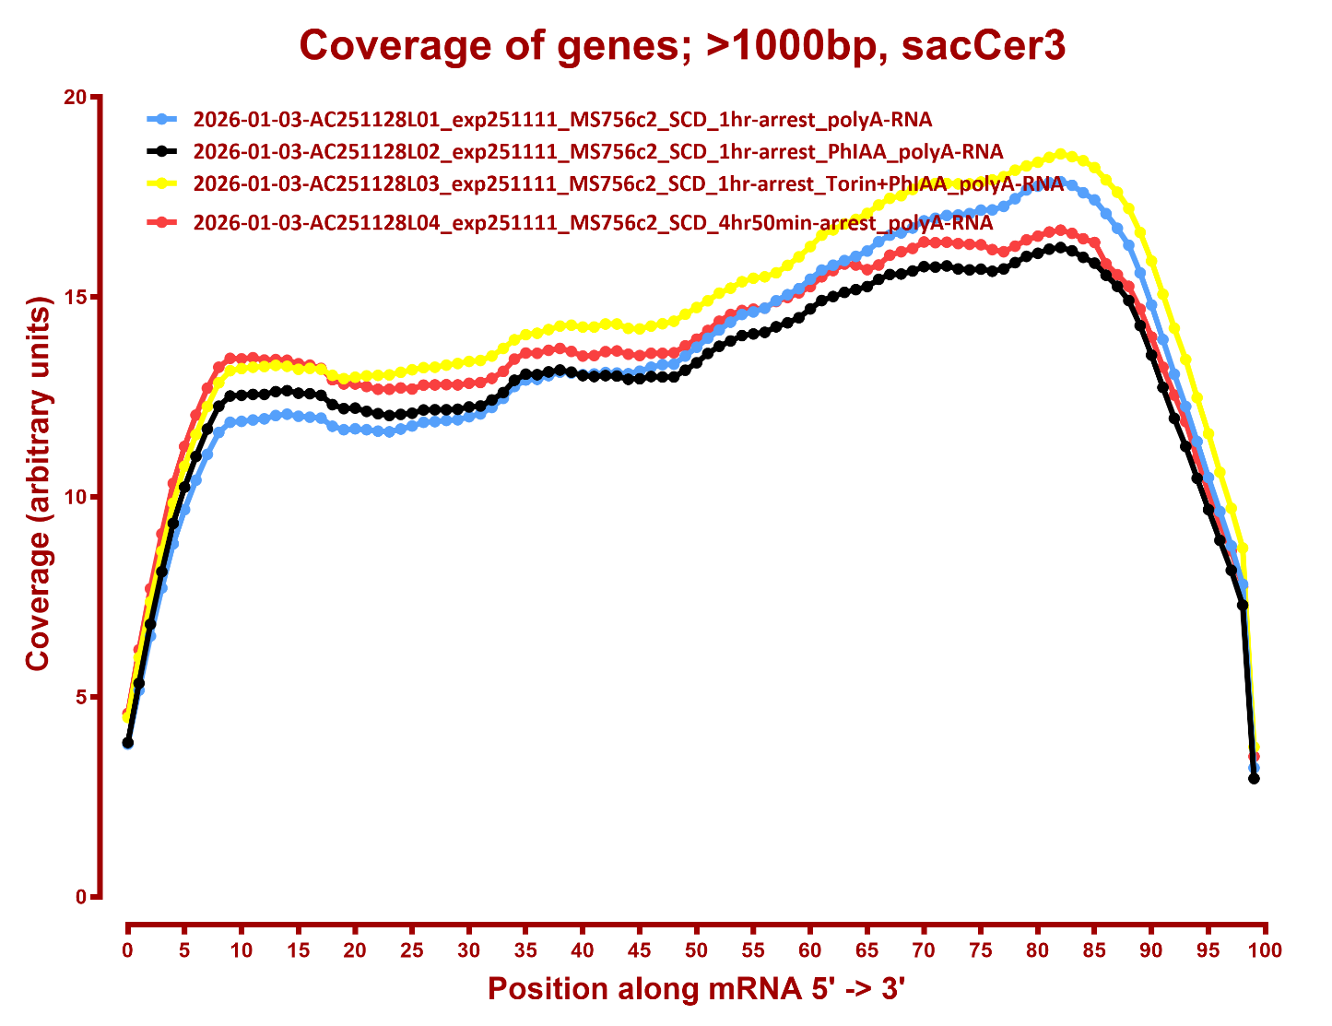
COVERAGE

Slide 5
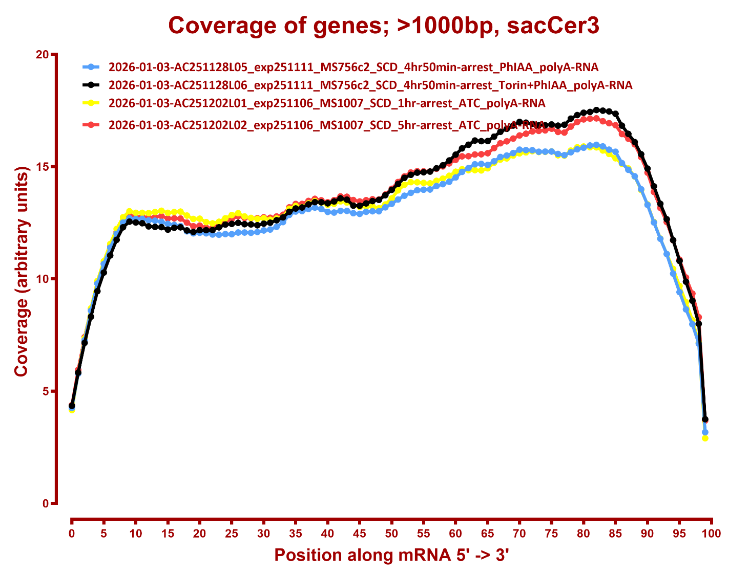

Slide 6
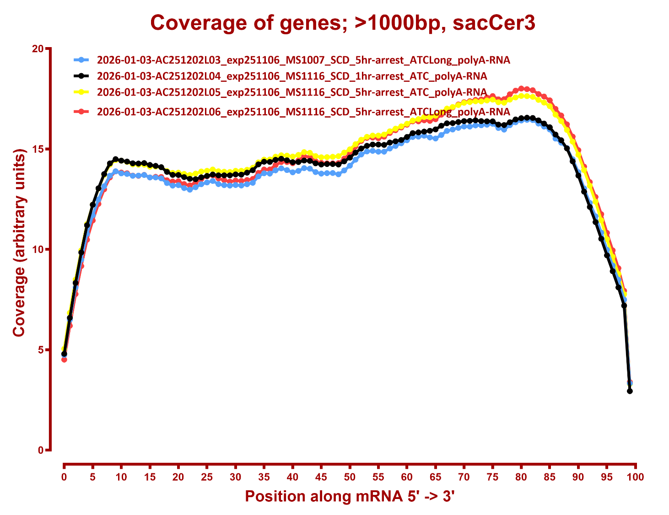

Slide 7
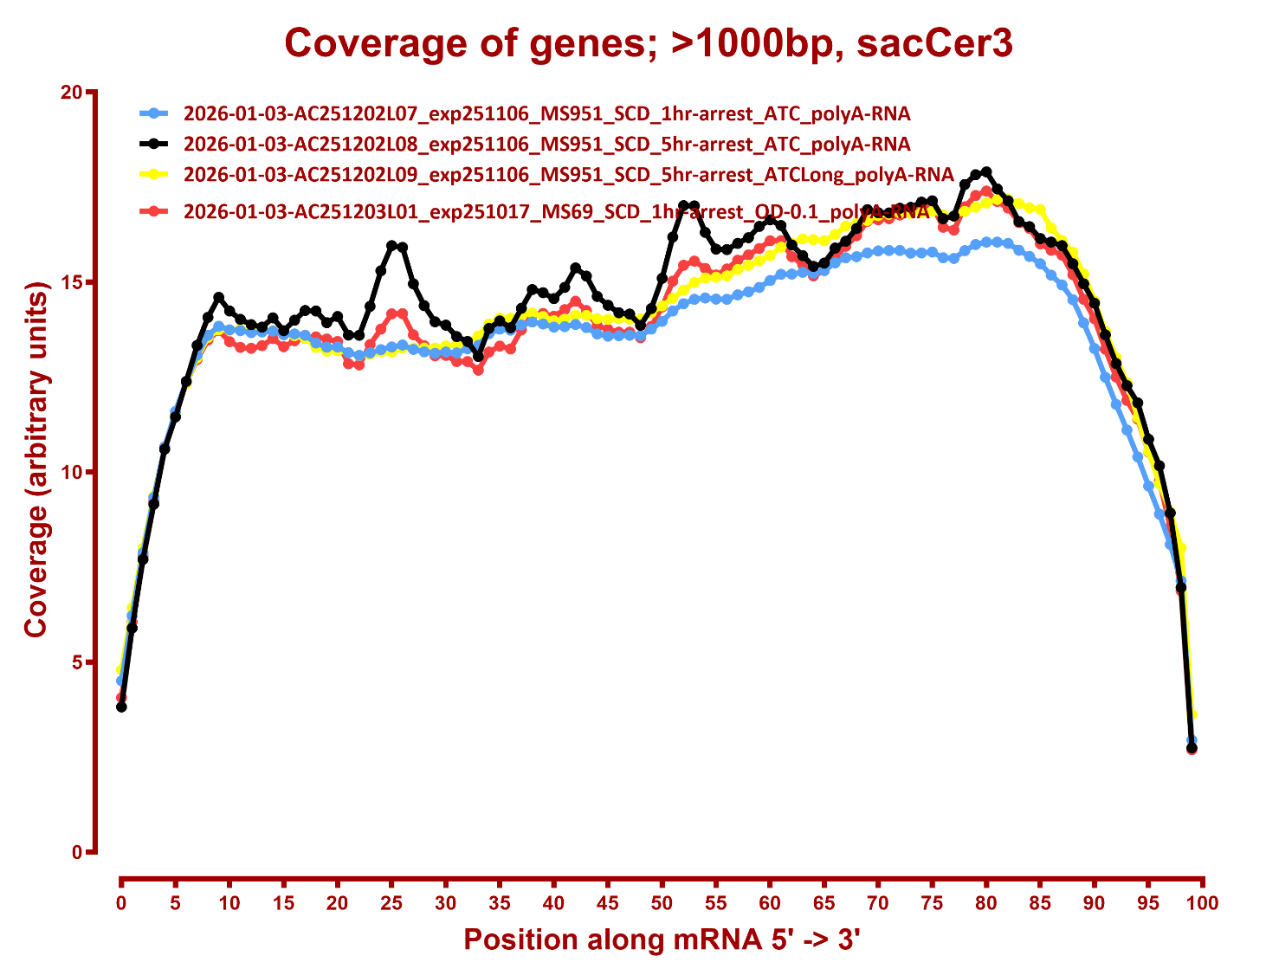

Slide 8
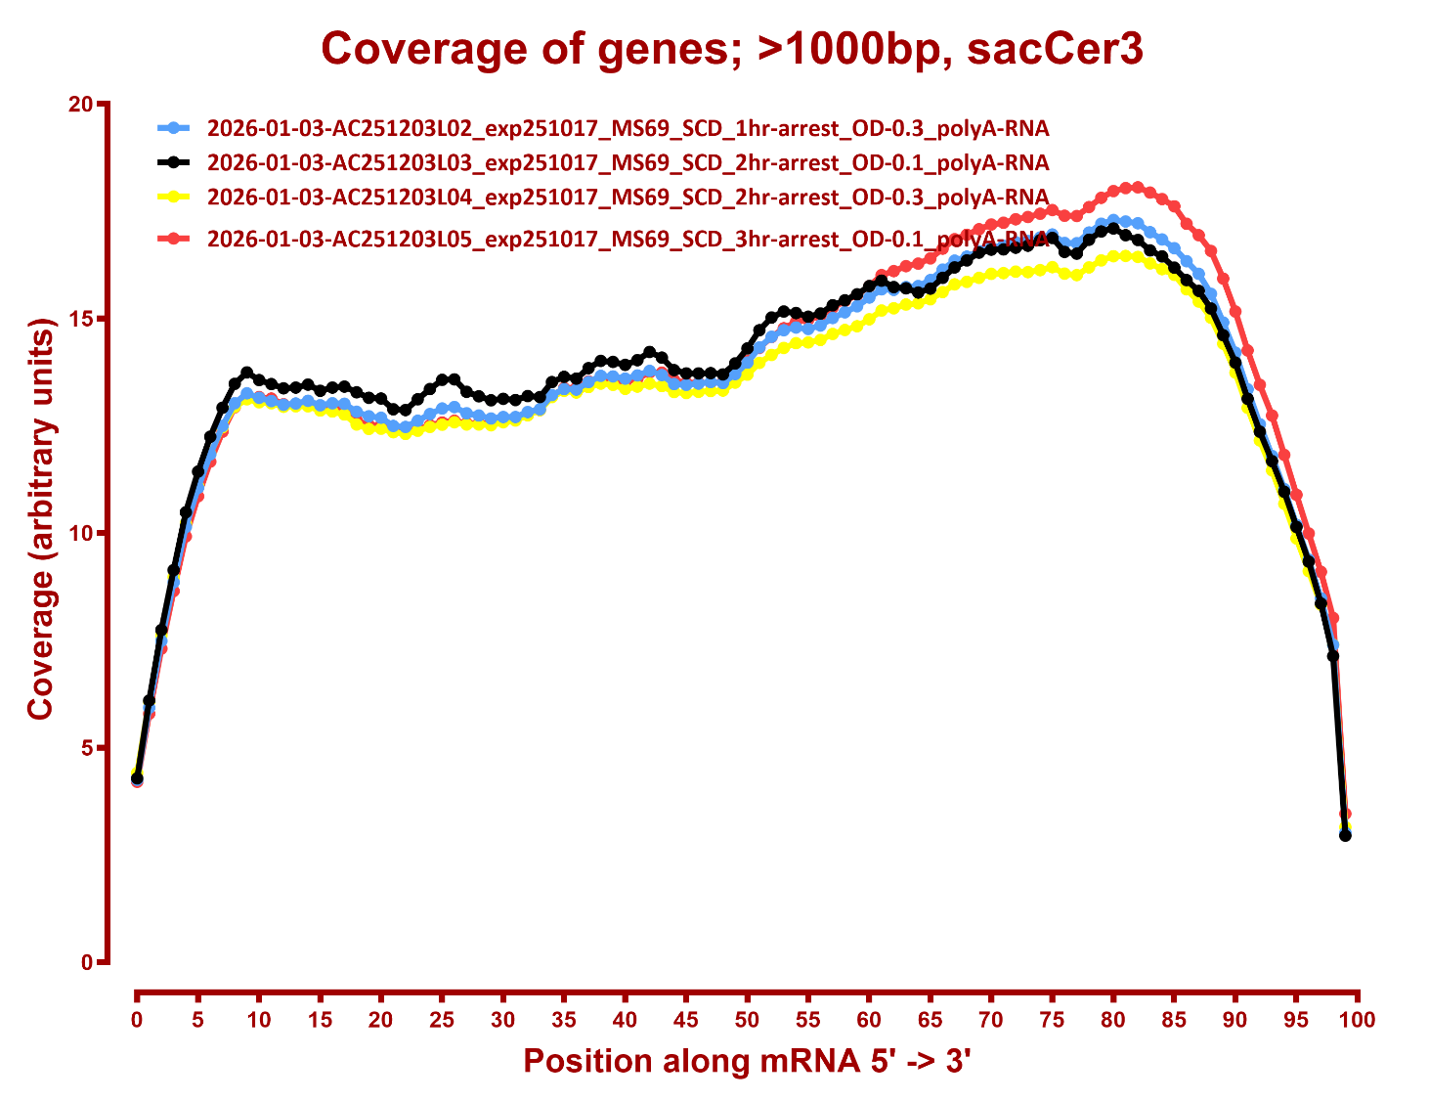

Slide 9
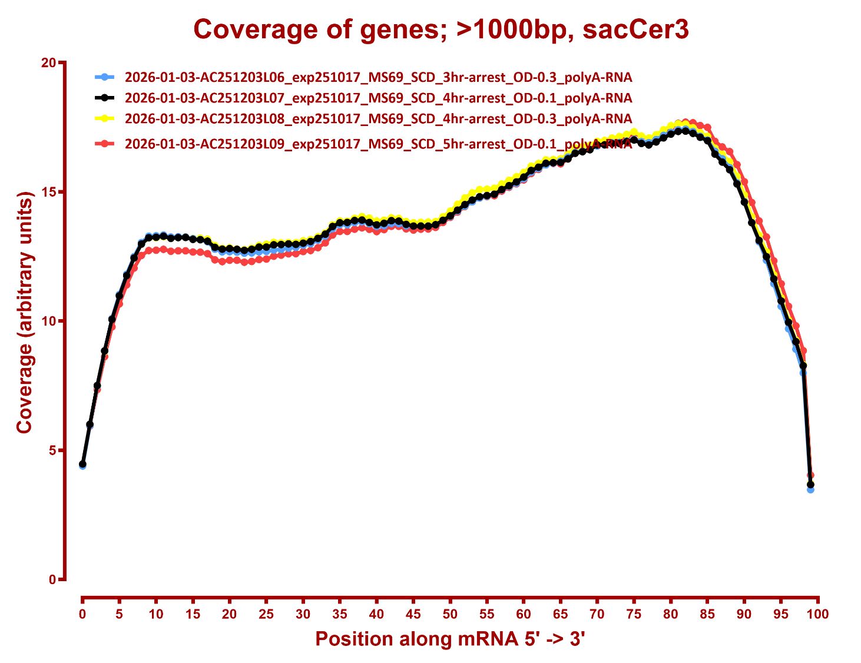

Slide 10
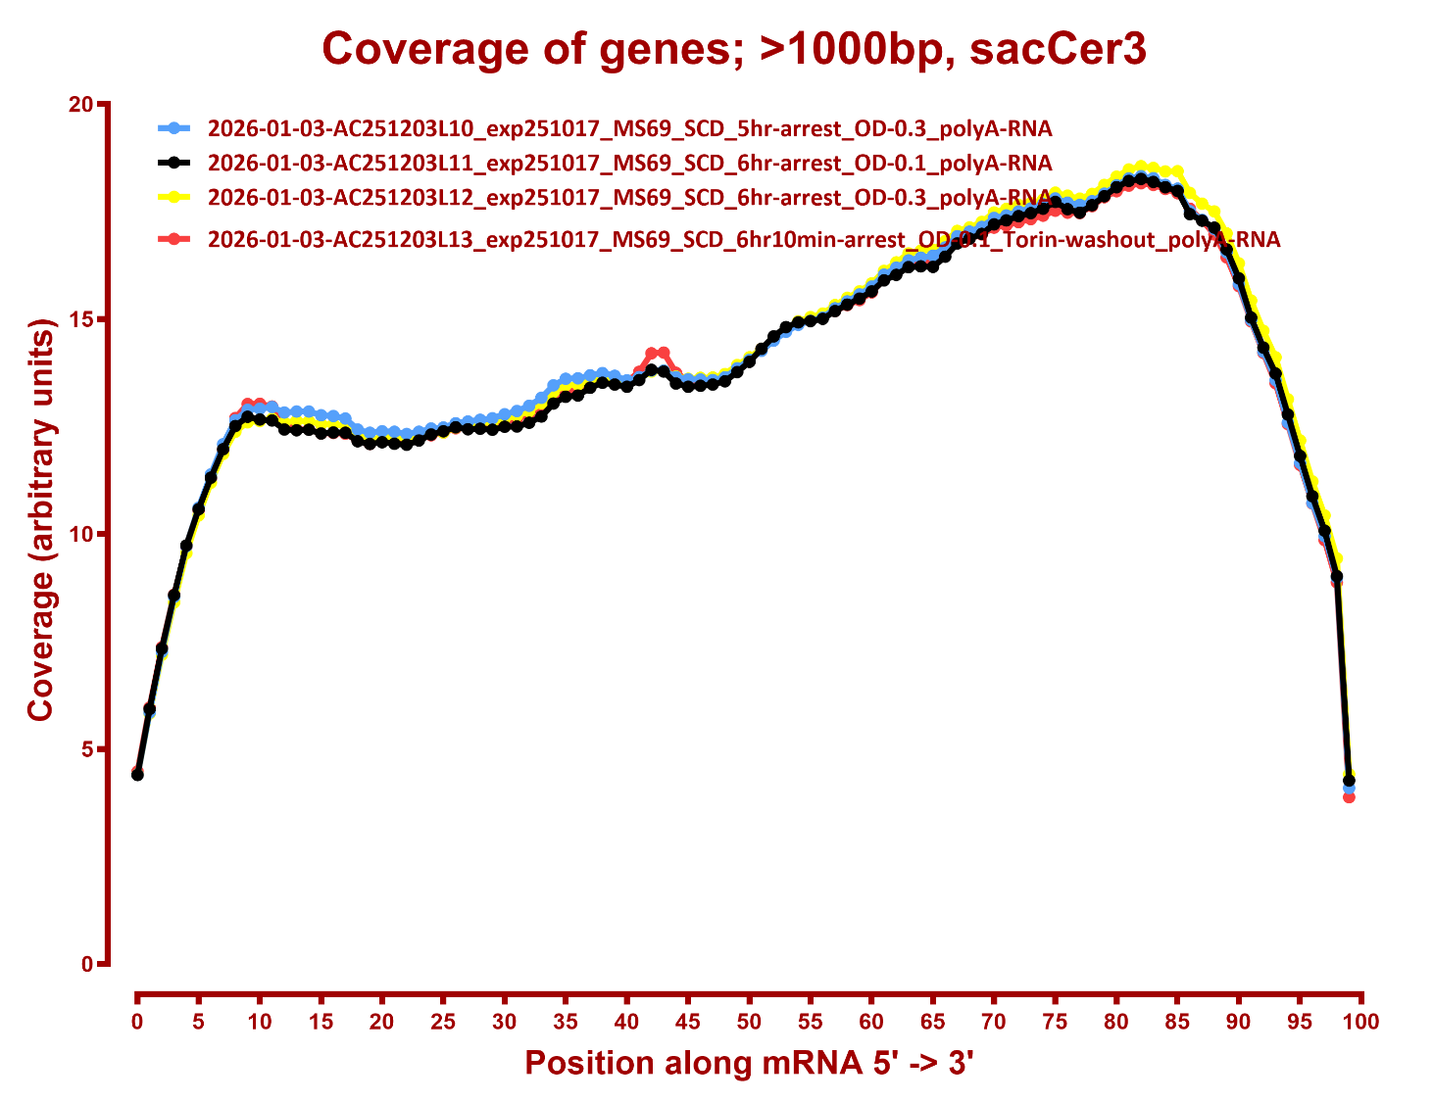

Slide 11
