Slide 1
MAPPING STATS
Library | Raw fragments | Species | 2x36mers unique
 |  |  | Unique reads | Complexity | Fraction aligned
2026-01-03-MS251125L01_exp251028_RPE1_ChIP_1_INPUT_DMSO | 930,257 | dm6 | 100,734 | 0.85 | 0.05
2026-01-03-MS251125L01_exp251028_RPE1_ChIP_1_INPUT_DMSO | 930,257 | hg38 | 1,446,052 | 0.83 | 0.78
2026-01-03-MS251125L02_exp251028_RPE1_ChIP_1_INPUT_TPL | 1,324,465 | dm6 | 122,272 | 0.88 | 0.05
2026-01-03-MS251125L02_exp251028_RPE1_ChIP_1_INPUT_TPL | 1,324,465 | hg38 | 2,085,266 | 0.86 | 0.79
2026-01-03-MS251125L03_exp251111_RPE1_ChIP_2_INPUT_DMSO | 1,014,184 | dm6 | 106,246 | 0.82 | 0.05
2026-01-03-MS251125L03_exp251111_RPE1_ChIP_2_INPUT_DMSO | 1,014,184 | hg38 | 1,576,054 | 0.80 | 0.78
2026-01-03-MS251125L04_exp251111_RPE1_ChIP_2_INPUT_TPL | 1,223,023 | dm6 | 137,322 | 0.84 | 0.06
2026-01-03-MS251125L04_exp251111_RPE1_ChIP_2_INPUT_TPL | 1,223,023 | hg38 | 1,902,044 | 0.84 | 0.78
2026-01-03-MS251125L05_exp251028_RPE1_ChIP_1_ChIP_RNAPII_DMSO | 14,789,394 | dm6 | 1,747,614 | 0.82 | 0.06
2026-01-03-MS251125L05_exp251028_RPE1_ChIP_1_ChIP_RNAPII_DMSO | 14,789,394 | hg38 | 22,500,606 | 0.83 | 0.76
2026-01-03-MS251125L06_exp251028_RPE1_ChIP_1_ChIP_RNAPII_TPL | 11,512,870 | dm6 | 1,229,096 | 0.81 | 0.05
2026-01-03-MS251125L06_exp251028_RPE1_ChIP_1_ChIP_RNAPII_TPL | 11,512,870 | hg38 | 17,255,270 | 0.82 | 0.75
2026-01-03-MS251125L07_exp251028_RPE1_ChIP_1_ChIP_S2P_DMSO | 11,204,377 | dm6 | 1,350,586 | 0.80 | 0.06
2026-01-03-MS251125L07_exp251028_RPE1_ChIP_1_ChIP_S2P_DMSO | 11,204,377 | hg38 | 17,028,760 | 0.79 | 0.76
2026-01-03-MS251125L08_exp251028_RPE1_ChIP_1_ChIP_S2P_TPL | 11,724,369 | dm6 | 2,016,934 | 0.79 | 0.09
2026-01-03-MS251125L08_exp251028_RPE1_ChIP_1_ChIP_S2P_TPL | 11,724,369 | hg38 | 16,675,648 | 0.78 | 0.71
2026-01-03-MS251125L09_exp251111_RPE1_ChIP_2_ChIP_S2P_DMSO | 11,248,866 | dm6 | 1,194,008 | 0.84 | 0.05
2026-01-03-MS251125L09_exp251111_RPE1_ChIP_2_ChIP_S2P_DMSO | 11,248,866 | hg38 | 16,838,558 | 0.84 | 0.75
2026-01-03-MS251125L10_exp251111_RPE1_ChIP_2_ChIP_S2P_TPL | 11,671,219 | dm6 | 2,086,256 | 0.81 | 0.09
2026-01-03-MS251125L10_exp251111_RPE1_ChIP_2_ChIP_S2P_TPL | 11,671,219 | hg38 | 16,513,140 | 0.81 | 0.71
2026-01-03-MS251125L11_exp251111_RPE1_ChIP_2_ChIP_S5P_DMSO | 13,459,803 | dm6 | 1,806,468 | 0.80 | 0.07
2026-01-03-MS251125L11_exp251111_RPE1_ChIP_2_ChIP_S5P_DMSO | 13,459,803 | hg38 | 19,597,462 | 0.80 | 0.73
2026-01-03-MS251125L12_exp251111_RPE1_ChIP_2_ChIP_S5P_TPL | 11,401,091 | dm6 | 2,726,128 | 0.77 | 0.12
2026-01-03-MS251125L12_exp251111_RPE1_ChIP_2_ChIP_S5P_TPL | 11,401,091 | hg38 | 13,586,332 | 0.80 | 0.60

Slide 2
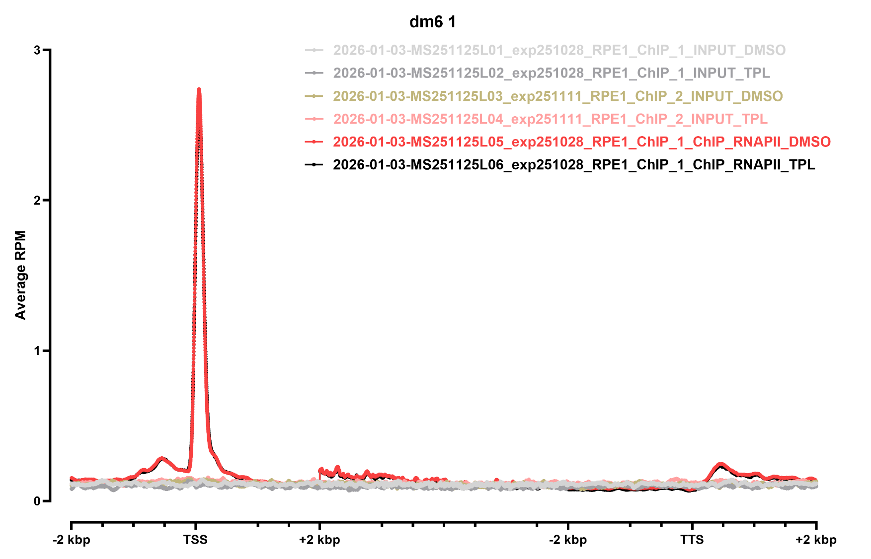
METAGENE PROFILES

Slide 3
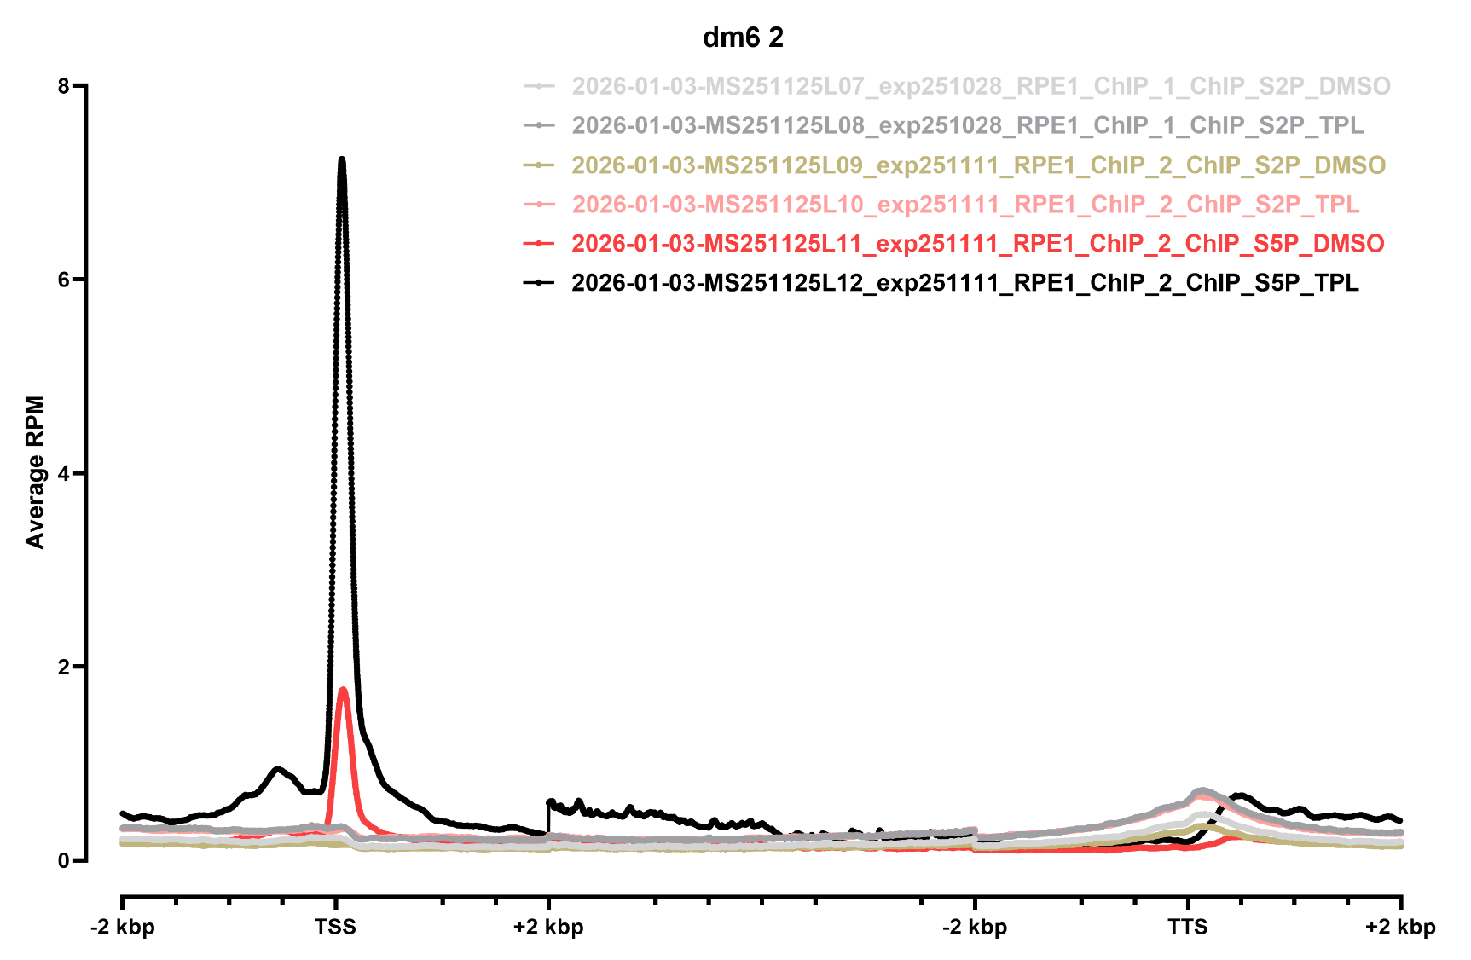
METAGENE PROFILES

Slide 4
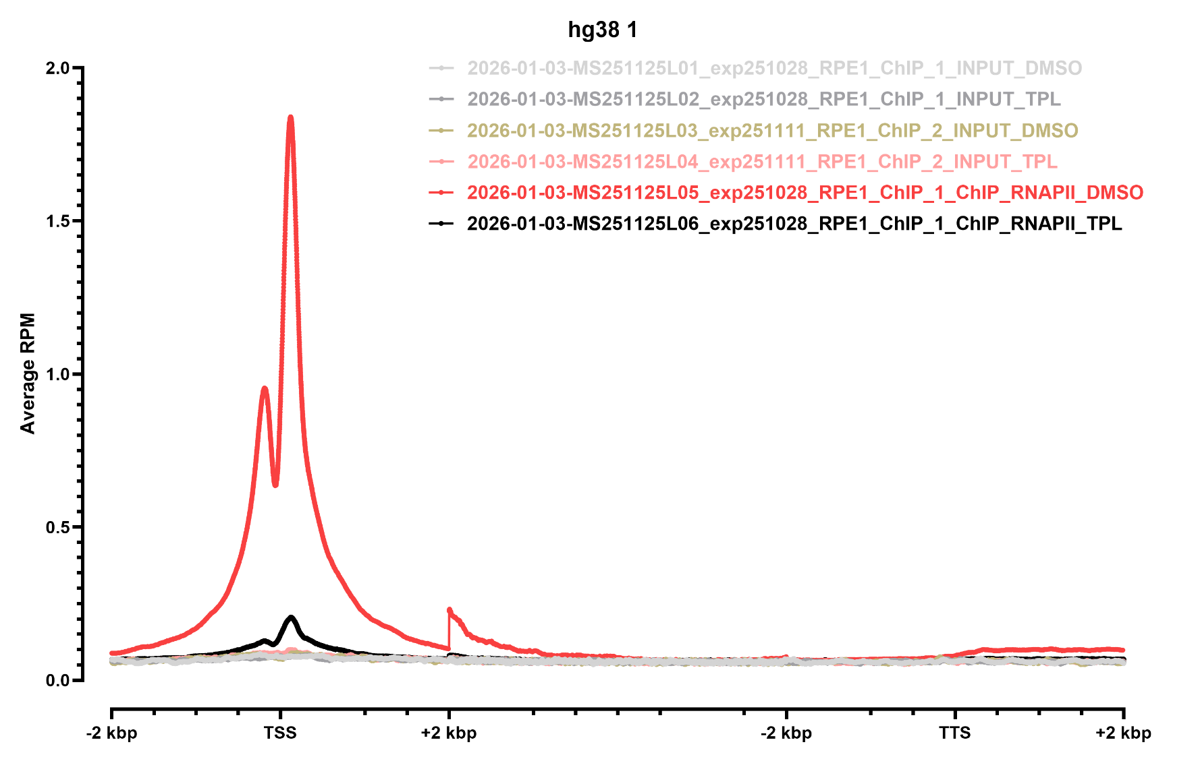
METAGENE PROFILES

Slide 5
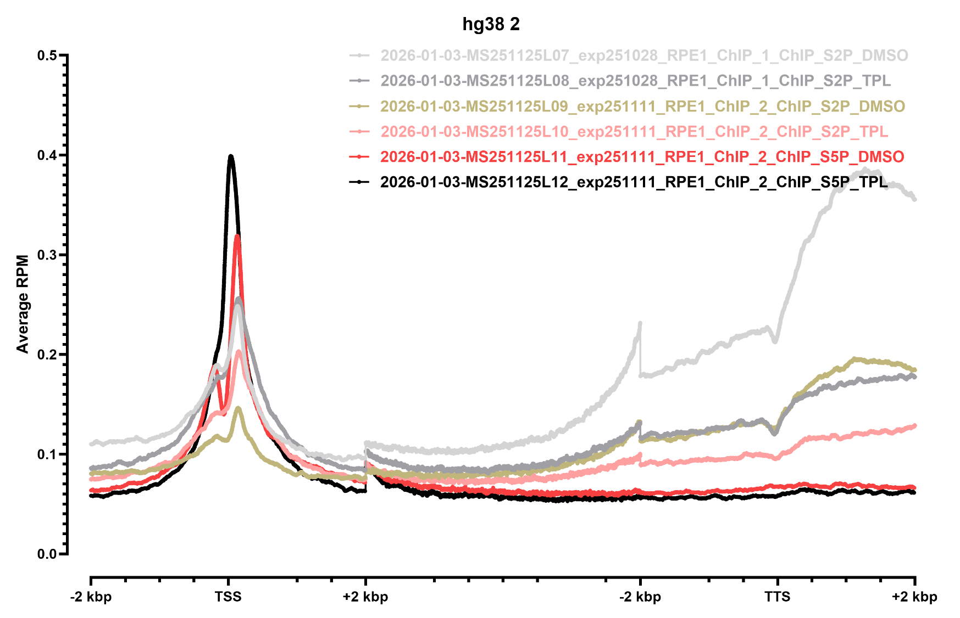
METAGENE PROFILES

