Slide 1
MAPPING STATS

Slide 2
# | Exonic: | Intergenic: | Intronic:
2025-09-29-MS250918L01_exp250905_MS8_SCD_no-EU_input | 0.99 | 0.01 | 0.00
2025-09-29-MS250918L02_exp250905_MS8_SCD_05min-EU_input | 0.99 | 0.01 | 0.00
2025-09-29-MS250918L03_exp250905_MS8_SCD_10min-EU_input | 0.99 | 0.01 | 0.00
2025-09-29-MS250918L04_exp250905_MS8_SCD_20min-EU_input | 0.99 | 0.01 | 0.00
2025-09-29-MS250918L05_exp250905_MS8_SCGE_no-EU_input | 0.99 | 0.01 | 0.00
2025-09-29-MS250918L06_exp250905_MS8_SCGE_05min-EU_input | 0.99 | 0.01 | 0.00
2025-09-29-MS250918L07_exp250905_MS8_SCGE_10min-EU_input | 0.99 | 0.01 | 0.00
2025-09-29-MS250918L08_exp250905_MS8_SCGE_20min-EU_input | 0.99 | 0.01 | 0.00
2025-09-29-MS250918L09_exp250905_MS8_SCD_no-EU_enriched | 0.98 | 0.02 | 0.00
2025-09-29-MS250918L10_exp250905_MS8_SCD_05min-EU_enriched | 0.94 | 0.05 | 0.02
2025-09-29-MS250918L11_exp250905_MS8_SCD_10min-EU_enriched | 0.95 | 0.04 | 0.01
2025-09-29-MS250918L12_exp250905_MS8_SCD_20min-EU_enriched | 0.96 | 0.03 | 0.01
2025-09-29-MS250918L13_exp250905_MS8_SCGE_no-EU_enriched | 0.98 | 0.02 | 0.00
2025-09-29-MS250918L14_exp250905_MS8_SCGE_05min-EU_enriched | 0.93 | 0.06 | 0.02
2025-09-29-MS250918L15_exp250905_MS8_SCGE_10min-Eu_enriched | 0.94 | 0.05 | 0.01
2025-09-29-MS250918L16_exp250905_MS8_SCGE_20min-EU_enriched | 0.95 | 0.05 | 0.01

Slide 3
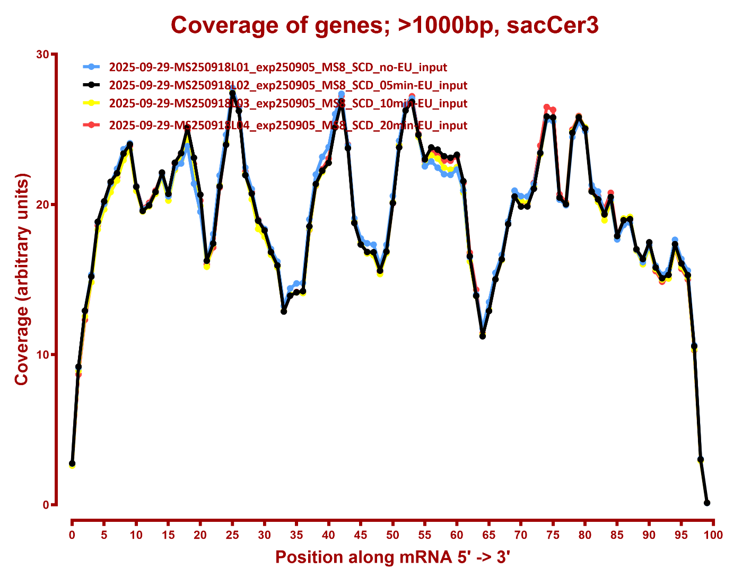
COVERAGE

Slide 4
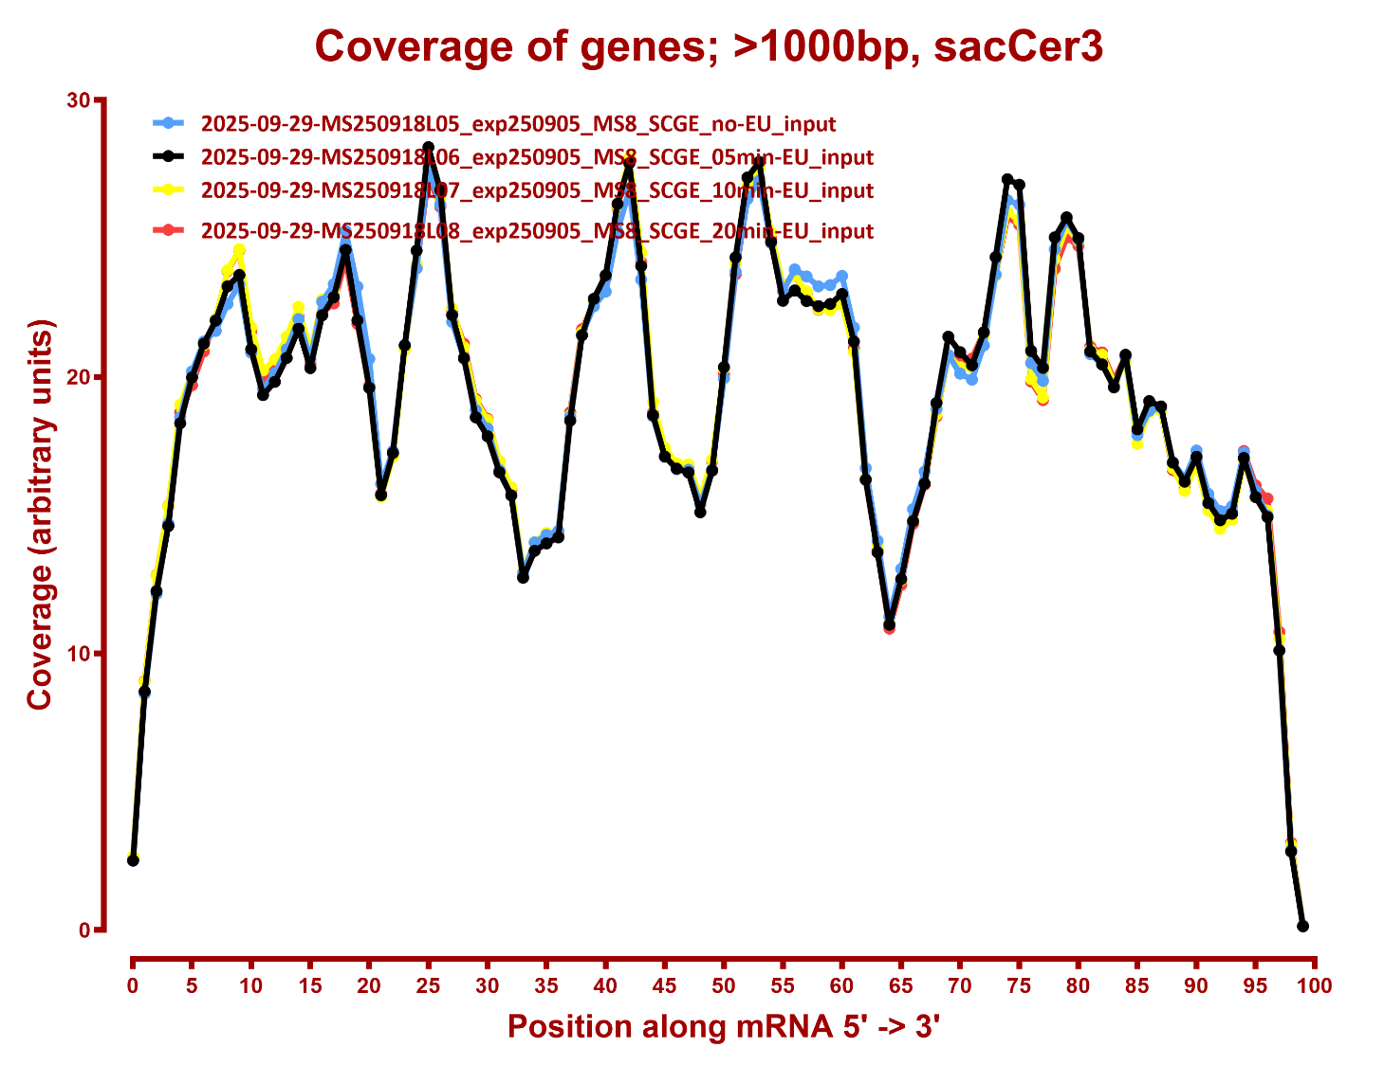

Slide 5
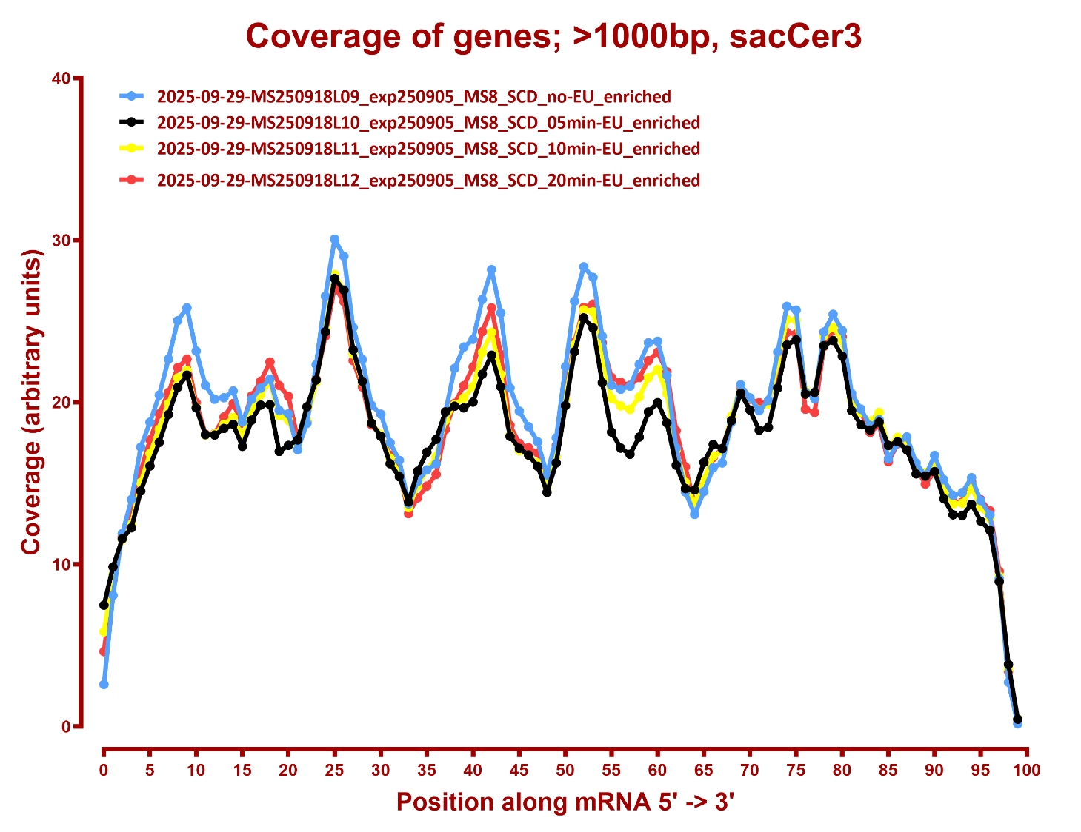

Slide 6
