Slide 1
MAPPING STATS

Slide 2
# | Exonic: | Intergenic: | Intronic:
2025-08-05-LHG250724L01_exp250527_MS8_YPD | 0.93 | 0.07 | 0.00
2025-08-05-LHG250724L02_exp250528_MS8_YPD | 0.93 | 0.07 | 0.00
2025-08-05-LHG250724L05_exp250527_MS8_SCGE | 0.91 | 0.08 | 0.00
2025-08-05-LHG250724L06_exp250528_MS8_SCGE | 0.91 | 0.08 | 0.00
2025-08-05-LHG_250724L03_exp250213_MS8_SCD | 0.93 | 0.07 | 0.00
2025-08-05-LHG_250724L04_exp250222_MS8_SCD | 0.93 | 0.07 | 0.00

Slide 3
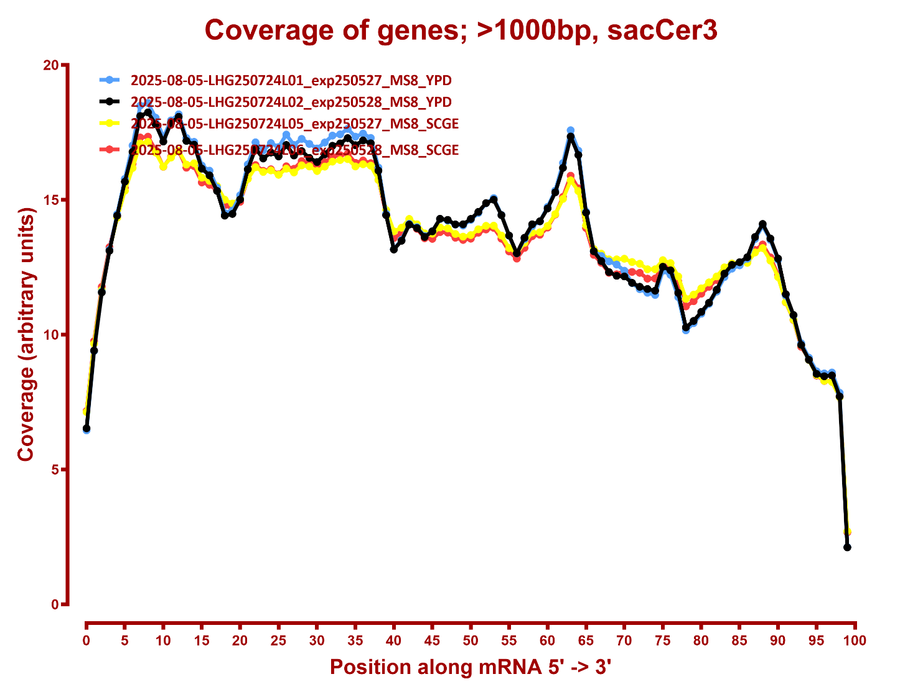
COVERAGE

Slide 4
