Slide 1
MAPPING STATS

Slide 5
# | Exonic: | Intergenic: | Intronic:
2025-07-29-MS250530L01_exp250523_MS69_SCD_1hr-arrest_DMSO_polyA-RNA | 0.93 | 0.07 | 0.00
2025-07-29-MS250530L02_exp250523_MS69_SCD_1hr-arrest_PhIAA_polyA-RNA | 0.93 | 0.07 | 0.00
2025-07-29-MS250530L03_exp250523_MS69_SCD_4hr45m-arrest_DMSO_polyA-RNA | 0.93 | 0.07 | 0.00
2025-07-29-MS250530L04_exp250523_MS69_SCD_4hr45m-arrest_PhIAA_polyA-RNA | 0.93 | 0.07 | 0.00
2025-07-29-MS250530L05_exp250523_MS793c2_SCD_1hr-arrest_DMSO_polyA-RNA | 0.93 | 0.07 | 0.00
2025-07-29-MS250530L06_exp250523_MS793c2_SCD_1hr-arrest_PhIAA_polyA-RNA | 0.93 | 0.07 | 0.00
2025-07-29-MS250530L07_exp250523_MS793c2_SCD_4hr35m-arrest_DMSO_polyA-RNA | 0.93 | 0.07 | 0.00
2025-07-29-MS250530L08_exp250523_MS793c2_SCD_4hr35m-arrest_PhIAA_polyA-RNA | 0.93 | 0.07 | 0.00
2025-07-29-MS250627L01_exp250624_MS1039_SCGEuri_1.5hr-arrest_no-EU_input | 0.90 | 0.10 | 0.00
2025-07-29-MS250627L02_exp250624_MS1039_SCGEuri_1.5hr-arrest_04min-EU-chase_input | 0.90 | 0.10 | 0.01
2025-07-29-MS250627L03_exp250624_MS1039_SCGEuri_1.5hr-arrest_07min-EU-chase_input | 0.90 | 0.10 | 0.00
2025-07-29-MS250627L04_exp250624_MS1039_SCGEuri_1.5hr-arrest_10min-EU-chase_input | 0.90 | 0.10 | 0.00
2025-07-29-MS250627L05_exp250624_MS1039_SCGEuri_1.5hr-arrest_13min-EU-chase_input | 0.90 | 0.10 | 0.00
2025-07-29-MS250627L06_exp250624_MS1039_SCGEuri_1.5hr-arrest_18min-EU-chase_input | 0.90 | 0.10 | 0.00
2025-07-29-MS250627L07_exp250624_MS1039_SCGEuri_1.5hr-arrest_28min-EU-chase_input | 0.90 | 0.10 | 0.00
2025-07-29-MS250627L08_exp250624_MS1039_SCGEuri_1.5hr-arrest_44min-EU-chase_input | 0.89 | 0.10 | 0.00
2025-07-29-MS250627L09_exp250624_MS1039_SCGEuri_7.5hr-arrest_no-EU_input | 0.90 | 0.10 | 0.00
2025-07-29-MS250627L10_exp250624_MS1039_SCGEuri_7.5hr-arrest_04min-EU-chase_input | 0.90 | 0.10 | 0.01
2025-07-29-MS250627L11_exp250624_MS1039_SCGEuri_7.5hr-arrest_07min-EU-chase_input | 0.90 | 0.10 | 0.00
2025-07-29-MS250627L12_exp250624_MS1039_SCGEuri_7.5hr-arrest_10min-EU-chase_input | 0.90 | 0.10 | 0.00
2025-07-29-MS250627L13_exp250624_MS1039_SCGEuri_7.5hr-arrest_13min-EU-chase_input | 0.90 | 0.10 | 0.00
2025-07-29-MS250627L14_exp250624_MS1039_SCGEuri_7.5hr-arrest_18min-EU-chase_input | 0.90 | 0.10 | 0.00
2025-07-29-MS250627L15_exp250624_MS1039_SCGEuri_7.5hr-arrest_28min-EU-chase_input | 0.89 | 0.10 | 0.00
2025-07-29-MS250627L16_exp250624_MS1039_SCGEuri_7.5hr-arrest_44min-EU-chase_input | 0.89 | 0.10 | 0.00
2025-07-29-MS250627L17_exp250624_MS1039_SCGEuri_1.5hr-arrest_no-EU_EU-enrich | 0.89 | 0.10 | 0.00
2025-07-29-MS250627L18_exp250624_MS1039_SCGEuri_1.5hr-arrest_04min-EU-chase_EU-enrich | 0.91 | 0.09 | 0.01
2025-07-29-MS250627L19_exp250624_MS1039_SCGEuri_1.5hr-arrest_07min-EU-chase_EU-enrich | 0.91 | 0.09 | 0.01
2025-07-29-MS250627L20_exp250624_MS1039_SCGEuri_1.5hr-arrest_10min-EU-chase_EU-enrich | 0.91 | 0.09 | 0.01
2025-07-29-MS250627L21_exp250624_MS1039_SCGEuri_1.5hr-arrest_13min-EU-chase_EU-enrich | 0.90 | 0.09 | 0.01
2025-07-29-MS250627L22_exp250624_MS1039_SCGEuri_1.5hr-arrest_18min-EU-chase_EU-enrich | 0.91 | 0.09 | 0.01
2025-07-29-MS250627L23_exp250624_MS1039_SCGEuri_1.5hr-arrest_28min-EU-chase_EU-enrich | 0.90 | 0.09 | 0.01
2025-07-29-MS250627L24_exp250624_MS1039_SCGEuri_1.5hr-arrest_44min-EU-chase_EU-enrich | 0.90 | 0.10 | 0.01
2025-07-29-MS250627L25_exp250624_MS1039_SCGEuri_7.5hr-arrest_no-EU_EU-enrich | 0.90 | 0.10 | 0.00
2025-07-29-MS250627L26_exp250624_MS1039_SCGEuri_7.5hr-arrest_04min-EU-chase_EU-enrich | 0.91 | 0.09 | 0.01

Slide 6
2025-07-29-MS250627L27_exp250624_MS1039_SCGEuri_7.5hr-arrest_07min-EU-chase_EU-enrich | 0.91 | 0.09 | 0.01
2025-07-29-MS250627L28_exp250624_MS1039_SCGEuri_7.5hr-arrest_10min-EU-chase_EU-enrich | 0.91 | 0.09 | 0.01
2025-07-29-MS250627L29_exp250624_MS1039_SCGEuri_7.5hr-arrest_13min-EU-chase_EU-enrich | 0.90 | 0.09 | 0.01
2025-07-29-MS250627L30_exp250624_MS1039_SCGEuri_7.5hr-arrest_18min-EU-chase_EU-enrich | 0.90 | 0.09 | 0.01
2025-07-29-MS250627L31_exp250624_MS1039_SCGEuri_7.5hr-arrest_28min-EU-chase_EU-enrich | 0.90 | 0.09 | 0.01
2025-07-29-MS250627L32_exp250624_MS1039_SCGEuri_7.5hr-arrest_44min-EU-chase_EU-enrich | 0.89 | 0.10 | 0.01
2025-07-29-MS250701L01_exp250515_MS69_SCD_1hr-arrest_DMSO_polyA-RNA | 0.93 | 0.07 | 0.00
2025-07-29-MS250701L02_exp250515_MS69_SCD_1hr-arrest_PhIAA_polyA-RNA | 0.93 | 0.07 | 0.00
2025-07-29-MS250701L03_exp250515_MS69_SCD_4hr45m-arrest_DMSO_polyA-RNA | 0.93 | 0.07 | 0.00
2025-07-29-MS250701L04_exp250515_MS69_SCD_4hr45m-arrest_PhIAA_polyA-RNA | 0.93 | 0.07 | 0.00
2025-07-29-MS250701L05_exp250624_MS69_SCD_1hr-arrest_Torin_polyA-RNA | 0.92 | 0.08 | 0.00
2025-07-29-MS250701L06_exp250624_MS69_SCD_1hr-arrest_PhIAA_polyA-RNA | 0.93 | 0.07 | 0.00
2025-07-29-MS250701L07_exp250624_MS69_SCD_1hr-arrest_Torin+PhIAA_polyA-RNA | 0.92 | 0.08 | 0.00
2025-07-29-MS250701L08_exp250624_MS69_SCD_4hr45m-arrest_Torin_polyA-RNA | 0.92 | 0.08 | 0.00
2025-07-29-MS250701L09_exp250624_MS69_SCD_4hr45m-arrest_PhIAA_polyA-RNA | 0.92 | 0.07 | 0.00
2025-07-29-MS250701L10_exp250624_MS69_SCD_4hr45m-arrest_Torin+PhIAA_polyA-RNA | 0.92 | 0.08 | 0.00
2025-07-29-MS250701L11_exp250624_MS756_SCD_1hr-arrest_Torin_polyA-RNA | 0.92 | 0.08 | 0.00
2025-07-29-MS250701L12_exp250624_MS756_SCD_1hr-arrest_PhIAA_polyA-RNA | 0.93 | 0.07 | 0.00
2025-07-29-MS250701L13_exp250624_MS756_SCD_1hr-arrest_Torin+PhIAA_polyA-RNA | 0.93 | 0.07 | 0.00
2025-07-29-MS250701L14_exp250624_MS756_SCD_4hr45m-arrest_Torin_polyA-RNA | 0.92 | 0.08 | 0.00
2025-07-29-MS250701L15_exp250624_MS756_SCD_4hr45m-arrest_PhIAA_polyA-RNA | 0.93 | 0.07 | 0.00
2025-07-29-MS250701L16_exp250624_MS756_SCD_4hr45m-arrest_Torin+PhIAA_polyA-RNA | 0.93 | 0.07 | 0.00
2025-07-29-MS250701L17_exp250611_MS69_SCGE_1.5hr-arrest_1hr-DMSO_RNA | 0.92 | 0.08 | 0.00
2025-07-29-MS250701L18_exp250611_MS69_SCGE_1.5hr-arrest_1hr-CHX_RNA | 0.90 | 0.09 | 0.00
2025-07-29-MS250701L19_exp250611_MS69_SCGE_1.5hr-arrest_30min-CHX_RNA | 0.91 | 0.09 | 0.00
2025-07-29-MS250701L20_exp250611_MS69_SCGE_8hr-arrest_1hr-DMSO_RNA | 0.92 | 0.08 | 0.00
2025-07-29-MS250701L21_exp250611_MS69_SCGE_8hr-arrest_1hr-CHX_RNA | 0.91 | 0.09 | 0.00
2025-07-29-MS250701L22_exp250611_MS69_SCGE_8hr-arrest_30min-CHX_RNA | 0.91 | 0.09 | 0.00
2025-07-29-MS250701L23_exp250611_MS504_SCGE_1.5hr-arrest_1hr-DMSO_RNA | 0.92 | 0.08 | 0.00
2025-07-29-MS250701L24_exp250611_MS504_SCGE_1.5hr-arrest_1hr-PhIAA_RNA | 0.90 | 0.09 | 0.00
2025-07-29-MS250701L25_exp250611_MS504_SCGE_1.5hr-arrest_30min-PhIAA_RNA | 0.91 | 0.09 | 0.00
2025-07-29-MS250701L26_exp250611_MS504_SCGE_8hr-arrest_1hr-DMSO_RNA | 0.91 | 0.08 | 0.00
2025-07-29-MS250701L27_exp250611_MS504_SCGE_8hr-arrest_1hr-PhIAA_RNA | 0.91 | 0.09 | 0.00
2025-07-29-MS250701L28_exp250611_MS504_SCGE_8hr-arrest_30min-PhIAA_RNA | 0.91 | 0.09 | 0.00

Slide 7
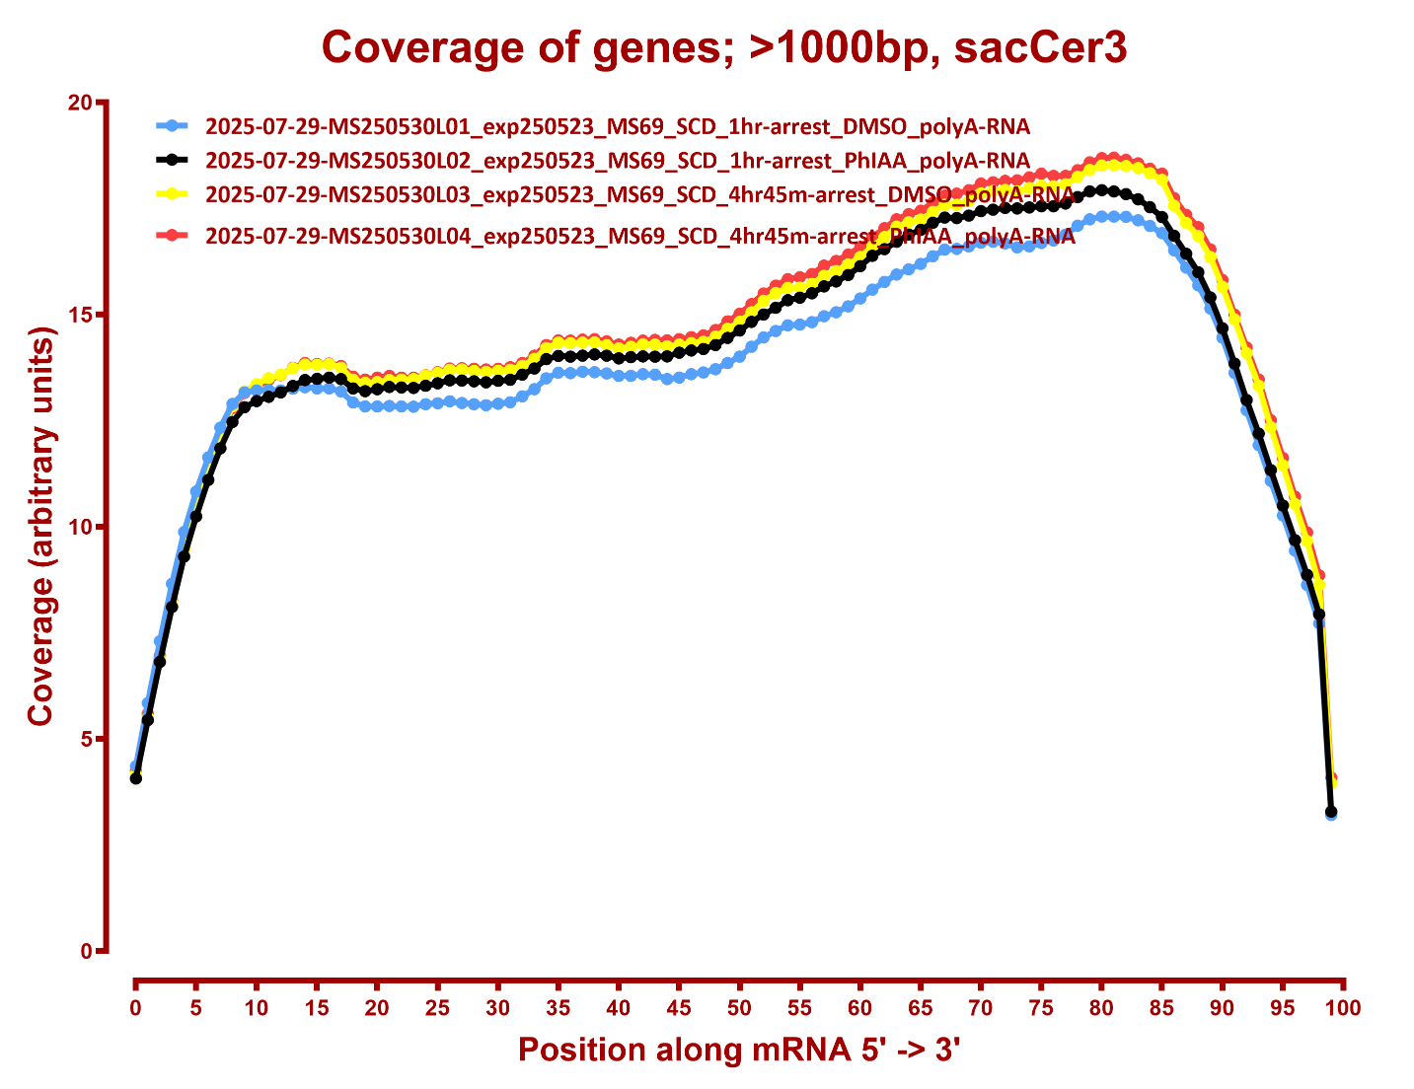
COVERAGE

Slide 8
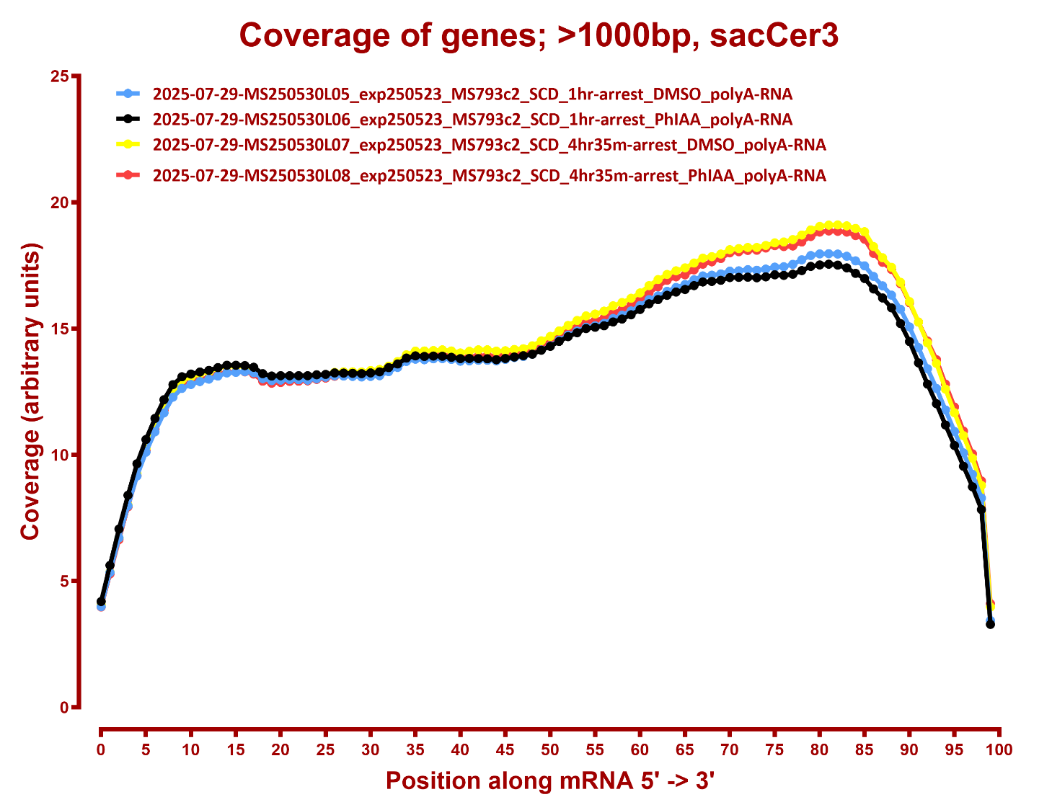

Slide 9
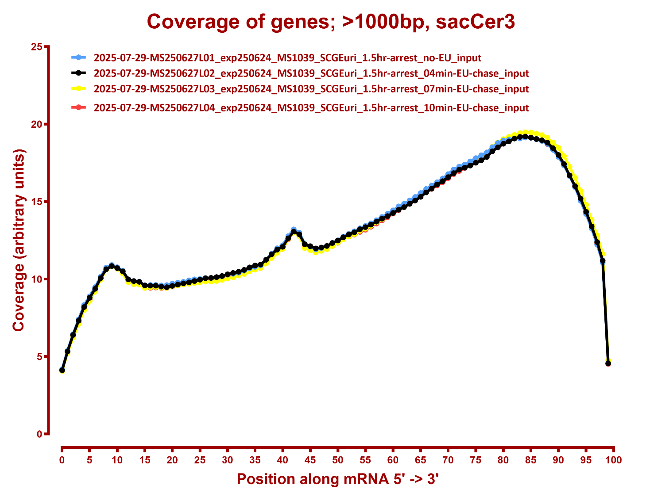

Slide 10
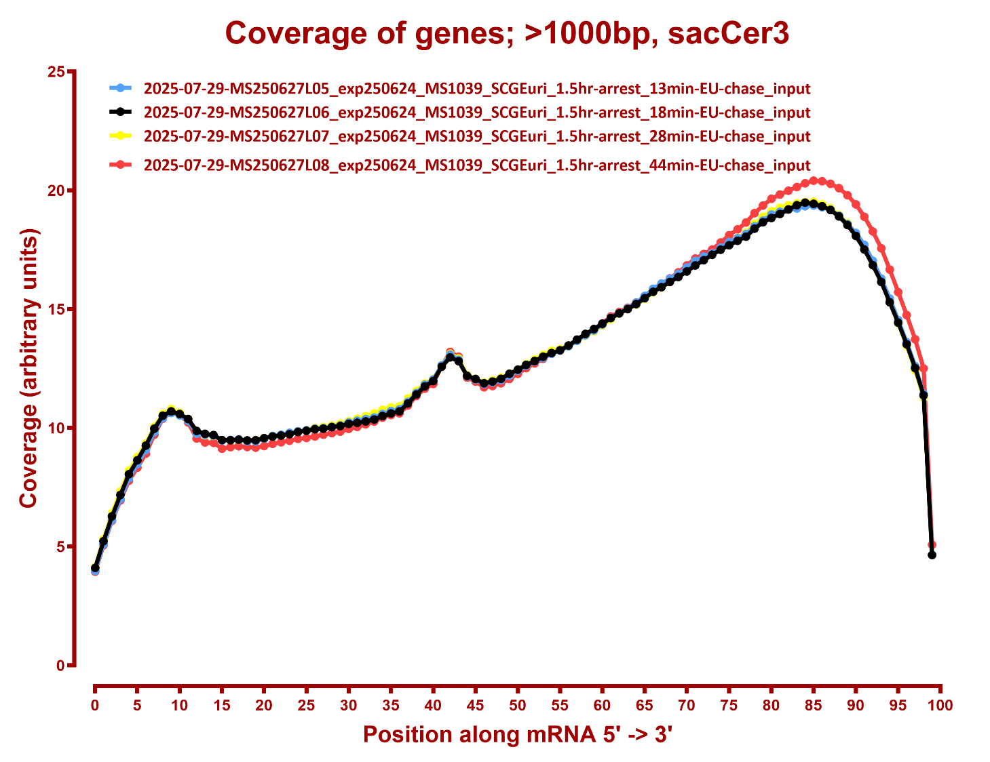

Slide 11
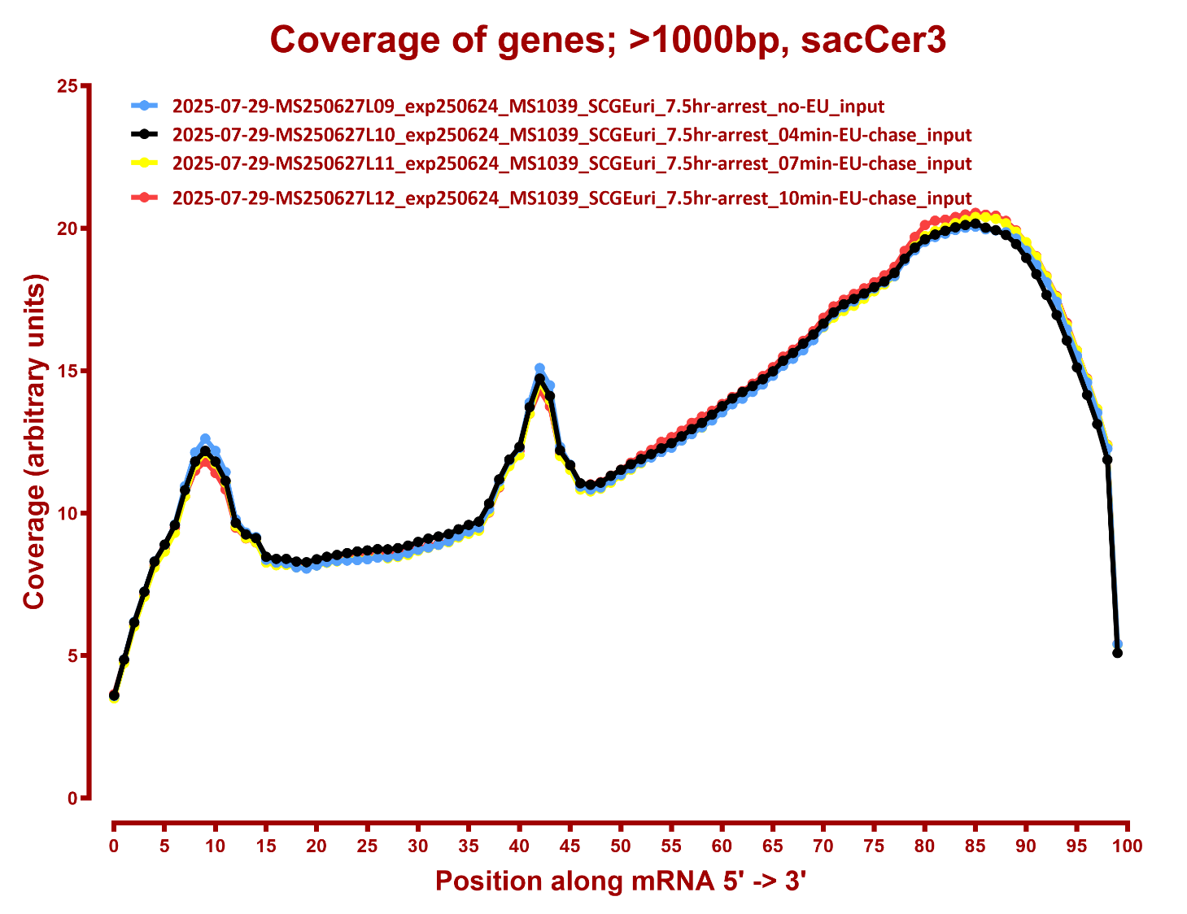

Slide 12
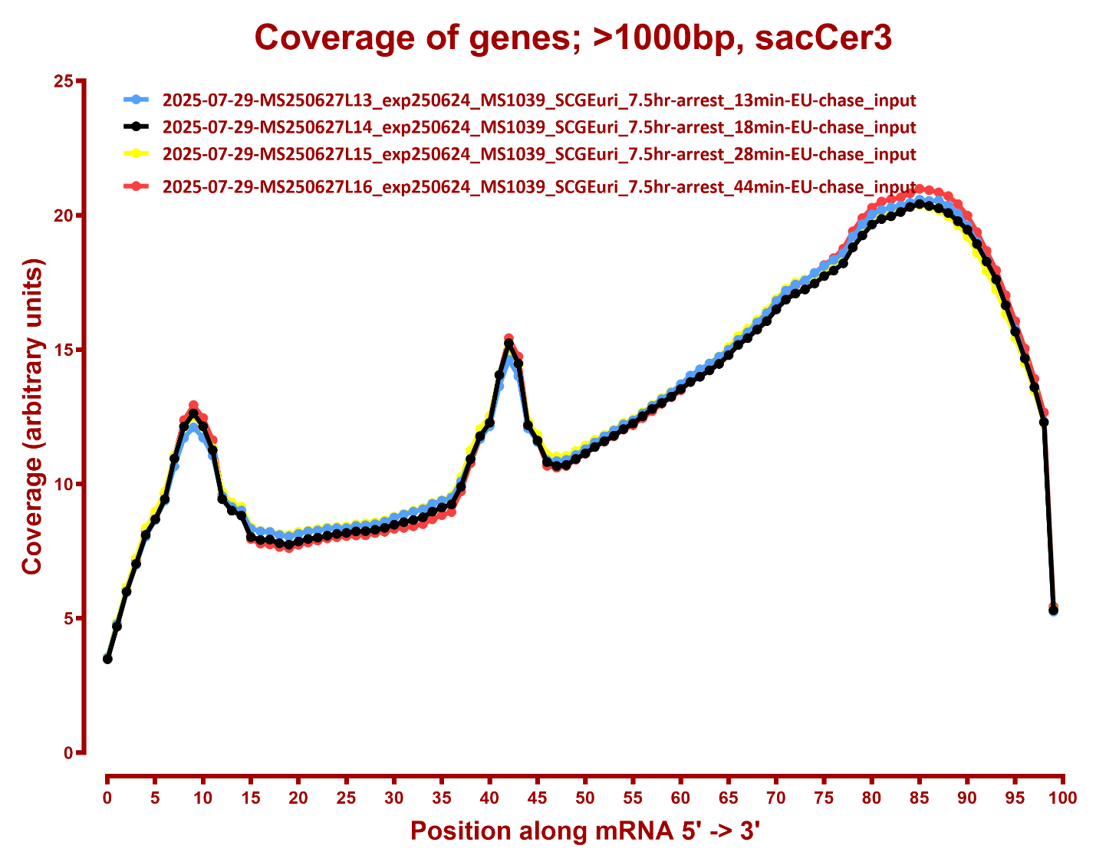

Slide 13
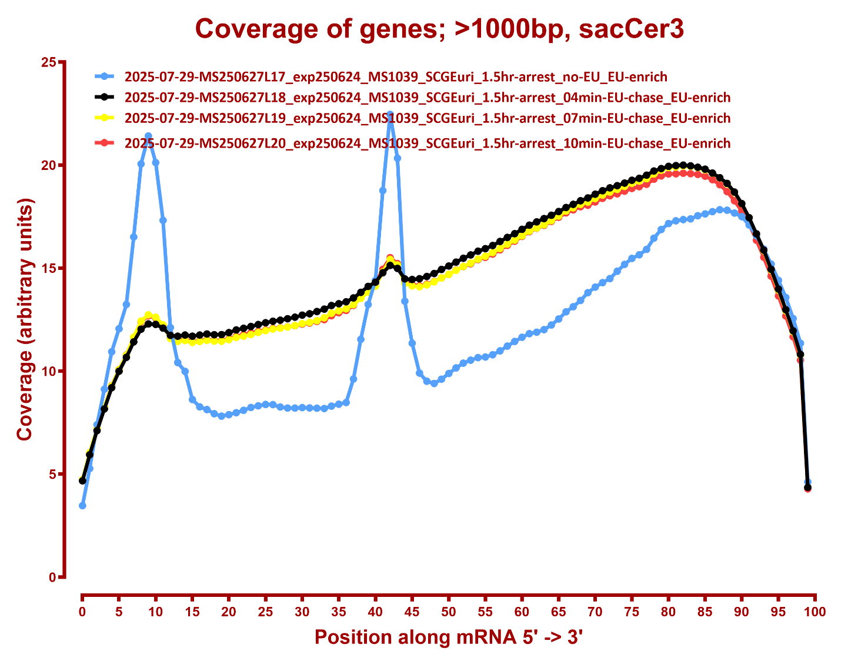

Slide 14
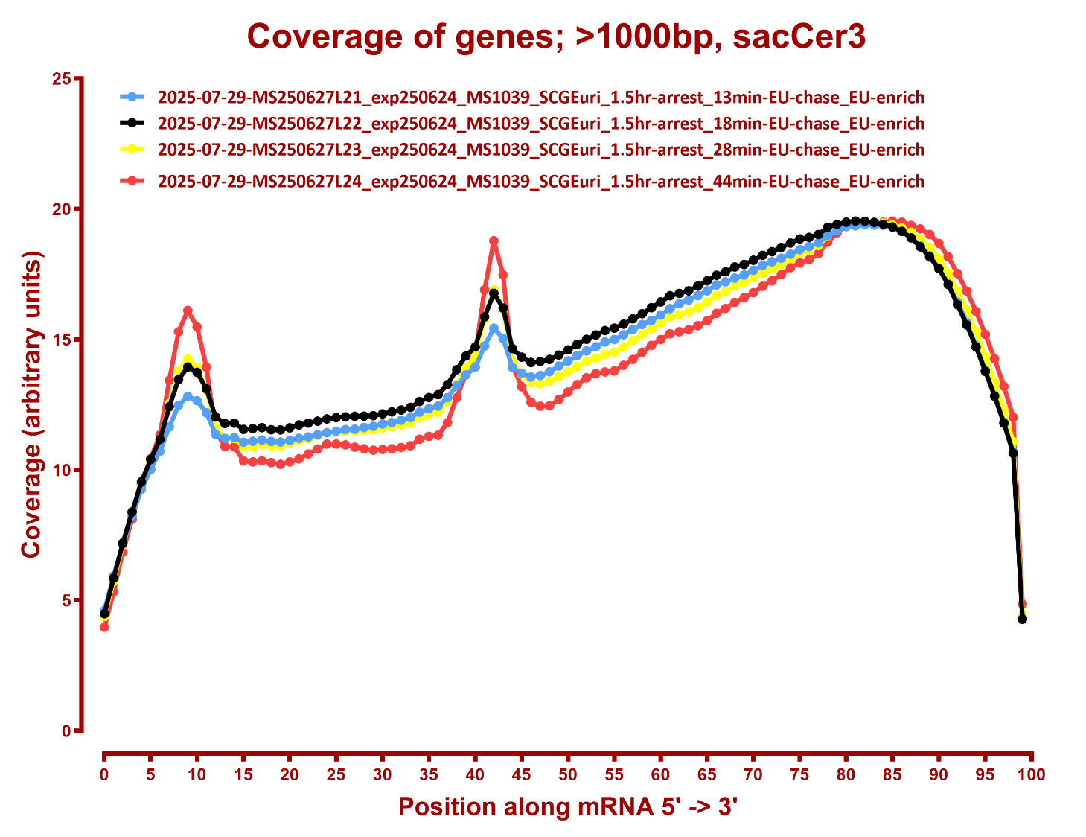

Slide 15
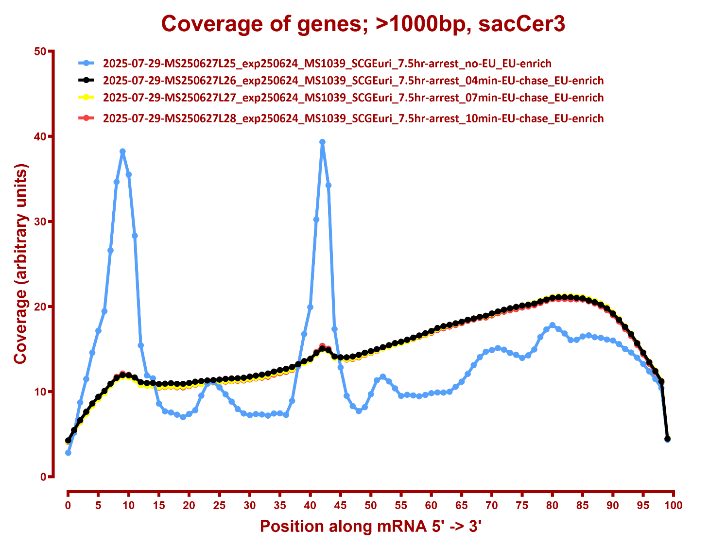

Slide 16
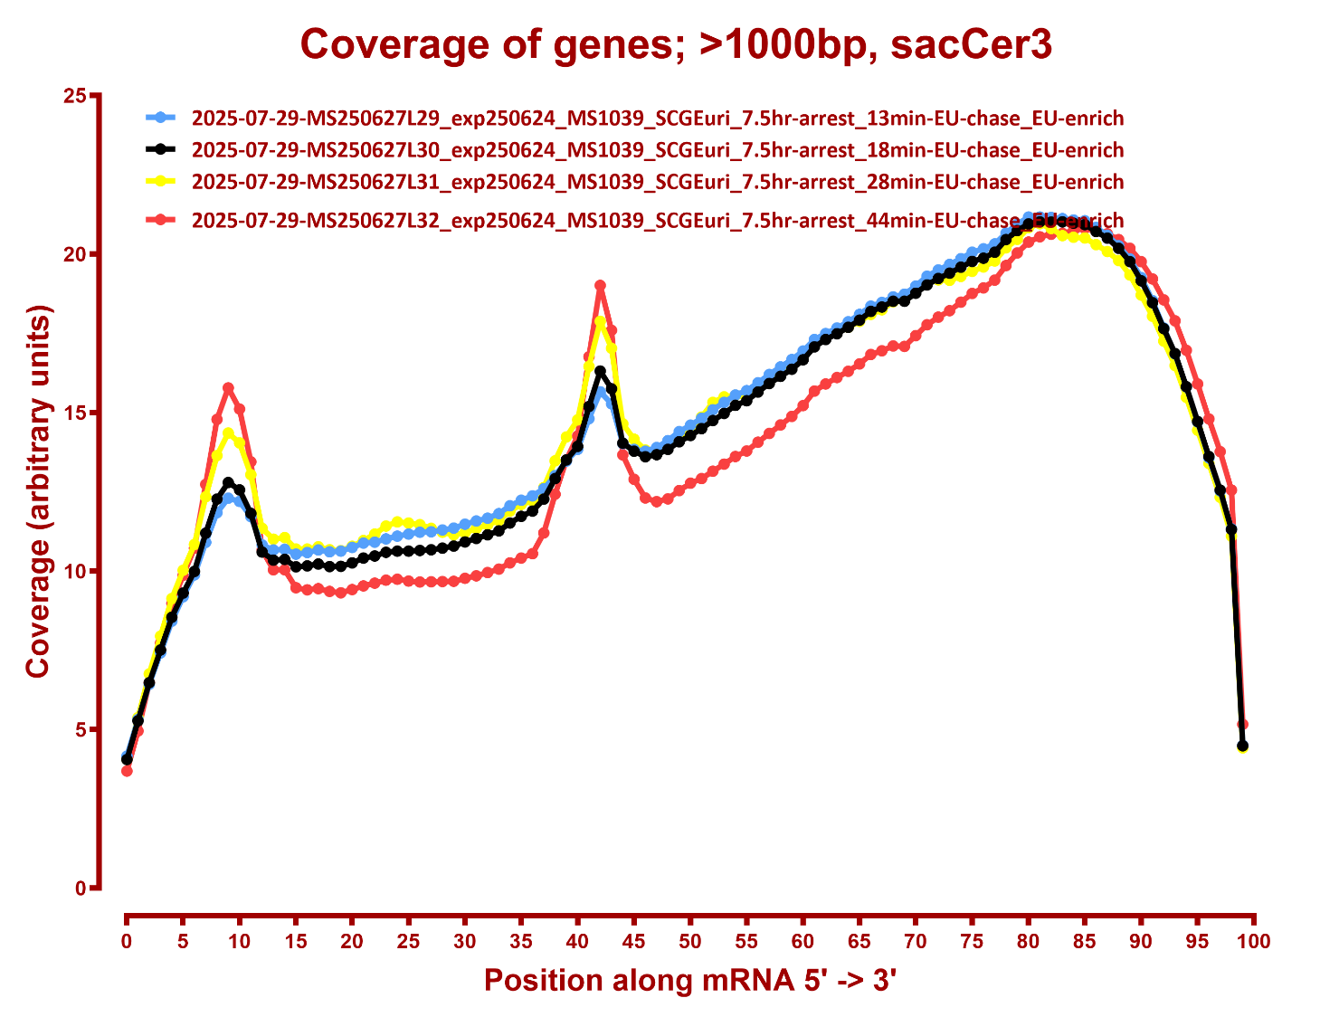

Slide 17
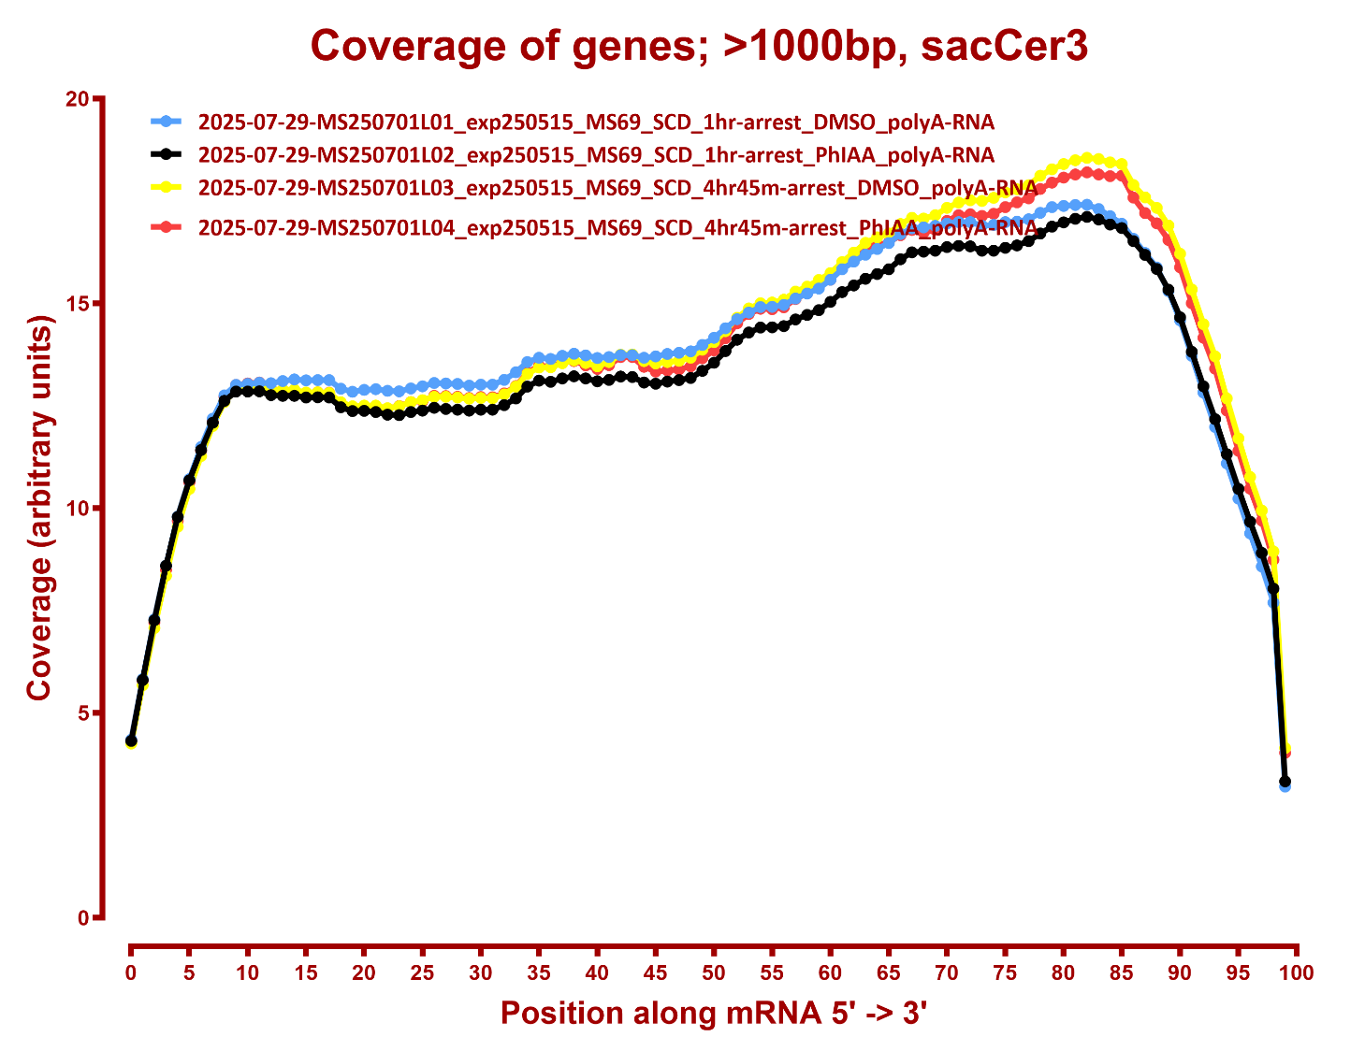

Slide 18
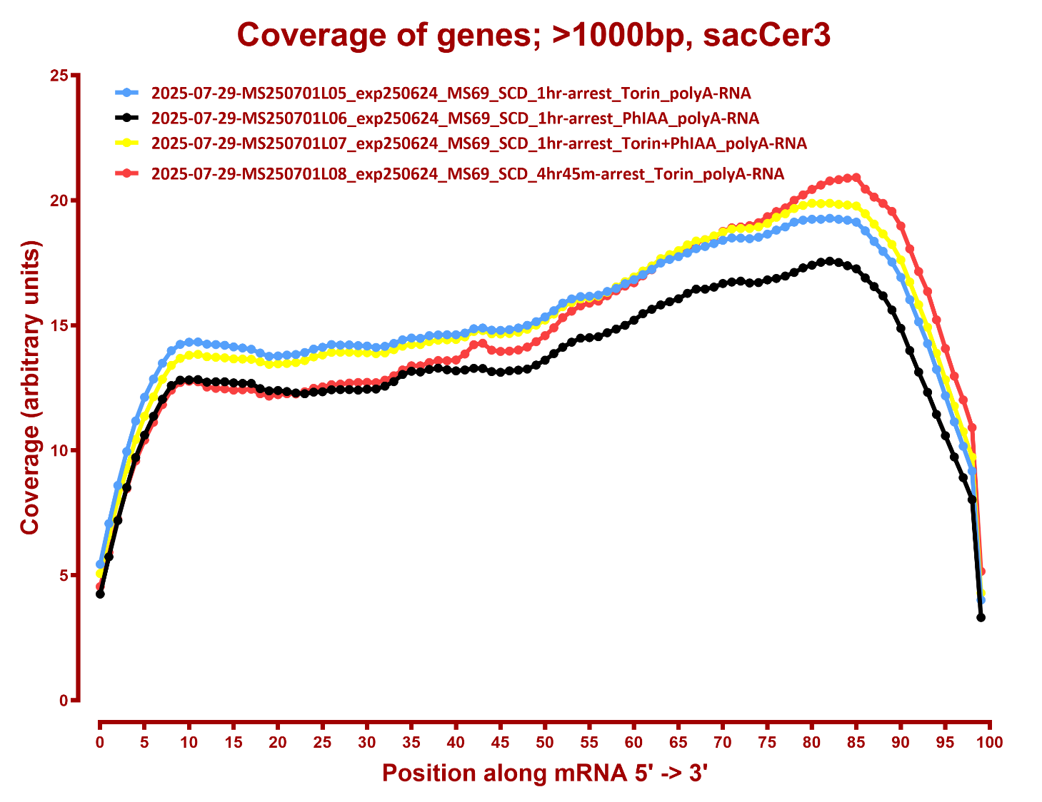

Slide 19
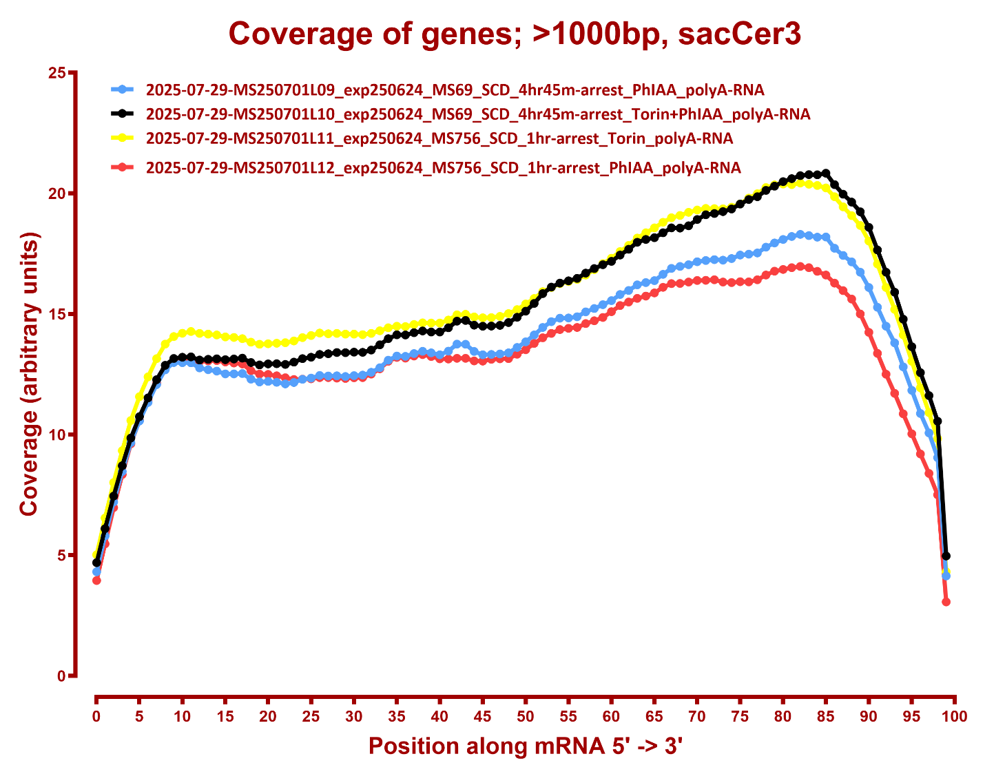

Slide 20
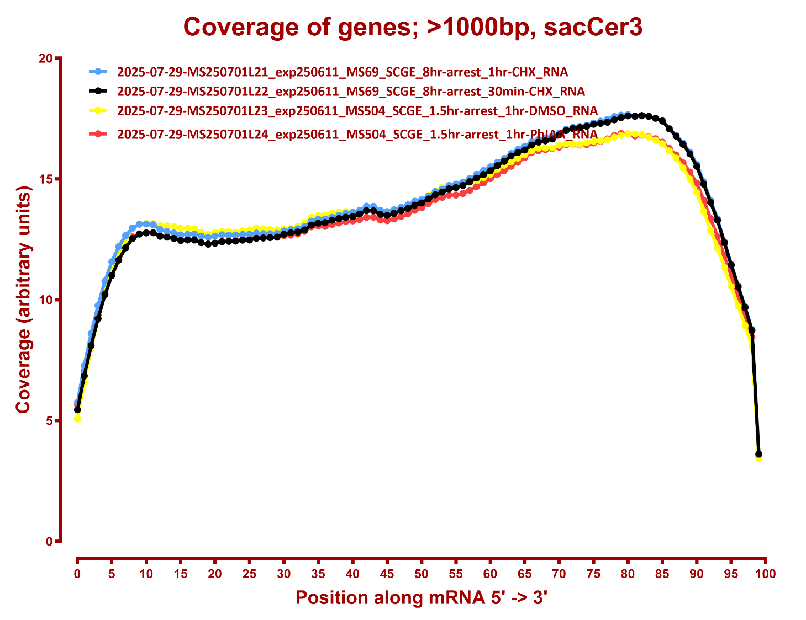

Slide 21
