Slide 1
MAPPING STATS
Library | Raw fragments | Species | 2x36mers unique
 |  |  | Unique reads | Complexity | Fraction aligned
2025-07-29-MS250708L01_exp250704_RPE1_5:1-S2-ratio_INPUT | 1,297,355 | dm6 | 78,646 | 0.88 | 0.03
2025-07-29-MS250708L01_exp250704_RPE1_5:1-S2-ratio_INPUT | 1,297,355 | hg38 | 2,104,402 | 0.87 | 0.81
2025-07-29-MS250708L02_exp250704_RPE1_10:1-S2-ratio_INPUT | 1,859,324 | dm6 | 61,132 | 0.88 | 0.02
2025-07-29-MS250708L02_exp250704_RPE1_10:1-S2-ratio_INPUT | 1,859,324 | hg38 | 3,084,276 | 0.86 | 0.83
2025-07-29-MS250708L03_exp250704_RPE1_20:1-S2-ratio_INPUT | 1,613,900 | dm6 | 27,400 | 0.87 | 0.01
2025-07-29-MS250708L03_exp250704_RPE1_20:1-S2-ratio_INPUT | 1,613,900 | hg38 | 2,709,058 | 0.86 | 0.84
2025-07-29-MS250708L04_exp250704_RPE1_5:1-S2-ratio_Rpb1-CTD-ChIP | 9,890,048 | dm6 | 752,446 | 0.83 | 0.04
2025-07-29-MS250708L04_exp250704_RPE1_5:1-S2-ratio_Rpb1-CTD-ChIP | 9,890,048 | hg38 | 15,727,864 | 0.83 | 0.80
2025-07-29-MS250708L05_exp250704_RPE1_10:1-S2-ratio_Rpb1-CTD-ChIP | 11,143,271 | dm6 | 404,622 | 0.84 | 0.02
2025-07-29-MS250708L05_exp250704_RPE1_10:1-S2-ratio_Rpb1-CTD-ChIP | 11,143,271 | hg38 | 18,386,866 | 0.82 | 0.83
2025-07-29-MS250708L06_exp250704_RPE1_20:1-S2-ratio_Rpb1-CTD-ChIP | 12,520,371 | dm6 | 256,248 | 0.84 | 0.01
2025-07-29-MS250708L06_exp250704_RPE1_20:1-S2-ratio_Rpb1-CTD-ChIP | 12,520,371 | hg38 | 20,931,460 | 0.83 | 0.84

Slide 2
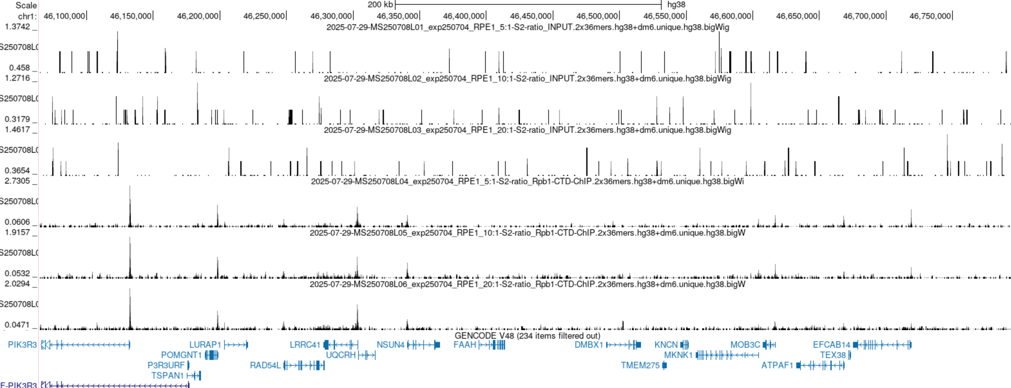
BROWSER SNAPSHOTS, HUMAN

Slide 3
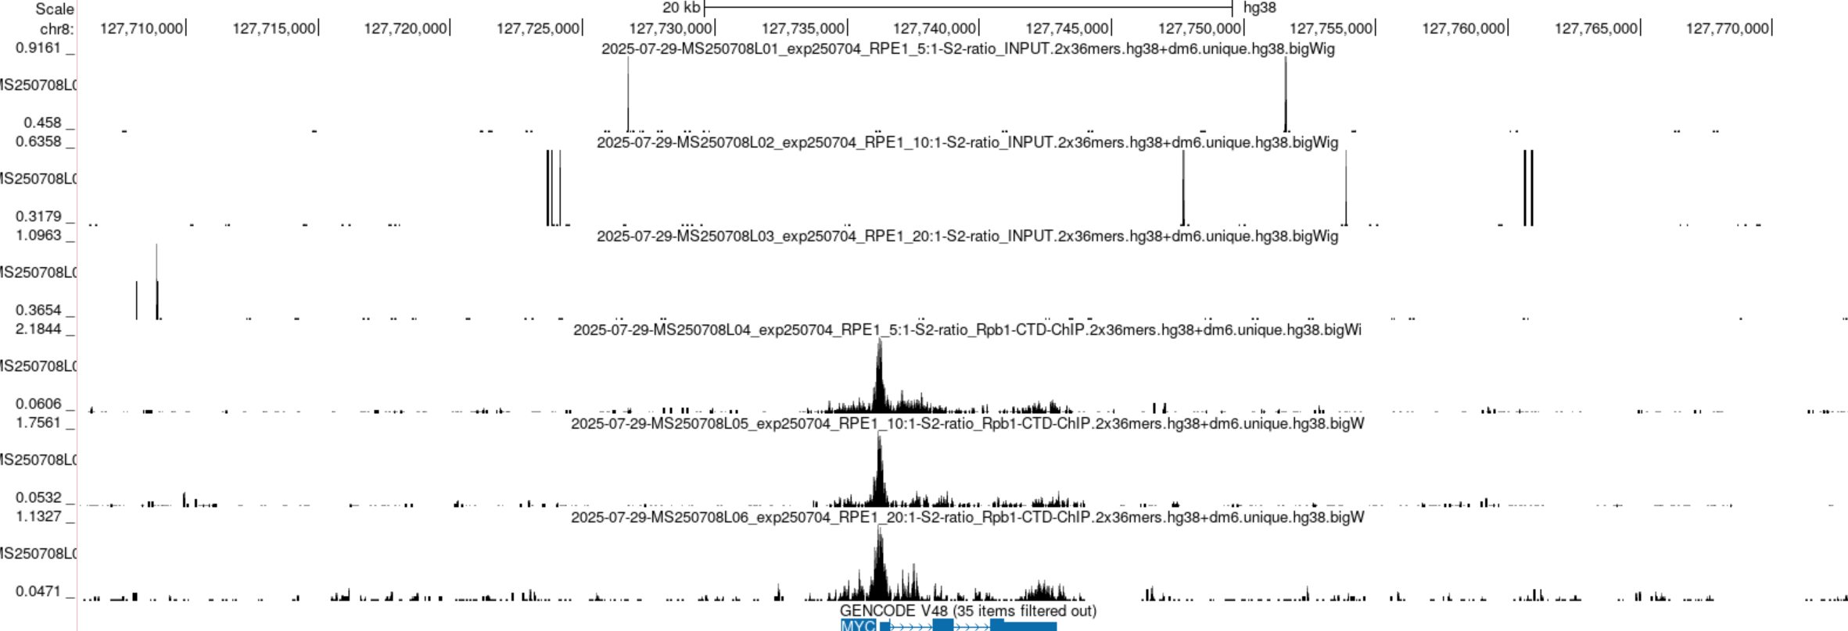
BROWSER SNAPSHOTS, HUMAN

Slide 4
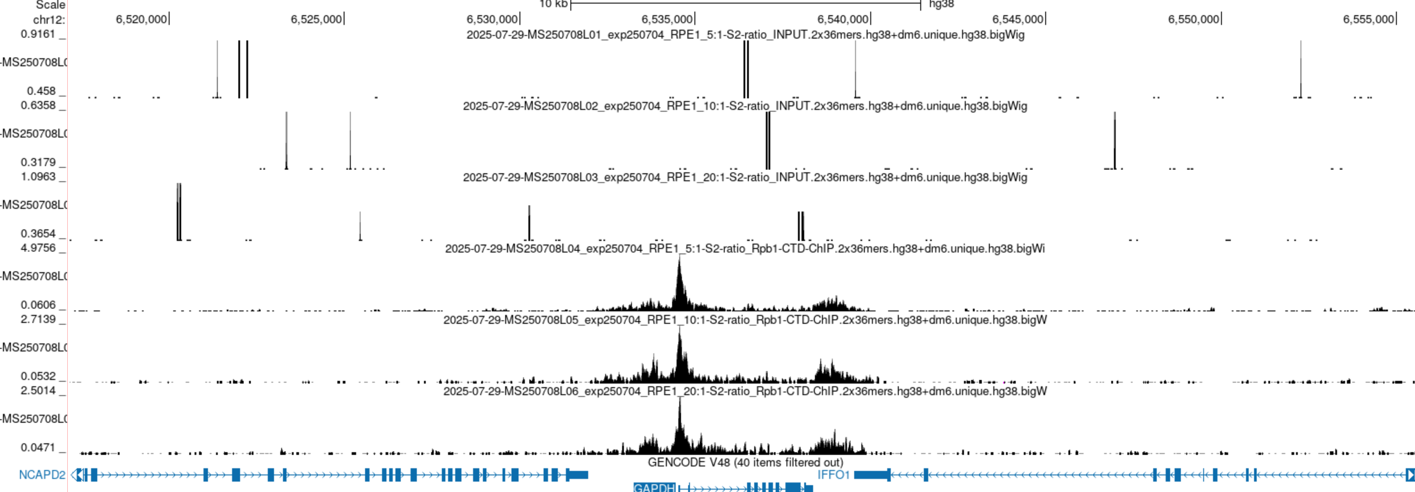
BROWSER SNAPSHOTS, HUMAN

Slide 5
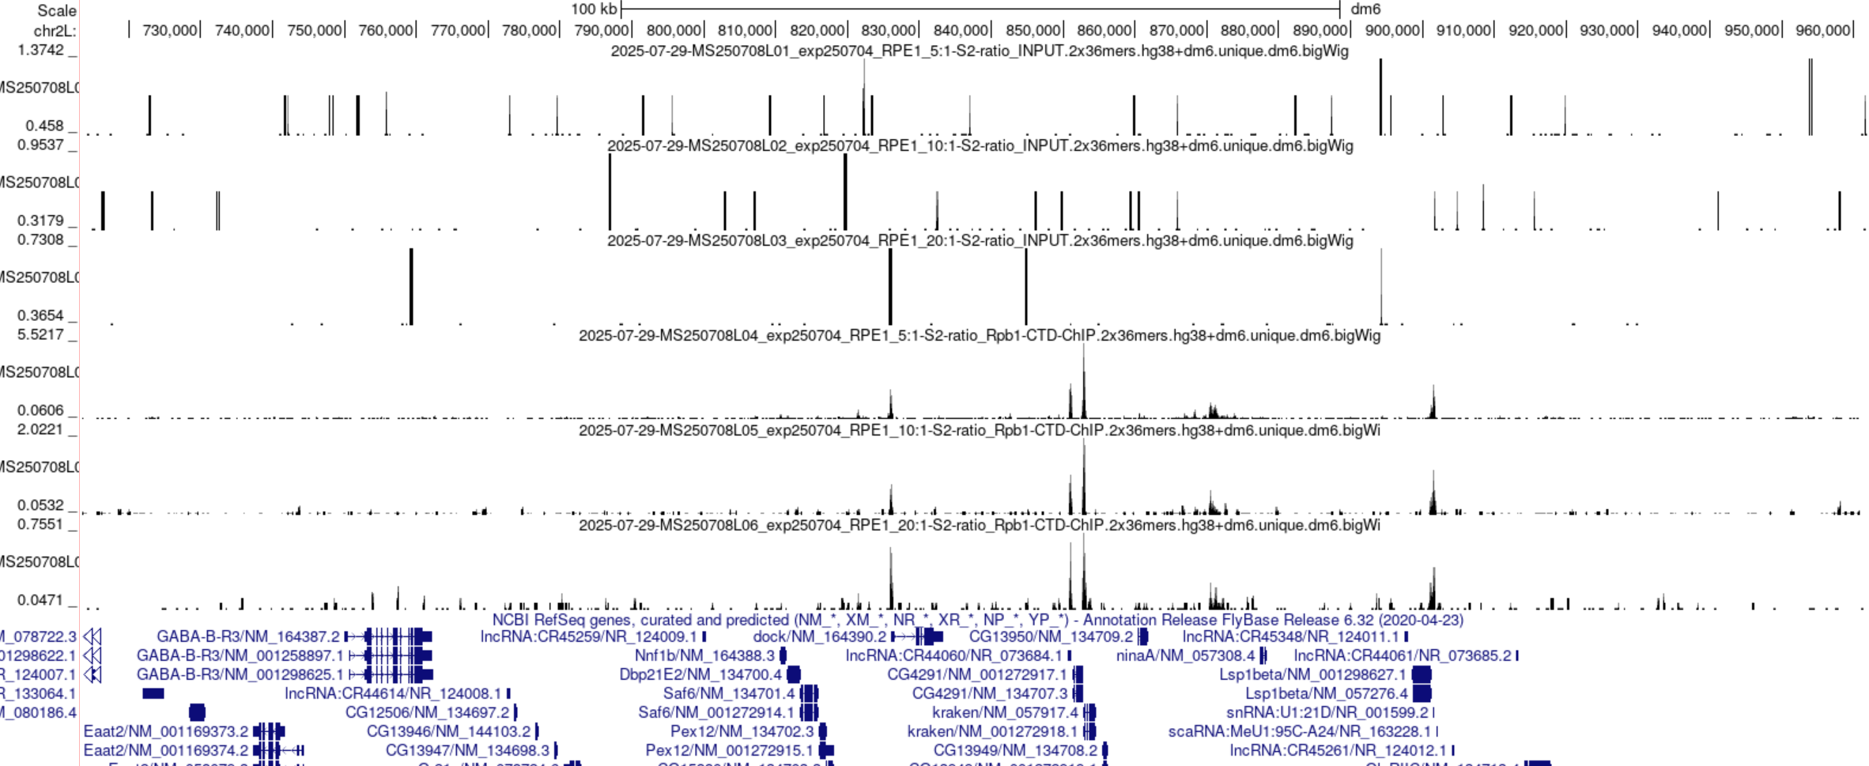
BROWSER SNAPSHOTS, DROSOPHILA

Slide 6
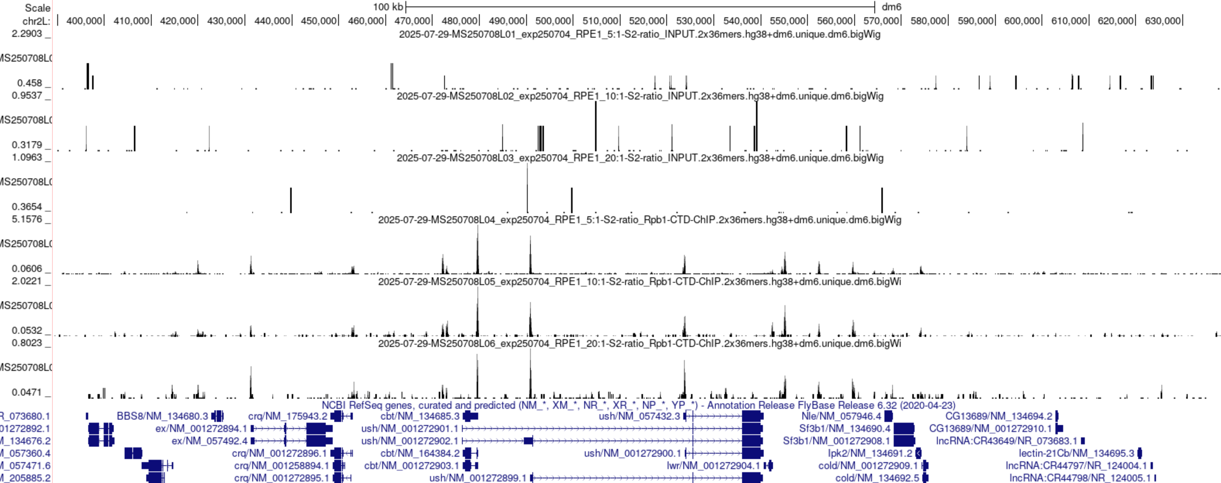
BROWSER SNAPSHOTS, DROSOPHILA

Slide 7
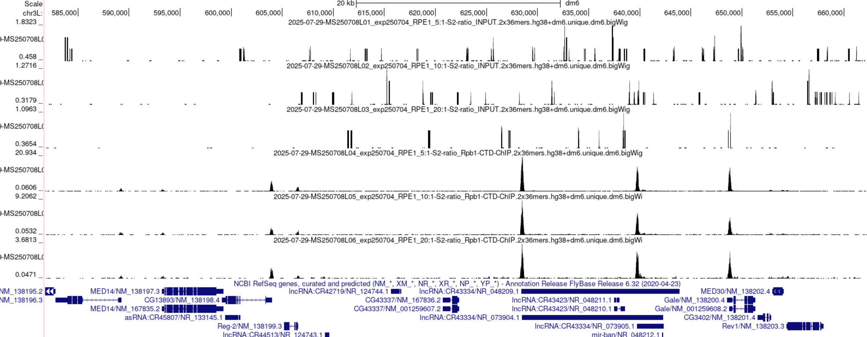
BROWSER SNAPSHOTS, DROSOPHILA

Slide 8
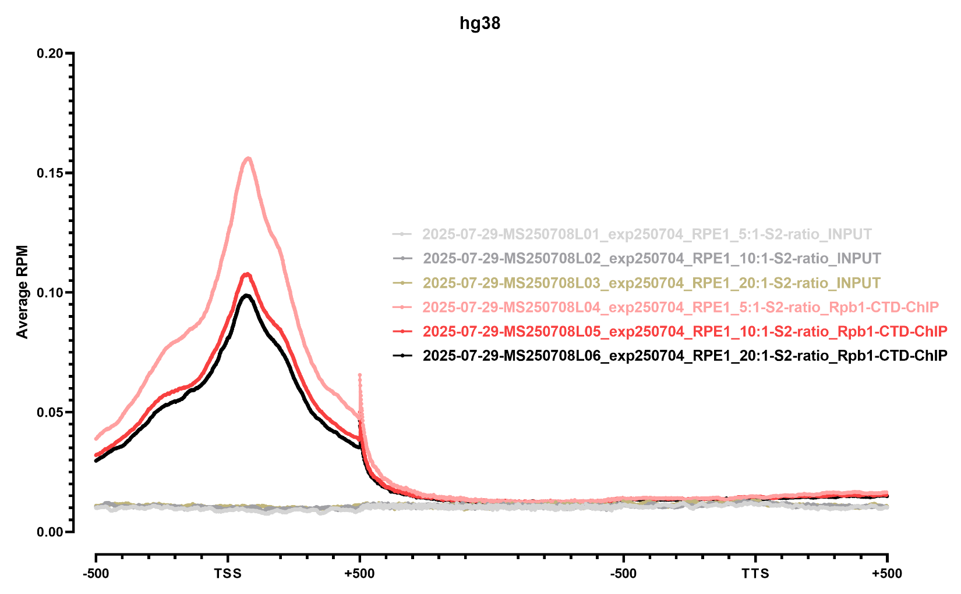
METAGENE PROFILES

Slide 9
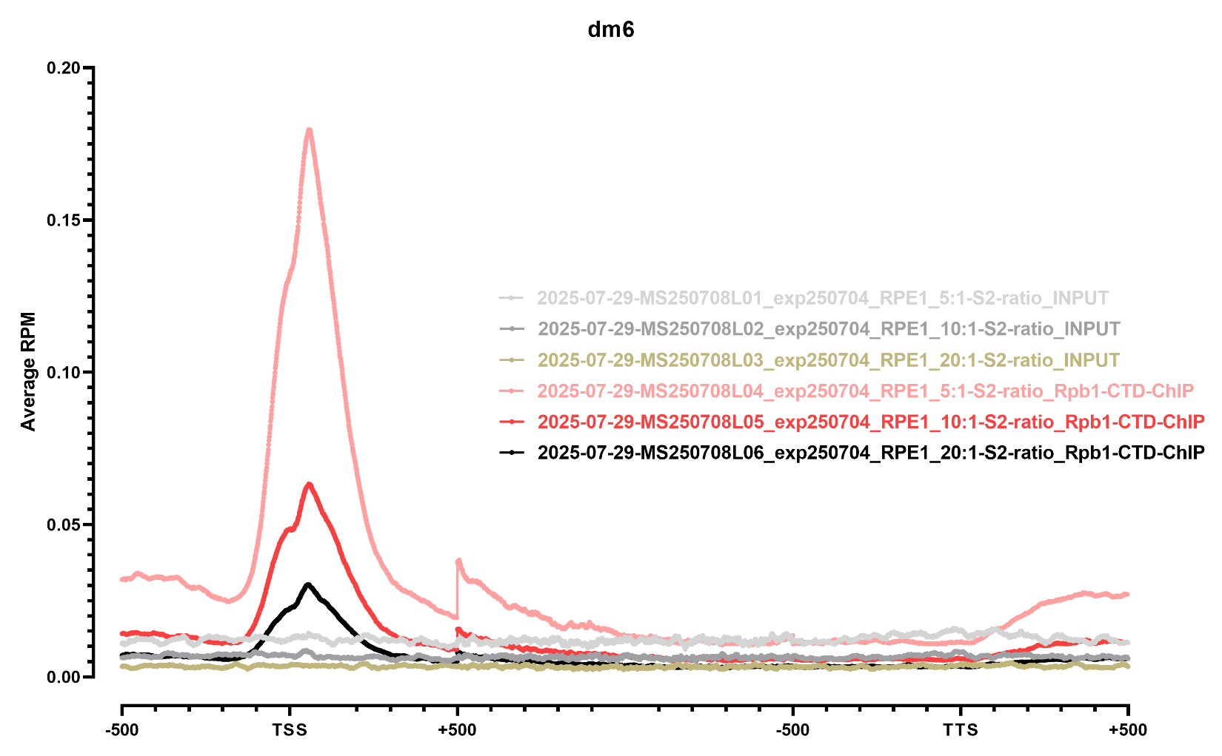
METAGENE PROFILES

