Slide 1
MAPPING STATS

Slide 3
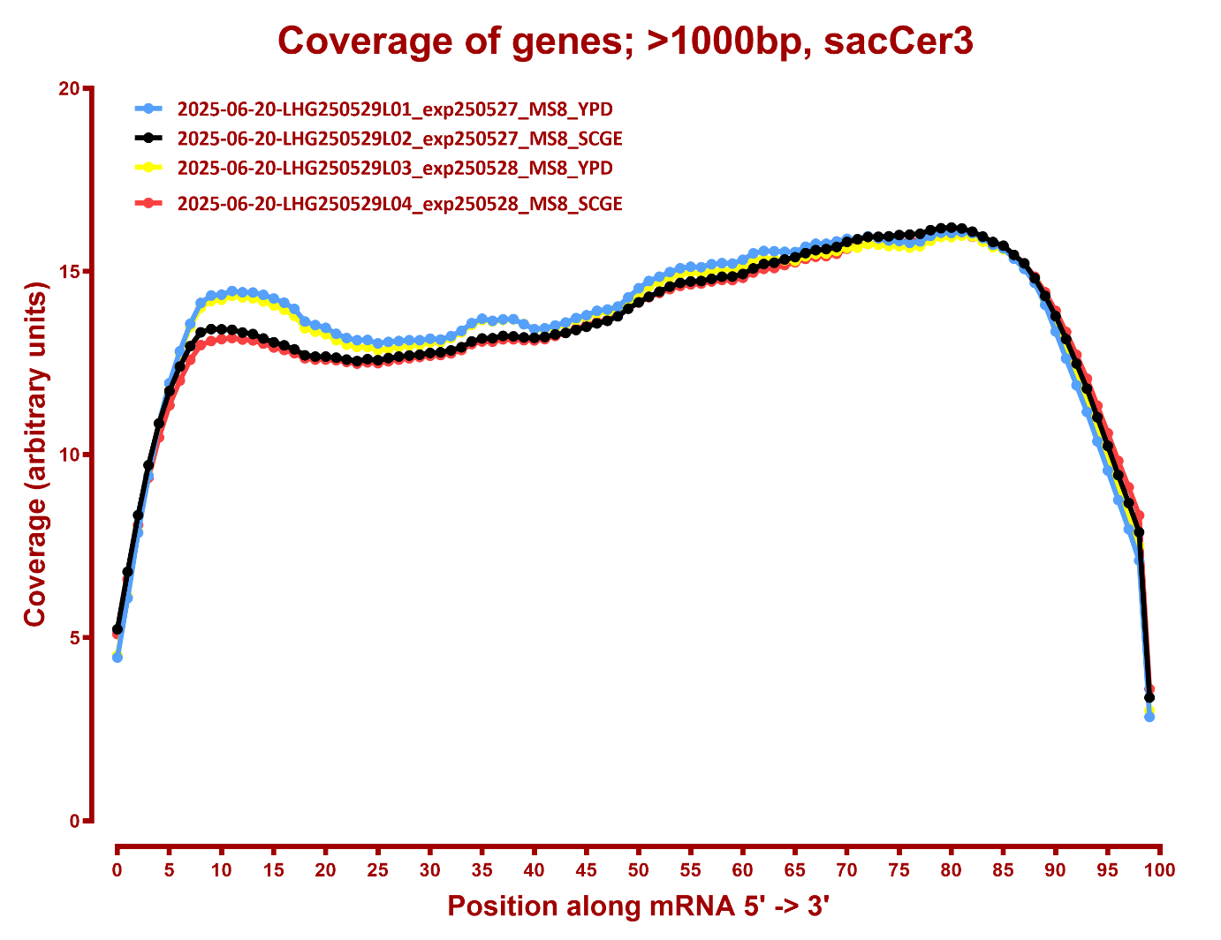
COVERAGE

