Slide 1
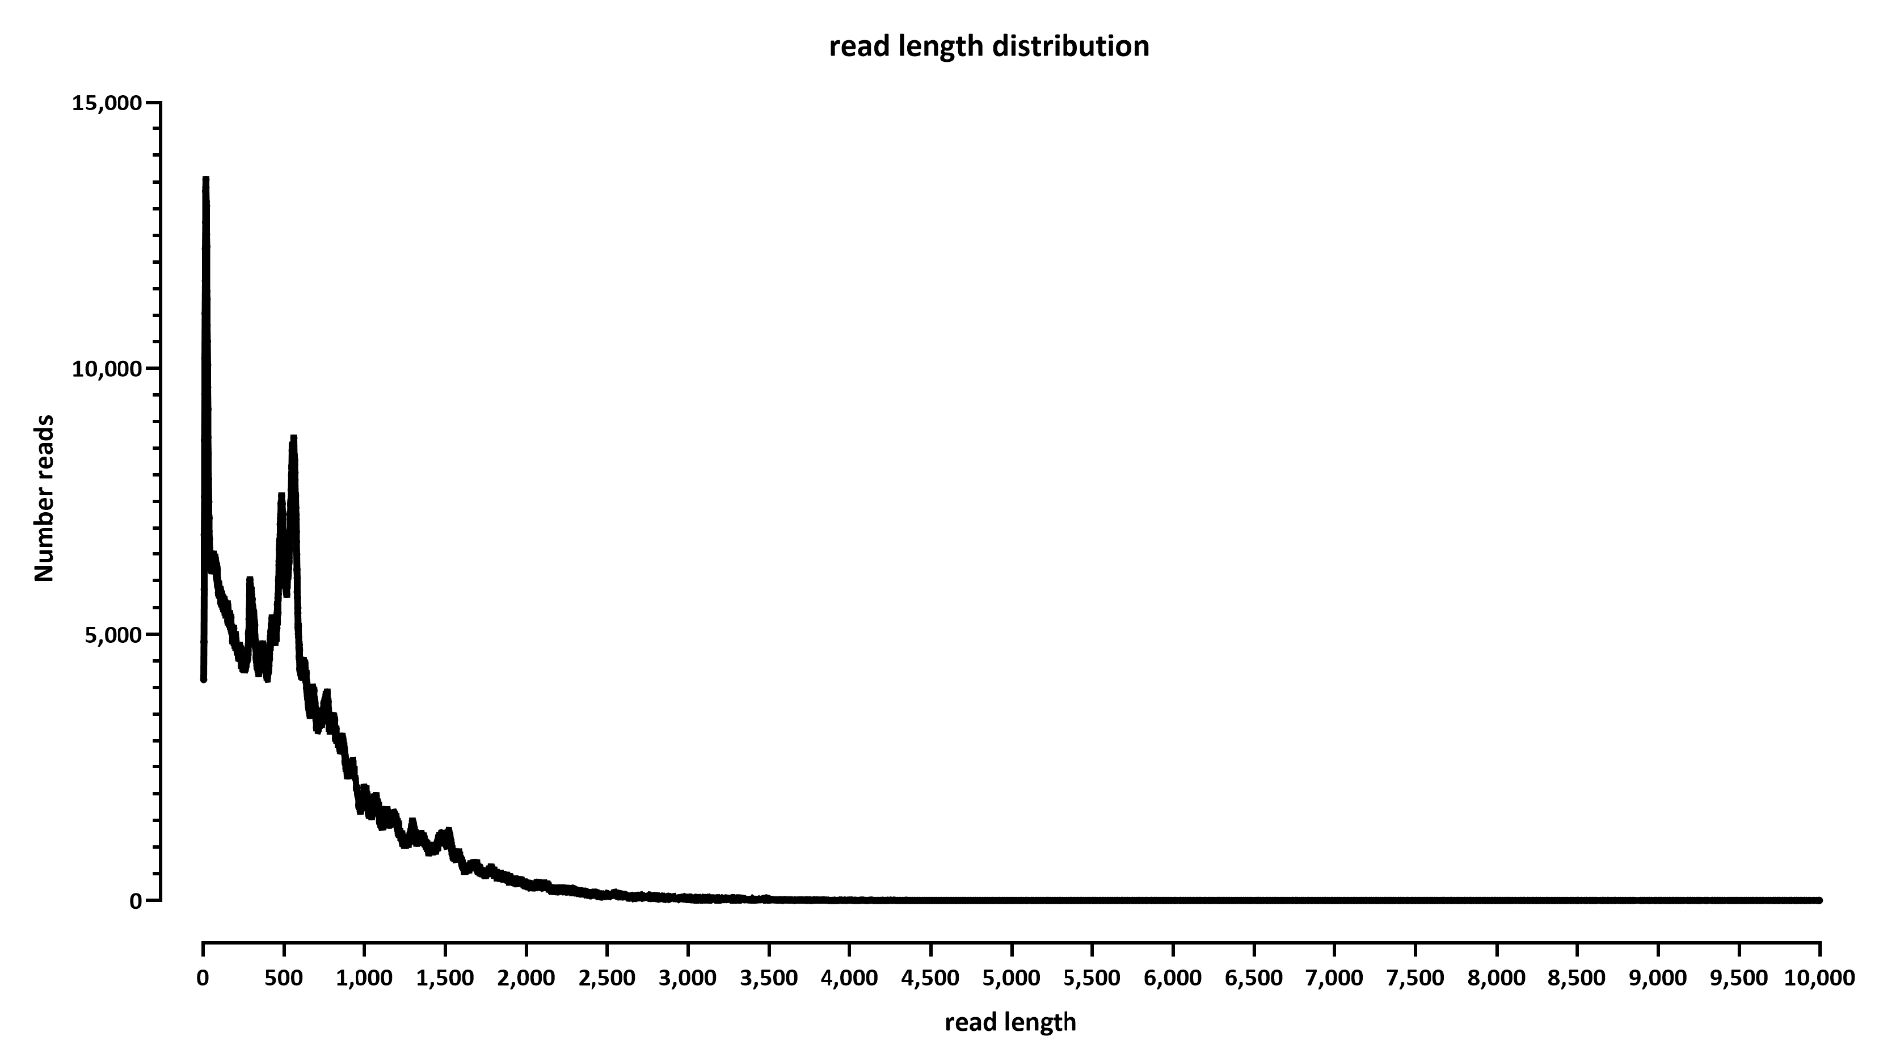
READ LENGTH DISTRIBUTION
Note: this has way too many very short reads for my taste

Slide 2
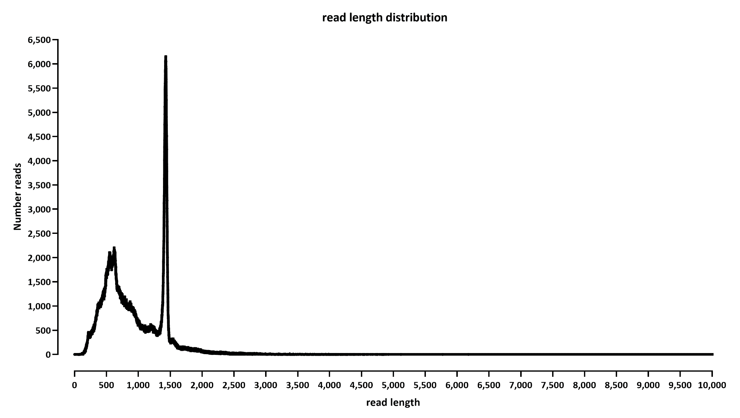
LAST TIME FOR COMPARISON

Slide 3
NEW PIPELINE:
dorado for rebasecalling and poly-A tail length estimation
Minimap2 alignment against the transcriptome
Post-processing by me to get TPMs and mean poly-A tail lengths

Slide 4
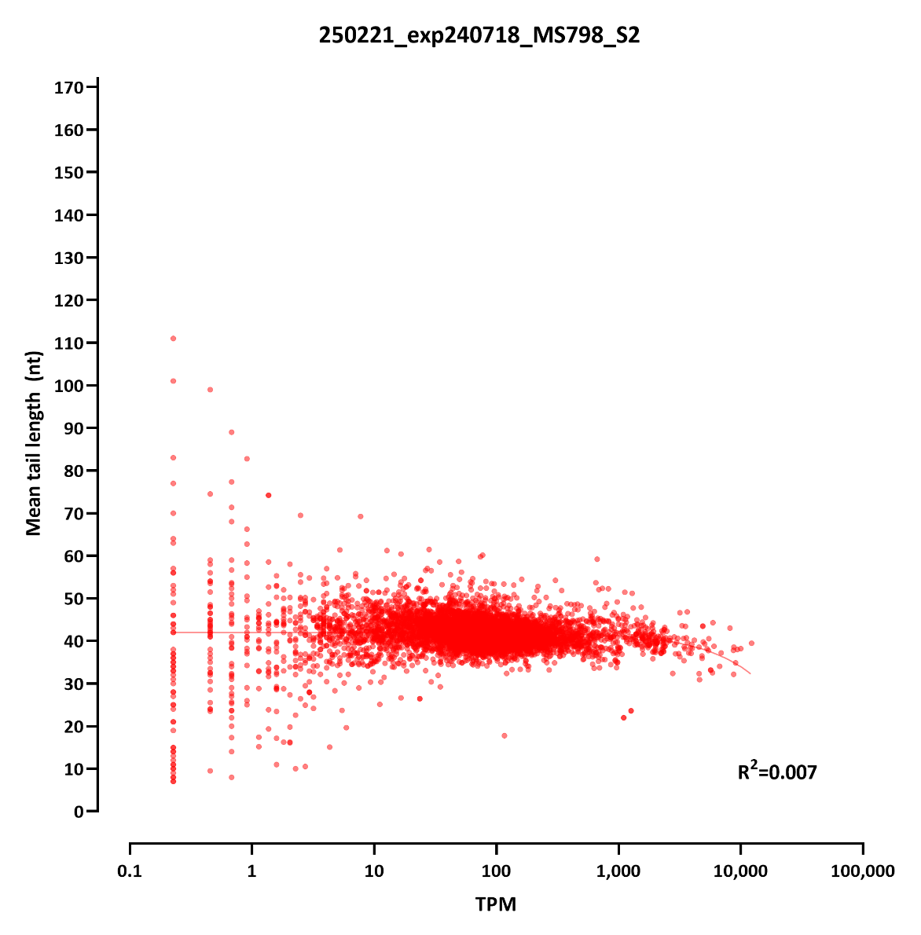

Slide 5
