Slide 1
MAPPING STATS

Slide 2
# | Exonic: | Intergenic: | Intronic:
2025-02-23-MS250211L01_exp250206_MS791_SCD_1hr-arrest_PhIAA_polyA-RNA | 0.93 | 0.07 | 0.00
2025-02-23-MS250211L02_exp250206_MS791_SCD_4hr45m-arrest_PhIAA_polyA-RNA | 0.93 | 0.07 | 0.00
2025-02-23-MS250211L03_exp250206_MS791_SCD_1hr-arrest_DMSO_polyA-RNA | 0.93 | 0.06 | 0.00
2025-02-23-MS250211L04_exp250206_MS791_SCD_4hr45m-arrest_DMSO_polyA-RNA | 0.93 | 0.07 | 0.00
2025-02-23-MS250211L05_exp250206_MS793_SCD_1hr-arrest_PhIAA_polyA-RNA | 0.93 | 0.06 | 0.00
2025-02-23-MS250211L06_exp250206_MS793_SCD_4hr35m-arrest_PhIAA_polyA-RNA | 0.93 | 0.06 | 0.00
2025-02-23-MS250211L07_exp250206_MS793_SCD_1hr-arrest_DMSO_polyA-RNA | 0.93 | 0.06 | 0.00
2025-02-23-MS250211L08_exp250206_MS793_SCD_4hr35m-arrest_DMSO_polyA-RNA | 0.93 | 0.06 | 0.00
2025-02-23-MS250211L09_exp250206_MS756_SCD_1hr-arrest_PhIAA_polyA-RNA | 0.94 | 0.06 | 0.00
2025-02-23-MS250211L10_exp250206_MS756_SCD_4hr45m-arrest_PhIAA_polyA-RNA | 0.94 | 0.06 | 0.00
2025-02-23-MS250211L11_exp250206_MS756_SCD_4hr45m-arrest_PhIAA-4hr35m_polyA-RNA | 0.94 | 0.06 | 0.00
2025-02-23-MS250211L12_exp250206_MS756_SCD_1hr-arrest-DMSO_polyA-RNA | 0.93 | 0.06 | 0.00
2025-02-23-MS250211L13_exp250206_MS756_SCD_4hr45m-arrest_DMSO_polyA-RNA | 0.93 | 0.07 | 0.00
2025-02-23-MS250211L14_exp250206_MS756_SCD_4hr45m-arrest_DMSO-4hr35m_polyA-RNA | 0.93 | 0.06 | 0.00

Slide 3
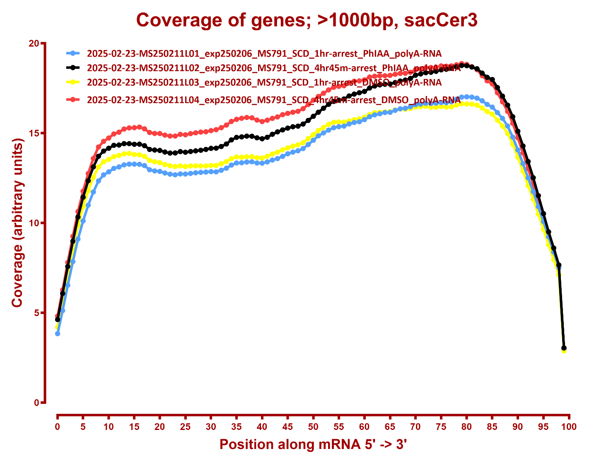
COVERAGE ALL READS

Slide 4
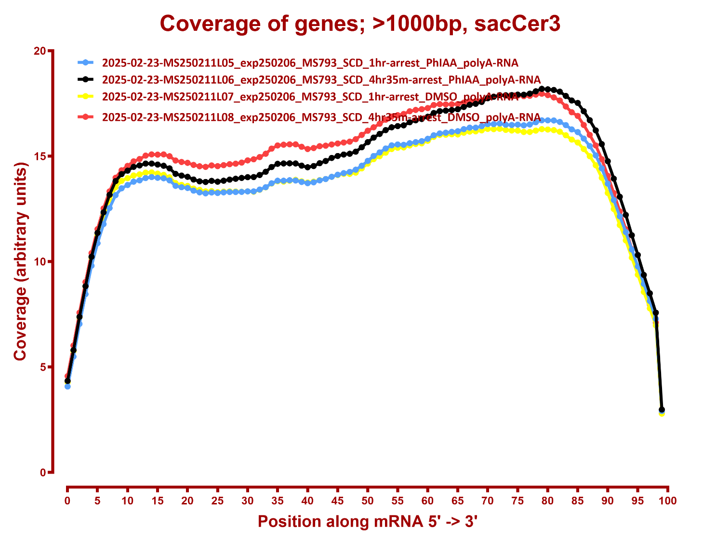

Slide 5
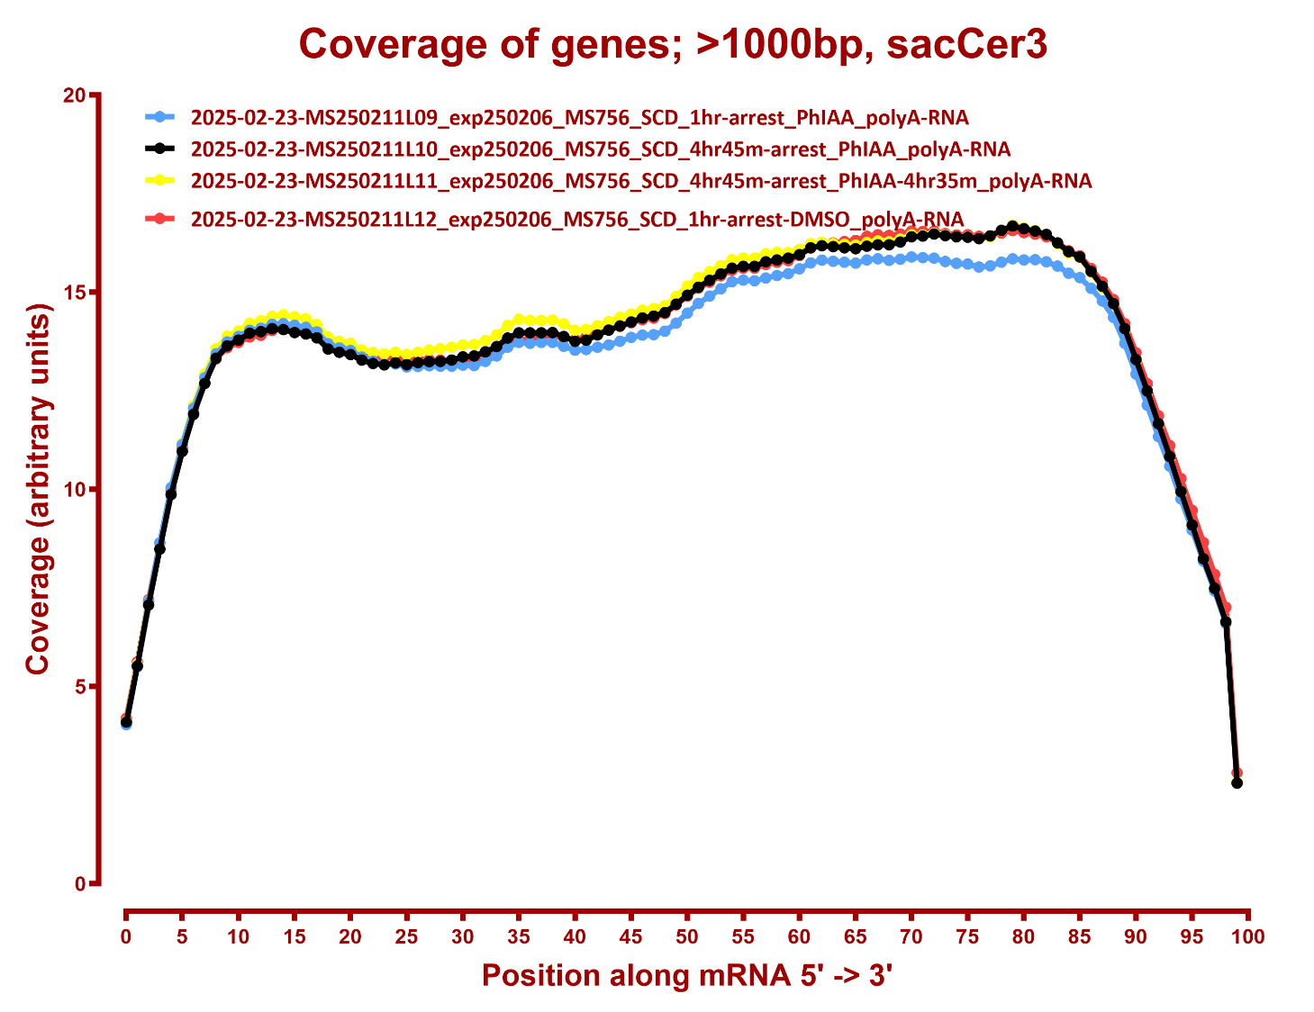

Slide 6
