Slide 1
MAPPING STATS

Slide 2
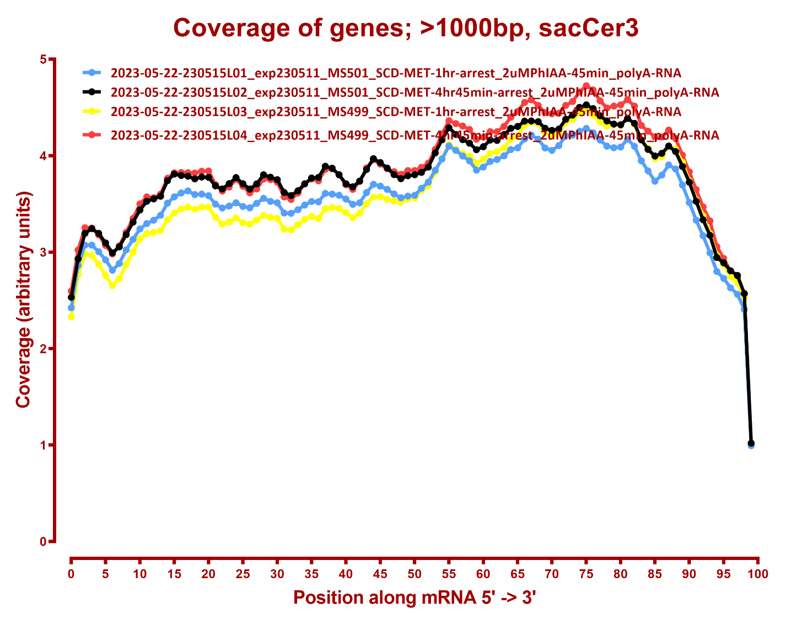
COVERAGE ALL READS

Slide 3
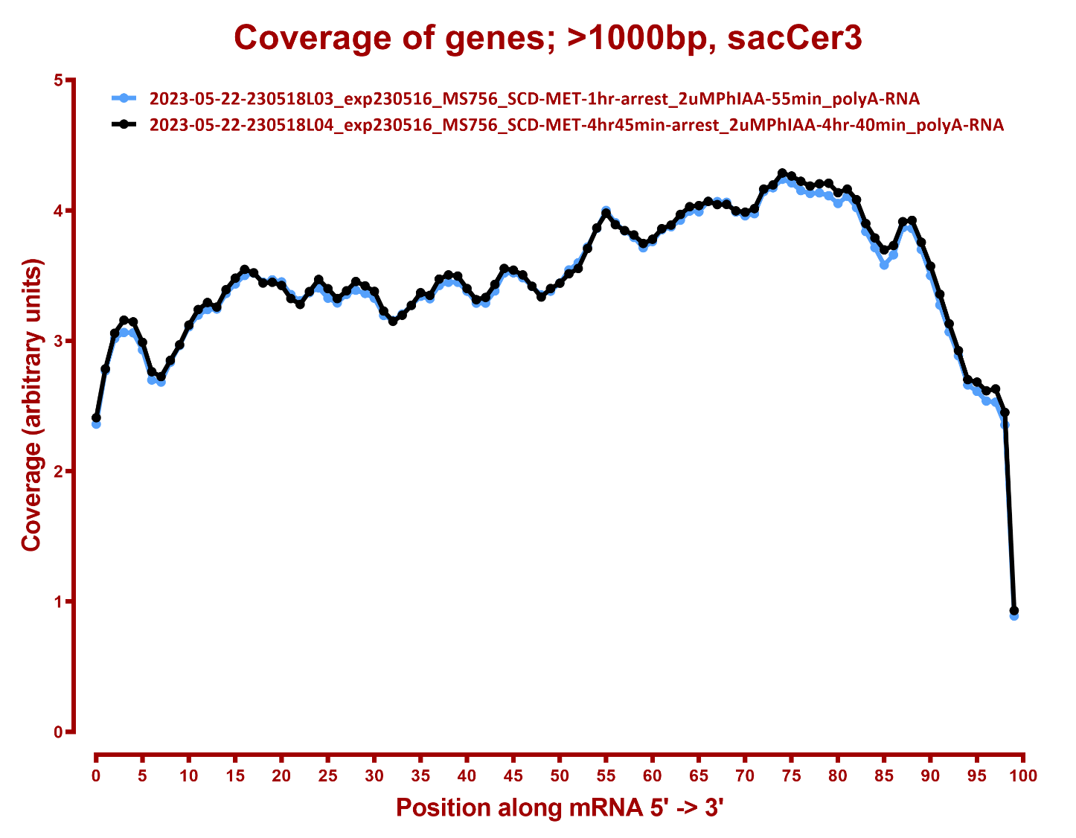

Slide 4
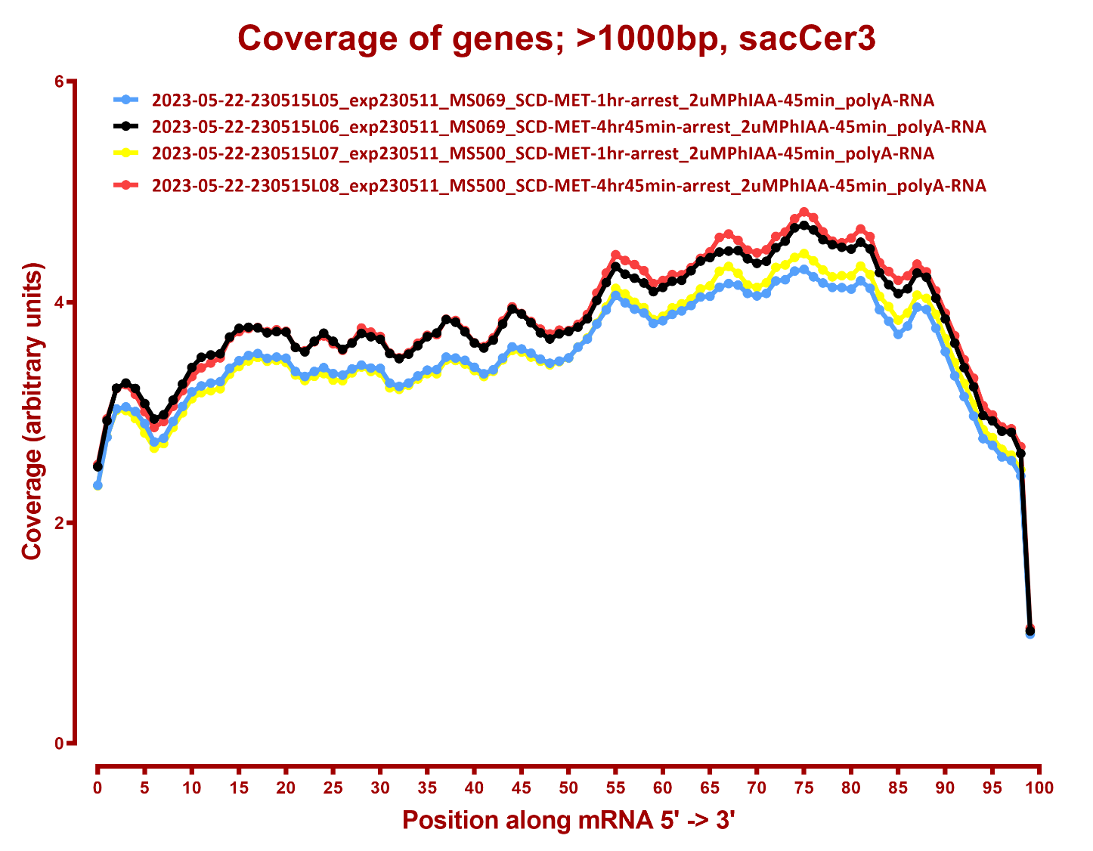

Slide 5
