Slide 1
MAPPING STATS

Slide 3
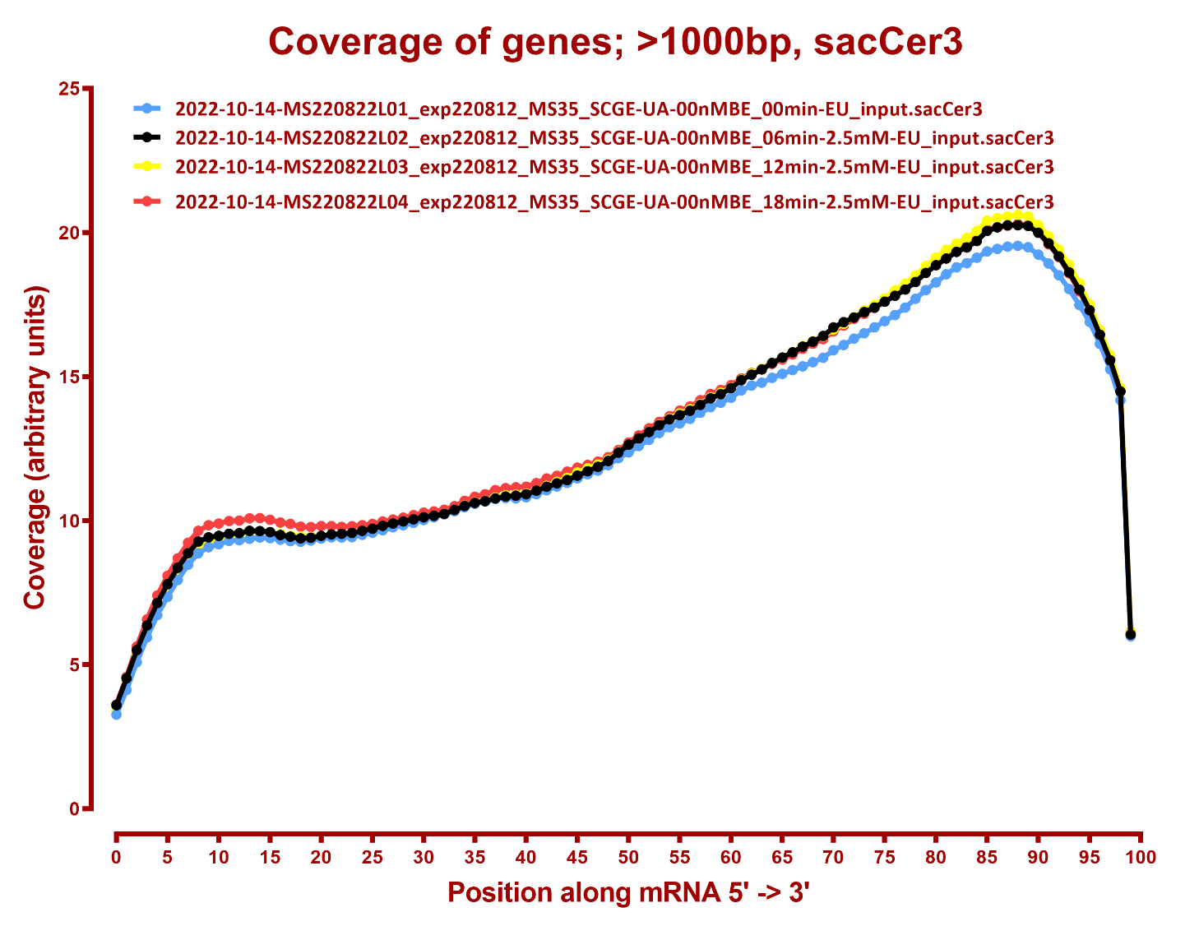
COVERAGE ALL READS

Slide 4
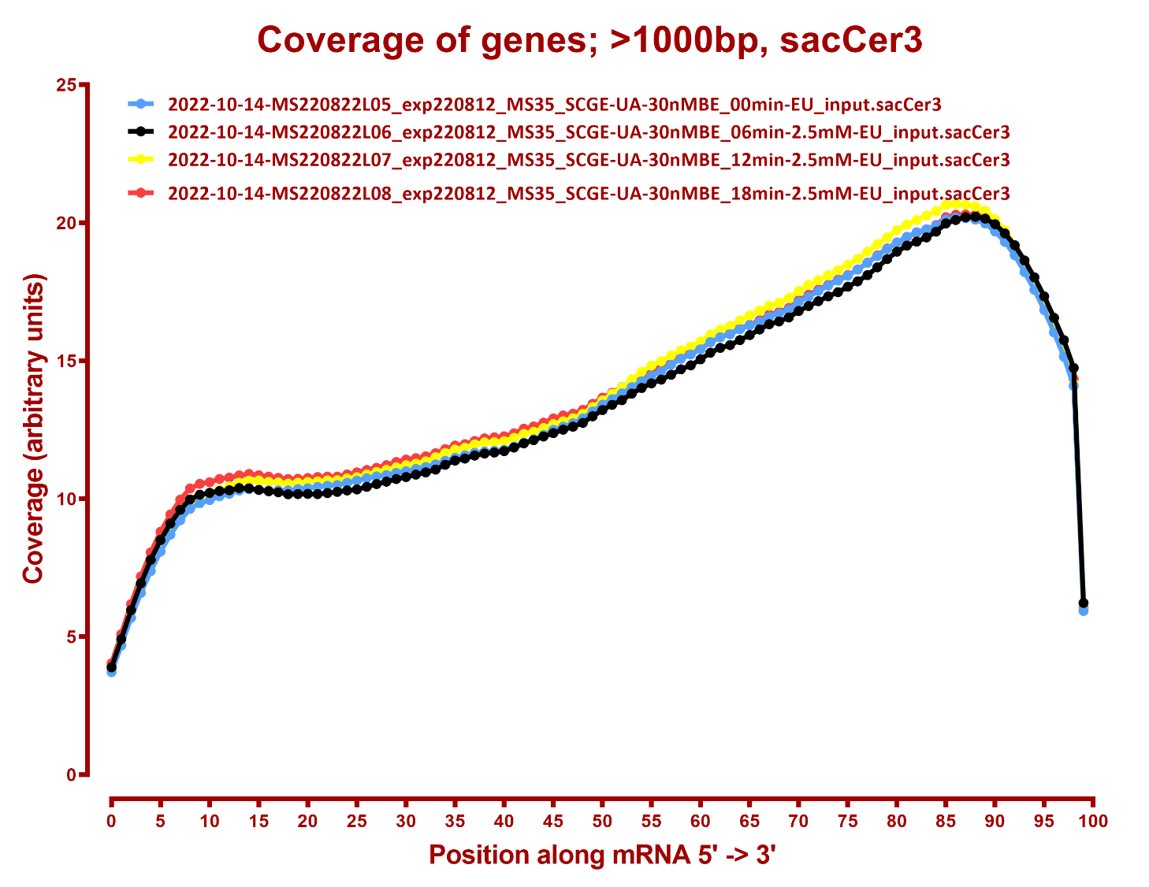

Slide 5
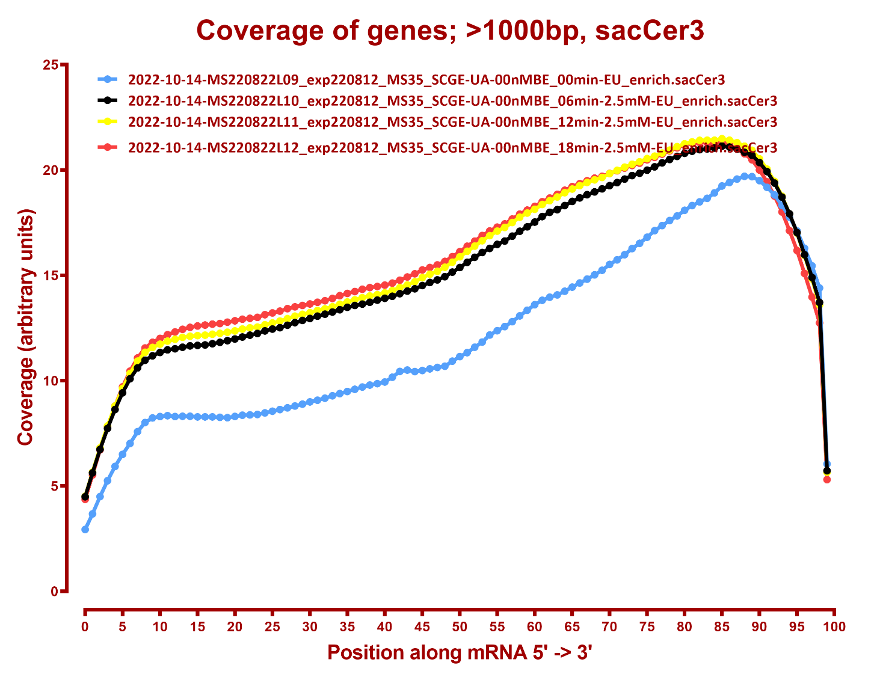

Slide 6
