Slide 1
MAPPING STATS

Slide 2
MAPPING STATS

Slide 3
READ DISTRIBUTION

Slide 4
READ DISTRIBUTION

Slide 5
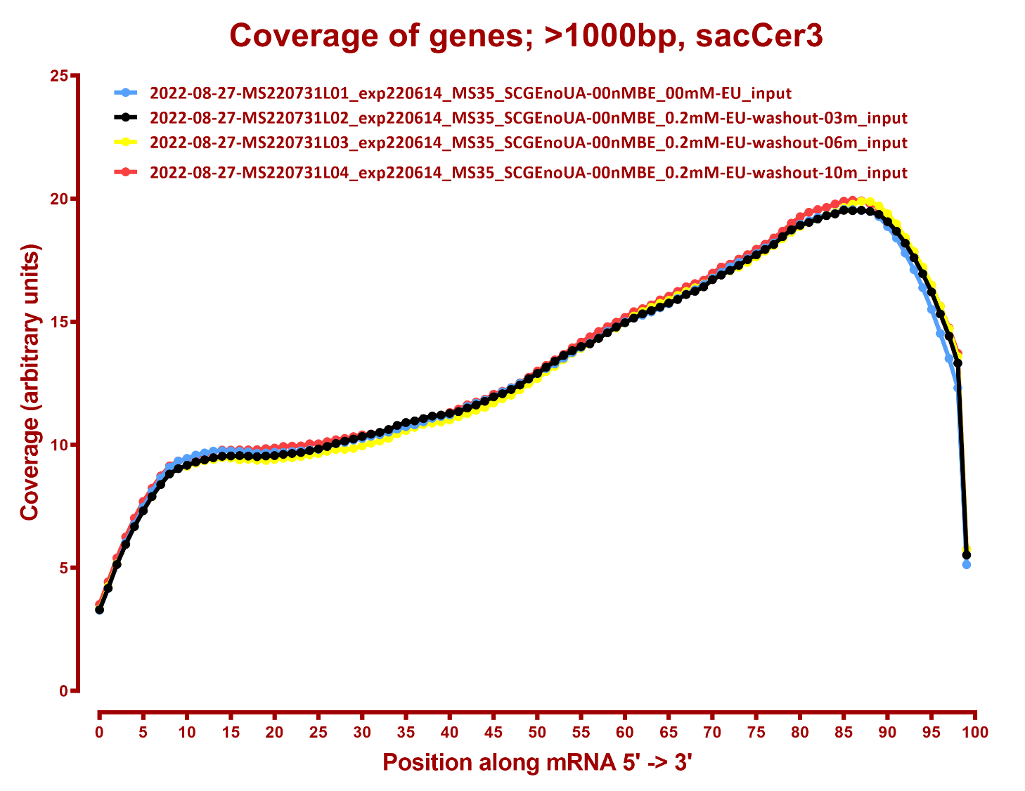
COVERAGE QC

Slide 6
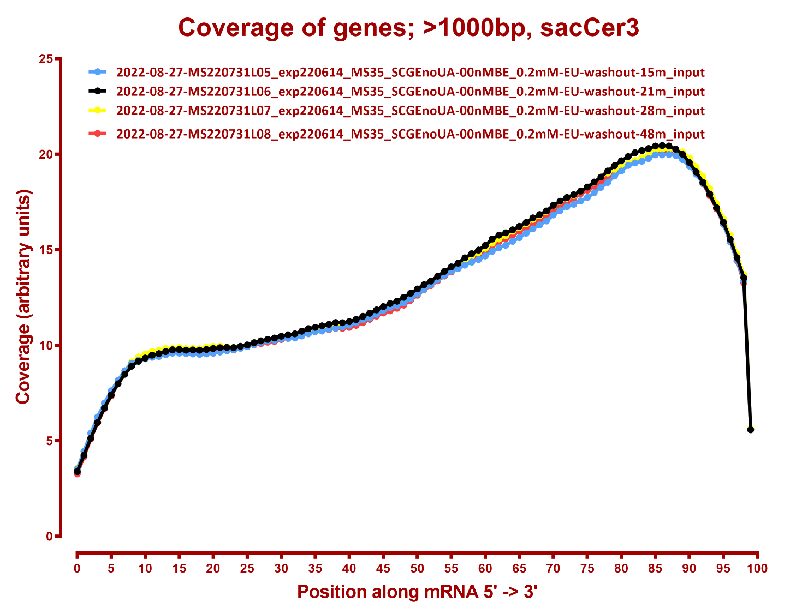

Slide 7
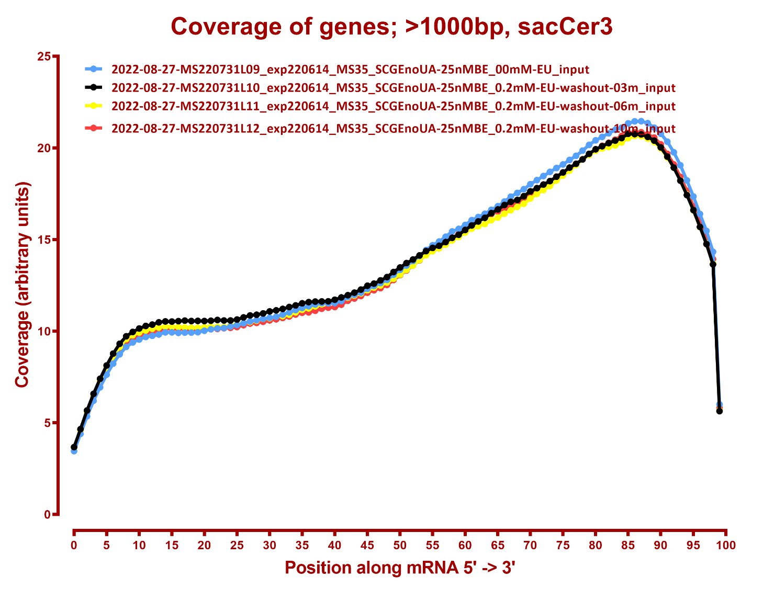

Slide 8
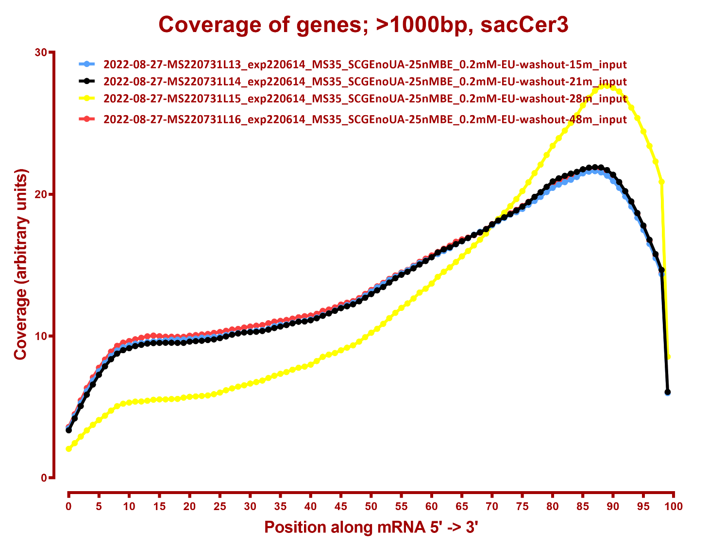

Slide 9
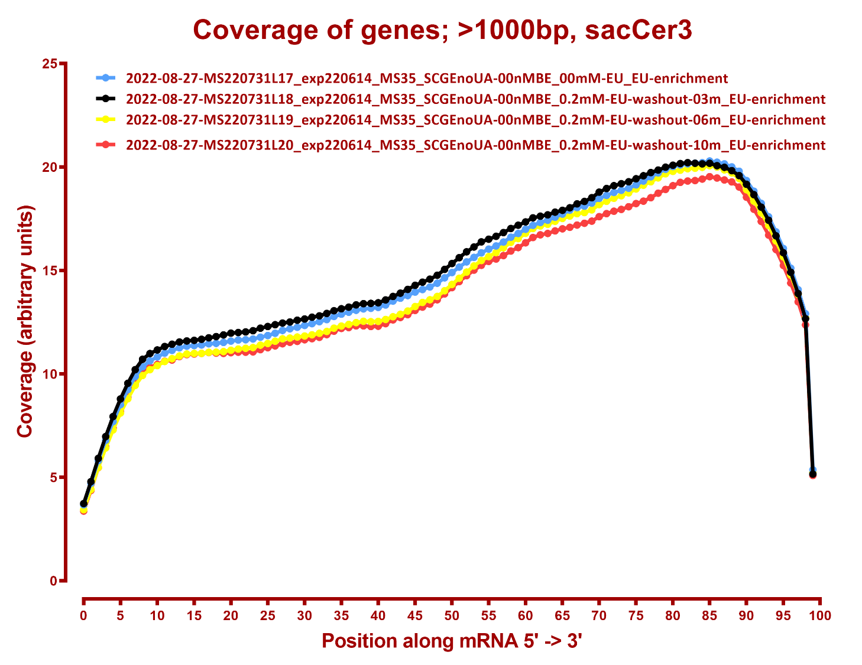

Slide 10
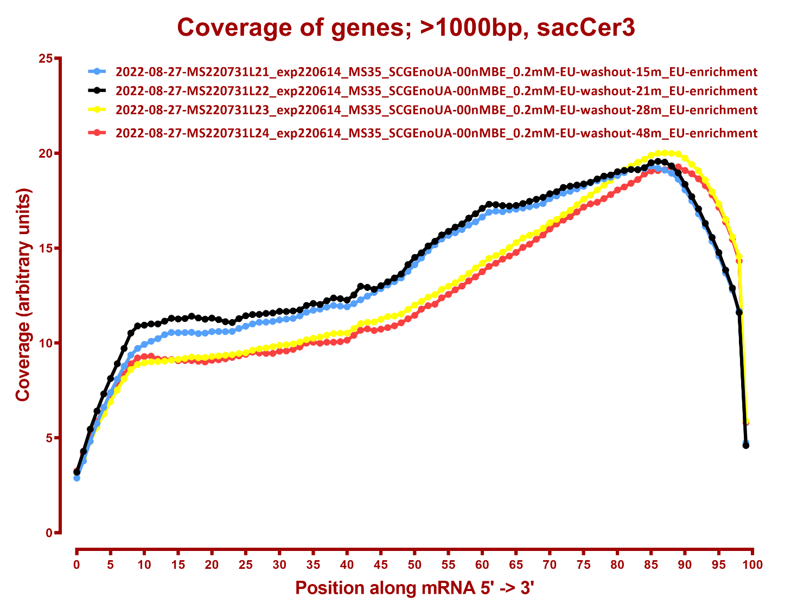

Slide 11
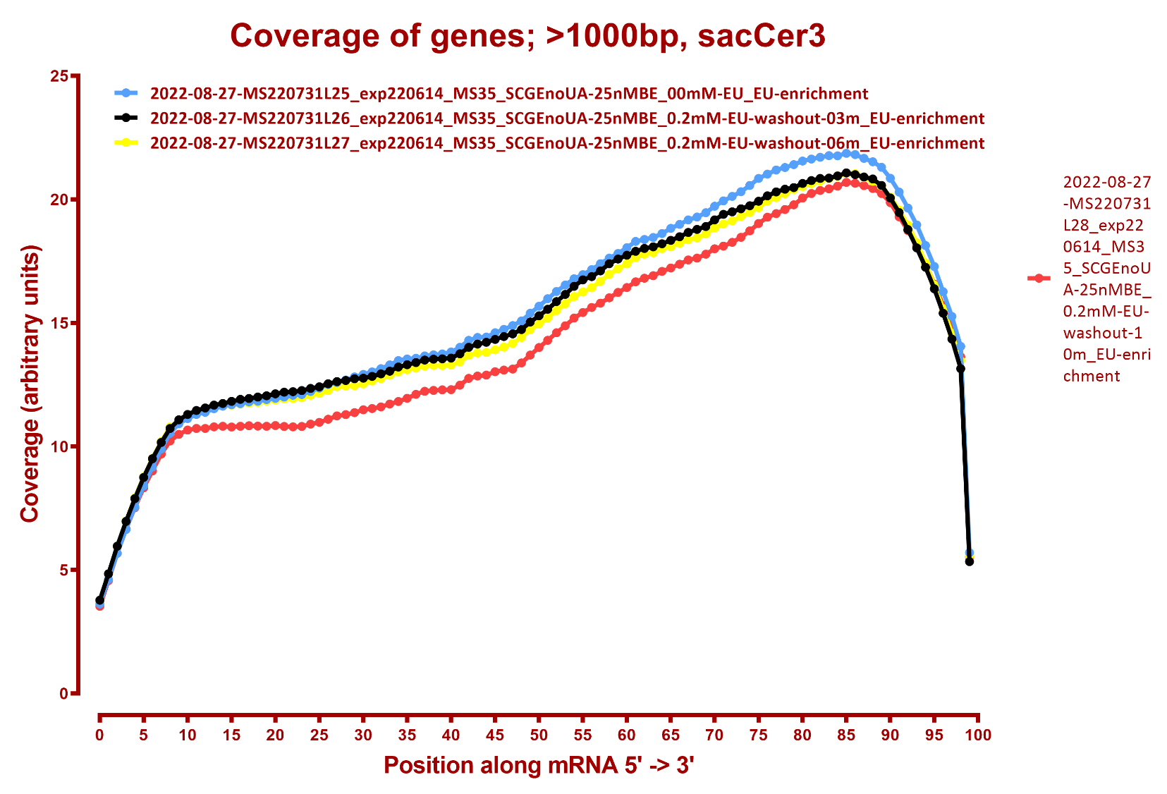

Slide 12
