Slide 1
MAPPING STATS

Slide 2
# | Exonic: | Intergenic: | Intronic:
2022-08-27-MS220819L01_exp220519_MS01_SCGE_polyA-RNA-seq | 0.92 | 0.08 | 0.00
2022-08-27-MS220819L02_exp220519_MS80_SCGE_polyA-RNA-seq | 0.92 | 0.08 | 0.00
2022-08-27-MS220819L03_exp220519_MS81_SCGE_polyA-RNA-seq | 0.92 | 0.08 | 0.00
2022-08-27-MS220819L04_exp220519_MS63_SCGE-00nMBE_polyA-RNA-seq | 0.92 | 0.08 | 0.00
2022-08-27-MS220819L05_exp220519_MS63_SCGE-04nMBE_polyA-RNA-seq | 0.92 | 0.08 | 0.00
2022-08-27-MS220819L06_exp220519_MS63_SCGE-15nMBE_polyA-RNA-seq | 0.92 | 0.08 | 0.00
2022-08-27-MS220819L07_exp220601_MS01_SCGE_polyA-RNA-seq | 0.92 | 0.08 | 0.00
2022-08-27-MS220819L08_exp220601_MS80_SCGE_polyA-RNA-seq | 0.92 | 0.08 | 0.00
2022-08-27-MS220819L09_exp220601_MS81_SCGE_polyA-RNA-seq | 0.92 | 0.08 | 0.00
2022-08-27-MS220819L10_exp220601_MS63_SCGE-00nMBE_polyA-RNA-seq | 0.92 | 0.08 | 0.00
2022-08-27-MS220819L11_exp220601_MS63_SCGE-04nMBE_polyA-RNA-seq | 0.92 | 0.08 | 0.00
2022-08-27-MS220819L12_exp220601_MS63_SCGE-15nMBE_polyA-RNA-seq | 0.92 | 0.08 | 0.00
2022-08-27-MS220819L13_exp220610_MS01_SCGE_polyA-RNA-seq | 0.92 | 0.08 | 0.00
2022-08-27-MS220819L14_exp220610_MS80_SCGE_polyA-RNA-seq | 0.92 | 0.08 | 0.00
2022-08-27-MS220819L15_exp220610_MS81_SCGE_polyA-RNA-seq | 0.92 | 0.08 | 0.00
2022-08-27-MS220819L16_exp220610_MS63_SCGE-00nMBE_polyA-RNA-seq | 0.92 | 0.08 | 0.00
2022-08-27-MS220819L17_exp220610_MS63_SCGE-3.5nMBE_polyA-RNA-seq | 0.92 | 0.08 | 0.00
2022-08-27-MS220819L18_exp220610_MS63_SCGE-16nMBE_polyA-RNA-seq | 0.92 | 0.08 | 0.00
2022-08-27-MS220819L19_exp220607_MS01_SCGE_polyA-RNA-seq | 0.92 | 0.08 | 0.00
2022-08-27-MS220819L20_exp220607_MS80_SCGE_polyA-RNA-seq | 0.92 | 0.08 | 0.00
2022-08-27-MS220819L21_exp220607_MS81_SCGE_polyA-RNA-seq | 0.92 | 0.08 | 0.00
2022-08-27-MS220819L22_exp220607_MS63_SCGE-00nMBE_polyA-RNA-seq | 0.92 | 0.08 | 0.00
2022-08-27-MS220819L23_exp220607_MS63_SCGE-3.5nMBE_polyA-RNA-seq | 0.92 | 0.08 | 0.00
2022-08-27-MS220819L24_exp220607_MS63_SCGE-16nMBE_polyA-RNA-seq | 0.92 | 0.08 | 0.00

Slide 3
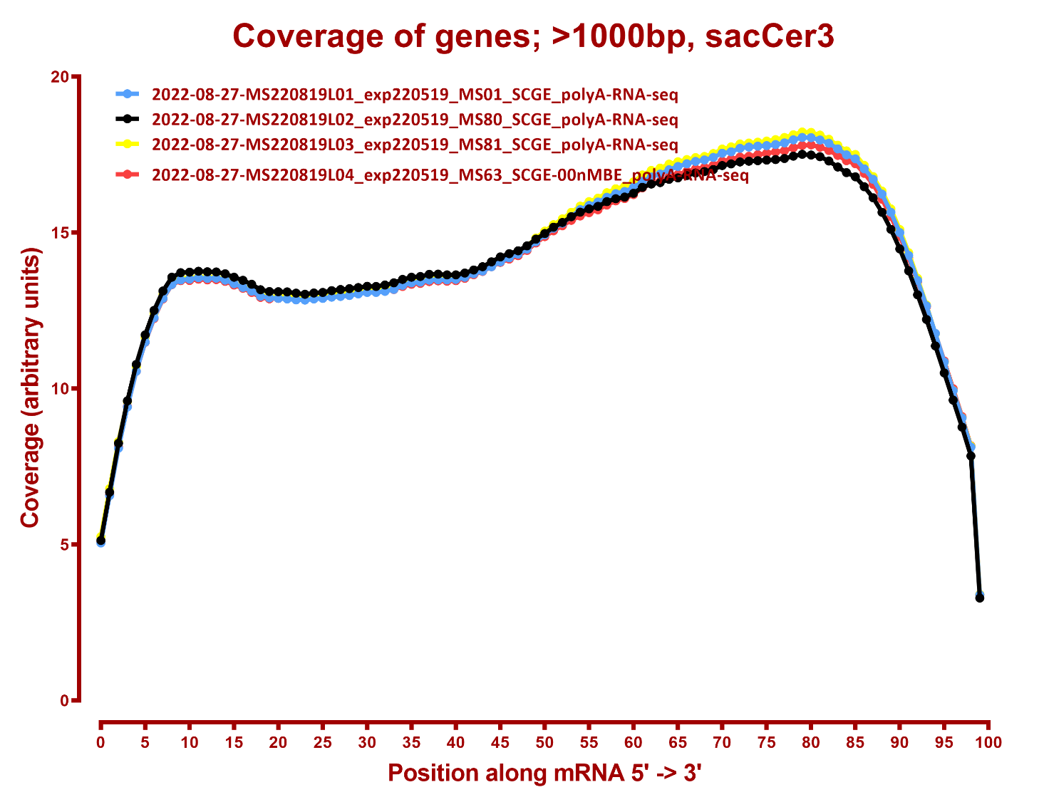
COVERAGE ALL READS

Slide 4
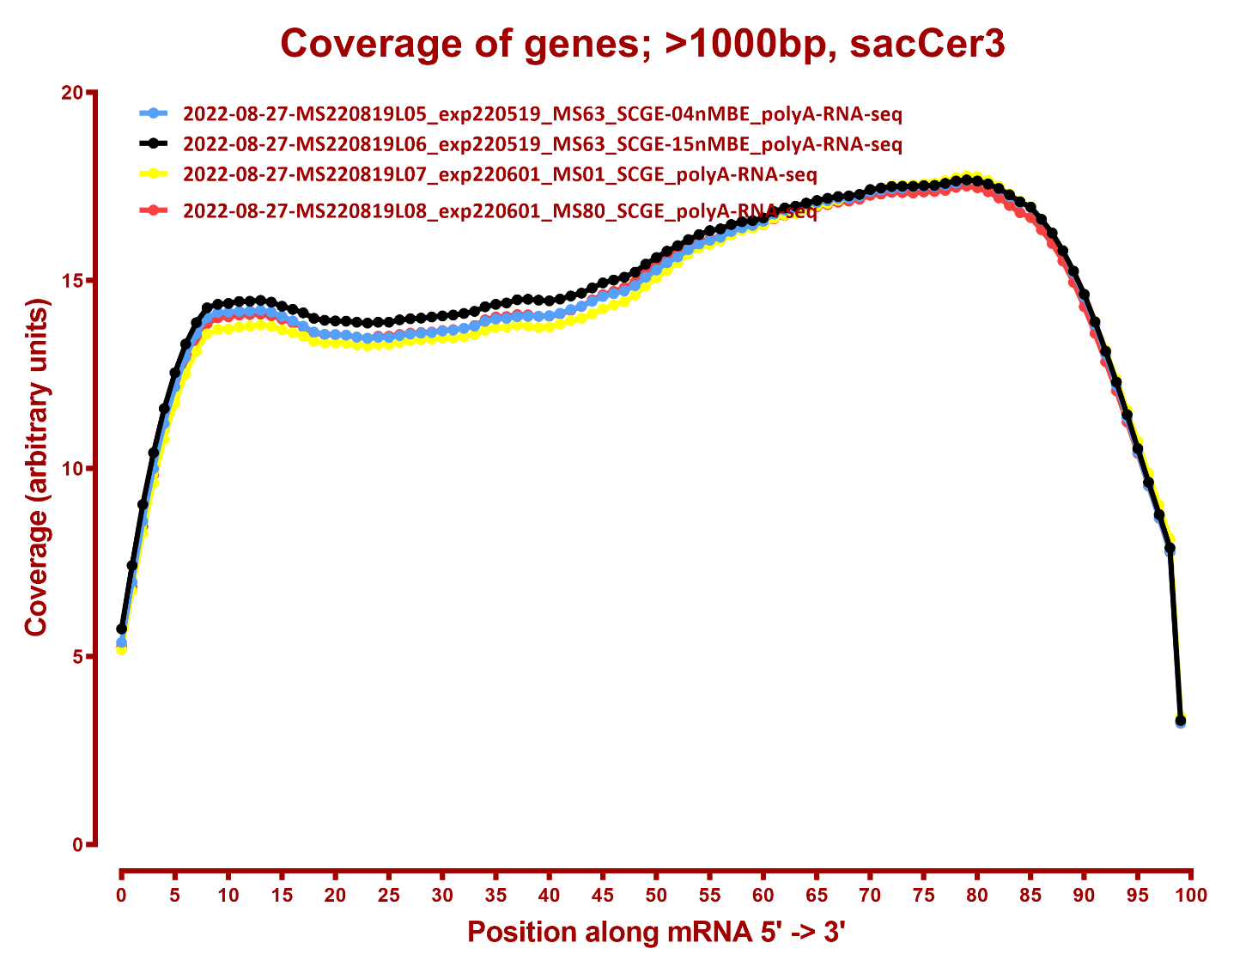

Slide 5
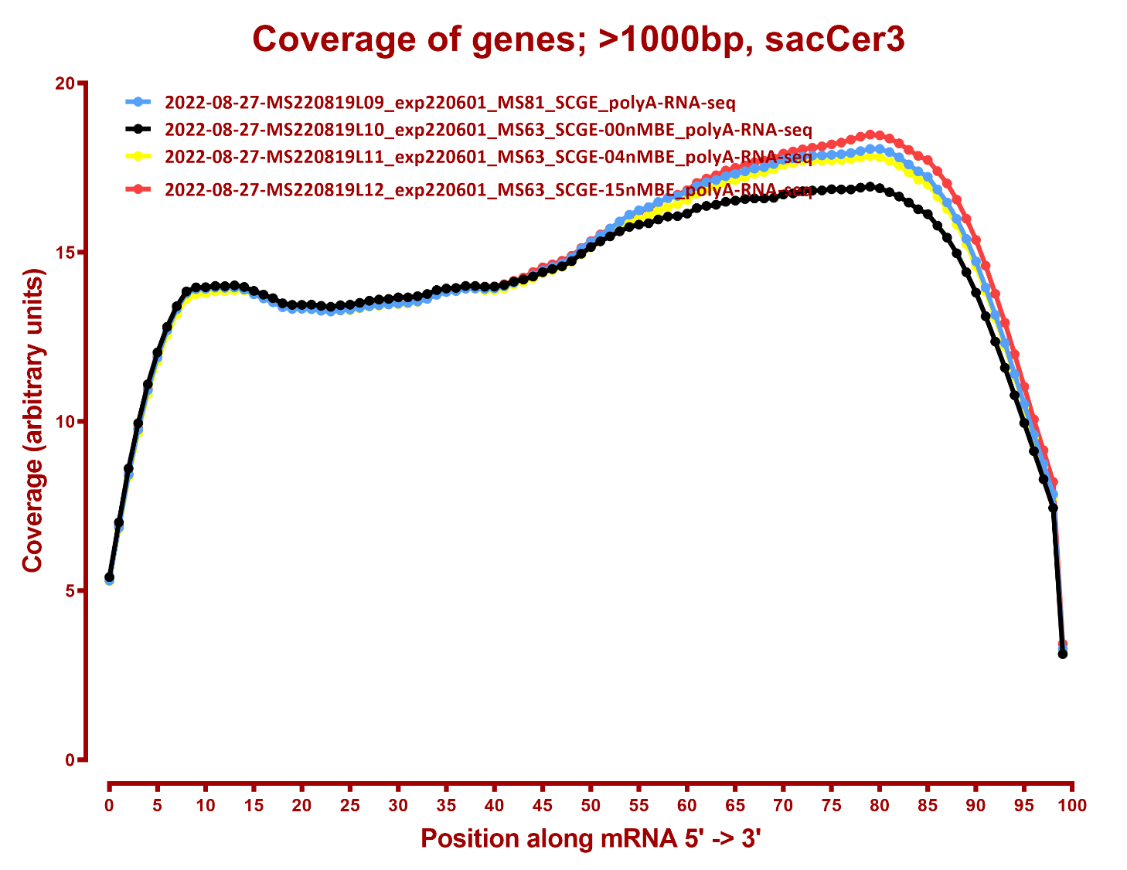

Slide 6
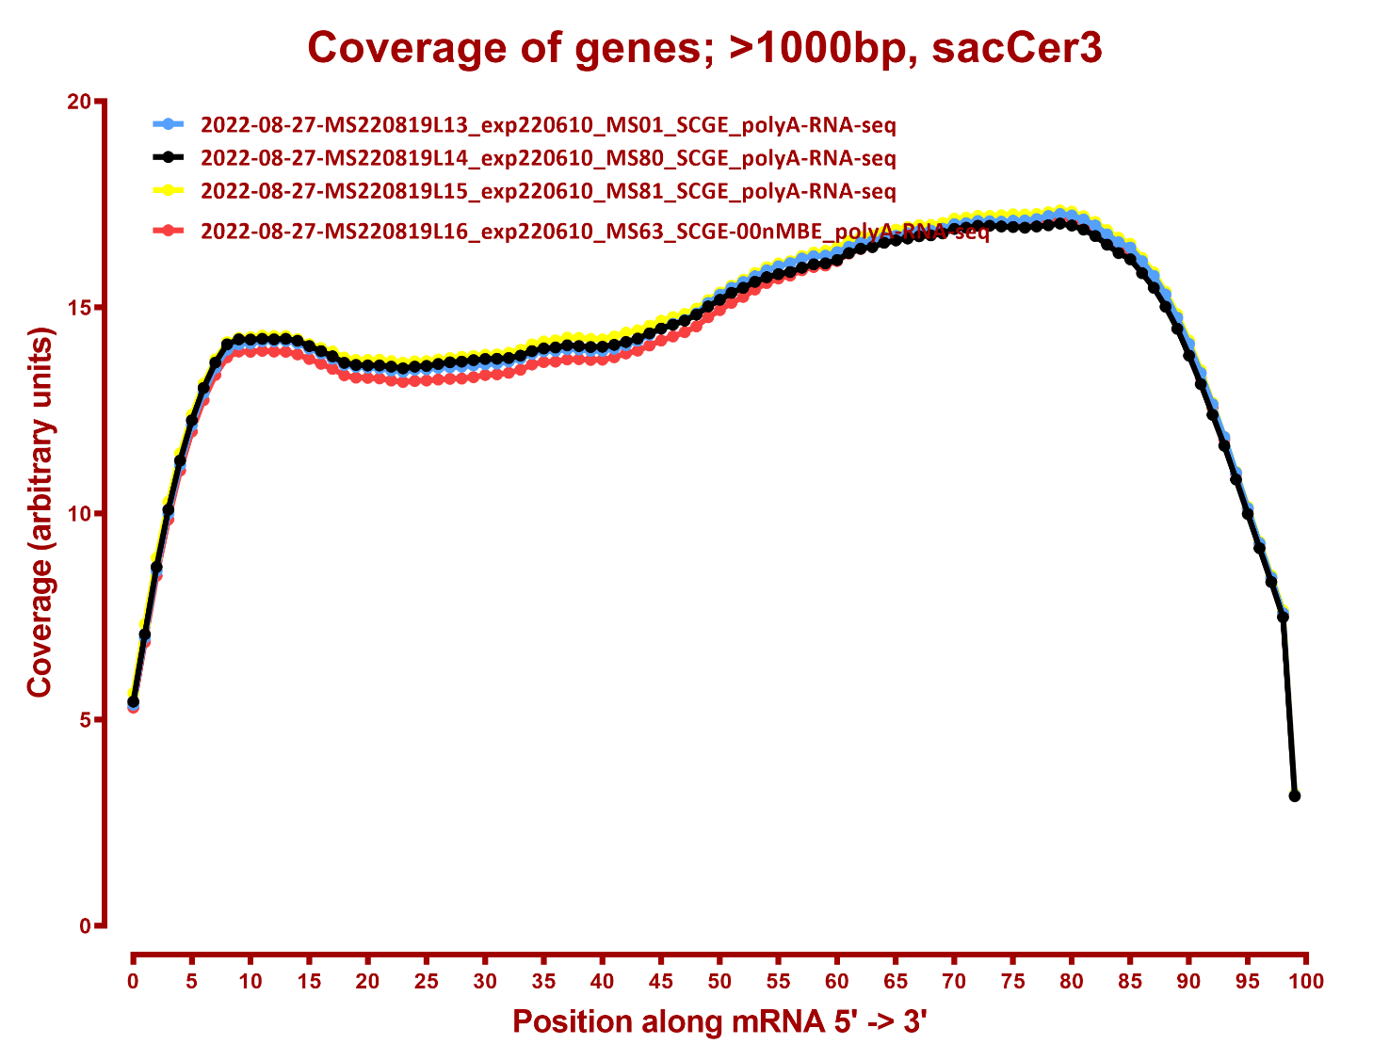

Slide 7
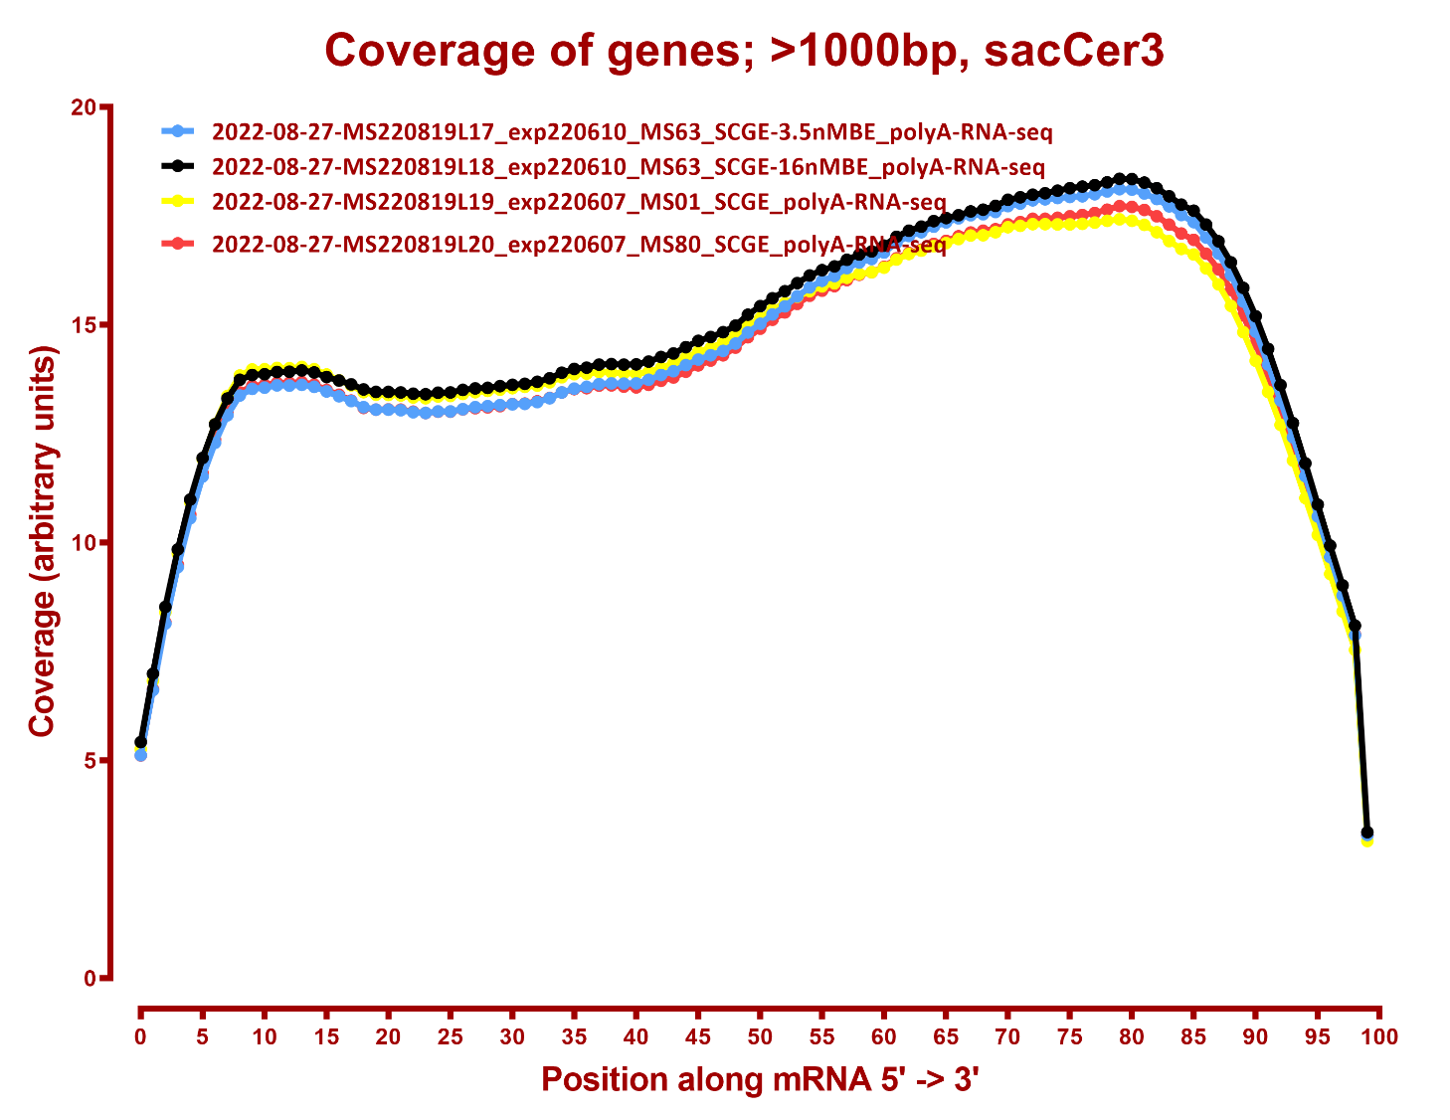

Slide 8
