Slide 1
MAPPING STATS

Slide 3
# | Exonic: | Intergenic: | Intronic:
2022-04-20-220328R01_exp211025_MS64_SCGE_F1_polyA-RNA-seq.sacCer3 | 0.91 | 0.09 | 0.00
2022-04-20-220328R02_exp211025_MS64_SCGE_F2_polyA-RNA-seq.sacCer3 | 0.91 | 0.08 | 0.00
2022-04-20-220328R03_exp211025_MS64_SCGE_F3_polyA-RNA-seq.sacCer3 | 0.91 | 0.08 | 0.00
2022-04-20-220328R04_exp211025_MS64_SCGE_F4_polyA-RNA-seq.sacCer3 | 0.91 | 0.09 | 0.00
2022-04-20-220328R05_exp211025_MS64_SCGE_F5_polyA-RNA-seq.sacCer3 | 0.91 | 0.08 | 0.00
2022-04-20-220328R06_exp211025_MS64_SCGE_F6_polyA-RNA-seq.sacCer3 | 0.92 | 0.08 | 0.00
2022-04-20-220328R07_exp211025_MS64_SCGE_F7_polyA-RNA-seq.sacCer3 | 0.91 | 0.09 | 0.00
2022-04-20-220328R08_exp211021_MS67_SCGE_F1_polyA-RNA-seq.sacCer3 | 0.91 | 0.08 | 0.00
2022-04-20-220328R09_exp211021_MS67_SCGE_F2_polyA-RNA-seq.sacCer3 | 0.92 | 0.08 | 0.00
2022-04-20-220328R10_exp211021_MS67_SCGE_F3_polyA-RNA-seq.sacCer3 | 0.91 | 0.08 | 0.00
2022-04-20-220328R11_exp211021_MS67_SCGE_F4_polyA-RNA-seq.sacCer3 | 0.92 | 0.08 | 0.00
2022-04-20-220328R12_exp211021_MS67_SCGE_F5_polyA-RNA-seq.sacCer3 | 0.92 | 0.08 | 0.00
2022-04-20-220328R13_exp211021_MS67_SCGE_F6_polyA-RNA-seq.sacCer3 | 0.92 | 0.08 | 0.00
2022-04-20-220328R14_exp211021_MS67_SCGE_F7_polyA-RNA-seq.sacCer3 | 0.92 | 0.08 | 0.00
2022-04-20-220328R15_exp211028_MS64_SCGE_F1_polyA-RNA-seq.sacCer3 | 0.91 | 0.09 | 0.00
2022-04-20-220328R16_exp211028_MS64_SCGE_F2_polyA-RNA-seq.sacCer3 | 0.91 | 0.08 | 0.00
2022-04-20-220328R17_exp211028_MS64_SCGE_F3_polyA-RNA-seq.sacCer3 | 0.92 | 0.08 | 0.00
2022-04-20-220328R18_exp211028_MS64_SCGE_F4_polyA-RNA-seq.sacCer3 | 0.92 | 0.08 | 0.00
2022-04-20-220328R19_exp211028_MS64_SCGE_F5_polyA-RNA-seq.sacCer3 | 0.92 | 0.08 | 0.00
2022-04-20-220328R20_exp211028_MS64_SCGE_F6_polyA-RNA-seq.sacCer3 | 0.91 | 0.08 | 0.00
2022-04-20-220328R21_exp211028_MS64_SCGE_F7_polyA-RNA-seq.sacCer3 | 0.91 | 0.09 | 0.00
2022-04-20-220328R22_exp211101_MS67_SCGE_F1_polyA-RNA-seq.sacCer3 | 0.92 | 0.08 | 0.00
2022-04-20-220328R23_exp211101_MS67_SCGE_F2_polyA-RNA-seq.sacCer3 | 0.92 | 0.08 | 0.00
2022-04-20-220328R24_exp211101_MS67_SCGE_F3_polyA-RNA-seq.sacCer3 | 0.92 | 0.08 | 0.00
2022-04-20-220328R25_exp211101_MS67_SCGE_F4_polyA-RNA-seq.sacCer3 | 0.92 | 0.08 | 0.00
2022-04-20-220328R26_exp211101_MS67_SCGE_F5_polyA-RNA-seq.sacCer3 | 0.92 | 0.08 | 0.00
2022-04-20-220328R27_exp211101_MS67_SCGE_F6_polyA-RNA-seq.sacCer3 | 0.92 | 0.08 | 0.00

Slide 4
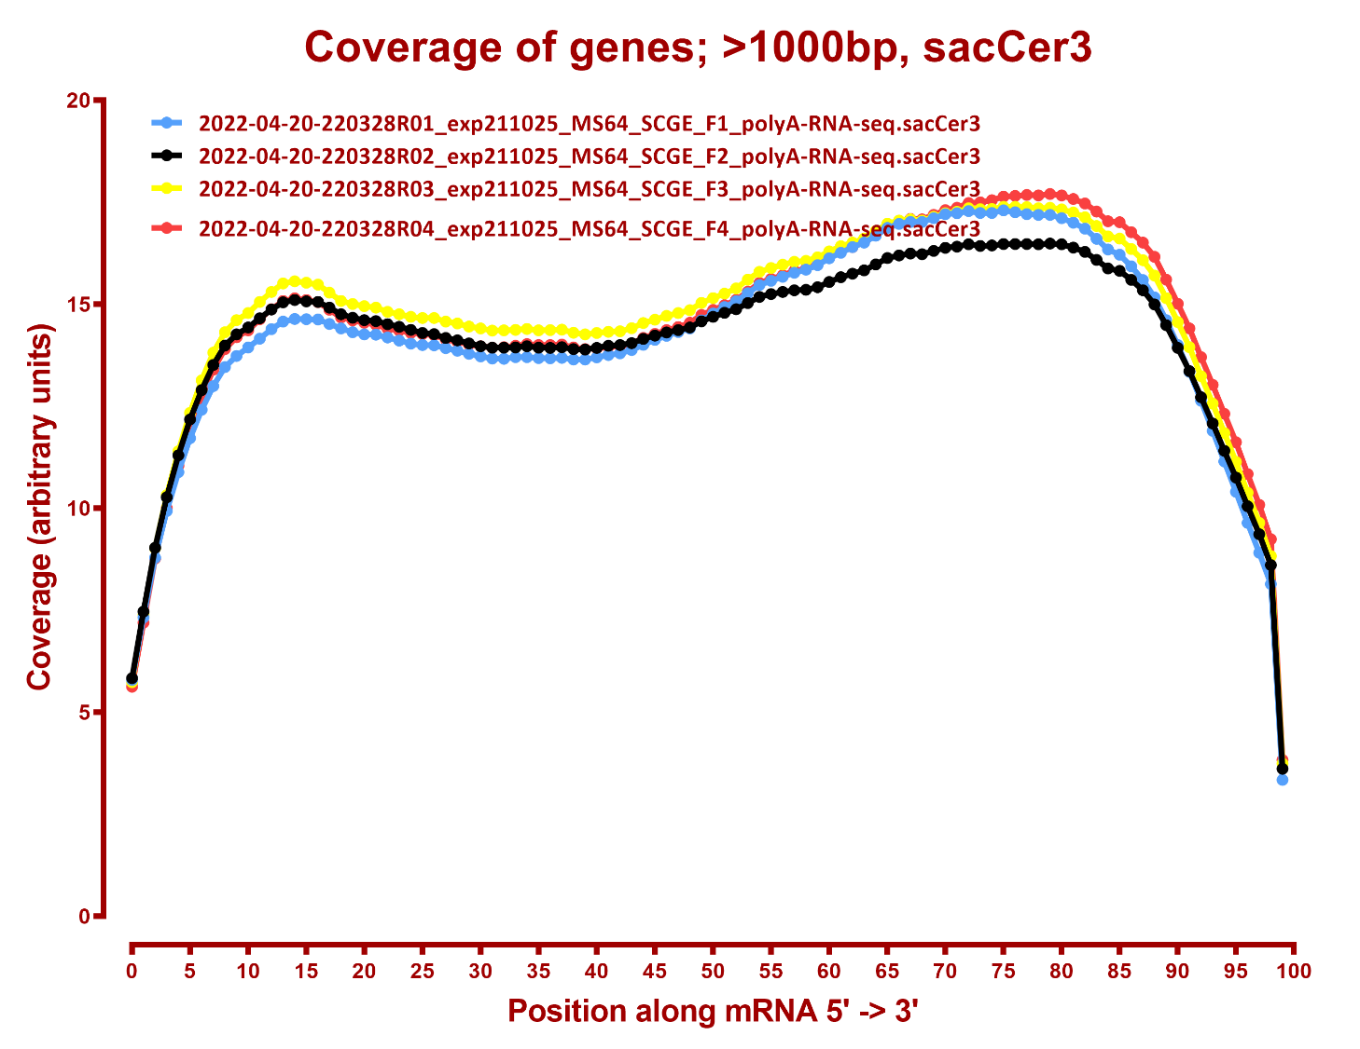
COVERAGE ALL READS

Slide 5
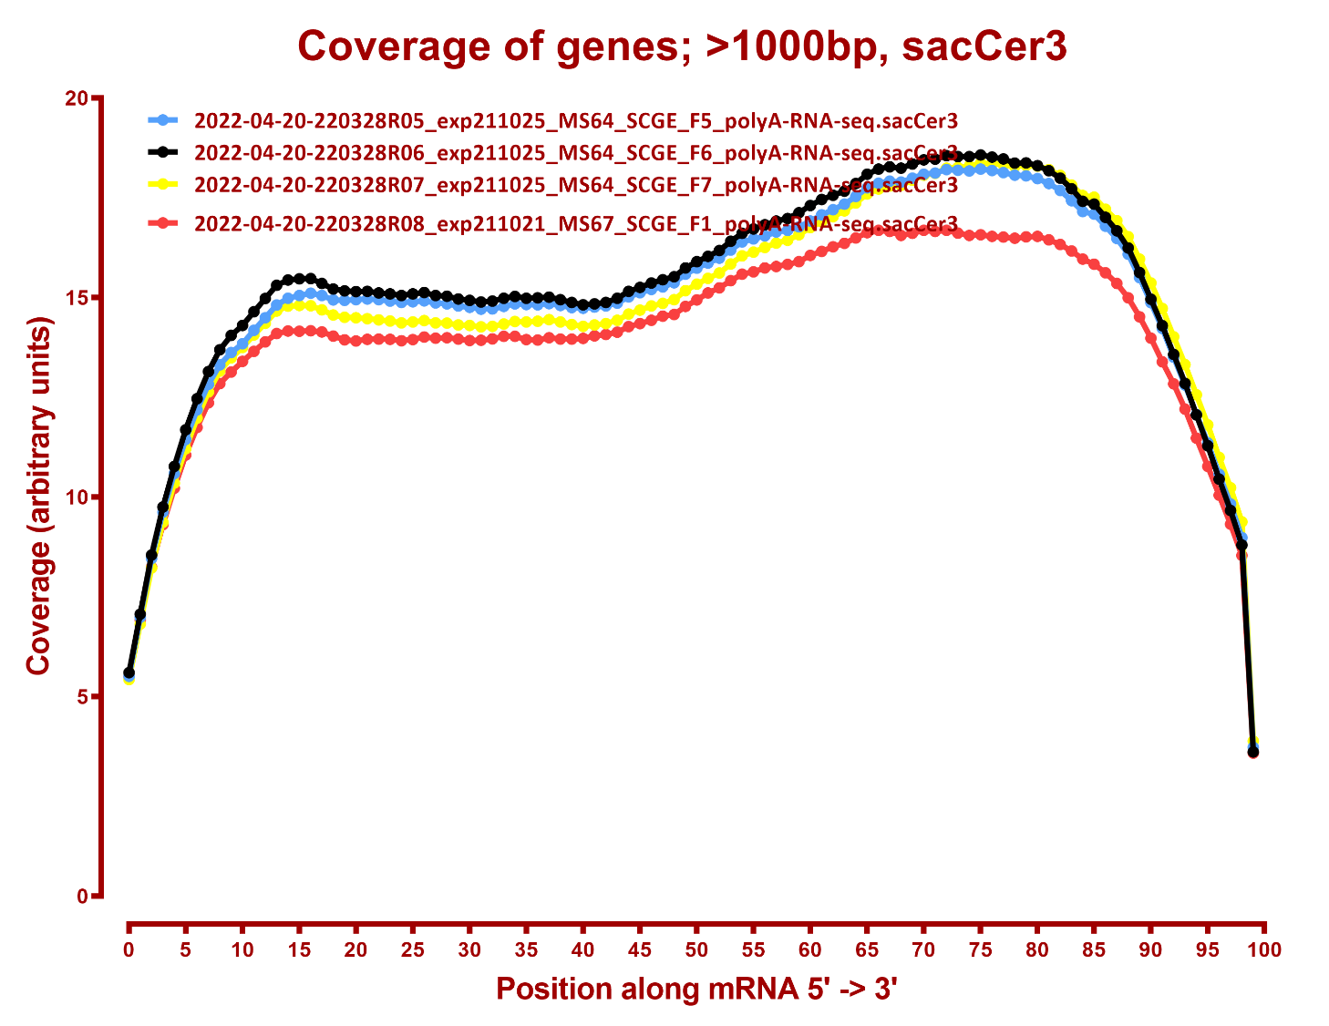

Slide 6
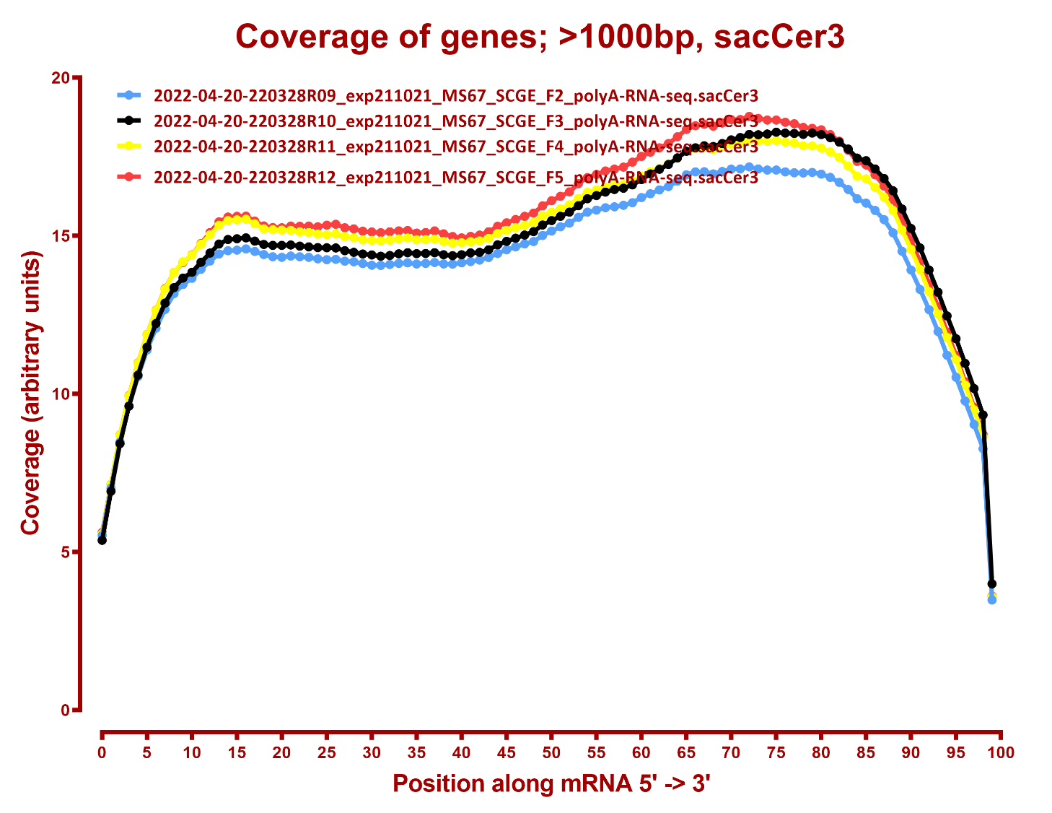

Slide 7
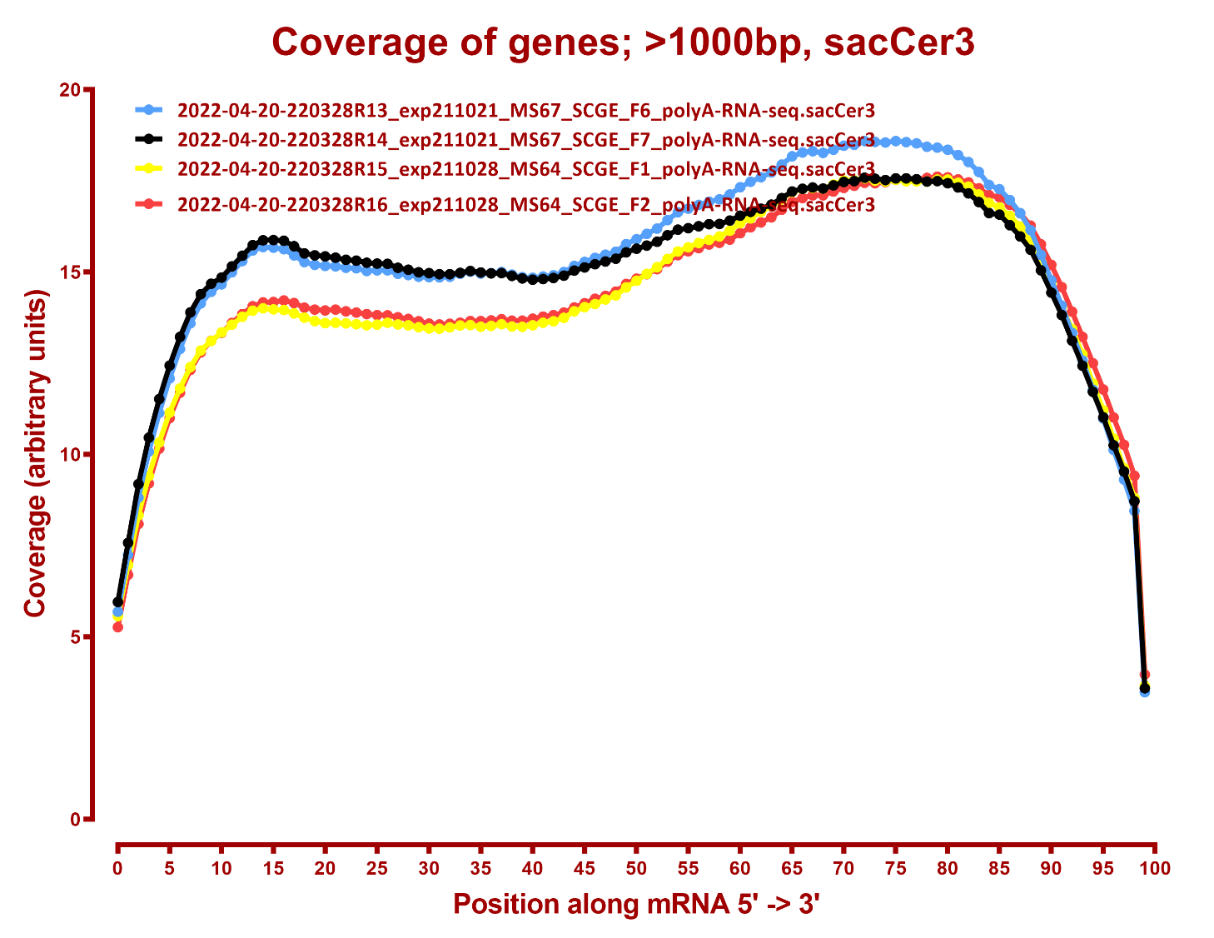

Slide 8
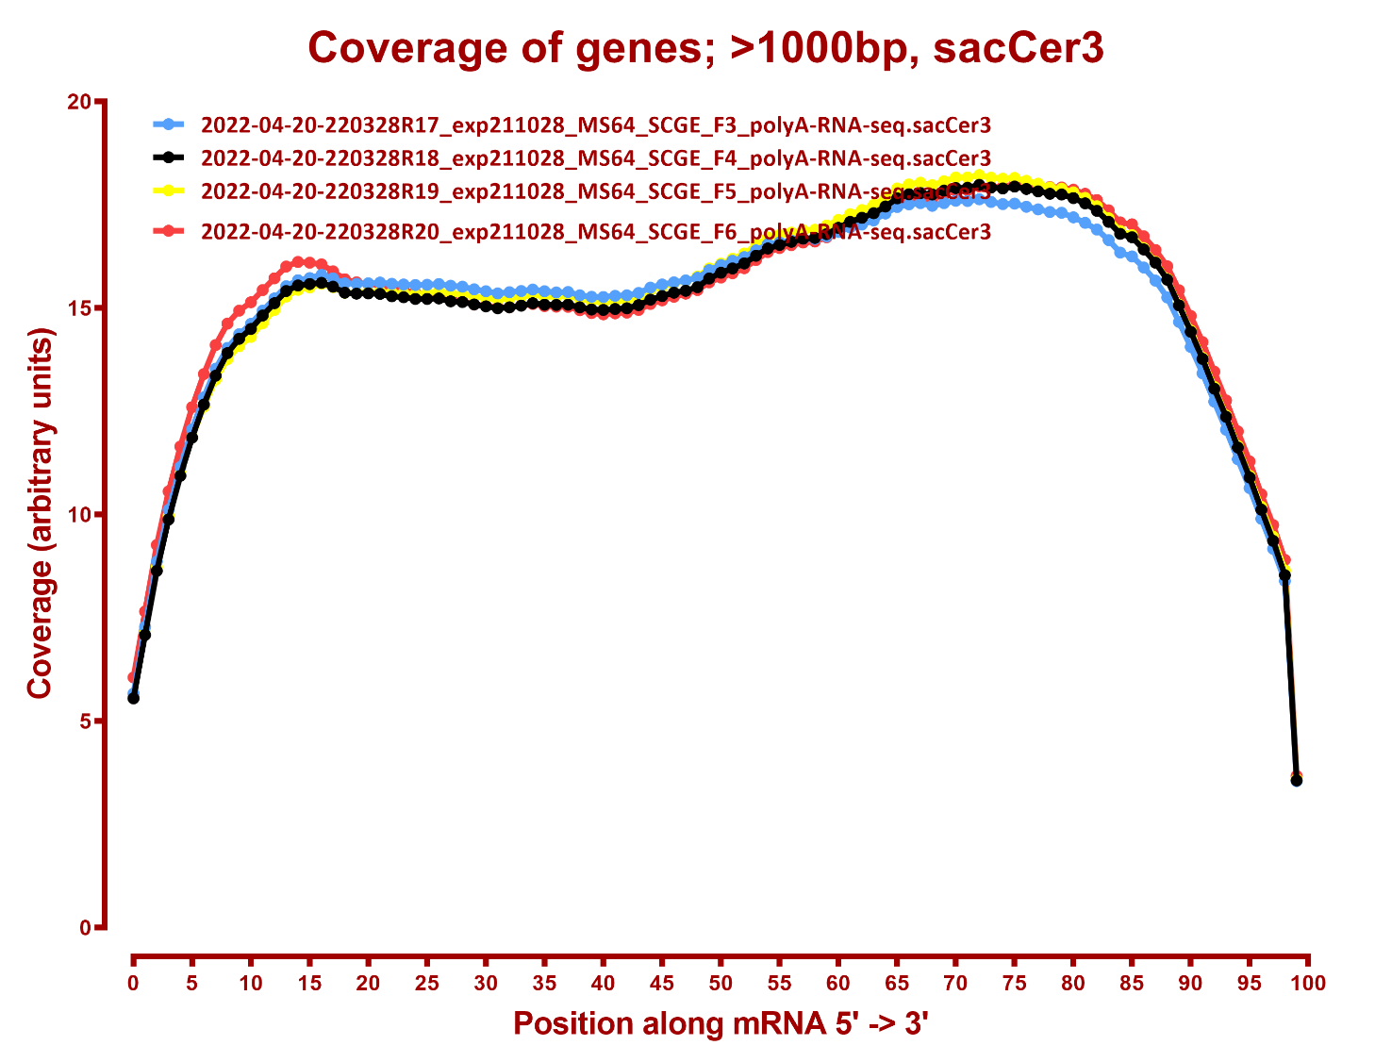

Slide 9
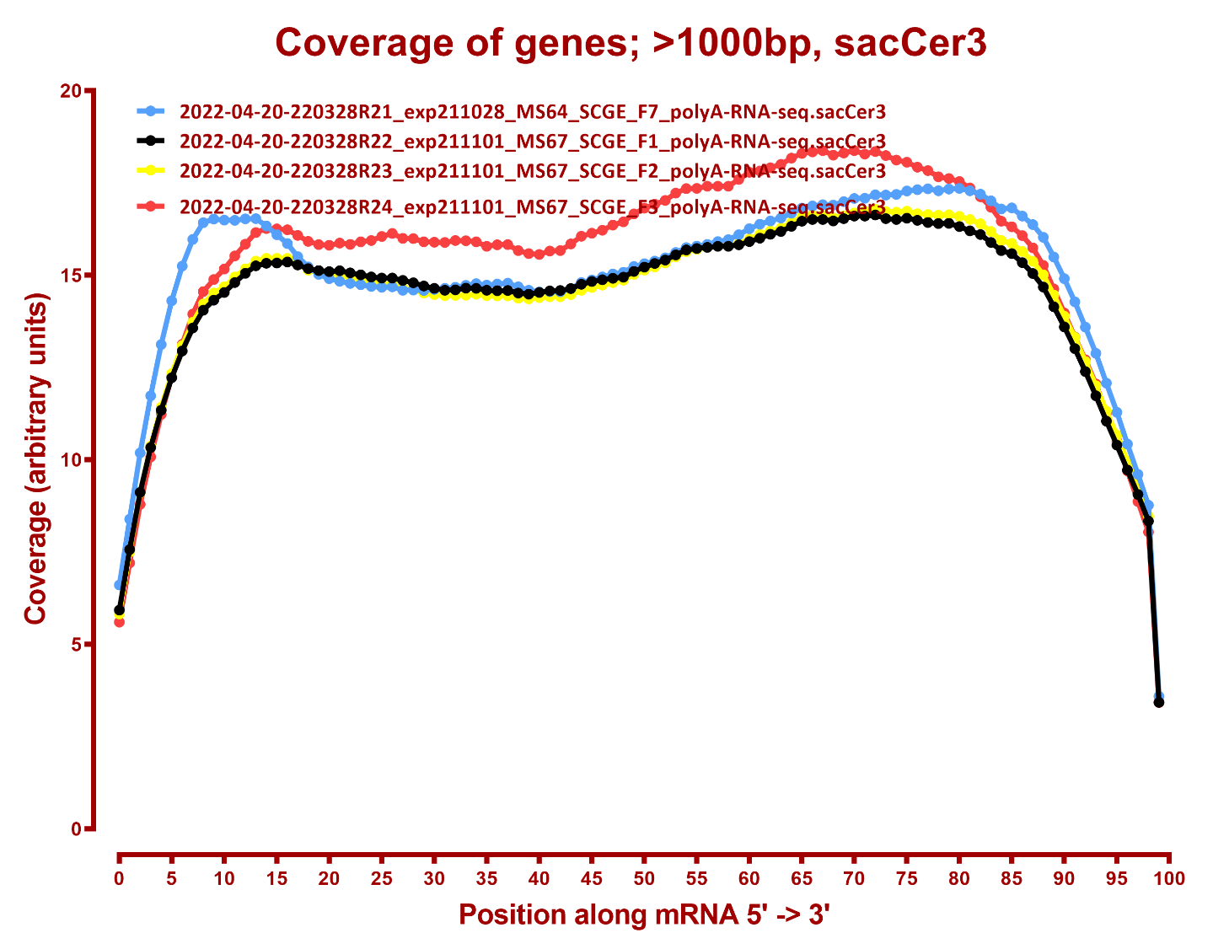

Slide 10
