Slide 1
MAPPING STATS

Slide 3
# | Exonic: | Intergenic: | Intronic:
2021-11-12-exp210929_MS63_SCGElowURA_00nMBE_00min4TU_elutionRNA.sacCer3 | 0.97 | 0.03 | 0.00
2021-11-12-exp210929_MS63_SCGElowURA_00nMBE_00min4TU_flowthroughRNA.sacCer3 | 0.96 | 0.04 | 0.01
2021-11-12-exp210929_MS63_SCGElowURA_00nMBE_00min4TU_inputRNA.sacCer3 | 0.96 | 0.04 | 0.01
2021-11-12-exp210929_MS63_SCGElowURA_00nMBE_05min4TU_elutionRNA.sacCer3 | 0.96 | 0.03 | 0.00
2021-11-12-exp210929_MS63_SCGElowURA_00nMBE_05min4TU_flowthroughRNA.sacCer3 | 0.96 | 0.03 | 0.01
2021-11-12-exp210929_MS63_SCGElowURA_00nMBE_05min4TU_inputRNA.sacCer3 | 0.96 | 0.04 | 0.01
2021-11-12-exp210929_MS63_SCGElowURA_00nMBE_10min4TU_elutionRNA.sacCer3 | 0.97 | 0.02 | 0.00
2021-11-12-exp210929_MS63_SCGElowURA_00nMBE_10min4TU_flowthroughRNA.sacCer3 | 0.96 | 0.03 | 0.01
2021-11-12-exp210929_MS63_SCGElowURA_00nMBE_10min4TU_inputRNA.sacCer3 | 0.96 | 0.03 | 0.01
2021-11-12-exp210929_MS63_SCGElowURA_05nMBE_00min4TU_elutionRNA.sacCer3 | 0.97 | 0.02 | 0.00
2021-11-12-exp210929_MS63_SCGElowURA_05nMBE_00min4TU_flowthroughRNA.sacCer3 | 0.96 | 0.04 | 0.01
2021-11-12-exp210929_MS63_SCGElowURA_05nMBE_00min4TU_inputRNA.sacCer3 | 0.96 | 0.04 | 0.01
2021-11-12-exp210929_MS63_SCGElowURA_05nMBE_05min4TU_elutionRNA.sacCer3 | 0.97 | 0.03 | 0.00
2021-11-12-exp210929_MS63_SCGElowURA_05nMBE_05min4TU_flowthroughRNA.sacCer3 | 0.96 | 0.04 | 0.01
2021-11-12-exp210929_MS63_SCGElowURA_05nMBE_05min4TU_inputRNA.sacCer3 | 0.96 | 0.04 | 0.01
2021-11-12-exp210929_MS63_SCGElowURA_05nMBE_10min4TU_elutionRNA.sacCer3 | 0.96 | 0.03 | 0.00
2021-11-12-exp210929_MS63_SCGElowURA_05nMBE_10min4TU_flowthroughRNA.sacCer3 | 0.96 | 0.03 | 0.01
2021-11-12-exp210929_MS63_SCGElowURA_05nMBE_10min4TU_inputRNA.sacCer3 | 0.96 | 0.03 | 0.01
2021-11-12-exp210929_MS63_SCGElowURA_15nMBE_00min4TU_elutionRNA.sacCer3 | 0.97 | 0.03 | 0.00
2021-11-12-exp210929_MS63_SCGElowURA_15nMBE_00min4TU_flowthroughRNA.sacCer3 | 0.96 | 0.03 | 0.01
2021-11-12-exp210929_MS63_SCGElowURA_15nMBE_00min4TU_inputRNA.sacCer3 | 0.96 | 0.03 | 0.01
2021-11-12-exp210929_MS63_SCGElowURA_15nMBE_05min4TU_elutionRNA.sacCer3 | 0.97 | 0.03 | 0.00
2021-11-12-exp210929_MS63_SCGElowURA_15nMBE_05min4TU_flowthroughRNA.sacCer3 | 0.96 | 0.04 | 0.01
2021-11-12-exp210929_MS63_SCGElowURA_15nMBE_05min4TU_inputRNA.sacCer3 | 0.96 | 0.04 | 0.01
2021-11-12-exp210929_MS63_SCGElowURA_15nMBE_10min4TU_elutionRNA.sacCer3 | 0.97 | 0.03 | 0.00
2021-11-12-exp210929_MS63_SCGElowURA_15nMBE_10min4TU_flowthroughRNA.sacCer3 | 0.96 | 0.03 | 0.01
2021-11-12-exp210929_MS63_SCGElowURA_15nMBE_10min4TU_inputRNA.sacCer3 | 0.96 | 0.03 | 0.01

Slide 4
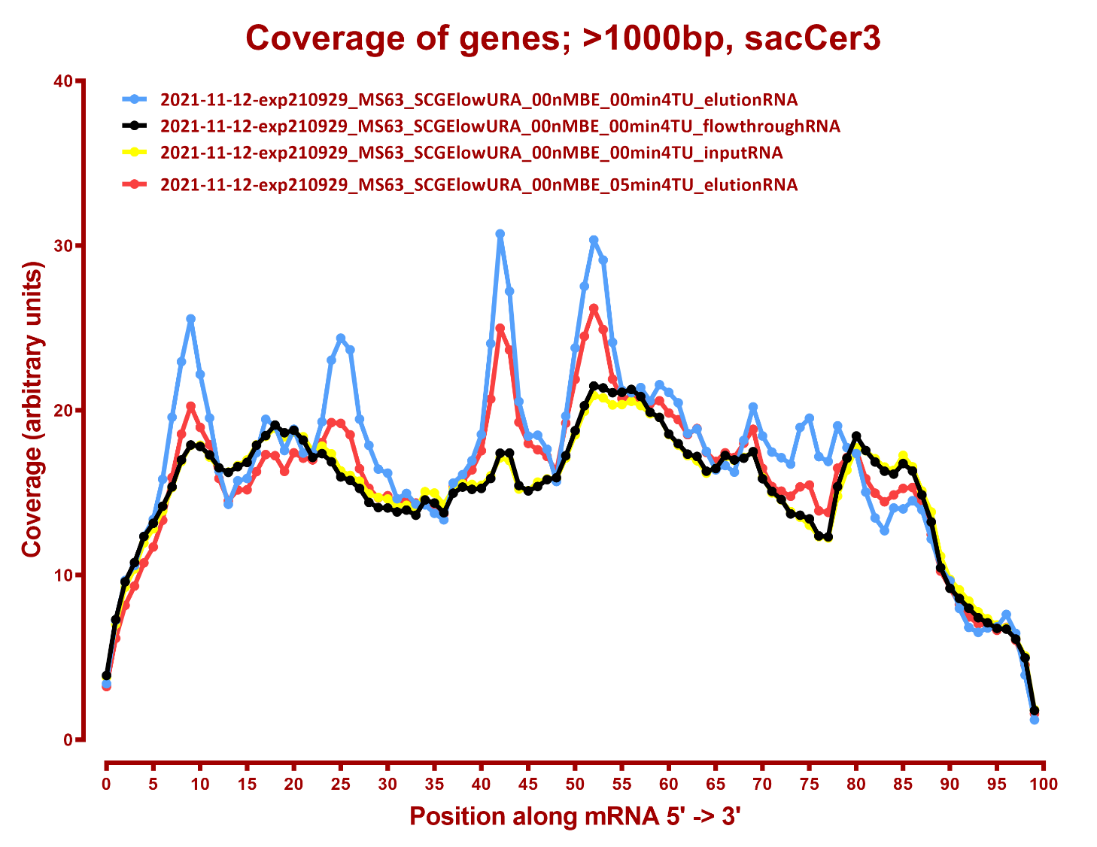
COVERAGE ALL READS

Slide 5
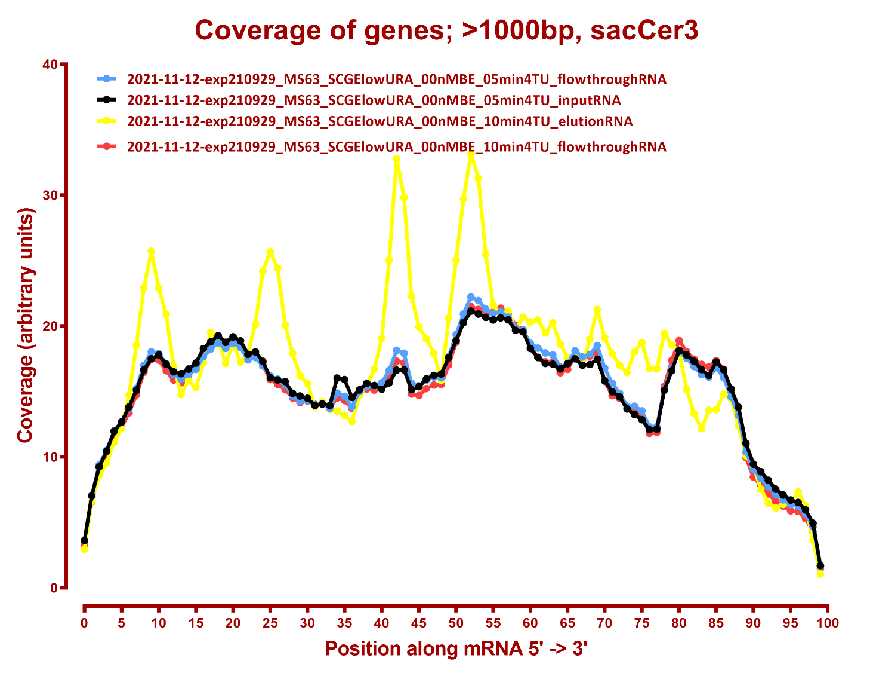

Slide 6
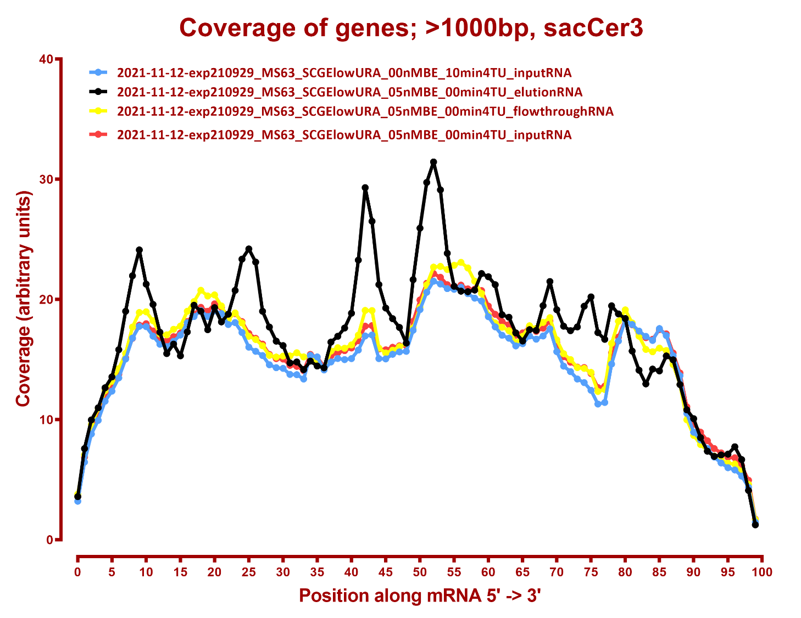

Slide 7
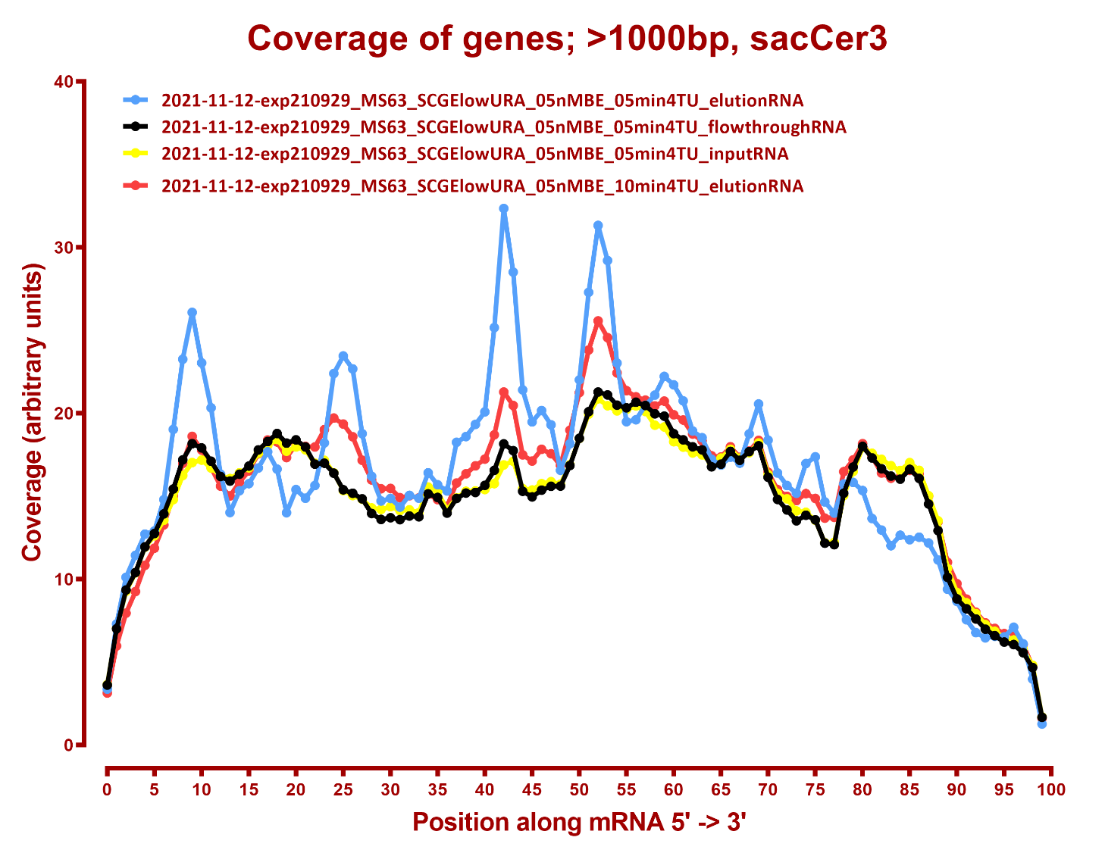

Slide 8
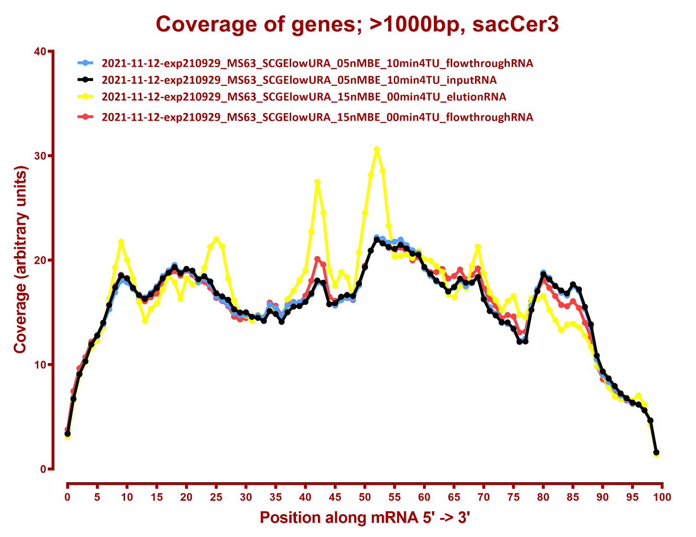

Slide 9
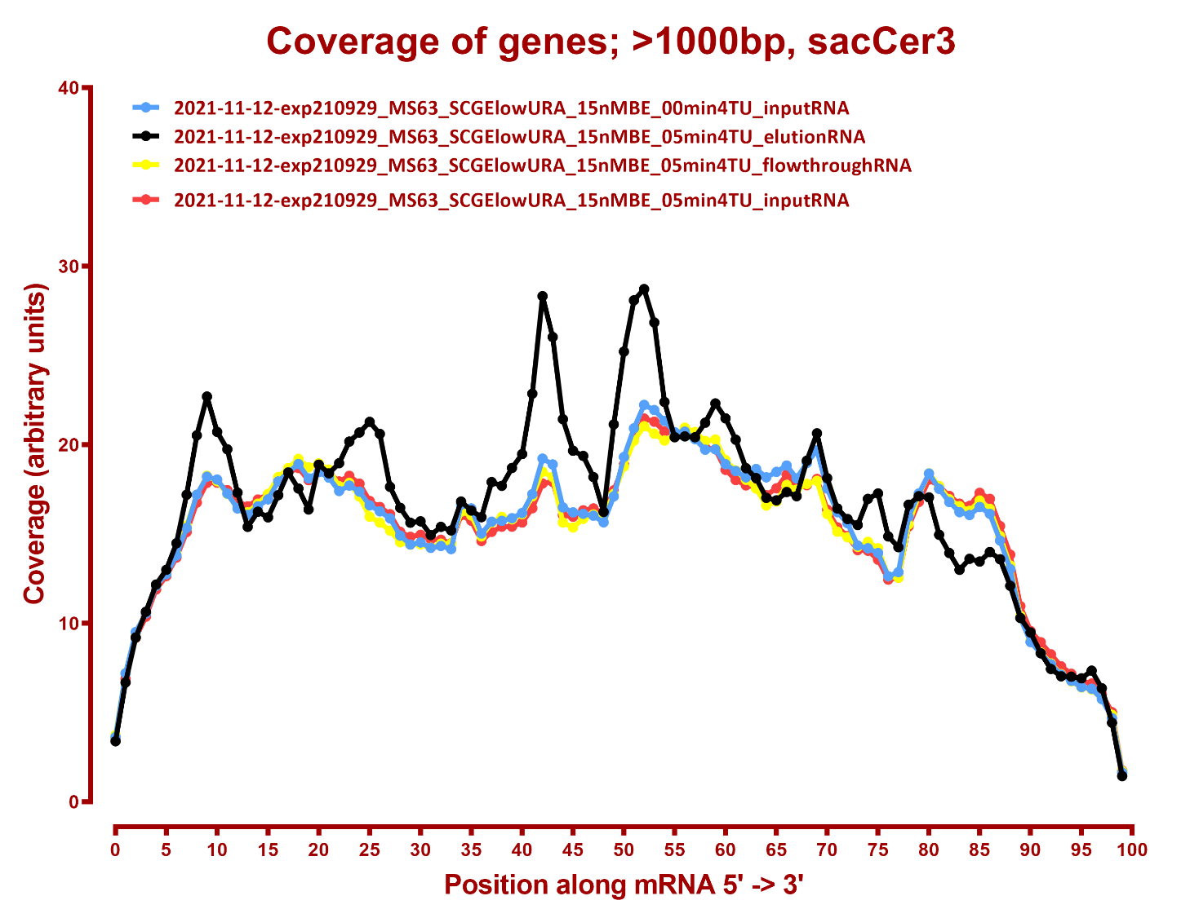

Slide 10
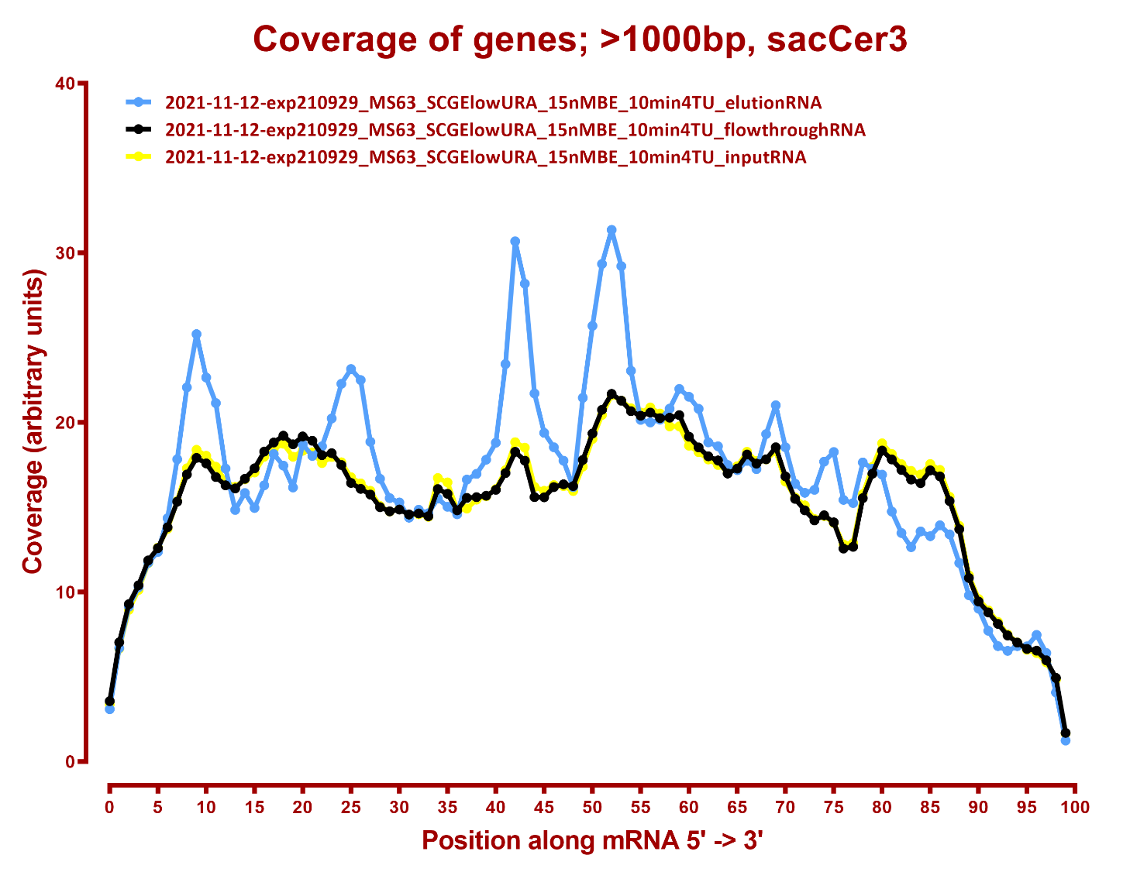

Slide 11
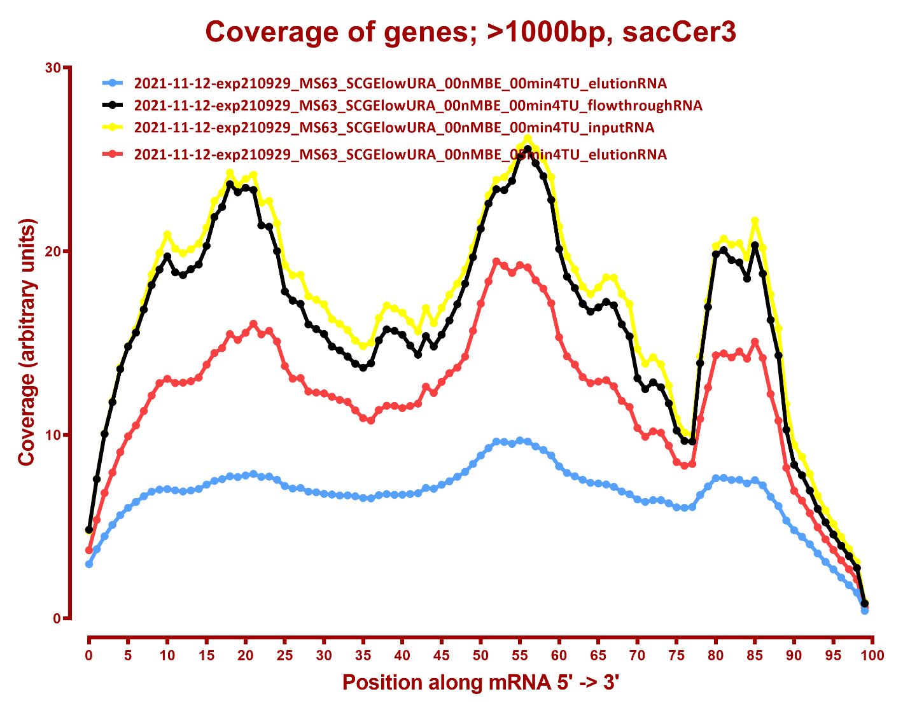
COVERAGE SENSE

Slide 12
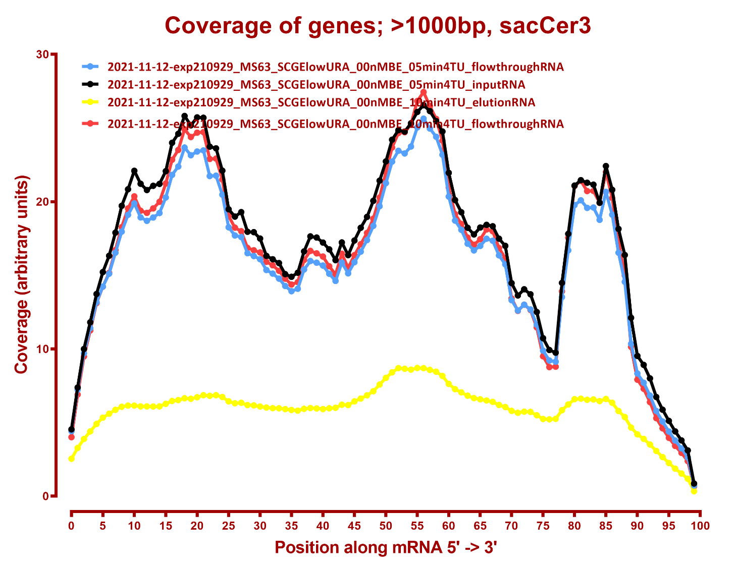

Slide 13
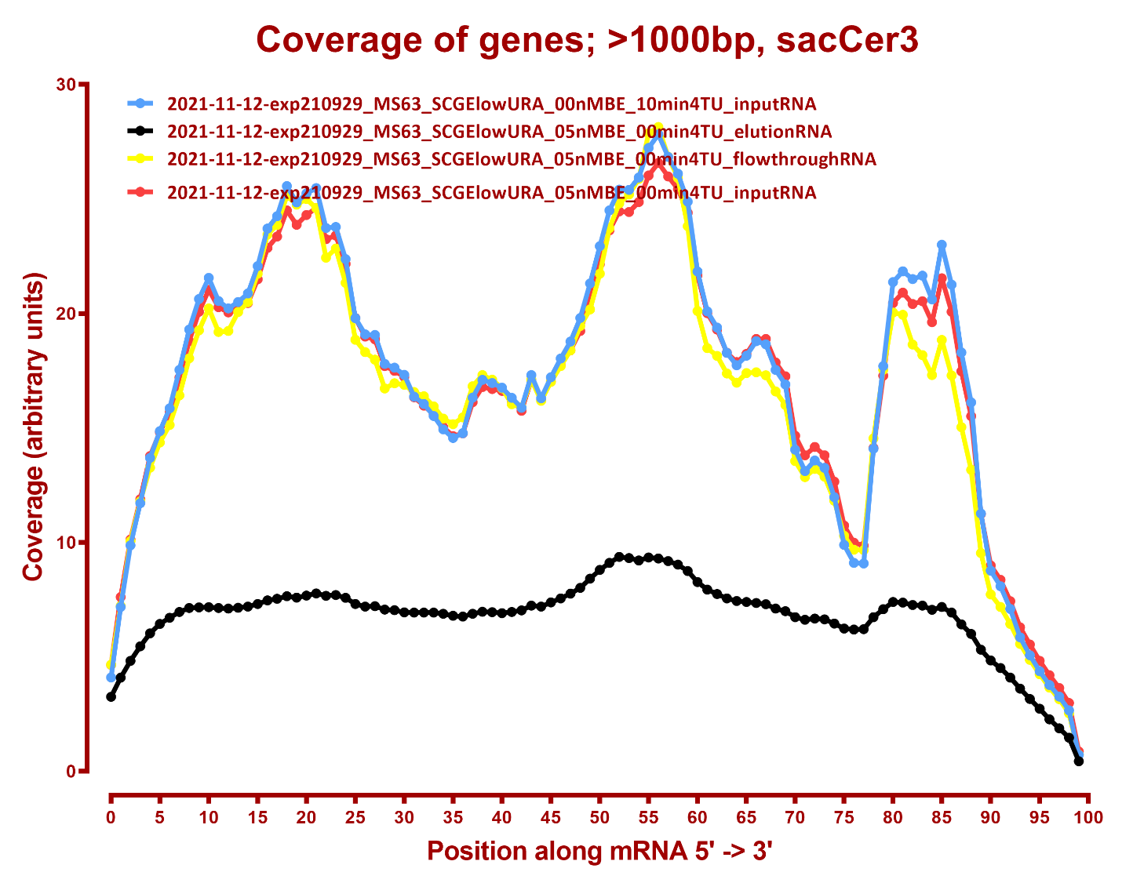

Slide 14
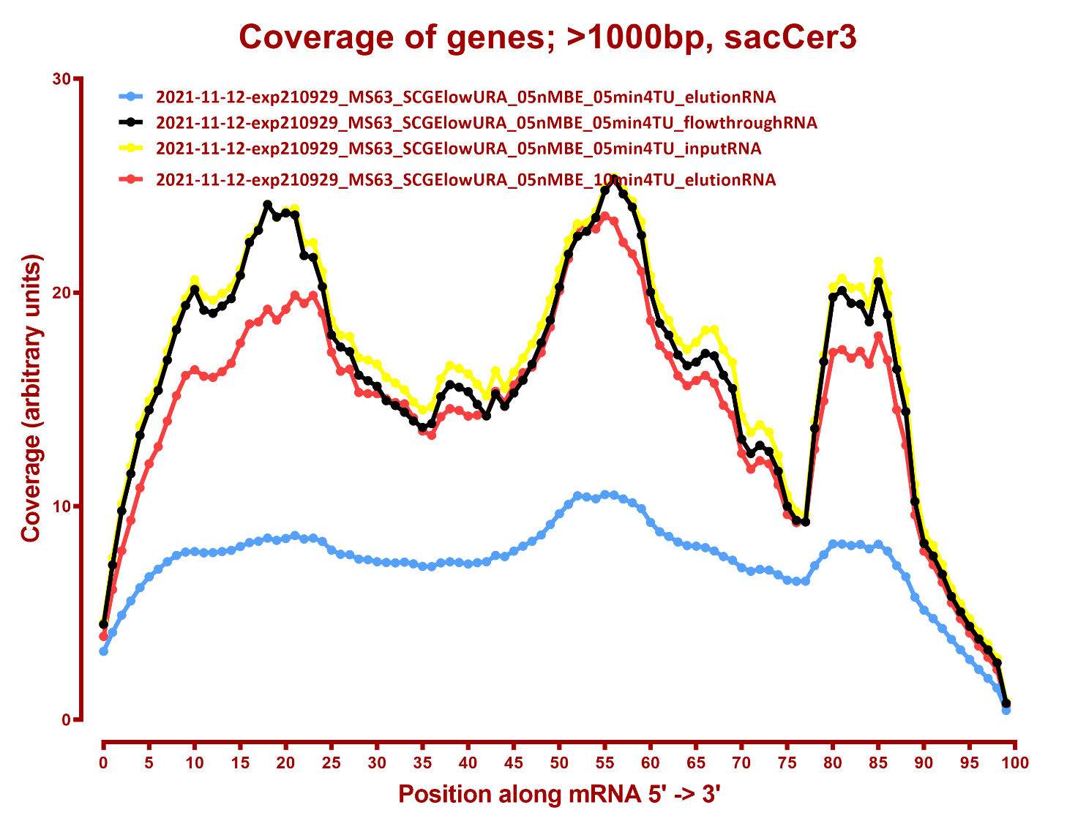

Slide 15
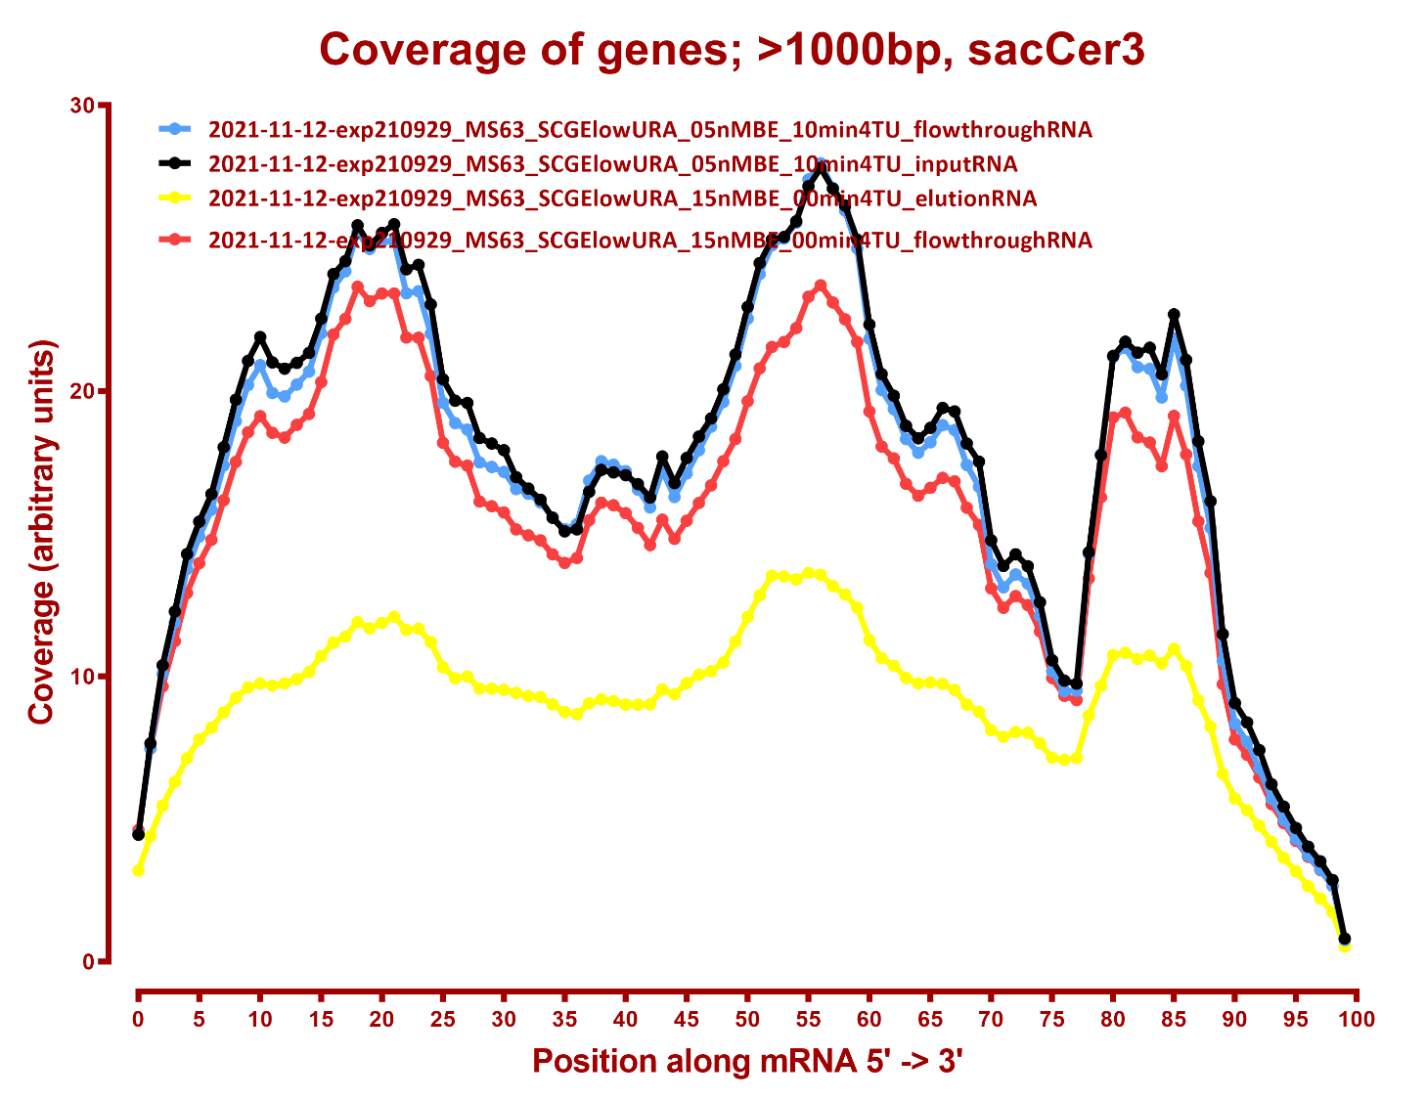

Slide 16
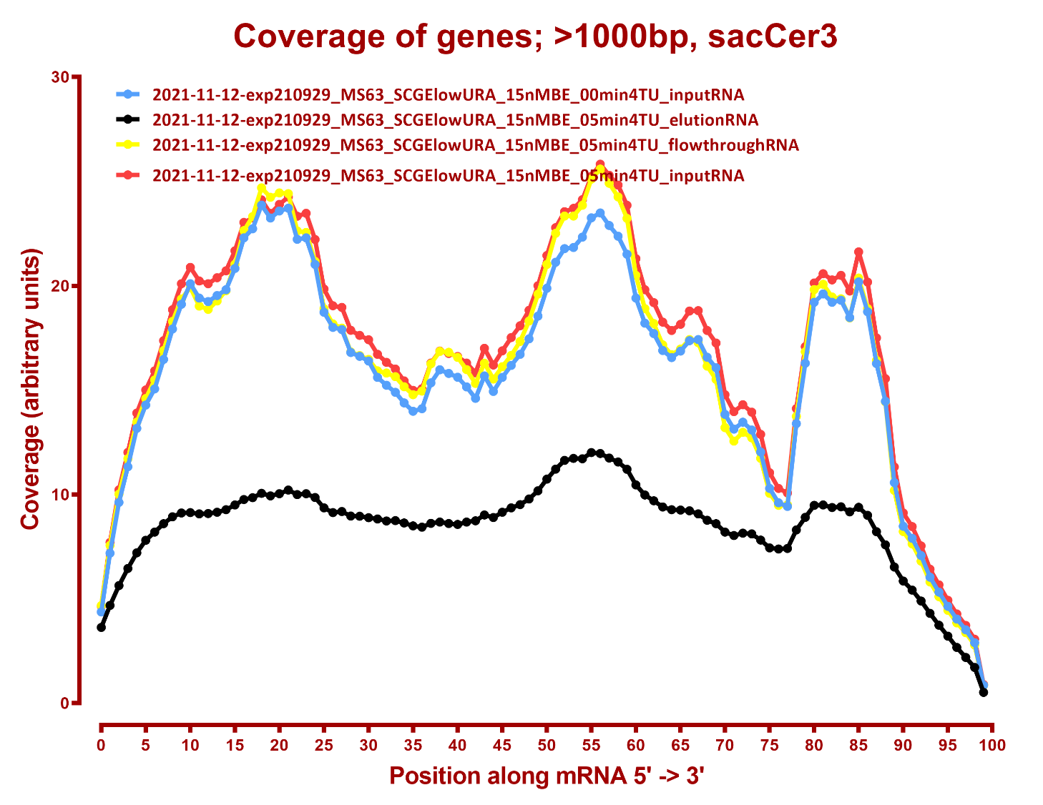

Slide 17
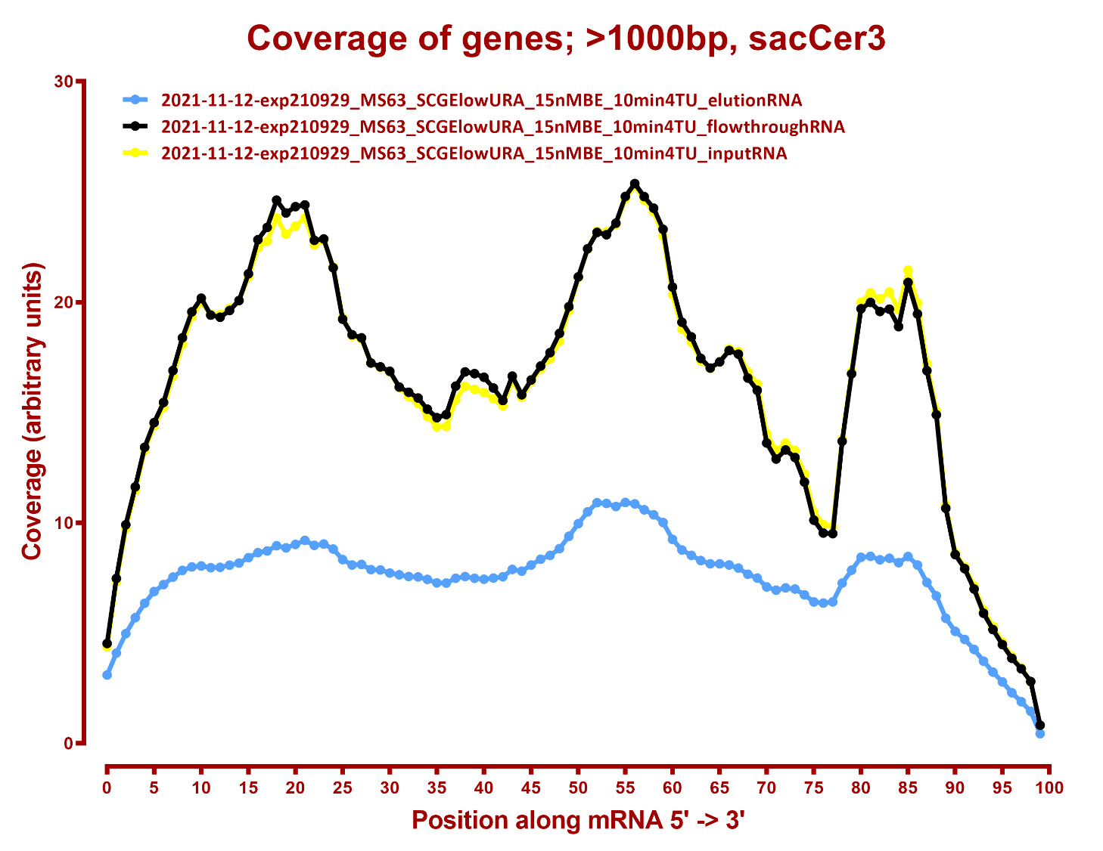

Slide 18
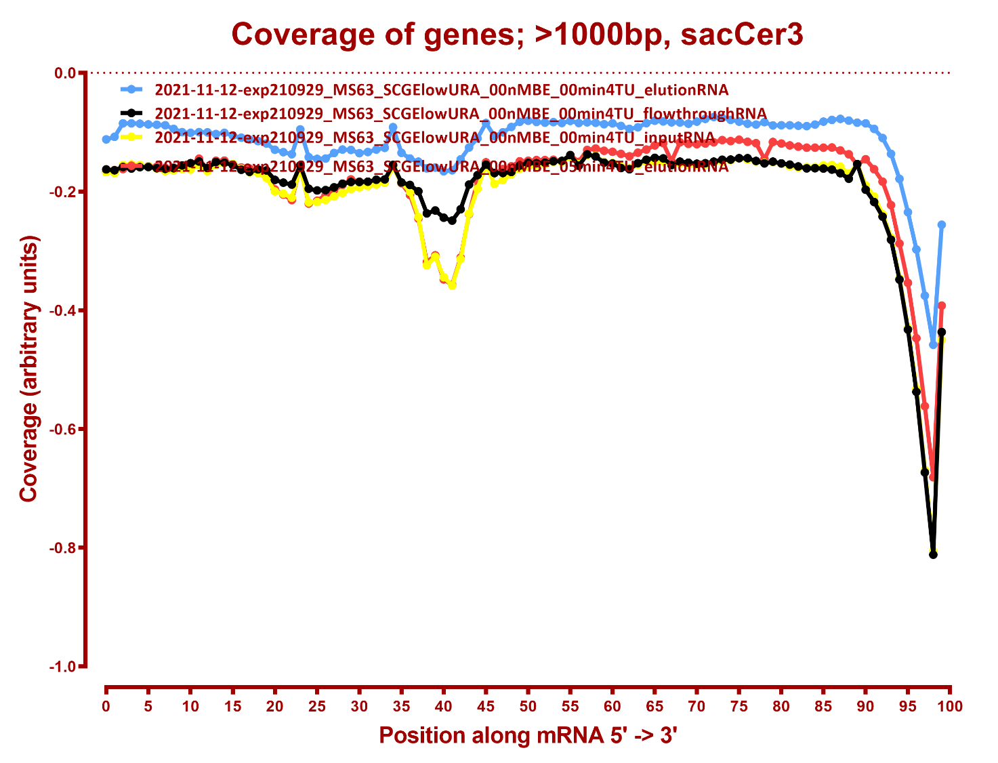
COVERAGE ANTISENSE

Slide 19
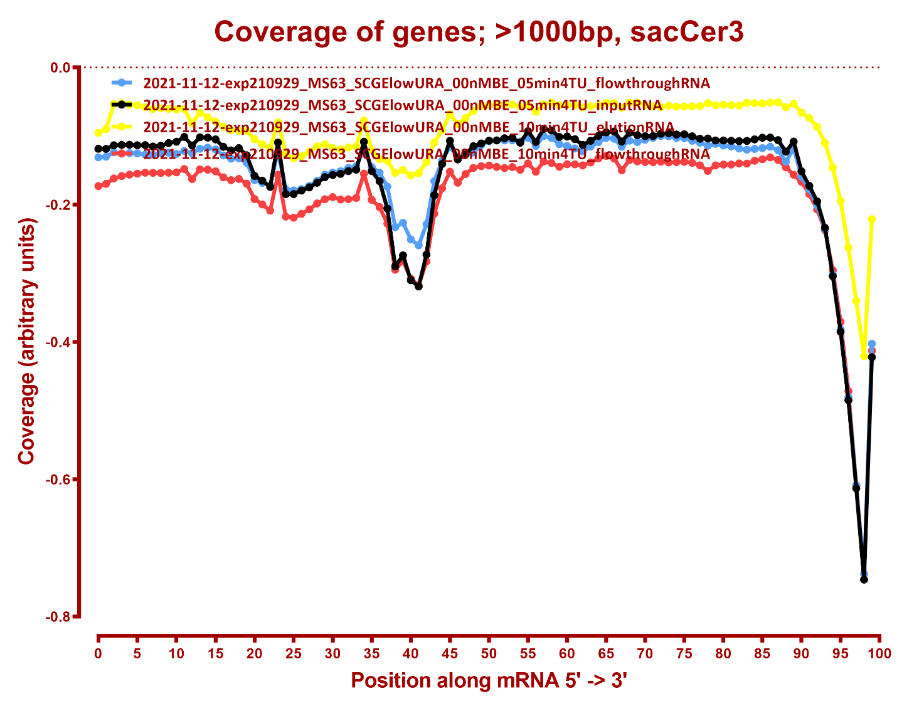

Slide 20
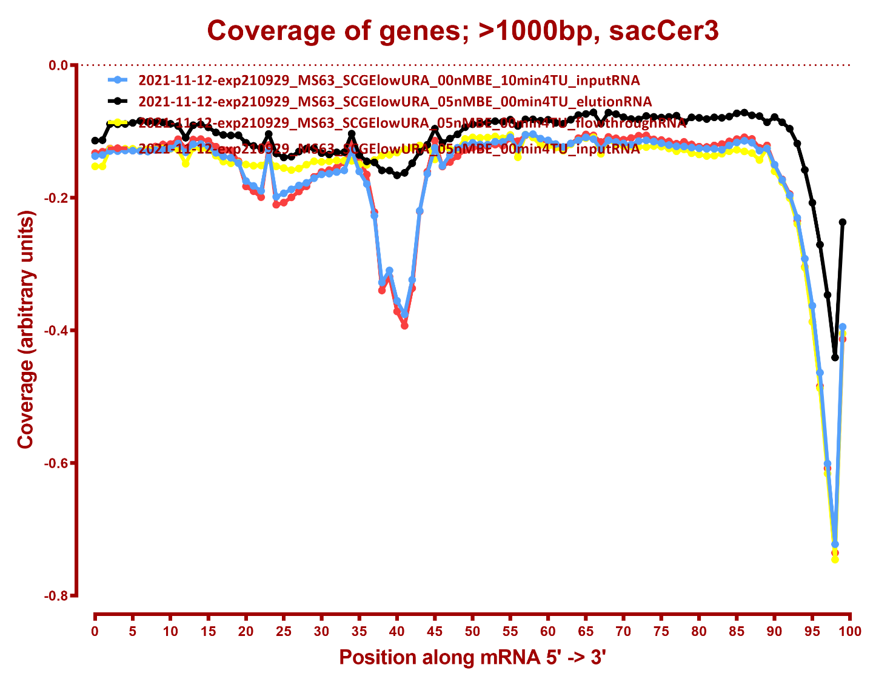

Slide 21
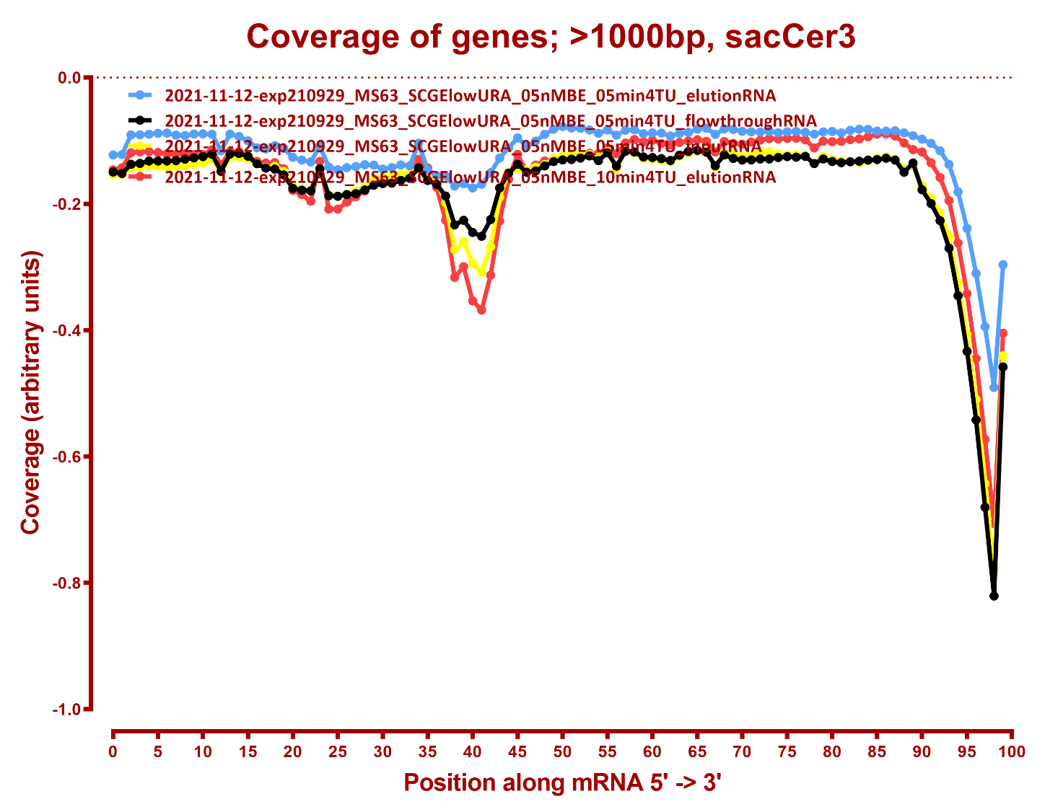

Slide 22
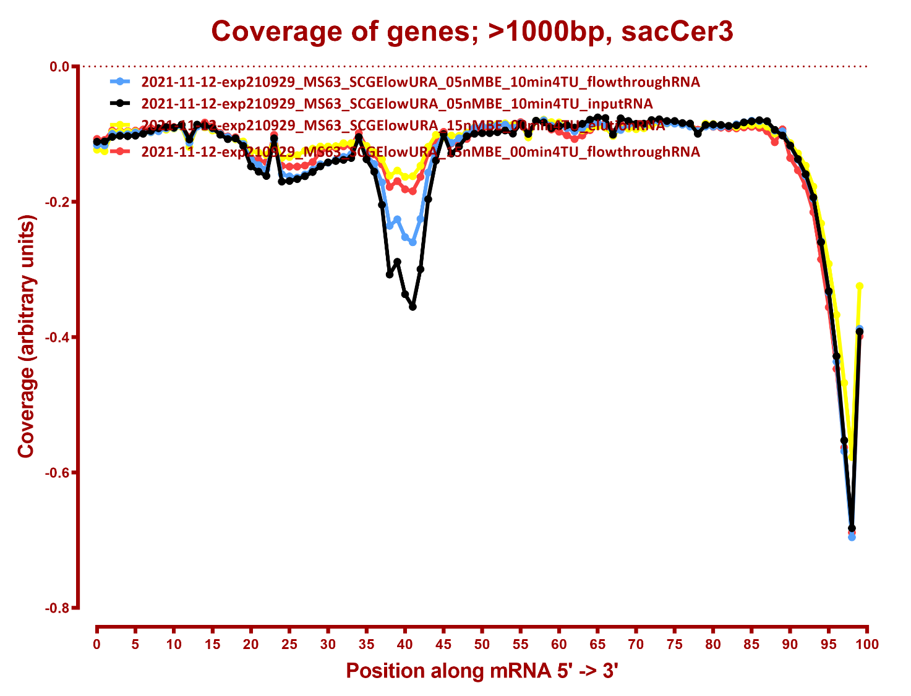

Slide 23
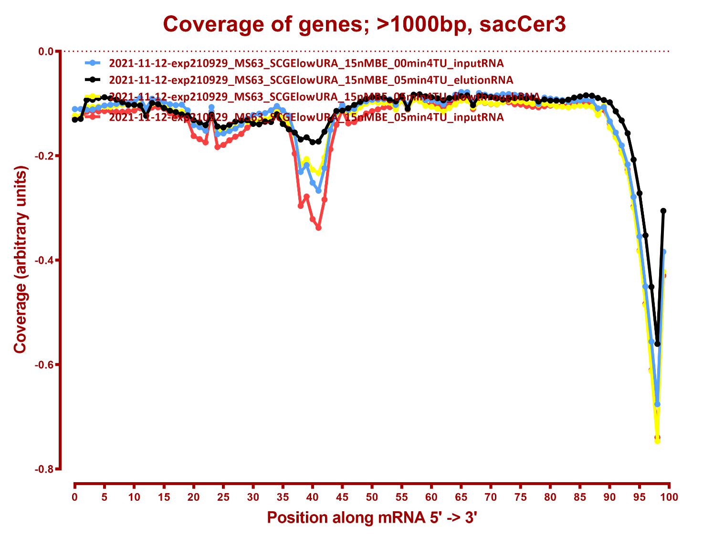

Slide 24
