Slide 1
MAPPING STATS
# | Exonic: | Intergenic: | Intronic:
2021-05-25-21508L01_exp210422_MS207_SCD_ribofree-RNA | 0.91 | 0.08 | 0.00
2021-05-25-21508L02_exp210422_MS208_SCD_ribofree-RNA | 0.91 | 0.08 | 0.00
2021-05-25-21508L03_exp210422_MS299_SCD_ribofree-RNA | 0.91 | 0.08 | 0.00
2021-05-25-21508L04_exp210422_MS207_SCD_RAPA-40min_ribofree-RNA | 0.91 | 0.09 | 0.00
2021-05-25-21508L05_exp210422_MS208_SCD_RAPA-40min_ribofree-RNA | 0.92 | 0.08 | 0.00
2021-05-25-21508L06_exp210422_MS299_SCD_RAPA-40min_ribofree-RNA | 0.91 | 0.09 | 0.00
2021-05-25-21508L07_exp210422_MS207_SCD_RAPA-60min_ribofree-RNA | 0.91 | 0.09 | 0.00
2021-05-25-21508L08_exp210422_MS208_SCD_RAPA-60min_ribofree-RNA | 0.92 | 0.08 | 0.00
2021-05-25-21508L09_exp210422_MS299_SCD_RAPA-60min_ribofree-RNA | 0.91 | 0.09 | 0.00
2021-05-25-21508L10_exp210422_MS207_SCD_RAPA-24hr_ribofree-RNA | 0.91 | 0.08 | 0.00
2021-05-25-21508L11_exp210422_MS208_SCD_RAPA-24hr_ribofree-RNA | 0.91 | 0.09 | 0.00
2021-05-25-21508L12_exp210422_MS299_SCD_RAPA-24hr_ribofree-RNA | 0.91 | 0.09 | 0.00

Slide 2
# | Exonic: | Intergenic: | Intronic:
2021-05-25-21508L01_exp210422_MS207_SCD_ribofree-RNA | 0.91 | 0.08 | 0.00
2021-05-25-21508L02_exp210422_MS208_SCD_ribofree-RNA | 0.91 | 0.08 | 0.00
2021-05-25-21508L03_exp210422_MS299_SCD_ribofree-RNA | 0.91 | 0.08 | 0.00
2021-05-25-21508L04_exp210422_MS207_SCD_RAPA-40min_ribofree-RNA | 0.91 | 0.09 | 0.00
2021-05-25-21508L05_exp210422_MS208_SCD_RAPA-40min_ribofree-RNA | 0.92 | 0.08 | 0.00
2021-05-25-21508L06_exp210422_MS299_SCD_RAPA-40min_ribofree-RNA | 0.91 | 0.09 | 0.00
2021-05-25-21508L07_exp210422_MS207_SCD_RAPA-60min_ribofree-RNA | 0.91 | 0.09 | 0.00
2021-05-25-21508L08_exp210422_MS208_SCD_RAPA-60min_ribofree-RNA | 0.92 | 0.08 | 0.00
2021-05-25-21508L09_exp210422_MS299_SCD_RAPA-60min_ribofree-RNA | 0.91 | 0.09 | 0.00
2021-05-25-21508L10_exp210422_MS207_SCD_RAPA-24hr_ribofree-RNA | 0.91 | 0.08 | 0.00
2021-05-25-21508L11_exp210422_MS208_SCD_RAPA-24hr_ribofree-RNA | 0.91 | 0.09 | 0.00
2021-05-25-21508L12_exp210422_MS299_SCD_RAPA-24hr_ribofree-RNA | 0.91 | 0.09 | 0.00

Slide 3
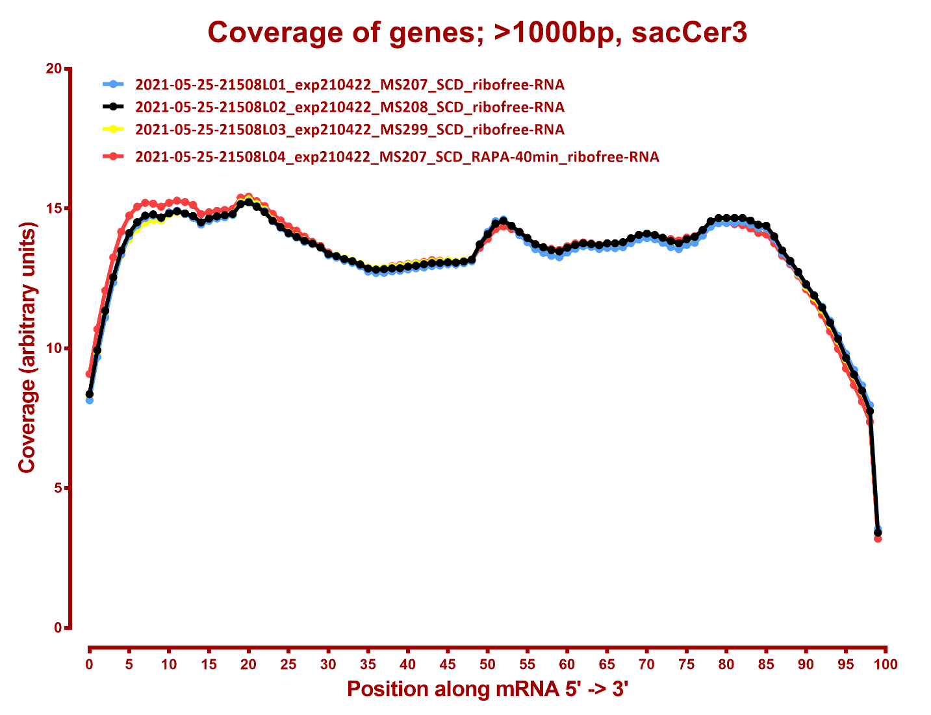
COVERAGE QC

Slide 4
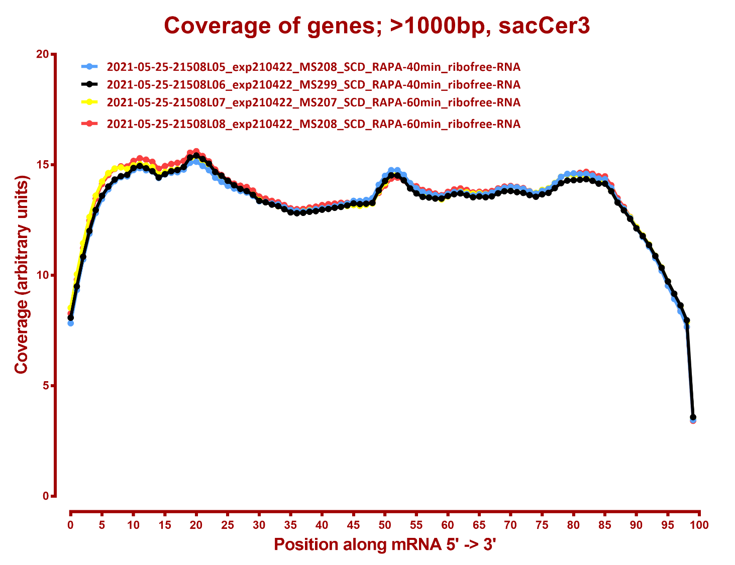

Slide 5
