Slide 1
MAPPING STATS

Slide 2
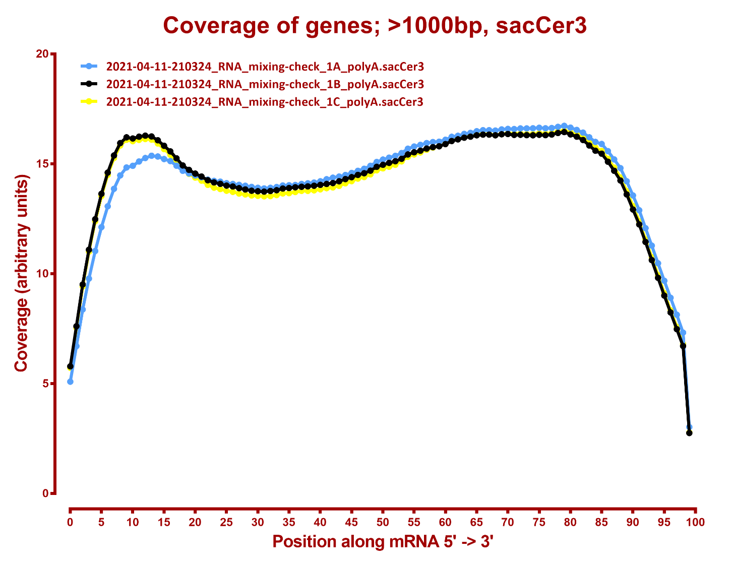
COVERAGE QC

Slide 3
