Slide 1
MAPPING STATS

Slide 2
READ DISTRIBUTION
# | Exonic: | Intergenic: | Intronic:
2020-02-17-HMEC_G1_bin1_rep1 | 0.92 | 0.01 | 0.07
2020-02-17-HMEC_G1_bin1_rep2 | 0.92 | 0.01 | 0.07
2020-02-17-HMEC_G1_bin4_rep1 | 0.92 | 0.01 | 0.07
2020-02-17-HMEC_G1_bin4_rep2 | 0.93 | 0.01 | 0.06
2020-02-17-HMEC_SG2M_bin1_rep1 | 0.92 | 0.01 | 0.07
2020-02-17-HMEC_SG2M_bin1_rep2 | 0.93 | 0.01 | 0.06
2020-02-17-HMEC_SG2M_bin2_rep1 | 0.93 | 0.01 | 0.06
2020-02-17-HMEC_SG2M_bin3_rep1 | 0.93 | 0.01 | 0.06
2020-02-17-HMEC_SG2M_bin4_rep1 | 0.95 | 0.01 | 0.04
2020-02-17-HMEC_SG2M_bin4_rep2 | 0.94 | 0.01 | 0.05

Slide 3
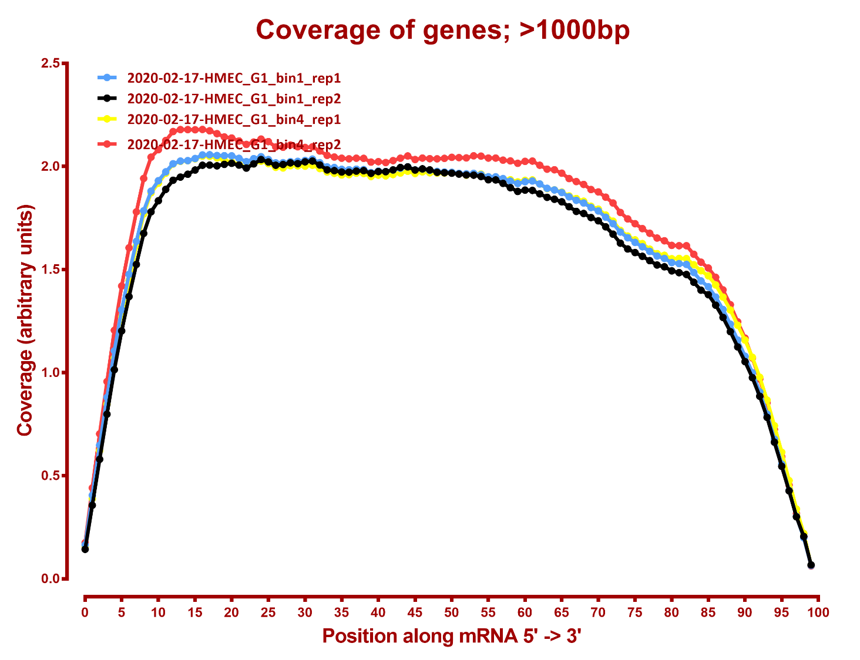
COVERAGE QC

Slide 4
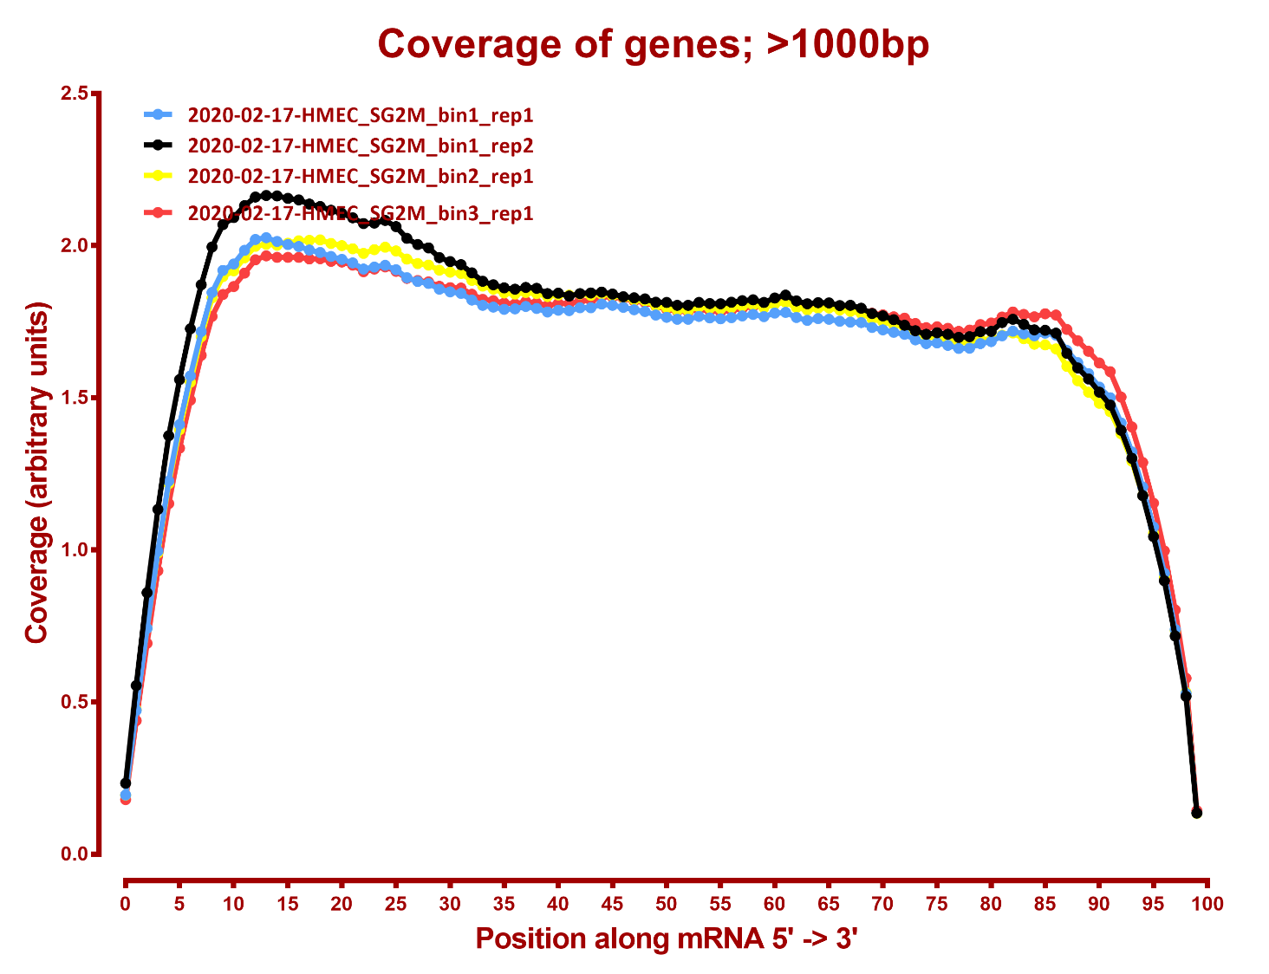

Slide 5
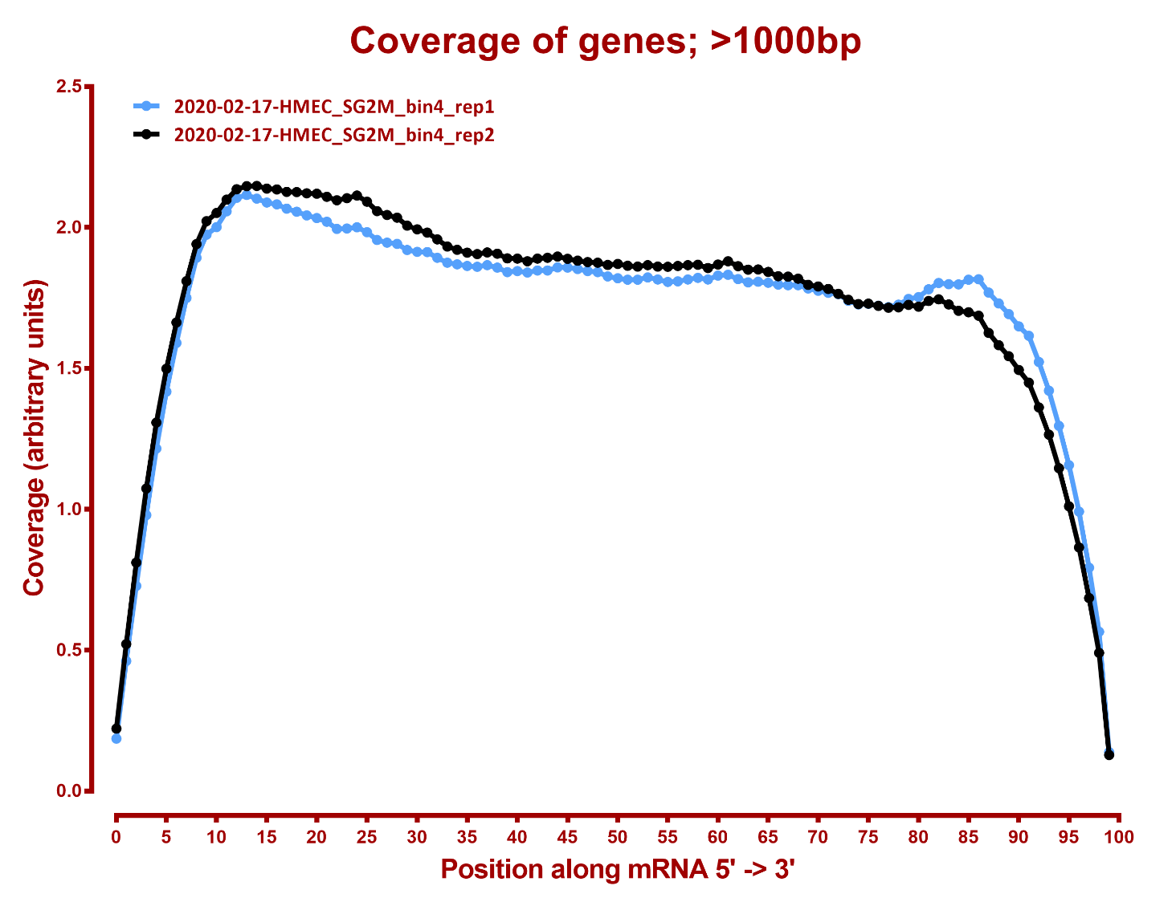

Slide 6
DE GENES SUMMARY
Number differential genes, hg38
A | B | p-adj |  | p-val
 |  | up in B vs A | down in B vs A | up in B vs A | down in B vs A
HMEC_G1_bin1 | HMEC_G1_bin4 | 635 | 394 | 1,677 | 1,517
HMEC_G1_bin1 | HMEC_SG2M_bin1 | 1,179 | 607 | 2,091 | 1,686
HMEC_G1_bin1 | HMEC_SG2M_bin2 | 1,154 | 672 | 2,024 | 1,777
HMEC_G1_bin1 | HMEC_SG2M_bin3 | 1,277 | 820 | 2,153 | 1,988
HMEC_G1_bin1 | HMEC_SG2M_bin4 | 1,503 | 1,053 | 2,361 | 2,153
HMEC_G1_bin4 | HMEC_SG2M_bin1 | 1,058 | 688 | 2,010 | 1,679
HMEC_G1_bin4 | HMEC_SG2M_bin2 | 694 | 345 | 1,530 | 1,255
HMEC_G1_bin4 | HMEC_SG2M_bin3 | 763 | 380 | 1,647 | 1,338
HMEC_G1_bin4 | HMEC_SG2M_bin4 | 1041 | 588 | 1825 | 1509
HMEC_SG2M_bin1 | HMEC_SG2M_bin2 | 4 | 6 | 288 | 409
HMEC_SG2M_bin1 | HMEC_SG2M_bin3 | 5 | 11 | 372 | 467
HMEC_SG2M_bin1 | HMEC_SG2M_bin4 | 18 | 49 | 508 | 649
HMEC_SG2M_bin2 | HMEC_SG2M_bin3 | 3 | 2 | 270 | 293
HMEC_SG2M_bin2 | HMEC_SG2M_bin4 | 3 | 9 | 420 | 473
HMEC_SG2M_bin3 | HMEC_SG2M_bin4 | 2 | 3 | 288 | 374

