Slide 1
MAPPING STATS

Slide 2
READ DISTRIBUTION
# | Exonic: | Intergenic: | Intronic:
2019-12-13-HFL_palobo_bin1_rep3.hg38 | 0.91 | 0.01 | 0.08
2019-12-13-HFL_palobo_bin1_rep4.hg38 | 0.91 | 0.01 | 0.08
2019-12-13-HFL_palobo_bin2_rep3.hg38 | 0.92 | 0.01 | 0.07
2019-12-13-HFL_palobo_bin2_rep4.hg38 | 0.92 | 0.01 | 0.07
2019-12-13-HFL_palobo_bin3_rep3.hg38 | 0.93 | 0.01 | 0.06
2019-12-13-HFL_palobo_bin3_rep4.hg38 | 0.92 | 0.01 | 0.07
2019-12-13-HFL_palobo_bin4_rep3.hg38 | 0.92 | 0.01 | 0.07
2019-12-13-HFL_palobo_bin4_rep4.hg38 | 0.92 | 0.01 | 0.07
2019-12-13-HFL_palobo_pre-sort_rep3.hg38 | 0.95 | 0.01 | 0.04
2019-12-13-HFL_palobo_pre-sort_rep4.hg38 | 0.92 | 0.01 | 0.07
2019-12-13-HFL_palobo_sort-all_rep3.hg38 | 0.91 | 0.01 | 0.08
2019-12-13-HFL_palobo_sort-all_rep4.hg38 | 0.92 | 0.01 | 0.06
2019-12-13-HMEC_G1_bin1_rep1.hg38 | 0.92 | 0.01 | 0.07
2019-12-13-HMEC_G1_bin1_rep2.hg38 | 0.92 | 0.01 | 0.07
2019-12-13-HMEC_G1_bin4_rep1.hg38 | 0.92 | 0.01 | 0.06
2019-12-13-HMEC_G1_bin4_rep2.hg38 | 0.94 | 0.01 | 0.06

Slide 3
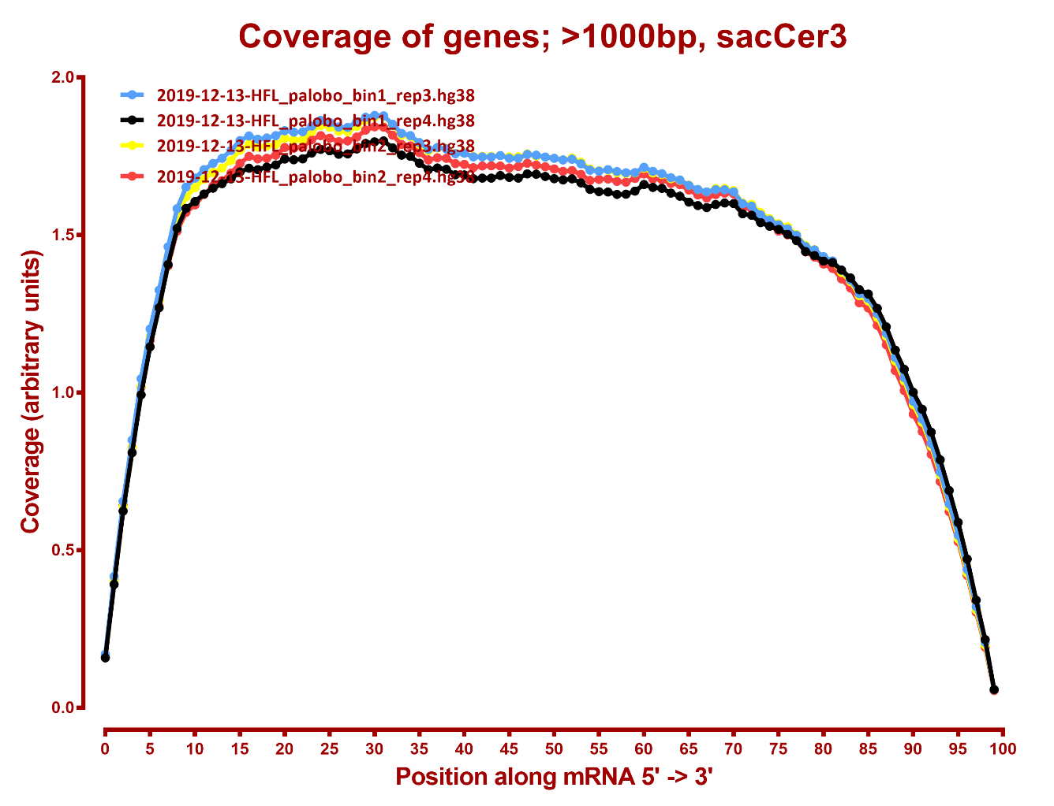
COVERAGE QC

Slide 4
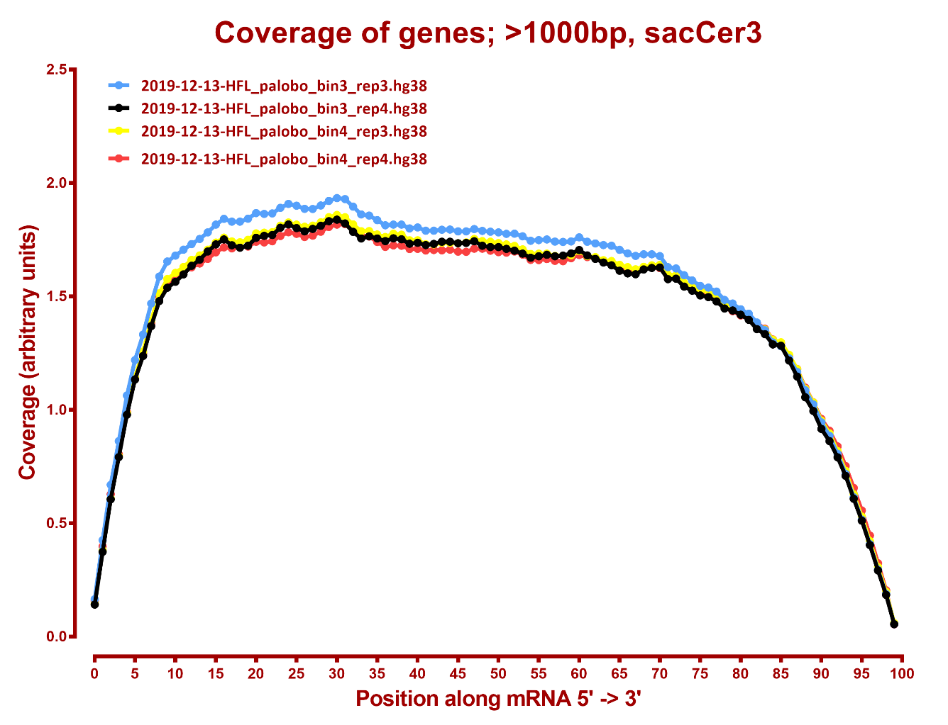

Slide 5
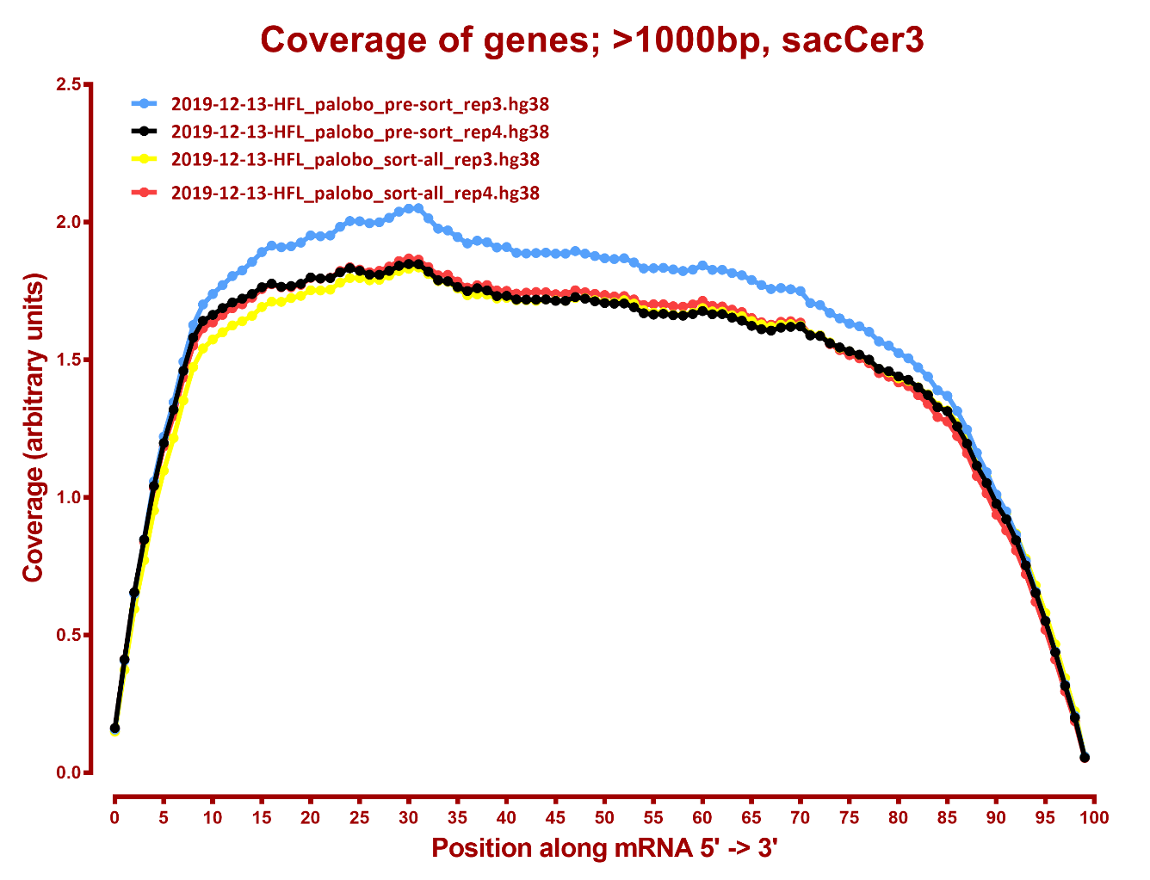

Slide 6
