Slide 1
MAPPING STATS
Library | Read Length | Mapping | Species | Raw fragments | Complexity | Unique | Unique Splices | Multi | Multi Splices | Fraction mapped
2019-12-03-RNAseq-exp191107-A040 | 2x150 | STAR-2.5.3a | S_pombe | 26,572,372 | 1.00 | 8 | 0 | 188 | 0 | 0.00
2019-12-03-RNAseq-exp191107-A040 | 2x150 | STAR-2.5.3a | sacCer3 | 26,572,372 | 0.47 | 38,429,226 | 1,971,036 | 2,895,440 | 227,550 | 0.82
2019-12-03-RNAseq-exp191107-A050 | 2x150 | STAR-2.5.3a | S_pombe | 29,977,052 | 1.00 | 4 | 2 | 326 | 12 | 0.00
2019-12-03-RNAseq-exp191107-A050 | 2x150 | STAR-2.5.3a | sacCer3 | 29,977,052 | 0.47 | 42,758,408 | 2,154,564 | 3,080,921 | 277,033 | 0.81
2019-12-03-RNAseq-exp191107-A060 | 2x150 | STAR-2.5.3a | S_pombe | 25,736,950 | N\A | 0 | 0 | 156 | 0 | 0.00
2019-12-03-RNAseq-exp191107-A060 | 2x150 | STAR-2.5.3a | sacCer3 | 25,736,950 | 0.47 | 36,559,872 | 1,764,448 | 2,339,496 | 196,222 | 0.79
2019-12-03-RNAseq-exp191107-A070 | 2x150 | STAR-2.5.3a | S_pombe | 25,520,705 | 1.00 | 10 | 0 | 237 | 1 | 0.00
2019-12-03-RNAseq-exp191107-A070 | 2x150 | STAR-2.5.3a | sacCer3 | 25,520,705 | 0.48 | 35,948,209 | 1,642,917 | 2,263,269 | 178,011 | 0.78
2019-12-03-RNAseq-exp191107-A080 | 2x150 | STAR-2.5.3a | S_pombe | 25,505,501 | 1.00 | 4 | 0 | 160 | 0 | 0.00
2019-12-03-RNAseq-exp191107-A080 | 2x150 | STAR-2.5.3a | sacCer3 | 25,505,501 | 0.47 | 37,033,779 | 1,669,721 | 2,321,165 | 212,693 | 0.81
2019-12-03-RNAseq-exp191107-A090 | 2x150 | STAR-2.5.3a | S_pombe | 25,342,979 | 1.00 | 1 | 1 | 210 | 2 | 0.00
2019-12-03-RNAseq-exp191107-A090 | 2x150 | STAR-2.5.3a | sacCer3 | 25,342,979 | 0.46 | 35,835,788 | 1,776,770 | 2,191,512 | 233,704 | 0.79
2019-12-03-RNAseq-exp191107-A100 | 2x150 | STAR-2.5.3a | S_pombe | 25,591,727 | 1.00 | 4 | 0 | 154 | 0 | 0.00
2019-12-03-RNAseq-exp191107-A100 | 2x150 | STAR-2.5.3a | sacCer3 | 25,591,727 | 0.46 | 37,028,891 | 1,748,949 | 2,307,185 | 240,617 | 0.81
2019-12-03-RNAseq-exp191107-A110 | 2x150 | STAR-2.5.3a | S_pombe | 23,662,166 | 1.00 | 10 | 0 | 317 | 1 | 0.00
2019-12-03-RNAseq-exp191107-A110 | 2x150 | STAR-2.5.3a | sacCer3 | 23,662,166 | 0.45 | 33,720,696 | 1,793,604 | 2,071,177 | 205,017 | 0.80
2019-12-03-RNAseq-exp191107-B010 | 2x150 | STAR-2.5.3a | S_pombe | 34,825,968 | 1.00 | 14 | 0 | 242 | 0 | 0.00
2019-12-03-RNAseq-exp191107-B010 | 2x150 | STAR-2.5.3a | sacCer3 | 34,825,968 | 0.49 | 47,988,915 | 1,797,097 | 3,667,488 | 294,632 | 0.77
2019-12-03-RNAseq-exp191107-B020 | 2x150 | STAR-2.5.3a | S_pombe | 36,718,625 | 1.00 | 2 | 2 | 369 | 13 | 0.00
2019-12-03-RNAseq-exp191107-B020 | 2x150 | STAR-2.5.3a | sacCer3 | 36,718,625 | 0.47 | 50,994,825 | 2,228,555 | 4,134,631 | 343,023 | 0.79
2019-12-03-RNAseq-exp191107-B030 | 2x150 | STAR-2.5.3a | S_pombe | 33,776,456 | 0.69 | 10 | 4 | 270 | 0 | 0.00
2019-12-03-RNAseq-exp191107-B030 | 2x150 | STAR-2.5.3a | sacCer3 | 33,776,456 | 0.46 | 46,779,819 | 2,306,749 | 3,449,894 | 278,924 | 0.78
2019-12-03-RNAseq-exp191107-B040 | 2x150 | STAR-2.5.3a | S_pombe | 29,522,644 | 1.00 | 9 | 1 | 263 | 1 | 0.00
2019-12-03-RNAseq-exp191107-B040 | 2x150 | STAR-2.5.3a | sacCer3 | 29,522,644 | 0.47 | 41,021,266 | 2,054,154 | 2,905,795 | 241,989 | 0.78
2019-12-03-RNAseq-exp191107-B050 | 2x150 | STAR-2.5.3a | S_pombe | 31,584,666 | 1.00 | 6 | 0 | 238 | 0 | 0.00
2019-12-03-RNAseq-exp191107-B050 | 2x150 | STAR-2.5.3a | sacCer3 | 31,584,666 | 0.46 | 44,067,176 | 2,231,330 | 2,962,416 | 264,384 | 0.78
2019-12-03-RNAseq-exp191107-B060 | 2x150 | STAR-2.5.3a | S_pombe | 33,934,589 | 1.00 | 4 | 2 | 274 | 18 | 0.00
2019-12-03-RNAseq-exp191107-B060 | 2x150 | STAR-2.5.3a | sacCer3 | 33,934,589 | 0.43 | 47,828,688 | 2,812,904 | 3,035,552 | 338,536 | 0.80
2019-12-03-RNAseq-exp191107-B070 | 2x150 | STAR-2.5.3a | S_pombe | 26,449,229 | 1.00 | 8 | 0 | 269 | 1 | 0.00
2019-12-03-RNAseq-exp191107-B070 | 2x150 | STAR-2.5.3a | sacCer3 | 26,449,229 | 0.46 | 37,147,870 | 2,038,974 | 2,443,247 | 238,465 | 0.79
2019-12-03-RNAseq-exp191107-B080 | 2x150 | STAR-2.5.3a | S_pombe | 29,770,088 | 1.00 | 14 | 2 | 248 | 0 | 0.00
2019-12-03-RNAseq-exp191107-B080 | 2x150 | STAR-2.5.3a | sacCer3 | 29,770,088 | 0.41 | 40,406,747 | 2,719,309 | 2,521,780 | 362,418 | 0.77
2019-12-03-RNAseq-exp191107-C000 | 2x150 | STAR-2.5.3a | S_pombe | 22,965,593 | 1.00 | 6 | 0 | 232 | 2 | 0.00
2019-12-03-RNAseq-exp191107-C000 | 2x150 | STAR-2.5.3a | sacCer3 | 22,965,593 | 0.52 | 32,332,894 | 1,149,092 | 3,322,001 | 214,655 | 0.81
2019-12-03-RNAseq-exp191107-C010 | 2x150 | STAR-2.5.3a | S_pombe | 20,960,512 | 1.00 | 2 | 0 | 170 | 2 | 0.00
2019-12-03-RNAseq-exp191107-C010 | 2x150 | STAR-2.5.3a | sacCer3 | 20,960,512 | 0.54 | 29,489,168 | 1,083,500 | 2,876,420 | 179,428 | 0.80
2019-12-03-RNAseq-exp191107-C020 | 2x150 | STAR-2.5.3a | S_pombe | 18,722,028 | N\A | 2 | 0 | 120 | 0 | 0.00
2019-12-03-RNAseq-exp191107-C020 | 2x150 | STAR-2.5.3a | sacCer3 | 18,722,028 | 0.53 | 26,168,105 | 1,125,293 | 2,342,513 | 128,025 | 0.79
2019-12-03-RNAseq-exp191107-C030 | 2x150 | STAR-2.5.3a | S_pombe | 20,602,719 | 1.00 | 9 | 1 | 90 | 0 | 0.00
2019-12-03-RNAseq-exp191107-C030 | 2x150 | STAR-2.5.3a | sacCer3 | 20,602,719 | 0.49 | 29,750,691 | 1,460,573 | 2,483,144 | 170,480 | 0.82
2019-12-03-RNAseq-exp191107-C040 | 2x150 | STAR-2.5.3a | S_pombe | 18,633,114 | 1.00 | 2 | 0 | 94 | 0 | 0.00
2019-12-03-RNAseq-exp191107-C040 | 2x150 | STAR-2.5.3a | sacCer3 | 18,633,114 | 0.50 | 25,505,226 | 1,383,828 | 1,793,008 | 119,774 | 0.77
2019-12-03-RNAseq-exp191107-C050 | 2x150 | STAR-2.5.3a | S_pombe | 19,021,824 | 1.00 | 2 | 0 | 156 | 0 | 0.00
2019-12-03-RNAseq-exp191107-C050 | 2x150 | STAR-2.5.3a | sacCer3 | 19,021,824 | 0.51 | 26,921,797 | 1,337,249 | 1,838,583 | 119,743 | 0.79
2019-12-03-RNAseq-exp191107-C060 | 2x150 | STAR-2.5.3a | S_pombe | 21,234,407 | 1.00 | 9 | 1 | 192 | 0 | 0.00
2019-12-03-RNAseq-exp191107-C060 | 2x150 | STAR-2.5.3a | sacCer3 | 21,234,407 | 0.51 | 29,717,632 | 1,364,654 | 2,118,182 | 148,872 | 0.79
2019-12-03-RNAseq-exp191107-C070 | 2x150 | STAR-2.5.3a | S_pombe | 18,039,123 | 1.00 | 10 | 0 | 146 | 0 | 0.00
2019-12-03-RNAseq-exp191107-C070 | 2x150 | STAR-2.5.3a | sacCer3 | 18,039,123 | 0.49 | 25,673,953 | 1,384,523 | 1,741,718 | 126,258 | 0.80

Slide 2
READ DISTRIBUTION
# | Exonic: | Intergenic: | Intronic:
2019-12-03-RNAseq-exp191107-A040.sacCer3 | 0.92 | 0.08 | 0.00
2019-12-03-RNAseq-exp191107-A050.sacCer3 | 0.92 | 0.08 | 0.00
2019-12-03-RNAseq-exp191107-A060.sacCer3 | 0.92 | 0.08 | 0.00
2019-12-03-RNAseq-exp191107-A070.sacCer3 | 0.91 | 0.08 | 0.00
2019-12-03-RNAseq-exp191107-A080.sacCer3 | 0.92 | 0.08 | 0.00
2019-12-03-RNAseq-exp191107-A090.sacCer3 | 0.91 | 0.08 | 0.00
2019-12-03-RNAseq-exp191107-A100.sacCer3 | 0.92 | 0.08 | 0.00
2019-12-03-RNAseq-exp191107-A110.sacCer3 | 0.91 | 0.08 | 0.00
2019-12-03-RNAseq-exp191107-B010.sacCer3 | 0.91 | 0.09 | 0.00
2019-12-03-RNAseq-exp191107-B020.sacCer3 | 0.91 | 0.08 | 0.00
2019-12-03-RNAseq-exp191107-B030.sacCer3 | 0.91 | 0.08 | 0.00
2019-12-03-RNAseq-exp191107-B040.sacCer3 | 0.91 | 0.09 | 0.00
2019-12-03-RNAseq-exp191107-B050.sacCer3 | 0.91 | 0.09 | 0.00
2019-12-03-RNAseq-exp191107-B060.sacCer3 | 0.91 | 0.09 | 0.00
2019-12-03-RNAseq-exp191107-B070.sacCer3 | 0.91 | 0.08 | 0.00
2019-12-03-RNAseq-exp191107-B080.sacCer3 | 0.91 | 0.09 | 0.00
2019-12-03-RNAseq-exp191107-C000.sacCer3 | 0.90 | 0.09 | 0.00
2019-12-03-RNAseq-exp191107-C010.sacCer3 | 0.91 | 0.09 | 0.00
2019-12-03-RNAseq-exp191107-C020.sacCer3 | 0.91 | 0.09 | 0.00
2019-12-03-RNAseq-exp191107-C030.sacCer3 | 0.91 | 0.09 | 0.00
2019-12-03-RNAseq-exp191107-C040.sacCer3 | 0.90 | 0.09 | 0.00
2019-12-03-RNAseq-exp191107-C050.sacCer3 | 0.91 | 0.09 | 0.00
2019-12-03-RNAseq-exp191107-C060.sacCer3 | 0.91 | 0.09 | 0.00
2019-12-03-RNAseq-exp191107-C070.sacCer3 | 0.91 | 0.09 | 0.00

Slide 3
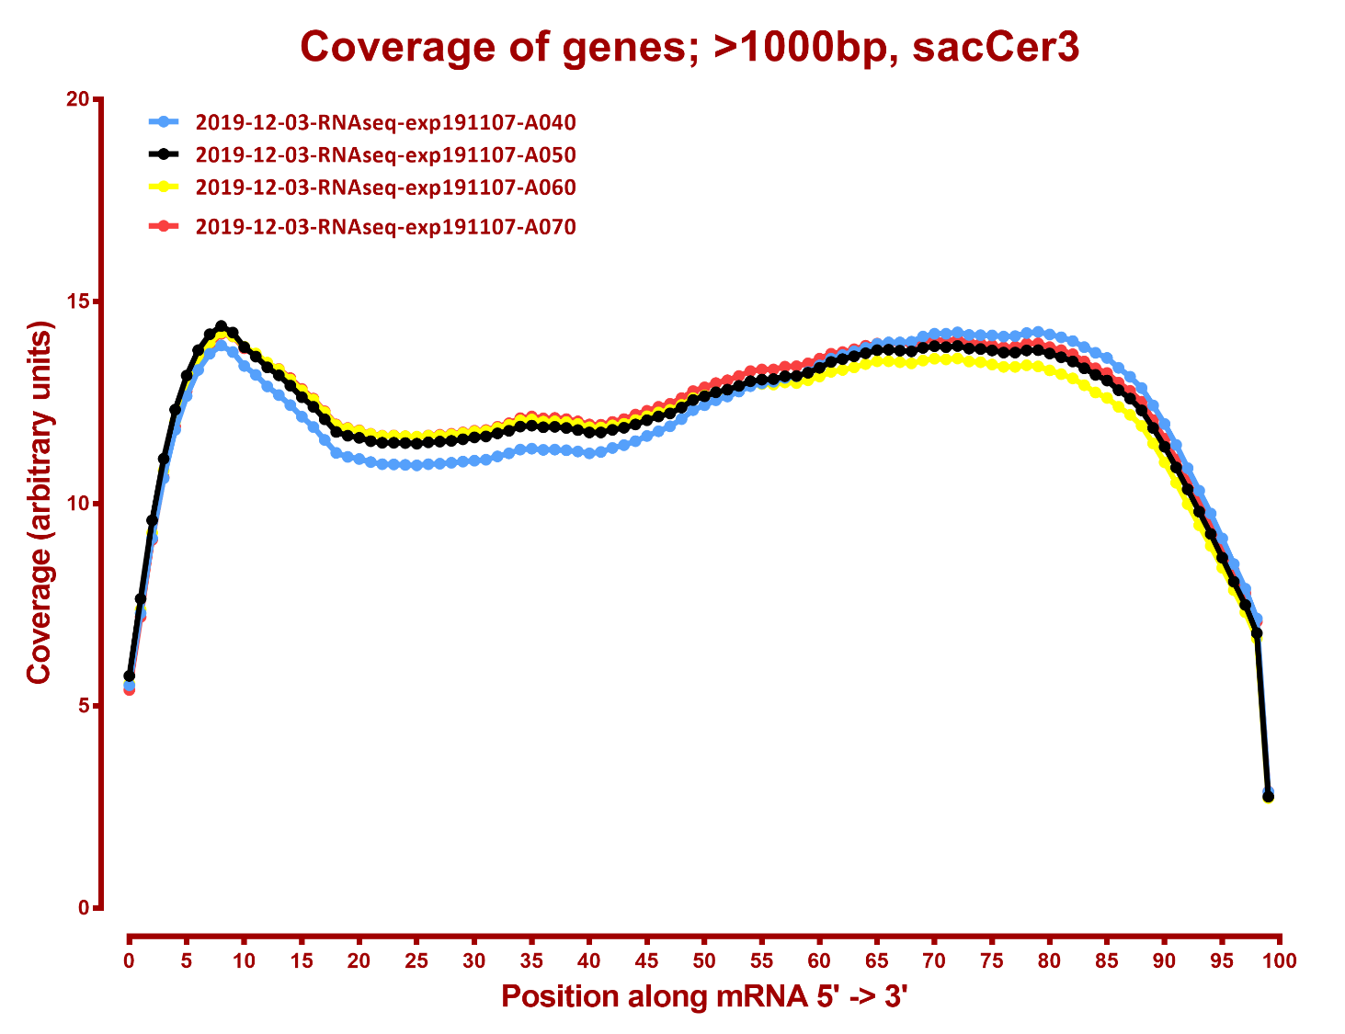
COVERAGE QC

Slide 4
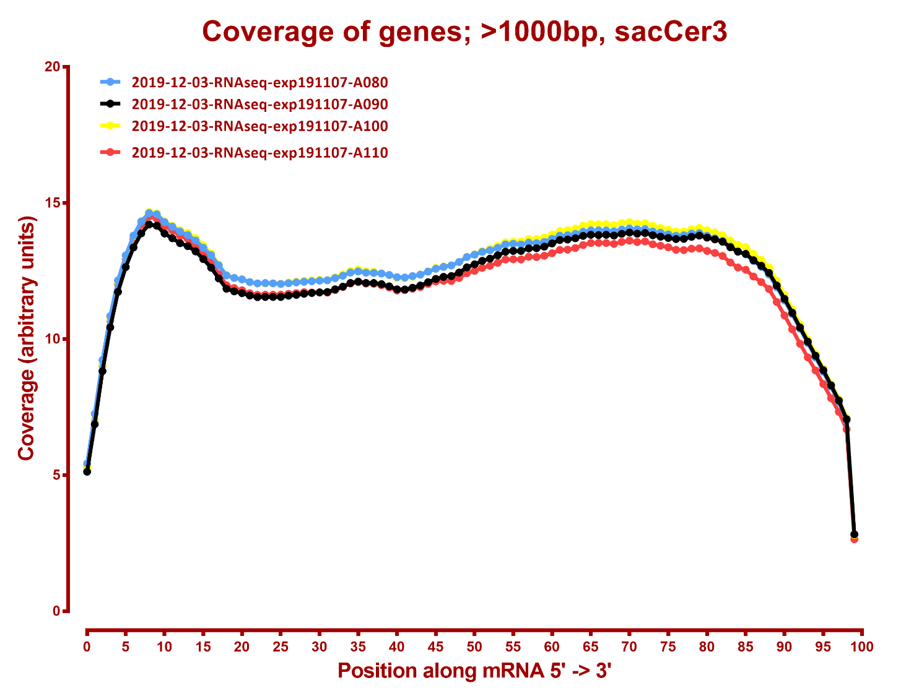

Slide 5
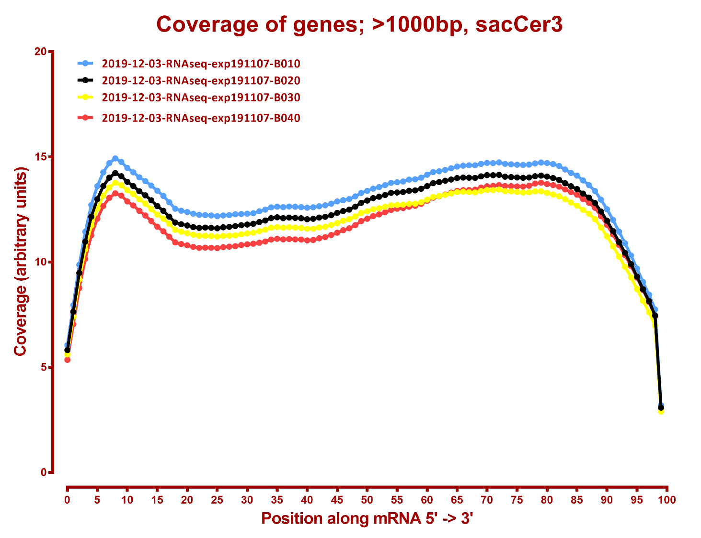

Slide 6
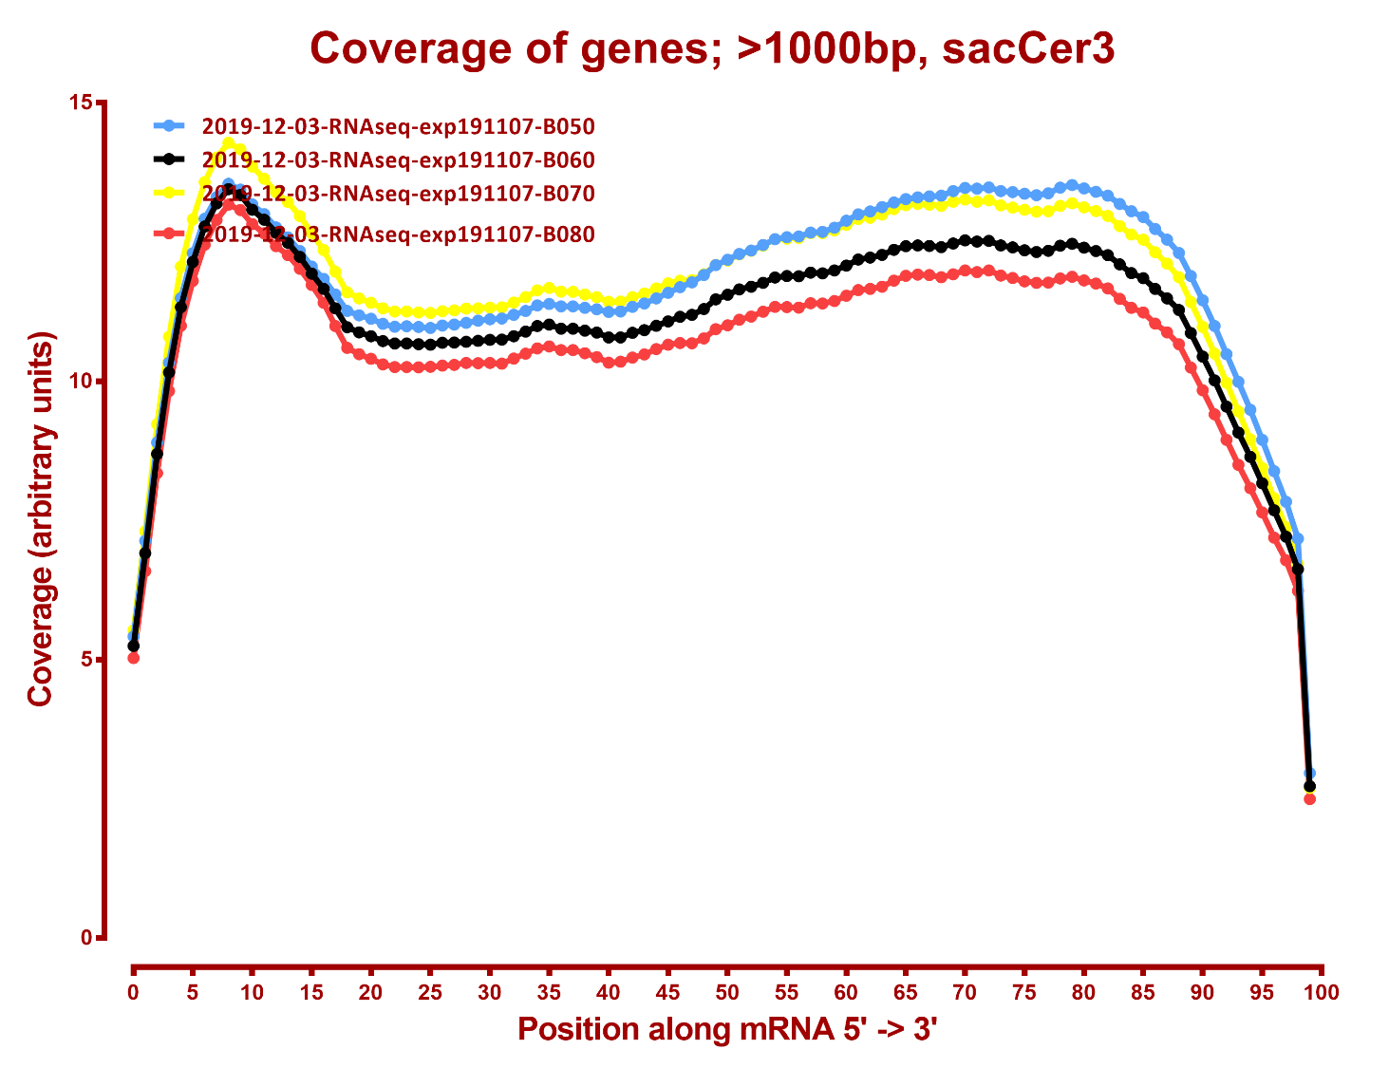

Slide 7
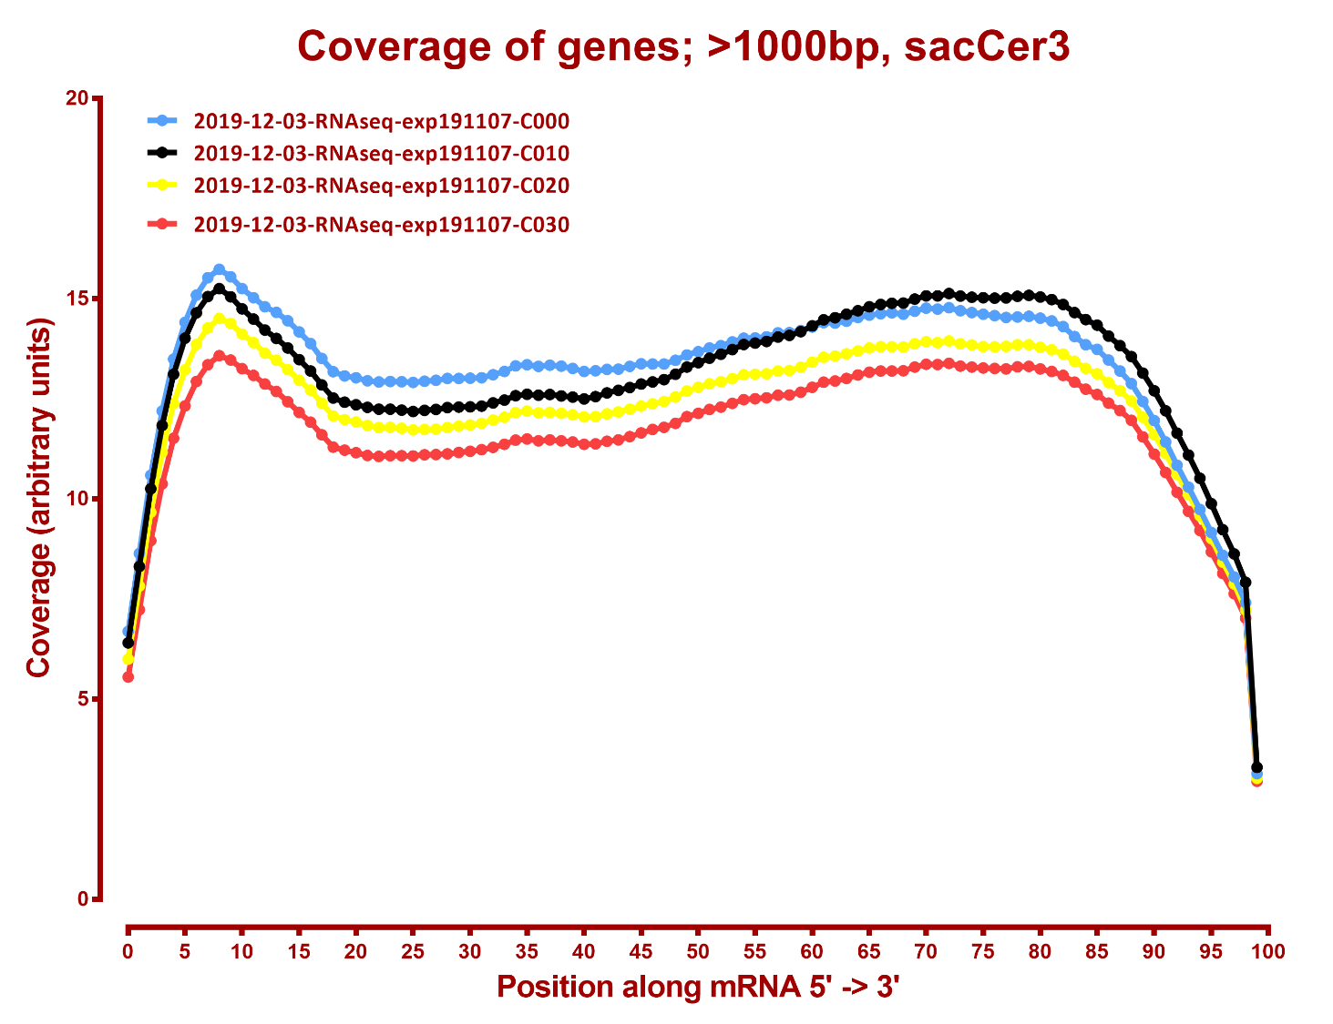

Slide 8
