Slide 1
MAPPING STATS, S.cerevisiae ChIP SAMPLES ONLY
Species | # | Complexity | MACS2 NumPeaks | MACS2 RPM | MACS2 PseudoRep NumPeaks | MACS2 RPM | NSC | RSC | QC | Read Length | Unique | Multi | Raw fragments
Saccharomyces cerevisiae sacCer3 | 2019-08-12-190722L65_MS521_AB101_GFP-NLS-V5 | 0.68 |  |  |  |  |  |  |  | 2x36 | 23,080,984 |  | 14,809,015
Saccharomyces cerevisiae sacCer3 | 2019-08-12-190722L66_MS529_AB101_WHI5-V5 | 0.67 | 287 | 53,340 |  |  |  |  |  | 2x36 | 26,585,258 |  | 17,119,001
Saccharomyces cerevisiae sacCer3 | 2019-08-12-190722L67_MS527_AB101_STB1-V5 | 0.67 | 384 | 73,912 |  |  |  |  |  | 2x36 | 26,251,504 |  | 16,476,649
Saccharomyces cerevisiae sacCer3 | 2019-08-12-190722L68_MS522_AB101_SWI4-V5 | 0.66 | 372 | 128,638 |  |  |  |  |  | 2x36 | 25,325,600 |  | 15,909,901
Saccharomyces cerevisiae sacCer3 | 2019-08-12-190722L69_MS524_AB101_SWI6-V5 | 0.64 | 466 | 692,720 |  |  |  |  |  | 2x36 | 27,924,198 |  | 17,829,144
Saccharomyces cerevisiae sacCer3 | 2019-08-12-190722L70_MS528_AB101_BCK2-V5 | 0.68 | 226 | 72,461 |  |  |  |  |  | 2x36 | 22,793,478 |  | 14,290,468
Saccharomyces cerevisiae sacCer3 | 2019-08-12-190722L71_MS523_AB101_MBP1-V5 | 0.68 | 665 | 134,528 |  |  |  |  |  | 2x36 | 23,911,870 |  | 15,103,878
Note: peaks were called with the GFP sample as control (I assumed this is why it was done)

Slide 2
PEAK OVERLAP
#DataSet: |  | 2019-08-12-190722L66_MS529_AB101_WHI5-V5 | 2019-08-12-190722L67_MS527_AB101_STB1-V5 | 2019-08-12-190722L68_MS522_AB101_SWI4-V5 | 2019-08-12-190722L69_MS524_AB101_SWI6-V5 | 2019-08-12-190722L70_MS528_AB101_BCK2-V5 | 2019-08-12-190722L71_MS523_AB101_MBP1-V5
 | Regions | 287 | 384 | 372 | 466 | 226 | 665
2019-08-12-190722L66_MS529_AB101_WHI5-V5 | 287 | 1.00 | 0.32 | 0.25 | 0.25 | 0.19 | 0.34
2019-08-12-190722L67_MS527_AB101_STB1-V5 | 384 | 0.23 | 1.00 | 0.63 | 0.70 | 0.40 | 0.76
2019-08-12-190722L68_MS522_AB101_SWI4-V5 | 372 | 0.19 | 0.68 | 1.00 | 0.80 | 0.48 | 0.88
2019-08-12-190722L69_MS524_AB101_SWI6-V5 | 466 | 0.14 | 0.56 | 0.61 | 1.00 | 0.56 | 0.76
2019-08-12-190722L70_MS528_AB101_BCK2-V5 | 226 | 0.23 | 0.65 | 0.70 | 0.82 | 1.00 | 0.81
2019-08-12-190722L71_MS523_AB101_MBP1-V5 | 665 | 0.18 | 0.54 | 0.57 | 0.60 | 0.36 | 1.00

Slide 3
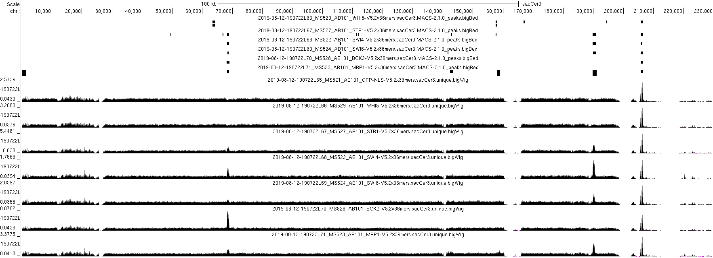
chrI

Slide 4
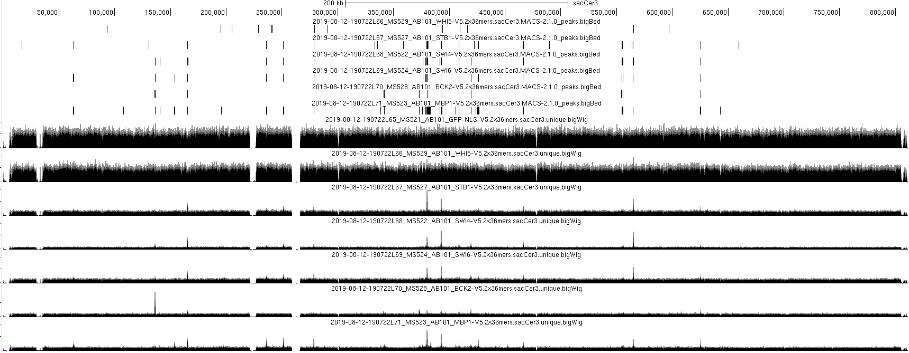
chrII

Slide 5
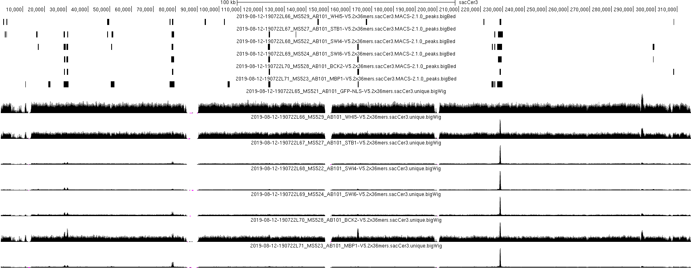
chrIII

Slide 6
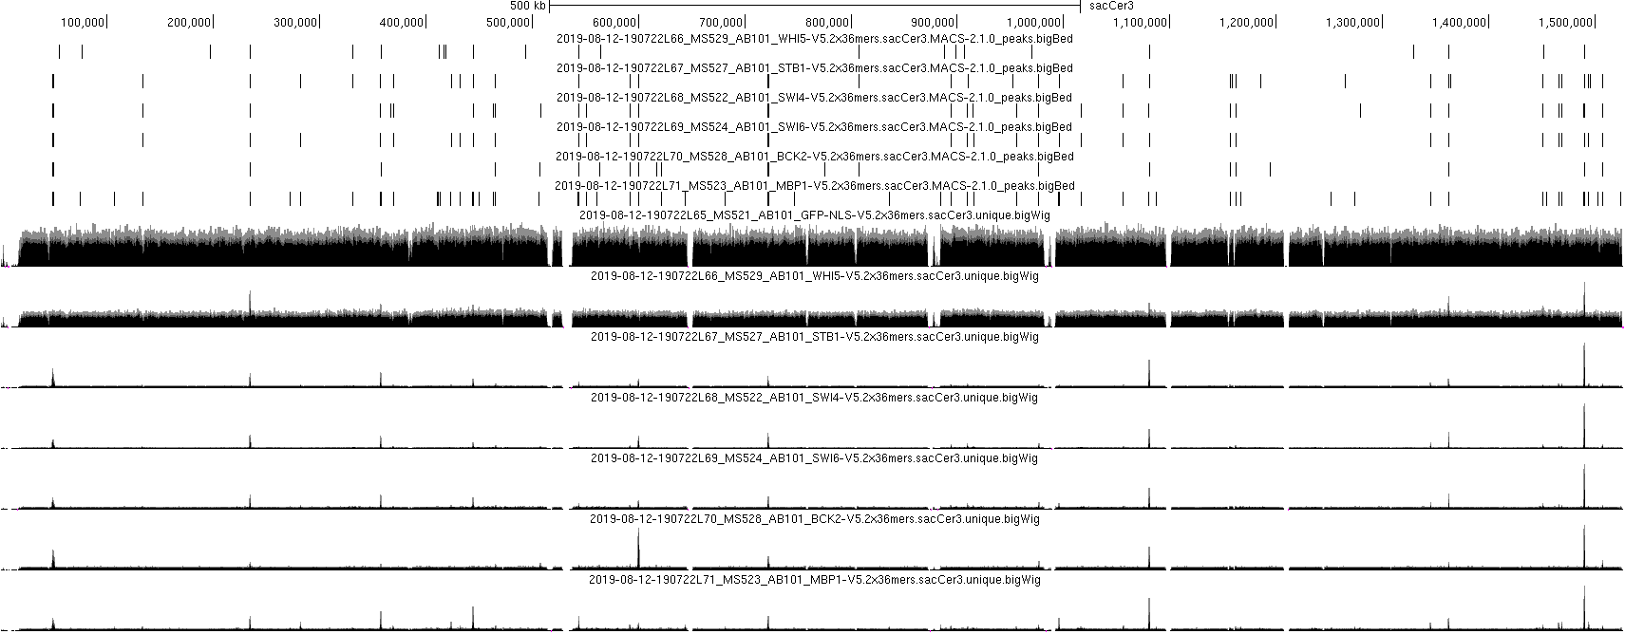
chrIV

