Slide 1
MAPPING STATS

Slide 2
READ DISTRIBUTION
# | Exonic: | Intergenic: | Intronic:
2019-07-06-G2M_1_rep1-A1.Schizosaccharomyces_pombe.ASM294v2.20 | 0.98 | 0.02 | 0.01
2019-07-06-G2M_1_rep1-A1.sacCer3 | 0.89 | 0.10 | 0.00
2019-07-06-G2M_1_rep2-A2.Schizosaccharomyces_pombe.ASM294v2.20 | 0.98 | 0.02 | 0.01
2019-07-06-G2M_1_rep2-A2.sacCer3 | 0.89 | 0.10 | 0.00
2019-07-06-G2M_2_rep1-B1.Schizosaccharomyces_pombe.ASM294v2.20 | 0.98 | 0.02 | 0.01
2019-07-06-G2M_2_rep1-B1.sacCer3 | 0.89 | 0.10 | 0.00
2019-07-06-G2M_2_rep1-B2.Schizosaccharomyces_pombe.ASM294v2.20 | 0.98 | 0.02 | 0.01
2019-07-06-G2M_2_rep1-B2.sacCer3 | 0.90 | 0.10 | 0.00
2019-07-06-G2M_3_rep1-C1.Schizosaccharomyces_pombe.ASM294v2.20 | 0.98 | 0.02 | 0.01
2019-07-06-G2M_3_rep1-C1.sacCer3 | 0.90 | 0.10 | 0.00
2019-07-06-G2M_3_rep2-C2.Schizosaccharomyces_pombe.ASM294v2.20 | 0.98 | 0.01 | 0.00
2019-07-06-G2M_3_rep2-C2.sacCer3 | 0.90 | 0.10 | 0.00
2019-07-06-G2M_4_rep1-D1.Schizosaccharomyces_pombe.ASM294v2.20 | 0.98 | 0.01 | 0.00
2019-07-06-G2M_4_rep1-D1.sacCer3 | 0.90 | 0.10 | 0.00
2019-07-06-G2M_4_rep2-D2.Schizosaccharomyces_pombe.ASM294v2.20 | 0.98 | 0.02 | 0.00
2019-07-06-G2M_4_rep2-D2.sacCer3 | 0.90 | 0.10 | 0.00
2019-07-06-input_rep1-E1.Schizosaccharomyces_pombe.ASM294v2.20 | 0.98 | 0.02 | 0.00
2019-07-06-input_rep1-E1.sacCer3 | 0.90 | 0.10 | 0.00
2019-07-06-input_rep2-E2.Schizosaccharomyces_pombe.ASM294v2.20 | 0.98 | 0.01 | 0.00
2019-07-06-input_rep2-E2.sacCer3 | 0.90 | 0.10 | 0.00
2019-07-06-unstained_input_rep1-F1.Schizosaccharomyces_pombe.ASM294v2.20 | 0.98 | 0.02 | 0.01
2019-07-06-unstained_input_rep1-F1.sacCer3 | 0.90 | 0.10 | 0.00
2019-07-06-unstained_input_rep2-F2.Schizosaccharomyces_pombe.ASM294v2.20 | 0.98 | 0.02 | 0.01
2019-07-06-unstained_input_rep2-F2.sacCer3 | 0.90 | 0.10 | 0.00

Slide 3
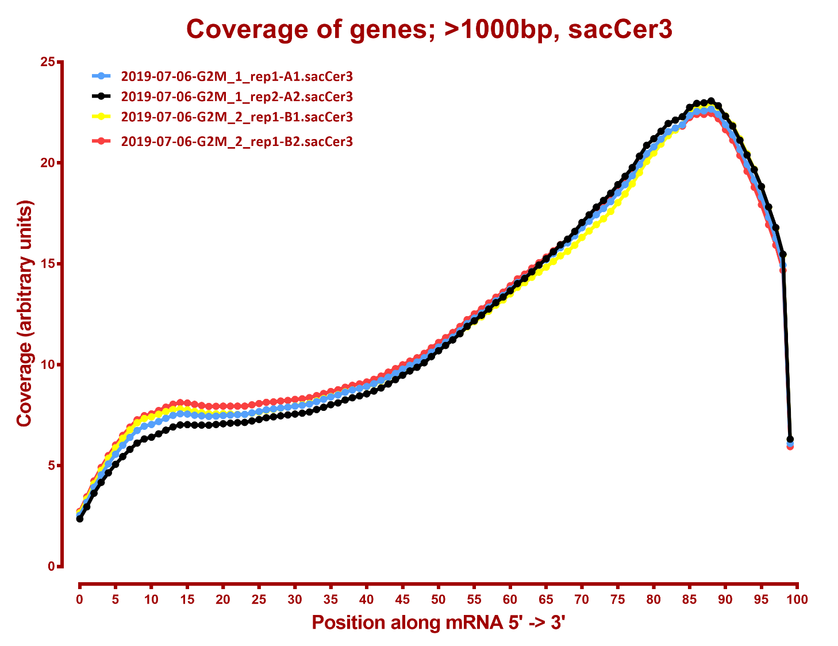

Slide 4
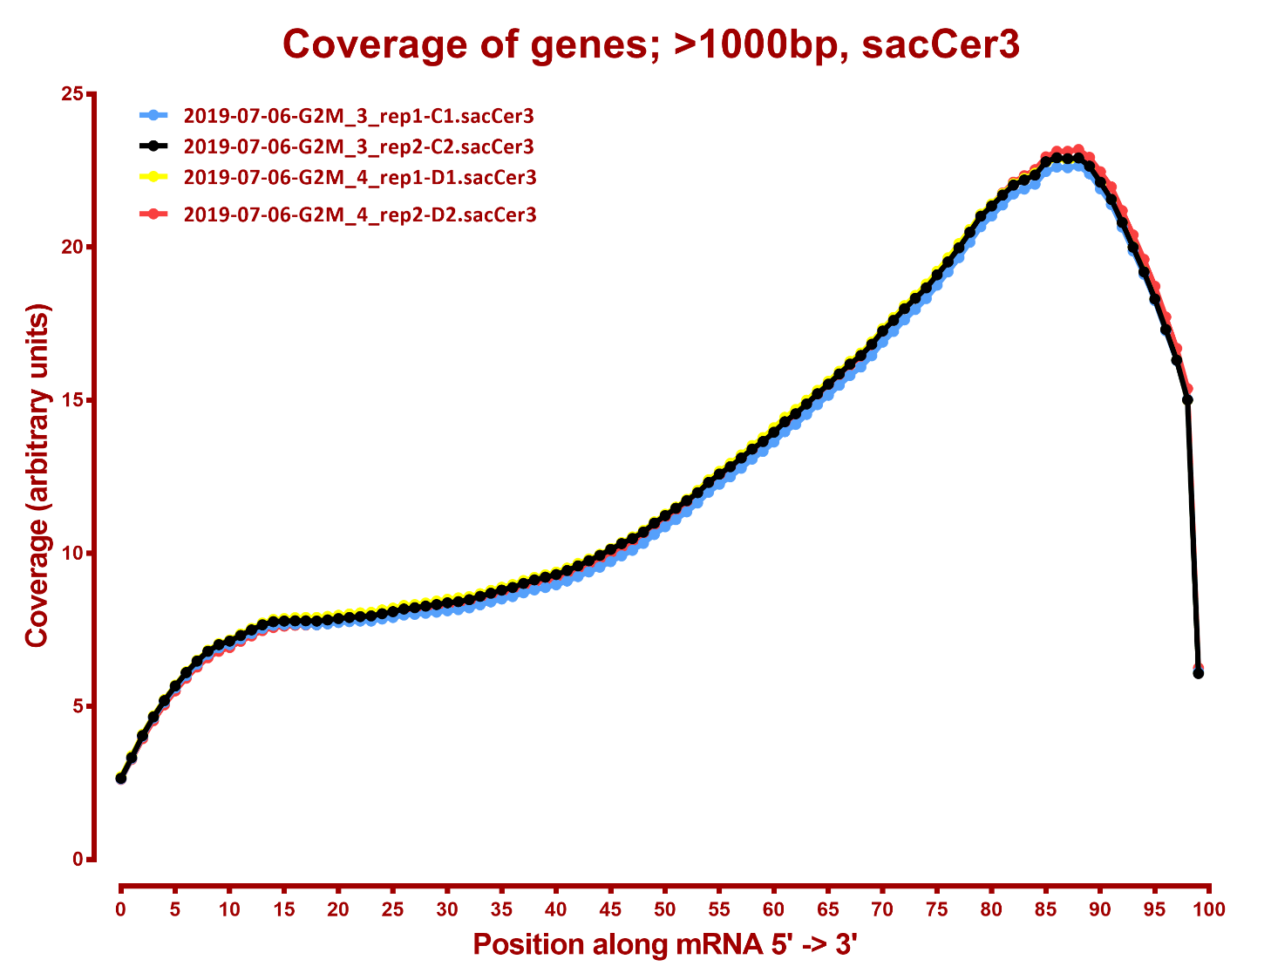

Slide 5
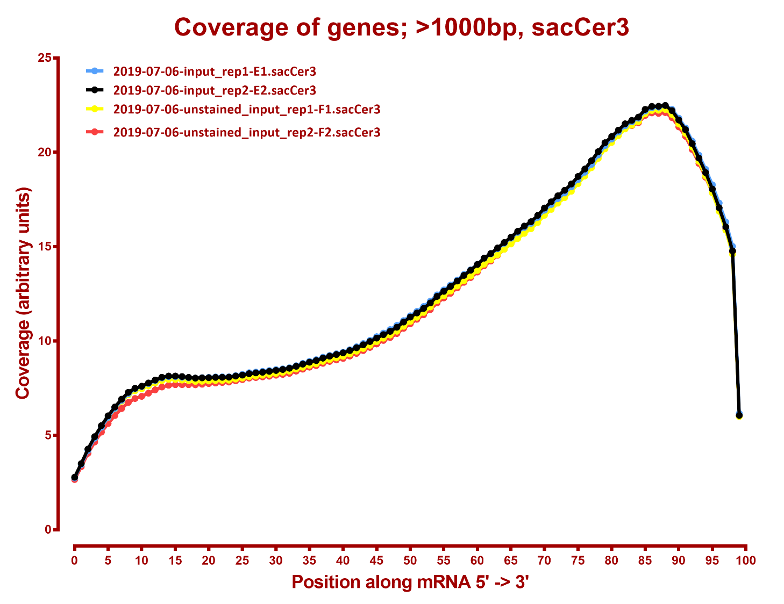

Slide 6
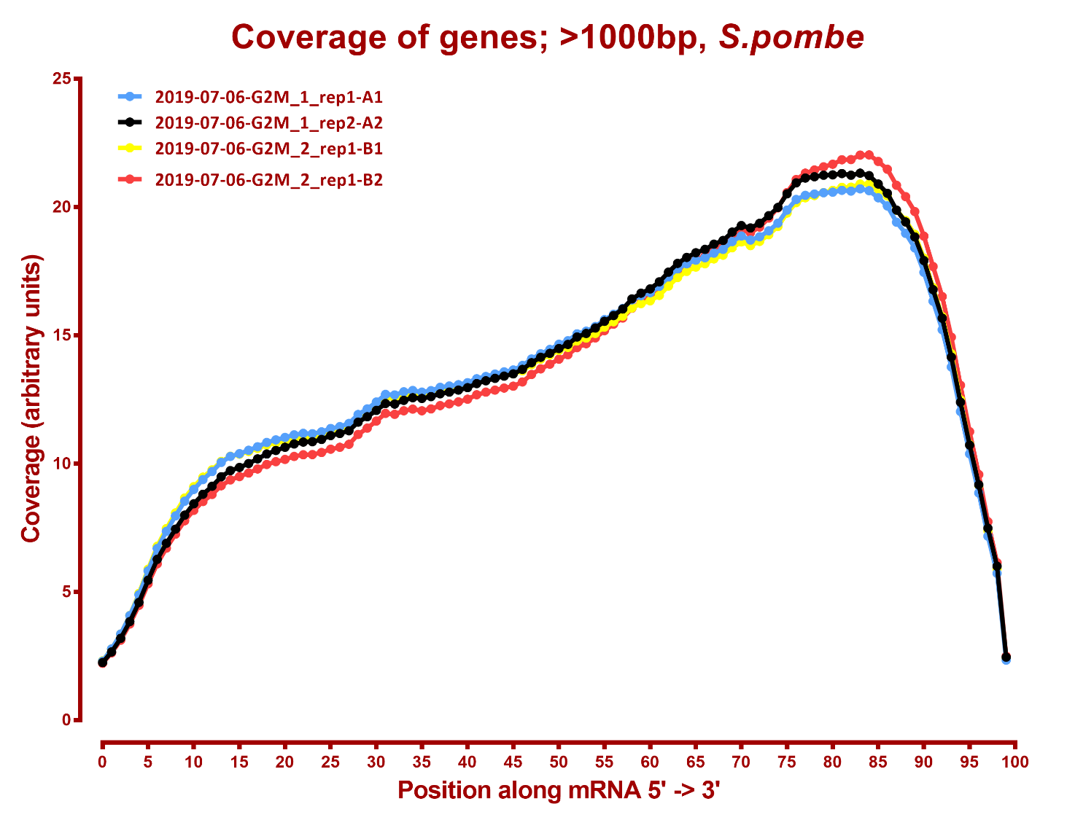

Slide 7
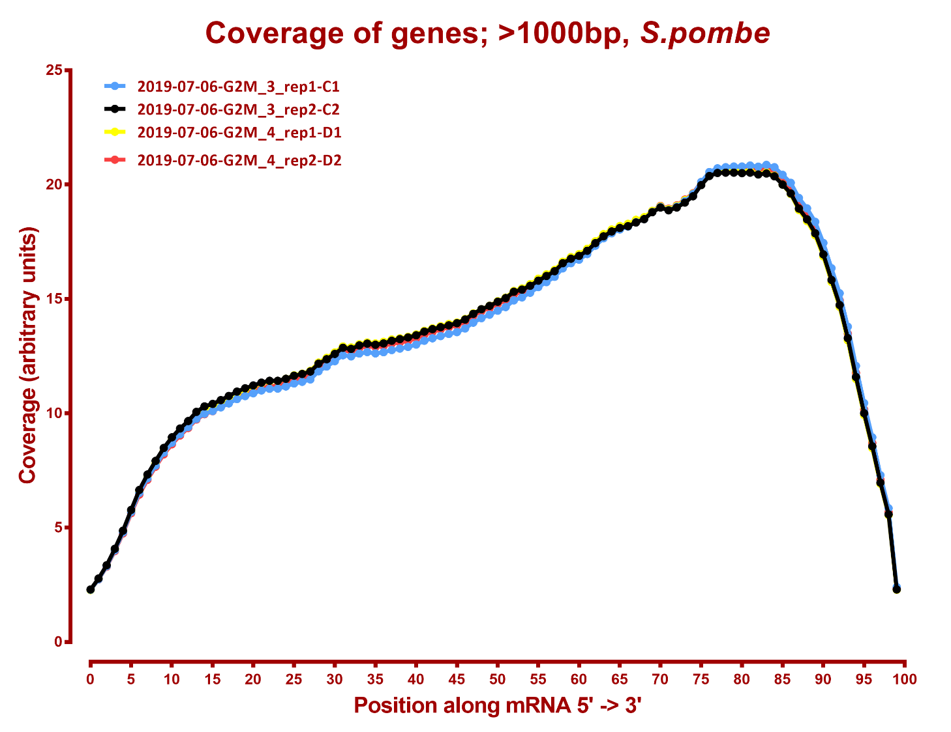

Slide 8
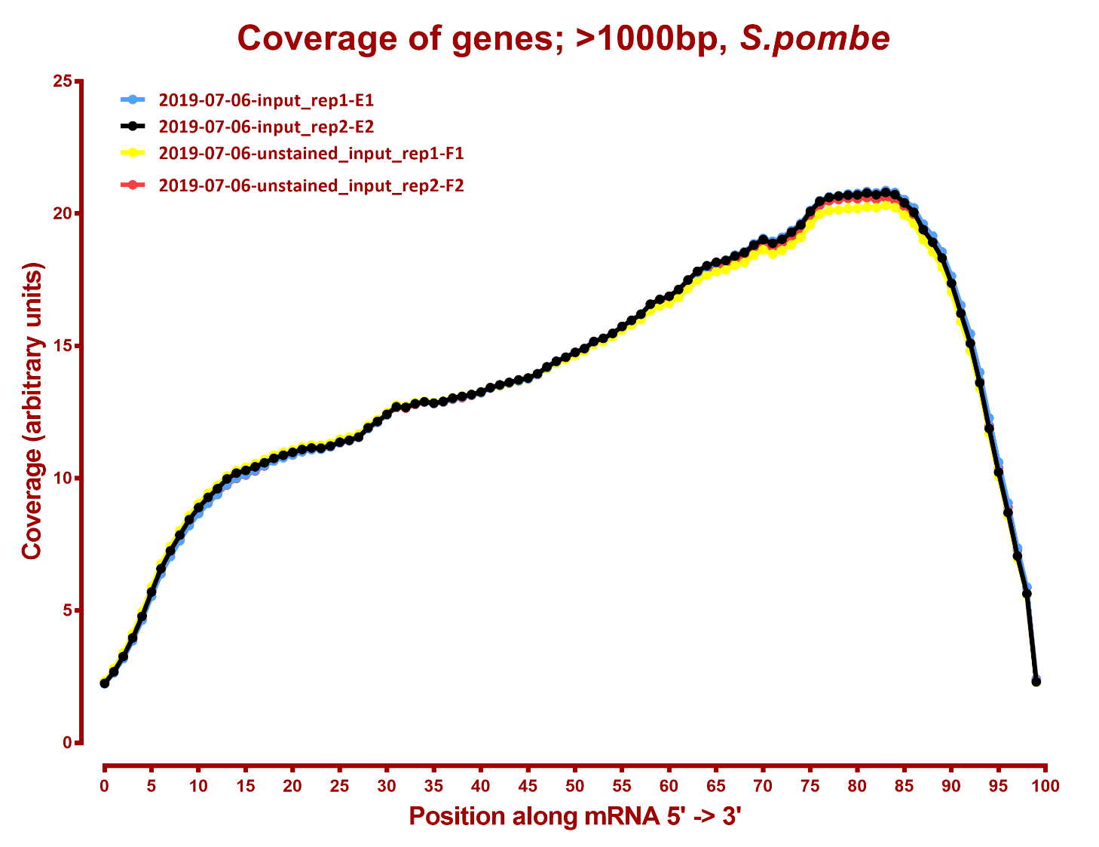

Slide 9
Number differential genes, sacCer3
A | B | p-adj |  | p-val
 |  | up in B vs A | down in B vs A | up in B vs A | down in B vs A
G2M_1 | G2M_2 | 548 | 417 | 898 | 741
G2M_1 | G2M_3 | 1,086 | 984 | 1,334 | 1,224
G2M_1 | G2M_4 | 1,330 | 1,242 | 1,527 | 1,439
G2M_1 | input | 987 | 919 | 1,226 | 1,181
G2M_1 | unstained_input | 987 | 906 | 1,239 | 1,186
G2M_2 | G2M_3 | 428 | 416 | 723 | 749
G2M_2 | G2M_4 | 774 | 728 | 1,071 | 1,046
G2M_2 | input | 484 | 347 | 793 | 706
G2M_2 | unstained_input | 510 | 390 | 770 | 737
G2M_3 | G2M_4 | 239 | 168 | 519 | 431
G2M_3 | input | 432 | 367 | 735 | 718
G2M_3 | unstained_input | 382 | 324 | 665 | 678
G2M_4 | input | 503 | 473 | 783 | 812
G2M_4 | unstained_input | 486 | 499 | 768 | 818
input | unstained_input | 2 | 6 | 223 | 222

Slide 10
Number differential genes, S. pombe
A | B | p-adj |  | p-val
 |  | up in B vs A | down in B vs A | up in B vs A | down in B vs A
G2M_1 | G2M_2 | 8 | 6 | 220 | 205
G2M_1 | G2M_3 | 1 | 3 | 109 | 165
G2M_1 | G2M_4 | 6 | 5 | 196 | 233
G2M_1 | input | 3 | 6 | 223 | 218
G2M_1 | unstained_input | 3 | 6 | 230 | 197
G2M_2 | G2M_3 | 8 | 20 | 256 | 260
G2M_2 | G2M_4 | 17 | 40 | 339 | 352
G2M_2 | input | 25 | 27 | 327 | 297
G2M_2 | unstained_input | 12 | 19 | 322 | 311
G2M_3 | G2M_4 | 2 | 4 | 146 | 191
G2M_3 | input | 1 | 1 | 231 | 206
G2M_3 | unstained_input | 5 | 3 | 201 | 197
G2M_4 | input | 7 | 4 | 229 | 220
G2M_4 | unstained_input | 17 | 8 | 242 | 201
input | unstained_input | 10 | 20 | 241 | 270

