Slide 1
MAPPING STATS
Library | Read Length | Mapping | Species | Raw fragments | Complexity | Unique | Unique Splices | Multi | Multi Splices | Fraction mapped
2019-05-16-SG2_1 | 2x150 | STAR-2.5.3a | hg38 | 50,777,738 | 0.27 | 51,192,843 | 42,319,409 | 2,574,408 | 3,426,282 | 0.98
2019-05-16-SG2_1R | 2x150 | STAR-2.5.3a | hg38 | 25,126,115 | 0.36 | 26,673,024 | 19,821,714 | 1,099,135 | 1,393,949 | 0.97
2019-05-16-SG2_2R | 2x150 | STAR-2.5.3a | hg38 | 48,472,733 | 0.25 | 50,551,498 | 38,918,858 | 2,209,399 | 2,923,625 | 0.98
2019-05-16-SG2_3R | 2x150 | STAR-2.5.3a | hg38 | 48,589,117 | 0.28 | 51,447,847 | 38,507,267 | 2,151,768 | 2,894,736 | 0.98
2019-05-16-SG2_4 | 2x150 | STAR-2.5.3a | hg38 | 51,428,399 | 0.27 | 51,372,568 | 43,186,766 | 2,360,903 | 3,450,769 | 0.98
2019-05-16-SG2_4R | 2x150 | STAR-2.5.3a | hg38 | 54,104,393 | 0.24 | 55,005,619 | 44,870,483 | 2,514,213 | 3,435,227 | 0.98
# | Exonic: | Intergenic: | Intronic:
2019-05-16-SG2_1 | 0.93 | 0.01 | 0.06
2019-05-16-SG2_1R | 0.92 | 0.01 | 0.06
2019-05-16-SG2_2R | 0.93 | 0.01 | 0.06
2019-05-16-SG2_3R | 0.93 | 0.01 | 0.06
2019-05-16-SG2_4 | 0.94 | 0.01 | 0.05
2019-05-16-SG2_4R | 0.95 | 0.01 | 0.04

Slide 2
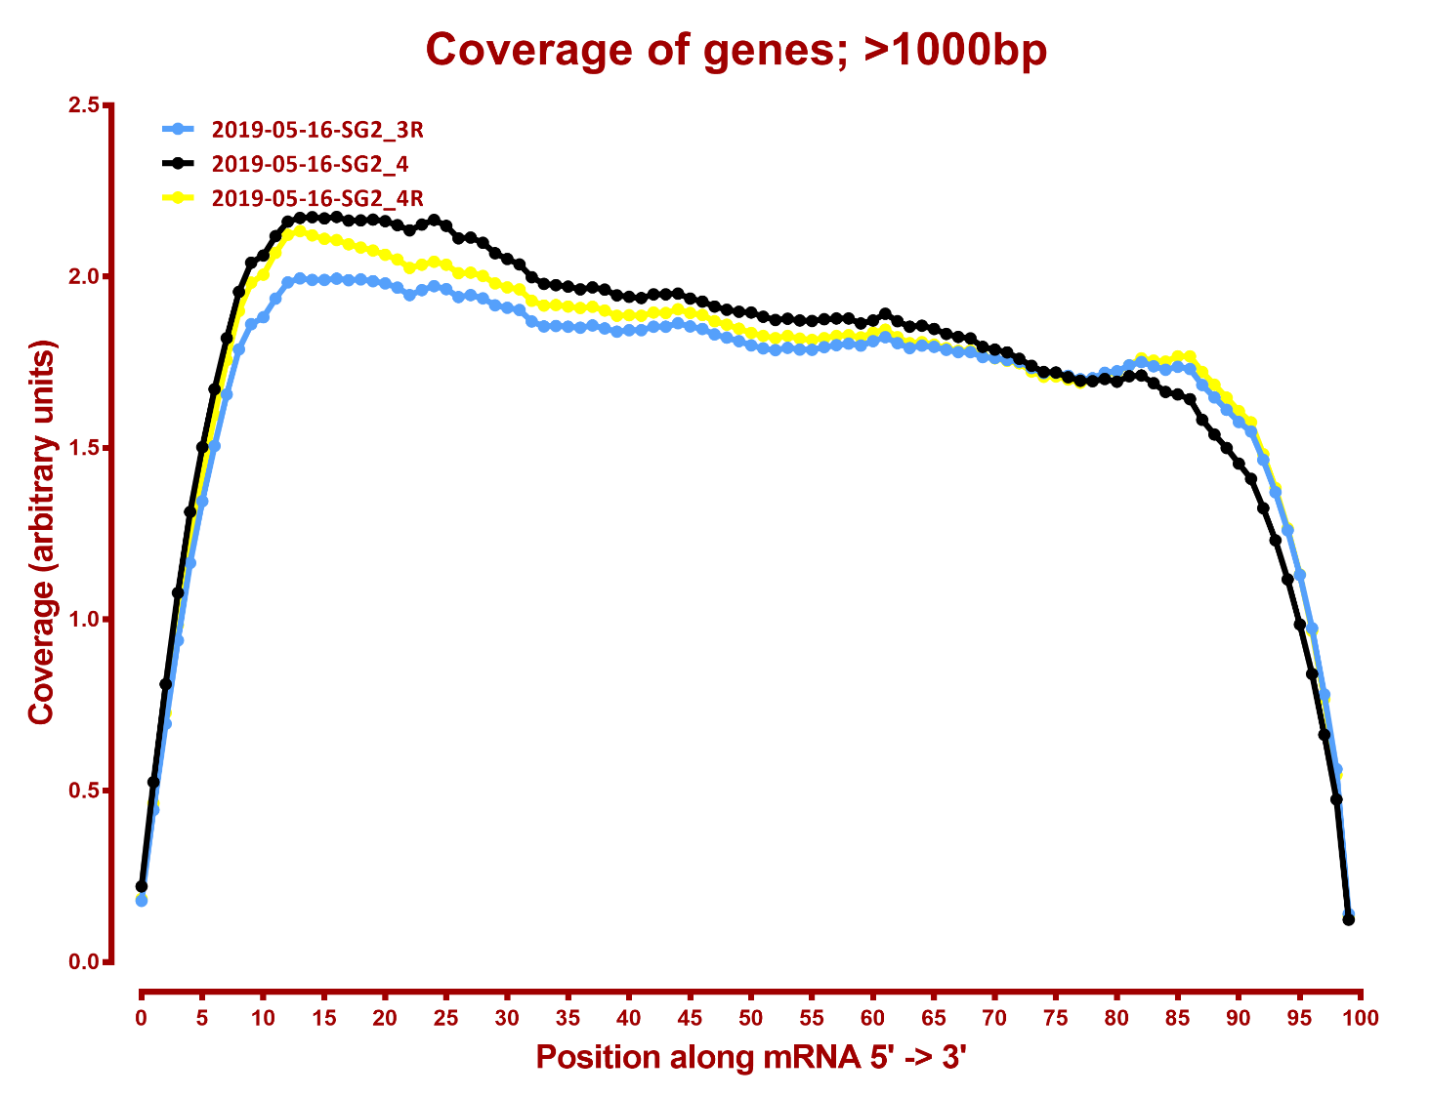

Slide 3
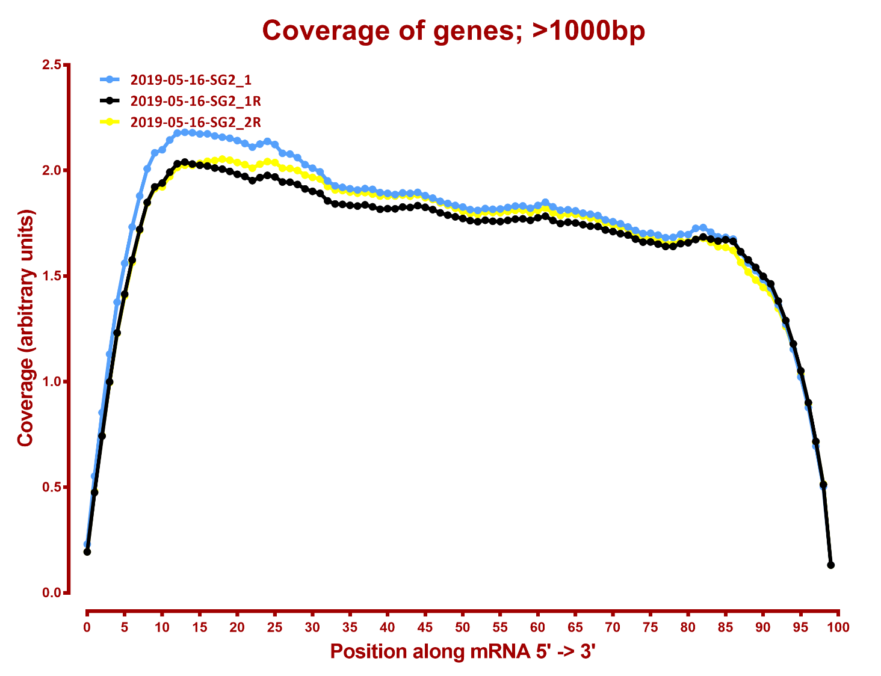

Slide 4
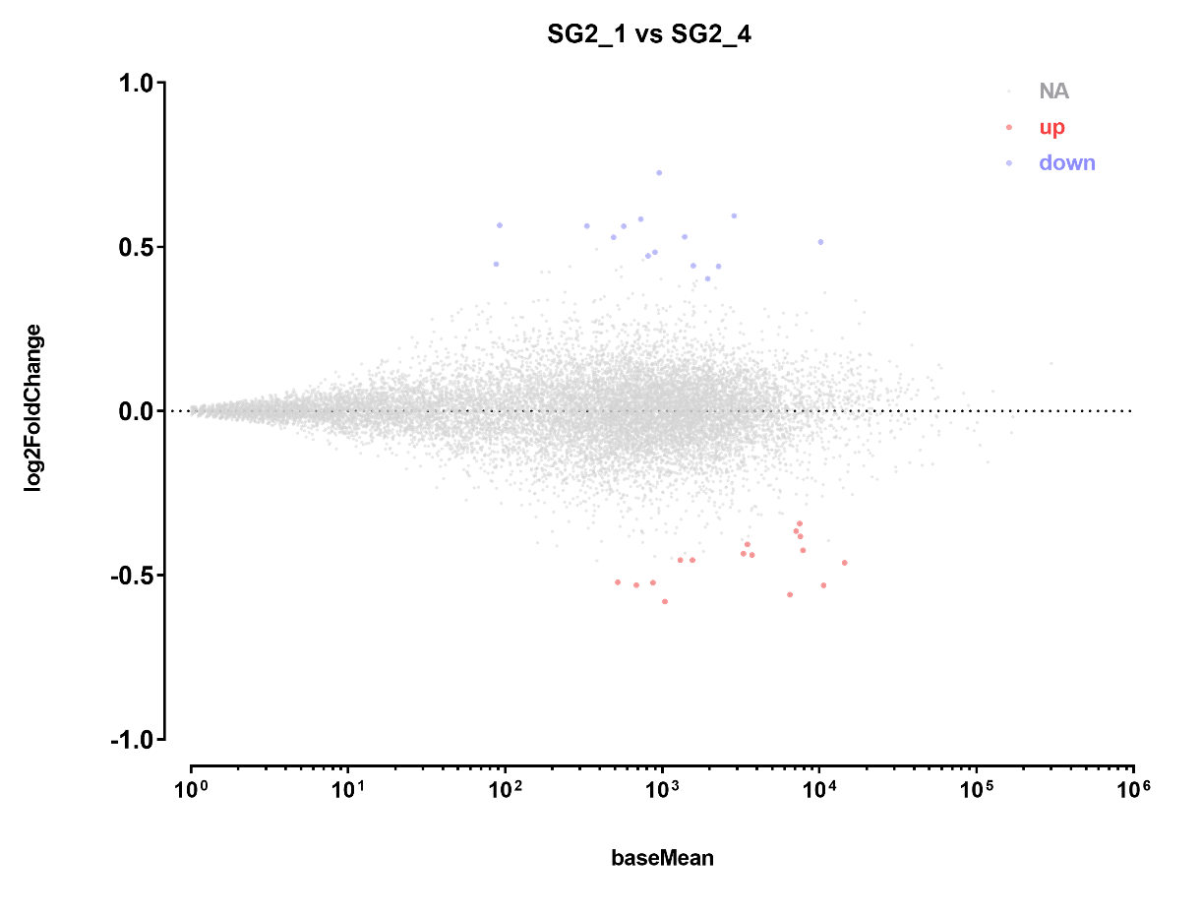
DESEQ SUMMARY
all genes
A | B | p-adj |  | p-val
 |  | up in B vs A | down in B vs A | up in B vs A | down in B vs A
SG2_1 | SG2_4 | 17 | 16 | 240 | 241

Slide 5
UP GENES

Slide 6
UP GENES, GO ENRICHMENT
N | X | LOD | P | P_adj | attrib ID | attrib name
3 | 46 | 2.034492 | 8.24E-06 | 0.014 | GO:0051310 | metaphase plate congression
3 | 60 | 1.912979 | 1.84E-05 | 0.024 | GO:0051303 | establishment of chromosome localization
3 | 62 | 1.898082 | 2.03E-05 | 0.033 | GO:0050000 | chromosome localization
4 | 116 | 1.762745 | 2.67E-06 | 0.004 | GO:0007062 | sister chromatid cohesion
4 | 119 | 1.751243 | 2.96E-06 | 0.005 | GO:0000922 | spindle pole
4 | 131 | 1.708027 | 4.34E-06 | 0.008 | GO:1903046 | meiotic cell cycle process
4 | 143 | 1.668674 | 6.15E-06 | 0.01 | GO:0030496 | midbody
7 | 601 | 1.369056 | 3.62E-07 | <0.001 | GO:1903047 | mitotic cell cycle process
5 | 396 | 1.33778 | 1.69E-05 | 0.024 | GO:0051301 | cell division
7 | 966 | 1.152069 | 8.63E-06 | 0.014 | GO:0022402 | cell cycle process
8 | 1403 | 1.080928 | 8.88E-06 | 0.014 | GO:0044430 | cytoskeletal part

Slide 7
DOWN GENES
# | baseMean | log2FoldChange | lfcSE | stat | pvalue | padj
BBS5 | 814.7579418 | 0.472978277 | 0.120148 | 3.936621 | 8.26E-05 | 4.09E-02
BLOC1S5-TXNDC5 | 92.34078793 | 0.56584155 | 0.102227 | 5.535132 | 3.11E-08 | 0.000123
CCNE2 | 332.1070888 | 0.563513455 | 0.129493 | 4.351686 | 1.35E-05 | 0.012435
CDCA7 | 731.5830586 | 0.584832591 | 0.1233 | 4.743156 | 2.10E-06 | 0.003228
FAM111B | 569.8101441 | 0.56315923 | 0.127981 | 4.400348 | 1.08E-05 | 0.010659
MCM3 | 1947.317109 | 0.403498533 | 0.103711 | 3.890621 | 1.00E-04 | 0.044533
MCM6 | 2289.011529 | 0.441274634 | 0.10191 | 4.330027 | 1.49E-05 | 0.012866
MSH6 | 1389.937637 | 0.530976016 | 0.116332 | 4.564322 | 5.01E-06 | 0.005766
NEAT1 | 10202.45143 | 0.514934012 | 0.101617 | 5.06742 | 4.03E-07 | 0.000928
RSRP1 | 490.5024905 | 0.529459797 | 0.128894 | 4.107709 | 4.00E-05 | 0.025079
SLBP | 1579.713343 | 0.44267597 | 0.113538 | 3.898933 | 9.66E-05 | 0.044533
SNHG19 | 957.3174482 | 0.72582046 | 0.121908 | 5.953844 | 2.62E-09 | 3.62E-05
TSIX | 2870.010355 | 0.594949245 | 0.107966 | 5.510549 | 3.58E-08 | 0.000123
UNG | 900.6557601 | 0.484285764 | 0.120294 | 4.025861 | 5.68E-05 | 0.031351
ZNF674-AS1 | 87.73523446 | 0.447716423 | 0.109993 | 4.070396 | 4.69E-05 | 0.02731

Slide 8
DOWN GENES, GO ENRICHMENT
N | X | LOD | P | P_adj | attrib ID | attrib name
2 | 8 | 2.714967 | 1.76E-05 | 0.03 | GO:0016446 | somatic hypermutation of immunoglobulin genes
2 | 8 | 2.714967 | 1.76E-05 | 0.03 | GO:0042555 | MCM complex
2 | 9 | 2.652795 | 2.27E-05 | 0.039 | GO:0002566 | somatic diversification of immune receptors via somatic mutation
3 | 29 | 2.283709 | 1.63E-06 | 0.002 | GO:0006270 | DNA replication initiation
6 | 726 | 1.220457 | 1.44E-05 | 0.025 | GO:0006259 | DNA metabolic process

