Slide 1
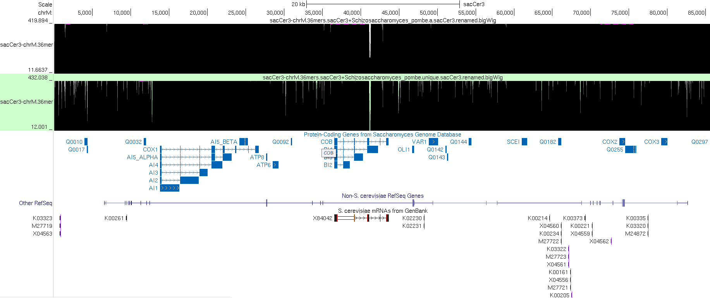

Slide 2
Other places with alignments:
chrI 189223 189355
chrIV 544679 544802
chrIV 149113 149170
chrIX 7014 7244
chrVII 404863 404975
chrVII 567877 567915
chrX 6997 7227
chrXI 15963 16238
chrXII 451345 451381
chrXII 682554 682608

