Slide 1
Dataset stats

Slide 2
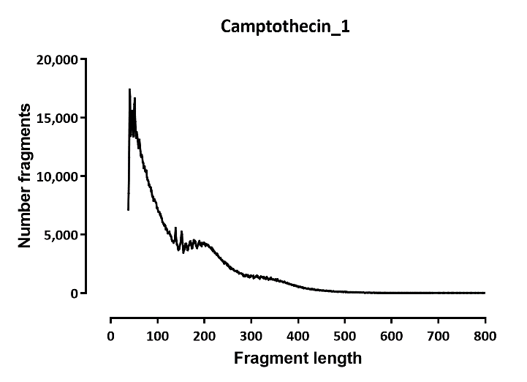
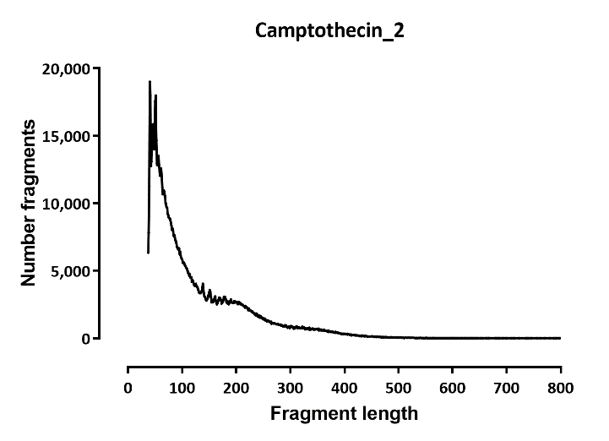
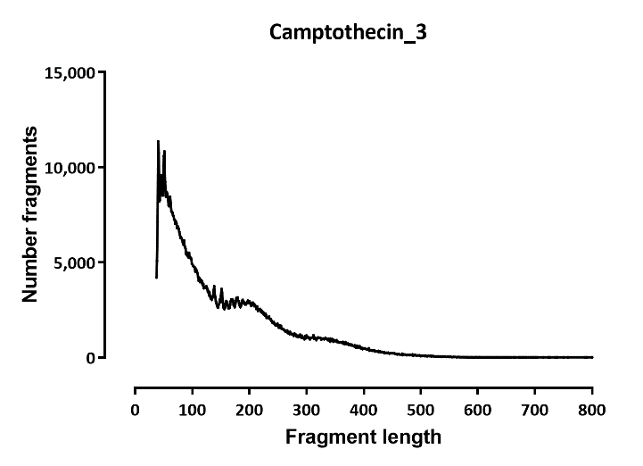
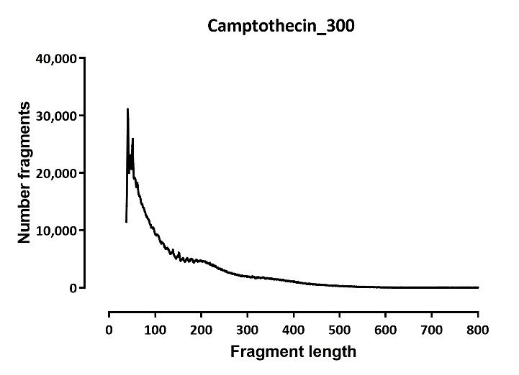
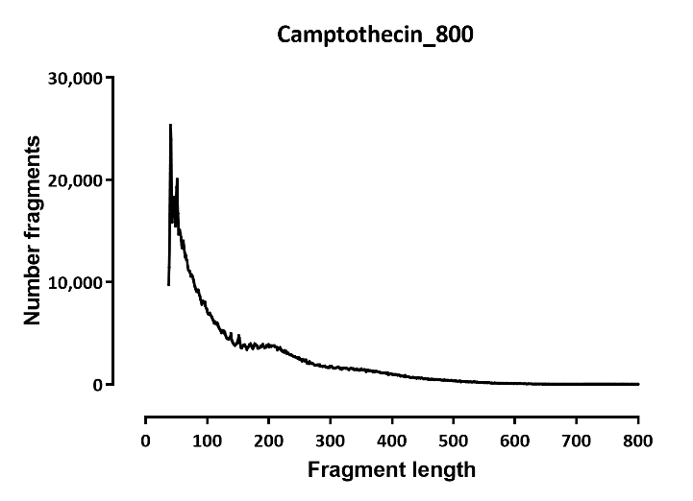
Fragment length distributions

Slide 3
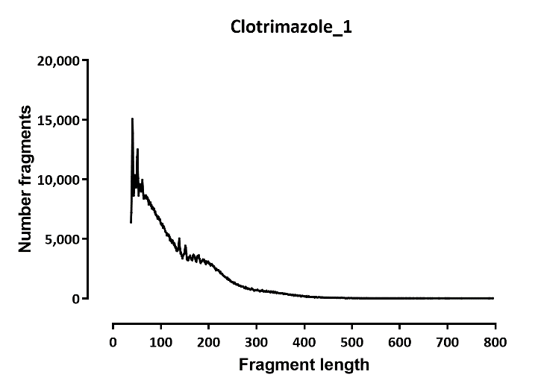
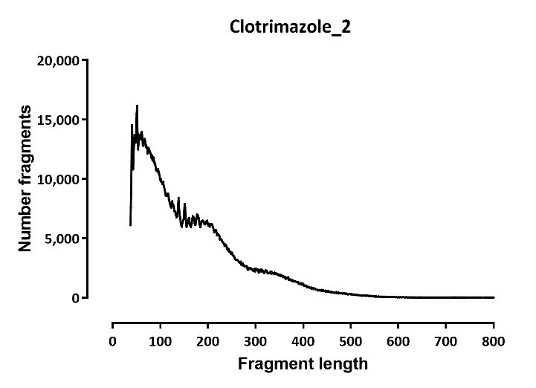
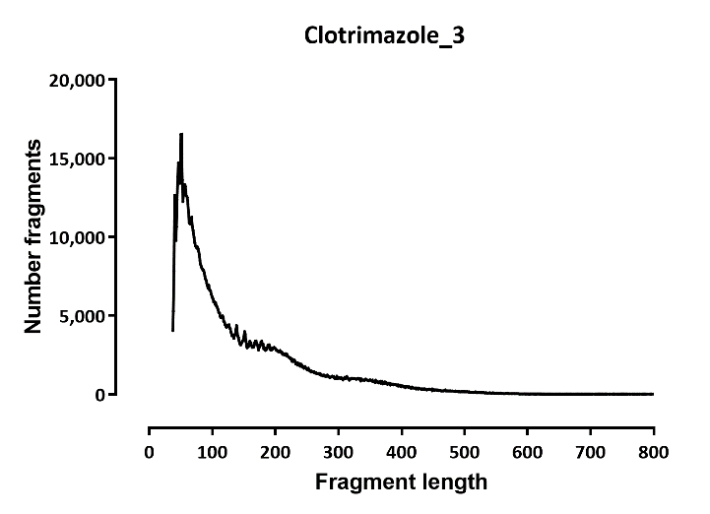
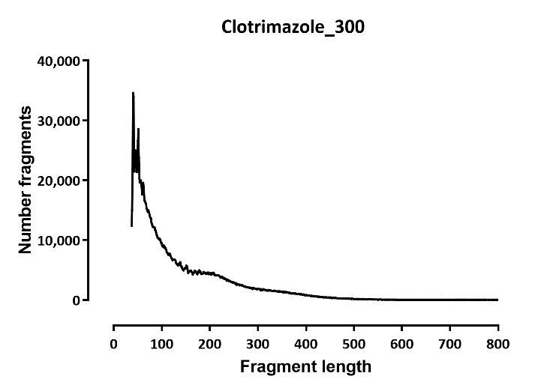
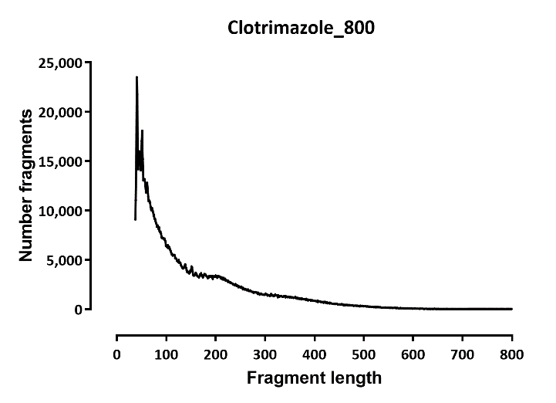

Slide 4
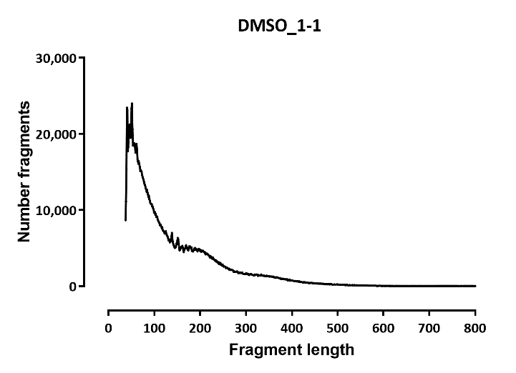
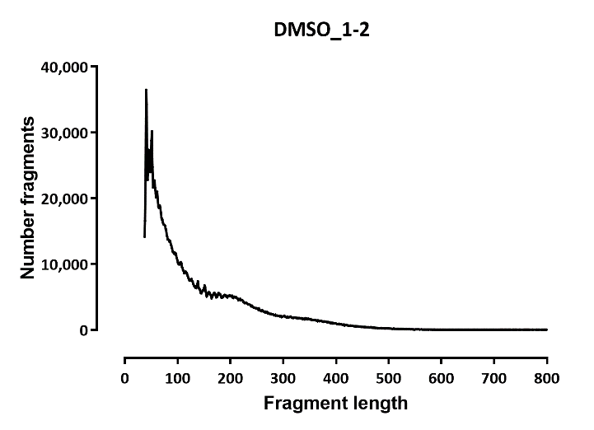

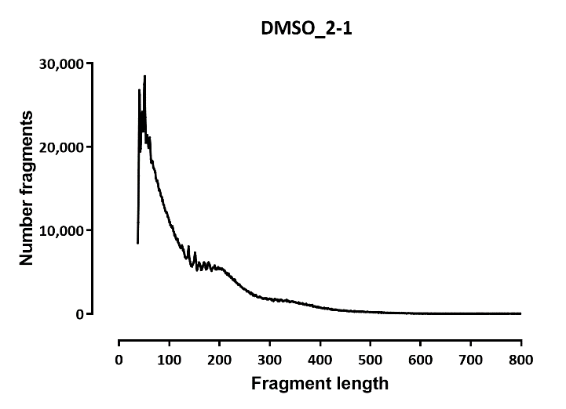

Slide 5
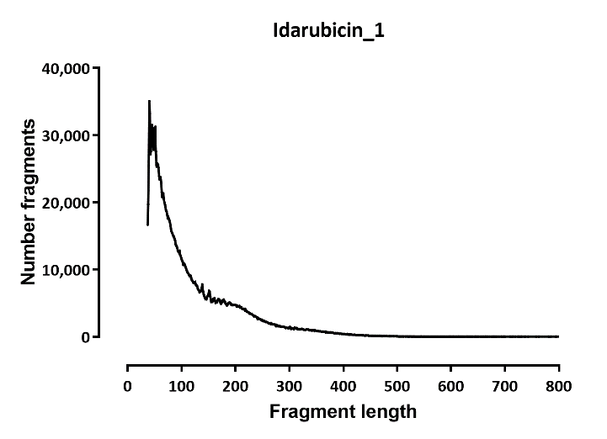

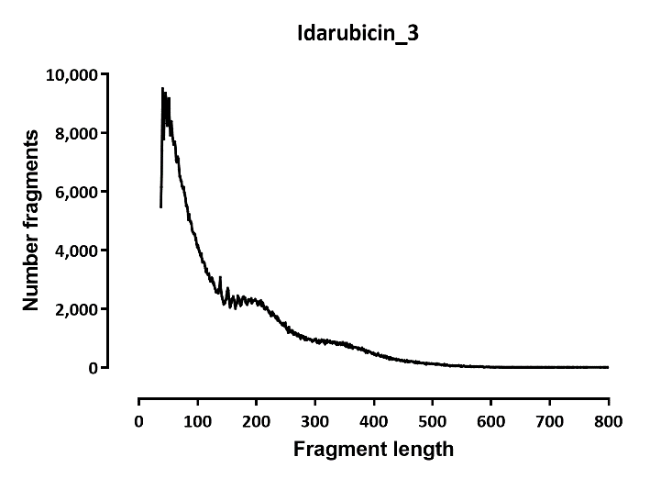
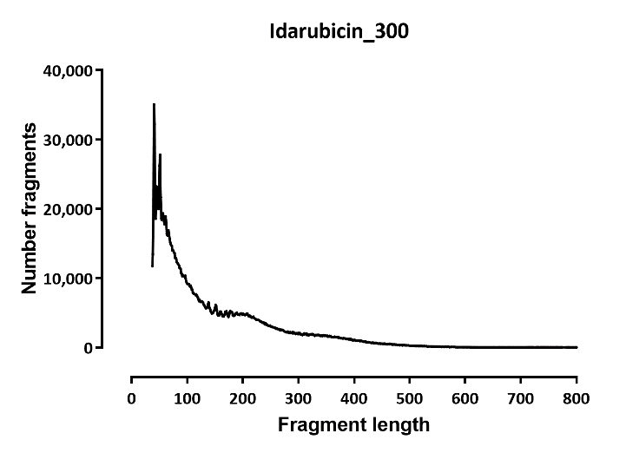


Slide 6

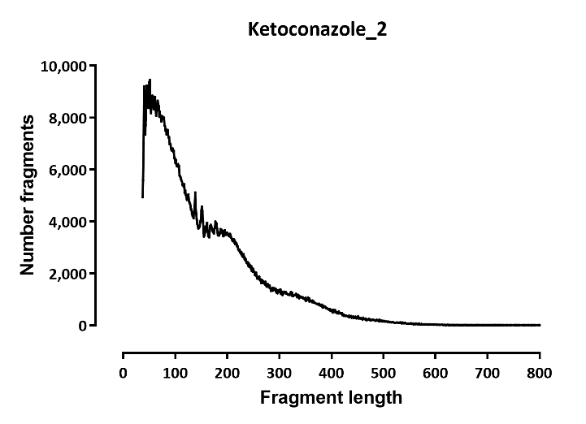
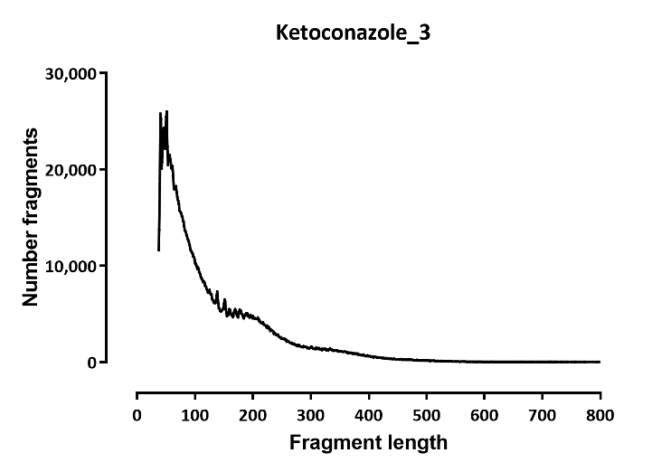
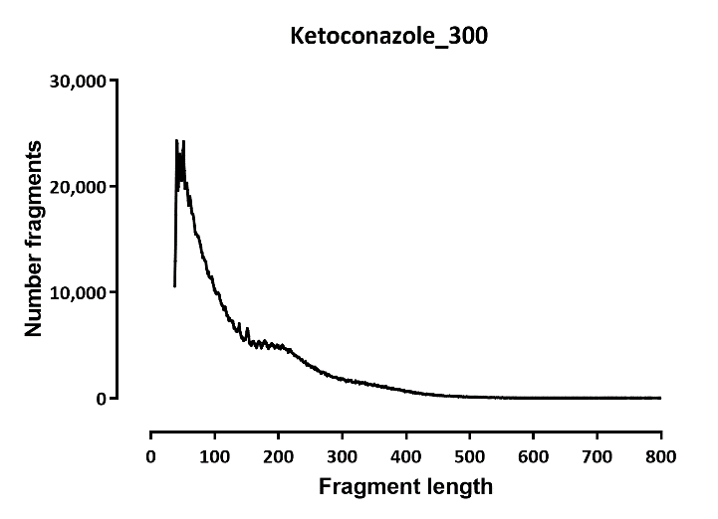
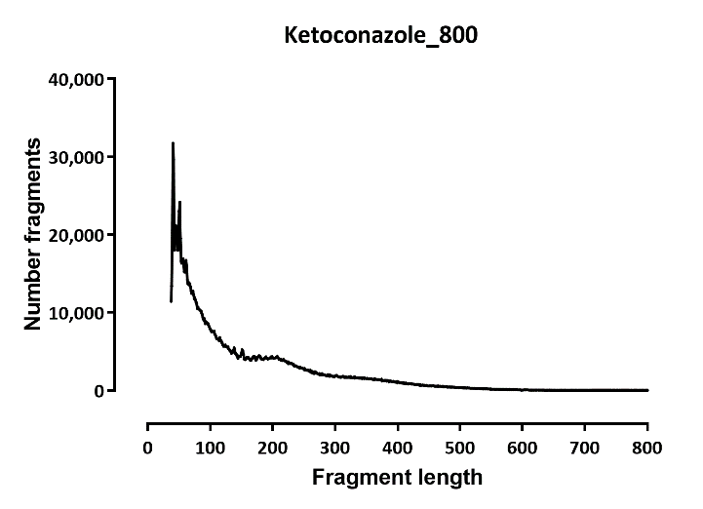

Slide 7
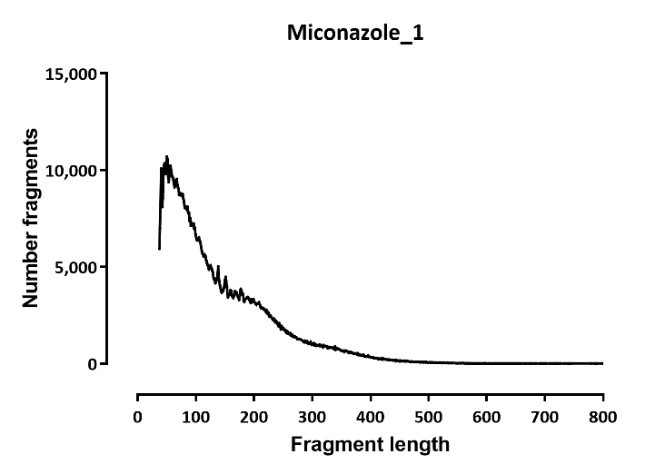
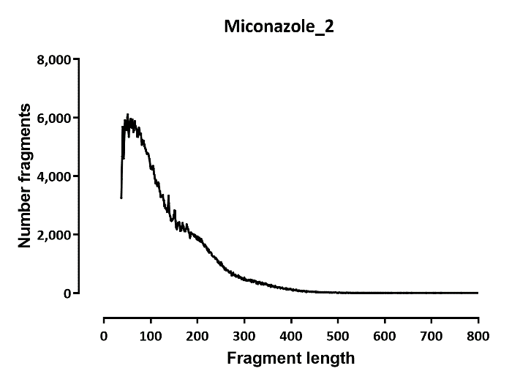
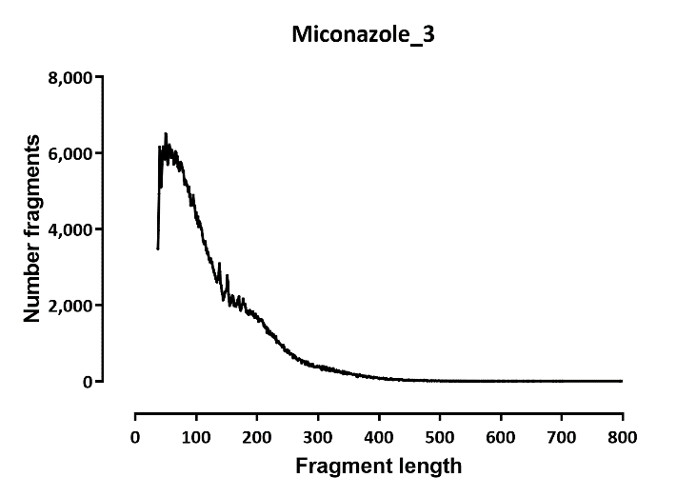

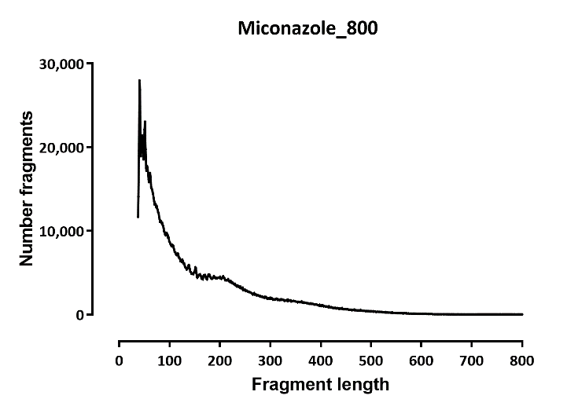

Slide 8


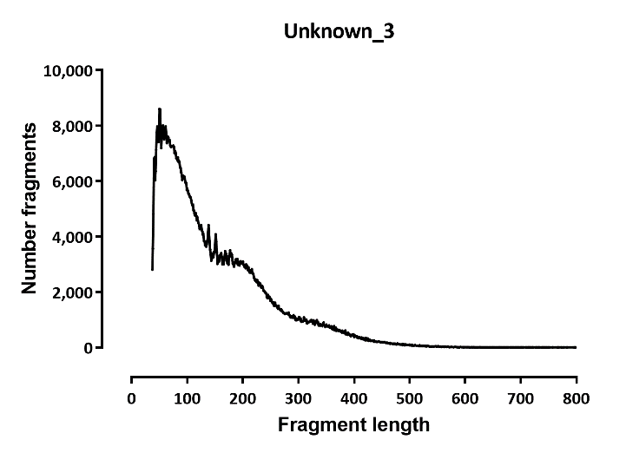

Slide 9
DESeq
Number differential ATAC promoters
A | B | p-adj
 |  | up in B vs A | down in B vs A
Camptothecin | Clotrimazole | 309 | 236
Camptothecin | Idarubicin | 1 | 0
Camptothecin | Ketoconazole | 53 | 36
Camptothecin | Miconazole | 366 | 400
Camptothecin | Unknown | 159 | 77
Clotrimazole | Idarubicin | 210 | 223
Clotrimazole | Ketoconazole | 24 | 1
Clotrimazole | Miconazole | 142 | 7
Clotrimazole | Unknown | 264 | 107
DMSO | Camptothecin | 14 | 1
DMSO | Clotrimazole | 164 | 220
DMSO | Idarubicin | 5 | 0
DMSO | Ketoconazole | 120 | 94
DMSO | Miconazole | 557 | 445
DMSO | Unknown | 326 | 127
Idarubicin | Ketoconazole | 36 | 28
Idarubicin | Miconazole | 312 | 357
Idarubicin | Unknown | 125 | 48
Ketoconazole | Miconazole | 20 | 10
Ketoconazole | Unknown | 1 | 0
Miconazole | Unknown | 42 | 10

