Slide 1
GENERAL NOTES
- We received samples for Cercocebus torquatus and Chlorocebus pygerythrus
- We currently have only very fragmented assemblies for both:
- N50 values in the 10-30 kb range
- lack of proper annotation
- Initially we didn’t even have these, and we were analyzing data against closely related species for which assemblies were available.
- The RNA analysis is particularly affected, keep this in mind for later on.

Slide 2
BRAIN LIBRARIES

Slide 3
Datasets ATAC

Slide 4
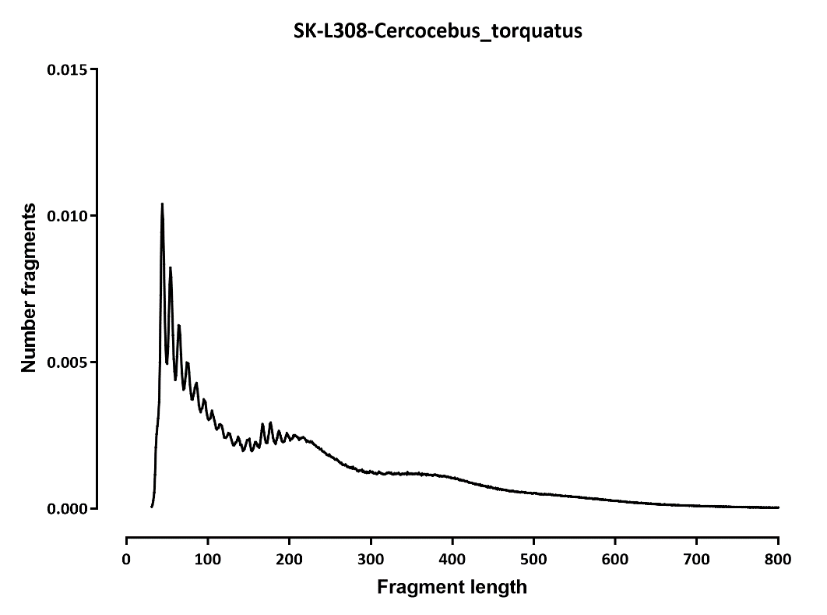

Fragment length

Slide 5
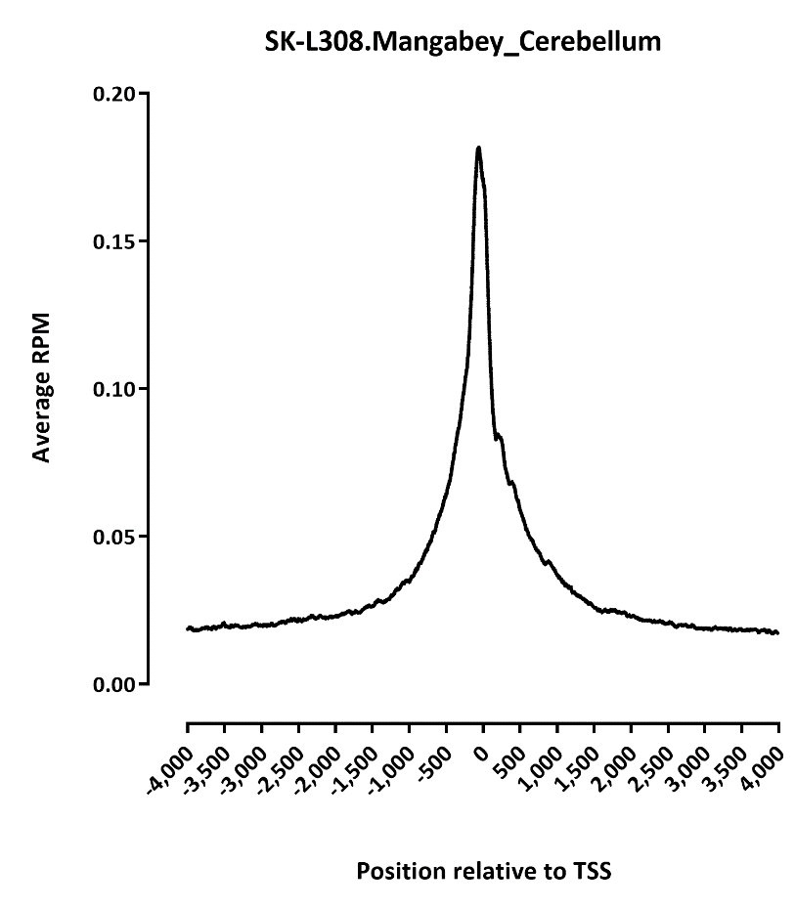
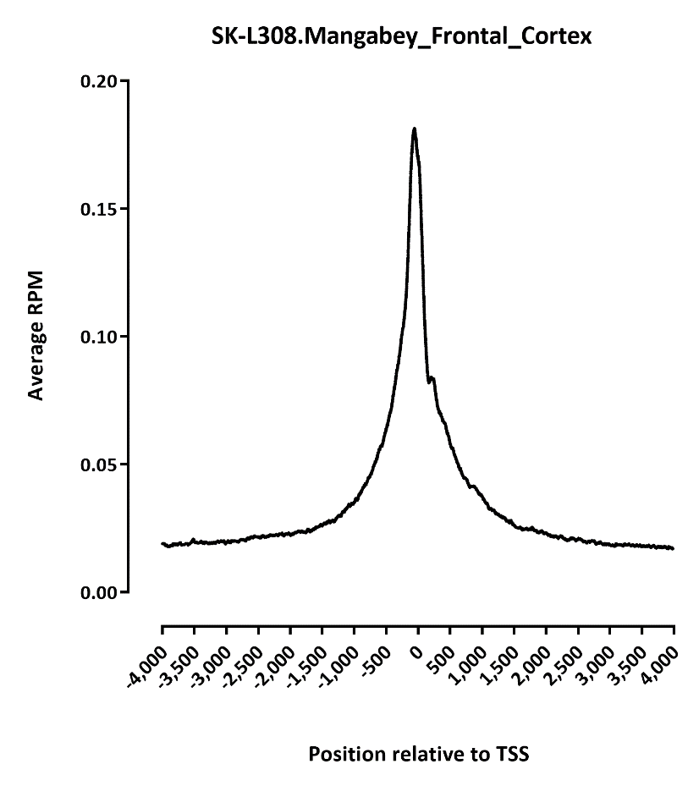
TSS profile
Note: we don’t have proper 5’UTR annotations!!!

Slide 6
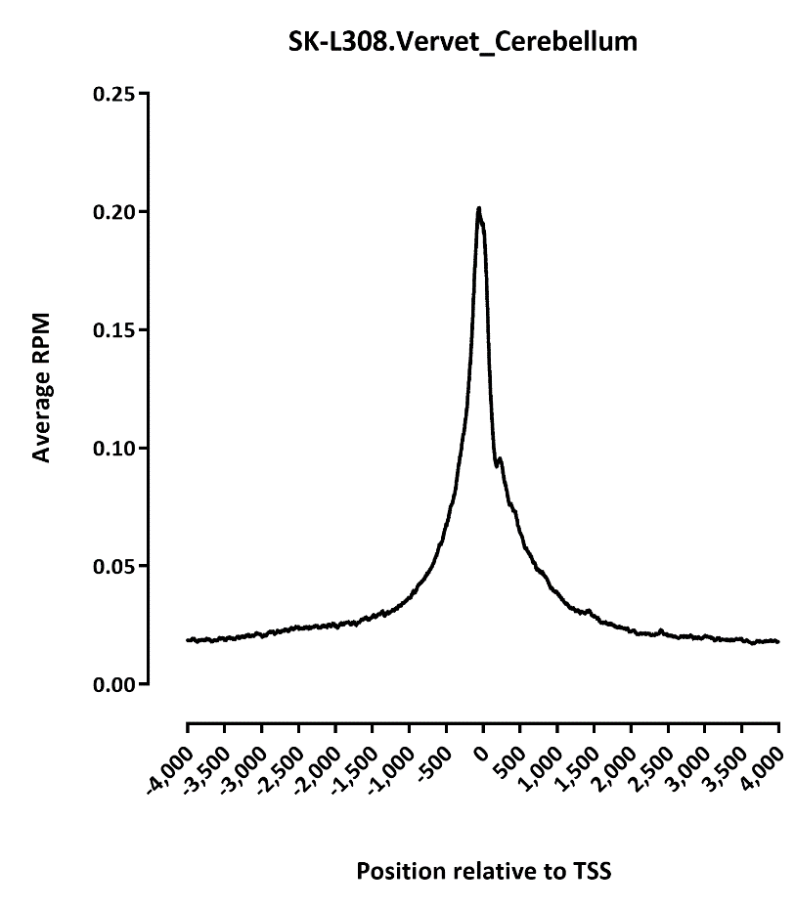
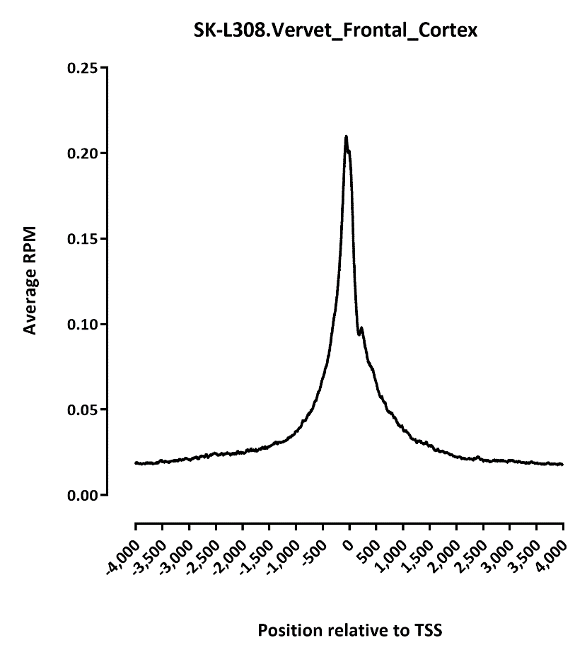
TSS profile
Note: we don’t have proper 5’UTR annotations!!!

Slide 7
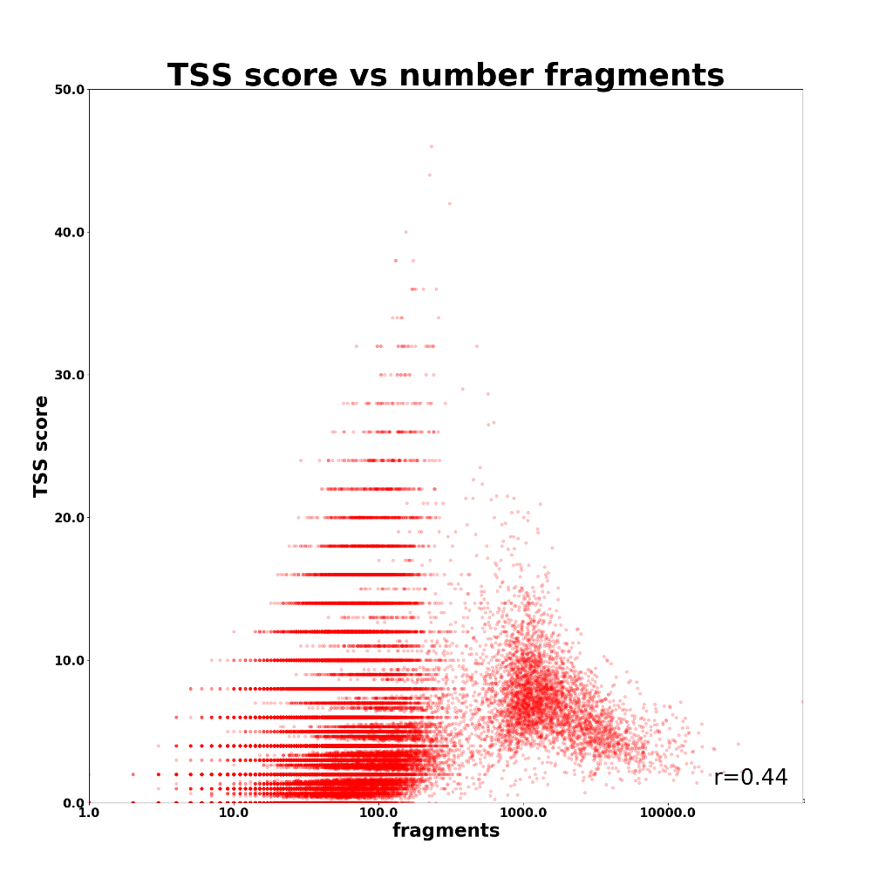
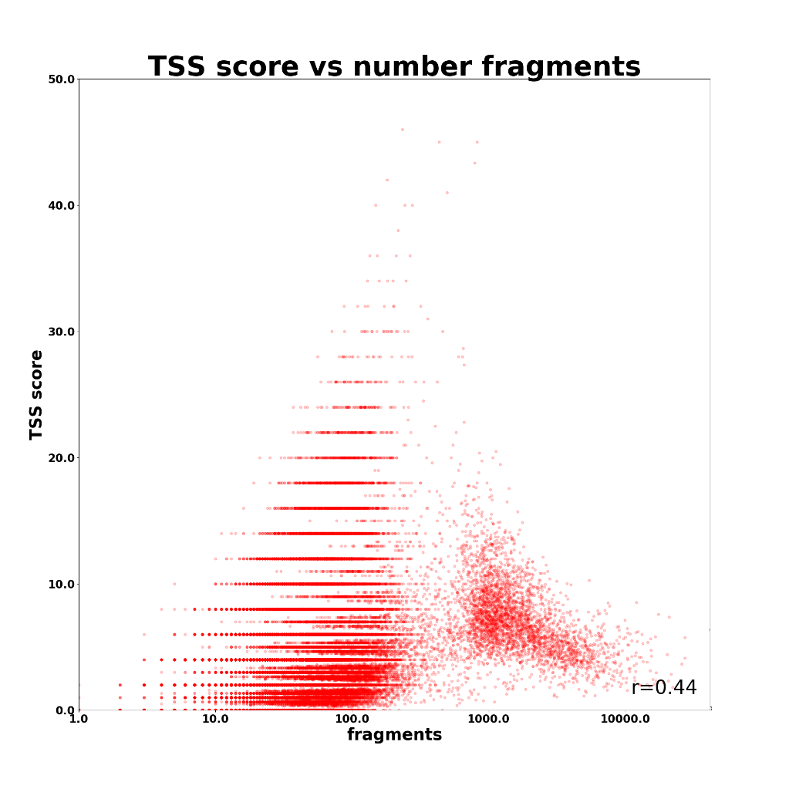
Mangabey Cerebellum
Mangabey Frontal Cortex

Slide 8
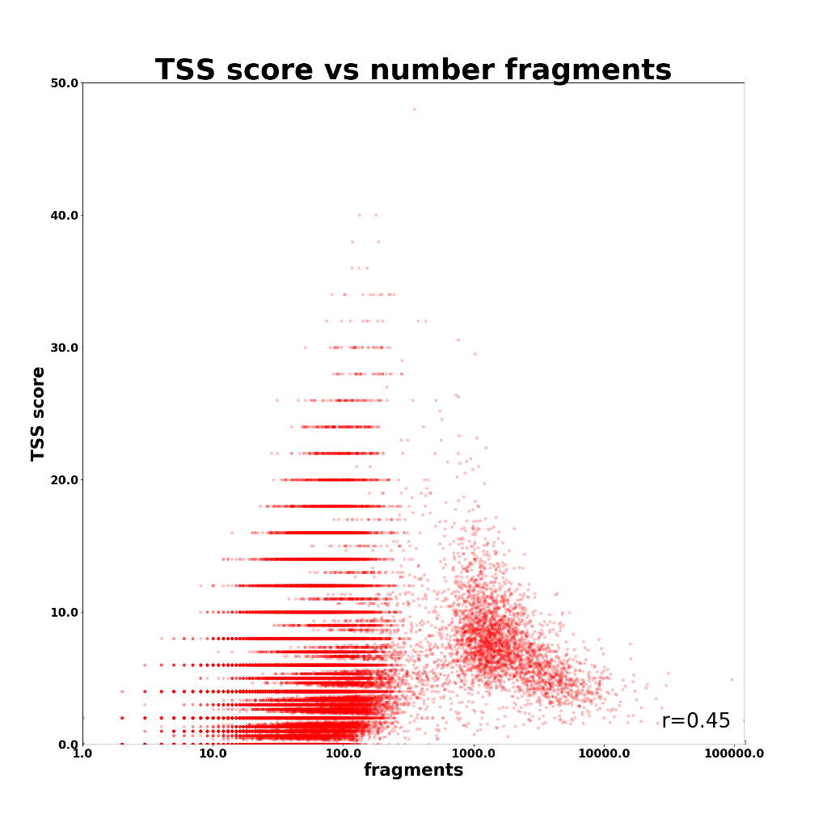
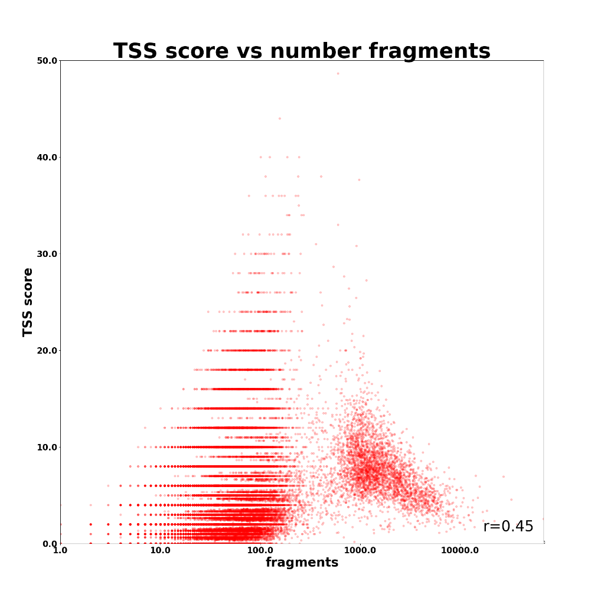
Vervet Cerebellum
Vervet Frontal Cortex

Slide 9
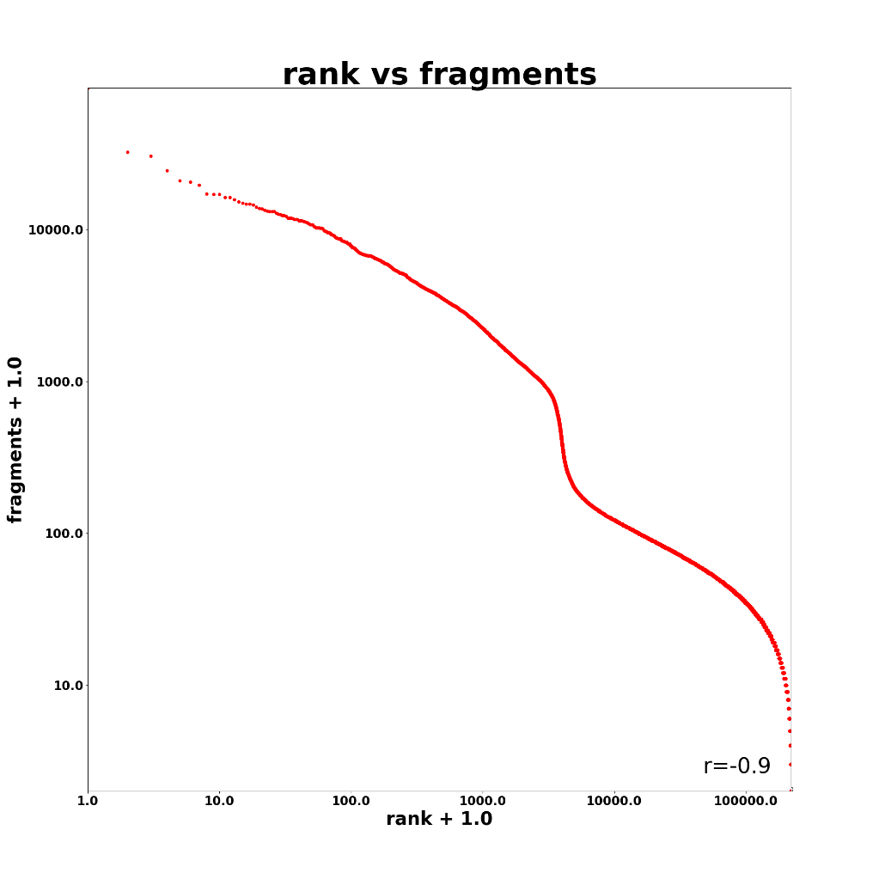
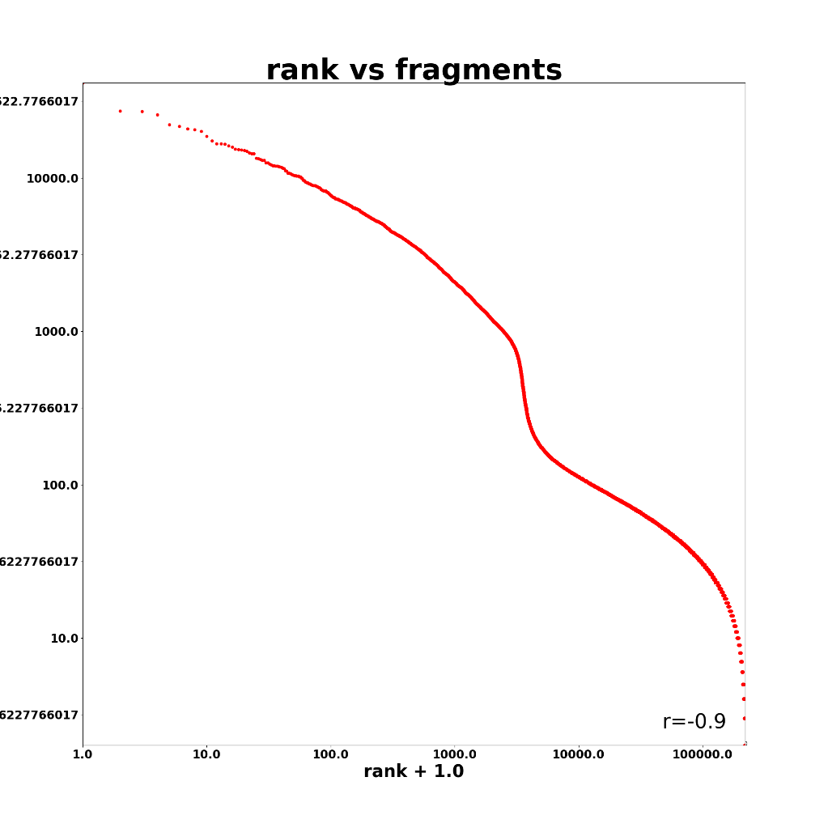
Mangabey Cerebellum
Mangabey Frontal Cortex

Slide 10
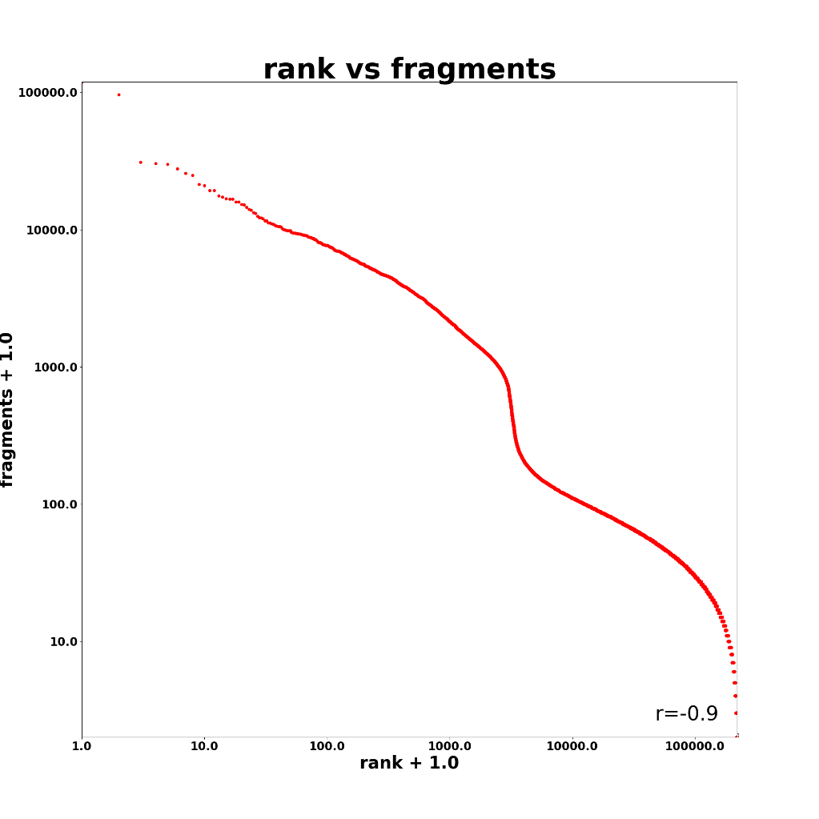

Vervet Cerebellum
Vervet Frontal Cortex

Slide 11
Datasets RNA
Cercocebus |  |  | Cercocebus
#Class | Fraction |  | #Class | Fraction
Exonic: | 0.072614 |  | Exonic: | 0.106201
Intronic: | 0.633489 |  | Intronic: | 0.718072
Intergenic: | 0.293897 |  | Intergenic: | 0.175727

Slide 12
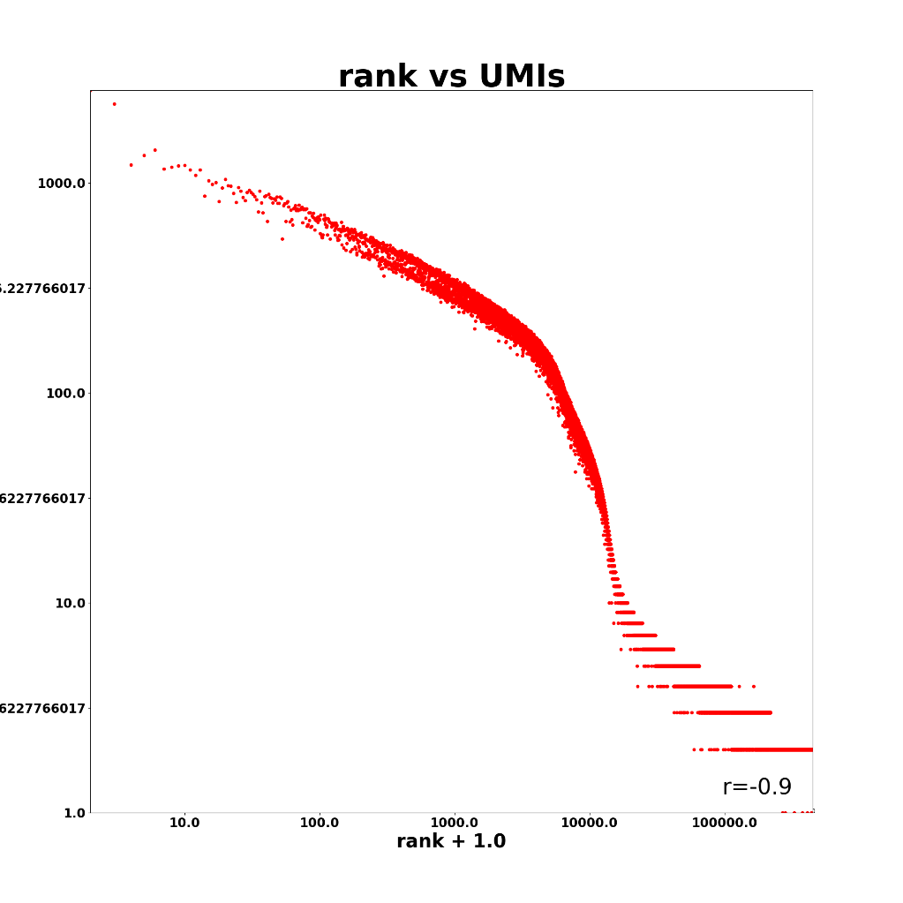
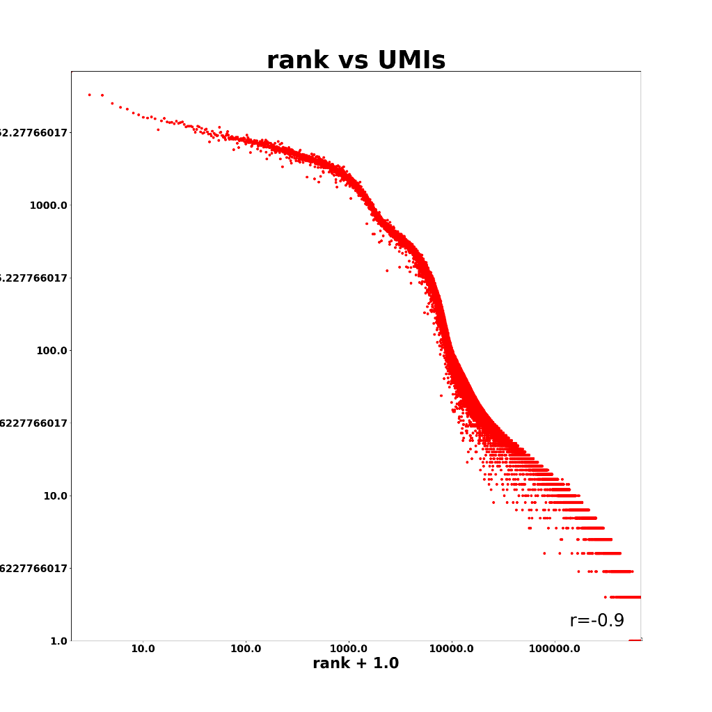
Cercocebus atys
Chlorocebus sabaeus

Slide 13
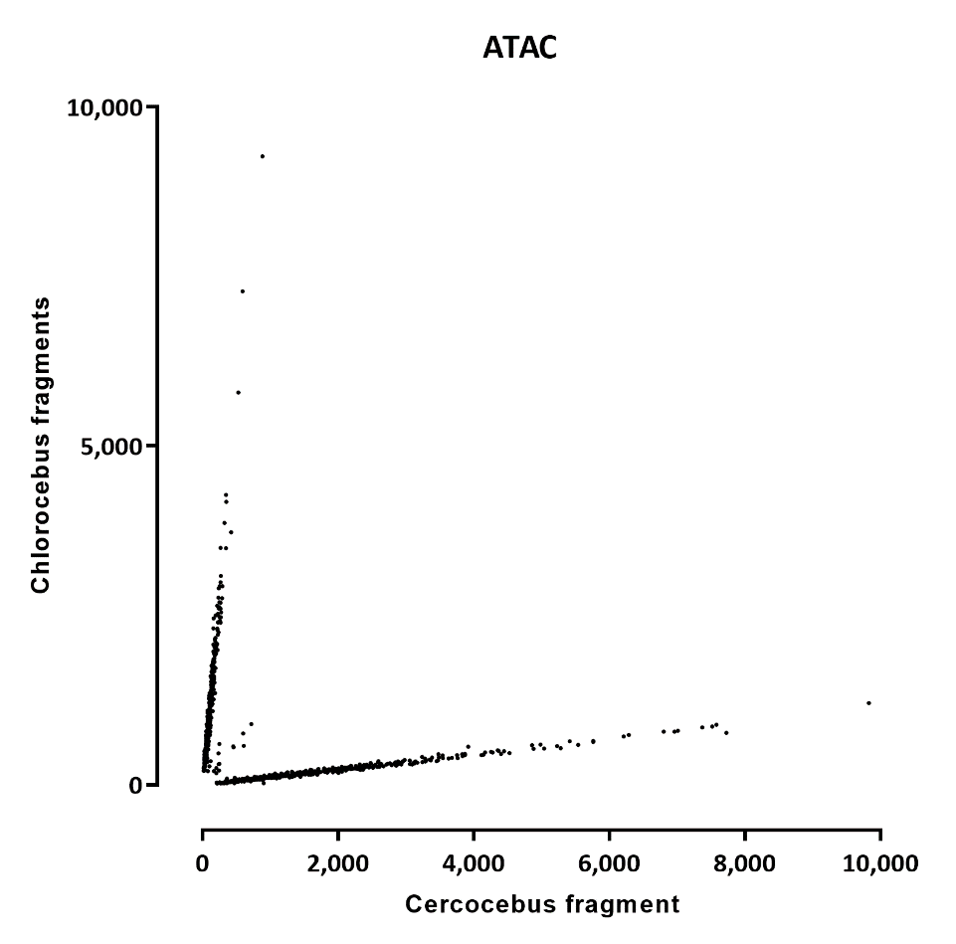
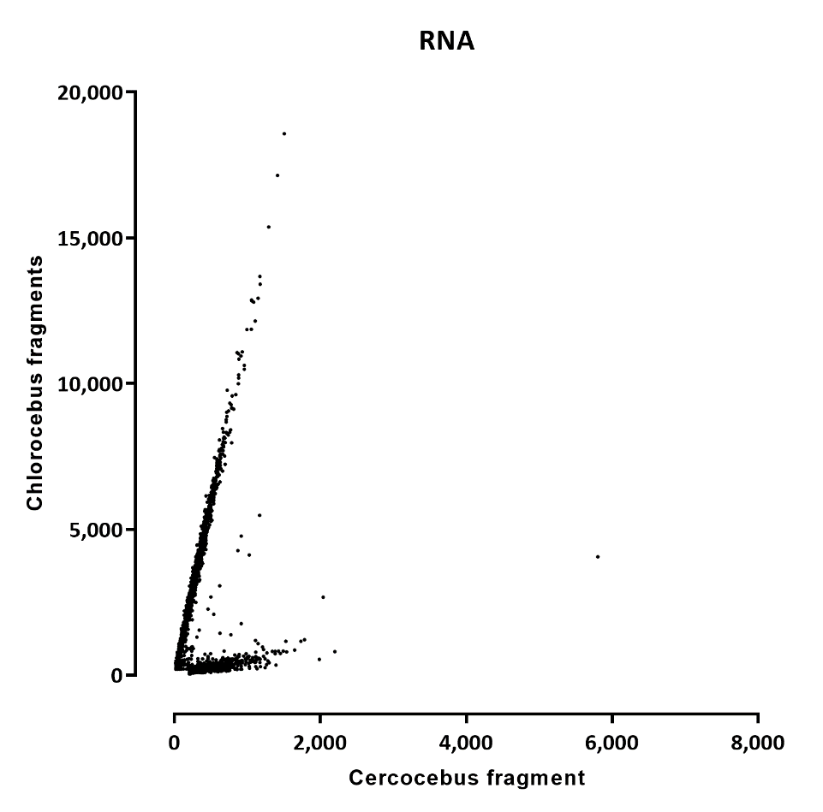
Species mapping
Note: alignment was against the combined index and only the second two rounds were pool split across species

Slide 14
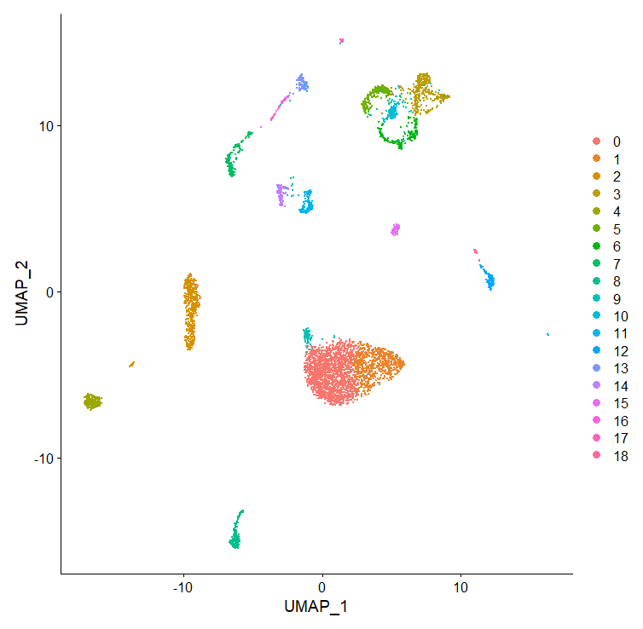
Chlorocebus sabaeus
No cluster assignment yet, as the annotation only had symbols, not gene names

Slide 15
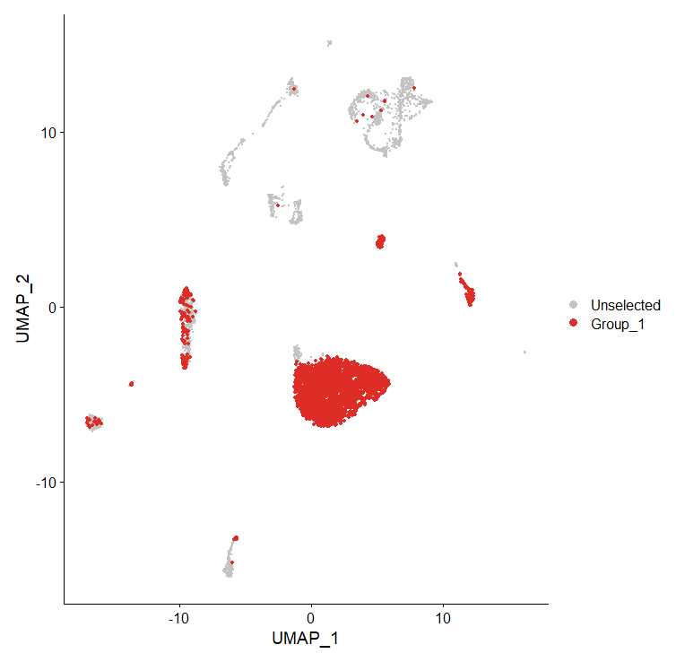
Chlorocebus sabaeus, cerebellum

Slide 16
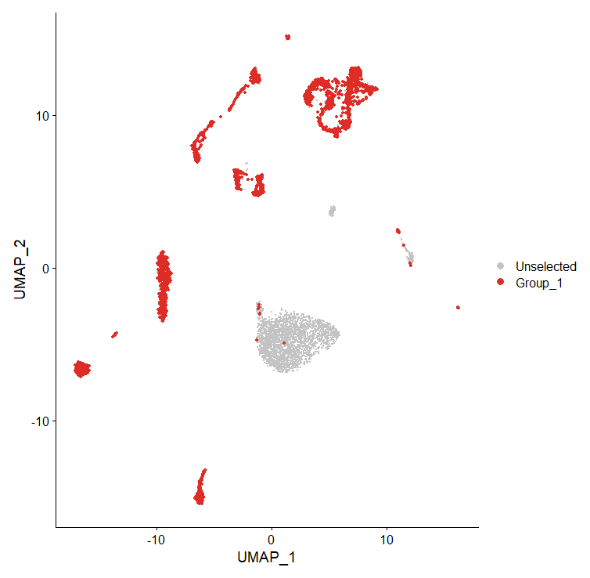
Chlorocebus sabaeus, cortex

Slide 17
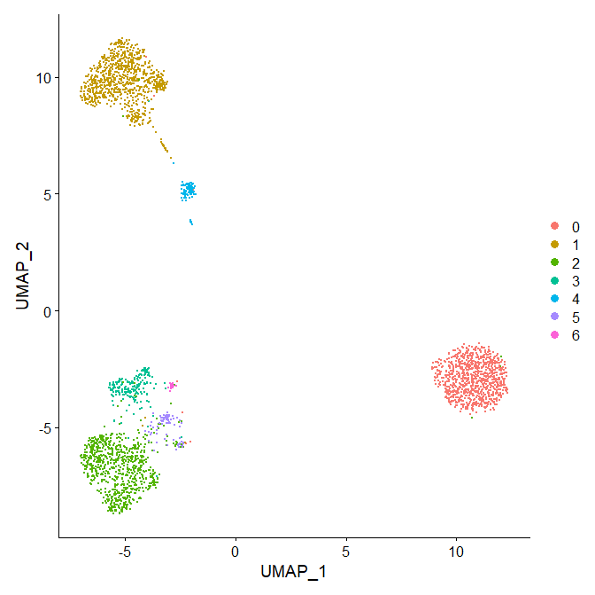
Cercocebus atys
Cluster 0 – NPC
Cluster 1 – oligodendrocyte
Cluster 2 – Glutamatergic neurons
Cluster 3 – GABAergic neurons
Cluster 4 – GABAergic neurons
Cluster 5 – GABAergic neurons
Cluster 1 – oligodendrocyte precursor

Slide 18
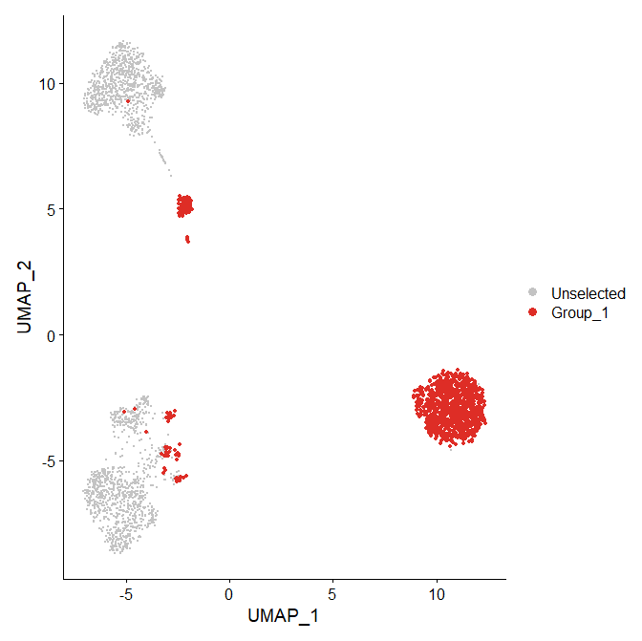
Cercocebus atys, cerebellum

Slide 19
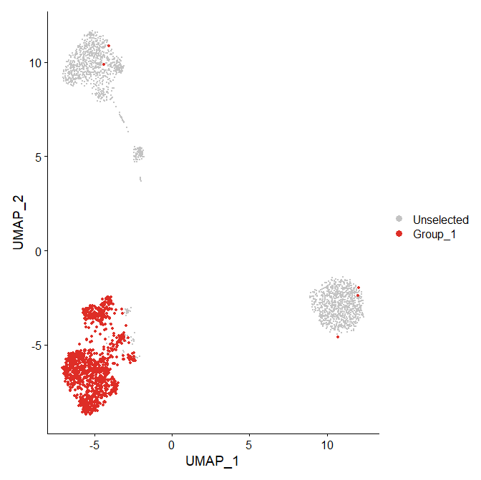
Cercocebus atys, cortex

Slide 20
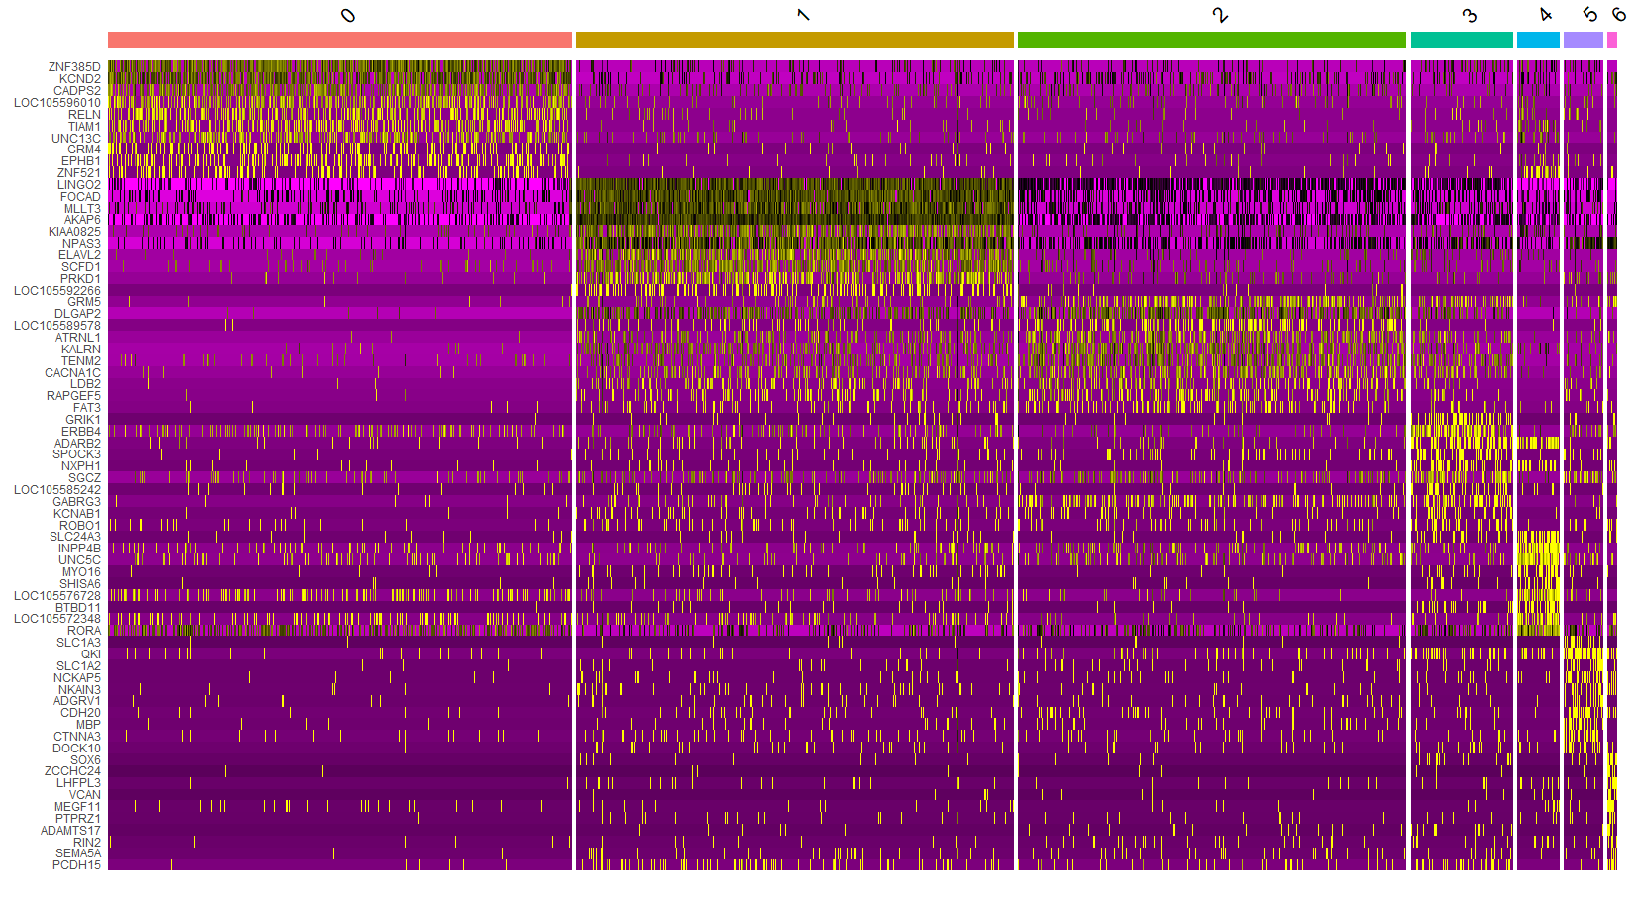
Cercocebus atys

Slide 21
BRAIN LIBRARIES, PRODUCTION-SCALE RUN

Slide 22
Datasets ATAC

Slide 23
Datasets RNA

Slide 24
Datasets RNA
Note: cells above 500 UMIs are low because of the poor assembly+annotation
When analyzed against Chlorocebus sabaeus, one of these libraries generated a lot more cells

Slide 25
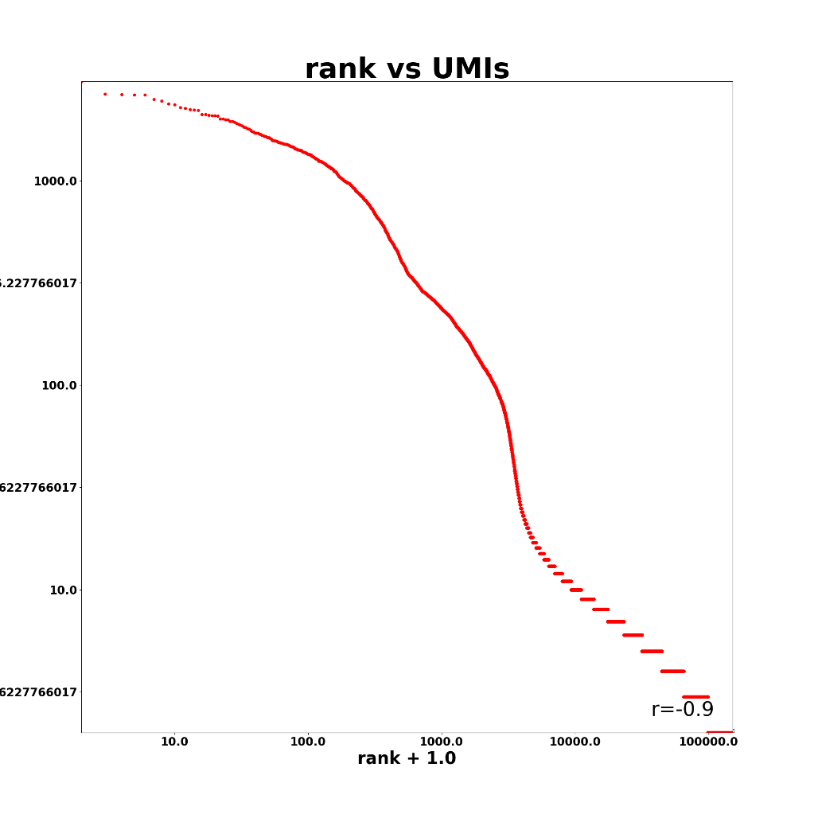
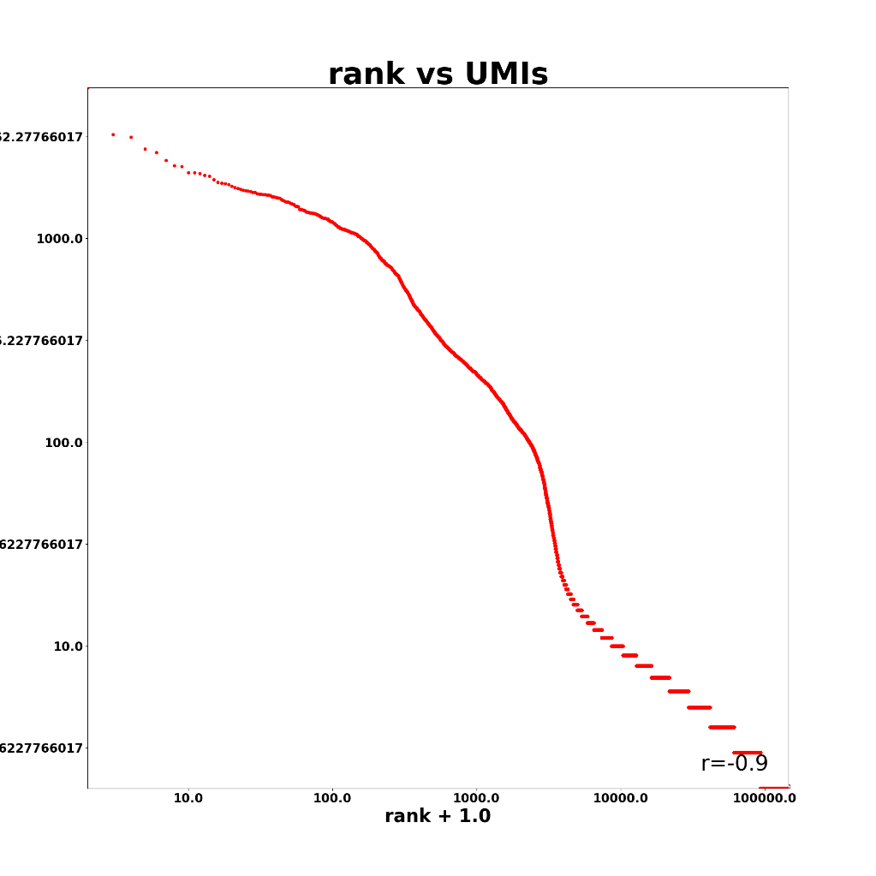
Mangabey Cerebellum 1
Mangabey Frontal Cortex 1

Slide 26
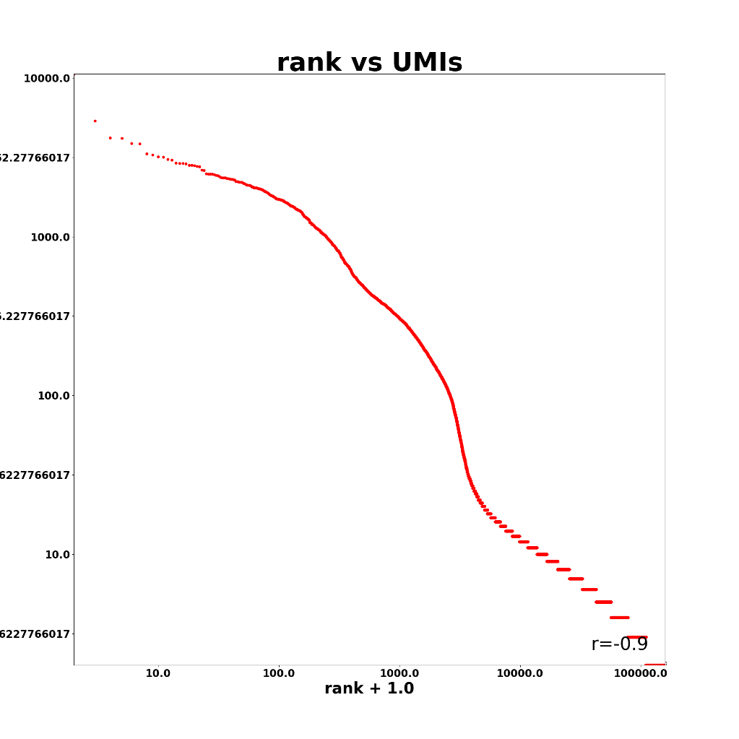
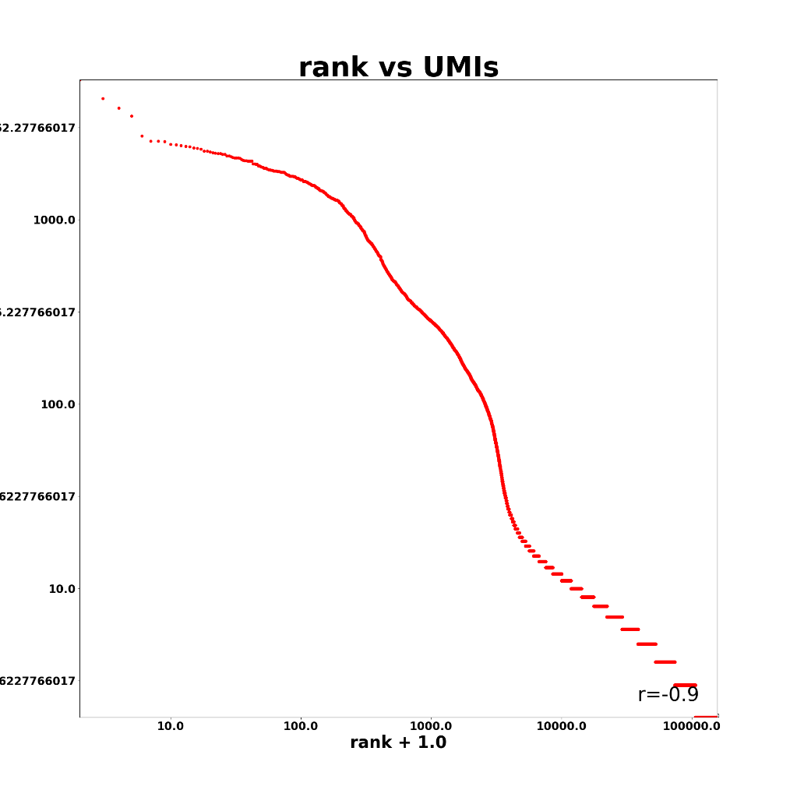
Vervet Cerebellum 1
Vervet Frontal Cortex 1

Slide 27
KIDNEY LIBRARIES

Slide 28
Datasets ATAC (single-cell processing)

Slide 29
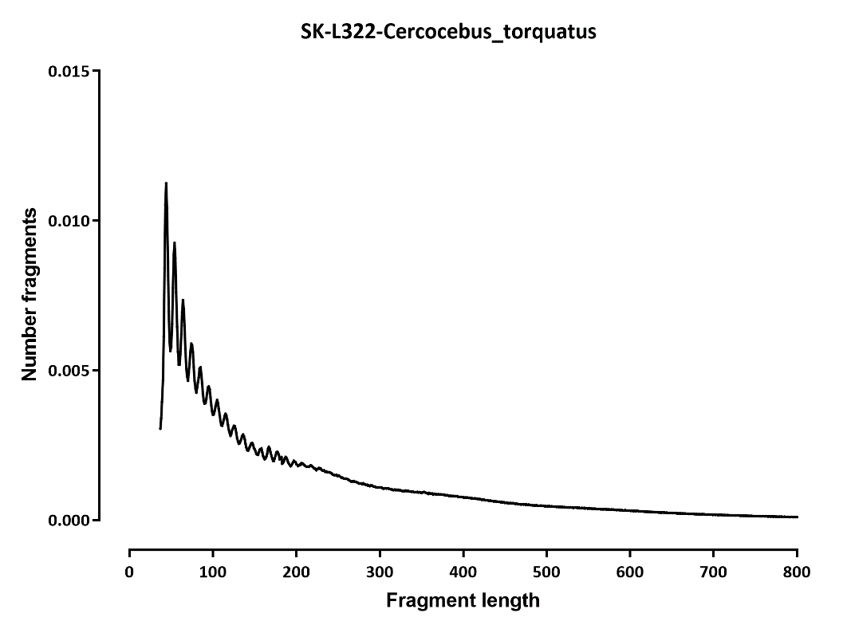
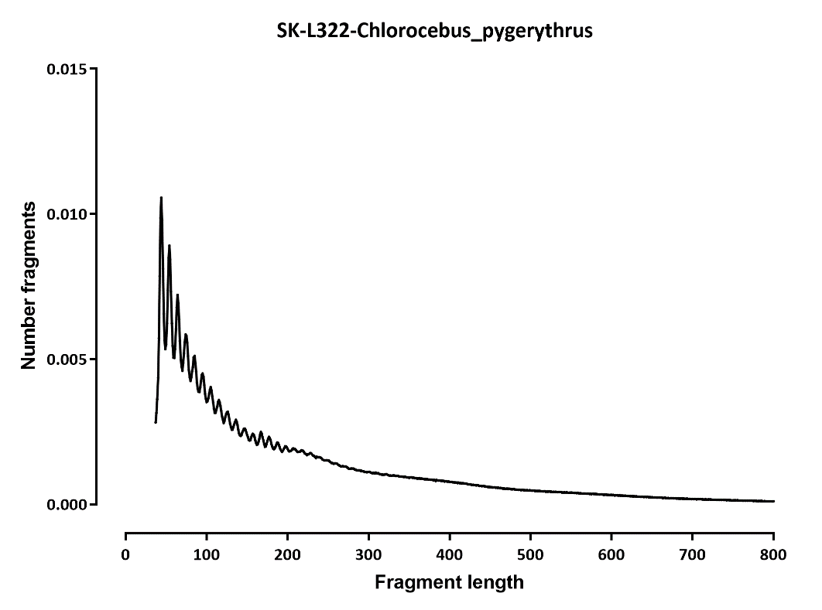
Fragment length

Slide 30


TSS profile
Note: we don’t have proper 5’UTR annotations!!!

Slide 31
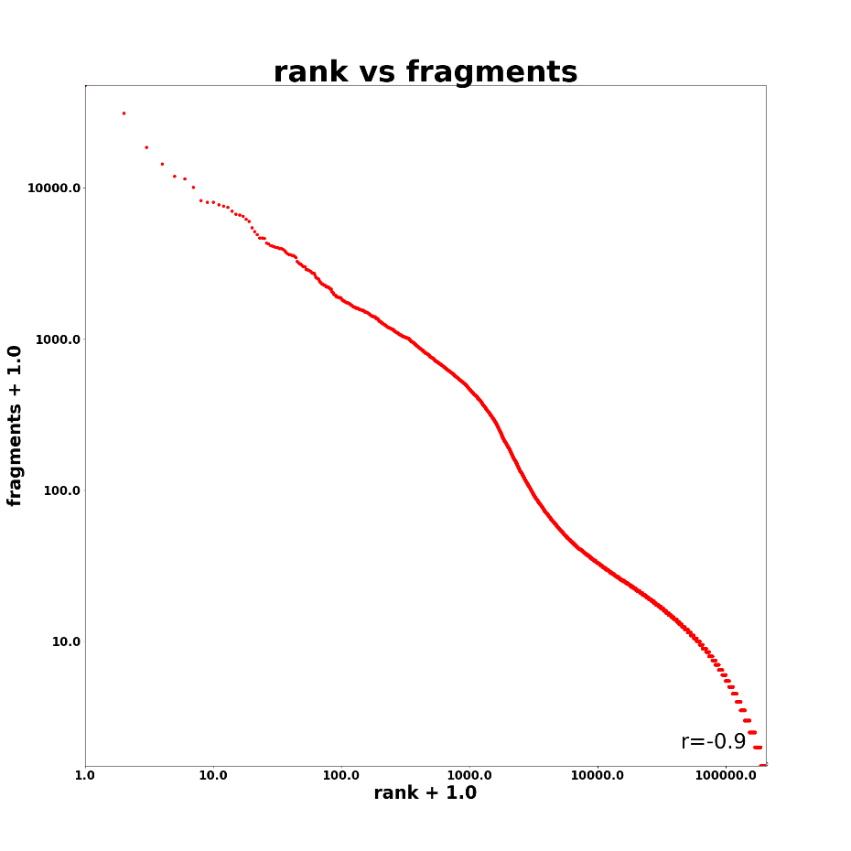
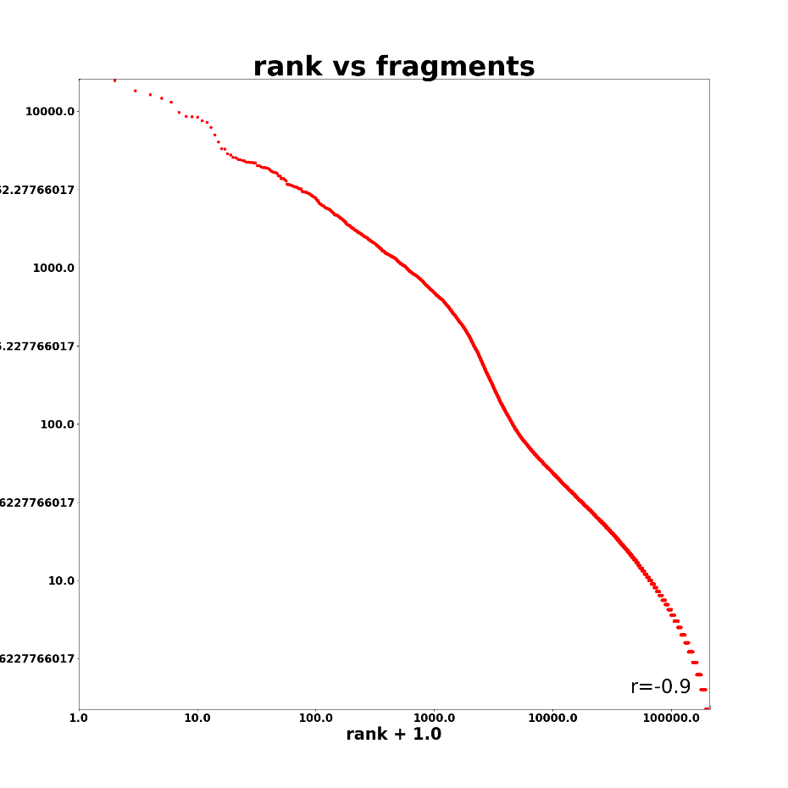
SK-L322-Mangabey_Left_kidney_ID_FRU SK-L322-Vervet_Left_kidney_ID_1140

Slide 32
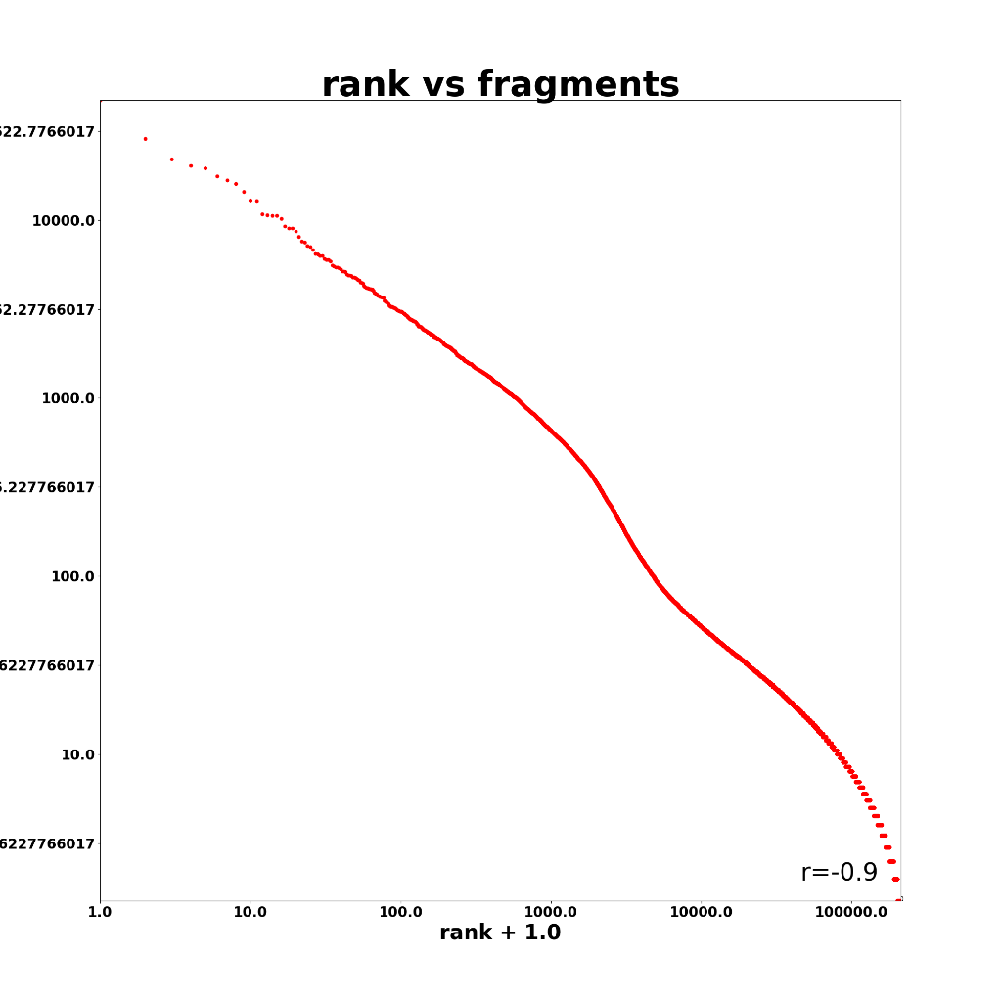
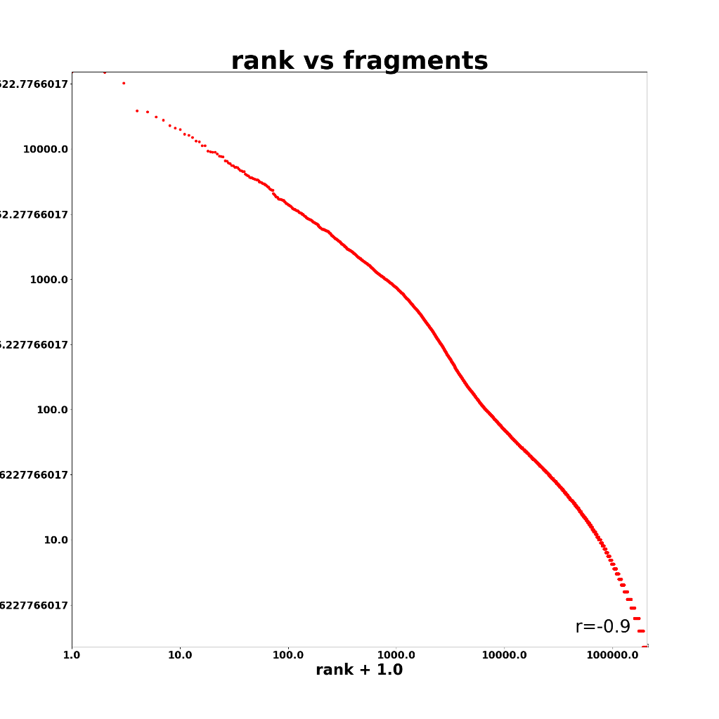
SK-L322-Vervet_Left_kidney_ID_1404 SK-L322-Vervet_Right_kidney_ID_1607

Slide 33
Datasets RNA

Slide 34
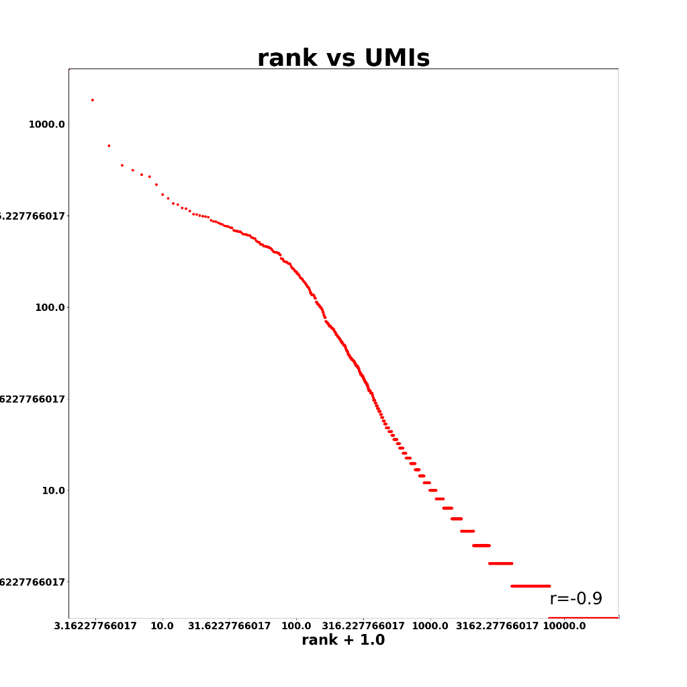
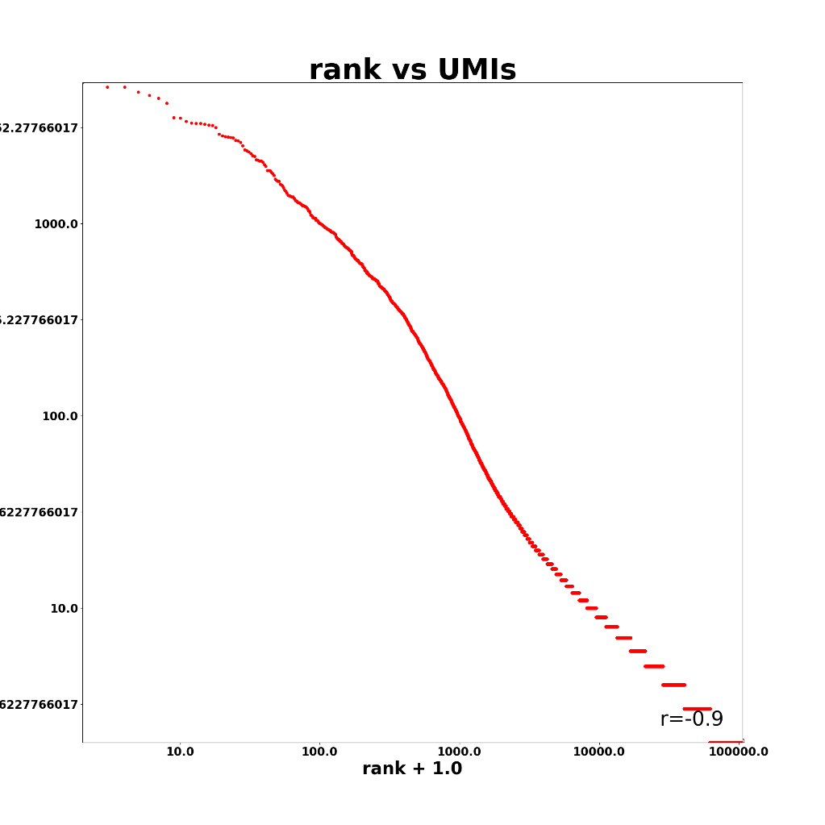
SK-L330-Mangabey_Left_kidney_ID_FRU SK-L330-Vervet_Left_kidney_ID_1140

Slide 35
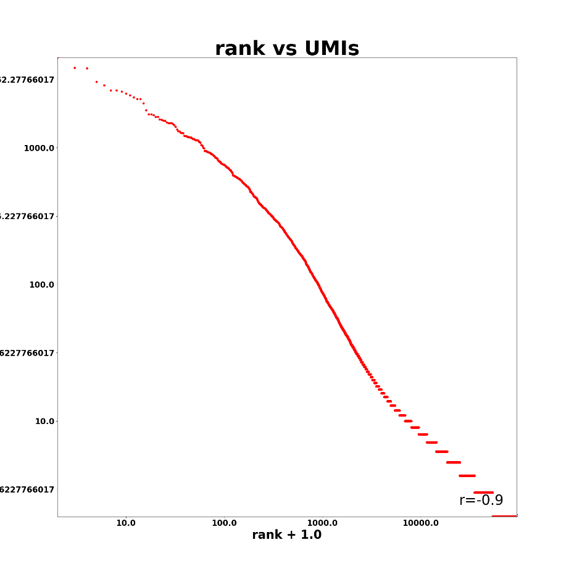
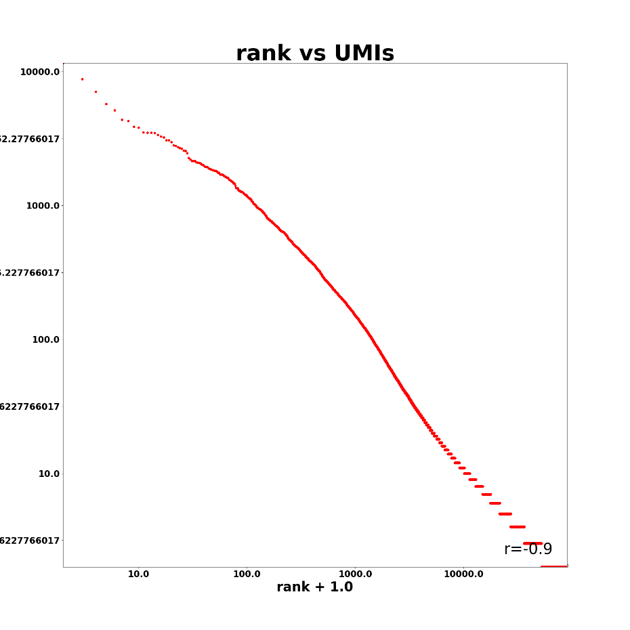
SK-L330-Vervet_Left_kidney_ID_1404 SK-L330-Vervet_Right_kidney_ID_1607

Slide 36
OVARY LIBRARIES

Slide 37
Ovary libraries ATAC

Slide 38
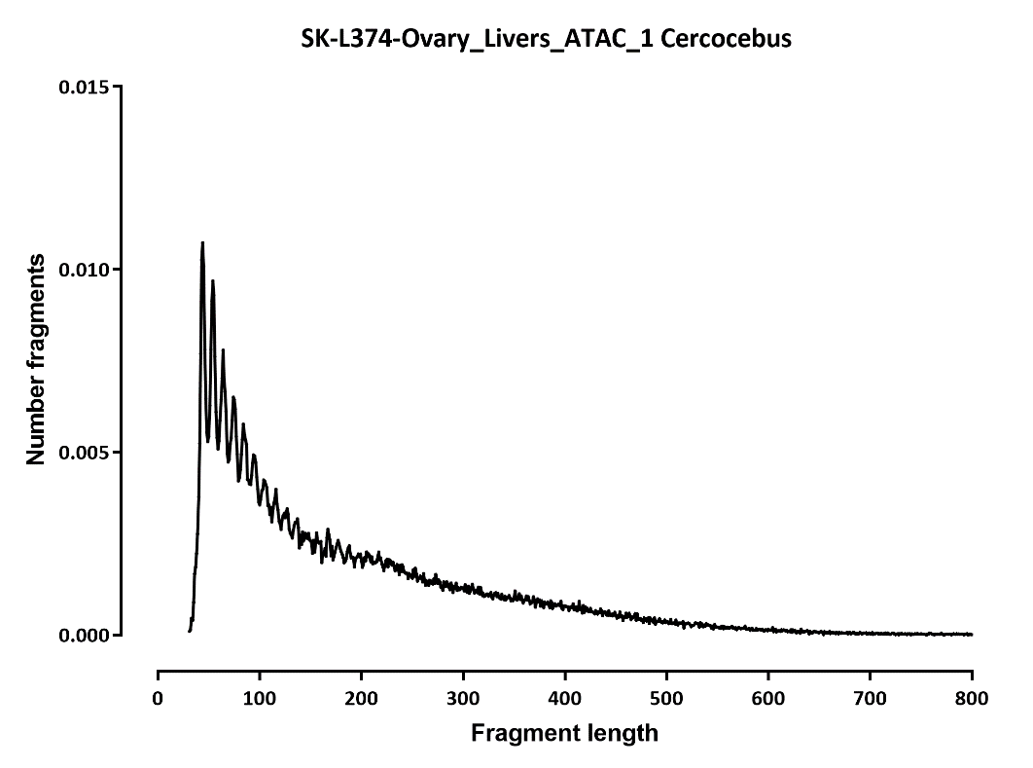
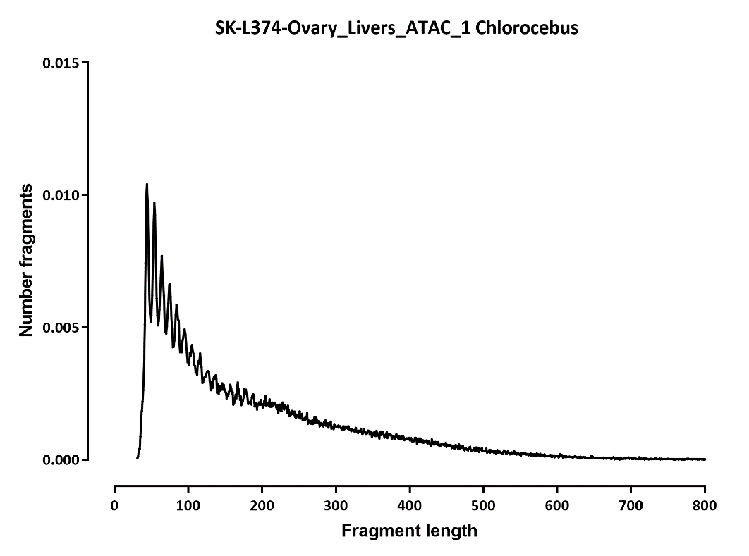

Slide 39
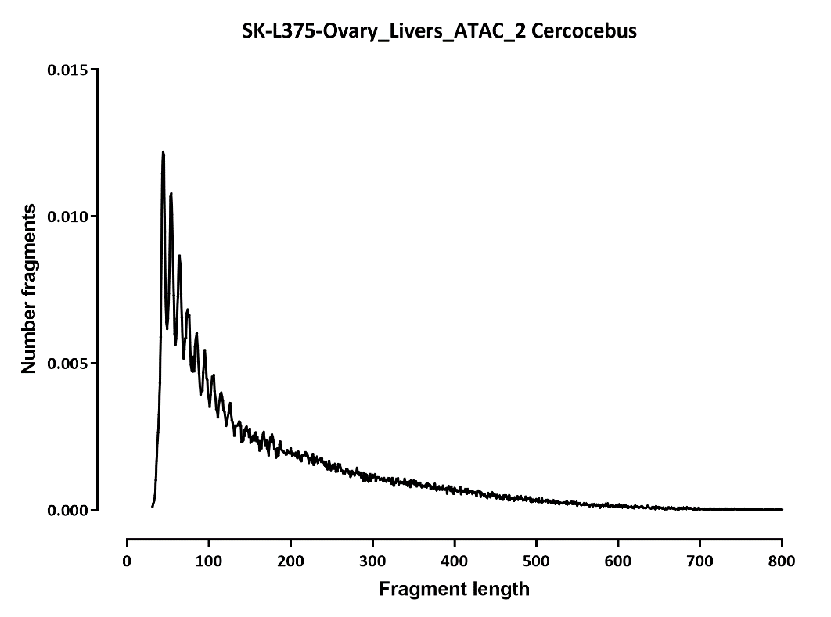
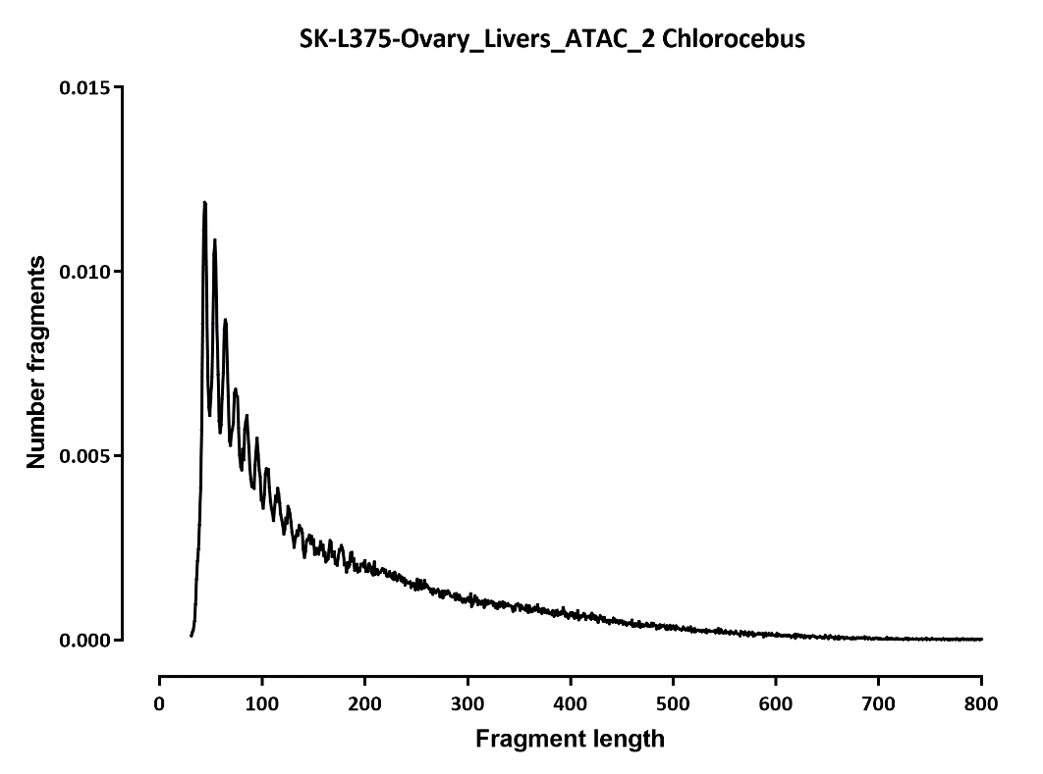

Slide 40
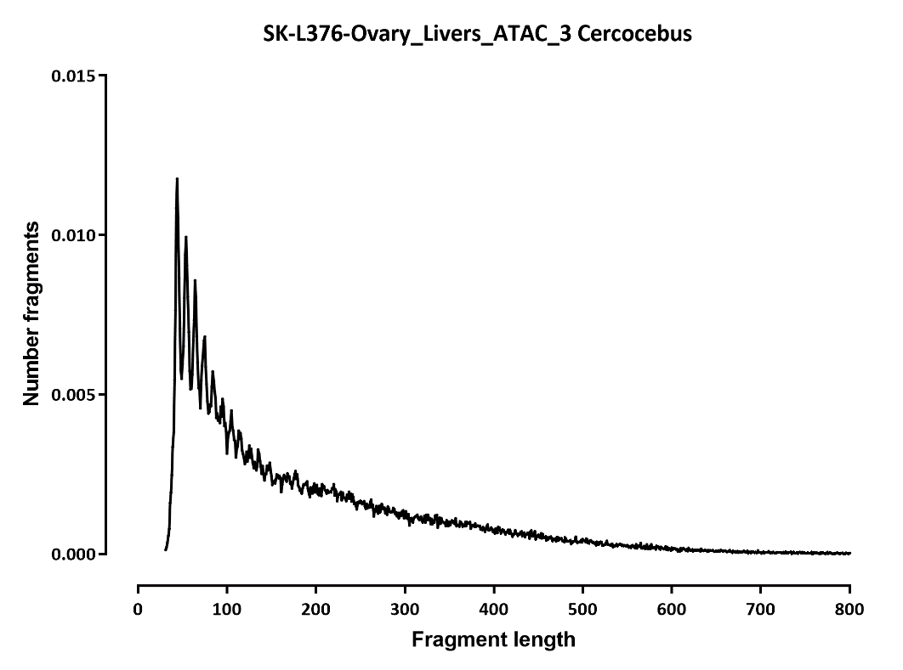
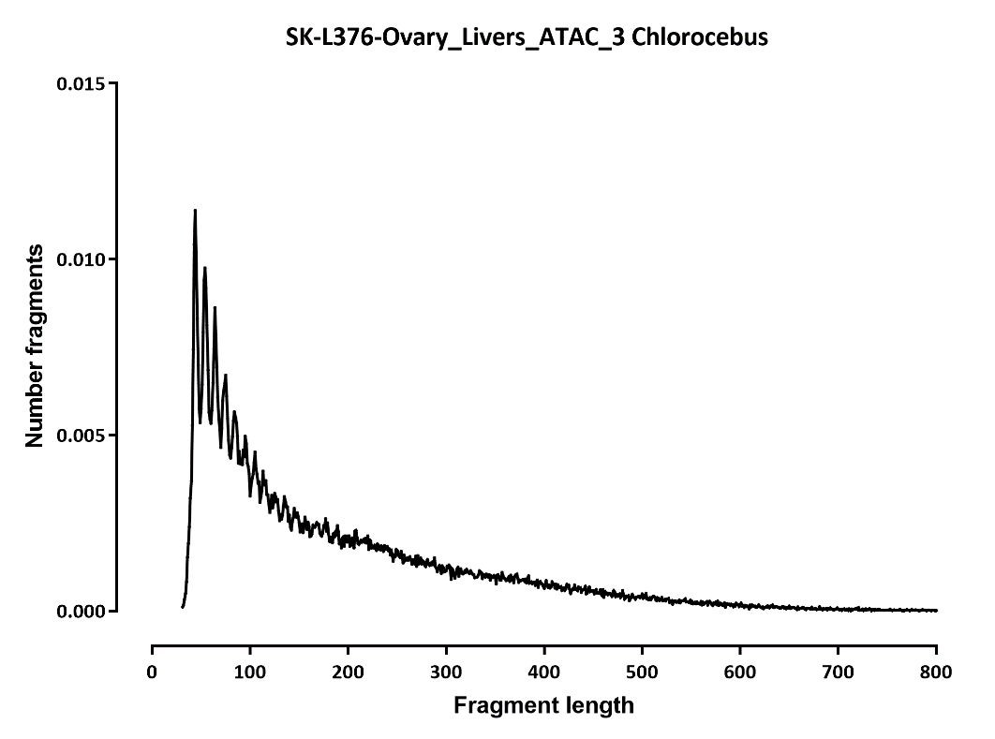

Slide 41
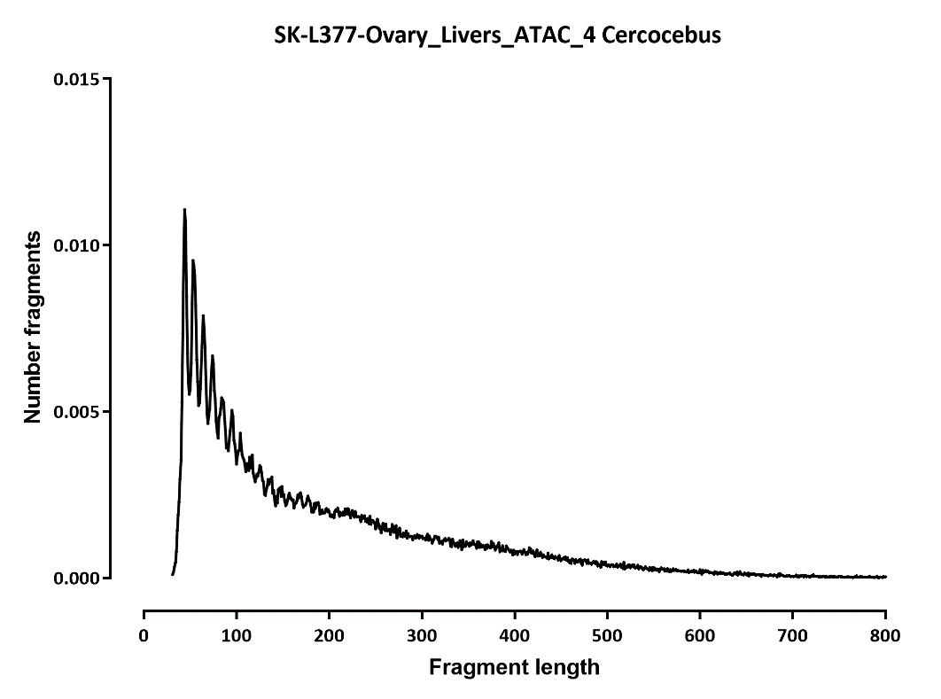


Slide 42
PROPOSAL FOR NEXT STEPS
Not all samples work reliably.
We have identified fragment distribution (specifically, the lack of a clear nucleosomal peak as a clear correlate of poor single-cell separation, which allows us to QC samples before committing to large-scale sequencing runs
However, for now brain appears to work best and the current proposal is to focus on it for the initial study out of this project
The goal is to do very deep (>5x the cell number we have now) brain profiling for as many species as we can.
The question is how many brains can be obtained and for what other species?

