Slide 1
Dataset stats RNA (incorrect human-only alignments)
 | SK-L247
 | mm10 | hg38
0 | 557,177 | 374,680
10 | 25,387 | 227,747
20 | 9,500 | 196,668
50 | 2,378 | 43,105
100 | 199 | 7,865
200 | 53 | 1,913
500 | 85 | 1,217
1000 | 856 | 6,556
 | SK-L248
 | mm10 | hg38
0 | 539,611 | 400,188
10 | 21,944 | 220,984
20 | 8,443 | 179,592
50 | 2,424 | 37,558
100 | 267 | 6,605
200 | 57 | 1,851
500 | 80 | 1,363
1000 | 879 | 6,339

Slide 2
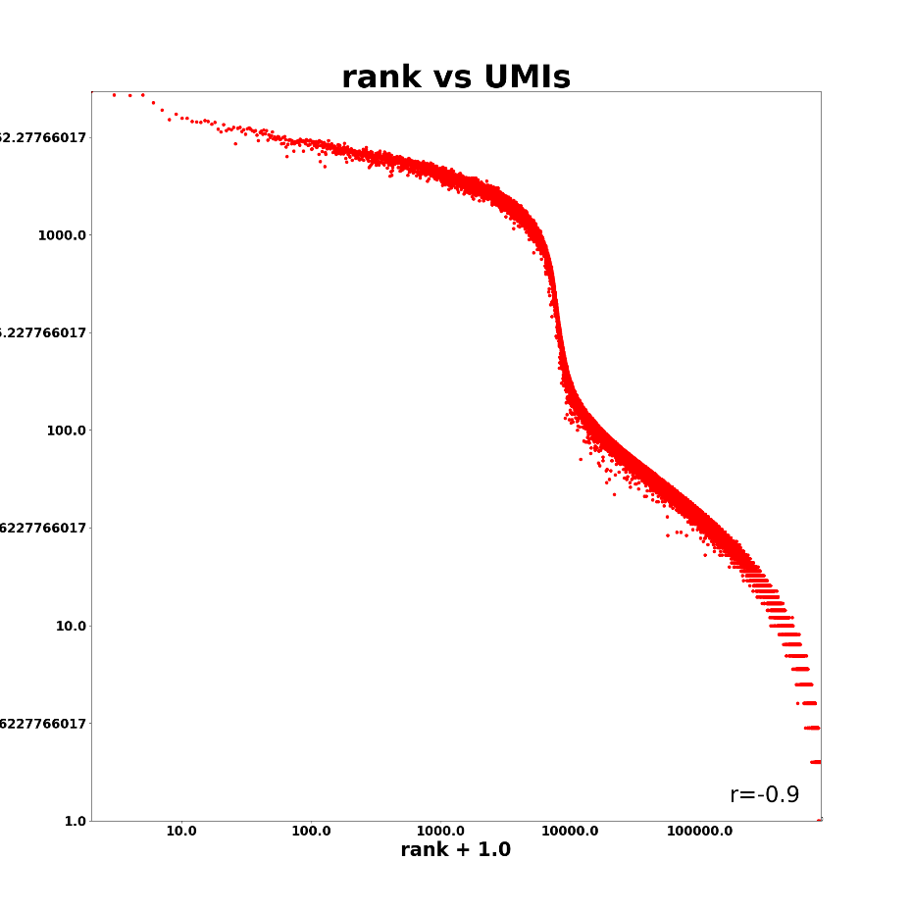
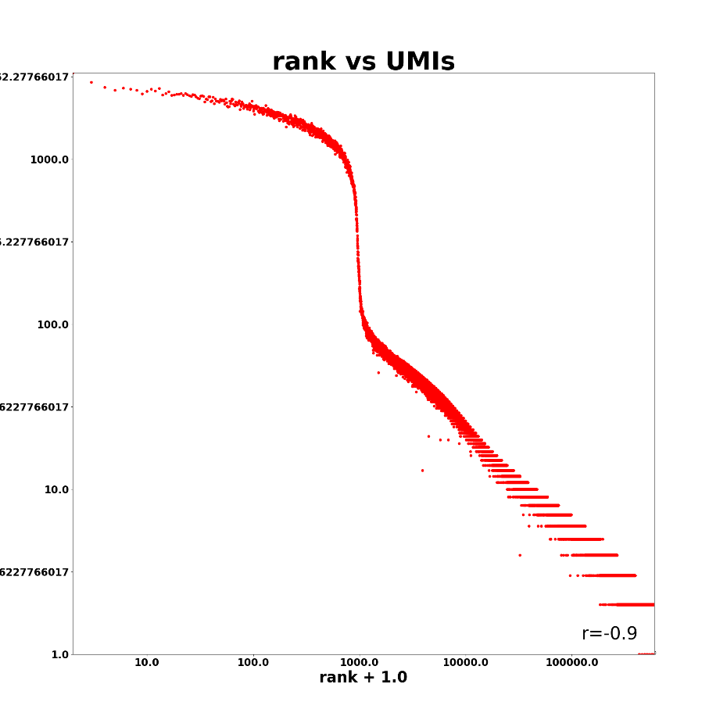
RNA SK-L247
hg38
mm10

Slide 3
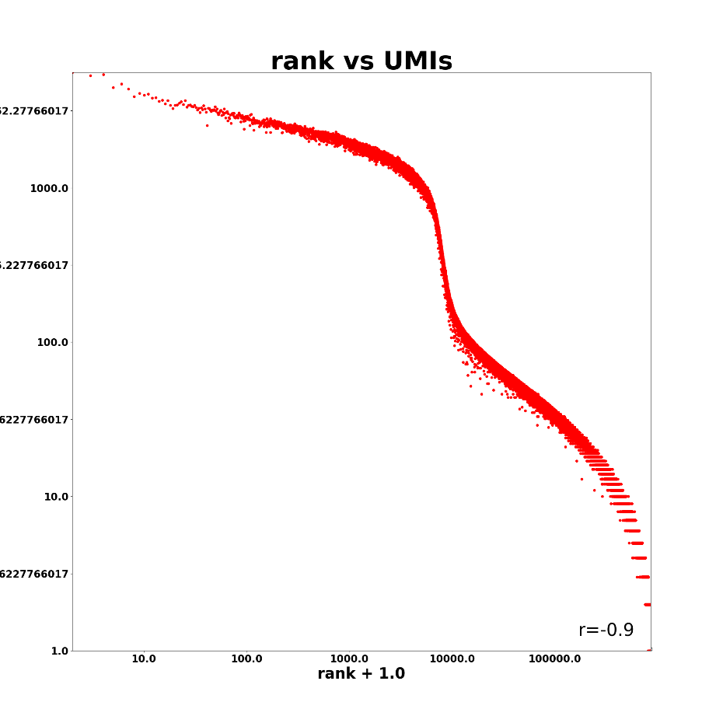
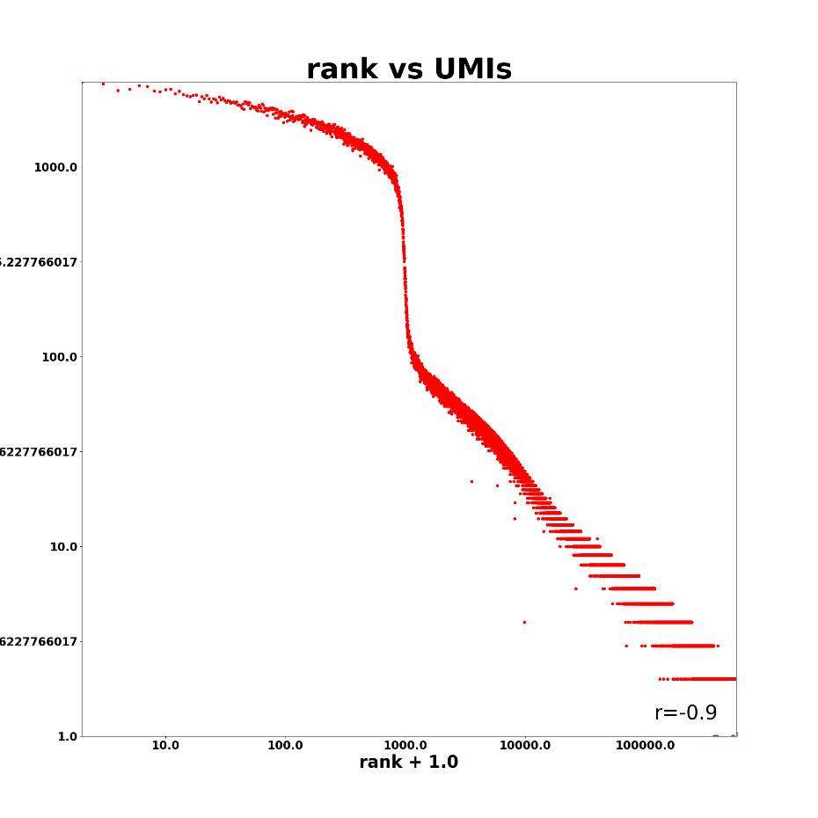
RNA SK-L248
hg38
mm10

Slide 4
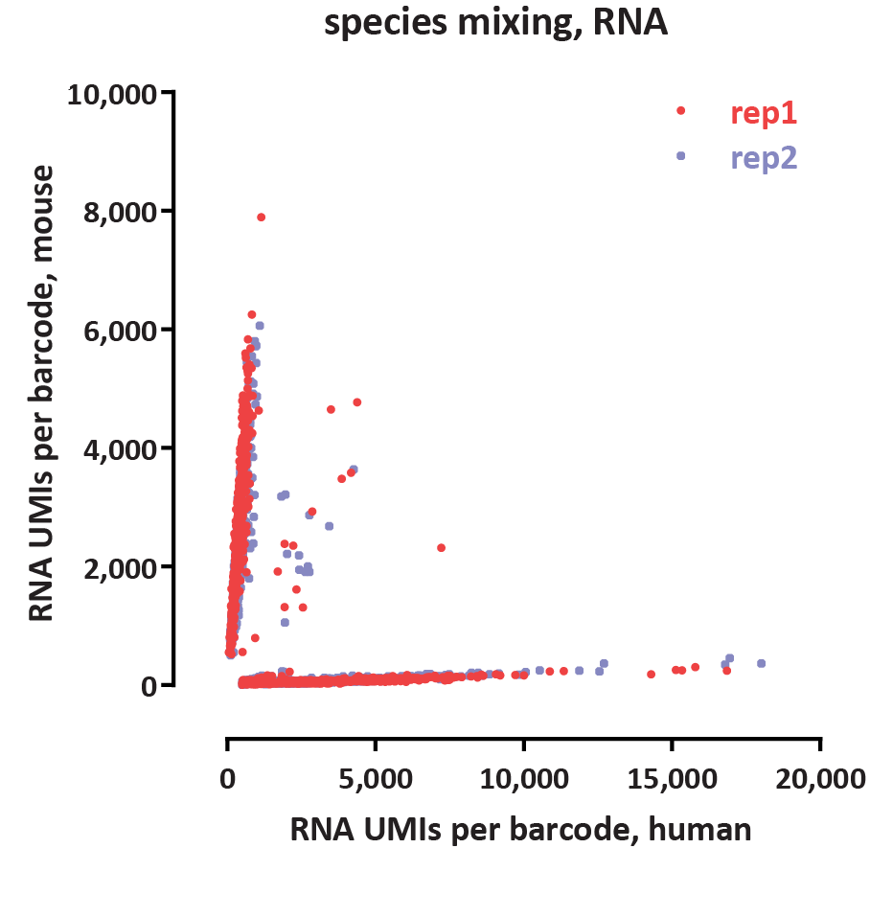
RNA

Slide 5
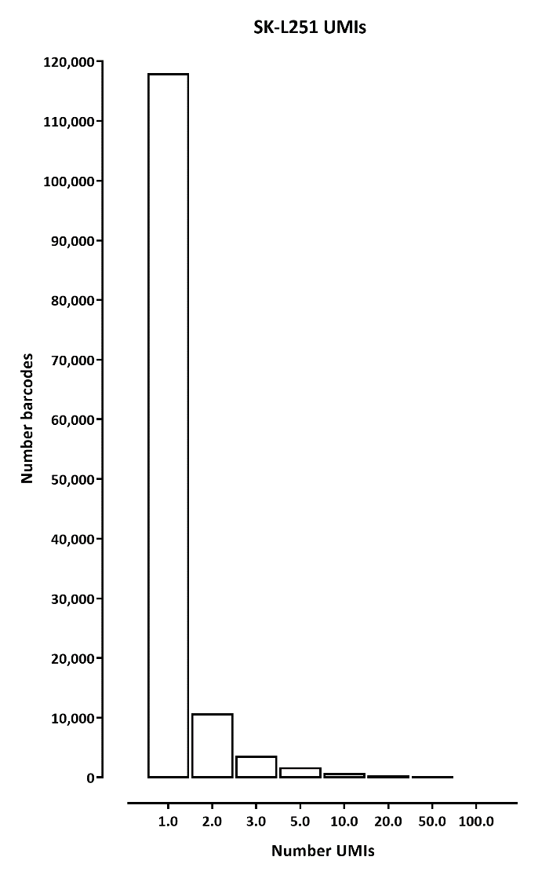
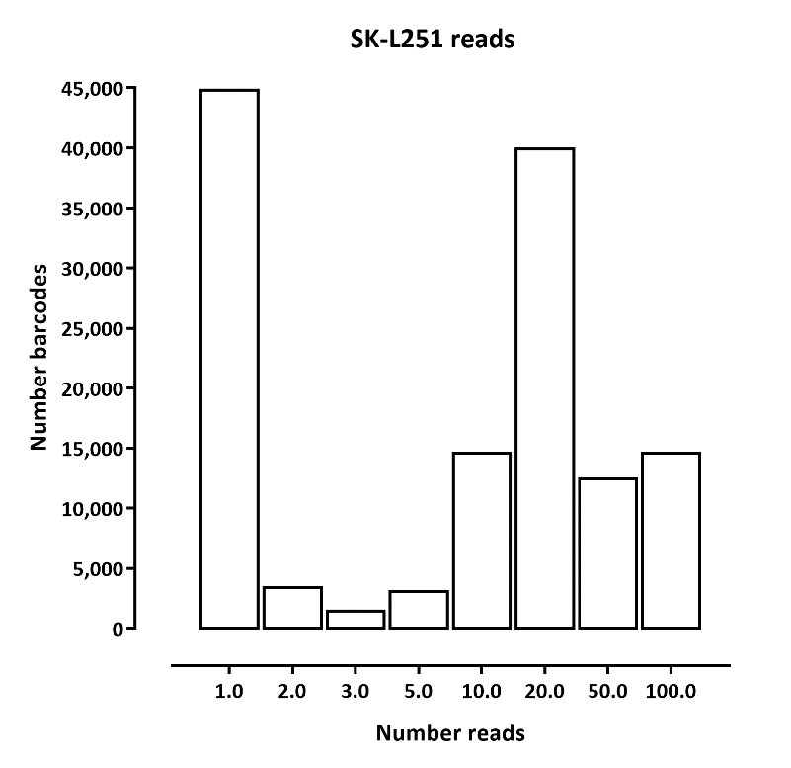
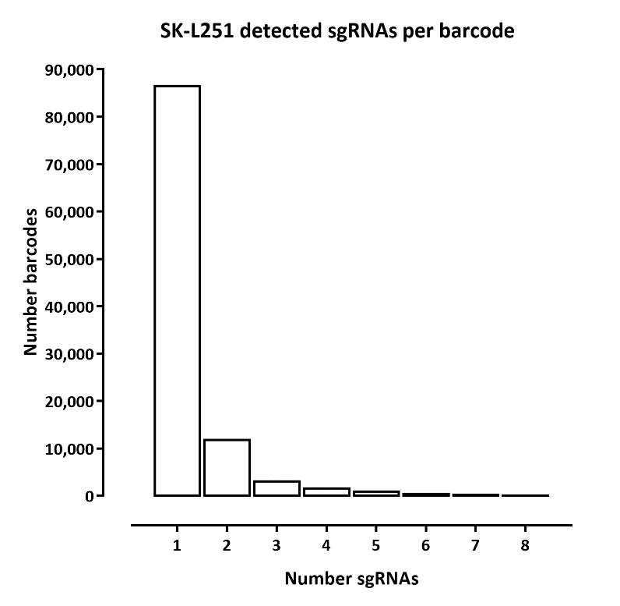
sgRNAs UMIs vs reads, all BCs

Slide 6
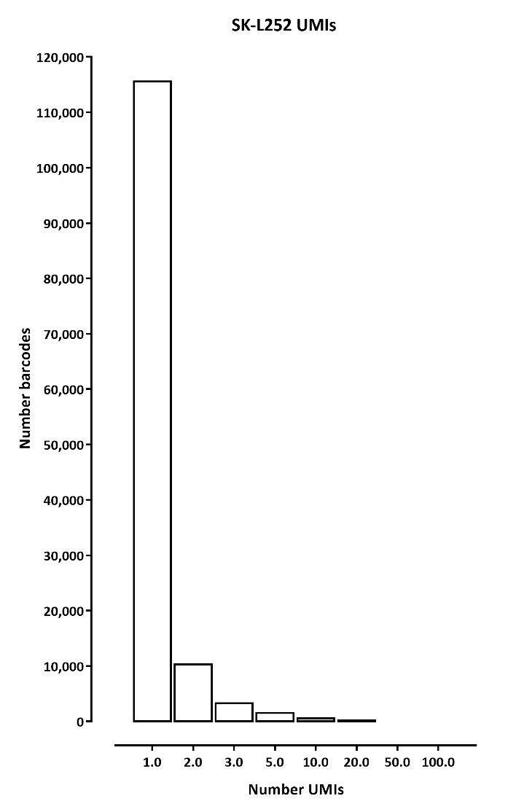
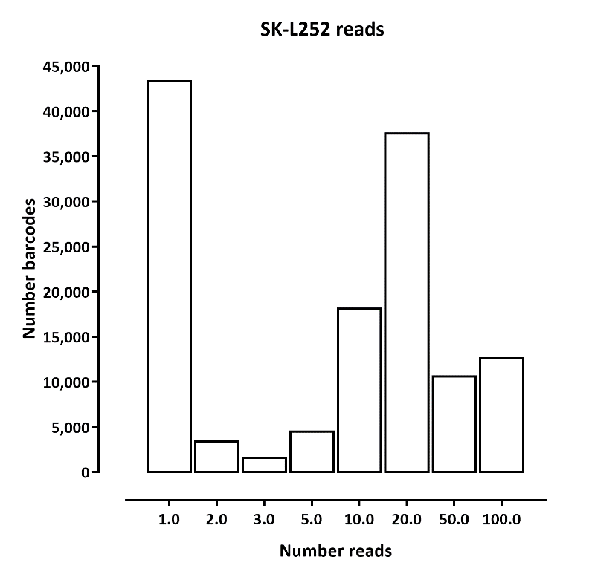
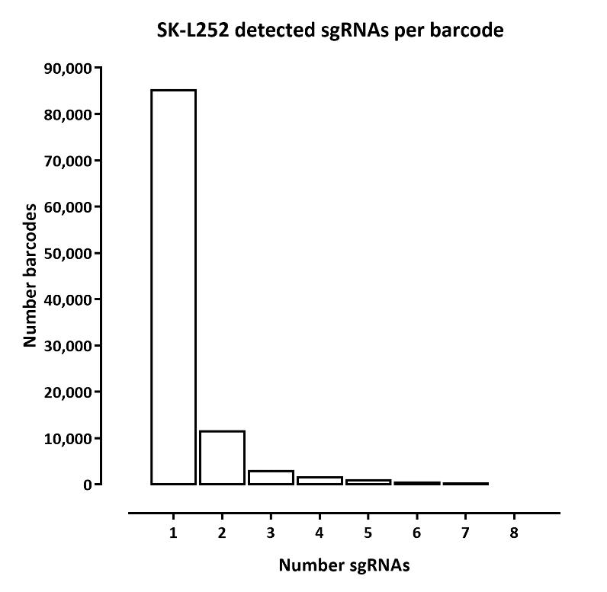
sgRNAs UMIs vs reads, all BCs

Slide 7
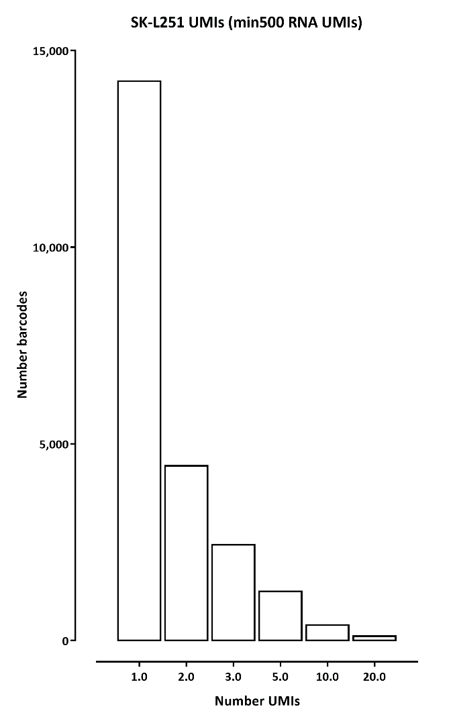
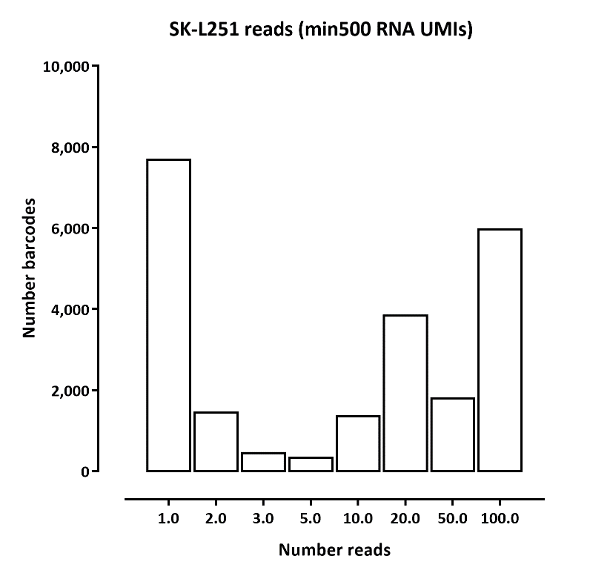
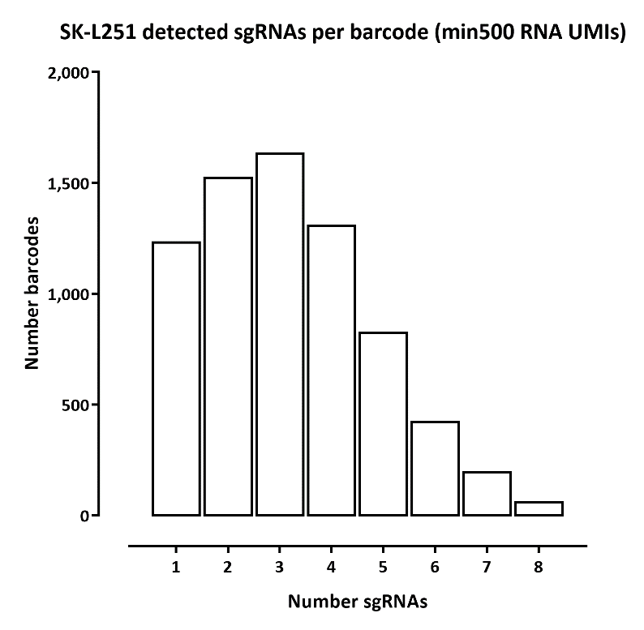
sgRNAs UMIs vs reads, >500 RNA UMIs BCs

Slide 8
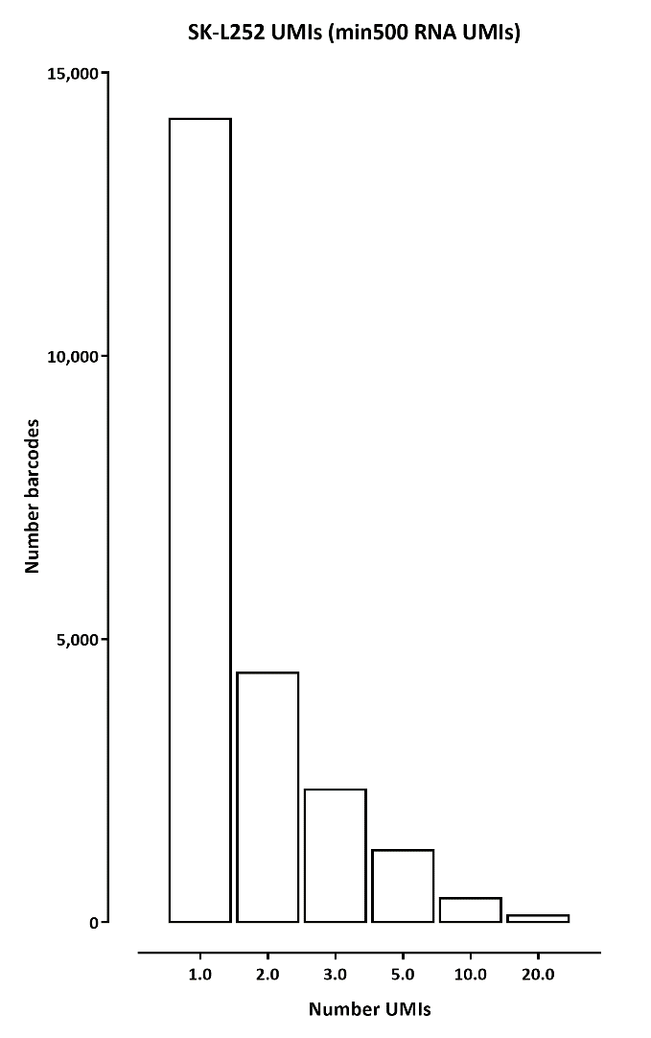
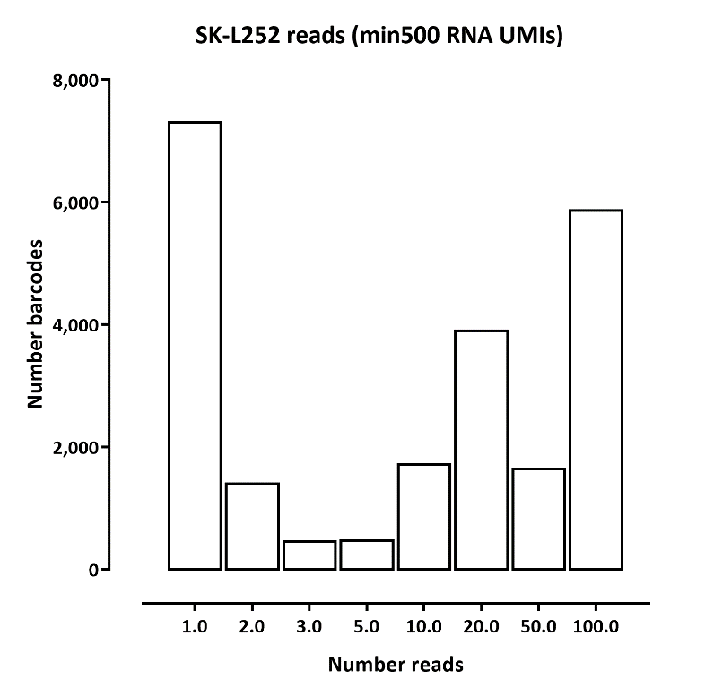

sgRNAs UMIs vs reads, >500 RNA UMIs BCs

Slide 9
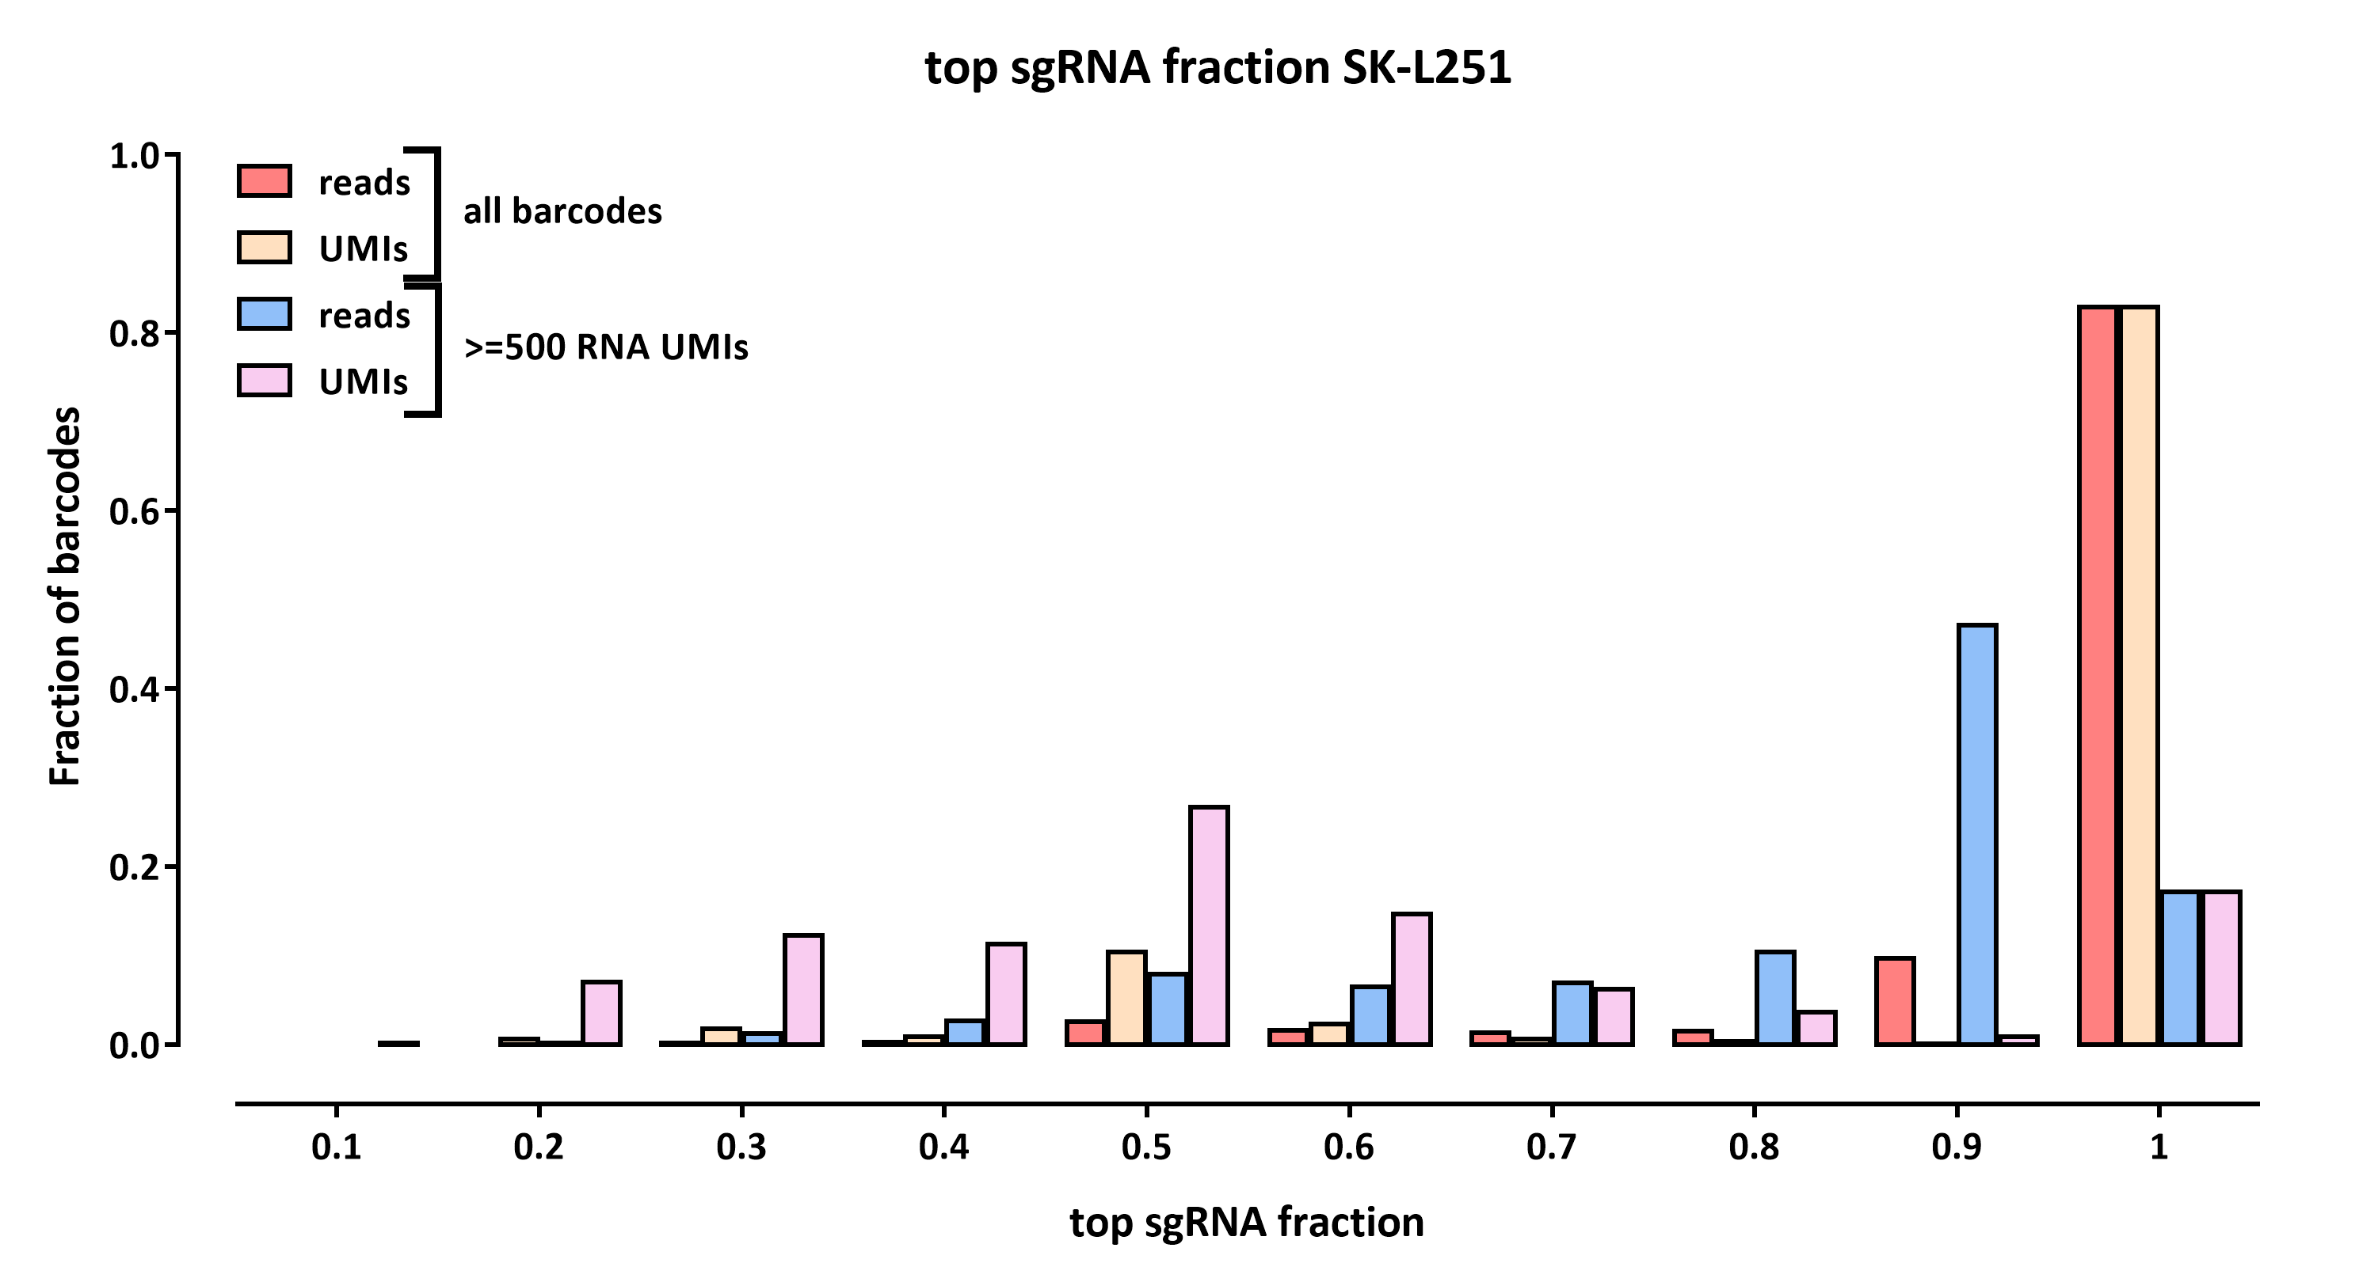
sgRNAs reads per barcode SK-L251

Slide 10
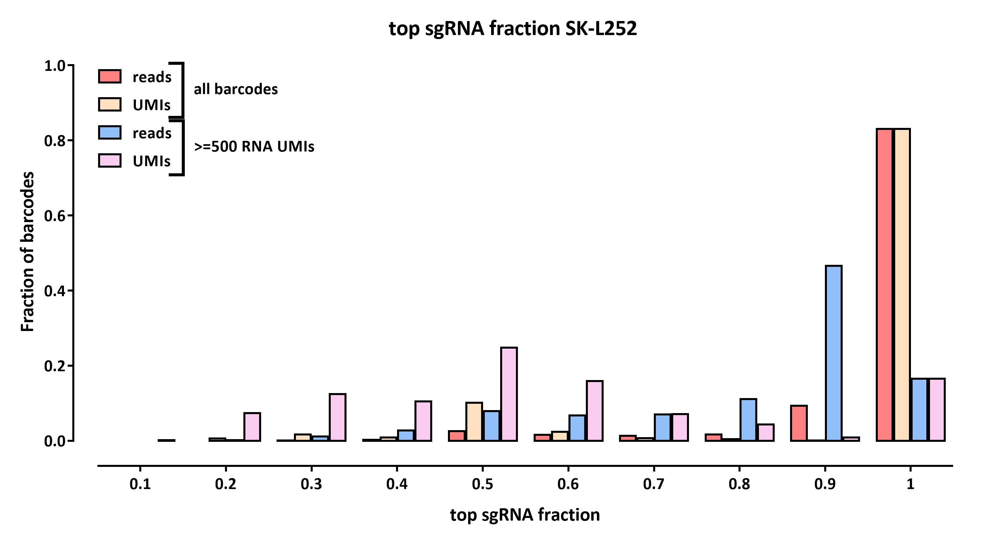
sgRNAs reads per barcode SK-L252

Slide 11
sgRNAs reads per barcode, min500 RNA UMI, SK-L251
 |  | top sgRNA fraction per barcode, min 500 RNA UMIs
 | # | 0 | 0.1 | 0.2 | 0.3 | 0.4 | 0.5 | 0.6 | 0.7 | 0.8 | 0.9 | 1
# readss per barcode | 1 | 0 | 0 | 0 | 0 | 0 | 0 | 0 | 0 | 0 | 0 | 365
 | 2 | 0 | 0 | 0 | 0 | 0 | 109 | 0 | 0 | 0 | 0 | 36
 | 3 | 0 | 0 | 3 | 30 | 0 | 14 | 24 | 7 | 0 | 0 | 7
 | 5 | 0 | 0 | 2 | 2 | 4 | 5 | 3 | 4 | 15 | 0 | 29
 | 10 | 0 | 0 | 0 | 0 | 0 | 0 | 2 | 12 | 26 | 68 | 97
 | 20 | 0 | 0 | 0 | 0 | 8 | 54 | 51 | 28 | 46 | 291 | 257
 | 50 | 0 | 0 | 1 | 20 | 42 | 103 | 92 | 65 | 34 | 147 | 111
 | 100 | 0 | 0 | 5 | 40 | 139 | 284 | 292 | 381 | 625 | 2,882 | 329
 |  | top sgRNA fraction per barcode, min 500 RNA UMIs
 | # | 0 | 0.1 | 0.2 | 0.3 | 0.4 | 0.5 | 0.6 | 0.7 | 0.8 | 0.9 | 1
# UMIss per barcode | 1 | 0 | 0 | 0 | 0 | 0 | 0 | 0 | 0 | 0 | 0 | 892
 | 2 | 0 | 0 | 0 | 0 | 0 | 707 | 0 | 0 | 0 | 0 | 201
 | 3 | 0 | 0 | 169 | 403 | 0 | 432 | 357 | 132 | 0 | 0 | 100
 | 5 | 0 | 9 | 216 | 358 | 566 | 452 | 402 | 135 | 166 | 0 | 32
 | 10 | 0 | 4 | 79 | 139 | 206 | 260 | 226 | 129 | 61 | 25 | 3
 | 20 | 0 | 0 | 2 | 20 | 40 | 64 | 69 | 49 | 32 | 17 | 2
 | 50 | 0 | 0 | 0 | 0 | 0 | 0 | 0 | 2 | 6 | 16 | 0
 | 100 | 0 | 0 | 0 | 0 | 0 | 0 | 0 | 1 | 0 | 9 | 1

Slide 12
sgRNAs reads per barcode, min500 RNA UMI, SK-L252
 |  | top sgRNA fraction per barcode, min 500 RNA UMIs
 | # | 0 | 0.1 | 0.2 | 0.3 | 0.4 | 0.5 | 0.6 | 0.7 | 0.8 | 0.9 | 1
# readss per barcode | 1 | 0 | 0 | 0 | 0 | 0 | 0 | 0 | 0 | 0 | 0 | 324
 | 2 | 0 | 0 | 0 | 0 | 0 | 114 | 0 | 0 | 0 | 0 | 49
 | 3 | 0 | 0 | 4 | 18 | 0 | 12 | 30 | 12 | 0 | 0 | 20
 | 5 | 0 | 0 | 1 | 5 | 3 | 8 | 6 | 5 | 16 | 0 | 27
 | 10 | 0 | 0 | 0 | 1 | 0 | 3 | 3 | 12 | 42 | 80 | 106
 | 20 | 0 | 0 | 0 | 0 | 13 | 57 | 61 | 52 | 54 | 267 | 231
 | 50 | 0 | 0 | 2 | 21 | 44 | 94 | 72 | 55 | 33 | 170 | 96
 | 100 | 0 | 0 | 4 | 35 | 138 | 279 | 316 | 371 | 657 | 2,832 | 336
 |  | top sgRNA fraction per barcode, min 500 RNA UMIs
 | # | 0 | 0.1 | 0.2 | 0.3 | 0.4 | 0.5 | 0.6 | 0.7 | 0.8 | 0.9 | 1
# UMIss per barcode | 1 | 0 | 0 | 0 | 0 | 0 | 0 | 0 | 0 | 0 | 0 | 828
 | 2 | 0 | 0 | 0 | 0 | 0 | 680 | 0 | 0 | 0 | 0 | 194
 | 3 | 0 | 0 | 166 | 419 | 0 | 426 | 373 | 145 | 0 | 0 | 118
 | 5 | 0 | 12 | 255 | 357 | 545 | 414 | 434 | 150 | 189 | 0 | 41
 | 10 | 0 | 1 | 63 | 144 | 184 | 229 | 243 | 164 | 86 | 21 | 8
 | 20 | 0 | 0 | 4 | 13 | 24 | 35 | 92 | 48 | 36 | 16 | 0
 | 50 | 0 | 0 | 0 | 0 | 0 | 1 | 2 | 4 | 3 | 17 | 0
 | 100 | 0 | 0 | 0 | 0 | 0 | 0 | 0 | 0 | 0 | 7 | 0

Slide 13
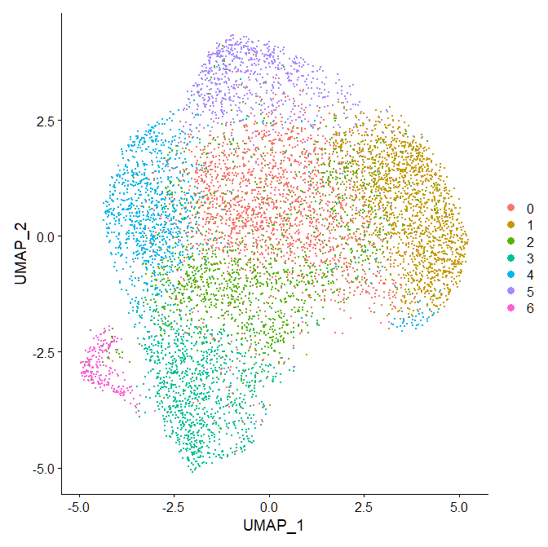
RNA UMAP SK-L247

Slide 14
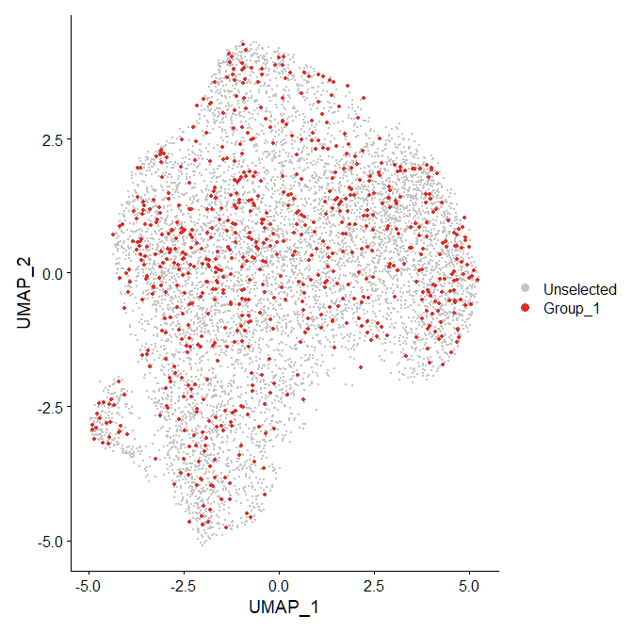
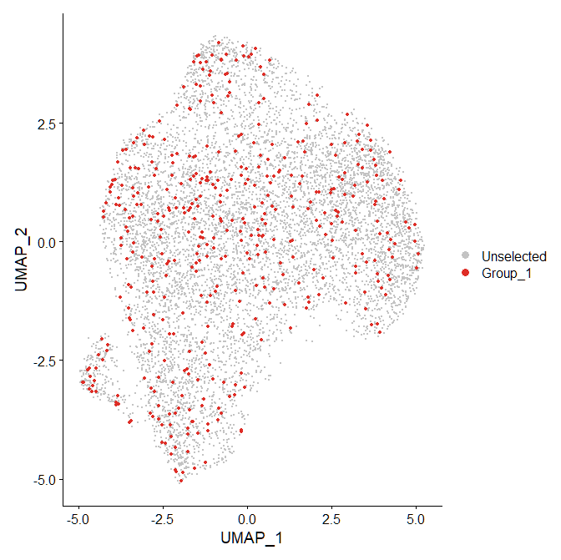
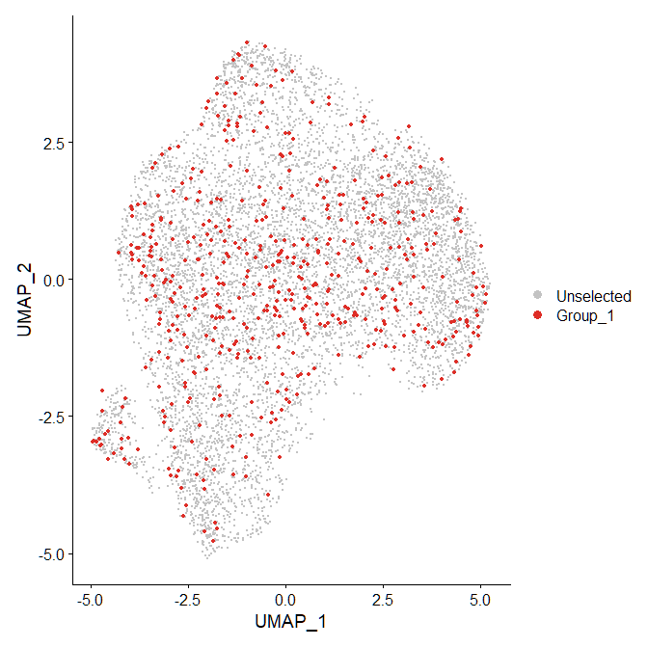
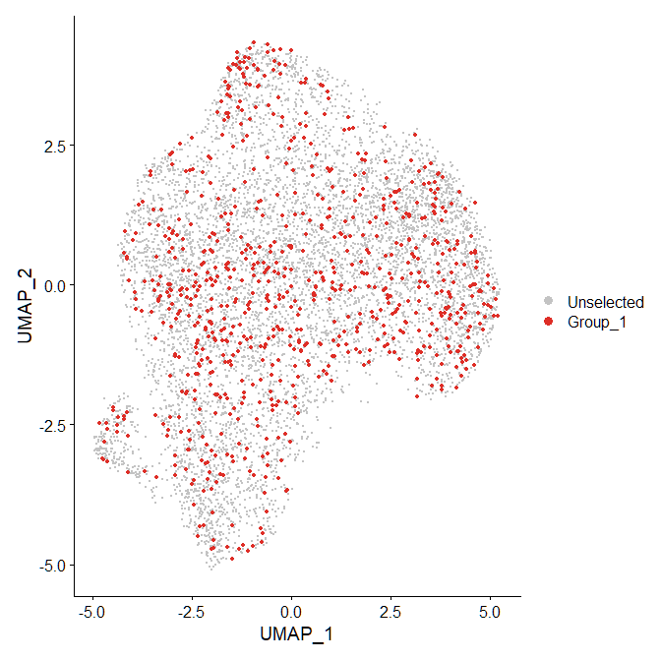
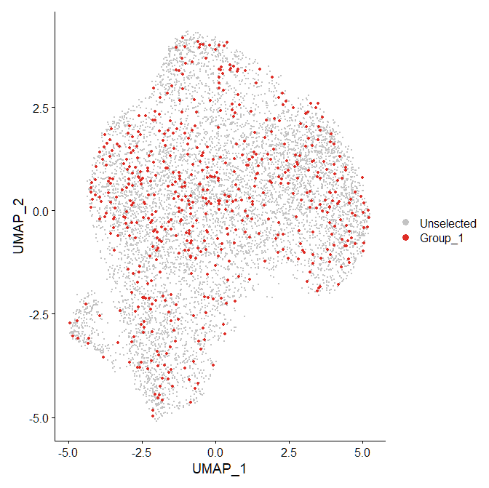
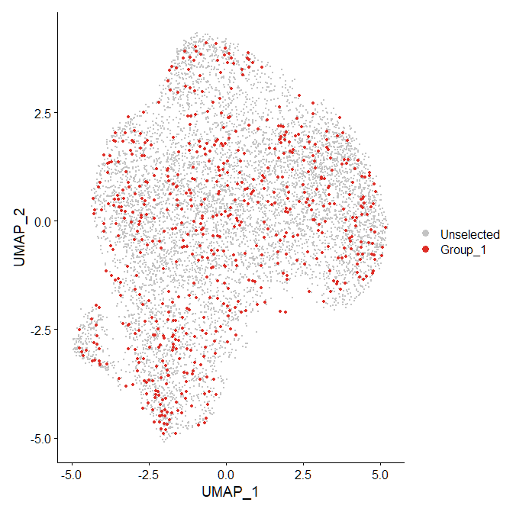
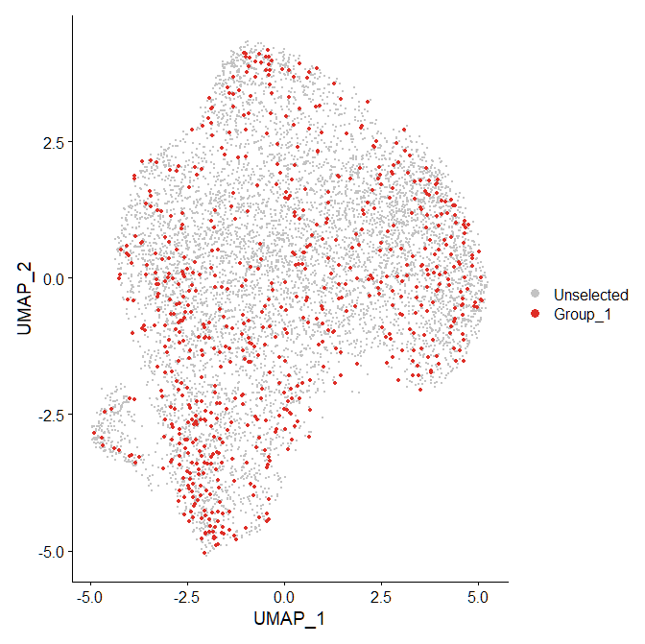
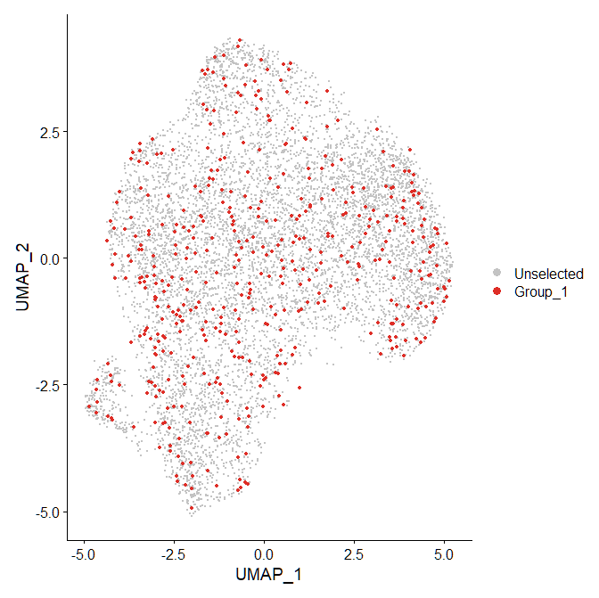
RNA UMAP SK-L247
1A 1B 2A 2B
4A 4B 5B 7B

Slide 15
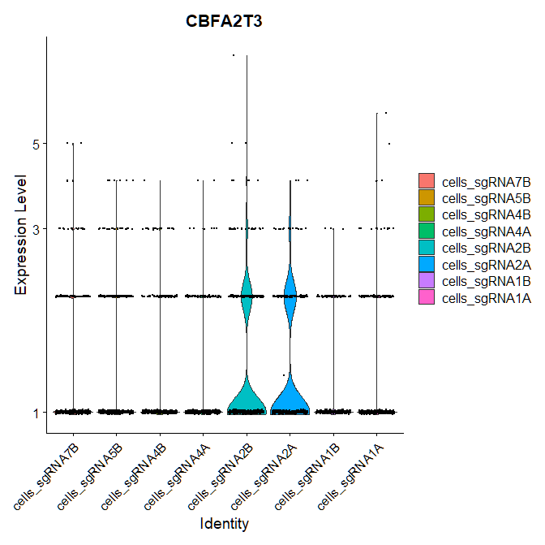

Slide 16
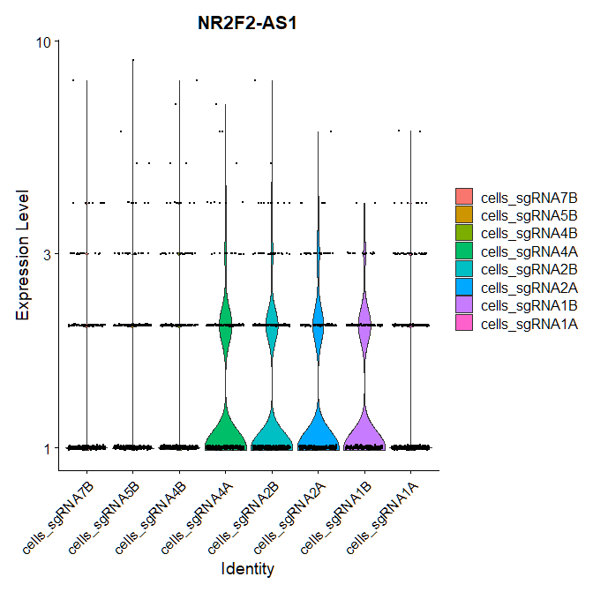

Slide 17
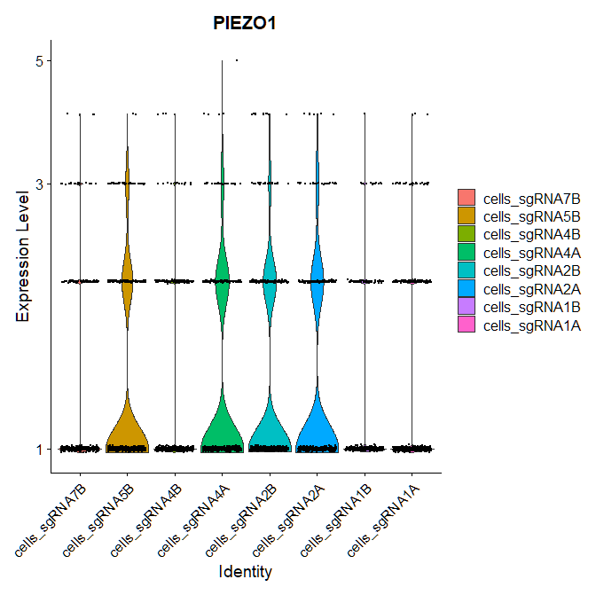

Slide 18
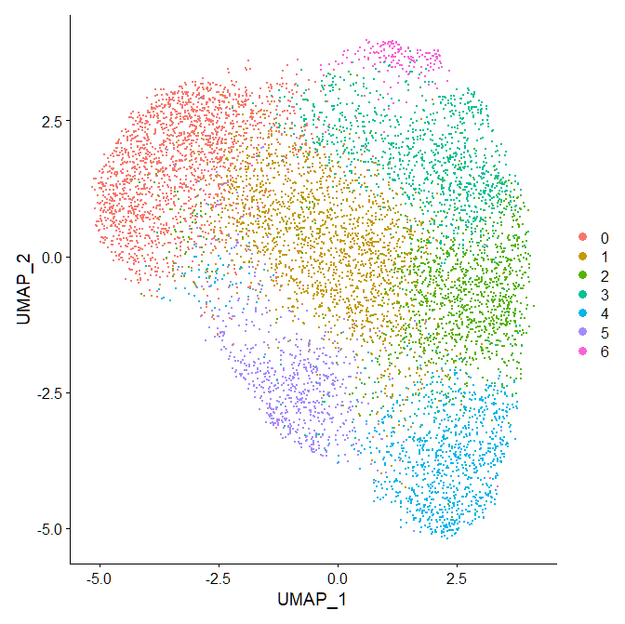
RNA UMAP SK-L248

Slide 19
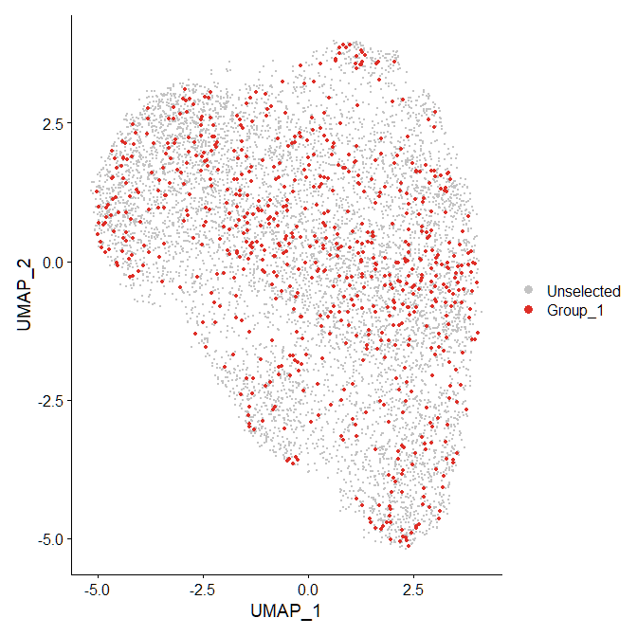
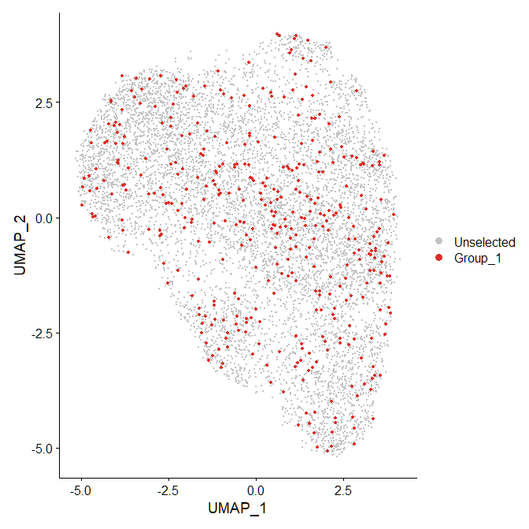
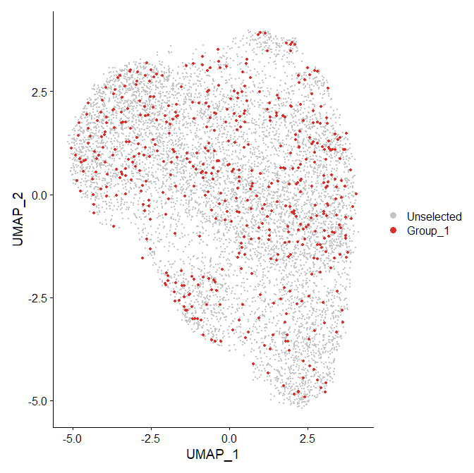
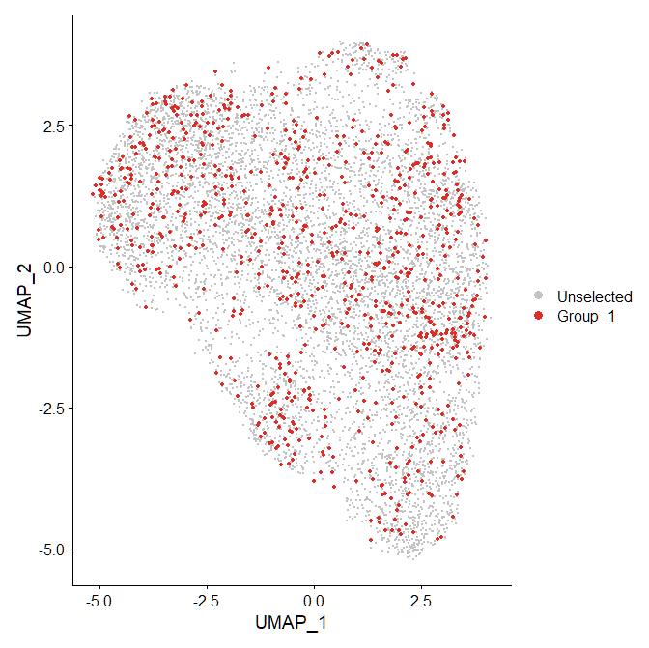
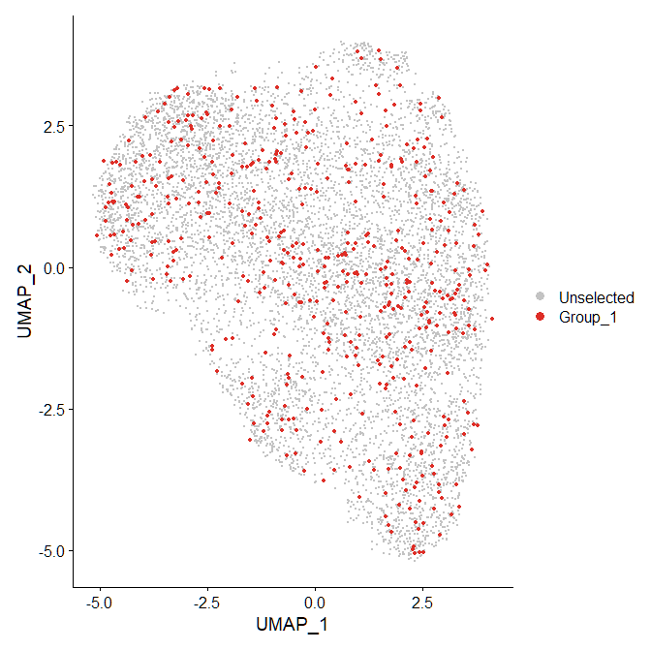
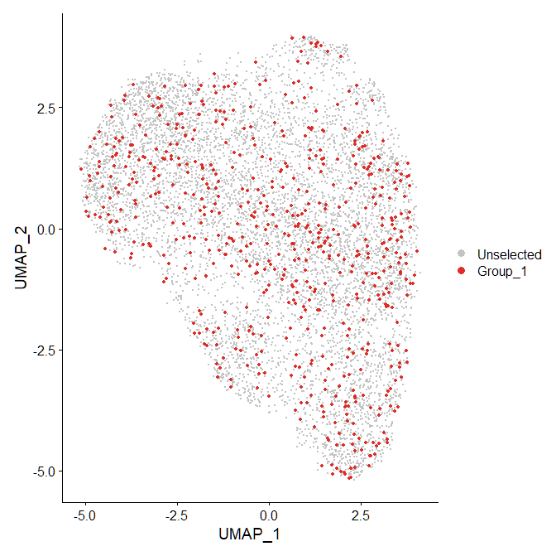
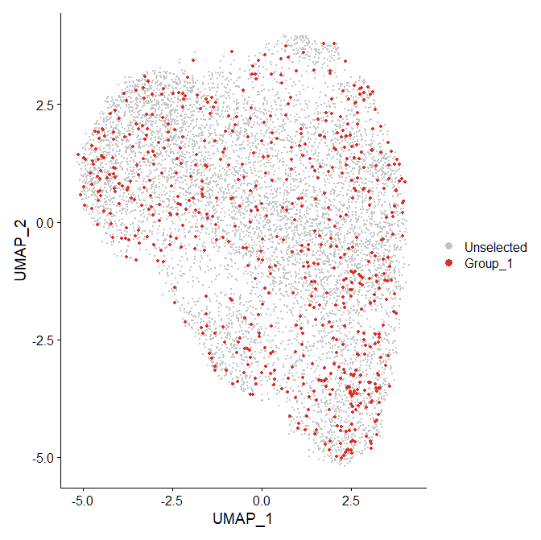
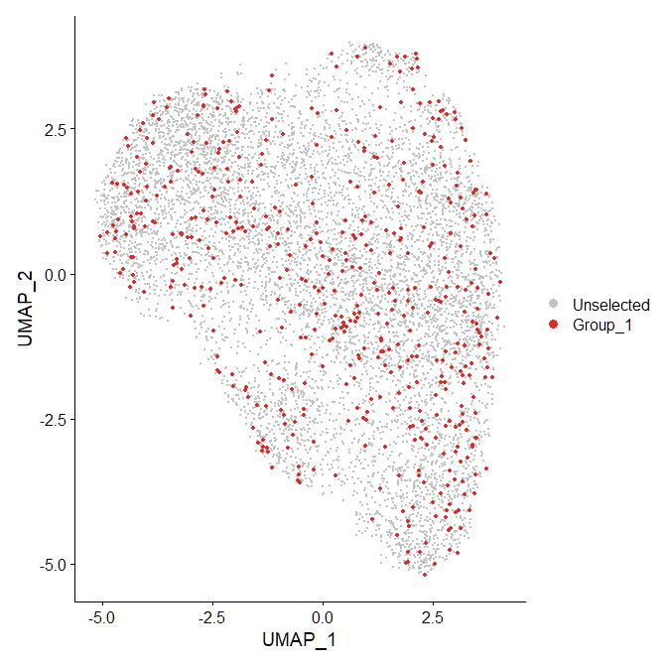
RNA UMAP SK-L248
1A 1B 2A 2B
4A 4B 5B 7B

Slide 20
