Slide 1
SPECIES DONE THIS ROUND:
Allochrocebus_lhoesti
Ametrida_centurio
Arctocephalus_forsteri
Balaenoptera_borealis
Caracal_caracal
Catopuma_temminckii
Cercocebus_torquatus_lunulatus
Cercopithecus_ascanius_schmidti
Cercopithecus_cephus
Cercopithecus_petaurista
Cercopithecus_wolfi
Cerradomys_subflavus
Enhydra_lutris
Herpestes_ichneumon
Lemmiscus_curtatus
Leopardus_paradalis
Leopardus_tigrinus
Leopardus_wiedii
Lepus_californicus
Lepus_townsendiis
Marmota_monax
Meles_meles
Microtus_miurus
Microtus_oregoni
Neovison_vison
Nomascus_concolor
Oryx_dammah
Osphranter_robustus-
Otocolobus_manul
Ovis_aries
Peromyscus_pectoralisa
Phocarctos_hookeri
Pipistrellus_abramus
Prionailurua_viverrina
Sigmodon_mascotensis
Sylvilagus_aquaticus
Sylvilagus_nuttallii
Taxidea_taxus
Tupaia_minor
Urocyon_littoralis
Note: there was a tube labelled “common wallaroo” (Osphranter robustus), which wasn’t in the lists of what was sent.

Slide 2
- Previous libraries were done as plateATAC by Arwa
- These were done by me with the usual omniATAC protocol in tubes (Arwa is gone)
Did several tests on frozen cells to make sure protocol is working before proceeding with the full run
Did more than two replicates as insurance, as previously we had some dropouts when we were doing only 2 reps per species

Slide 3
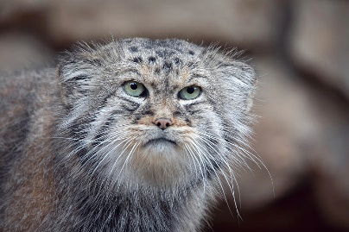
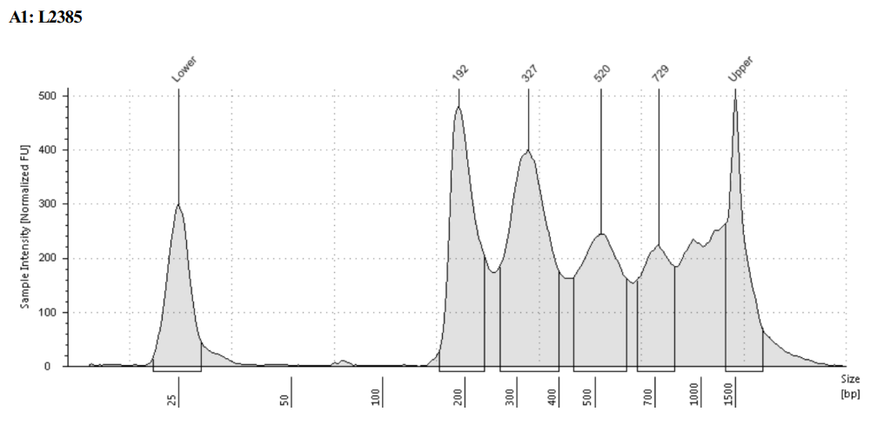
Otocolobus_manul

Slide 4
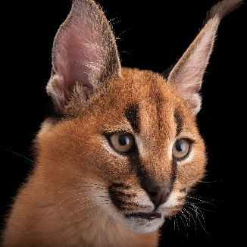
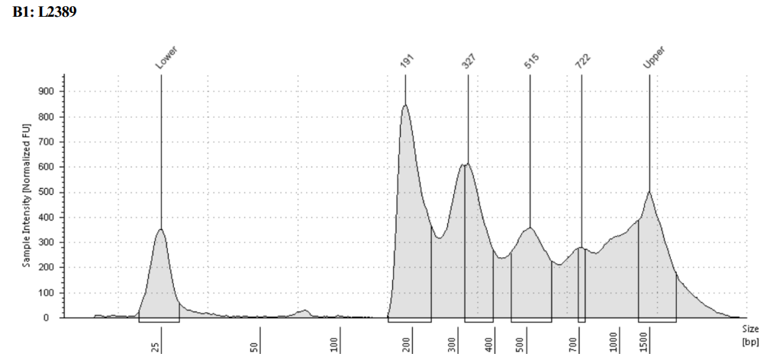
Caracal_caracal

Slide 5
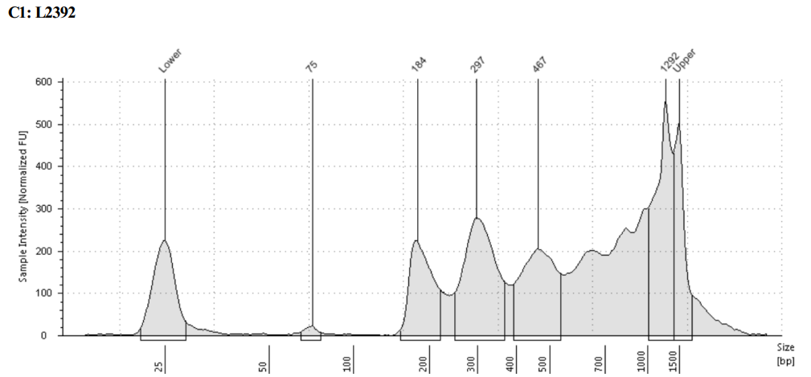
Sigmodon_mascotensis

Slide 6
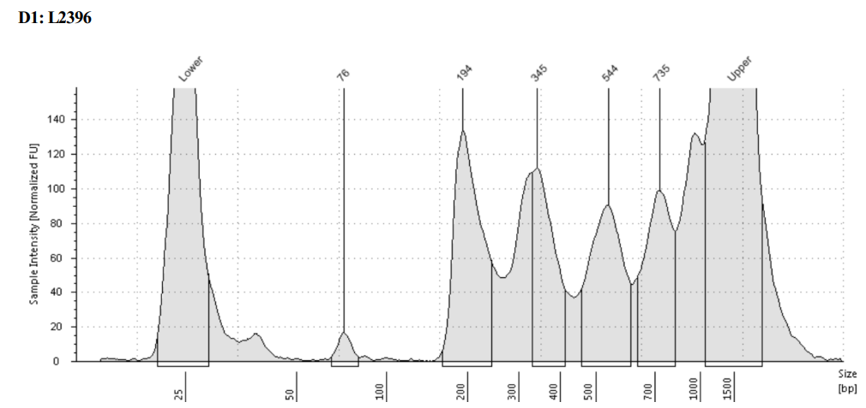
Cercopithecus_ascanius_schmidti

Slide 7
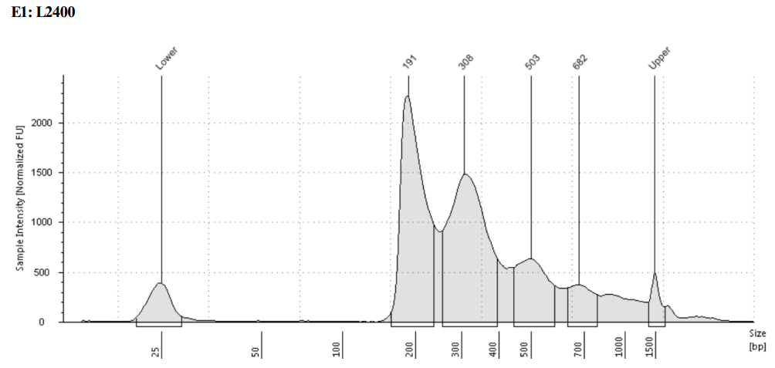
Prionailurua_viverrina

Slide 8
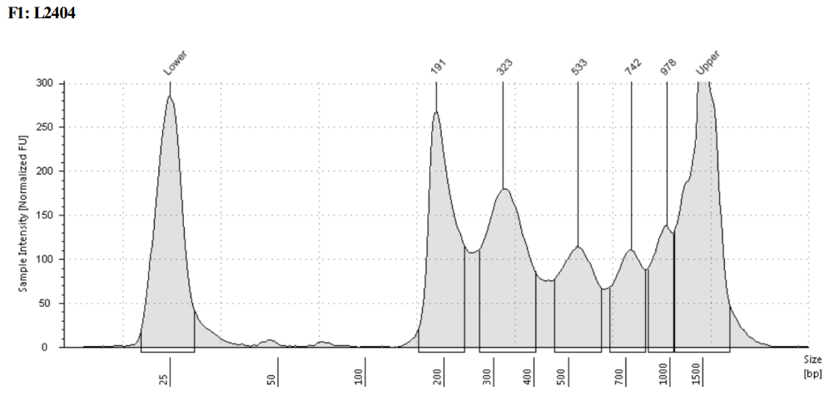
Arctocephalus_forsteri

Slide 9
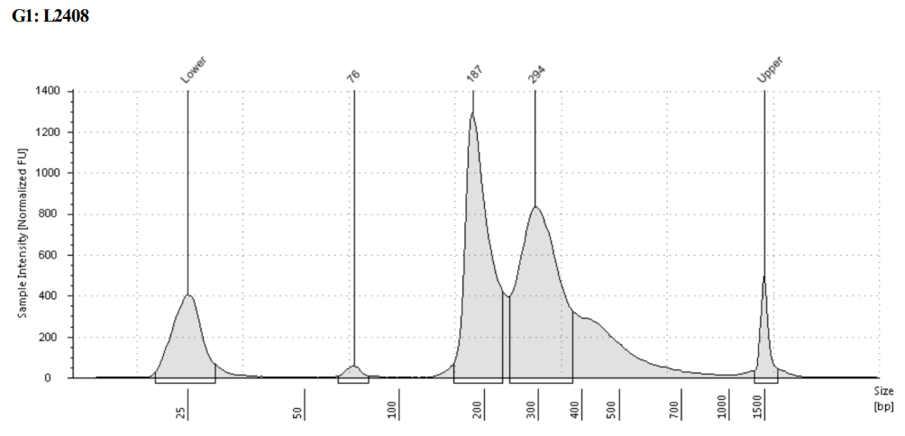
Urocyon_littoralis

Slide 10
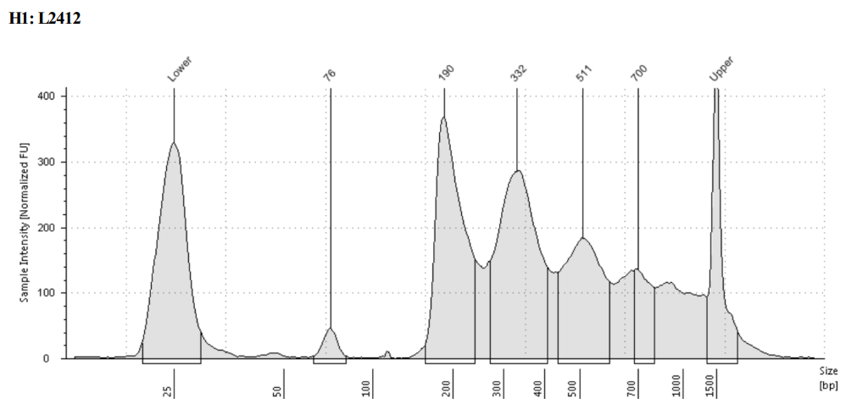
Leopardus_paradalis

Slide 11
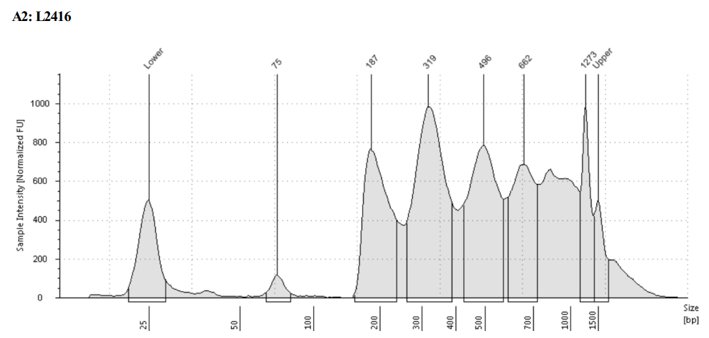
Sylvilagus_aquaticus

Slide 12
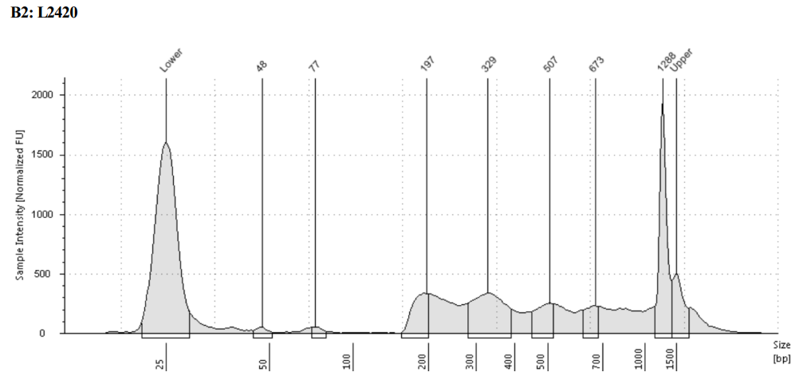
Cercopithecus_petaurista

Slide 13
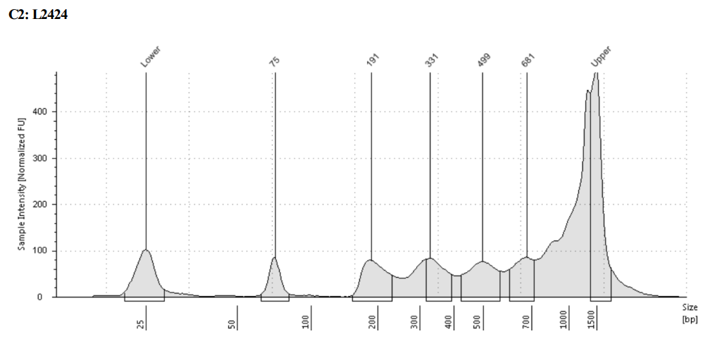
Lemmiscus_curtatus

Slide 14
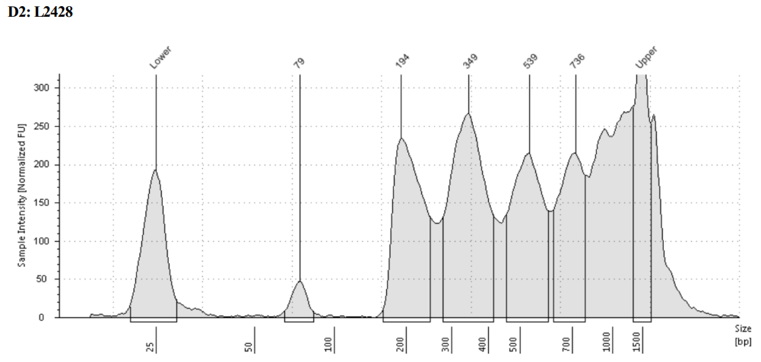
Cercocebus_torquatus_lunulatus

Slide 15
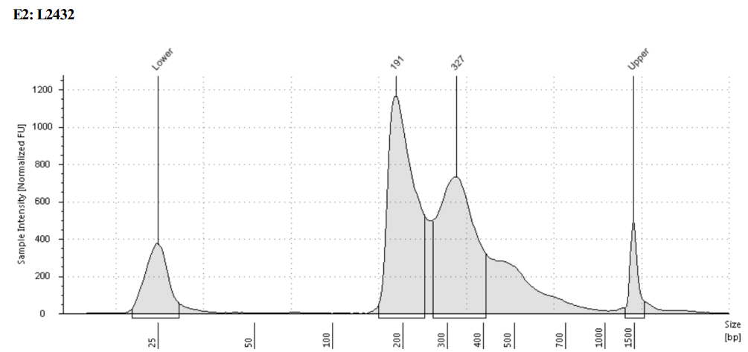
Catopuma_temminckii

Slide 16
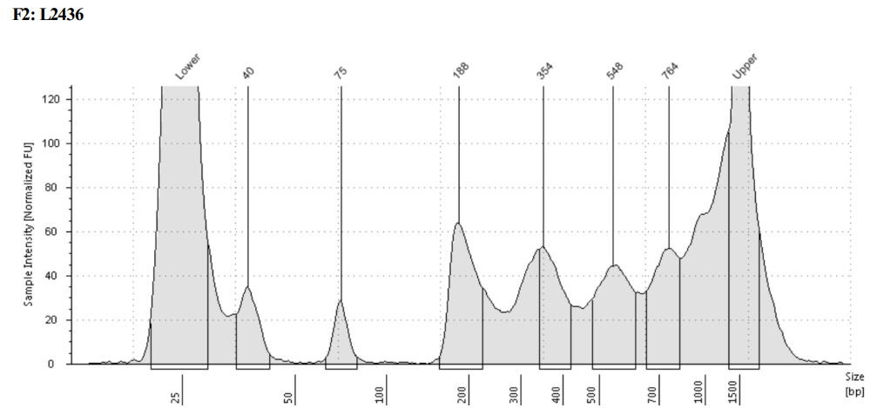
Phocarctos_hookeri

Slide 17
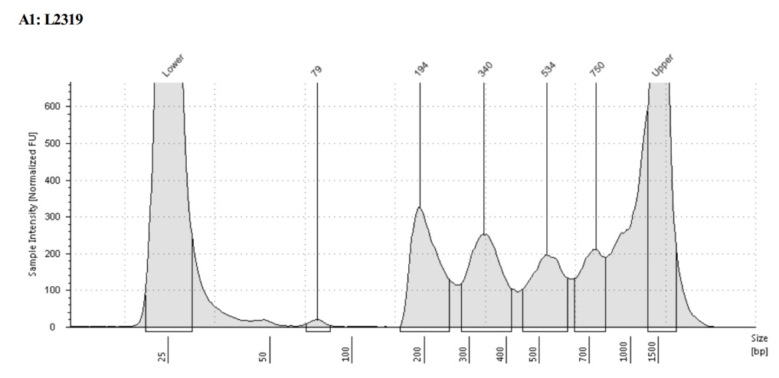
Oryx_dammah

Slide 18
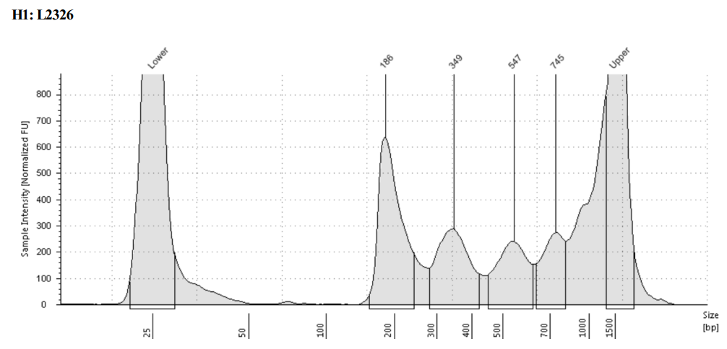
Pipistrellus_abramus

Slide 19
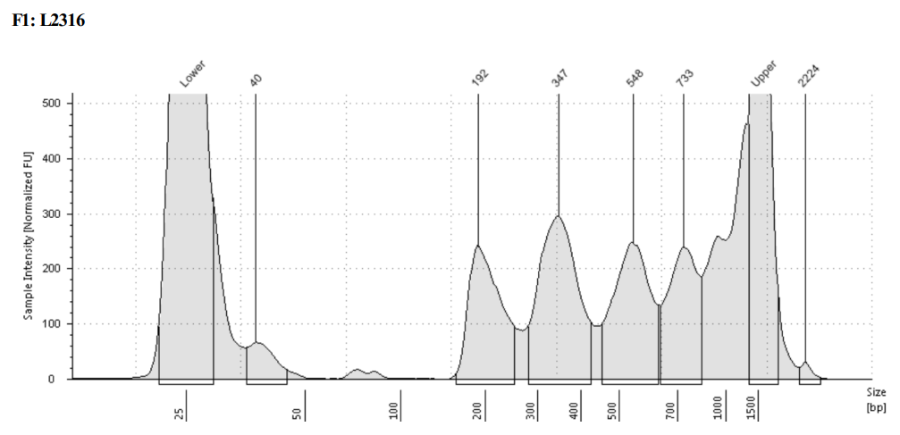
Cercopithecus_cephus

Slide 20
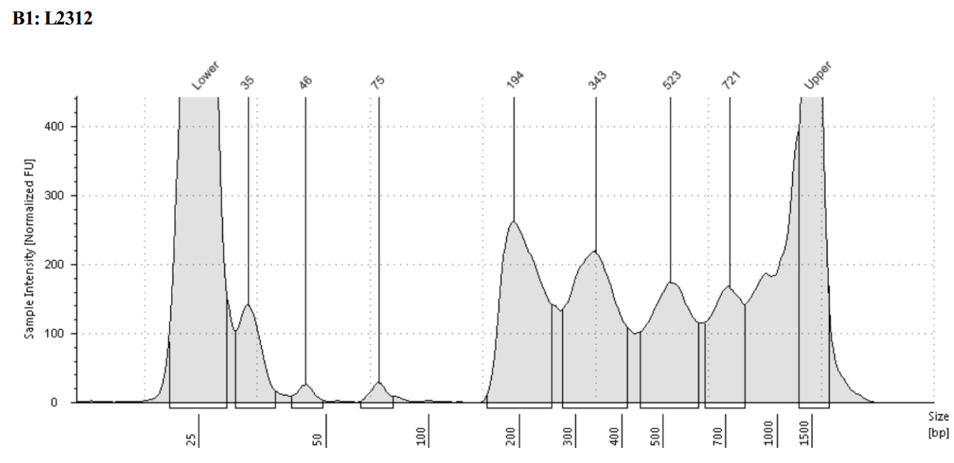
Ovis_aries

