Slide 1
Datasets stats
Note: the 1x36mers alignment is done in order to run cross-correlation QC after that (cannot run CC on PE reads, or reads that are too long)

Slide 2
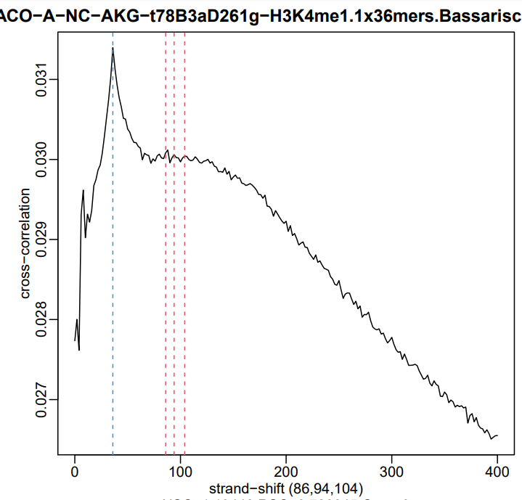
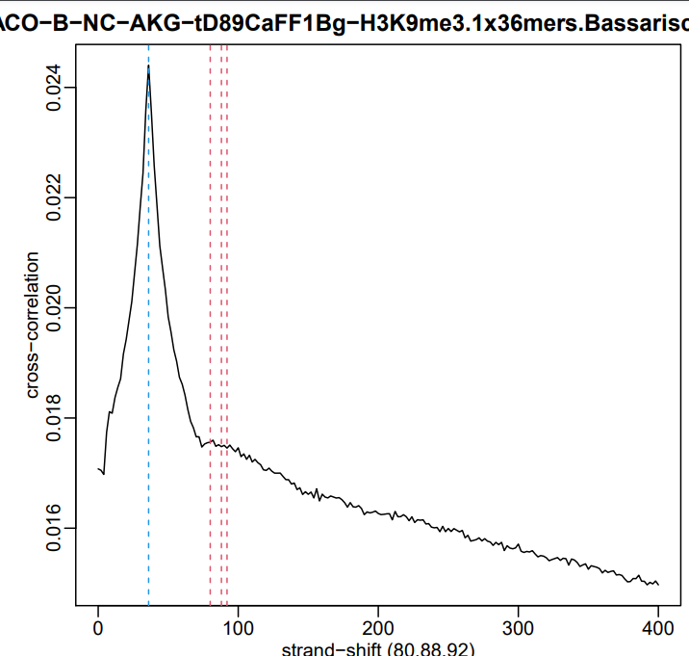
Cross-correlation

Slide 3
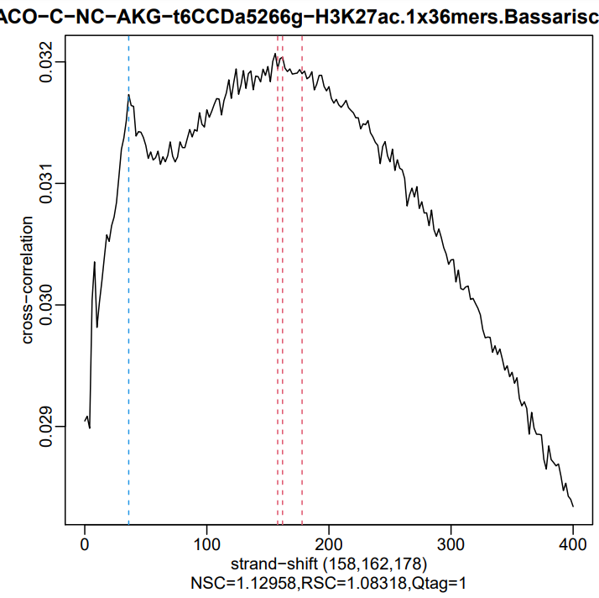
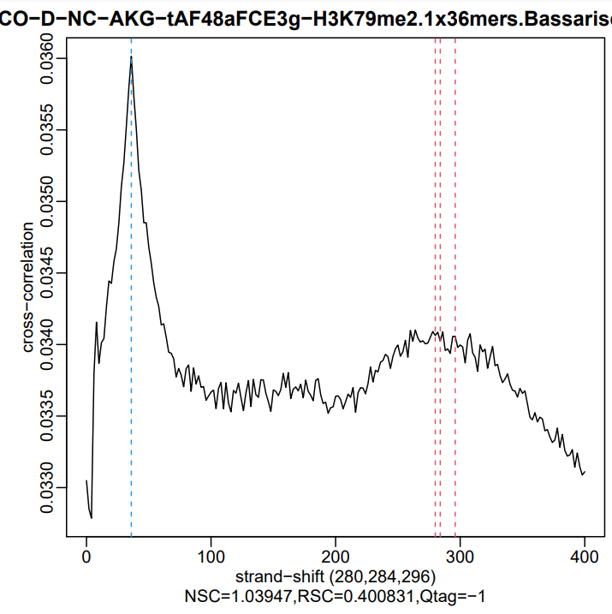

Slide 4
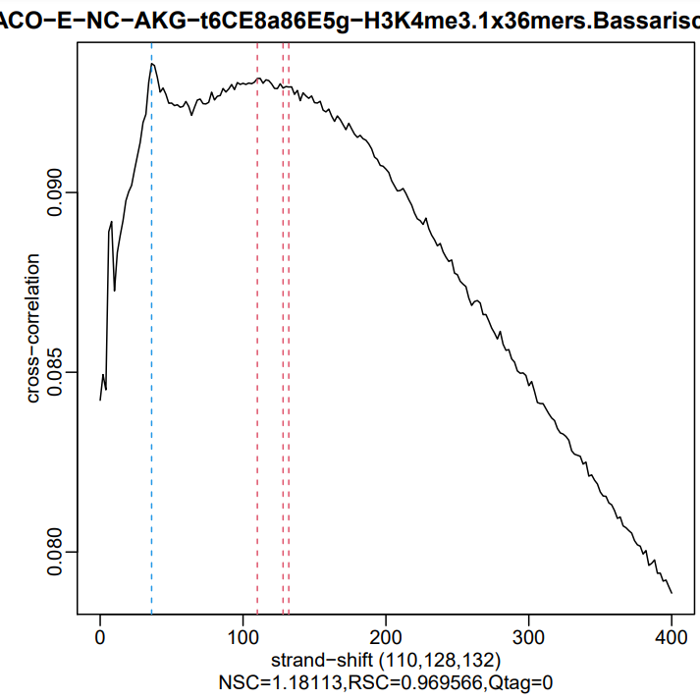
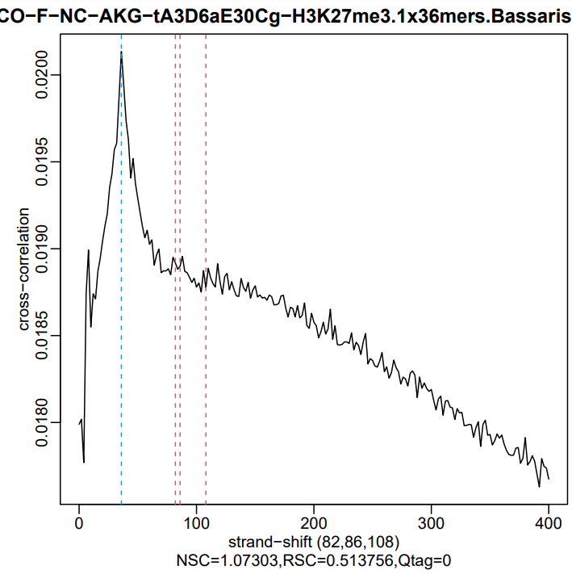

Slide 5
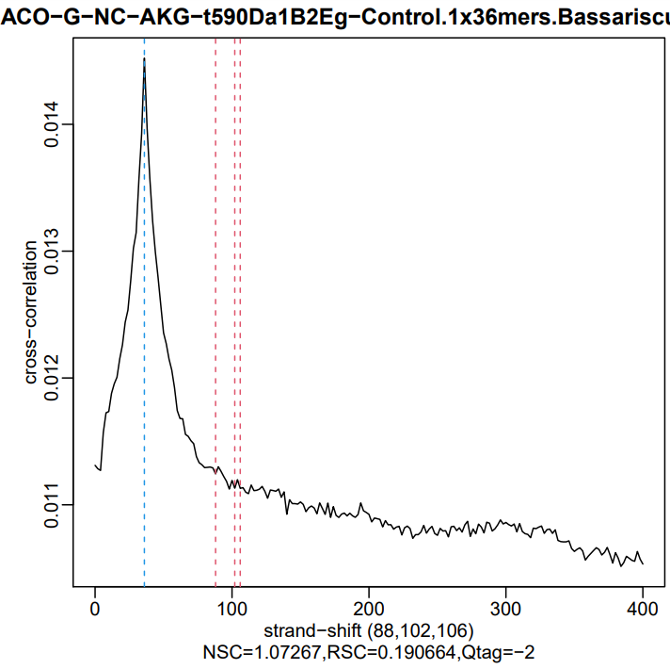
Summary:
- The phantom peak does not look as strong as it is in humans and mouse
Likely this is because the repeat structure of the cacomistle assembly isn’t the same
This makes the plots look different than usual
But still, it looks like the point-source marks (H3K4me1, H3K4me3, H3K27ac) worked
The broad marks usually do not show strong CC peaks, so those CC plots are OK too
The control does not look to have the occasionally seen artifactual read clustering, which is good too

Slide 6
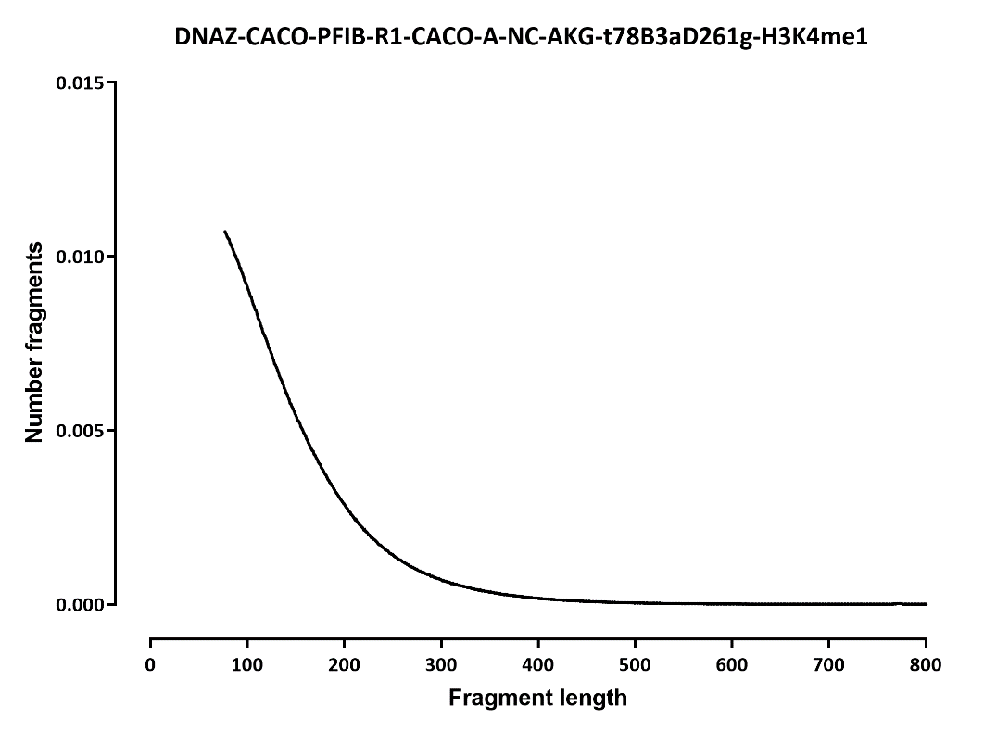
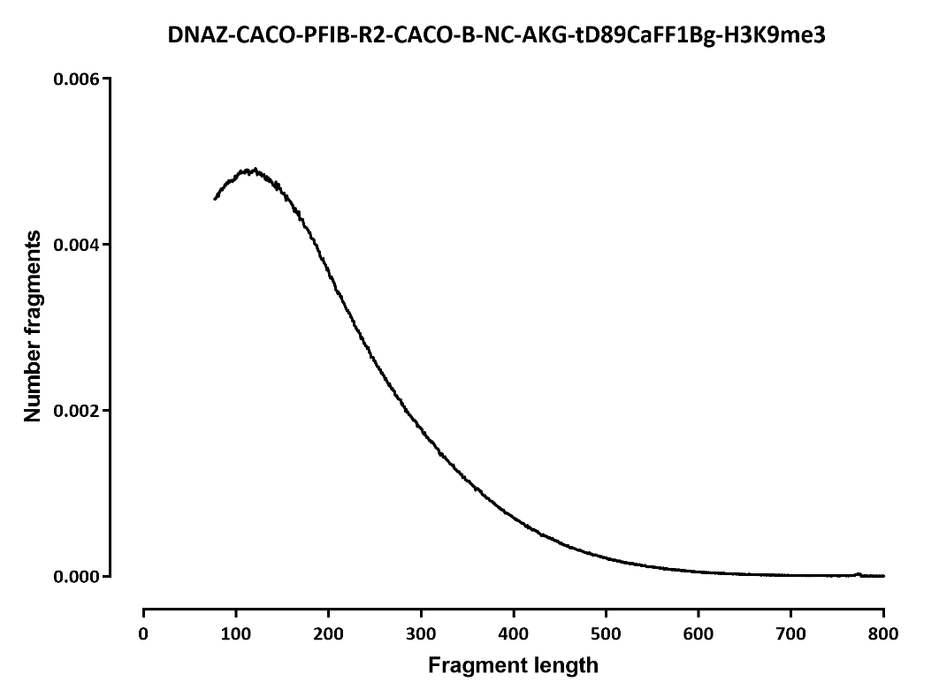
Fragment length

Slide 7
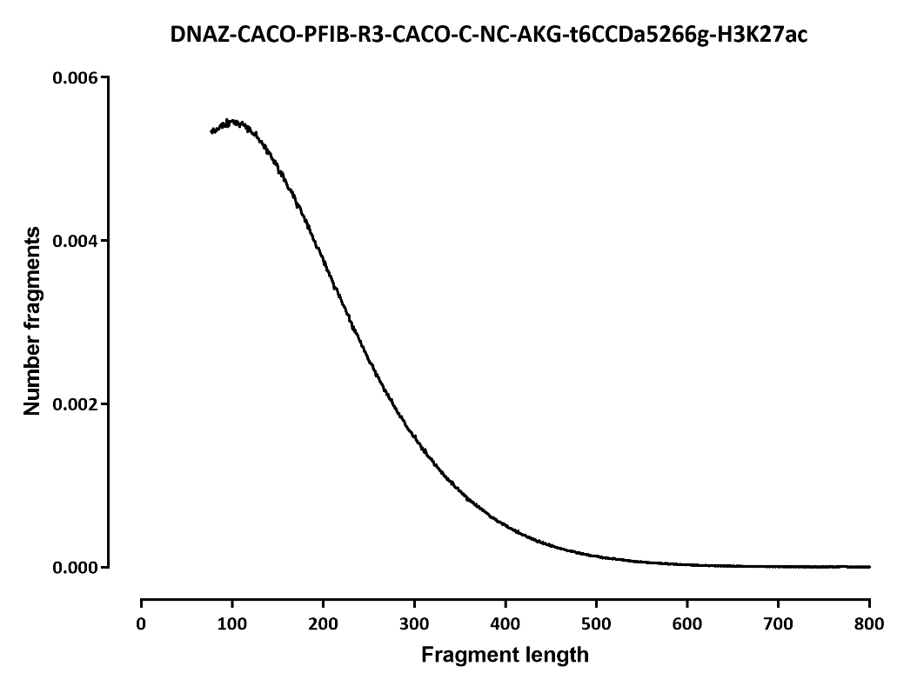
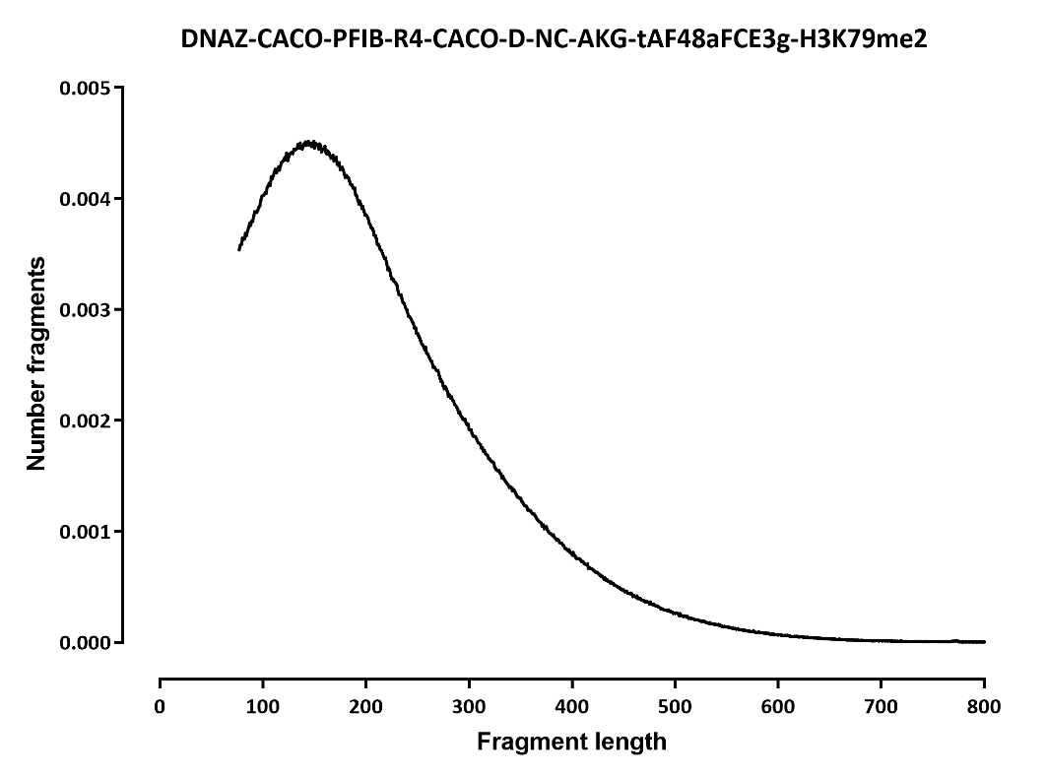

Slide 8
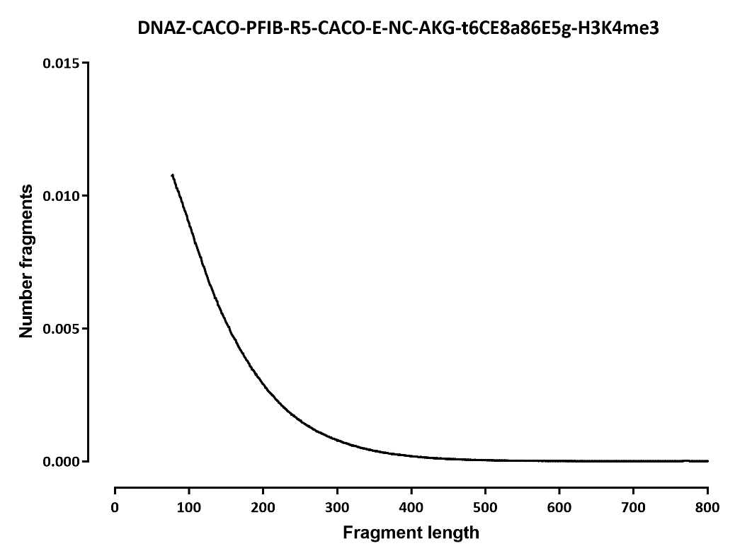
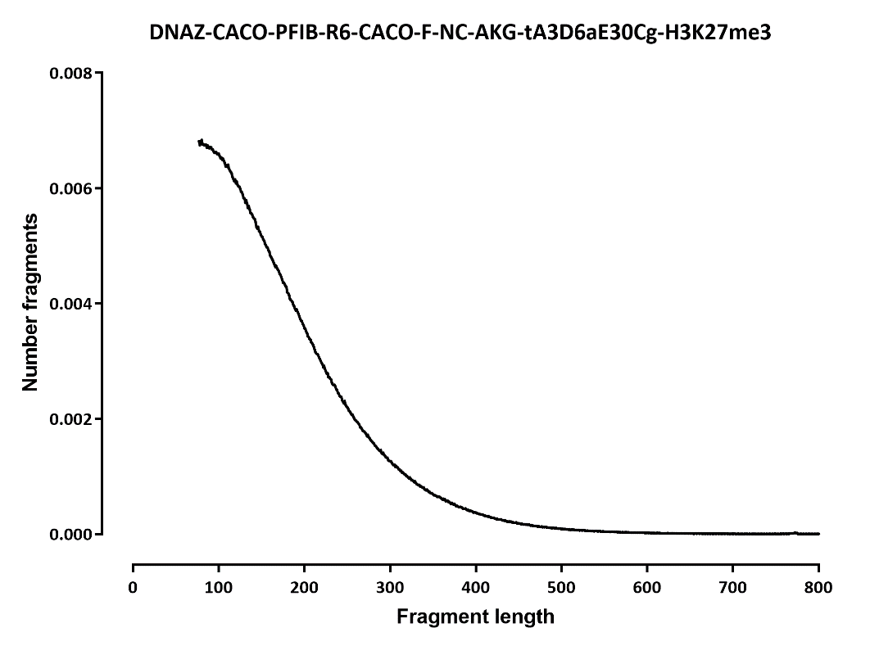

Slide 9
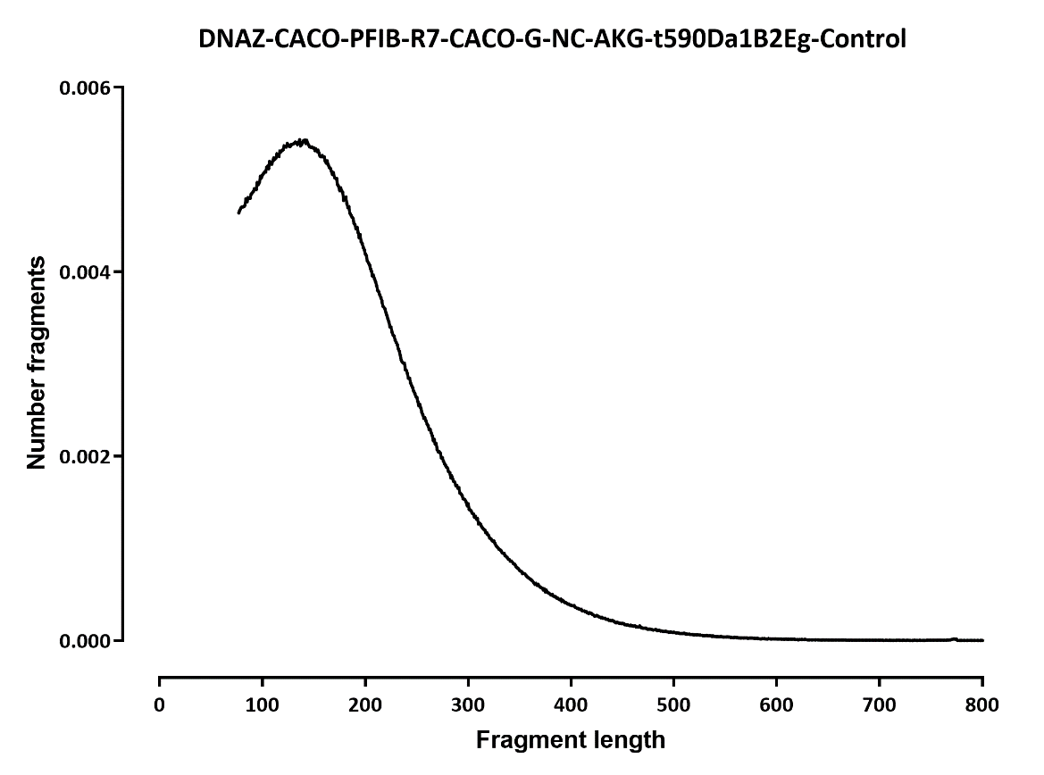

Slide 10
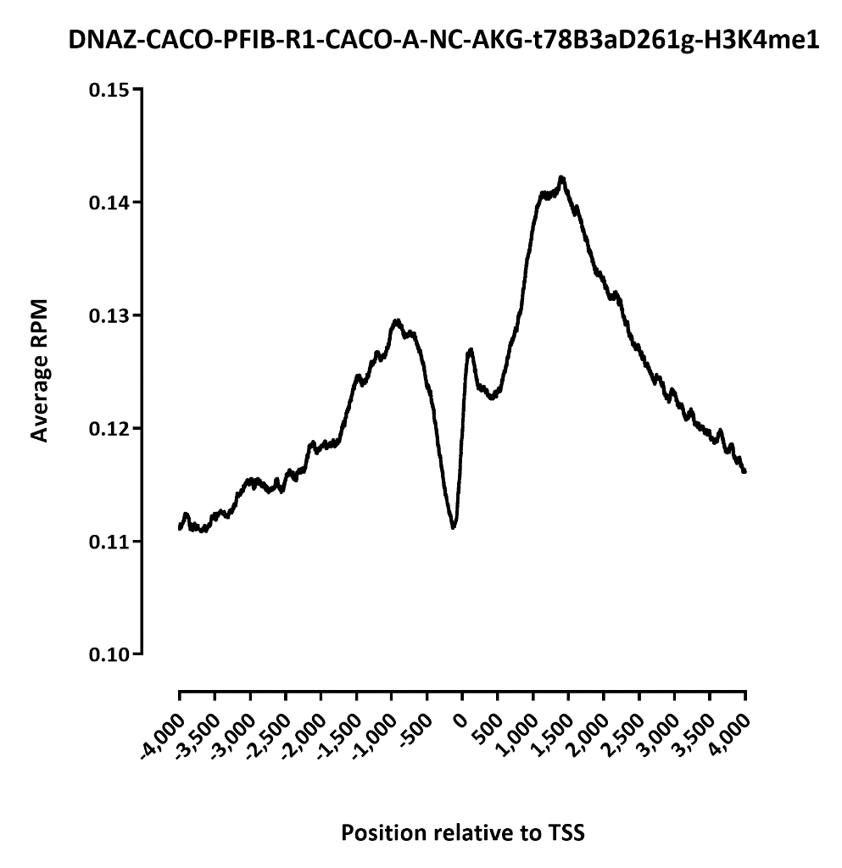
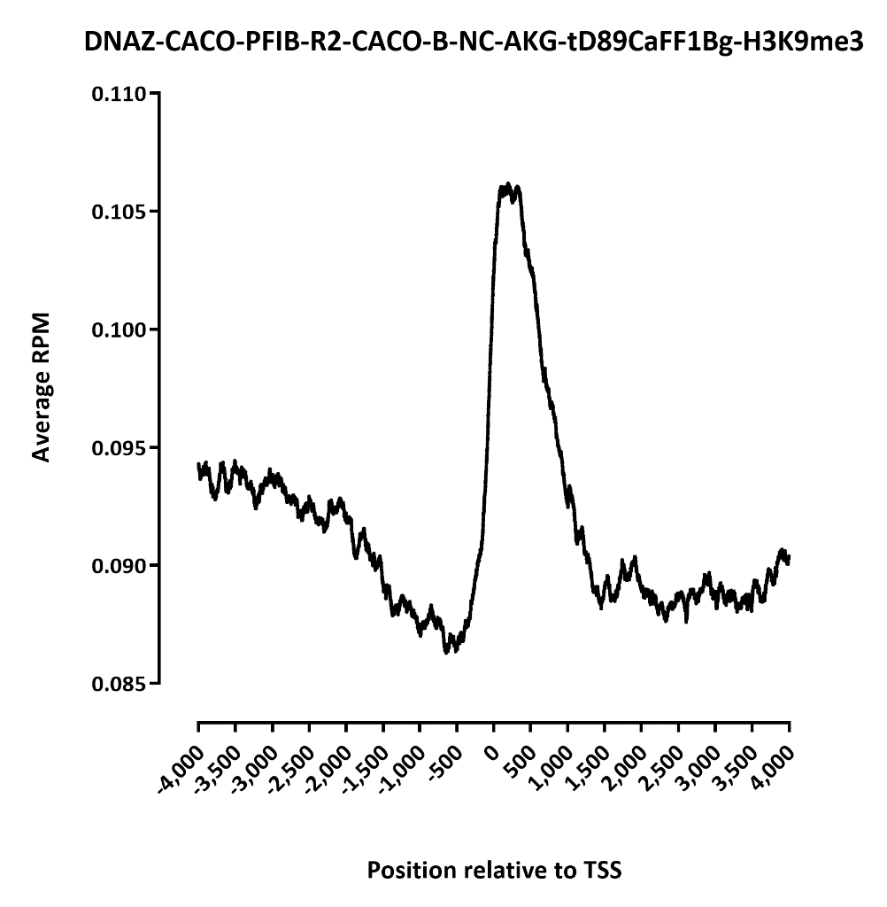
TSS profiles

Slide 11
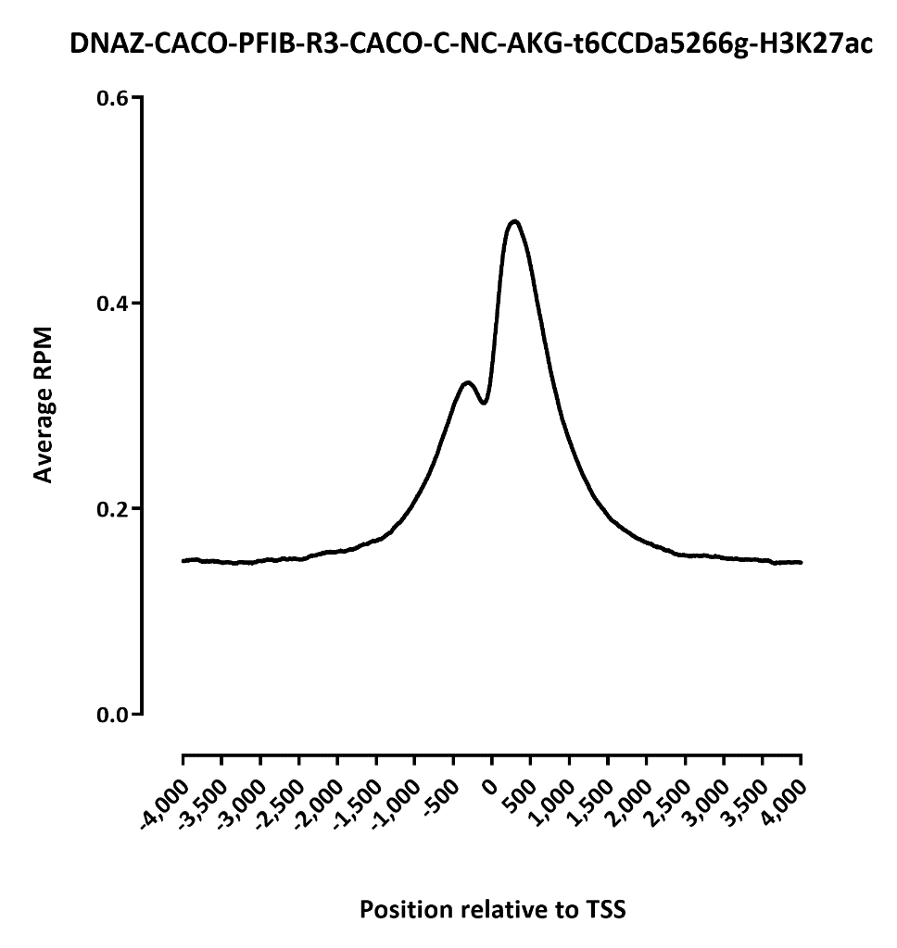
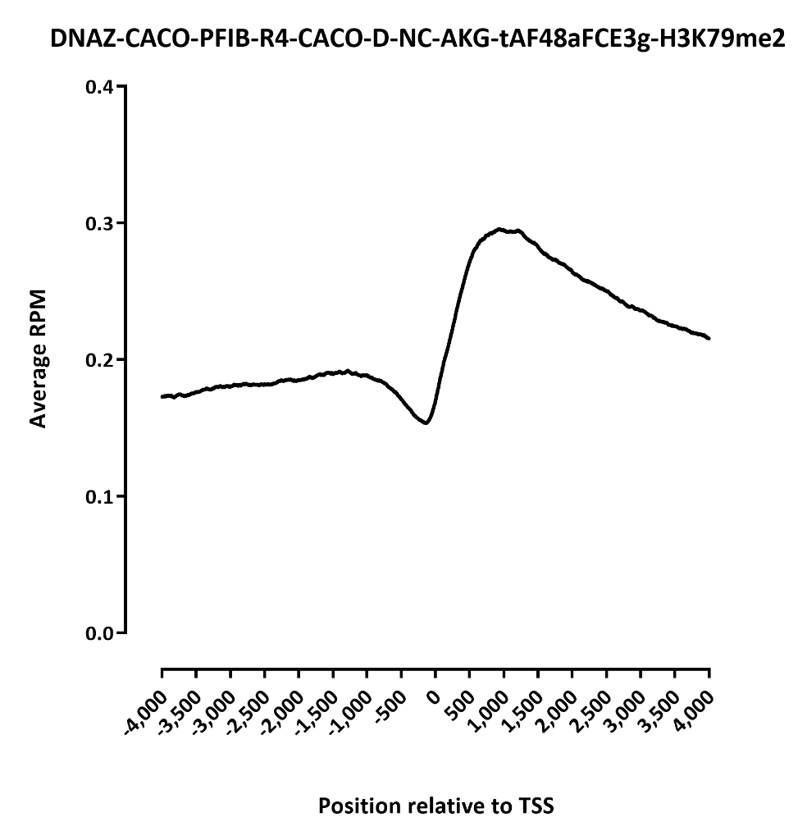

Slide 12
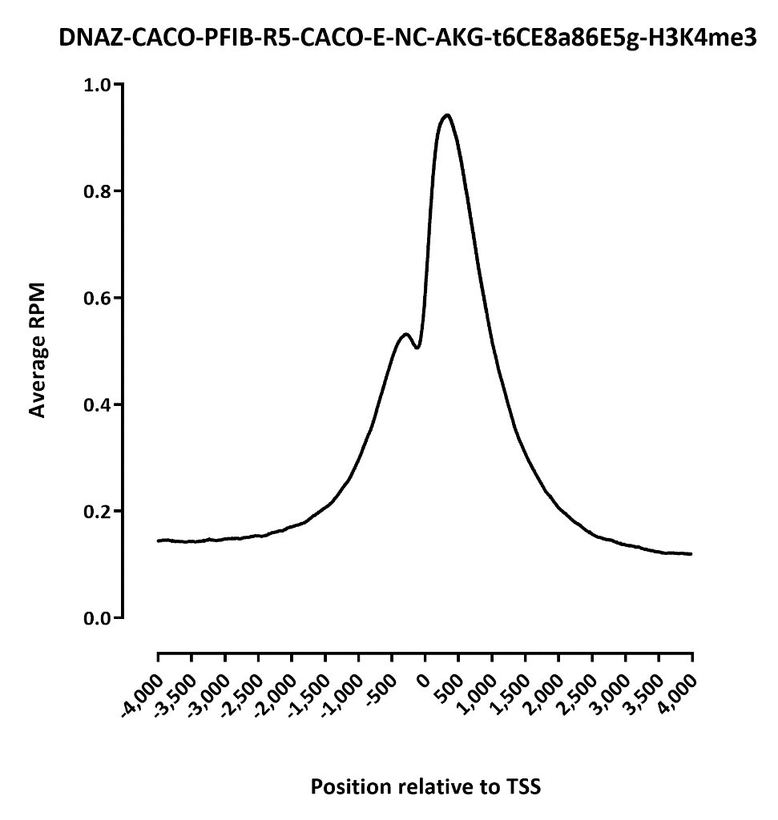
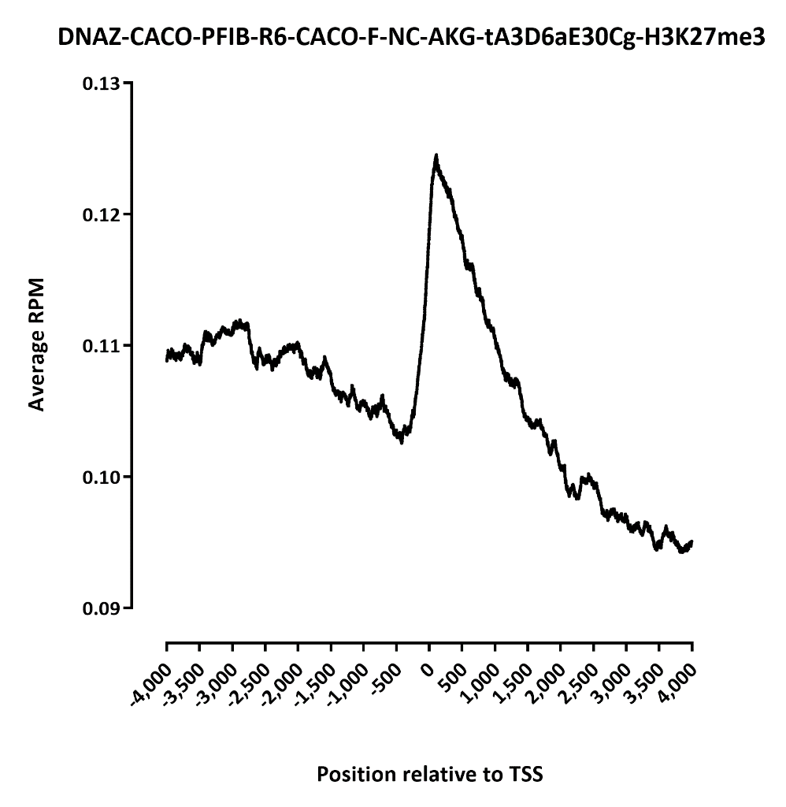

Slide 13
