Slide 1
LIBRARY STATS:

Slide 2
LIBRARY STATS:

Slide 3
CELL VIABILITY

Slide 4
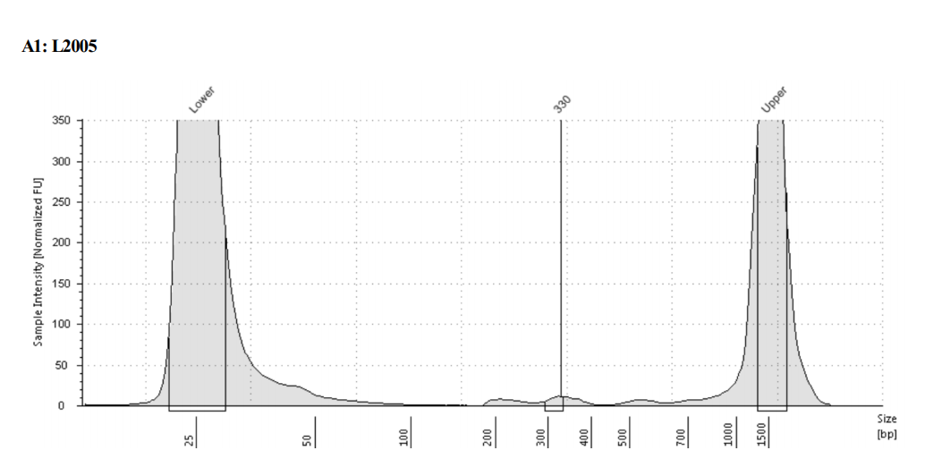
TAPE STATION FRAGMENT DISTRIBUTION
Should be OK

Slide 5
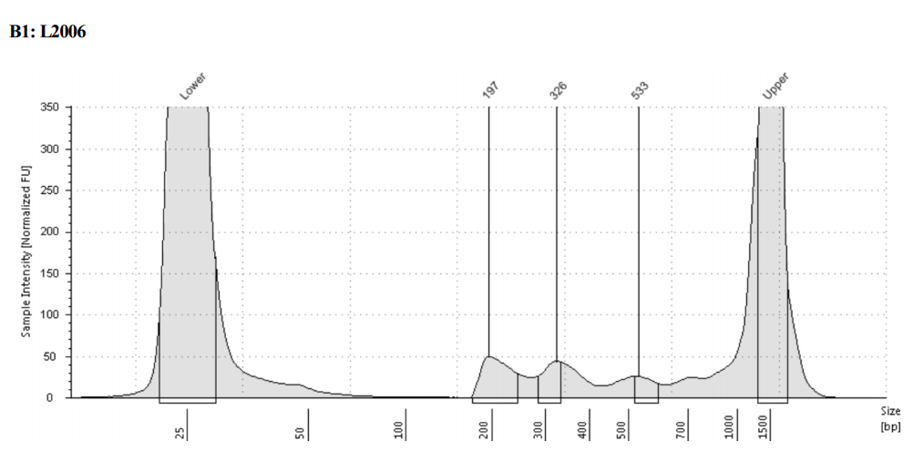
TAPE STATION FRAGMENT DISTRIBUTION
Should be OK

Slide 6
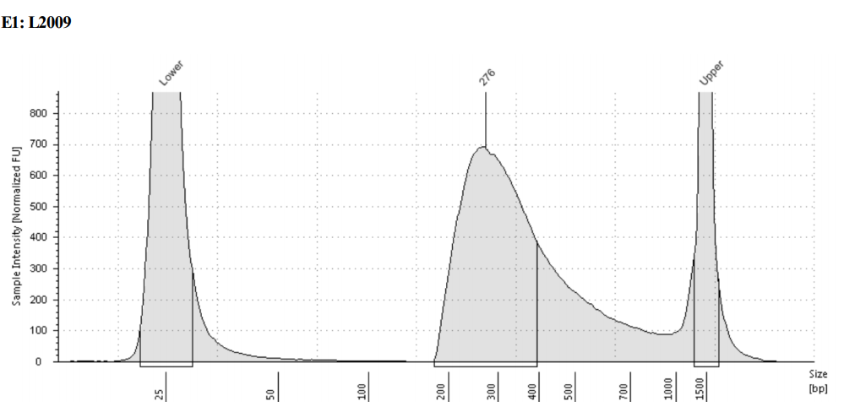
TAPE STATION FRAGMENT DISTRIBUTION
This one is potentially bad

Slide 7
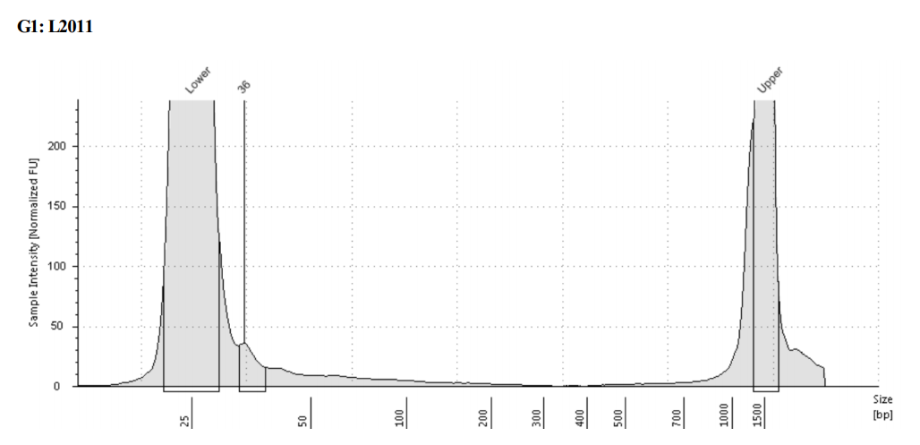
TAPE STATION FRAGMENT DISTRIBUTION
This one probably has too little DNA

Slide 8
MAPPING STATS

Slide 9
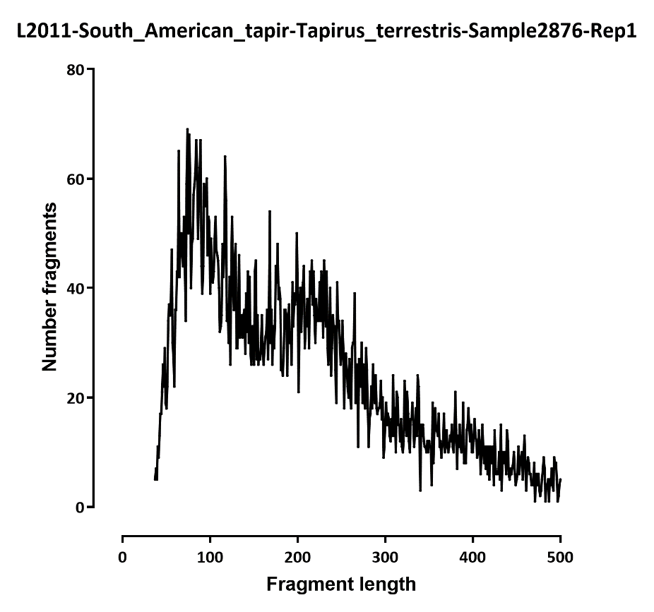
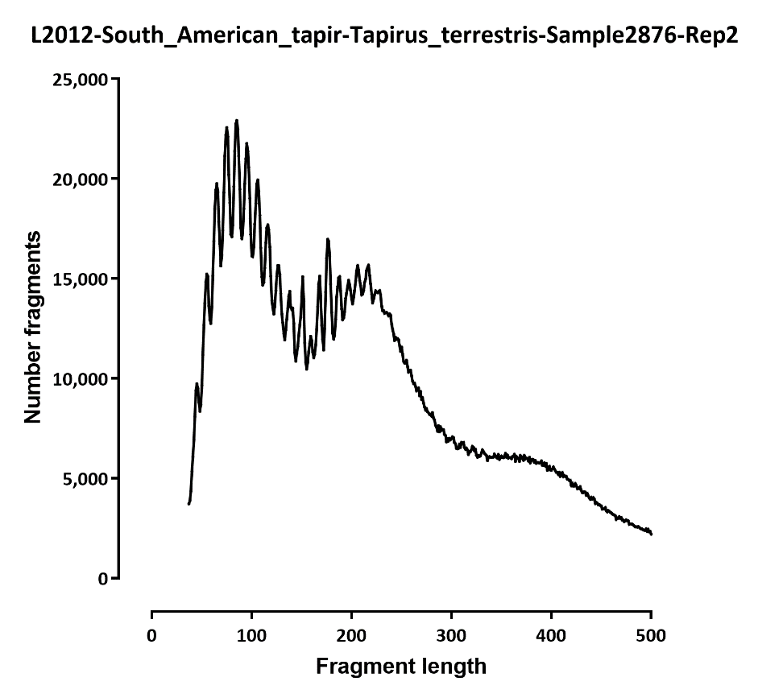
FRAGMENT LENGTH DISTRIBUTION

Slide 10
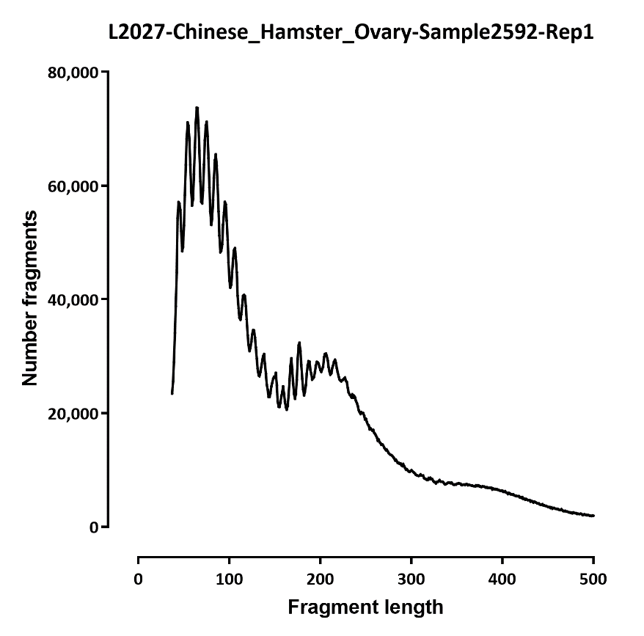
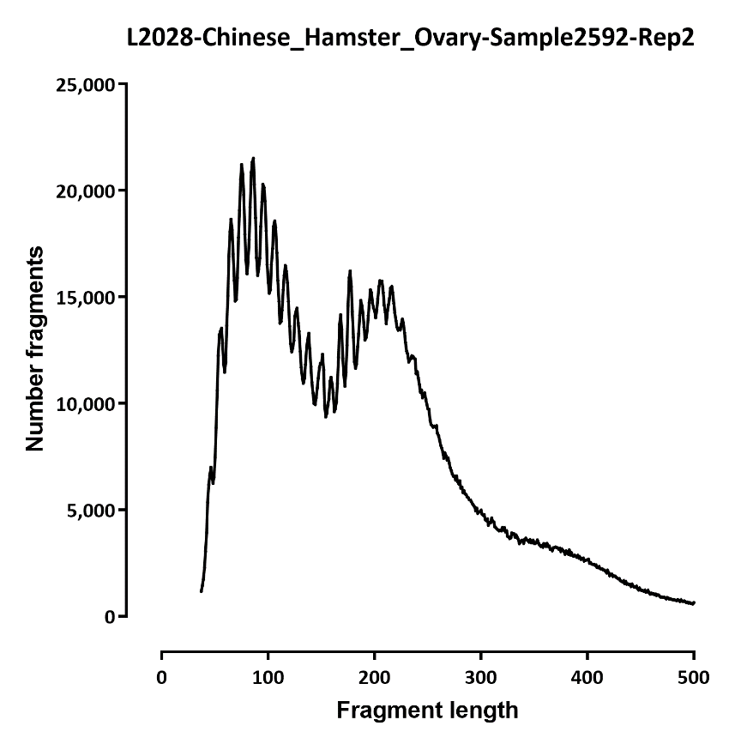

Slide 11
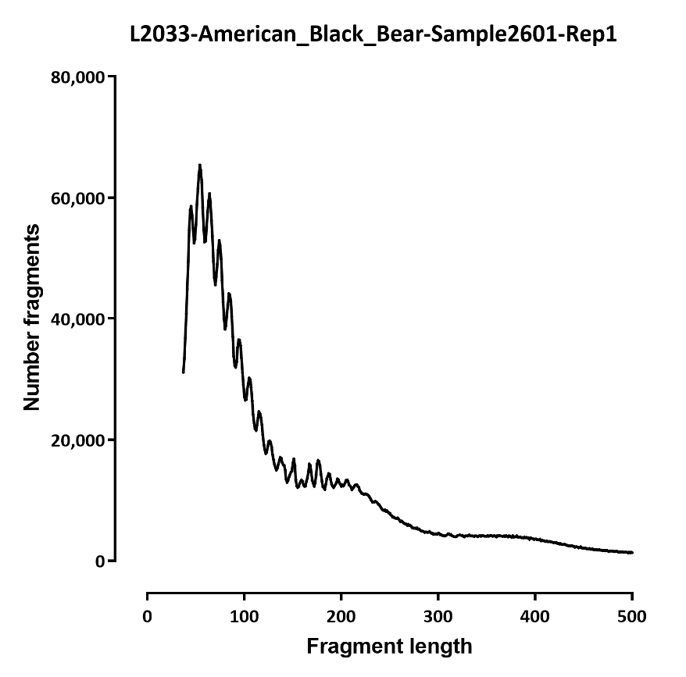
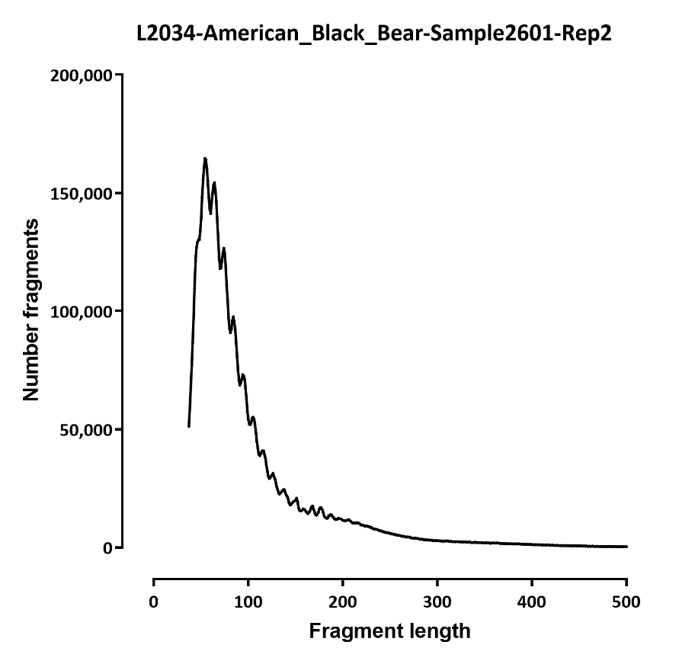

Slide 12
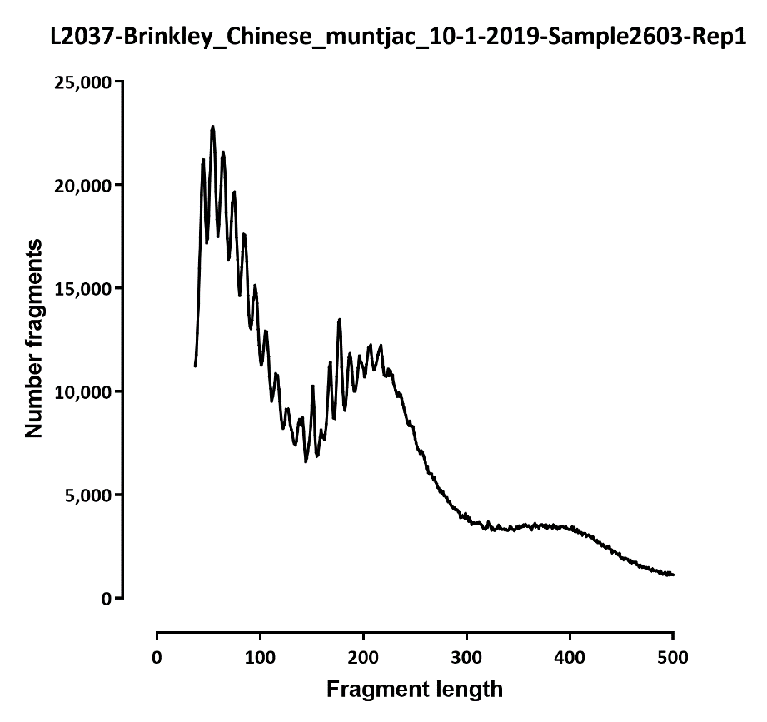
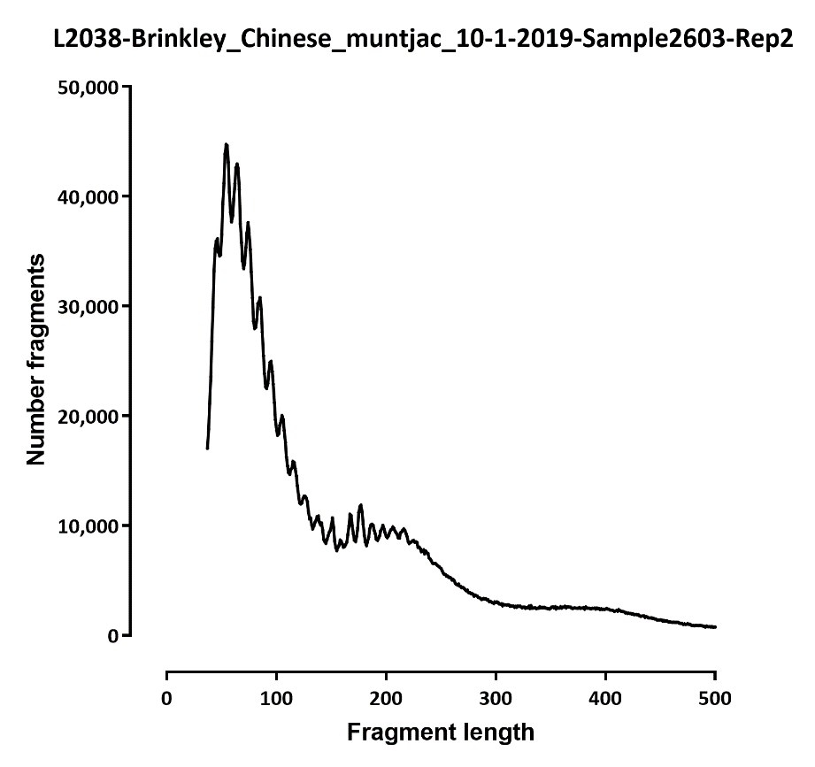

Slide 13
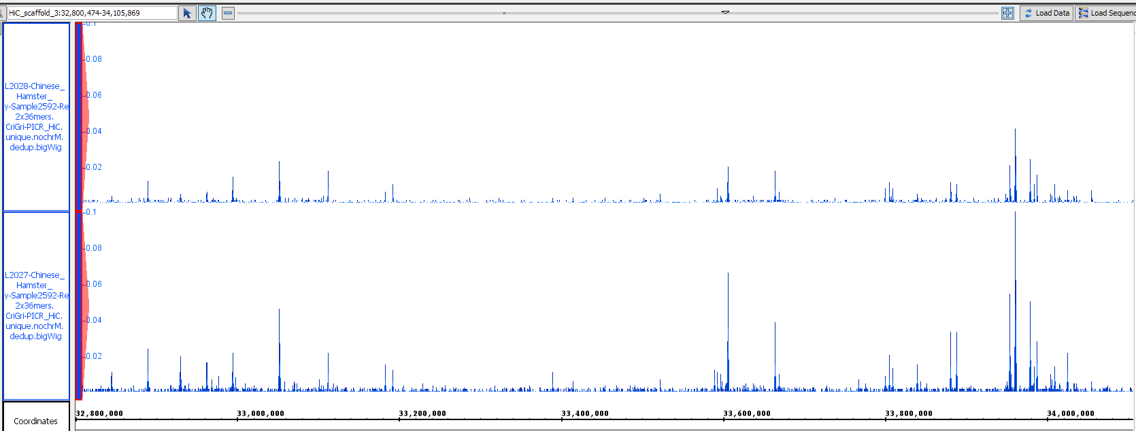
BROWSER SNAPSHOTS

Slide 14
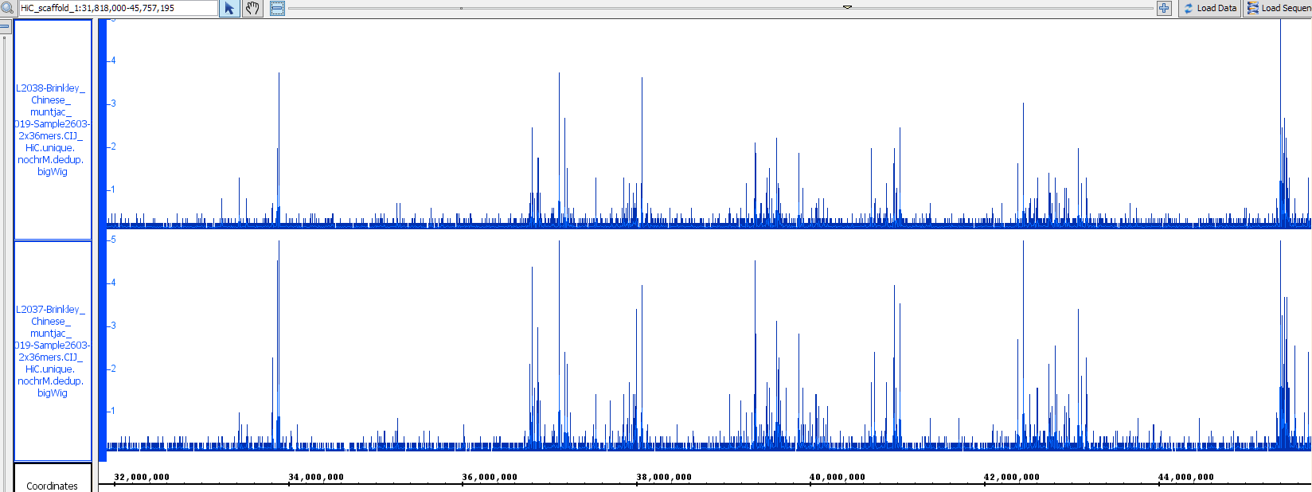

Slide 15
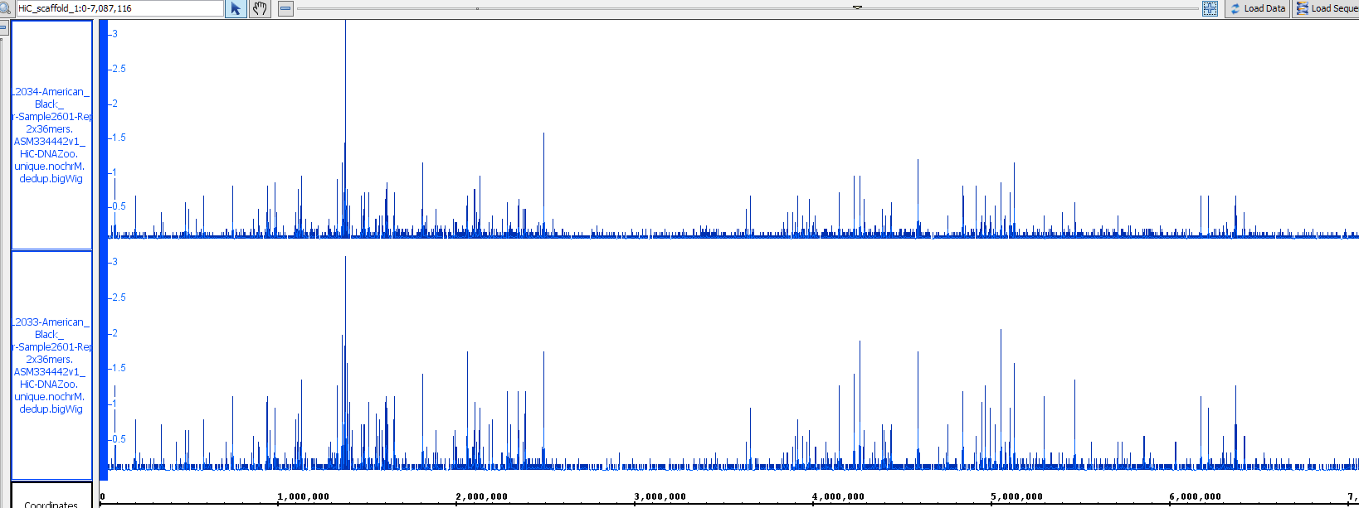

Slide 16
