Slide 1
Dataset stats

Slide 2
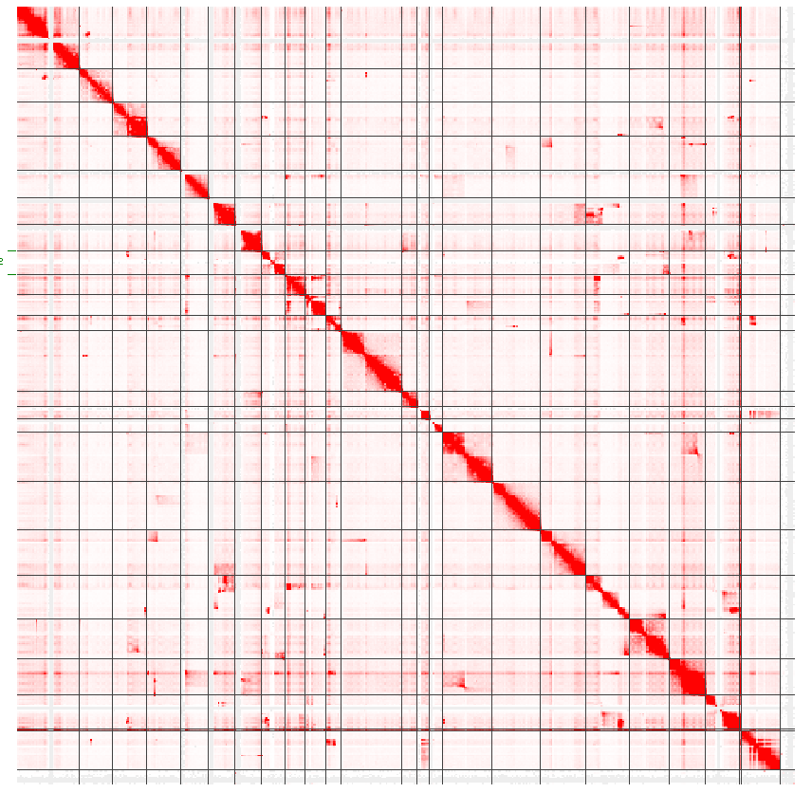
OS08 Global map

Slide 3
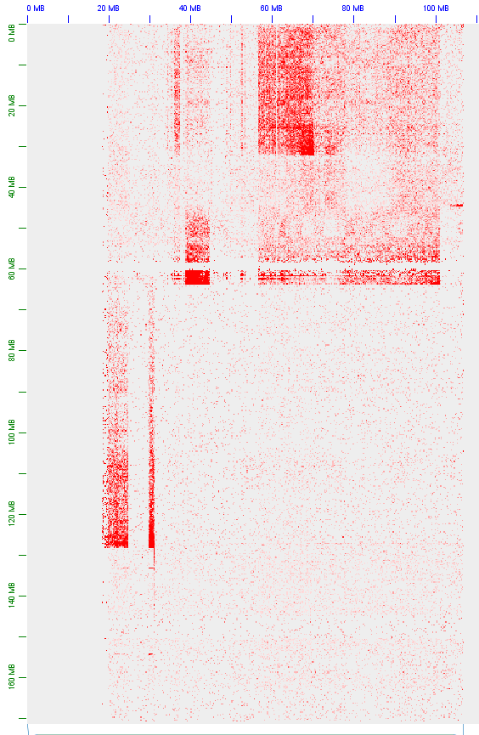
chr6 vs chr14

Slide 4
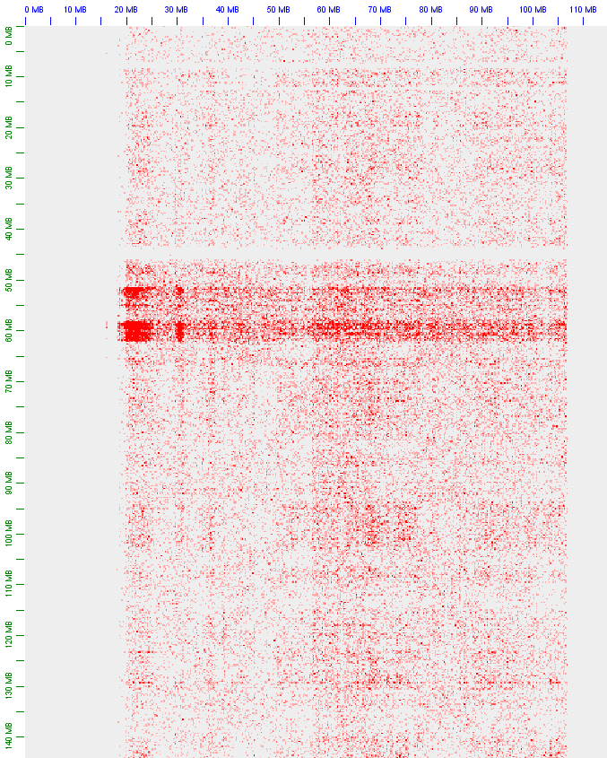
chr14 vs chr 8

Slide 5
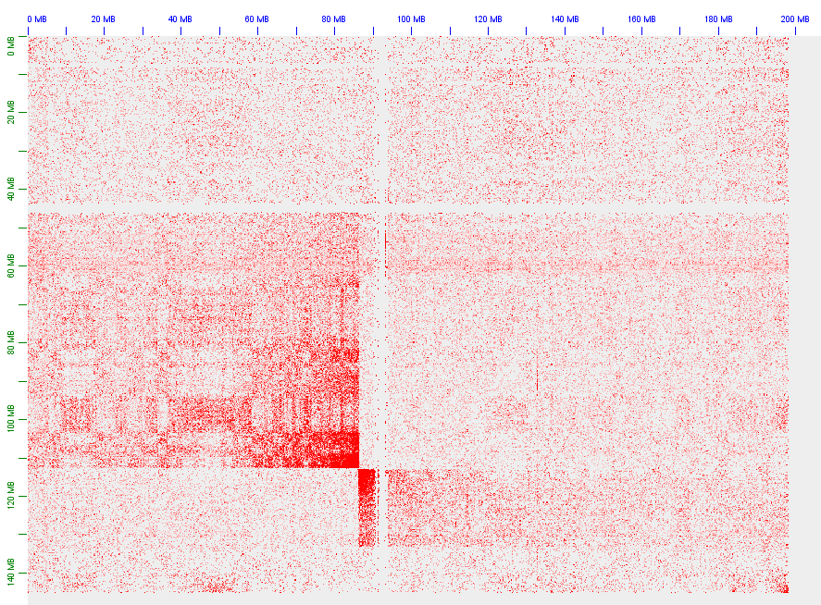
chr3 vs chr8

Slide 6
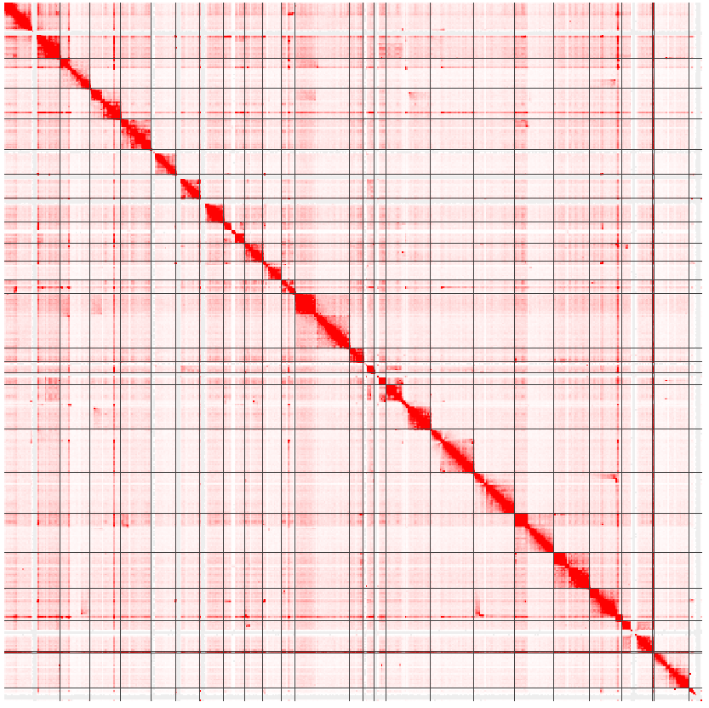
OS89 Global map

Slide 7
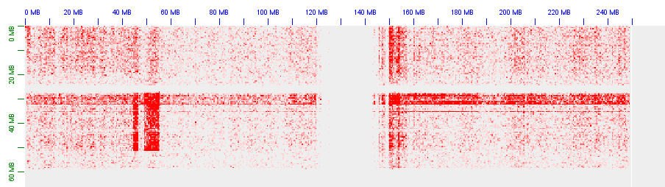
chr1 vs chr 11

Slide 8
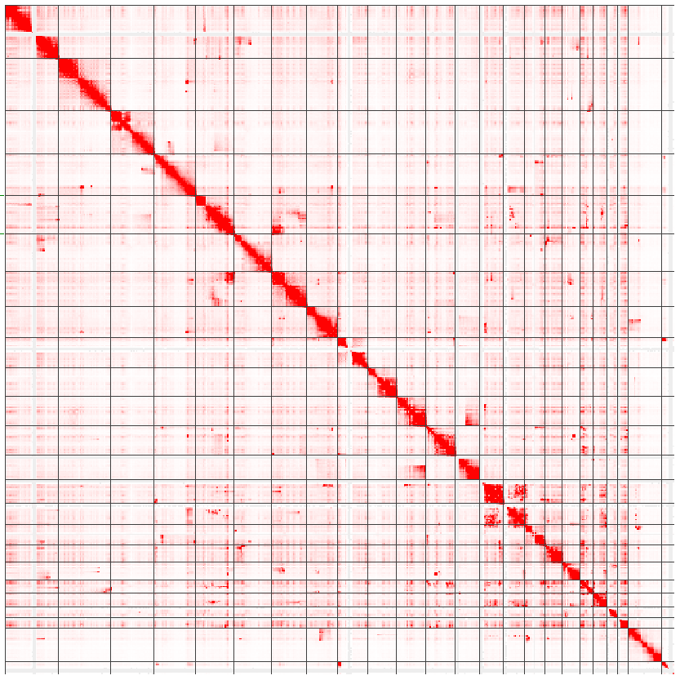
PSS0141 Global map

Slide 9
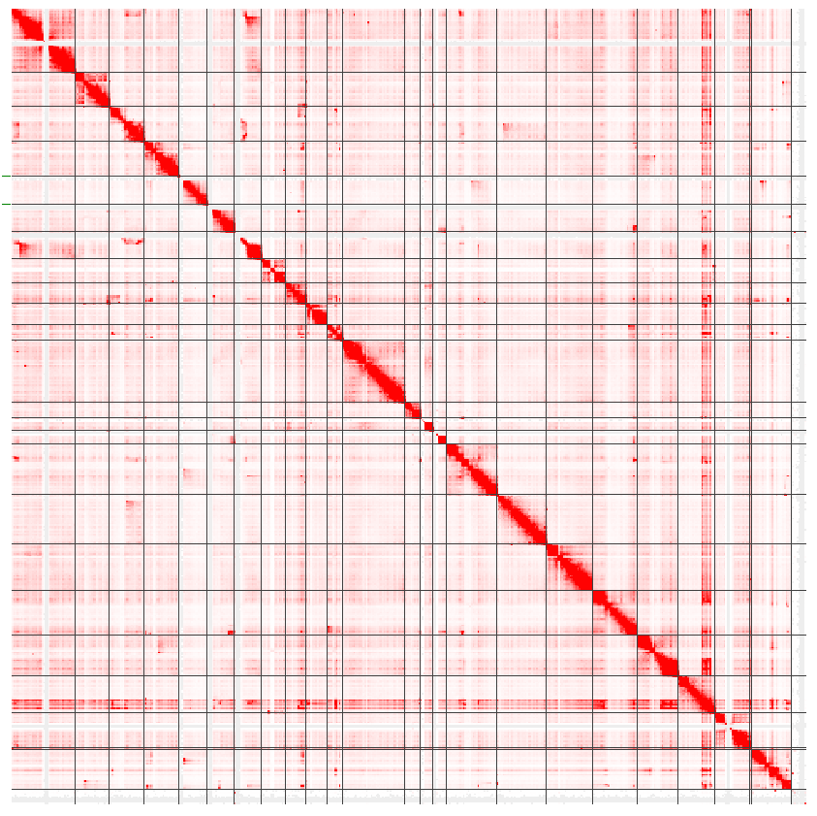
PSS085 Global map

Slide 10
Still running:
Automated 3D-DNA rescaffolding
Manual review and final genome assembly
CNVs can be called from the Hi-C data
SNPs will be difficult as we sequenced 2x36mers

