Slide 1
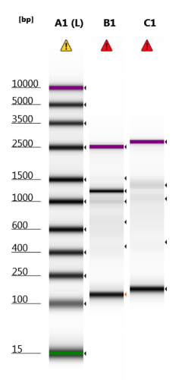
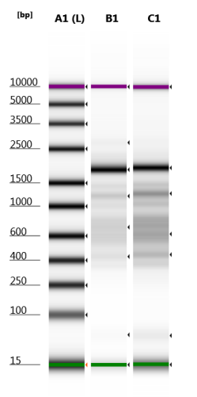
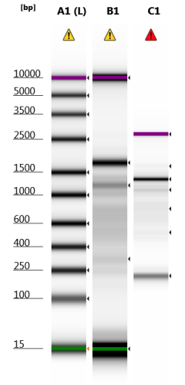
D5000 TapeStation
crosslinked samples:
3h Proteinase K, before clean-up
3h Proteinase K, post clean-up
125nM
500nM
125nM
500nM
125nM
500nM

Slide 2
Mapping stats
Note:
242,138 reads mapped to the amplified regions
1,880,086 reads mapped elsewhere

Slide 3
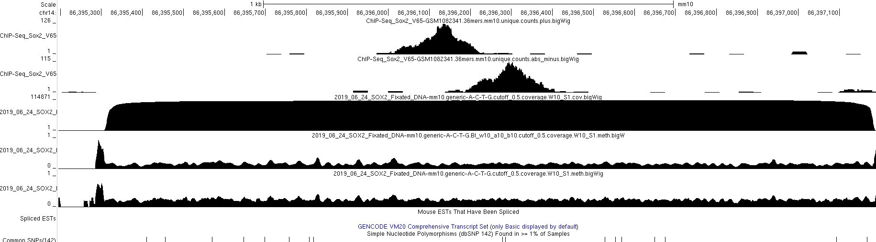

Slide 4
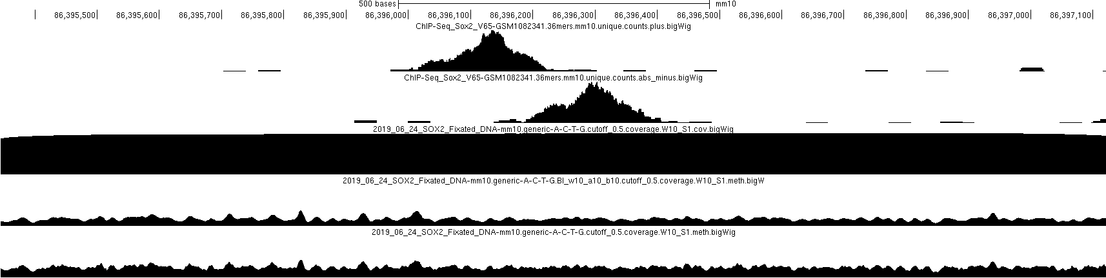

Single-molecule (1000 reads subsample)
p=0.5 binarization

Slide 5

Single-molecule (1000 reads subsample)
p=0.3 binarization

Slide 6

Single-molecule (1000 reads subsample)
p=0.1 binarization

Slide 7
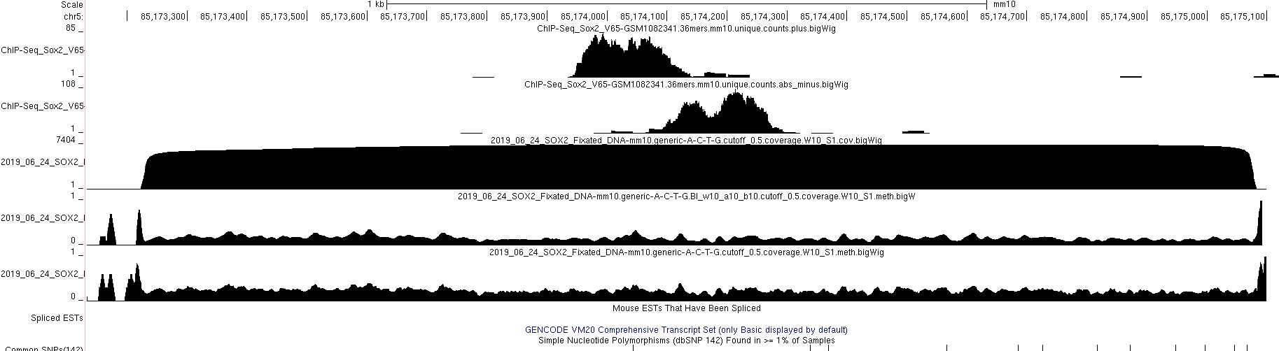

Slide 8
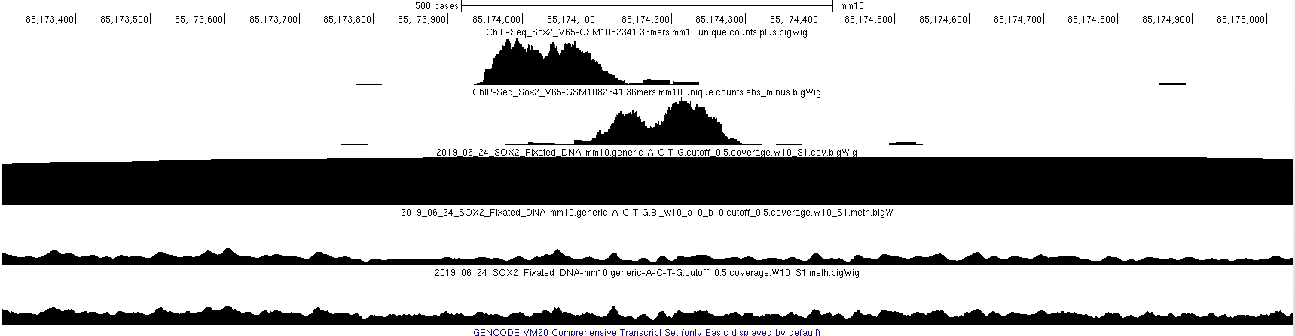
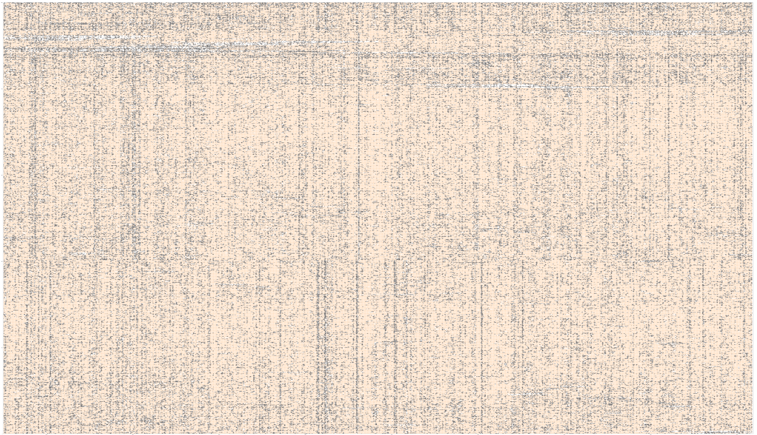
Single-molecule (1000 reads subsample)
p=0.5 binarization

Slide 9
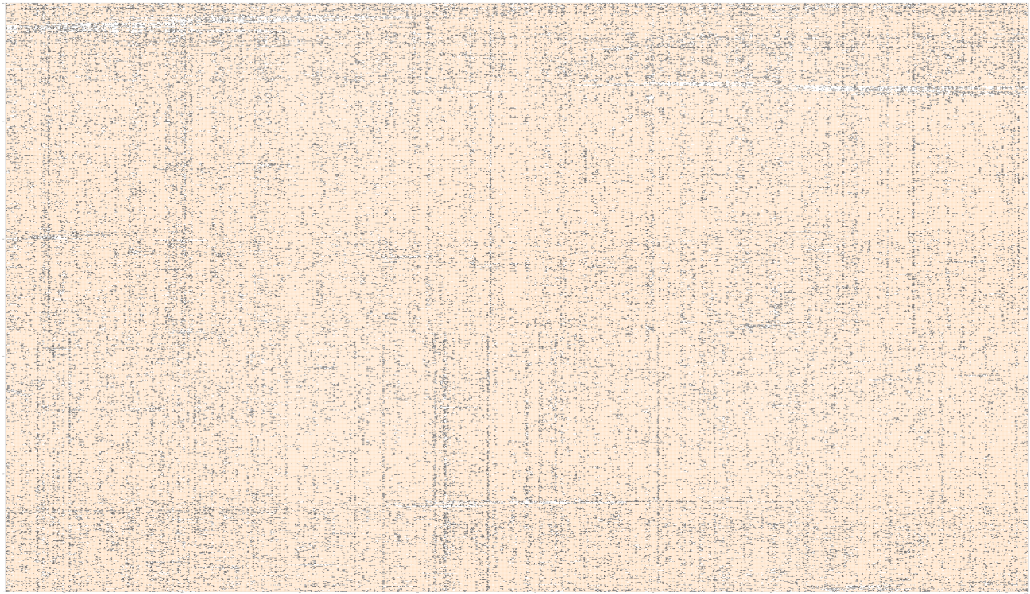
Single-molecule (1000 reads subsample)
p=0.3 binarization

Slide 10

Single-molecule (1000 reads subsample)
p=0.1 binarization

Slide 11
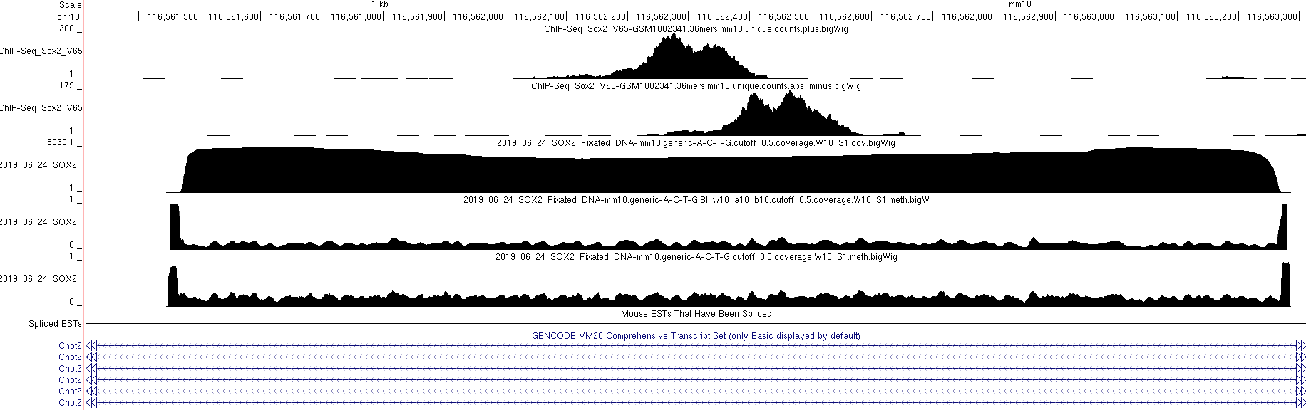

Slide 12
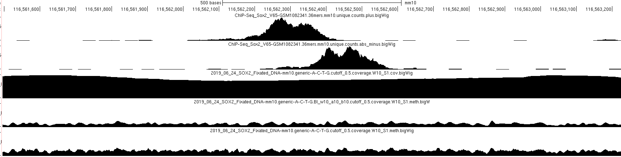
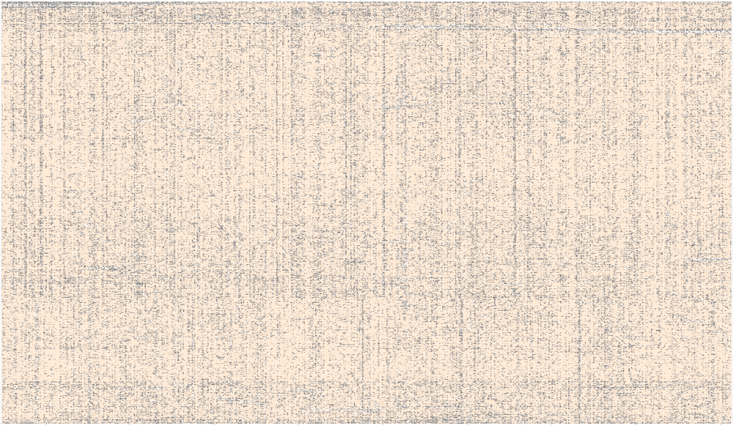
Single-molecule (1000 reads subsample)
p=0.5 binarization

Slide 13

Single-molecule (1000 reads subsample)
p=0.3 binarization

Slide 14

Single-molecule (1000 reads subsample)
p=0.1 binarization

Slide 15
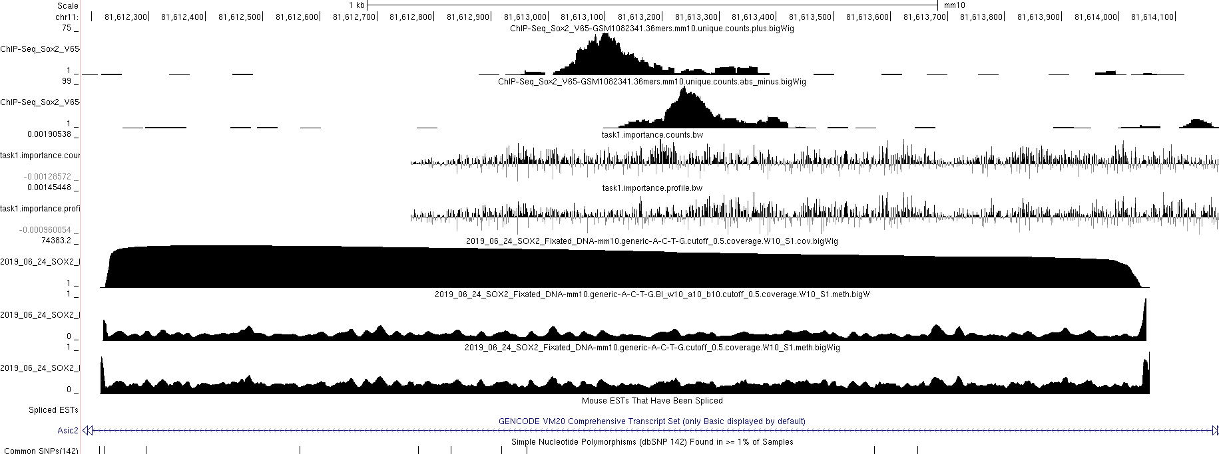

Slide 16
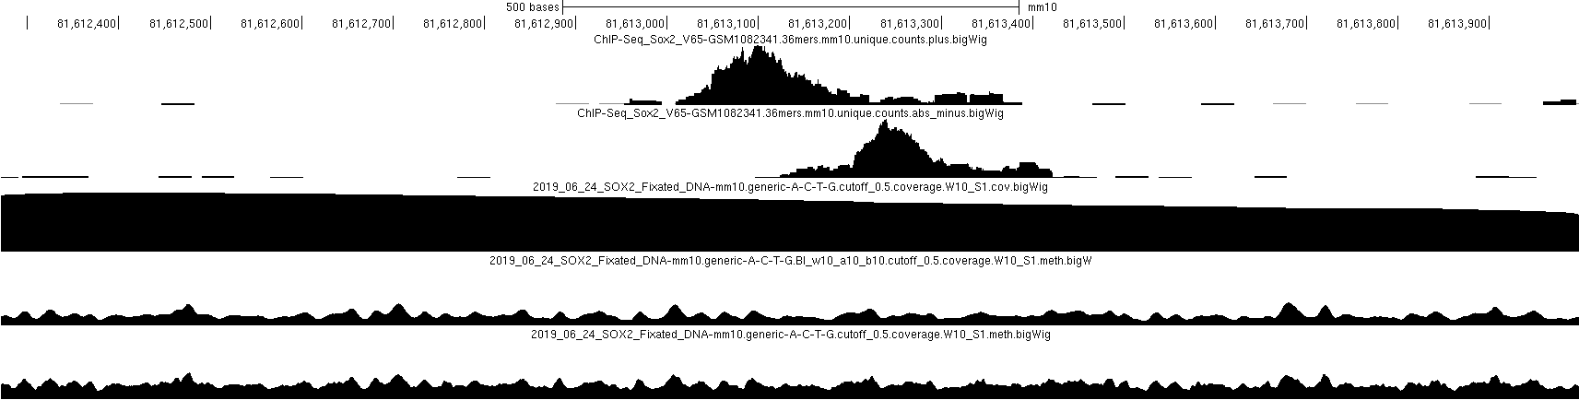

Single-molecule (1000 reads subsample)
p=0.5 binarization

Slide 17
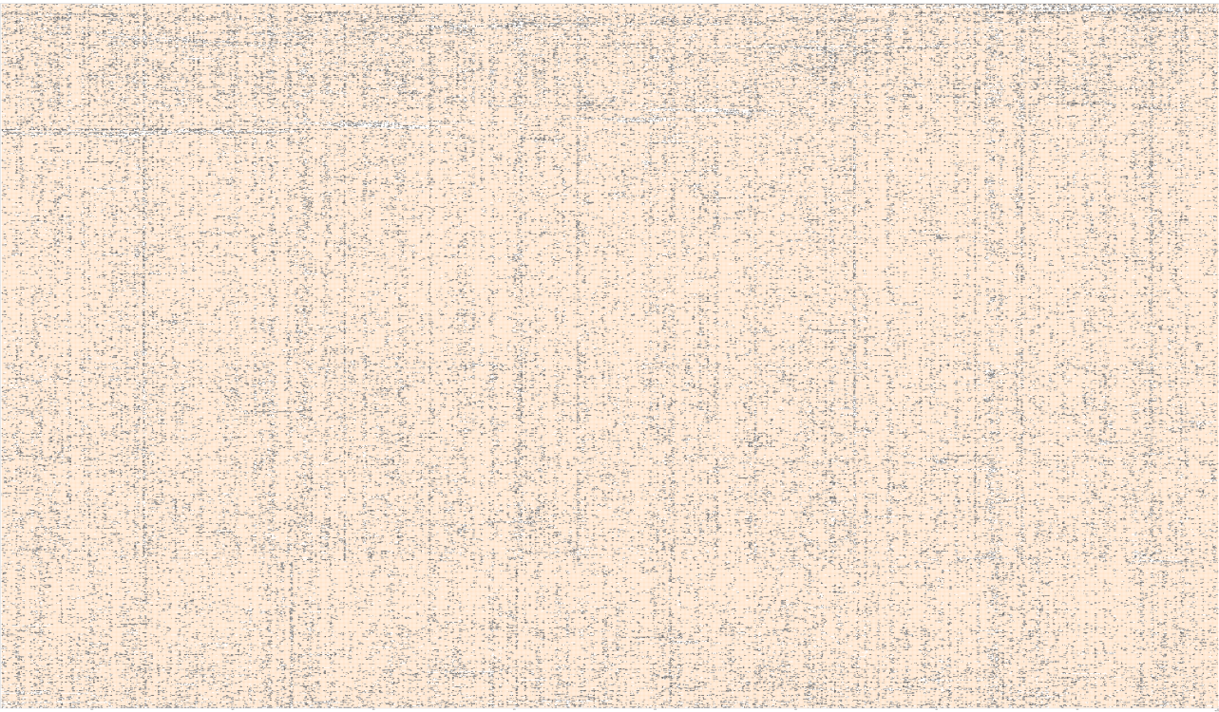
Single-molecule (1000 reads subsample)
p=0.5 binarization

Slide 18

Single-molecule (1000 reads subsample)
p=0.5 binarization

