Slide 1
I. RICIN ENHANCER SCREEN

Slide 2
OBJECTIVES:
All candidate enhancer/promoter elements around the set of 884 CRISPRk ricin genes
Ricin provides a strong phenotype that should result in real hits (also, off-target effects should be mitigated somewhat)
Format: CRISPRi primarily, but would not hurt to also run CRISPRk/a screens
single-sgRNA, multiple sgRNAs per enhancer element

Slide 3
Summary of possible libraries
Number sgRNAs*
 | radius around ricin gene: | 30kb |  | 50kb |  | 100kb
 | screen type: | 10 sgRNAs | fine mapping | 10 sgRNAs | fine mapping | 10 sgRNAs | fine mapping
cRE definition | DNAse | 168,354 | 2,091,317 | 181,367 | 2,263,783 | 209,612 | 2,646,083
 | H3K27ac | 137,814 | 1,532,074 | 149,030 | 1,661,616 | 173,104 | 1,941,066
 | DNAse+H3K27ac | 74,631 | 1,314,458 | 80,762 | 1,422,407 | 94,035 | 1,665,511
Number cCREs*
 | radius around ricin gene: | 30kb |  | 50kb |  | 100kb
cRE definition | DNAse | 19,342 |  | 20,733 |  | 23,800
 | H3K27ac | 14,594 |  | 15,741 |  | 18,231
 | DNAse+H3K27ac | 7,933 |  | 8,565 |  | 9,941

Slide 4
Final library:
Two-stage strategy:
CRISPRi/a with 5 guides per element
Follow up fine-mapping analysis on hits
Final library:
CRISPRi/a with 5 guides per element
Positive controls: 5 guides per TSS of ricin gene
1000 safes + other positives
Total: ~55K sgRNAs

Slide 5
II. ENHANCER COMBINATORICS SCREENS

Slide 6
OVERALL DESIGN AND PREMISE:
Picked a dozen surface marker genes + MYC and GATA1
Targeted all DNAse HS sites in the neighborhood with the 5 best guides available
All pairwise guide combinations
For each site, all pairwise guide combinations with safes (assaying the single-sgRNA effects)
CRISPRi, CRISPRa screens

Slide 7
III. Enhancer combinatorics screens
Summary for surface markers:
In addition:
GATA1 – 12,374 guides
MYC -- 34,151 guides
These two have been ordered and exist on a chip
gene | #guides
CD114/CSFR3 | 4096
CD117/c-Kit | 13696
CD146/MCAM | 1126
CD235a+b | 11828
CD24 | 10586
CD30/TNFRSF8 | 4751
CD31 | 4851
CD33 | 1651
CD41/ITGA2B | 2556
EEA1 | 9455
Ki-67 | 4371

Slide 8
III. CRISPR-X ENHANCER MUTAGENESIS

Slide 9
OVERALL DESIGN AND PREMISE:
Generate all pairwise pgRNA pairs within an enhancers that is known to have a growth effect
Use CRIPSR-X to carry out saturation mutagenesis in a pgRNA format
Run a growth screen
Sequence the DNA in the region, see which mutations are enriched/depleted
Two libraries were designed and ordered:
eGATA1 – 1,108 guides
eHDAC6 – 1,876 guides
In addition, 4 libraries were designed an ordered for each of the b-globin LCR enhancers (with the idea of the doing flowFISH)

Slide 10
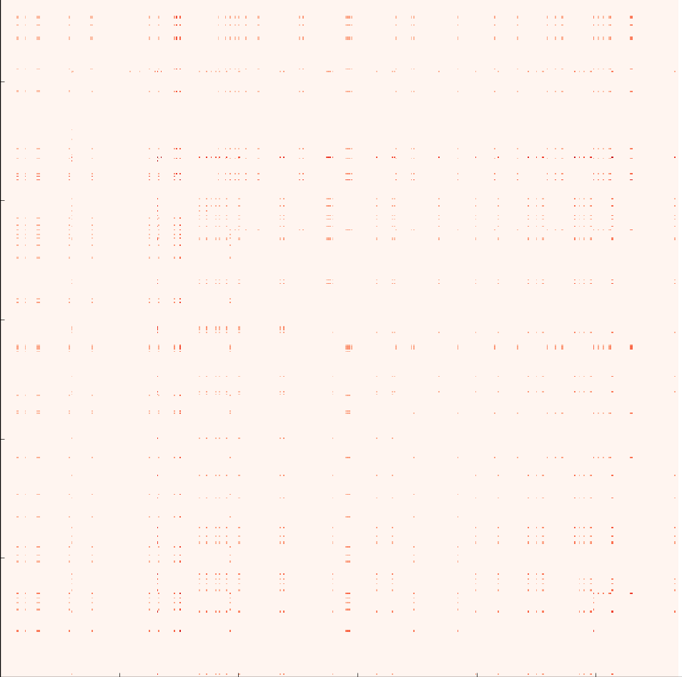
eGATA1
CFD>0.2
1,108 pgRNAs

Slide 11
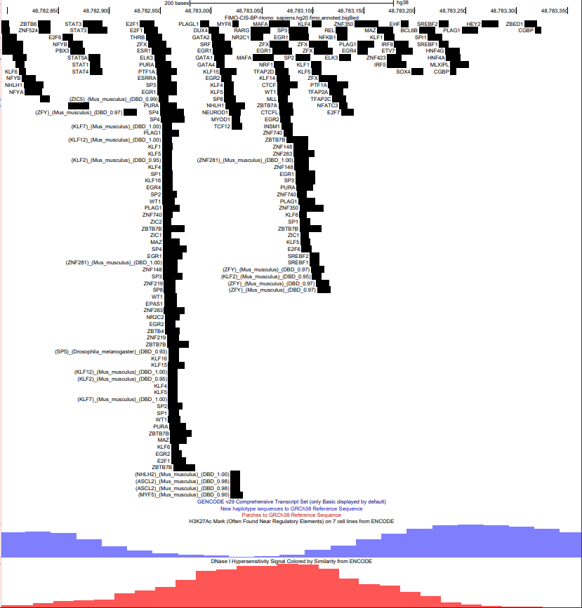
CFD>0.2

Slide 12
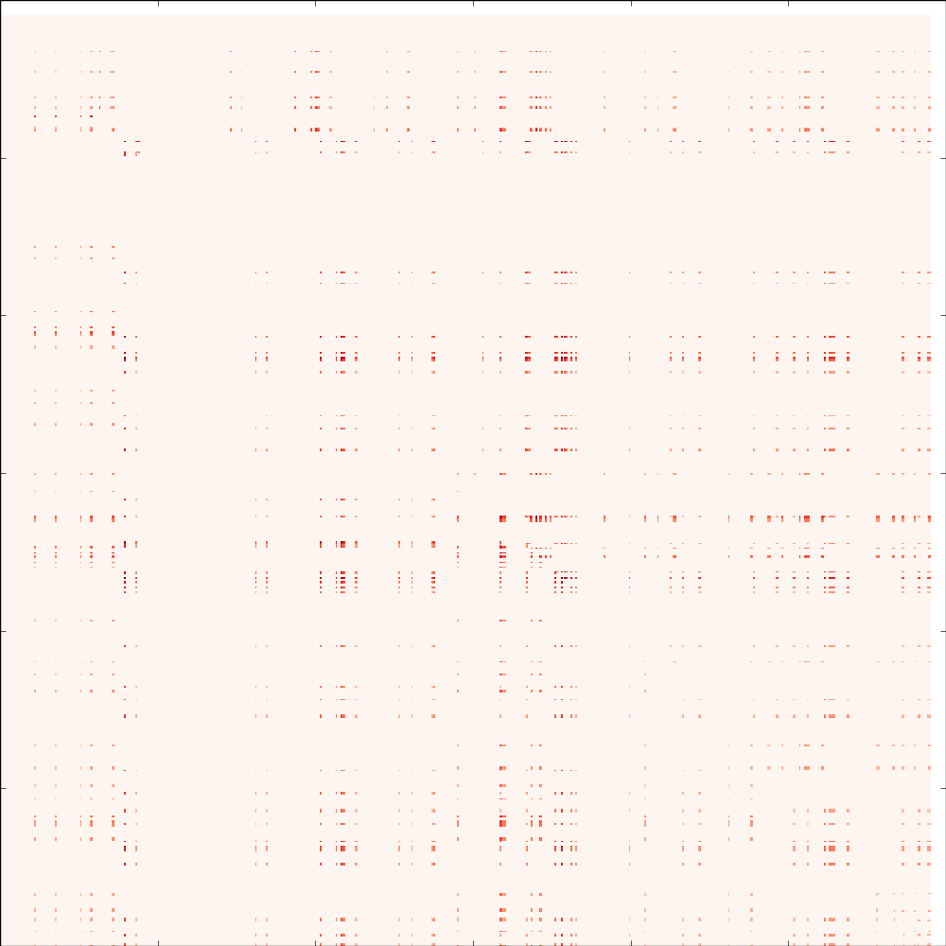
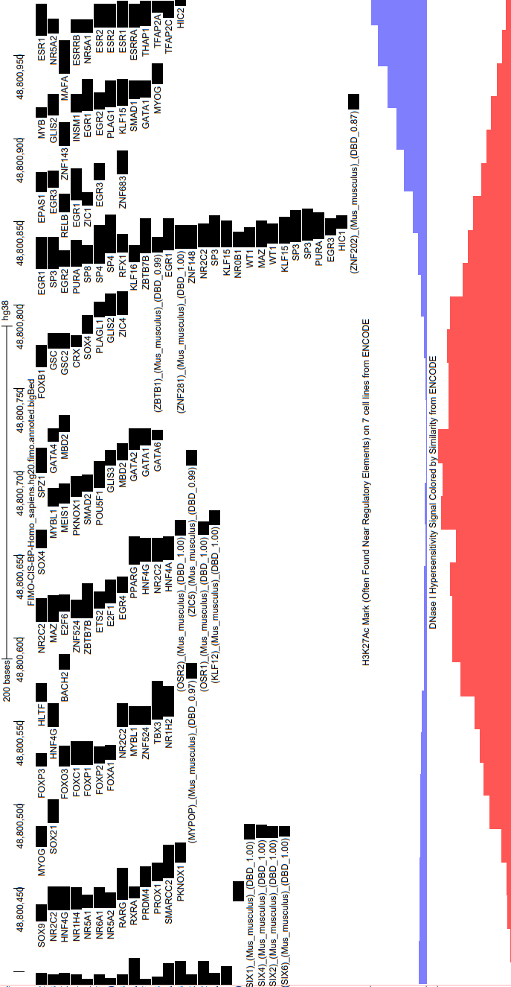
eHDAC6
CFD>0.2
1,876
pgRNAs

Slide 13
IV. TRANSCRIPTION FACTOR BINDING SATURATION MUTAGENESIS

Slide 14
OVERALL DESIGN AND PREMISE:
Tile a transcription factor binding site and its neighborhood with sgRNAs
Use CRISPR-X to generate point mutations
Carry out ChIP experiments against the population of cells (using restriction digestion for fragmentation)
Do amplicon sequencing on the region(s) of interest in the ChIP and in an input sample
Look at enriched/depleted variants in the ChIP relative to the input
The goals are to validate deep learning models and to find interesting cases of interaction between neighboring motifs where binding of one TF is dependent on adjacent binding of other TFs
Two sites were picked for an initial test – a CTCF site and a GATA1 site (this for technical validation)

Slide 15
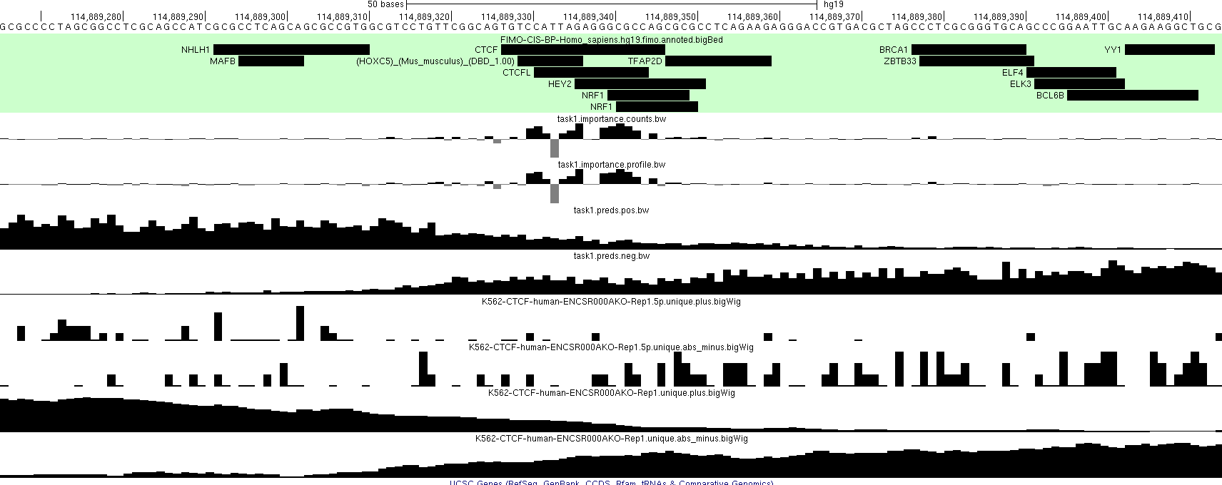
CTCF site

Slide 16
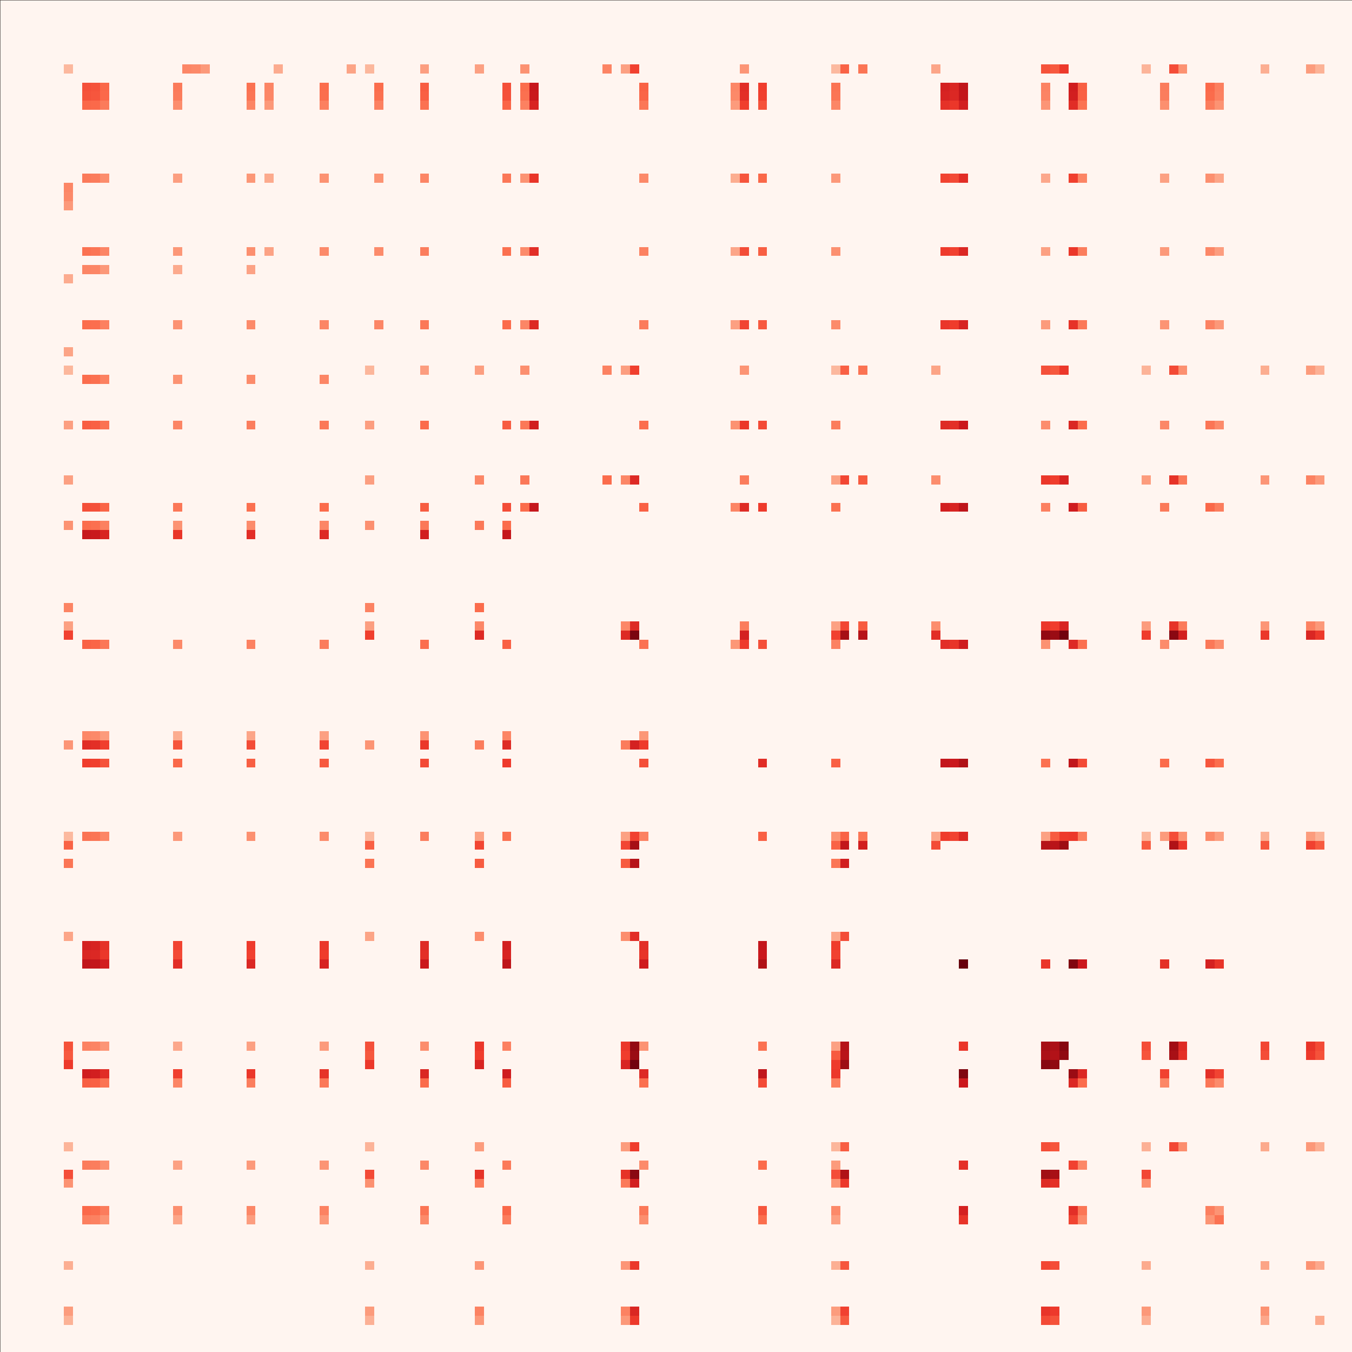

Slide 17
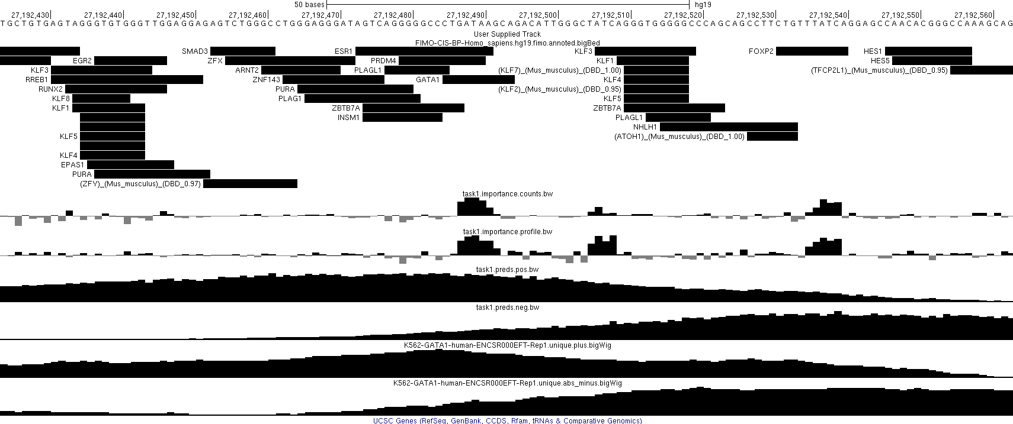
GATA1 site

Slide 18
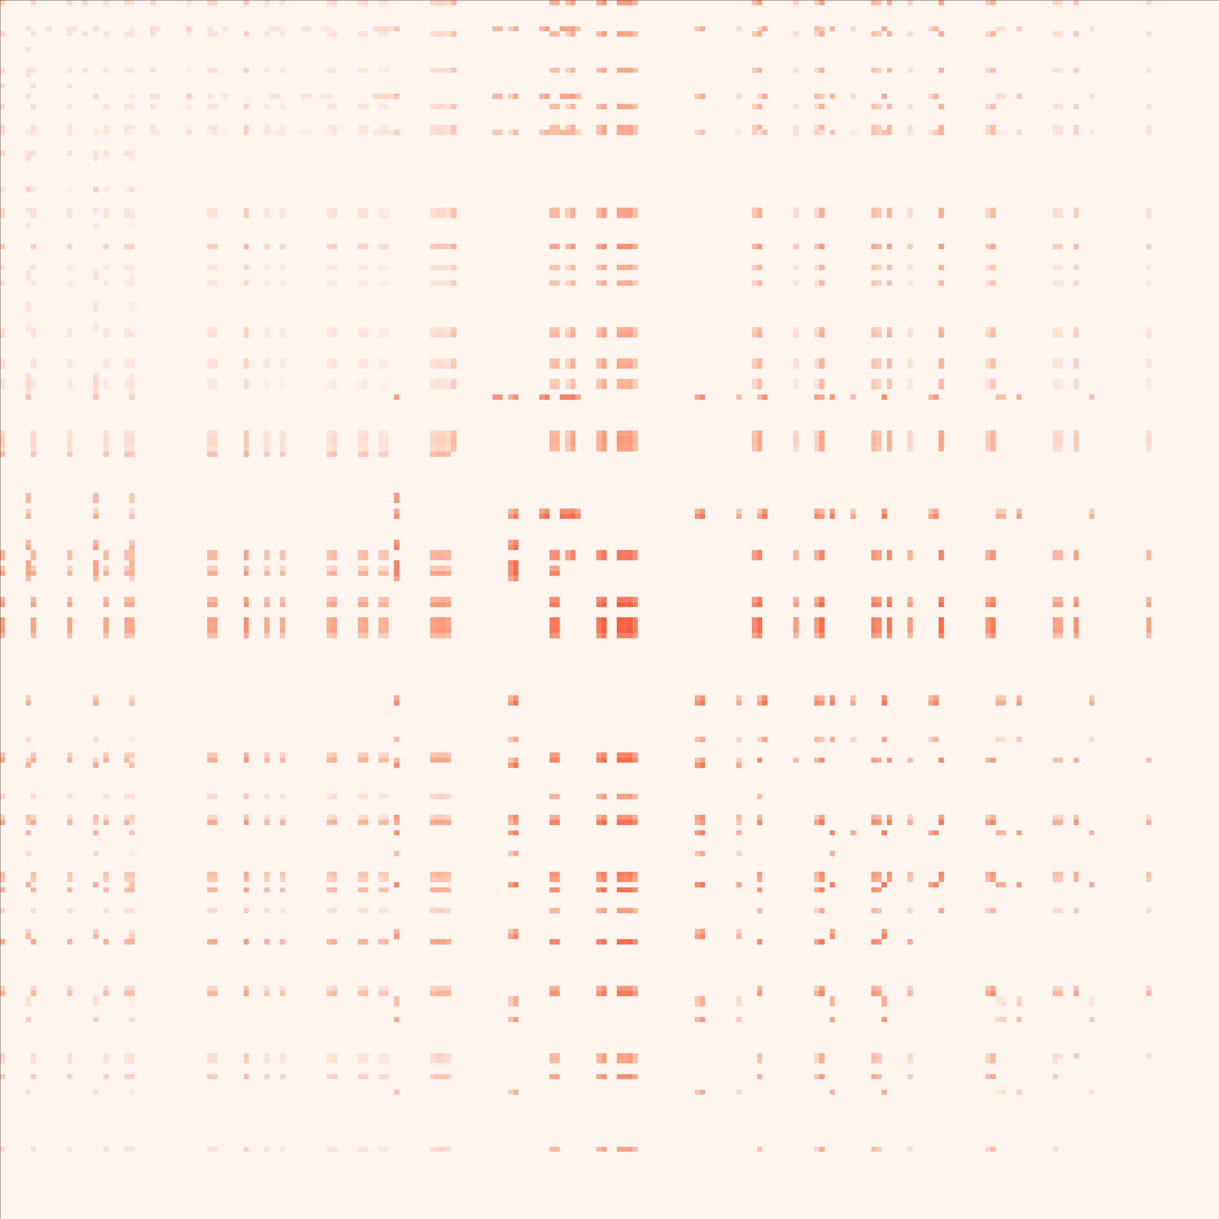

Slide 19
V. PROMOTER-AI VALIDATION WITH ILLUMINA

Slide 20
OVERALL DESIGN AND PREMISE:
Building on the SpliceAI approach, the Illumina group had generated predictions for sequence variants in te promoter of genes that will disruption gene expression (“PromoterAI” models)
The agreement was that we would install those variants using base editing (or more direct approaches) and directly test gene expression effects
We were given a list of some 400 such sites
After manual curation and accounting for limitations imposed by editing windows and sequence composition, we were left with 29 sites that could be installed with base editing
Of course, since then prime editing became available, so if that turns out to be straightforward to adopt, now we can go back to the original list and test many more. But we have not begun to do any of the original 29 either.

Slide 21
VI. PROTEIN CODING GENES SATURATION MUTAGENESIS

Slide 22
OVERALL DESIGN AND PREMISE:
When those designs were being finalized, we also discussed with Illumina doing saturation mutagenesis on disease-relevant genes
This would involve tilling a gene with all valid sgRNAs and doing CRISPR-X
Capture probes would be designed by Illumina, and the sequencing (which would be massive) would also be done by them
We generated a design for 10 growth genes and also for a set of ricin genes (summarized below)

Slide 23
DESIGN DETAILS
Used GENCODE V29 (hg38) as annotation
Split genes by biotypes:
  protein_coding
  lincRNAs
  miRNA
  Ribozyme
  snoRNA
  snRNA
  scaRNA
  misc_RNA
Extended exons by 20bp on each side
Picked all guides within the extended exons for each gene (so that the site 12-16bp from the PAM is within the extended exon)

Slide 24
Top 10 growth genes

Slide 25
All guides, i.e. CFD > 0.0
#gene | exons | total_length | total_guides_passing_CFD | fraction_of_bases_covered
ACTA1 | 11 | 1768 | 236 | 0.29638009
BRCA2 | 43 | 13404 | 778 | 0.184049537
DKC1 | 41 | 4788 | 522 | 0.300960735
DYNC1H1 | 167 | 39010 | 4122 | 0.29671879
GNE | 26 | 6467 | 553 | 0.244008041
KIF1A | 107 | 18957 | 3761 | 0.47618294
POLG | 81 | 6912 | 1311 | 0.457899306
SDHB | 19 | 2891 | 323 | 0.312348668
SOD1 | 10 | 2253 | 315 | 0.373280071
SOS1 | 38 | 10277 | 781 | 0.231390484
 |  | Total guides: | 12702

Slide 26
All guides, i.e. CFD > 0.2
#gene | exons | total_length | total_guides_passing_CFD | fraction_of_bases_covered
ACTA1 | 11 | 1768 | 173 | 0.238122172
BRCA2 | 43 | 13404 | 437 | 0.1087735
DKC1 | 41 | 4788 | 357 | 0.219298246
DYNC1H1 | 167 | 39010 | 2733 | 0.211407331
GNE | 26 | 6467 | 378 | 0.175506417
KIF1A | 107 | 18957 | 2179 | 0.311019676
POLG | 81 | 6912 | 871 | 0.335069444
SDHB | 19 | 2891 | 220 | 0.227948807
SOD1 | 10 | 2253 | 234 | 0.286284953
SOS1 | 38 | 10277 | 477 | 0.151211443
 |  | Total guides: | 8059

Slide 27
Top 10 ricin genes
#genesymbol | totalSNPs | nClinvarBenignSNPs | nClinvarPathogenicSNPs | nClinvarTotal
NF1 | 18784 | 12 | 68 | 80
PIK3CA | 7111 | 2 | 35 | 37
CDKL5 | 6792 | 8 | 34 | 42
SMAD4 | 3631 | 0 | 31 | 31
ACTB | 2483 | 0 | 26 | 26
PMM2 | 1636 | 2 | 25 | 27
SMCHD1 | 13282 | 6 | 22 | 28
HMBS | 2354 | 0 | 22 | 22
TBC1D24 | 3678 | 7 | 20 | 27
MEN1 | 3952 | 5 | 20 | 25

Slide 28
All guides, i.e. CFD > 0.0
#gene | exons | total_length | total_guides_passing_CFD | fraction_of_bases_covered
ACTB | 44 | 3831 | 417 | 0.266249021
CDKL5 | 43 | 18167 | 1590 | 0.251665107
HMBS | 77 | 5317 | 817 | 0.397404551
MEN1 | 31 | 4597 | 942 | 0.486839243
NF1 | 102 | 29548 | 1830 | 0.19074049
PIK3CA | 30 | 10430 | 524 | 0.14928092
PMM2 | 41 | 8152 | 789 | 0.263493621
SMAD4 | 38 | 13715 | 1131 | 0.242726941
SMCHD1 | 79 | 14541 | 967 | 0.202118149
TBC1D24 | 29 | 12642 | 2018 | 0.405711122
 |  | Total guides: | 11025

Slide 29
All guides, i.e. CFD > 0.2
#gene | exons | total_length | total_guides_passing_CFD | fraction_of_bases_covered
ACTB | 44 | 3831 | 267 | 0.184547116
CDKL5 | 43 | 18167 | 1024 | 0.173721583
HMBS | 77 | 5317 | 505 | 0.277223998
MEN1 | 31 | 4597 | 596 | 0.350663476
NF1 | 102 | 29548 | 986 | 0.109313659
PIK3CA | 30 | 10430 | 290 | 0.085522531
PMM2 | 41 | 8152 | 521 | 0.18326791
SMAD4 | 38 | 13715 | 649 | 0.149325556
SMCHD1 | 79 | 14541 | 557 | 0.124269307
TBC1D24 | 29 | 12642 | 1046 | 0.23991457
 |  | Total guides: | 6441

Slide 30
VII. MOTIF SCREENS

Slide 31
OVERALL DESIGN AND PREMISE:
We did the CTCF screen, but now we know that CTCF is not an ordinary TF.
The goal of this phase of ENCODE is functional characterization. It would still be a valuable contribution to properly characterize essentiality for a set of regular TFs.
These would be CRISPRk screens (with an option to carry out CRISPRi in parallel)
The screens would be done assaying for both growth and ricin sensitivity in parallel

Slide 32
K562 CEBPB
HAIB
Stanford
5,368
20,092
26,815
Used the union

Slide 33
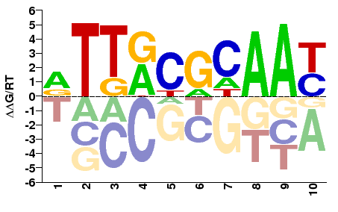
CEBP motif (CIS-BP)
- present in 29,185 out of 52,275 ChIP peaks
Library summary (without safes)
- 45,837 sgRNAs
- 17,802 ChIP-seq peaks
- 19,035 motifs

Slide 34
K562 E2F6
USC
HAIB
2,382
16,221
15,964
Used the union

Slide 35
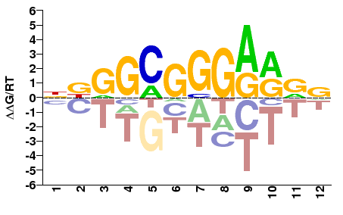
E2F6 motif (CIS-BP)
- present in 17,018 out of 34,567 ChIP peaks
Library summary (without safes)
- 161,050 sgRNAs
- 15,938 ChIP-seq peaks
- 23,822 motifs

Slide 36
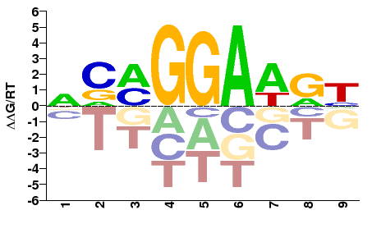
ETS1 motif (CIS-BP)
- present in 2,998 out of 11,327 ChIP peaks
Library summary (without safes)
- 30,260 sgRNAs
- 2,878 ChIP-seq peaks
- 3,566 motifs

Slide 37
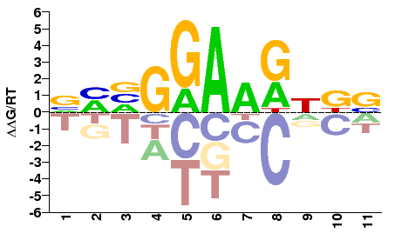
ETS2 motif (CIS-BP)
- present in 454 out of 1,705 ChIP peaks
Library summary (without safes)
- 3,070 sgRNAs
- 363 ChIP-seq peaks
- 458 motifs

Slide 38
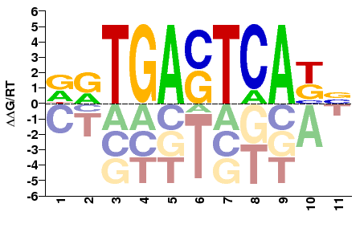
FOSL1 motif (CIS-BP)
- present in 6,568 out of 8,194 ChIP peaks
Library summary (without safes)
- 24,198 sgRNAs
- 5,649 ChIP-seq peaks
- 10,164 motifs

Slide 39
K562 GATA1
USC
Stanford
1132
3,274
11,410
Used the union

Slide 40
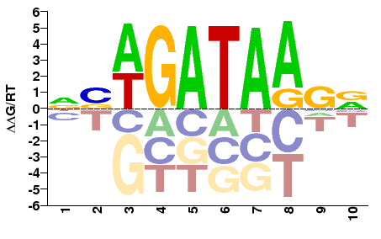
GATA1 motif (CIS-BP)
- present in 6,749 out of 15,816 ChIP peaks
Library summary (without safes)
- 22,620 sgRNAs
- 5,874 ChIP-seq peaks
- 6,599 motifs

Slide 41
K562 GATA2
HAIB
Stanford
18,863
459
11,118
Used the union, results to be parsed after screen (will be interesting)

Slide 42
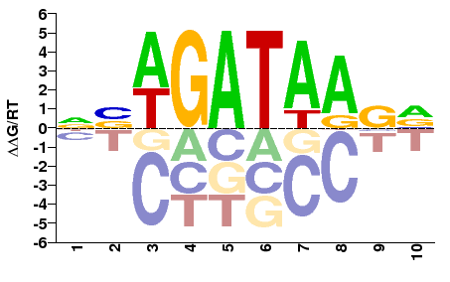
GATA2 motif (CIS-BP)
- present in 5,547 out of 30,440 ChIP peaks
Library summary (without safes)
- 17,898 sgRNAs
- 4,601 ChIP-seq peaks
- 4,988 motifs

Slide 43
K562 JUN
Stanford-ENCFF394CEC
Stanford-ENCFF213EYD
2,713
18,604
28,873
Used the union

Slide 44
K562 JUN
HAIB
Stanford union
748
4,282
45,908
Used the union

Slide 45
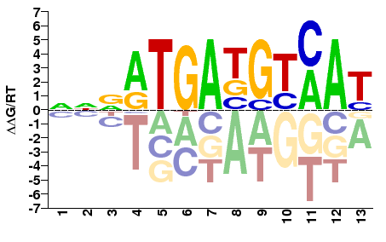
JUN motif (CIS-BP)
- present in 7,535 out of 50,938 ChIP peaks
Library summary (without safes)
- 23,103 sgRNAs
- 6,190 ChIP-seq peaks
- 7,571 motifs

Slide 46
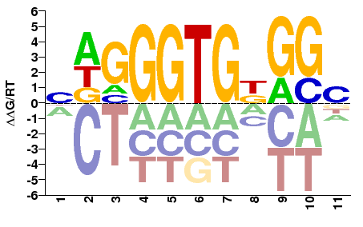
KLF1 motif (CIS-BP)
- present in 5,561 out of 11,755 ChIP peaks
Library summary (without safes)
- 52,008 sgRNAs
- 5,038 ChIP-seq peaks
- 6,624 motifs

Slide 47
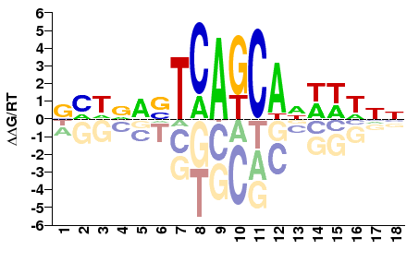
MAFF motif (CIS-BP)
- present in 15,767 out of 26,934 ChIP peaks
Library summary (without safes)
- 33,220 sgRNAs
- 11,720 ChIP-seq peaks
- 17,610 motifs

Slide 48
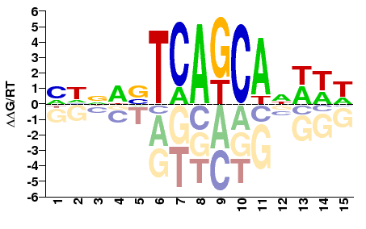
MAFK motif (CIS-BP)
- present in 15,772 out of 26,862 ChIP peaks
Library summary (without safes)
- 32,103 sgRNAs
- 11,583 ChIP-seq peaks
- 13,246 motifs

Slide 49
K562 MAX
HAIB
Stanford
27,052
32,255
7,535
Used the union

Slide 50
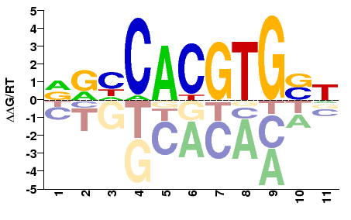
MAX motif (CIS-BP)
- present in 17,144 out of 66,842 ChIP peaks
Library summary (without safes)
- 71,600 sgRNAs
- 15,336 ChIP-seq peaks
- 17,391 motifs

Slide 51
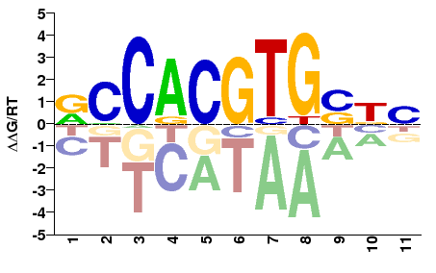
MYC motif (CIS-BP)
- present in 7,854 out of 31,139 ChIP peaks
Library summary (without safes)
- 44,714 sgRNAs
- 7,305 ChIP-seq peaks
- 10,060 motifs

Slide 52
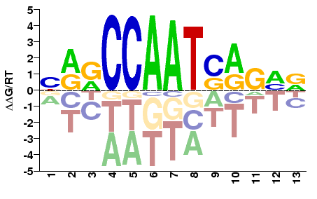
NFYB motif (CIS-BP)
- present in 6,937 out of 9,159 ChIP peaks
Library summary (without safes)
- 45,783 sgRNAs
- 5,696 ChIP-seq peaks
- 8,285 motifs

Slide 53
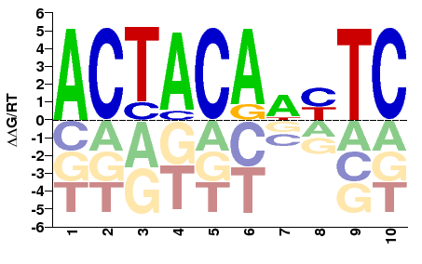
SIX5 motif (CIS-BP)
- present in 1,420 out of 3,590 ChIP peaks
Library summary (without safes)
- 4,645 sgRNAs
- 1,142 ChIP-seq peaks
- 1,353 motifs

Slide 54
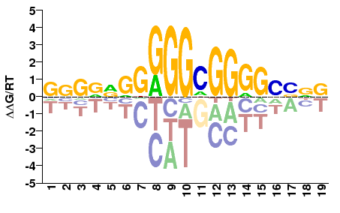
SP1 motif (CIS-BP)
- present in 11,871 out of 14,782 ChIP peaks
Library summary (without safes)
- 218,798 sgRNAs
- 10,884 ChIP-seq peaks
- 27,977 motifs

Slide 55
K562 TAL1
Stanford-ENCFF078OUD
Stanford-ENCFF475LFH
9,197
19,266
8,905
Used the union

Slide 56
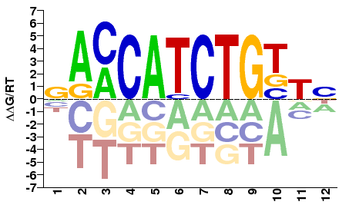
TAL1 motif (CIS-BP)
- present in 4,294 out of 37,368 ChIP peaks
Library summary (without safes)
- 12,537 sgRNAs
- 3,401 ChIP-seq peaks
- 3,615 motifs

Slide 57
K562 TCF12
Stanford-ENCFF912LXU
Stanford-ENCFF952JIK
17,118
11,485
4,773
Used the union

Slide 58
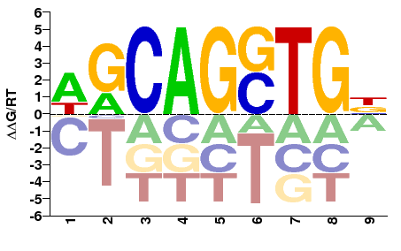
TCF12 motif (CIS-BP)
- present in 7,086 out of 33,376 ChIP peaks
Library summary (without safes)
- 30,362 sgRNAs
- 5,821 ChIP-seq peaks
- 8,340 motifs

Slide 59
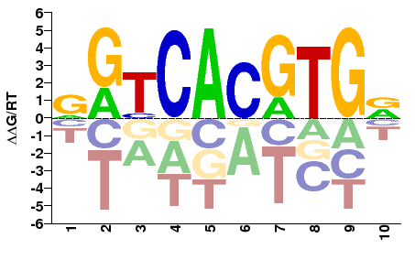
USF1 motif (CIS-BP)
- present in 14,014 out of 21,382 ChIP peaks
Library summary (without safes)
- 61,147 sgRNAs
- 12,715 ChIP-seq peaks
- 18,503 YY1 motifs

Slide 60
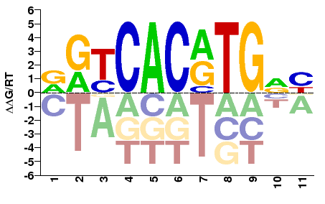
USF2 motif (CIS-BP)
- present in 2,674 out of 3,542 ChIP peaks
Library summary (without safes)
- 17,912 sgRNAs
- 2,526 ChIP-seq peaks
- 4,606 motifs

Slide 61
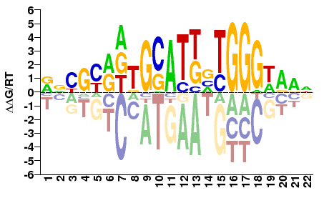
ZNF143 motif (CIS-BP)
- present in 4,765 out of 29,840 ChIP peaks
Library summary (without safes)
- 28,957 sgRNAs
- 4,267 ChIP-seq peaks
- 5,244 motifs

