Slide 1
Design
Used GENCODE V29 (hg38) as annotation
Split genes by biotypes:
protein_coding
lincRNAs
miRNA
Ribozyme
snoRNA
snRNA
scaRNA
misc_RNA
Extended exons by 20bp on each side
Picked all guides within the extended exons for each gene (so that the site 12-16bp from the PAM is within the extended exon)

Slide 2
Top 10 growth genes

Slide 3
All guides, i.e. CFD > 0.0
#gene | exons | total_length | total_guides_passing_CFD | fraction_of_bases_covered
ACTA1 | 11 | 1768 | 236 | 0.29638009
BRCA2 | 43 | 13404 | 778 | 0.184049537
DKC1 | 41 | 4788 | 522 | 0.300960735
DYNC1H1 | 167 | 39010 | 4122 | 0.29671879
GNE | 26 | 6467 | 553 | 0.244008041
KIF1A | 107 | 18957 | 3761 | 0.47618294
POLG | 81 | 6912 | 1311 | 0.457899306
SDHB | 19 | 2891 | 323 | 0.312348668
SOD1 | 10 | 2253 | 315 | 0.373280071
SOS1 | 38 | 10277 | 781 | 0.231390484
 |  | Total guides: | 12702

Slide 4
All guides, i.e. CFD > 0.2
#gene | exons | total_length | total_guides_passing_CFD | fraction_of_bases_covered
ACTA1 | 11 | 1768 | 173 | 0.238122172
BRCA2 | 43 | 13404 | 437 | 0.1087735
DKC1 | 41 | 4788 | 357 | 0.219298246
DYNC1H1 | 167 | 39010 | 2733 | 0.211407331
GNE | 26 | 6467 | 378 | 0.175506417
KIF1A | 107 | 18957 | 2179 | 0.311019676
POLG | 81 | 6912 | 871 | 0.335069444
SDHB | 19 | 2891 | 220 | 0.227948807
SOD1 | 10 | 2253 | 234 | 0.286284953
SOS1 | 38 | 10277 | 477 | 0.151211443
 |  | Total guides: | 8059

Slide 5
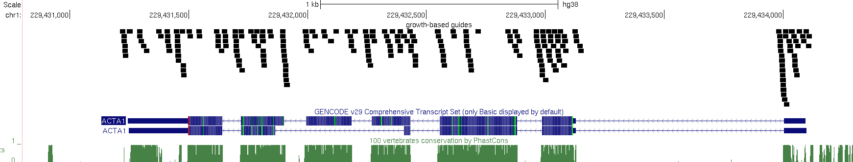

Slide 6
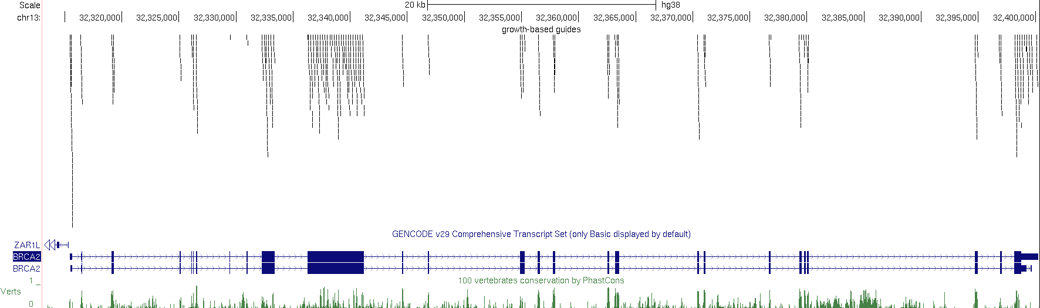

Slide 7
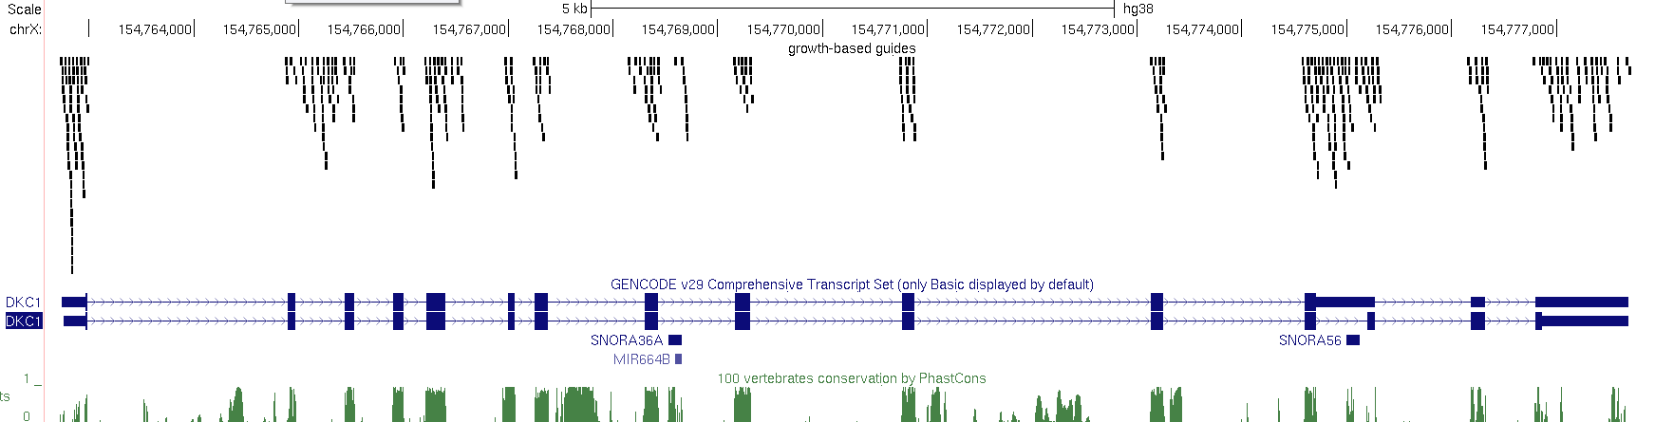

Slide 8
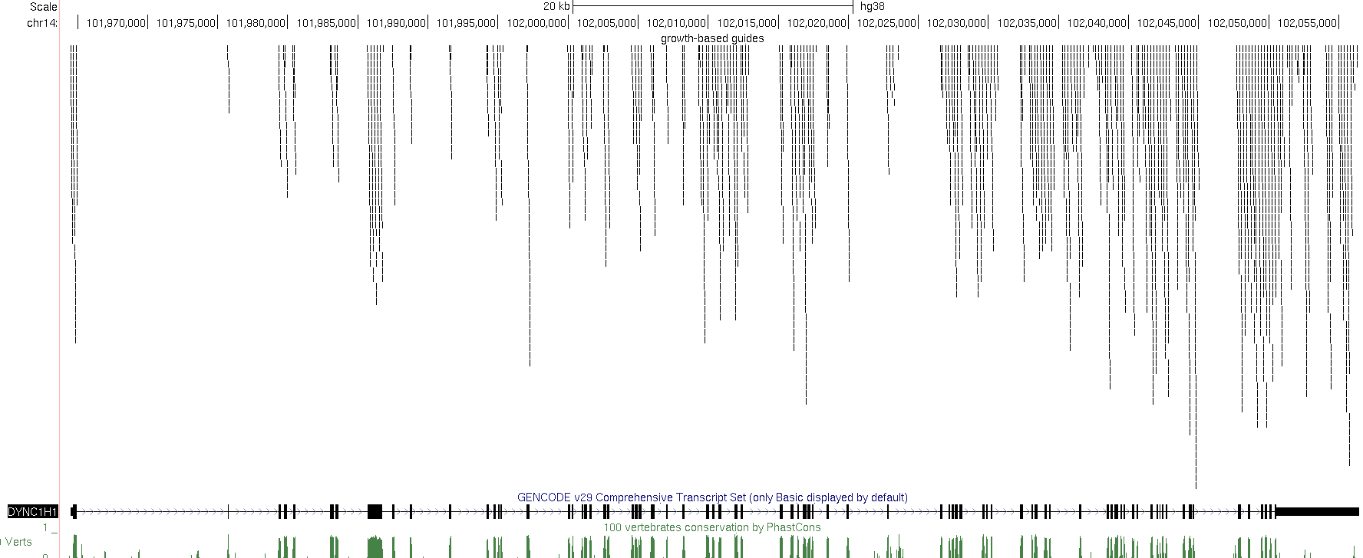

Slide 9
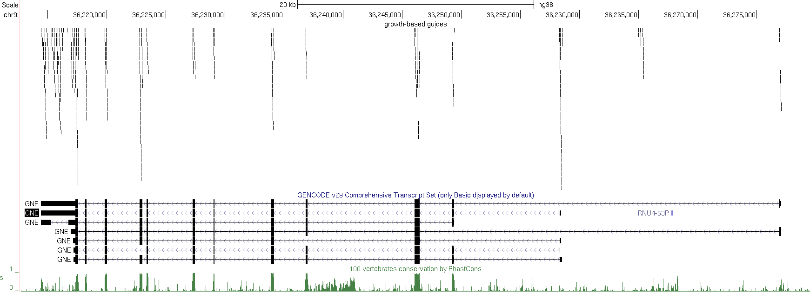

Slide 10
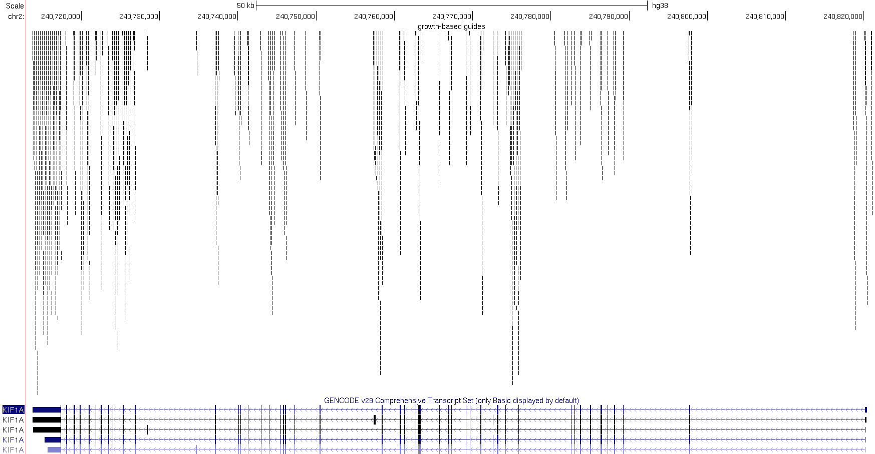

Slide 11
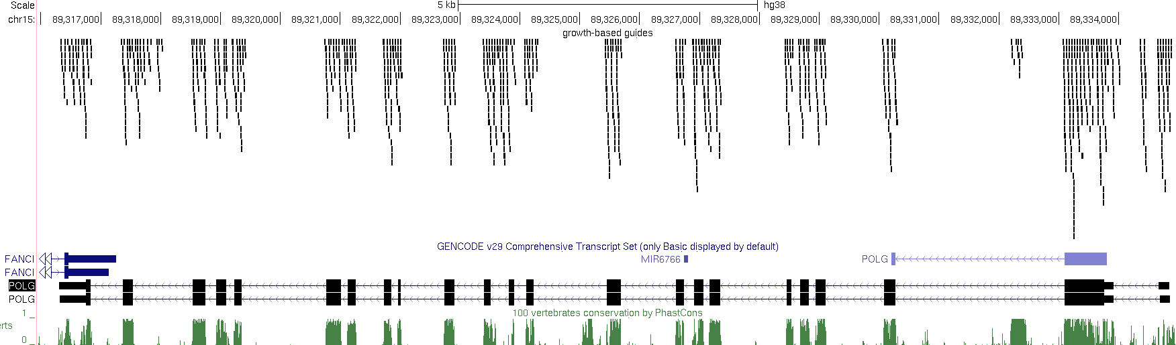

Slide 12
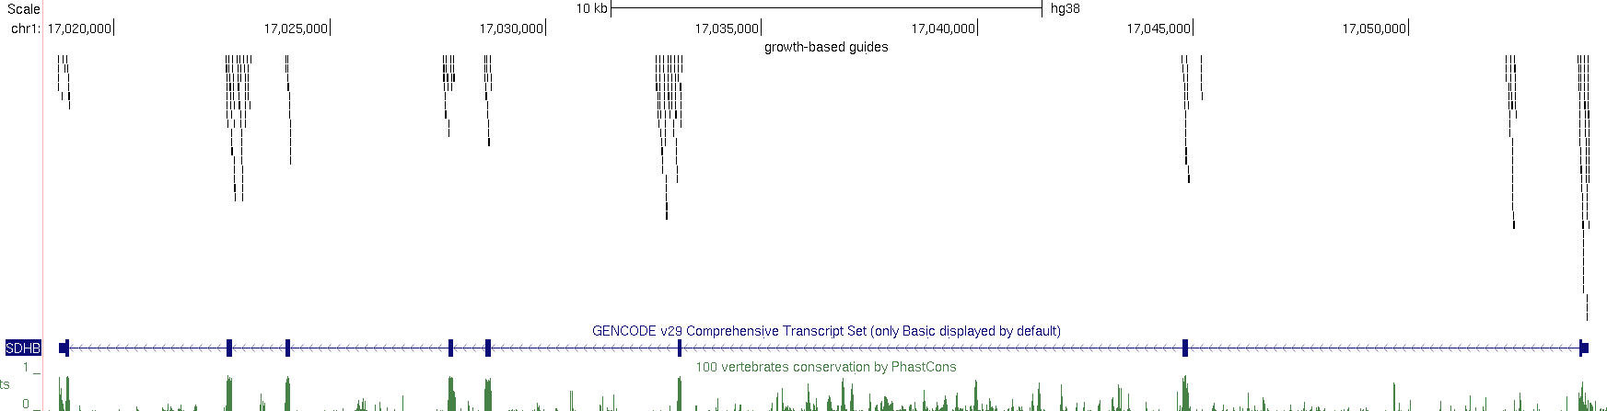

Slide 13
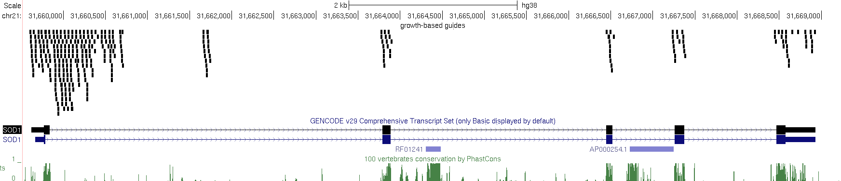

Slide 14
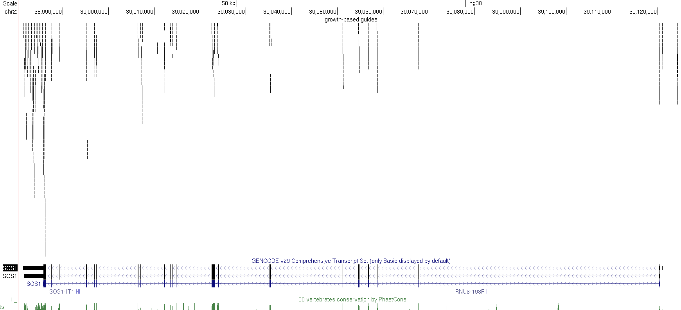

Slide 15
Top 10 ricin genes
#genesymbol | totalSNPs | nClinvarBenignSNPs | nClinvarPathogenicSNPs | nClinvarTotal
NF1 | 18784 | 12 | 68 | 80
PIK3CA | 7111 | 2 | 35 | 37
CDKL5 | 6792 | 8 | 34 | 42
SMAD4 | 3631 | 0 | 31 | 31
ACTB | 2483 | 0 | 26 | 26
PMM2 | 1636 | 2 | 25 | 27
SMCHD1 | 13282 | 6 | 22 | 28
HMBS | 2354 | 0 | 22 | 22
TBC1D24 | 3678 | 7 | 20 | 27
MEN1 | 3952 | 5 | 20 | 25

Slide 16
All guides, i.e. CFD > 0.0
#gene | exons | total_length | total_guides_passing_CFD | fraction_of_bases_covered
ACTB | 44 | 3831 | 417 | 0.266249021
CDKL5 | 43 | 18167 | 1590 | 0.251665107
HMBS | 77 | 5317 | 817 | 0.397404551
MEN1 | 31 | 4597 | 942 | 0.486839243
NF1 | 102 | 29548 | 1830 | 0.19074049
PIK3CA | 30 | 10430 | 524 | 0.14928092
PMM2 | 41 | 8152 | 789 | 0.263493621
SMAD4 | 38 | 13715 | 1131 | 0.242726941
SMCHD1 | 79 | 14541 | 967 | 0.202118149
TBC1D24 | 29 | 12642 | 2018 | 0.405711122
 |  | Total guides: | 11025

Slide 17
All guides, i.e. CFD > 0.2
#gene | exons | total_length | total_guides_passing_CFD | fraction_of_bases_covered
ACTB | 44 | 3831 | 267 | 0.184547116
CDKL5 | 43 | 18167 | 1024 | 0.173721583
HMBS | 77 | 5317 | 505 | 0.277223998
MEN1 | 31 | 4597 | 596 | 0.350663476
NF1 | 102 | 29548 | 986 | 0.109313659
PIK3CA | 30 | 10430 | 290 | 0.085522531
PMM2 | 41 | 8152 | 521 | 0.18326791
SMAD4 | 38 | 13715 | 649 | 0.149325556
SMCHD1 | 79 | 14541 | 557 | 0.124269307
TBC1D24 | 29 | 12642 | 1046 | 0.23991457
 |  | Total guides: | 6441

Slide 18
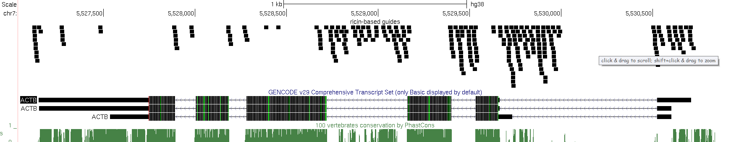

Slide 19
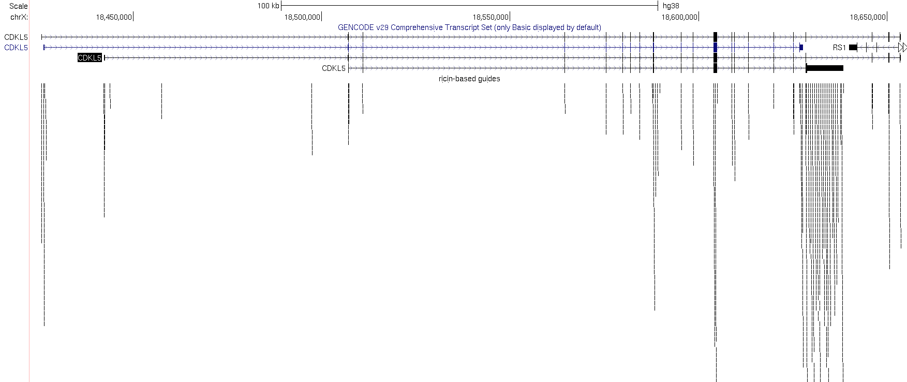

Slide 20
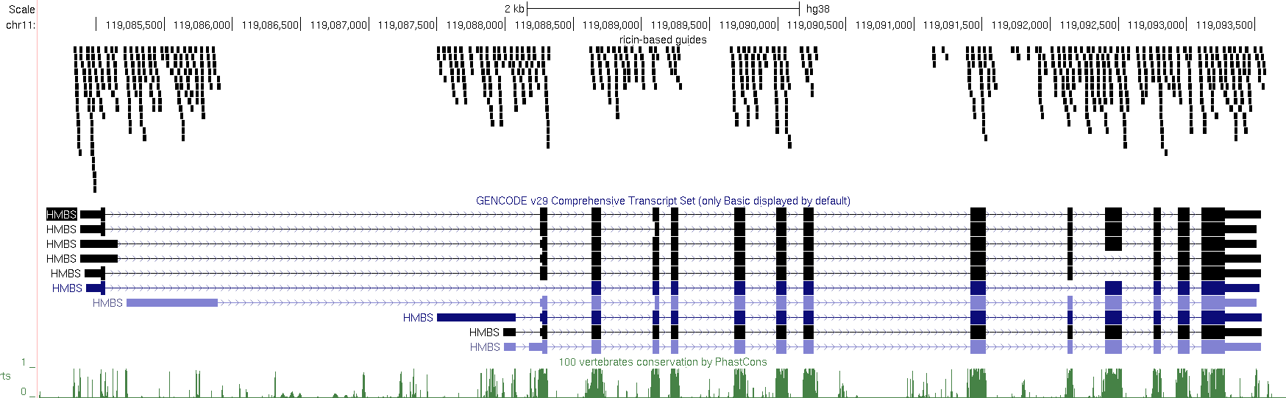

Slide 21
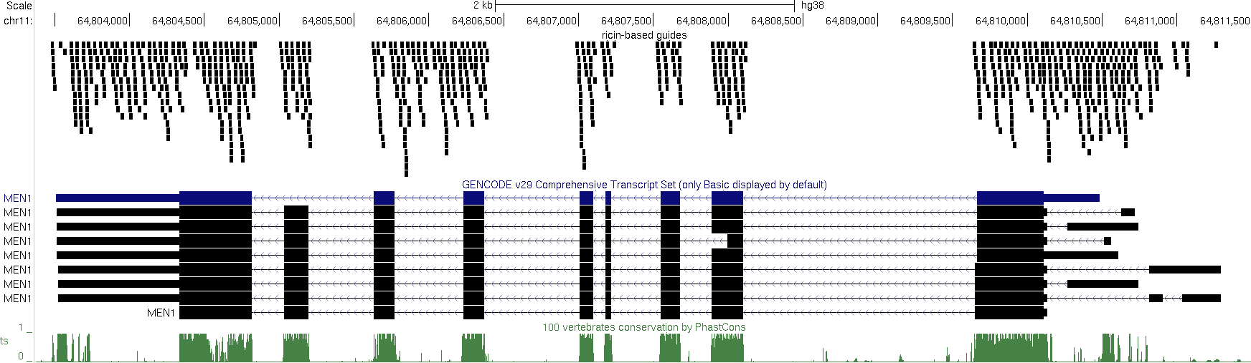

Slide 22
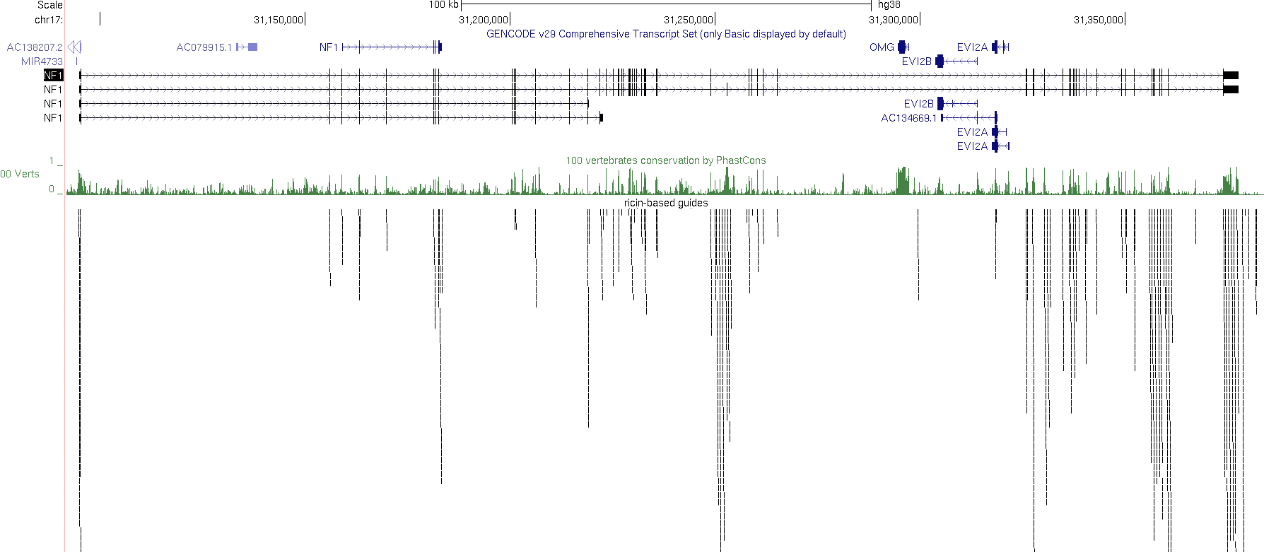

Slide 23
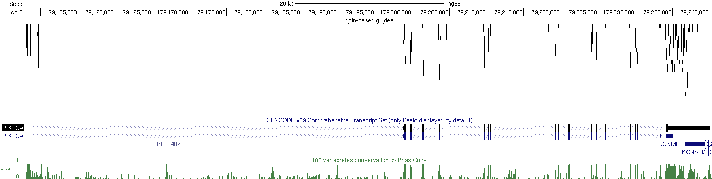

Slide 24
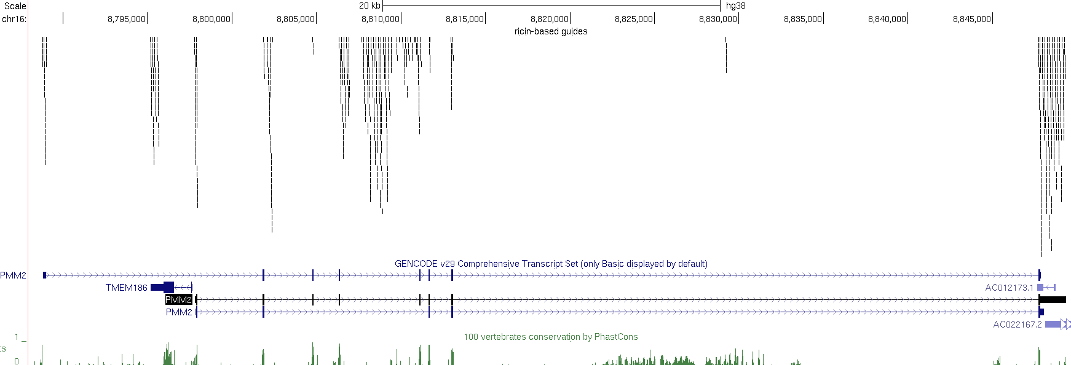

Slide 25
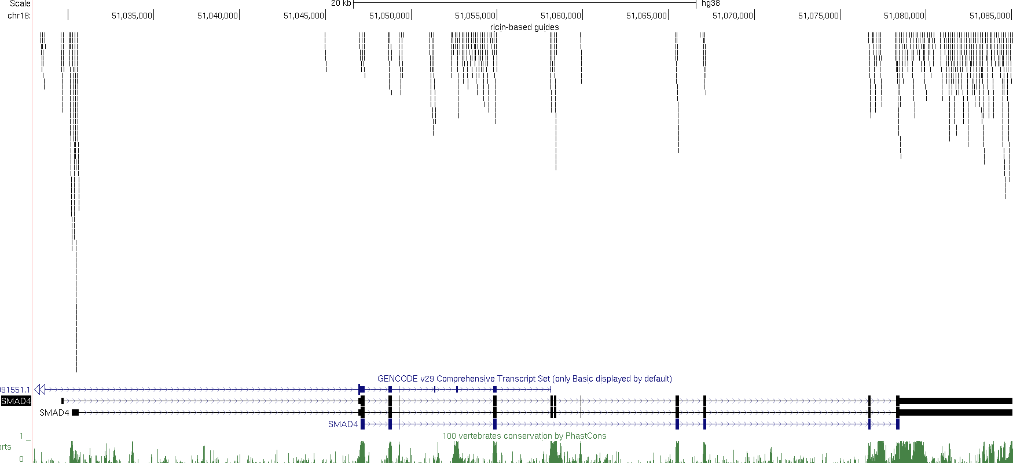

Slide 26
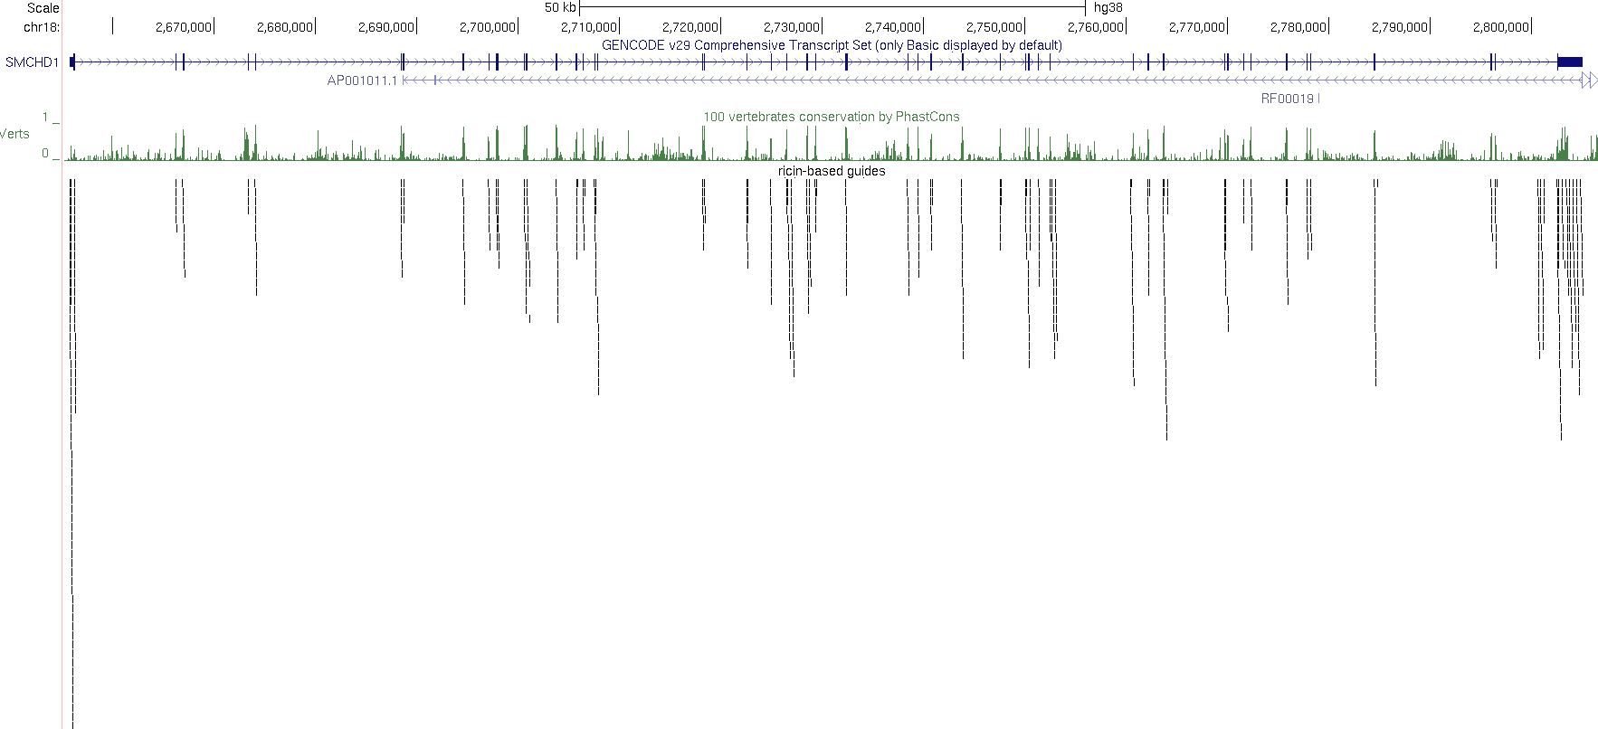

Slide 27
