Slide 1
Design
Used GENCODE V29 (hg38) as annotation
Split genes by biotypes:
protein_coding
lincRNAs
miRNA
Ribozyme
snoRNA
snRNA
scaRNA
misc_RNA
Extended exons by 20bp on each side
Picked all guides within the extended exons for each gene (so that the site 12-16bp from the PAM is within the extended exon)

Slide 2
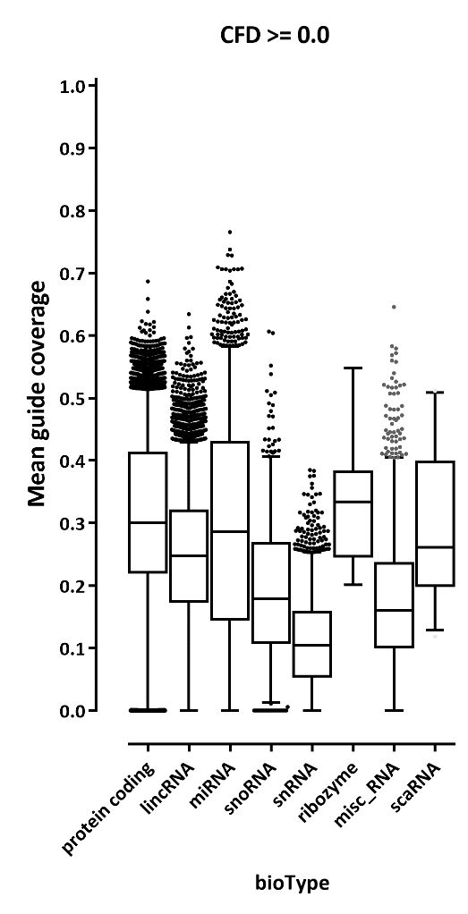
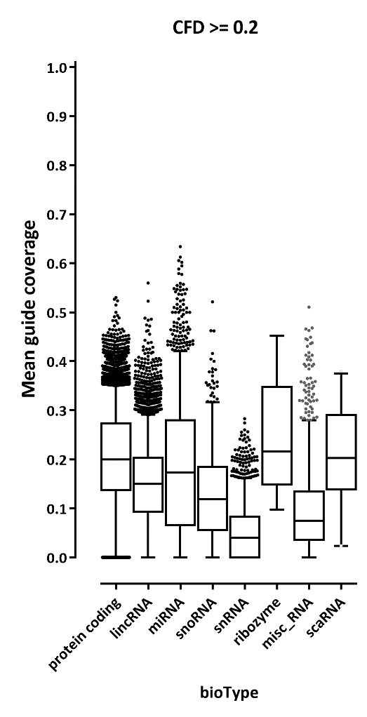
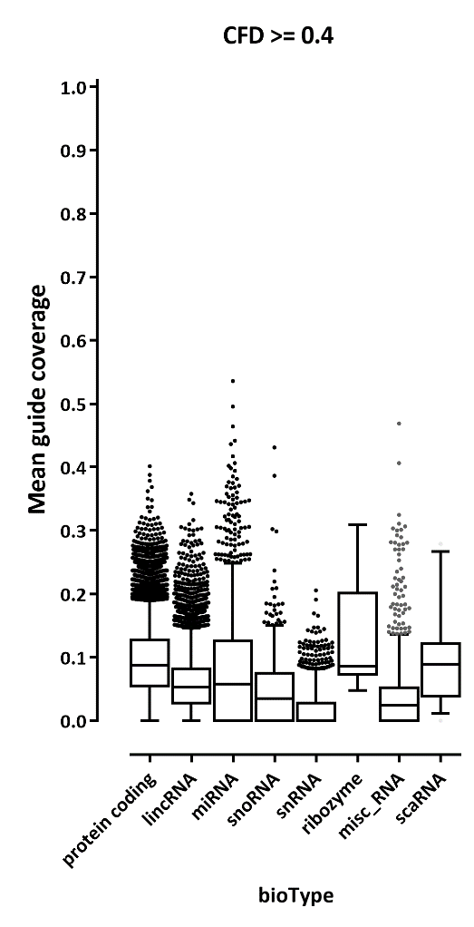
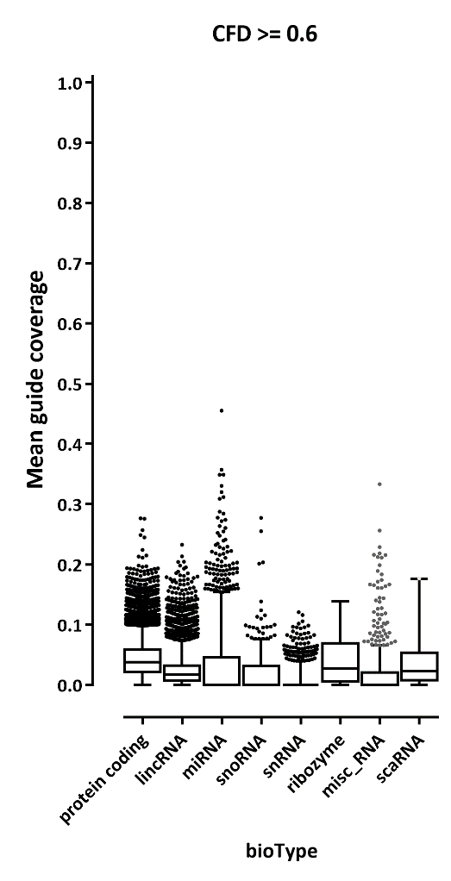
Distribution of guide coverage (assuming a 4-bp editing window)

Slide 3
Growth-based gene picks
#gene | exons | total_length | total_guides_passing_CFD | fraction_of_bases_covered
GATA1 | 8 | 1734 | 575 | 0.33160323
FOXA1 | 11 | 4138 | 1022 | 0.246979217
TAL1 | 16 | 6051 | 1805 | 0.298297802
CEBPA | 1 | 2670 | 962 | 0.360299625
CEBPB | 1 | 1995 | 737 | 0.369423559
CEBPD | 1 | 2217 | 887 | 0.400090212
CEBPE | 2 | 1632 | 544 | 0.333333333
CEBPG | 3 | 4528 | 901 | 0.198984099
CEBPZ | 20 | 4292 | 712 | 0.165890028
ATF1 | 16 | 3219 | 514 | 0.159676918
ATF2 | 45 | 6570 | 858 | 0.130593607
ATF3 | 25 | 4235 | 1107 | 0.261393152
ATF4 | 7 | 2631 | 586 | 0.222729
ATF5 | 13 | 3188 | 799 | 0.250627353
ATF6 | 18 | 8553 | 1436 | 0.167894306
ATF7 | 25 | 7462 | 1574 | 0.210935406
MYC | 18 | 3118 | 910 | 0.291853752
Some TFs:
CTCF and cohesins:
#gene | exons | total_length | total_guides_passing_CFD | fraction_of_bases_covered
CTCF | 48 | 10759 | 1485 | 0.13802398
RAD21 | 32 | 6738 | 760 | 0.112793114
SMC1A | 31 | 11498 | 2735 | 0.237867455
SMC1B | 27 | 5228 | 690 | 0.131981637
SMC2 | 34 | 7521 | 972 | 0.129238133
SMC3 | 31 | 5445 | 590 | 0.10835629

Slide 4
GTFs
#gene | exons | total_length | total_guides_passing_CFD | fraction_of_bases_covered
TAF10 | 11 | 6229 | 1865 | 0.299406004
TAF11 | 9 | 2241 | 368 | 0.164212405
TAF12 | 12 | 2688 | 499 | 0.185639881
TAF13 | 7 | 1595 | 165 | 0.103448276
TAF15 | 45 | 6572 | 8 | 0.001217285
TAF1A | 25 | 3402 | 362 | 0.106407995
TAF1B | 37 | 4830 | 728 | 0.150724638
TAF1C | 66 | 5967 | 1817 | 0.304508128
TAF1D | 62 | 8693 | 1046 | 0.1203267
TAF1 | 78 | 12732 | 1348 | 0.105874961
TAF1L | 1 | 6255 | 440 | 0.070343725
TAF2 | 44 | 7678 | 1120 | 0.145871321
TAF3 | 7 | 5145 | 1096 | 0.213022352
TAF4B | 21 | 6019 | 1138 | 0.189067951
TAF4 | 34 | 10666 | 963 | 0.090286893
TAF5 | 11 | 3697 | 857 | 0.231809575
TAF5L | 13 | 6685 | 1035 | 0.154824233
TAF6 | 54 | 4731 | 1262 | 0.266751215
TAF6L | 25 | 3578 | 1161 | 0.324482951
TAF7 | 6 | 2840 | 512 | 0.18028169
TAF7L | 17 | 3260 | 562 | 0.172392638
TAF8 | 26 | 9793 | 1261 | 0.128765445
TAF9B | 10 | 3025 | 267 | 0.088264463
CCNH | 35 | 6499 | 865 | 0.1330974
DNMTs
#gene | exons | total_length | total_guides_passing_CFD | fraction_of_bases_covered
DNMT1 | 100 | 11611 | 3386 | 0.291620016
DNMT3A | 50 | 13097 | 3728 | 0.284645339
DNMT3B | 29 | 5566 | 1475 | 0.265001797
DNMT3L | 17 | 2366 | 468 | 0.197802198

Slide 5
Kinetochores
Topoisomerases

Slide 6
Replication initiation
Mitochondrial replication and transcription proteins

Slide 7
Some other genes:
Some other possibilities:
Mediator
Pol1/2/3 subunits
H1 histones
- Ribosomal proteins
- ATP-synthase proteins

Slide 8
Ricin-based picks

