Slide 1
Species | Read Length | Library | Raw fragments | Unique non-chrM reads | Multi reads | Complexity | chrM reads | chrM fraction | Unique non-chrM reads after dedup | TSS ratio | MACS default peaks | FRiP (MACS)
Aiptasia pallida 1.1 | 1x36 | apo_Exaiptasia_pallida_10 | 11,442,420 | 5,753,696 |  | 0.48 |  |  |  | 1.22 | 176,886 | 386,452
Aiptasia pallida 1.1 | 1x36 | apo_Exaiptasia_pallida_11 | 2,002,699 | 1,025,512 |  | 0.93 |  |  |  | 1.17 | 11,389 | 73,335
Aiptasia pallida 1.1 | 1x36 | apo_Exaiptasia_pallida_12 | 16,932,864 | 8,968,138 |  | 0.74 |  |  |  | 1.16 | 86,118 | 221,438
Aiptasia pallida 1.1 | 1x36 | apo_Exaiptasia_pallida_13 | 6,987,492 | 2,662,212 |  | 0.69 |  |  |  | 1.14 | 69,611 | 250,256
Aiptasia pallida 1.1 | 1x36 | apo_Exaiptasia_pallida_14 | 6,999,125 | 3,525,725 |  | 0.80 |  |  |  | 1.23 | 30,829 | 122,322
Aiptasia pallida 1.1 | 1x36 | apo_Exaiptasia_pallida_15 | 41,358,948 | 21,822,510 |  | 0.73 |  |  |  | 1.11 | 141,701 | 279,046
Aiptasia pallida 1.1 | 1x36 | apo_Exaiptasia_pallida_16 | 20,462,944 | 10,680,364 |  | 0.76 |  |  |  | 1.21 | 133,697 | 382,540
Aiptasia pallida 1.1 | 1x36 | apo_Exaiptasia_pallida_17 | 13,522,874 | 7,008,985 |  | 0.82 |  |  |  | 1.09 | 66,774 | 183,695
Aiptasia pallida 1.1 | 1x36 | apo_Exaiptasia_pallida_18 | 21,944,102 | 11,309,351 |  | 0.73 |  |  |  | 1.10 | 98,910 | 230,350
Aiptasia pallida 1.1 | 1x36 | apo_Exaiptasia_pallida_19 | 22,868,175 | 11,563,893 |  | 0.76 |  |  |  | 1.22 | 89,176 | 220,119
Aiptasia pallida 1.1 | 1x36 | apo_Exaiptasia_pallida_1 | 8,202,111 | 3,319,212 |  | 0.73 |  |  |  | 1.14 | 81,394 | 250,834
Aiptasia pallida 1.1 | 1x36 | apo_Exaiptasia_pallida_20 | 8,158,980 | 4,136,302 |  | 0.60 |  |  |  | 1.21 | 89,254 | 250,196
Aiptasia pallida 1.1 | 1x36 | apo_Exaiptasia_pallida_21 | 15,289,433 | 7,834,252 |  | 0.79 |  |  |  | 1.32 | 86,874 | 241,331
Aiptasia pallida 1.1 | 1x36 | apo_Exaiptasia_pallida_2 | 17,226,162 | 8,767,107 |  | 0.80 |  |  |  | 1.21 | 64,697 | 181,996
Aiptasia pallida 1.1 | 1x36 | apo_Exaiptasia_pallida_3 | 5,004,459 | 2,554,411 |  | 0.73 |  |  |  | 1.17 | 55,423 | 185,524
Aiptasia pallida 1.1 | 1x36 | apo_Exaiptasia_pallida_4 | 11,856,935 | 6,090,190 |  | 0.63 |  |  |  | 1.23 | 135,689 | 368,882
Aiptasia pallida 1.1 | 1x36 | apo_Exaiptasia_pallida_5 | 5,728,917 | 2,891,422 |  | 0.74 |  |  |  | 1.29 | 69,098 | 268,091
Aiptasia pallida 1.1 | 1x36 | apo_Exaiptasia_pallida_6 | 16,869,690 | 9,054,330 |  | 0.80 |  |  |  | 1.27 | 91,821 | 279,244
Aiptasia pallida 1.1 | 1x36 | apo_Exaiptasia_pallida_7 | 5,597,040 | 2,646,835 |  | 0.83 |  |  |  | 1.35 | 36,661 | 182,076
Aiptasia pallida 1.1 | 1x36 | apo_Exaiptasia_pallida_8 | 18,597,825 | 9,783,147 |  | 0.85 |  |  |  | 1.15 | 60,634 | 168,105
Aiptasia pallida 1.1 | 1x36 | apo_Exaiptasia_pallida_9 | 10,411,584 | 5,424,916 |  | 0.82 |  |  |  | 1.37 | 74,316 | 243,414
Aiptasia pallida 1.1 | 1x36 | sym_Exaiptasia_pallida_22 | 25,375,005 | 12,543,644 |  | 0.70 |  |  |  | 1.18 | 142,049 | 359,755
Aiptasia pallida 1.1 | 1x36 | sym_Exaiptasia_pallida_23 | 11,367,424 | 5,617,444 |  | 0.85 |  |  |  | 1.17 | 68,870 | 216,754
Aiptasia pallida 1.1 | 1x36 | sym_Exaiptasia_pallida_24 | 11,497,118 | 6,172,885 |  | 0.61 |  |  |  | 1.24 | 107,033 | 352,073
Aiptasia pallida 1.1 | 1x36 | sym_Exaiptasia_pallida_25 | 16,869,690 | 9,054,330 |  | 0.80 |  |  |  | 1.27 | 91,821 | 279,244
Aiptasia pallida 1.1 | 1x36 | sym_Exaiptasia_pallida_26 | 16,869,690 | 9,054,330 |  | 0.80 |  |  |  | 1.27 | 91,821 | 279,244
Aiptasia pallida 1.1 | 1x36 | sym_Exaiptasia_pallida_27 | 16,869,690 | 9,054,330 |  | 0.80 |  |  |  | 1.27 | 91,821 | 279,244
Aiptasia pallida 1.1 | 1x36 | sym_Exaiptasia_pallida_28 | 22,118,207 | 11,704,053 |  | 0.77 |  |  |  | 1.27 | 120,148 | 355,164
Aiptasia pallida 1.1 | 1x36 | sym_Exaiptasia_pallida_29 | 18,576,644 | 9,508,526 |  | 0.79 |  |  |  | 1.15 | 107,810 | 359,193
Aiptasia pallida 1.1 | 1x36 | sym_Exaiptasia_pallida_30 | 19,738,191 | 10,399,723 |  | 0.78 |  |  |  | 1.28 | 124,284 | 363,238
Aiptasia pallida 1.1 | 1x36 | sym_Exaiptasia_pallida_31 | 15,866,605 | 7,464,684 |  | 0.44 |  |  |  | 1.31 | 179,634 | 418,163
Aiptasia pallida 1.1 | 1x36 | sym_Exaiptasia_pallida_32 | 25,223,341 | 12,192,739 |  | 0.54 |  |  |  | 1.16 | 159,046 | 331,864
Aiptasia pallida 1.1 | 1x36 | sym_Exaiptasia_pallida_33 | 2,067,856 | 1,025,271 |  | 0.92 |  |  |  | 1.17 | 11,482 | 80,356
Aiptasia pallida 1.1 | 1x36 | sym_Exaiptasia_pallida_34 | 21,843,706 | 11,557,294 |  | 0.77 |  |  |  | 1.27 | 118,254 | 352,249
Aiptasia pallida 1.1 | 1x36 | sym_Exaiptasia_pallida_35 | 15,291,922 | 7,796,463 |  | 0.80 |  |  |  | 1.16 | 99,109 | 329,594
Aiptasia pallida 1.1 | 1x36 | sym_Exaiptasia_pallida_36 | 81,679,335 | 41,897,607 |  | 0.58 |  |  |  | 1.17 | 241,938 | 541,741
Aiptasia pallida 1.1 | 1x36 | sym_Exaiptasia_pallida_37 | 5,837,718 | 2,923,740 |  | 0.61 |  |  |  | 1.16 | 110,556 | 316,757
Aiptasia pallida 1.1 | 1x36 | sym_Exaiptasia_pallida_38 | 8,580,565 | 4,238,717 |  | 0.48 |  |  |  | 1.17 | 220,023 | 483,239
Aiptasia pallida 1.1 | 1x36 | sym_Exaiptasia_pallida_39 | 39,970,381 | 21,487,661 |  | 0.71 |  |  |  | 1.13 | 161,302 | 331,243
Aiptasia pallida 1.1 | 1x36 | sym_Exaiptasia_pallida_40 | 21,707,955 | 11,001,042 |  | 0.76 |  |  |  | 1.15 | 131,634 | 403,109
Aiptasia pallida 1.1 | 1x36 | sym_Exaiptasia_pallida_41 | 25,303,884 | 12,299,618 |  | 0.70 |  |  |  | 1.19 | 138,076 | 358,267
Aiptasia pallida 1.1 | 1x36 | sym_Exaiptasia_pallida_42 | 61,849,885 | 31,063,216 |  | 0.69 |  |  |  | 1.08 | 186,248 | 459,705

Slide 2
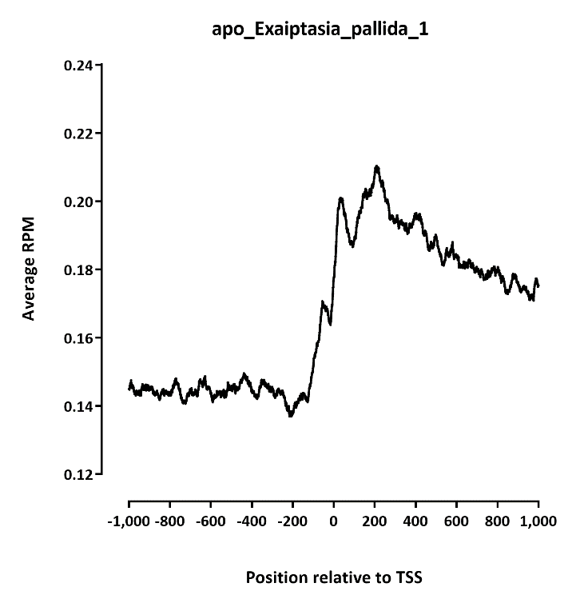
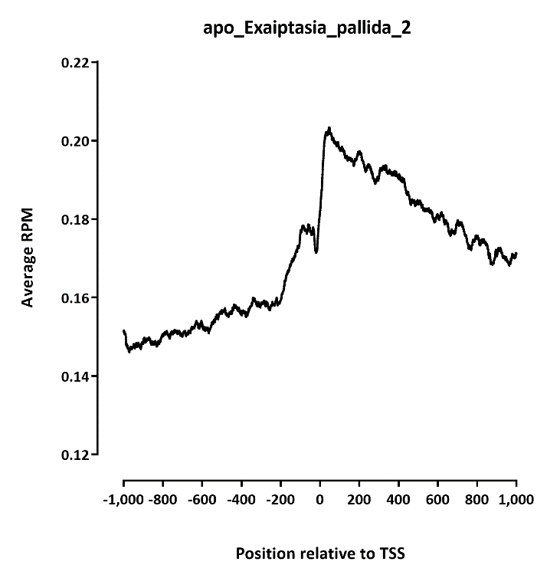
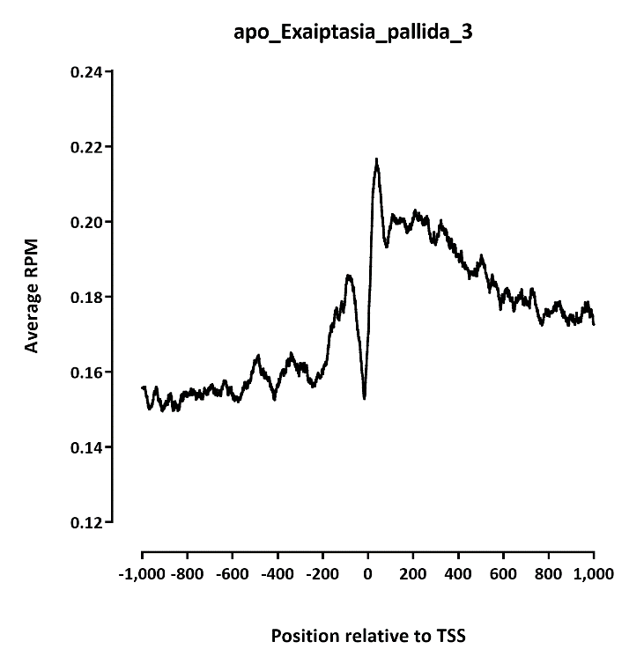

Slide 3
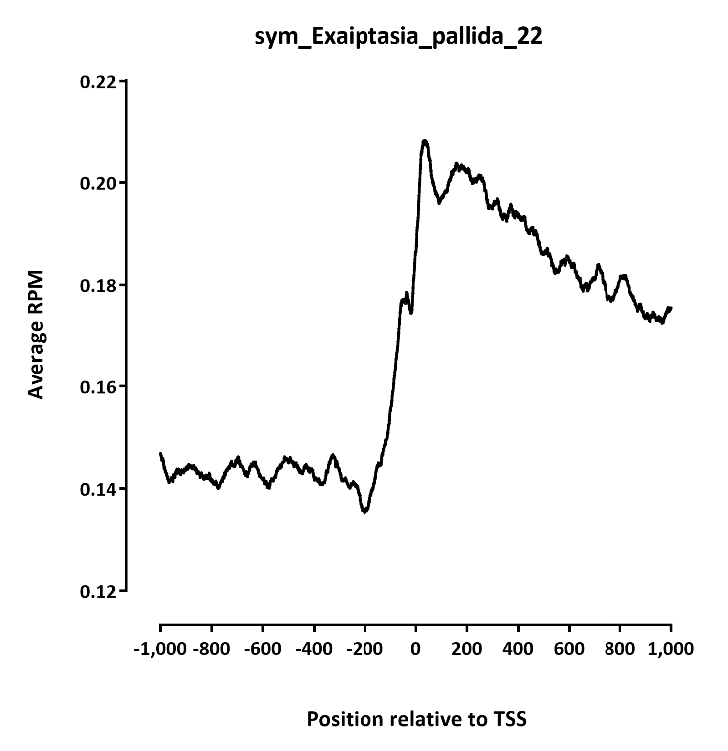
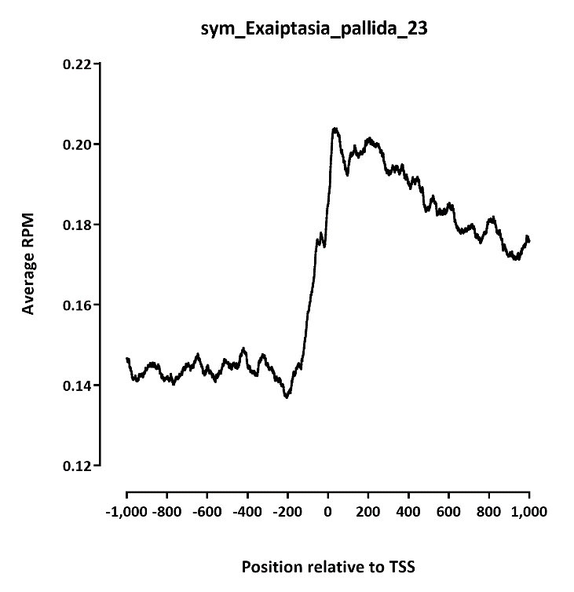
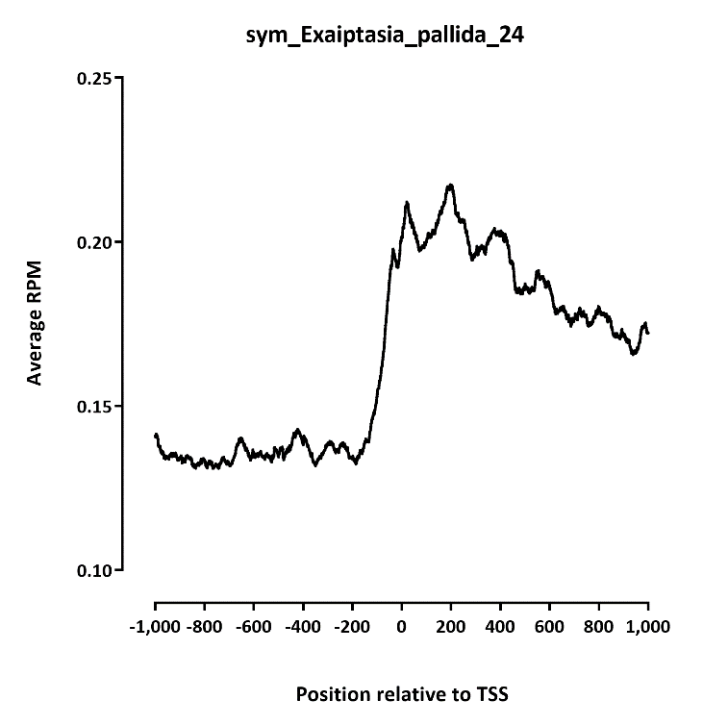

Slide 4
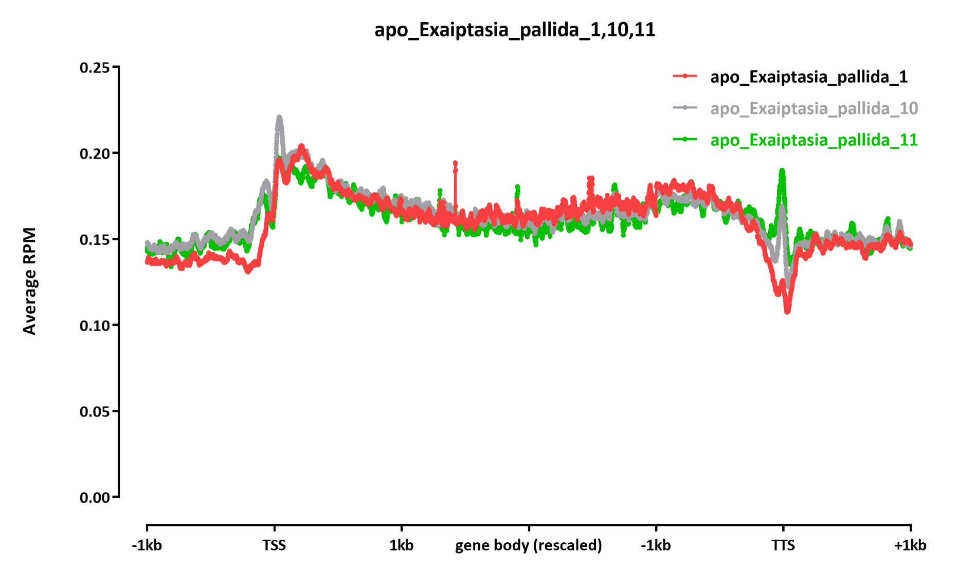

Slide 5
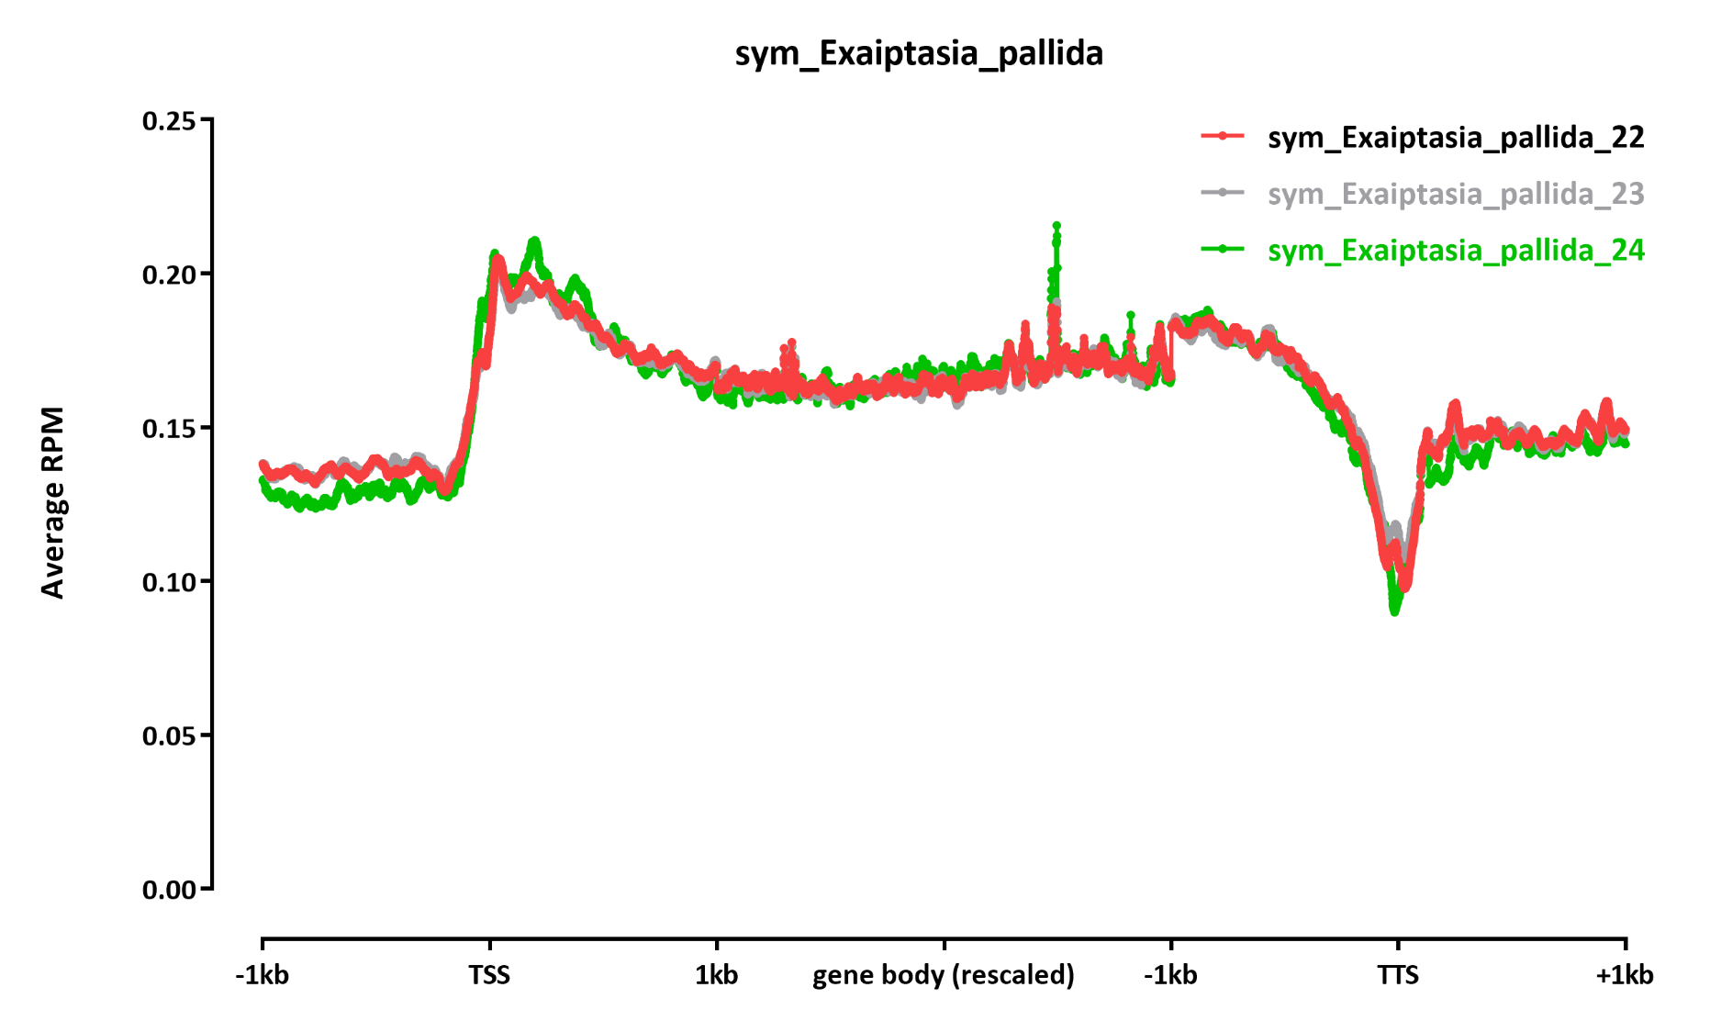

Slide 6
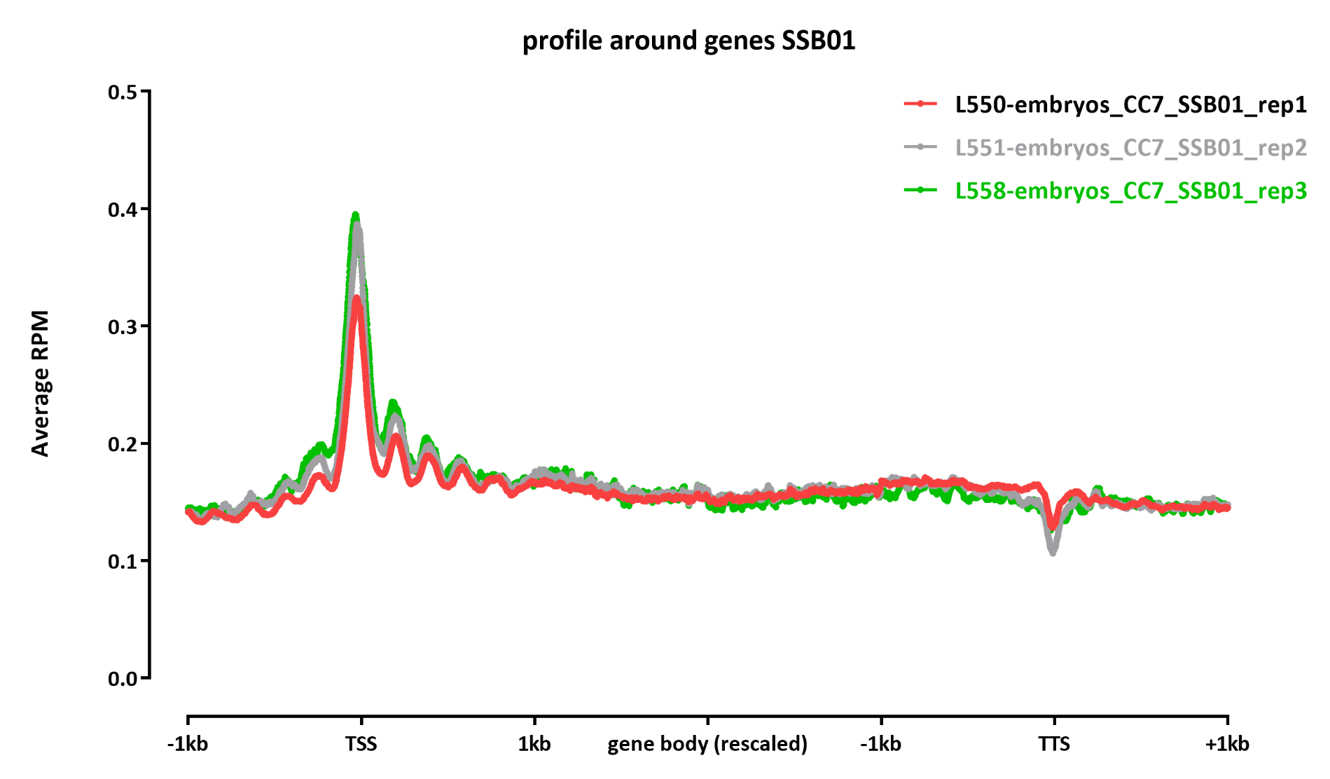
Our embryo data:

Slide 7
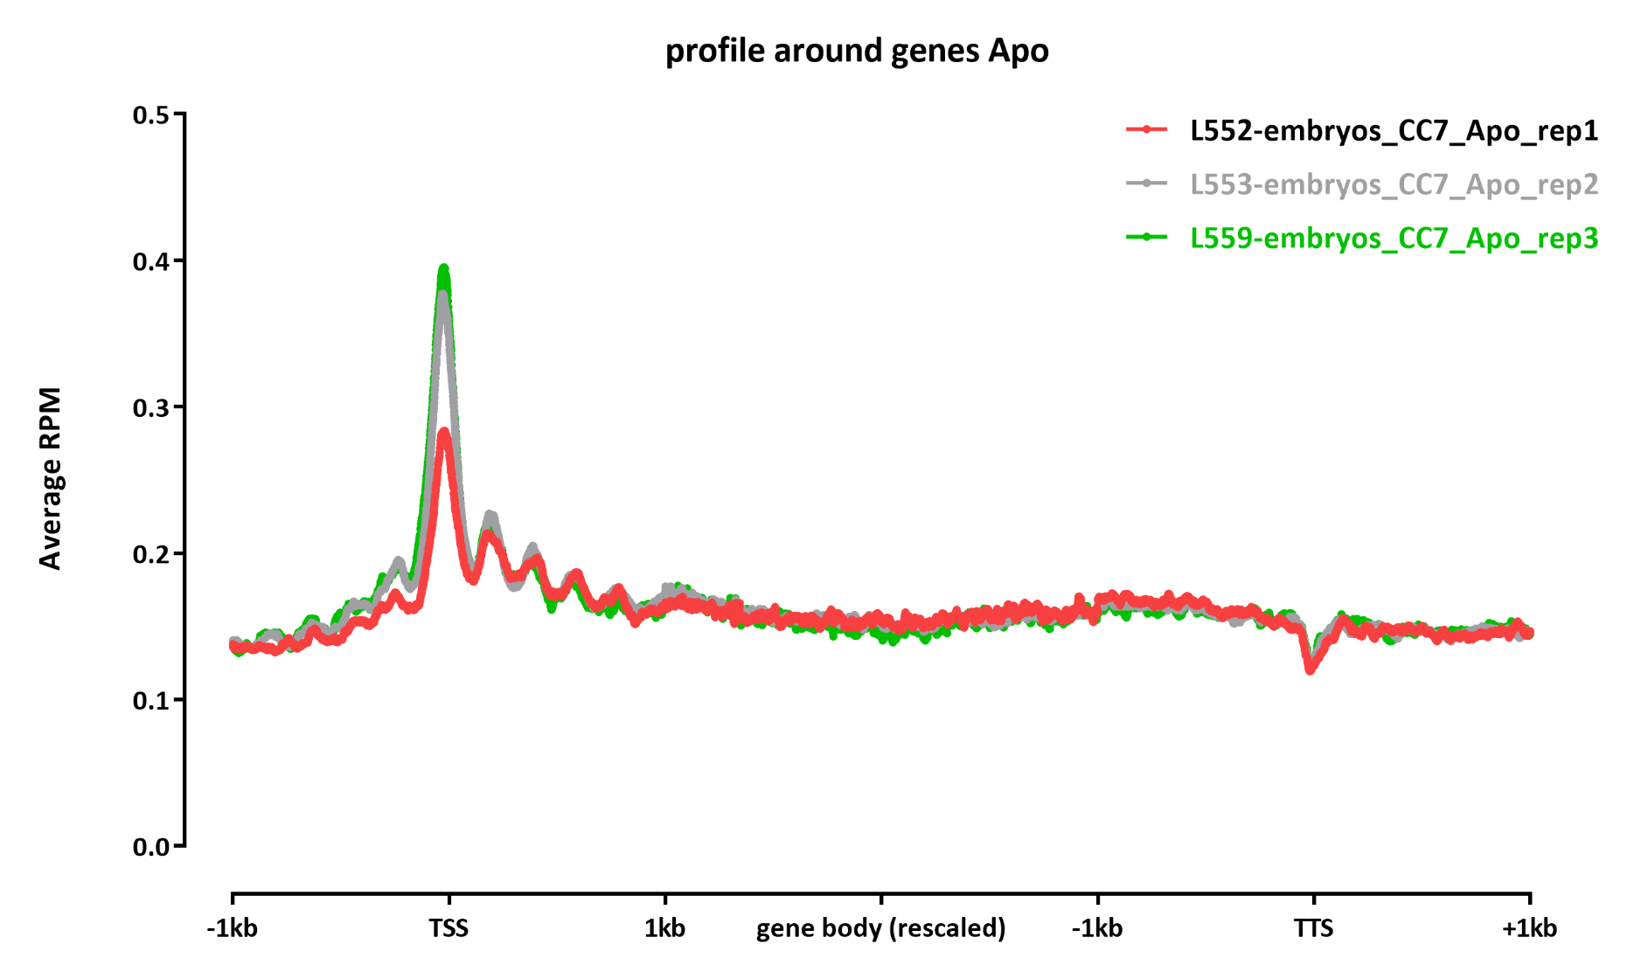
Our embryo data:

