Slide 1
Dataset stats

Slide 2
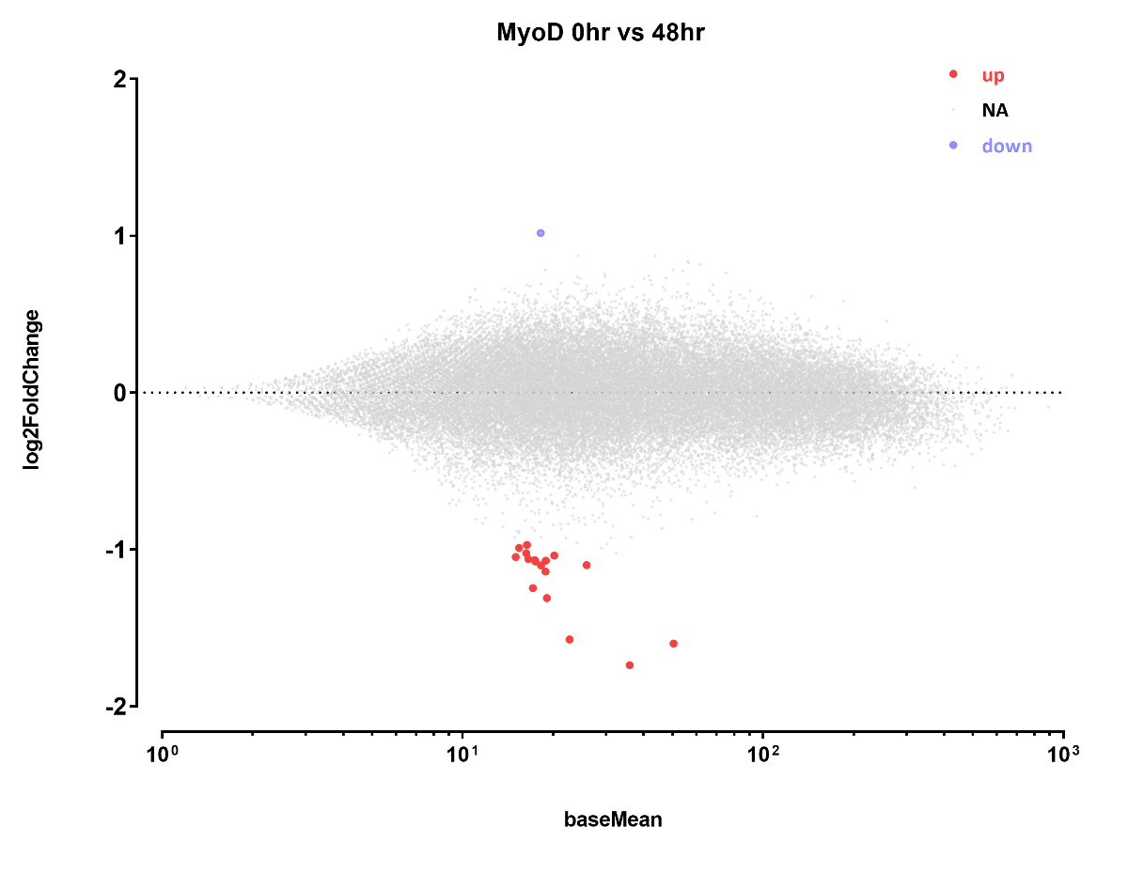
Differential sites
Number differential ATAC peaks
A | B | p-adj
 |  | up in B vs A | down in B vs A
MyoD-0hr | MyoD-48hr | 19 | 1

Slide 3

MYOD1

Slide 4

The other sites:

Slide 5


Slide 6


Slide 7


Slide 8


Slide 9


Slide 10


Slide 11

Cleart artifact. Does anyone have plasmids with MTOR around the lab?

Slide 12


Slide 13


Slide 14


Slide 15


Slide 16


Slide 17


Slide 18


Slide 19


Slide 20


Slide 21


Slide 22


