Slide 1
Read mapping stats
Species | Read Length | Mapping | Library | Raw reads | Complexity | Unique | Unique Splices | Multi | Multi Splices | Fraction mapped
mm10 | 2x50 | STAR-2.5.3 GENCODEvm4 | normal_lung_rep1_total_RNA | 171,553,662 | 0.39 | 201,539,293 | 20,675,233 | 55,200,098 | 5,693,986 | 0.83
mm10 | 2x50 | STAR-2.5.3 GENCODEvm4 | normal_lung_rep2_total_RNA | 171,393,687 | 0.52 | 216,013,642 | 12,771,338 | 30,304,806 | 2,442,980 | 0.76
mm10 | 2x50 | STAR-2.5.3 GENCODEvm4 | normal_lung_rep3_total_RNA | 180,671,287 | 0.46 | 236,600,064 | 13,784,236 | 33,333,604 | 2,872,718 | 0.79
mm10 | 2x50 | STAR-2.5.3 GENCODEvm4 | tumor_rep1_total_RNA | 165,569,498 | 0.38 | 197,335,840 | 22,305,060 | 48,771,844 | 5,410,268 | 0.83
mm10 | 2x50 | STAR-2.5.3 GENCODEvm4 | tumor_rep2_total_RNA | 149,208,283 | 0.40 | 170,815,796 | 15,195,114 | 33,476,161 | 3,293,747 | 0.75
mm10 | 2x50 | STAR-2.5.3 GENCODEvm4 | tumor_rep3_total_RNA | 164,380,205 | 0.41 | 197,226,532 | 17,185,620 | 44,762,745 | 4,872,901 | 0.80
# | Exonic: | Intergenic: | Intronic:
normal_lung_rep1_total_RNA | 0.58 | 0.12 | 0.29
normal_lung_rep2_total_RNA | 0.38 | 0.15 | 0.46
normal_lung_rep3_total_RNA | 0.40 | 0.17 | 0.43
tumor_rep1_total_RNA | 0.60 | 0.12 | 0.28
tumor_rep2_total_RNA | 0.55 | 0.13 | 0.33
tumor_rep3_total_RNA | 0.54 | 0.18 | 0.28

Slide 2
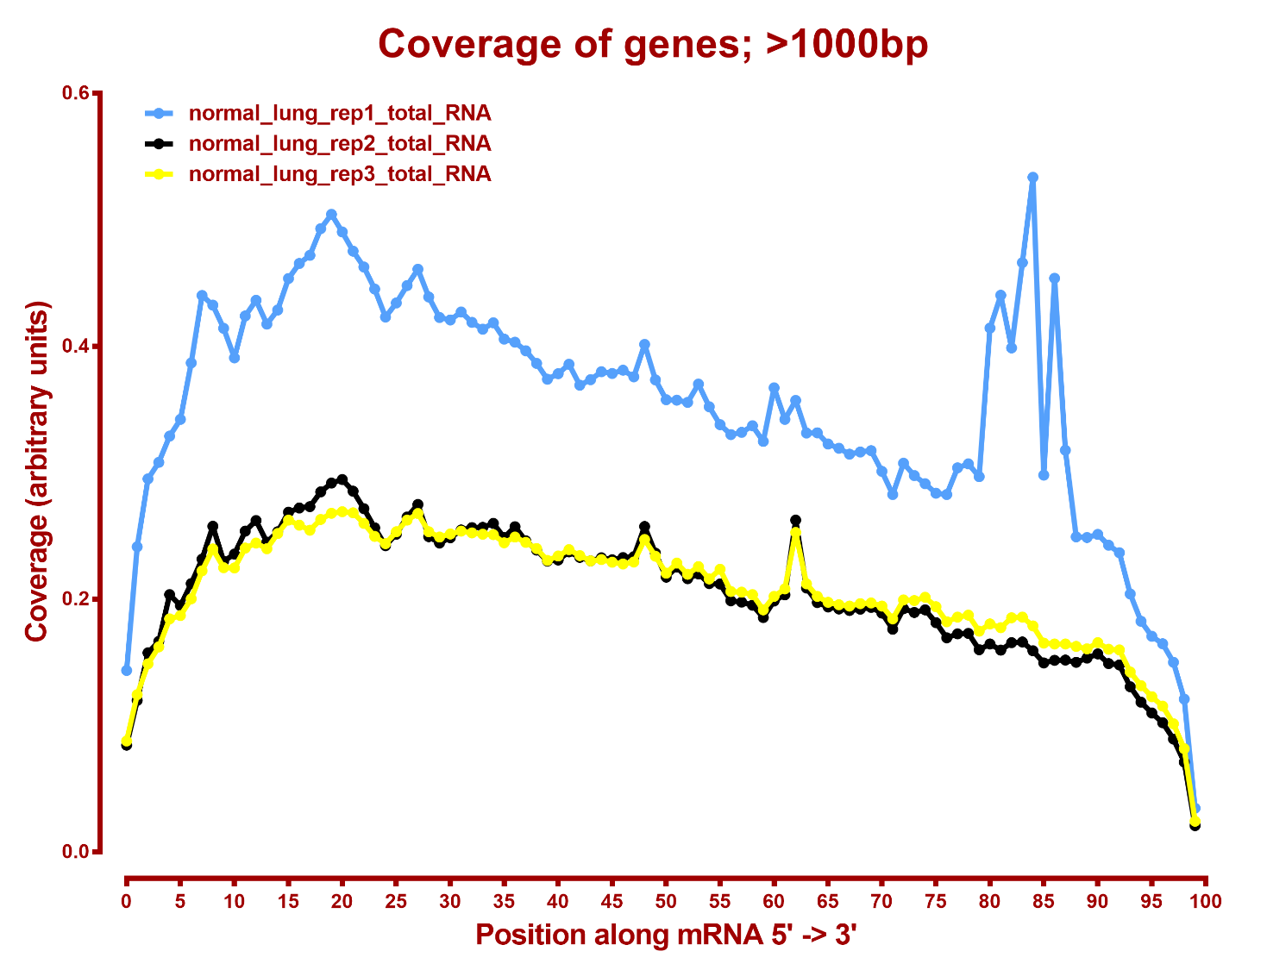

Slide 3
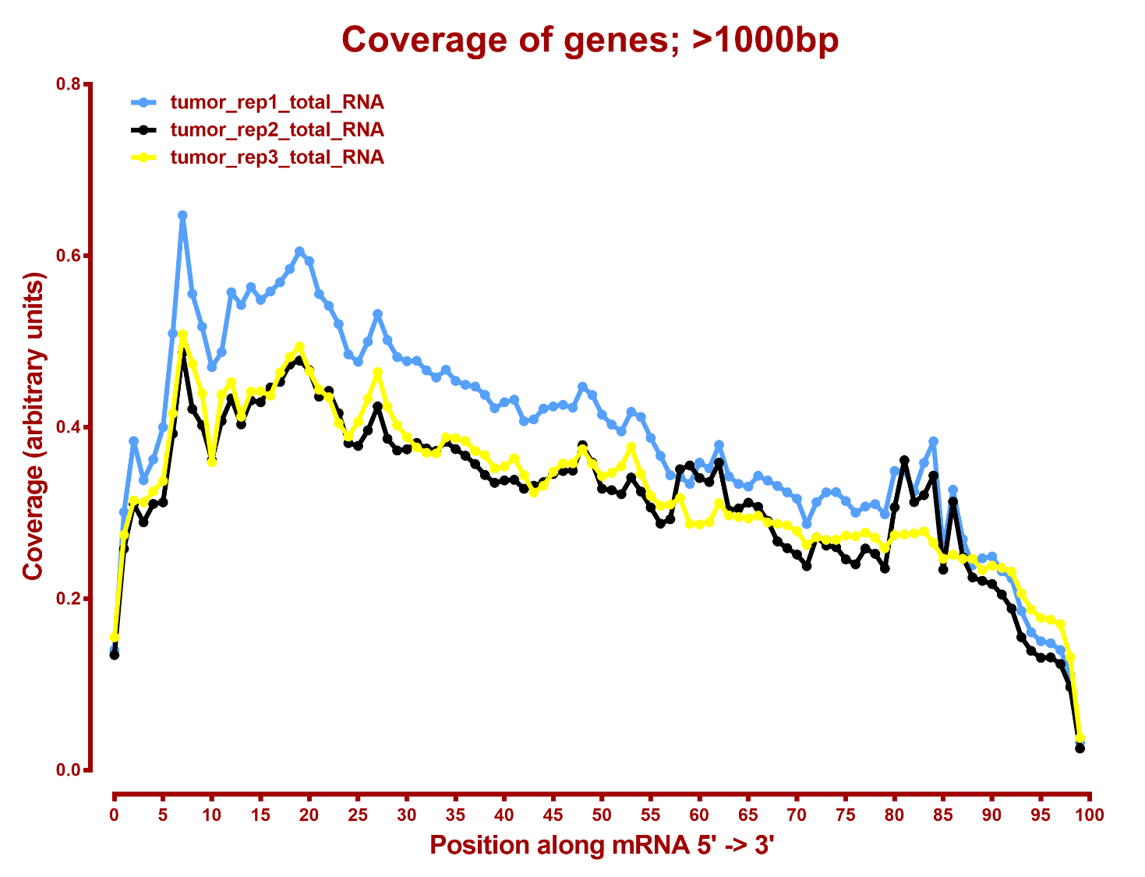

Slide 4
Number DE genes, DESeq2, eXpress
all genes
A | B | p-val |  | p-adj
 |  | up in B vs A | down in B vs A | up in B vs A | down in B vs A
normal_lung | tumor | 913 | 1,107 | 106 | 223

