Slide 1
Read mapping stats
Species | Read Length | Mapping | Library | Raw reads | Complexity | Unique | Unique Splices | Multi | Multi Splices | Fraction mapped
hg38 | 1x50 | STAR-2.5.3a GENCODE25 | h358_ars_rep1 | 11,391,695 | 0.31 | 8,311,668 | 590,788 | 2,119,361 | 198,534 | 0.49
hg38 | 1x50 | STAR-2.5.3a GENCODE25 | h358_ars_rep2 | 15,897,214 | 0.27 | 11,335,611 | 918,185 | 3,113,466 | 307,945 | 0.49
hg38 | 1x50 | STAR-2.5.3a GENCODE25 | h358_combo_rep1 | 21,810,762 | 0.22 | 15,685,059 | 1,220,272 | 4,184,335 | 437,278 | 0.49
hg38 | 1x50 | STAR-2.5.3a GENCODE25 | h358_combo_rep2 | 14,194,775 | 0.28 | 10,340,059 | 742,140 | 2,671,465 | 254,459 | 0.49
hg38 | 1x50 | STAR-2.5.3a GENCODE25 | h358_dmso_rep1 | 20,049,741 | 0.25 | 14,478,866 | 1,083,740 | 3,839,586 | 379,725 | 0.49
hg38 | 1x50 | STAR-2.5.3a GENCODE25 | h358_dmso_rep2 | 15,275,833 | 0.28 | 11,076,823 | 840,670 | 2,866,762 | 301,569 | 0.49
hg38 | 1x50 | STAR-2.5.3a GENCODE25 | h358_palbo_rep1 | 16,992,183 | 0.24 | 12,272,643 | 908,184 | 3,278,272 | 316,193 | 0.49
hg38 | 1x50 | STAR-2.5.3a GENCODE25 | h358_palbo_rep2 | 14,383,624 | 0.27 | 10,353,779 | 816,546 | 2,754,187 | 277,726 | 0.49
# | Exonic: | Intergenic: | Intronic:
h358_ars_rep1 | 0.90 | 0.05 | 0.05
h358_ars_rep2 | 0.92 | 0.04 | 0.04
h358_combo_rep1 | 0.91 | 0.04 | 0.05
h358_combo_rep2 | 0.91 | 0.04 | 0.05
h358_dmso_rep1 | 0.90 | 0.05 | 0.06
h358_dmso_rep2 | 0.91 | 0.04 | 0.04
h358_palbo_rep1 | 0.91 | 0.04 | 0.05
h358_palbo_rep2 | 0.92 | 0.04 | 0.04

Slide 2
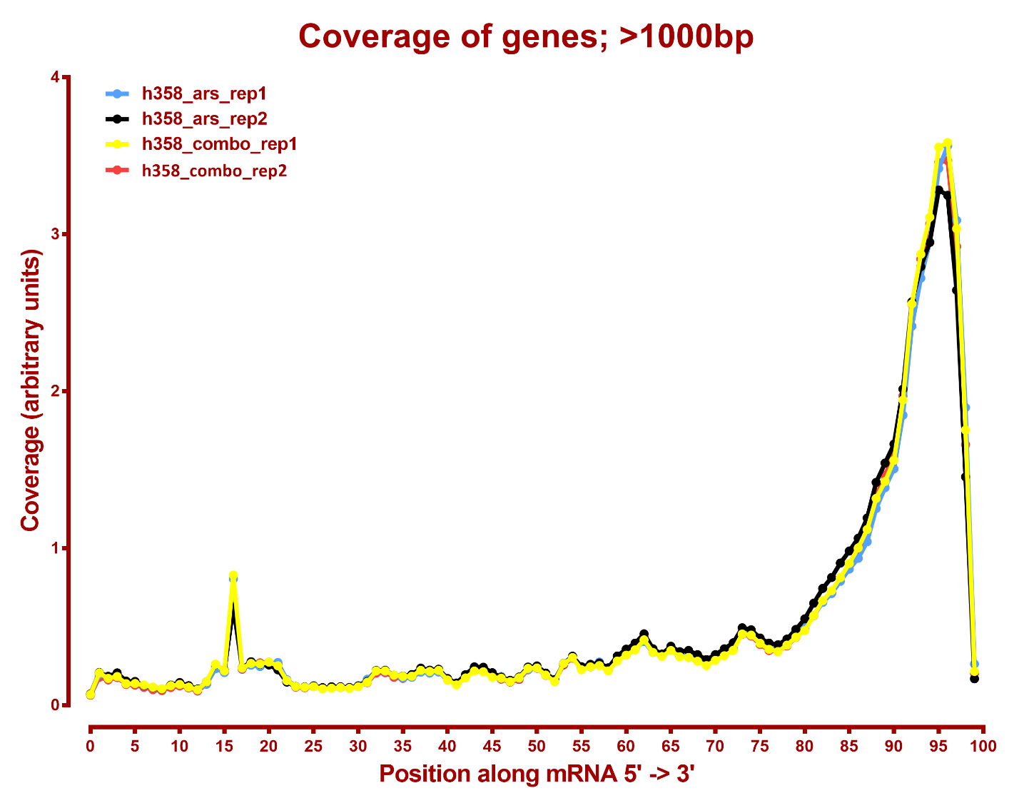
From the methods section on GEO:
“RNA-seq libraries were prepared with the QuantSeq 3’ mRNA-Seq Library Prep Kit FWD for Illumina (Lexogen) and assessed on a BioAnalyzer 2100 (Agilent) for quantification and quality control.”

Slide 3
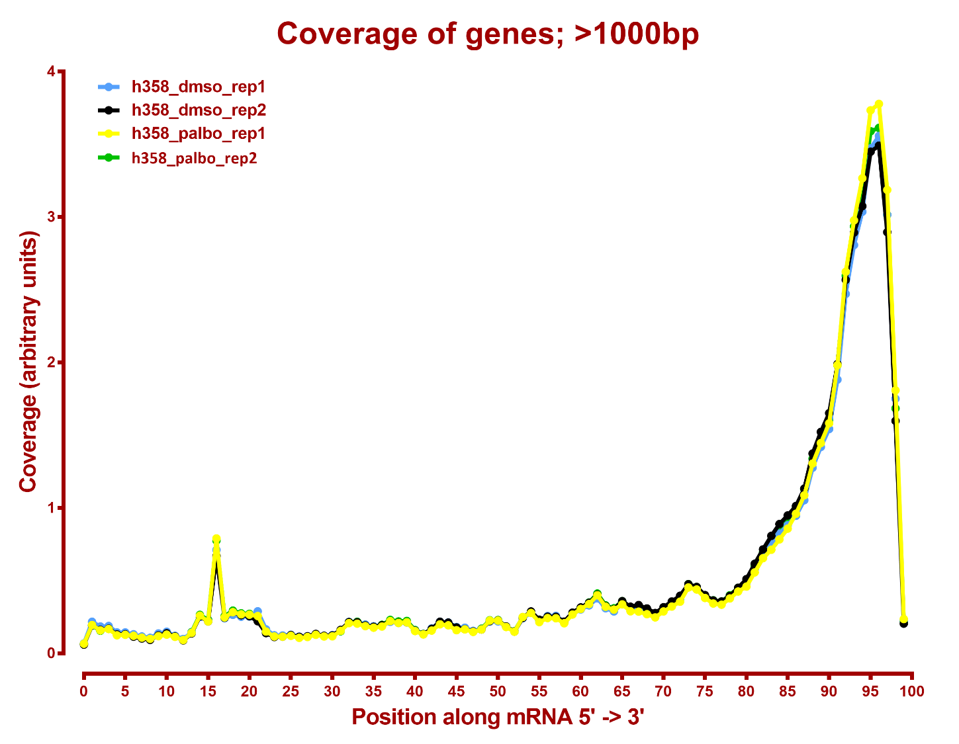

Slide 4
Number DE genes, DESeq2, eXpress
all genes
A | B | p-val |  | p-adj
 |  | up in B vs A | down in B vs A | up in B vs A | down in B vs A
h358_combo | h358_ars | 520 | 372 | 42 | 8
h358_dmso | h358_ars | 1,125 | 1,517 | 350 | 651
h358_dmso | h358_combo | 1,244 | 1,703 | 480 | 923
h358_dmso | h358_palbo | 498 | 872 | 39 | 308
h358_palbo | h358_ars | 1,336 | 1,434 | 506 | 592
h358_palbo | h358_combo | 969 | 1,195 | 225 | 445

