Slide 1
Read mapping stats
# | Exonic: | Intergenic: | Intronic:
2019-01-16-DKEL010A | 0.96 | 0.01 | 0.03
2019-01-16-DKEL010B | 0.95 | 0.02 | 0.03

Slide 2
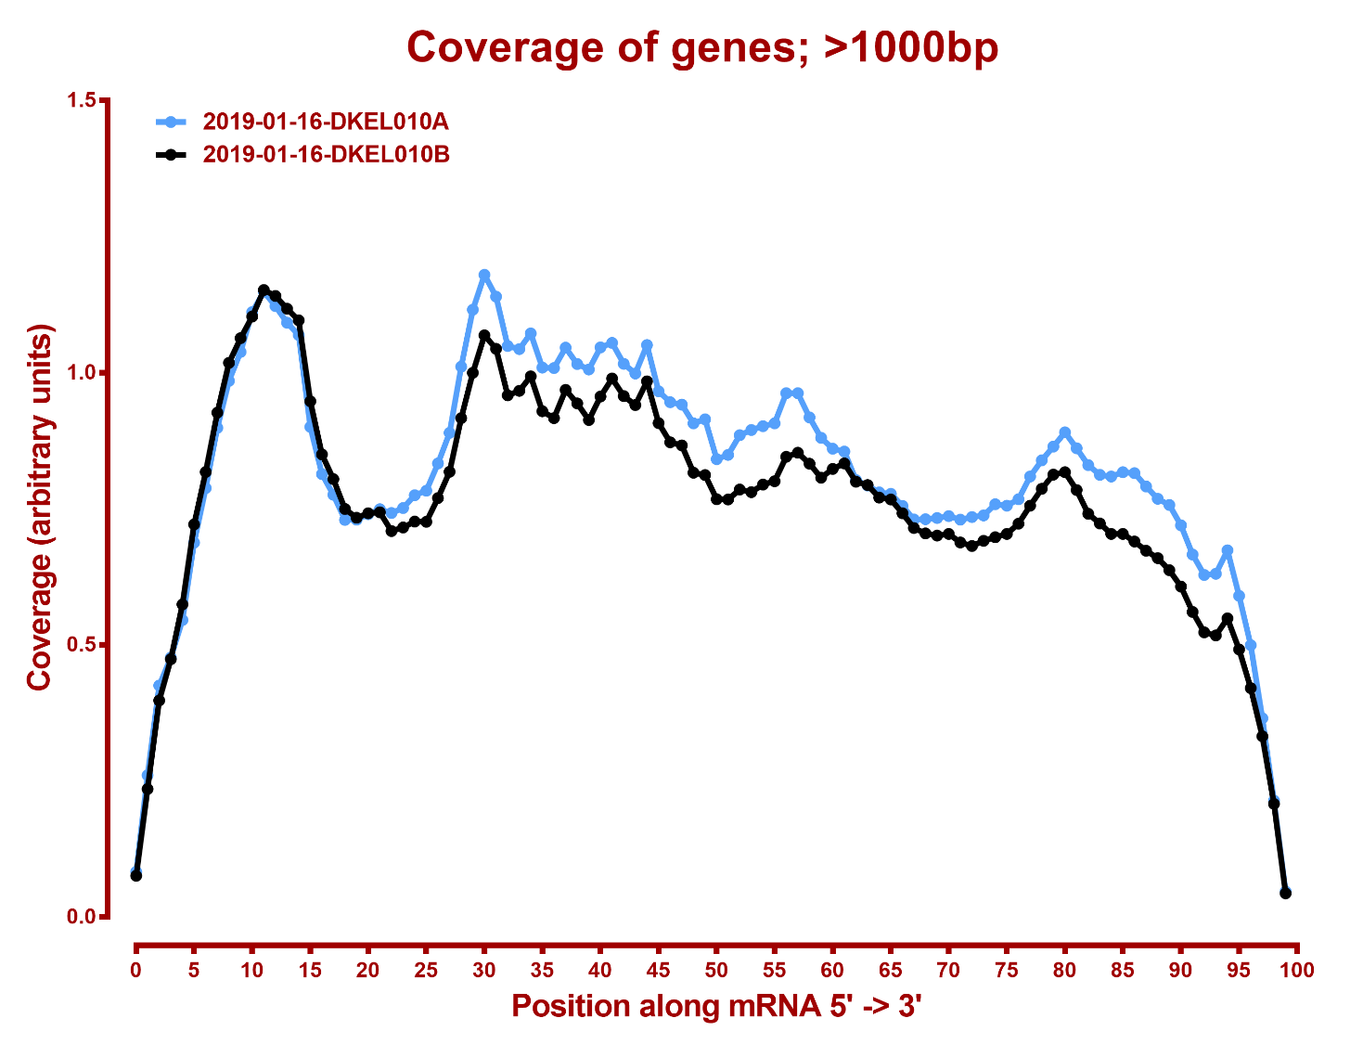

Slide 3
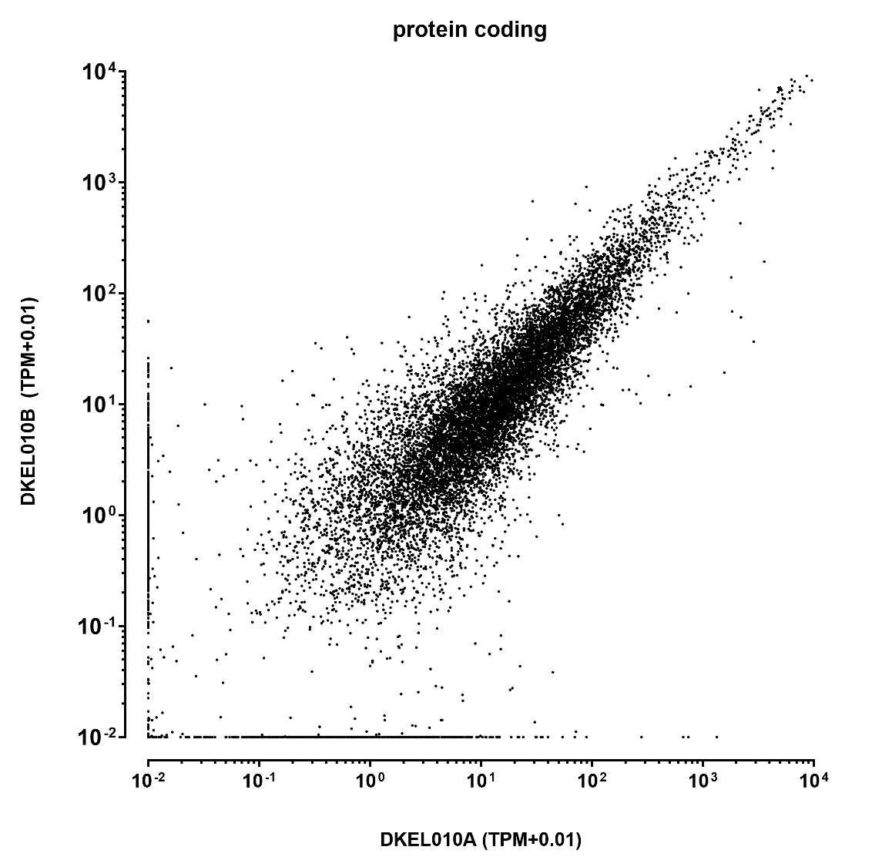

Slide 4
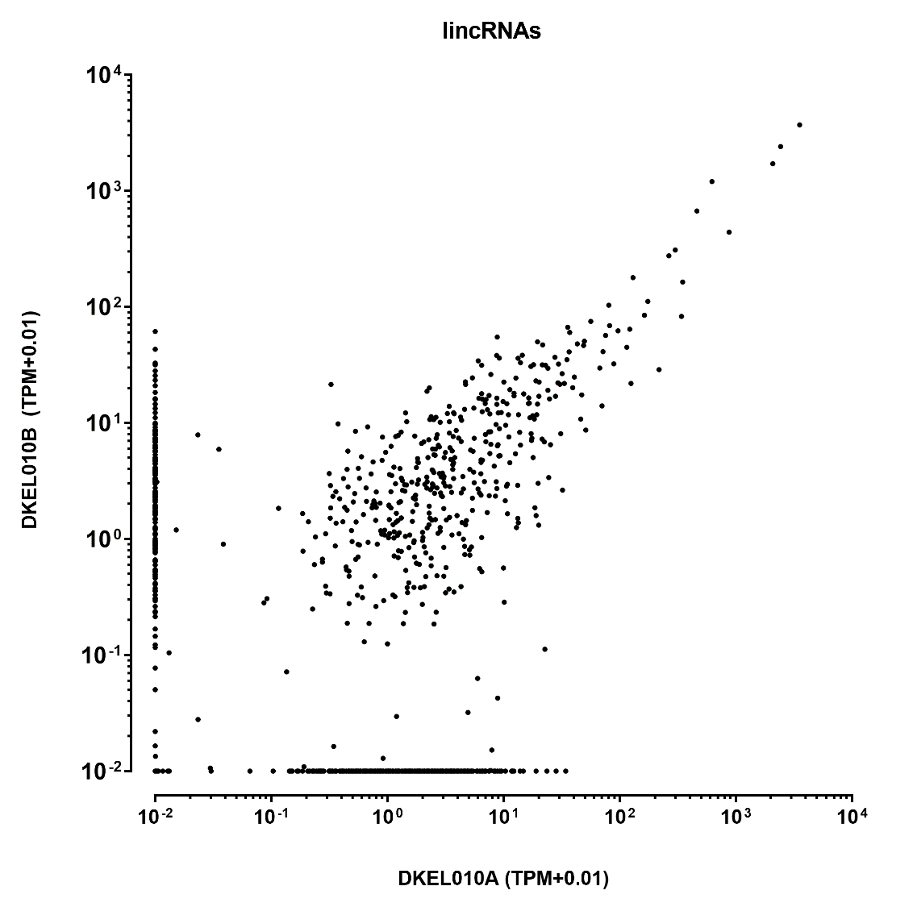

Slide 5
