Slide 1
Read mapping stats
Species | Read Length | Mapping | Library | Raw reads | Complexity | Unique | Unique Splices | Multi | Multi Splices | Fraction mapped | Date Entered
hg20 | 2x75 | STAR-2.5.3 GENCODE V26 | C2-1_Diff_rep1-GSM3028917 | 28,477,672 | 0.61 | 37,122,567 | 13,182,519 | 2,683,201 | 1,141,875 | 0.95 | 2018/11/22
hg20 | 2x75 | STAR-2.5.3 GENCODE V26 | C2-1_Undiff_rep1-GSM3028913 | 30,051,935 | 0.58 | 37,926,863 | 14,659,355 | 2,964,872 | 1,277,772 | 0.95 | 2018/11/22
hg20 | 2x75 | STAR-2.5.3 GENCODE V26 | C2-2_Diff_rep1-GSM3028918 | 12,165,291 | 0.69 | 15,594,109 | 5,825,105 | 1,192,464 | 492,596 | 0.95 | 2018/11/22
hg20 | 2x75 | STAR-2.5.3 GENCODE V26 | C2-2_Undiff_rep1-GSM3028914 | 33,759,629 | 0.56 | 41,894,574 | 16,921,108 | 3,405,047 | 1,484,415 | 0.94 | 2018/11/22
hg20 | 2x75 | STAR-2.5.3 GENCODE V26 | R2-1_Diff_rep1-GSM3028919 | 15,258,104 | 0.69 | 19,958,273 | 6,545,259 | 1,678,081 | 567,061 | 0.94 | 2018/11/22
hg20 | 2x75 | STAR-2.5.3 GENCODE V26 | R2-1_Undiff_rep1-GSM3028915 | 25,496,513 | 0.60 | 32,007,066 | 12,436,304 | 2,747,693 | 1,075,733 | 0.95 | 2018/11/22
hg20 | 2x75 | STAR-2.5.3 GENCODE V26 | R2-2_Diff_rep1-GSM3028920 | 13,543,220 | 0.68 | 17,255,730 | 6,443,508 | 1,369,321 | 553,873 | 0.95 | 2018/11/22
hg20 | 2x75 | STAR-2.5.3 GENCODE V26 | R2-2_Undiff_rep1-GSM3028916 | 23,077,940 | 0.60 | 28,762,354 | 11,493,428 | 2,250,677 | 981,833 | 0.94 | 2018/11/22
# | Exonic: | Intergenic: | Intronic:
C2-1_Diff_rep1-GSM3028917 | 0.93 | 0.02 | 0.06
C2-1_Undiff_rep1-GSM3028913 | 0.92 | 0.02 | 0.07
C2-2_Diff_rep1-GSM3028918 | 0.94 | 0.01 | 0.04
C2-2_Undiff_rep1-GSM3028914 | 0.94 | 0.01 | 0.04
R2-1_Diff_rep1-GSM3028919 | 0.85 | 0.03 | 0.12
R2-1_Undiff_rep1-GSM3028915 | 0.92 | 0.03 | 0.05
R2-2_Diff_rep1-GSM3028920 | 0.93 | 0.02 | 0.06
R2-2_Undiff_rep1-GSM3028916 | 0.95 | 0.01 | 0.04

Slide 2
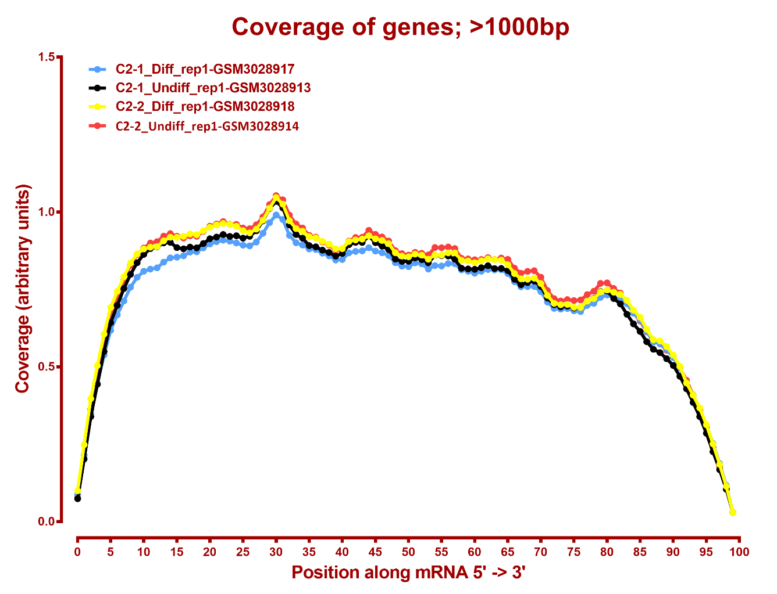

Slide 3
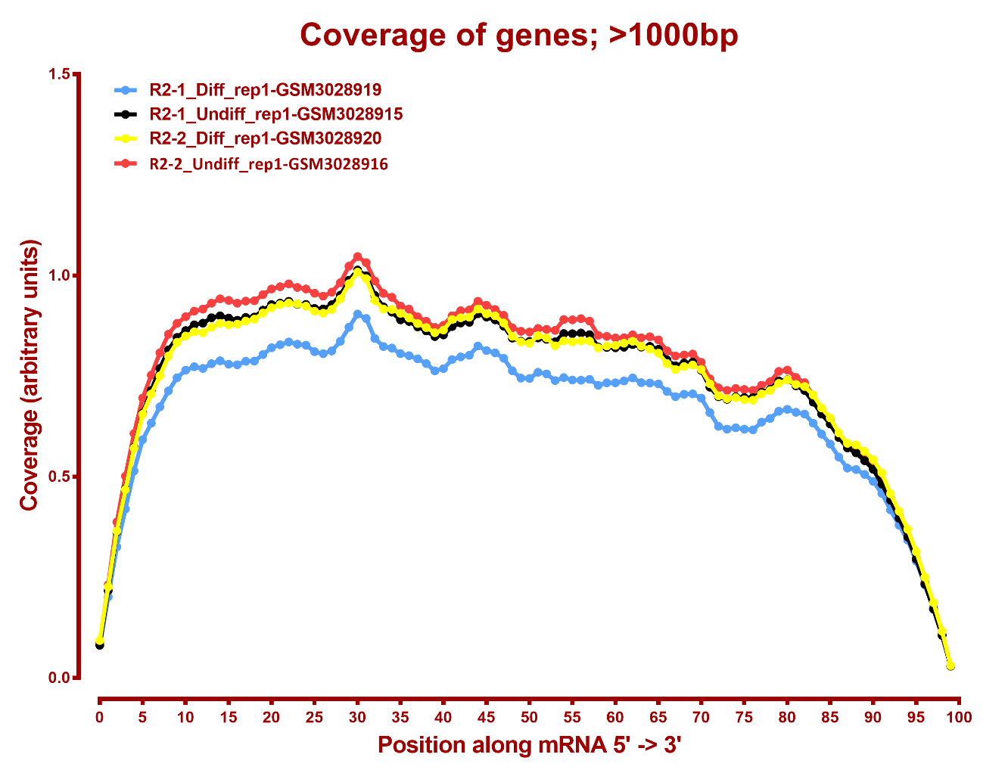

Slide 4
DE genes summary
all genes
A | B | p-val |  | p-adj
 |  | up in B vs A | down in B vs A | up in B vs A | down in B vs A
C2_Diff | C2_Undiff | 3,908 | 4,696 | 3,195 | 3,911
C2_Diff | R2_Diff | 2,502 | 2,723 | 1,340 | 1,532
C2_Diff | R2_Undiff | 4,162 | 4,609 | 3,411 | 3,793
C2_Undiff | R2_Diff | 3,987 | 3,427 | 3,117 | 2,641
C2_Undiff | R2_Undiff | 821 | 528 | 176 | 49
R2_Diff | R2_Undiff | 3,755 | 4,065 | 2,958 | 3,197
lincRNA
A | B | p-val |  | p-adj
 |  | up in B vs A | down in B vs A | up in B vs A | down in B vs A
C2_Diff | C2_Undiff | 168 | 154 | 120 | 109
C2_Diff | R2_Diff | 165 | 92 | 85 | 42
C2_Diff | R2_Undiff | 178 | 176 | 124 | 130
C2_Undiff | R2_Diff | 150 | 104 | 95 | 62
C2_Undiff | R2_Undiff | 34 | 32 | 3 | 5
R2_Diff | R2_Undiff | 89 | 175 | 50 | 126

