Slide 1
A549 FOSL2 post-IDR peak calls
#DataSet: |  | 2018-10-02-A549-eGFP-FOSL2-ChIP.MACS2.IDR-0.05 | 2018-10-02-A549-eGFP-FOSL2-ChIP.SPP.IDR_0.05 | 2018-11-09-SCGPM_CUT-RUN-test3_A549-FOSL2-GFP.MACS2.IDR-0.05 | 2018-11-09-SCGPM_CUT-RUN-test3_A549-FOSL2-GFP.maxFL120bp.MACS2.IDR-0.05 | 2018-11-09-SCGPM_CUT-RUN-test3_A549-FOSL2-GFP.minFL150bp.MACS2.IDR-0.05
 | Regions | 32943 | 34830 | 35009 | 15321 | 23894
2018-10-02-A549-eGFP-FOSL2-ChIP.MACS2.IDR-0.05 | 32943 | 1.00 | 0.85 | 0.67 | 0.38 | 0.53
2018-10-02-A549-eGFP-FOSL2-ChIP.SPP.IDR_0.05 | 34830 | 0.86 | 1.00 | 0.70 | 0.39 | 0.56
2018-11-09-SCGPM_CUT-RUN-test3_A549-FOSL2-GFP.MACS2.IDR-0.05 | 35009 | 0.62 | 0.63 | 1.00 | 0.42 | 0.65
2018-11-09-SCGPM_CUT-RUN-test3_A549-FOSL2-GFP.maxFL120bp.MACS2.IDR-0.05 | 15321 | 0.85 | 0.84 | 1.00 | 1.00 | 0.84
2018-11-09-SCGPM_CUT-RUN-test3_A549-FOSL2-GFP.minFL150bp.MACS2.IDR-0.05 | 23894 | 0.72 | 0.74 | 0.95 | 0.54 | 1.00

Slide 2
Overlap with ChIP-seq peaks and CTCF motifs:
 | number peaks |  |  |  |  |  |  |  | fraction
 | ChIP peak |  | no ChIP peak |  |  |  | ChIP peak | no ChIP peak | ChIP peak |  | no ChIP peak
 | motif | no motif | motif | no motif |  |  |  |  | motif | no motif | motif | no motif
A549-FOSL2-HA-ENCFF374ZCG | 18,729 | 14,625 | 0 | 0 |  | A549-FOSL2-HA-ENCFF374ZCG | 1.00 | 0.00 | 0.56 | 0.44 | n/a | n/a
A549-eGFP-FOSL2-Snyder-IDR | 22,880 | 11,950 | 0 | 0 |  | A549-eGFP-FOSL2-Snyder-IDR | 1.00 | 0.00 | 0.66 | 0.34 | n/a | n/a
CUT&RUN-1uL | 14,147 | 8,243 | 6,345 | 14,540 |  | TTAGGC | 0.52 | 0.48 | 0.63 | 0.37 | 0.30 | 0.70
CUT&RUN-1uL.maxFL120bp | 11,350 | 8,977 | 3,963 | 19,271 |  | TTAGGC.maxFL120bp | 0.47 | 0.53 | 0.56 | 0.44 | 0.17 | 0.83
CUT&RUN-1uL.minFL150bp | 11,751 | 7,006 | 3,666 | 8,614 |  | TTAGGC.minFL150bp | 0.60 | 0.40 | 0.63 | 0.37 | 0.30 | 0.70
CUT&RUN-0.25uL | 11,459 | 6,472 | 3,006 | 7,586 |  |  | 0.63 | 0.37 | 0.64 | 0.36 | 0.28 | 0.72
CUT&RUN-0.25uL.maxFL120bp | 9,968 | 7,504 | 2,620 | 10,830 |  |  | 0.57 | 0.43 | 0.57 | 0.43 | 0.19 | 0.81
CUT&RUN-0.25uL.minFL150bp | 8,088 | 5,042 | 1,315 | 3,805 |  |  | 0.72 | 0.28 | 0.62 | 0.38 | 0.26 | 0.74
CUT&RUN-0.5uL | 12,472 | 7,088 | 4,131 | 10,231 |  |  | 0.58 | 0.42 | 0.64 | 0.36 | 0.29 | 0.71
CUT&RUN-0.5uL.maxFL120bp | 11,619 | 8,328 | 4,192 | 16,649 |  |  | 0.49 | 0.51 | 0.58 | 0.42 | 0.20 | 0.80
CUT&RUN-0.5uL.minFL150bp | 8,542 | 5,389 | 1,538 | 4,398 |  |  | 0.70 | 0.30 | 0.61 | 0.39 | 0.26 | 0.74
MACS2 calls
post-IDR
 |  | number peaks |  |  |  |  |  |  |  | fraction
 |  | ChIP peak |  | no ChIP peak |  |  |  | ChIP peak | no ChIP peak | ChIP peak |  | no ChIP peak
 |  | motif | no motif | motif | no motif |  |  |  |  | motif | no motif | motif | no motif
 | A549-eGFP-FOSL2-Snyder-IDR-MACS | 24,321 | 8,622 | 0 | 0 |  | A549-eGFP-FOSL2-Snyder-IDR-MACS | 1.00 | 0.00 | 0.74 | 0.26 | n/a | n/a
 | A549-eGFP-FOSL2-Snyder-IDR-SPP | 22,880 | 11,950 | 0 | 0 |  | A549-eGFP-FOSL2-Snyder-IDR-SPP | 1.00 | 0.00 | 0.66 | 0.34 | n/a | n/a
vs-MACS-IDR-ChIP | CUT&RUN-all_reads-IDR-MACS | 15,652 | 6,184 | 4,823 | 8,350 | vs-MACS-IDR-ChIP | CUT&RUN-all_reads-IDR-MACS | 0.62 | 0.38 | 0.72 | 0.28 | 0.37 | 0.63
 | CUT&RUN.maxFL120bp-IDR-MACS | 8,969 | 4,002 | 593 | 1,757 |  | CUT&RUN.maxFL120bp-IDR-MACS | 0.85 | 0.15 | 0.69 | 0.31 | 0.25 | 0.75
 | CUT&RUN.minFL150bp-IDR-MACS | 11,978 | 5,317 | 2,352 | 4,247 |  | CUT&RUN.minFL150bp-IDR-MACS | 0.72 | 0.28 | 0.69 | 0.31 | 0.36 | 0.64
vs-SPP-IDR-ChIP | CUT&RUN-all_reads-IDR-MACS | 15,558 | 6,614 | 4,917 | 7,920 | vs-SPP-IDR-ChIP | CUT&RUN-all_reads-IDR-MACS | 0.63 | 0.37 | 0.70 | 0.30 | 0.38 | 0.62
 | CUT&RUN.maxFL120bp-IDR-MACS | 8,934 | 4,004 | 628 | 1,755 |  | CUT&RUN.maxFL120bp-IDR-MACS | 0.84 | 0.16 | 0.69 | 0.31 | 0.26 | 0.74
 | CUT&RUN.minFL150bp-IDR-MACS | 11,942 | 5,665 | 2,388 | 3,899 |  | CUT&RUN.minFL150bp-IDR-MACS | 0.74 | 0.26 | 0.68 | 0.32 | 0.38 | 0.62
post-IDR calls

Slide 3
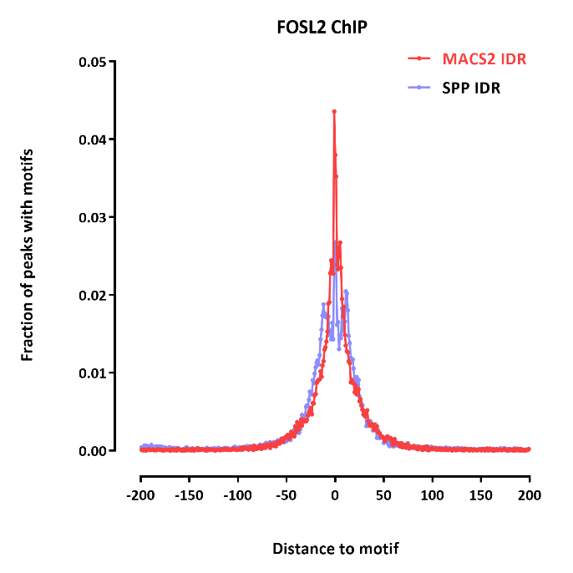
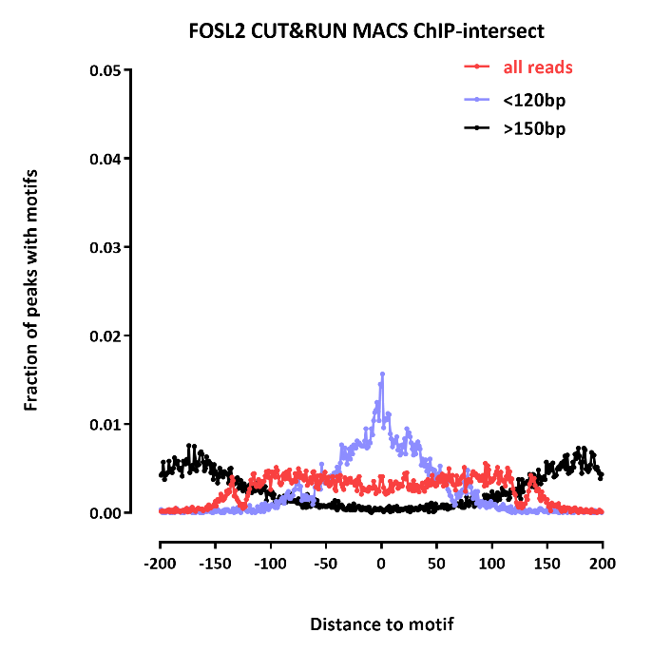
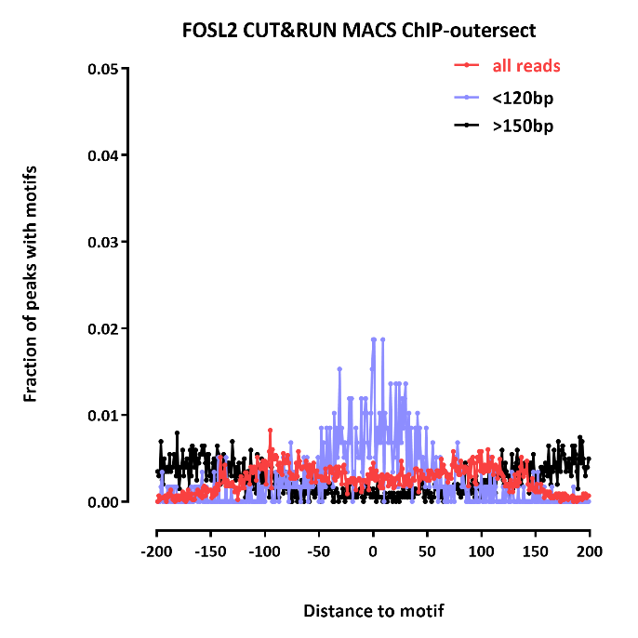
Distance to motif

Slide 4
A549 CTCF post-IDR peak calls
#DataSet: |  | 2018-09-05-SCGPM_CUT-RUN-test1-CTCF.MACS2.IDR-0.05 | 2018-09-05-SCGPM_CUT-RUN-test1-CTCF.maxFL120bp.MACS2.IDR-0.05 | 2018-09-05-SCGPM_CUT-RUN-test1-CTCF.minFL150bp.MACS2.IDR-0.05 | A549-CTCF-Snyder-ENCFF543VGD
 | Regions | 48243 | 22862 | 40514 | 46775
2018-09-05-SCGPM_CUT-RUN-test1-CTCF.MACS2.IDR-0.05 | 48243 | 1.00 | 0.47 | 0.83 | 0.73
2018-09-05-SCGPM_CUT-RUN-test1-CTCF.maxFL120bp.MACS2.IDR-0.05 | 22862 | 1.00 | 1.00 | 0.94 | 0.91
2018-09-05-SCGPM_CUT-RUN-test1-CTCF.minFL150bp.MACS2.IDR-0.05 | 40514 | 0.99 | 0.52 | 1.00 | 0.80
A549-CTCF-Snyder-ENCFF543VGD | 46775 | 0.77 | 0.45 | 0.71 | 1.00

Slide 5
A549 CTCF post-IDR peak calls
 | number peaks |  |  |  |  |  |  |  | fraction
 | ChIP peak |  | no ChIP peak |  |  |  | ChIP peak | no ChIP peak | ChIP peak |  | no ChIP peak
 | motif | no motif | motif | no motif |  |  |  |  | motif | no motif | motif | no motif
ENCODE A549 CTCF | 39,669 | 7,106 | 0 | 0 |  | ENCODE A549 CTCF | 1.00 | 0.00 | 0.85 | 0.15 | n/a | n/a
ACTTGA | 29,650 | 5,376 | 5,325 | 13,168 |  | ACTTGA | 0.65 | 0.35 | 0.85 | 0.15 | 0.29 | 0.71
ACTTGA.maxFL120bp | 20,710 | 3,098 | 2,048 | 11,643 |  | ACTTGA.maxFL120bp | 0.63 | 0.37 | 0.87 | 0.13 | 0.15 | 0.85
ACTTGA.minFL150bp | 24,321 | 5,645 | 3,276 | 7,349 |  | ACTTGA.minFL150bp | 0.74 | 0.26 | 0.81 | 0.19 | 0.31 | 0.69
TTAGGC | 28,644 | 4,318 | 4,283 | 8,360 |  | TTAGGC | 0.72 | 0.28 | 0.87 | 0.13 | 0.34 | 0.66
TTAGGC.maxFL120bp | 18,679 | 2,822 | 1,770 | 9,450 |  | TTAGGC.maxFL120bp | 0.66 | 0.34 | 0.87 | 0.13 | 0.16 | 0.84
TTAGGC.minFL150bp | 23,663 | 4,791 | 2,796 | 5,029 |  | TTAGGC.minFL150bp | 0.78 | 0.22 | 0.83 | 0.17 | 0.36 | 0.64
MACS2 calls
post-IDR
 | number peaks |  |  |  |  |  |  |  | fraction
 | ChIP peak |  | no ChIP peak |  |  |  | ChIP peak | no ChIP peak | ChIP peak |  | no ChIP peak
 | motif | no motif | motif | no motif |  |  |  |  | motif | no motif | motif | no motif
SPP A549 CTCF ENCODE | 39,669 | 7,106 | 0 | 0 |  | SPP A549 CTCF ENCODE | 1.00 | 0.00 | 0.85 | 0.15 | n/a | n/a
CUT&RUN-all_reads-IDR-MACS | 31,360 | 3,672 | 5,530 | 7,681 |  | CUT&RUN-all_reads-IDR-MACS | 0.73 | 0.27 | 0.90 | 0.10 | 0.42 | 0.58
CUT&RUN.maxFL120bp-IDR-MACS | 18,729 | 2,053 | 718 | 1,362 |  | CUT&RUN.maxFL120bp-IDR-MACS | 0.91 | 0.09 | 0.90 | 0.10 | 0.35 | 0.65
CUT&RUN.minFL150bp-IDR-MACS | 28,009 | 4,307 | 3,452 | 4,746 |  | CUT&RUN.minFL150bp-IDR-MACS | 0.80 | 0.20 | 0.87 | 0.13 | 0.42 | 0.58
post-IDR calls

Slide 6
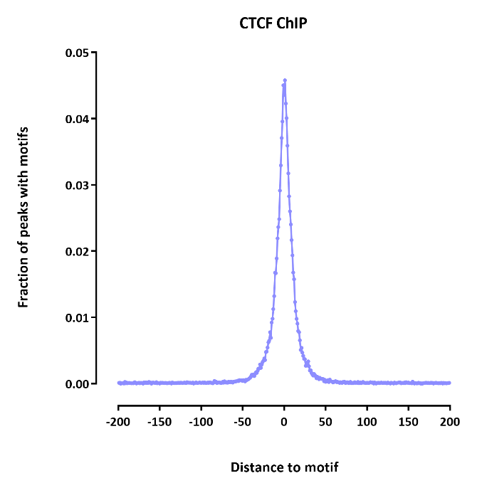
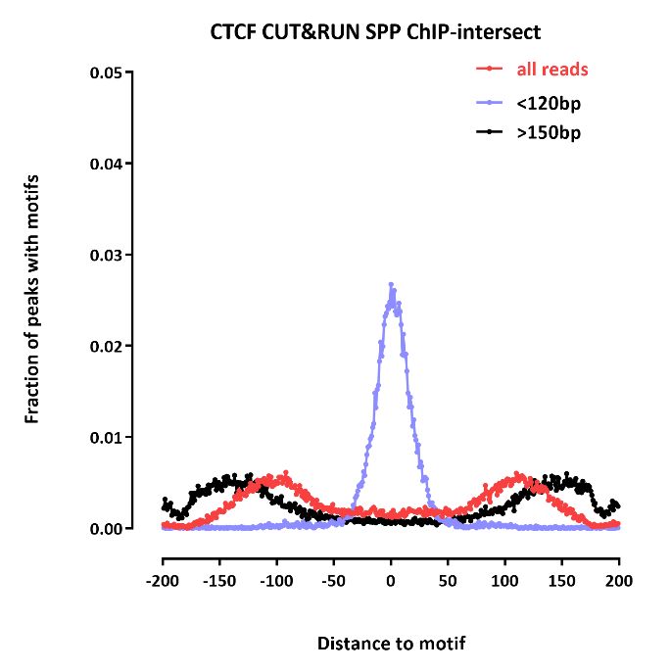
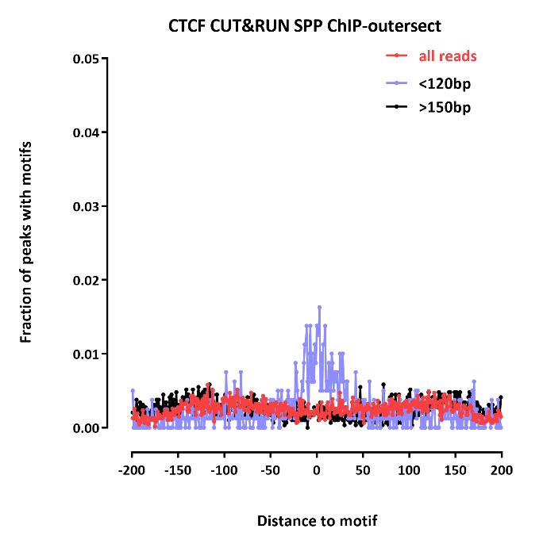
Distance to motif

Slide 7
K562 GATA1 post-IDR peak calls
#DataSet: |  | 2018-10-08-NF_Gata1_250.MACS2.IDR-0.05 | 2018-10-08-NF_Gata1_250.maxFL120bp.MACS2.IDR-0.05 | 2018-10-08-NF_Gata1_250.minFL120bp.MACS2.IDR-0.05 | K562-GATA1-Snyder-ENCFF632NQI
 | Regions | 11221 | 3531 | 4270 | 14605
2018-10-08-NF_Gata1_250.MACS2.IDR-0.05 | 11221 | 1.00 | 0.31 | 0.36 | 0.39
2018-10-08-NF_Gata1_250.maxFL120bp.MACS2.IDR-0.05 | 3531 | 0.98 | 1.00 | 0.43 | 0.53
2018-10-08-NF_Gata1_250.minFL120bp.MACS2.IDR-0.05 | 4270 | 0.95 | 0.36 | 1.00 | 0.40
K562-GATA1-Snyder-ENCFF632NQI | 14605 | 0.31 | 0.13 | 0.13 | 1.00

Slide 8
K562 GATA1 post-IDR peak calls
 | number peaks |  |  |  |  |  |  |  | fraction
 | ChIP peak |  | no ChIP peak |  |  |  | ChIP peak | no ChIP peak | ChIP peak |  | no ChIP peak
 | motif | no motif | motif | no motif |  |  |  |  | motif | no motif | motif | no motif
ENCODE K562 GATA1 | 6,328 | 8,277 |  |  |  | ENCODE K562 GATA1 | 1.00 | 0.00 | 0.43 | 0.57 | n/a | n/a
Fixated_Gata1_250_a | 0 | 2 | 0 | 6 |  | Fixated_Gata1_250_a | 0.25 | 0.75 | 0.00 | 1.00 | 0.00 | 1.00
NF_Gata1_250_a | 1,108 | 1,738 | 518 | 5,873 |  | NF_Gata1_250_a | 0.31 | 0.69 | 0.39 | 0.61 | 0.08 | 0.92
NF_Gata1_250_b | 1,123 | 1,631 | 467 | 4,910 |  | NF_Gata1_250_b | 0.34 | 0.66 | 0.41 | 0.59 | 0.09 | 0.91
MACS2 calls
post-IDR
 | number peaks |  |  |  |  |  |  |  | fraction
 | ChIP peak |  | no ChIP peak |  |  |  | ChIP peak | no ChIP peak | ChIP peak |  | no ChIP peak
 | motif | no motif | motif | no motif |  |  |  |  | motif | no motif | motif | no motif
ENCODE K562 GATA1 | 6,328 | 8,277 | 0 | 0 |  | ENCODE K562 GATA1 | 1.00 | 0.00 | 0.43 | 0.57 | n/a | n/a
CUT&RUN-all_reads-IDR-MACS | 2,137 | 2,192 | 1,130 | 5,762 |  | CUT&RUN-all_reads-IDR-MACS | 0.39 | 0.61 | 0.49 | 0.51 | 0.16 | 0.84
CUT&RUN.maxFL120bp-IDR-MACS | 939 | 934 | 216 | 1,442 |  | CUT&RUN.maxFL120bp-IDR-MACS | 0.53 | 0.47 | 0.50 | 0.50 | 0.13 | 0.87
CUT&RUN.minFL150bp-IDR-MACS | 917 | 799 | 455 | 2,099 |  | CUT&RUN.minFL150bp-IDR-MACS | 0.40 | 0.60 | 0.53 | 0.47 | 0.18 | 0.82
post-IDR calls

Slide 9
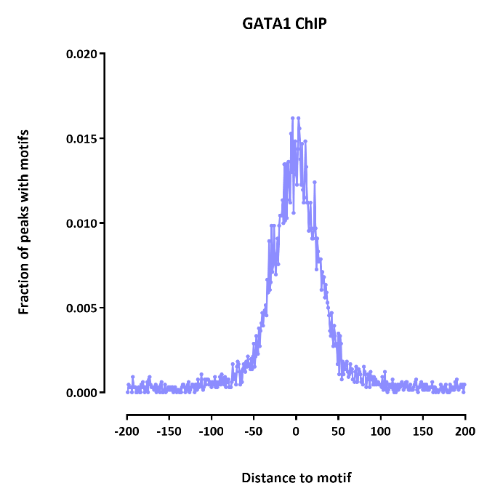
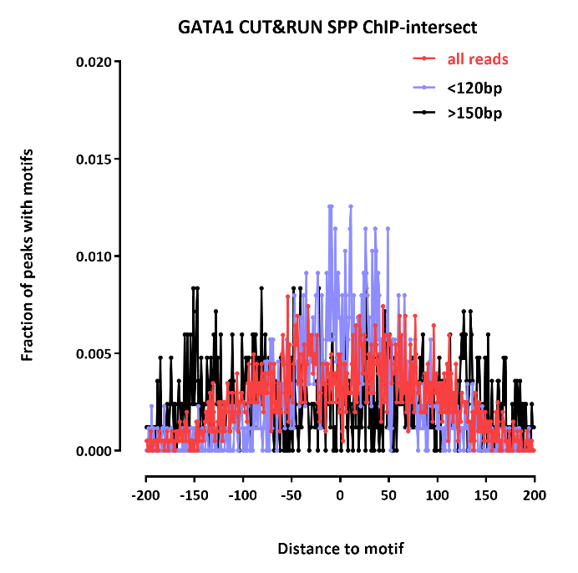
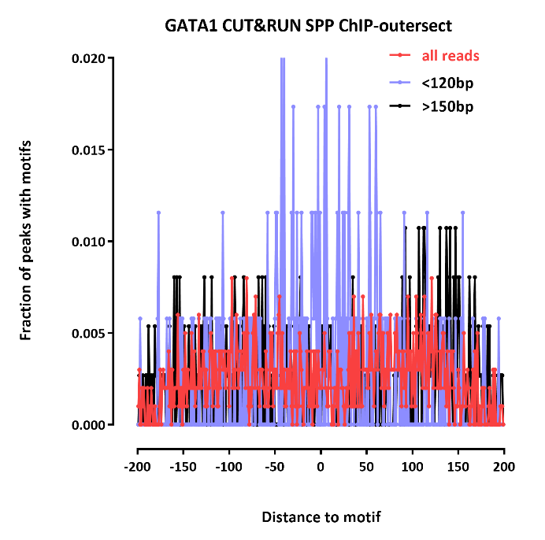
Distance to motif

